Slide 1
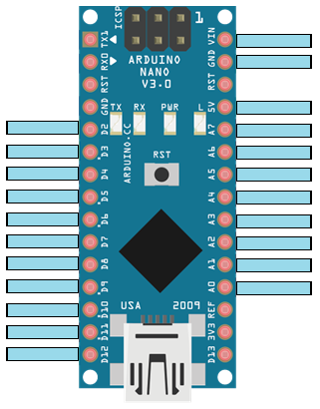
7-12[V] In
Tierra Común
5v Out
BUZZER
QTR8A-8
AIN1
QTR8A-7
AIN2
QTR8A-6
PWMA
QTR8A-5
PWMB
QTR8A-4
BIN1
QTR8A-3
BIN2
QTR8A-2
StandBy
QTR8A-1
Button
TCRT5000-2
TCRT5000-1

