Slide 1
Artificial Intelligence Assignment Group B,TESE
Ma’am Uzma Zehra
M. Talha Nadeem (se - 071)
Abdul Ahad (Se - 070)
Sunaina asif (Se - 047)

Slide 2
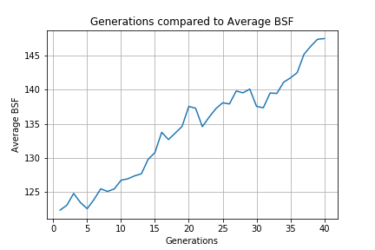
Generation vs Average BSF

Slide 3
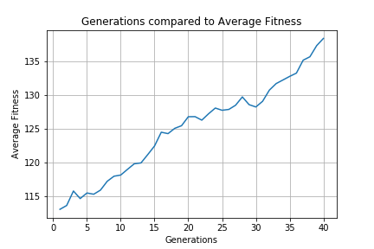
Generation vs Average Fitness

Slide 4
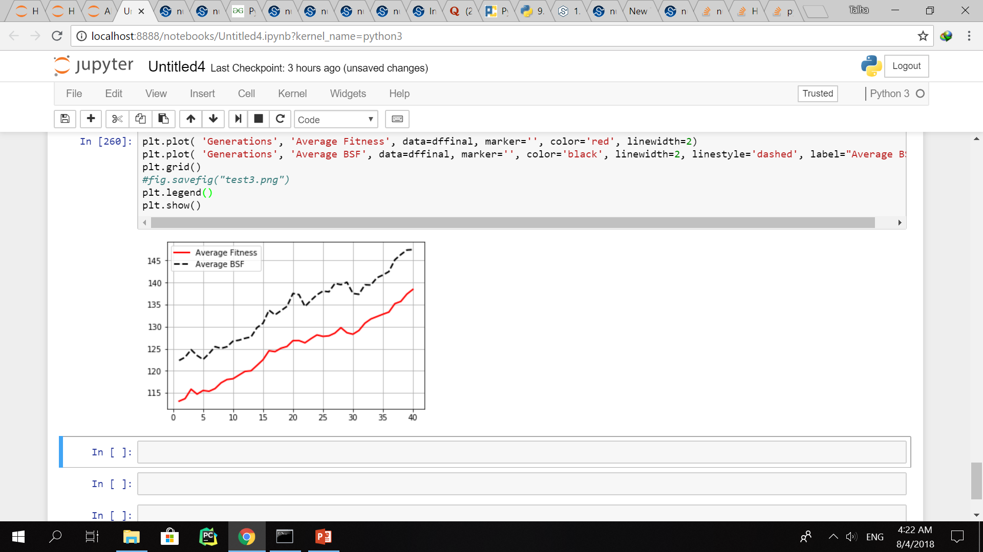
Average BFS and Average Fitness

