Slide 1


DATA ANALYTICS · COURSE PROJECT
Data-Driven Insights:
Analyzing Spotify Music Data
Turning music data into insight for strategic decision-making through statistics, visualization, and machine learning techniques.
600K+
8
2
Track records
Visual analyses
ML models

Slide 2

THE TEAM
02
Team Members
Data Analytics — Group Project
Omer Furkan Bilici
Team Lead
Necla Ilayda Guler
Planning & Coordination
Tabassum Nadavinmani
Data Sourcing & Reporting
Sourav Jaiswal
Analysis & Modelling
Harshal Tittamelanahalli
Analysis & Modelling

Slide 3




INTRODUCTION
03
Project Goal and DSS Context
Streaming platforms like Spotify generate massive amounts of music data every day. This project analyzes that data to show how it can support intelligent, evidence-based decision-making in the music industry.
Objective
Support strategic decisions using data analysis, visualization, and ML.
Approach
Exploratory data analysis (EDA) + statistical visualization.
Models
Outcome: insights that guide music production, playlist curation, and personalized recommendations.
KMeans clustering and a KNN-based recommendation engine.

Slide 4



DATA
04
Data Source and Integration
tracks.csv
artists.csv
Track-level metadata + audio features
Artist-level metadata
id, name, popularity, release_date
duration_ms, explicit
danceability, energy, tempo, loudness
acousticness, valence, instrumentalness
id_artists, artists
id, name
popularity
followers
genres
id_artists
⟷ id
Merged dataset: track features combined with artist popularity and follower counts into one structure, enabling holistic analysis at both track and artist level.

Slide 5




METHODOLOGY
05
Data Preprocessing and Cleaning
Cleaning steps carried out with Pandas and NumPy established a reliable foundation for analysis and modeling.
1. Missing Values
2. Type Formatting
Rows with nulls in popularity, release_date, and audio features were removed with dropna().
release_date converted to datetime; numeric fields cast to proper types.
3. Feature Engineering
4. Dataset Merging
duration_min derived from duration_ms; year extracted from release_date.
Follower and artist data added via id_artists ⟷ id matching.
Note: The report also describes duplicate removal and dropping of irrelevant columns; these steps are not explicitly implemented in the code.

Slide 6
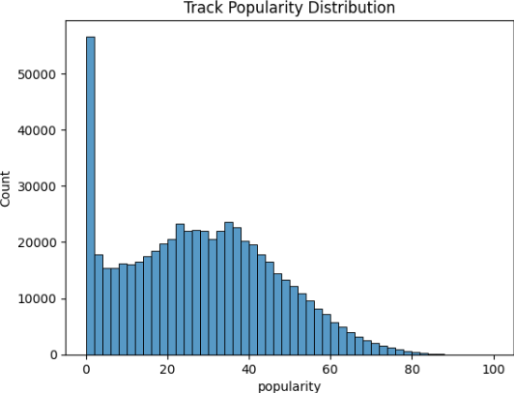
EDA · INSIGHT 01
06
Popularity Distribution & Listener Behavior
Long-Tail Pattern
Many tracks cluster at 0 popularity; counts peak in the 20–40 range then decline. Only a tiny fraction score above 80.
Strategic Meaning
Engagement concentrates on a few hits. Recommendation systems and playlists reinforce this gap — visibility and positioning become critical.
Fig 1 · Track Popularity Distribution
⚠ The notebook markdown mislabels this distribution as "symmetric/normal"; the histogram and report correctly describe it as long-tail.

Slide 7
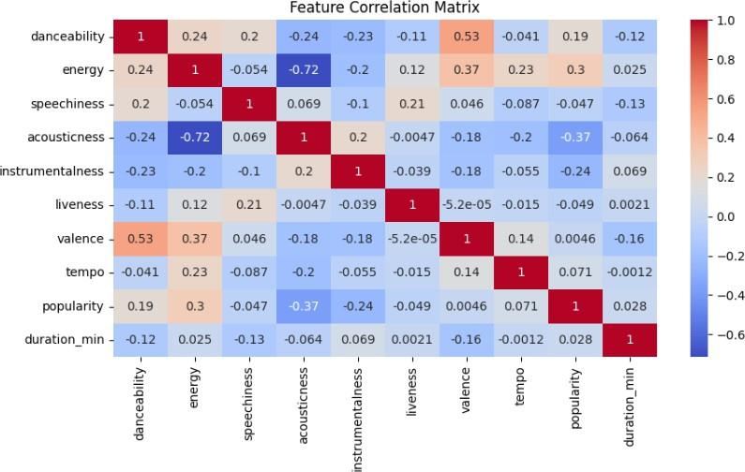

EDA · INSIGHT 02
07
Correlation Analysis of Audio Features
Correlation of Features with Popularity
Key Finding
Fig 2 · Feature Correlation Matrix
No single feature determines popularity alone; the strongest link is energy (+0.30). Success is multifactorial — marketing, recognition, and algorithms.

Slide 8
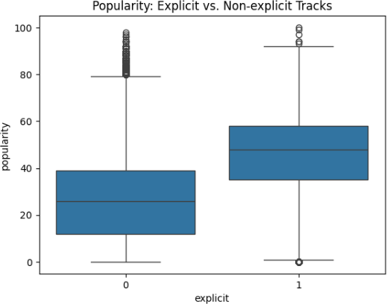

EDA · INSIGHT 03
08
Impact of Explicit Content on Popularity
Observation
Explicit tracks show a higher median popularity and a wider interquartile range; they dominate the upper popularity band.
Interpretation
This reflects mainstream genres like hip-hop and pop. However, the distributions overlap — being explicit alone is not a strong predictor.
Fig 3 · Popularity: Explicit vs Non-explicit

Slide 9
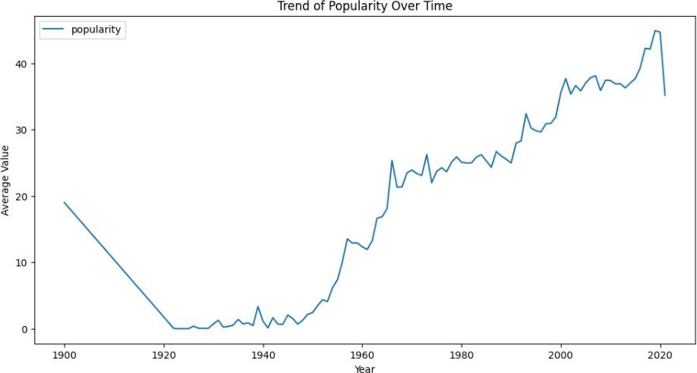
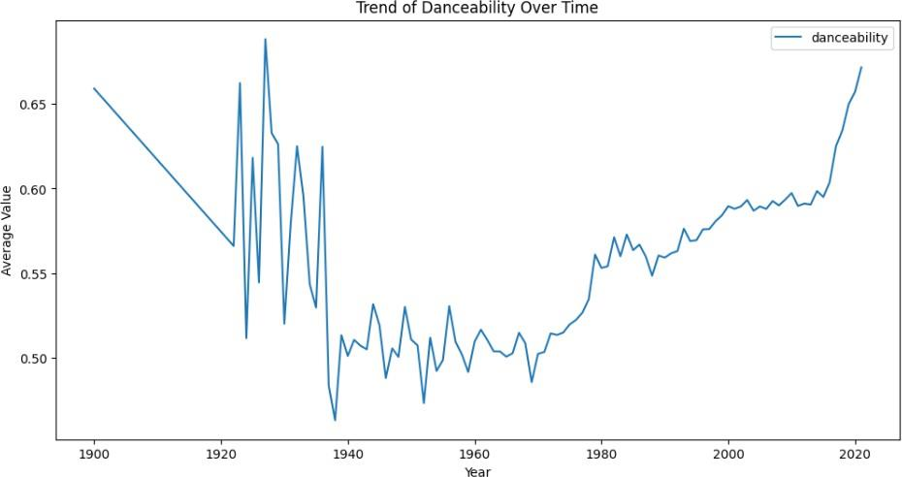
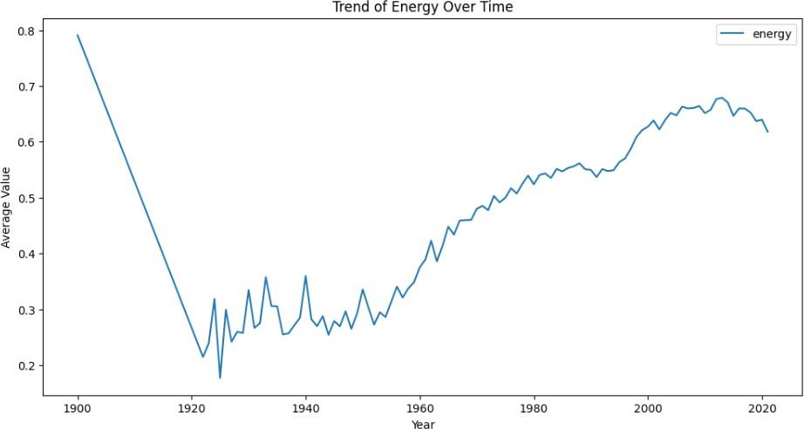

EDA · INSIGHT 04
09
Temporal Trends in Music Features
Fig 4 · Popularity
Fig 5 · Danceability
Fig 6 · Energy
Rises from the 1950s, with a marked jump after 2000 in the digital era.
Steady increase since the 1980s, driven by disco, hip-hop, and EDM.
Rises from the 1960s and stays consistently high after the 2000s.
Overall trend: modern music is evolving toward more energetic, rhythmic, and broadly appealing forms — shaped by digitalization and data-driven personalization.

Slide 10
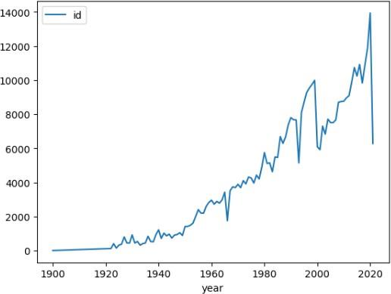


EDA · INSIGHT 05
10
Growth in Music Production Over Time
Exponential Growth
The number of tracks released per year grows exponentially from 1900 to 2020, with a sharp jump after 2015.
Why?
Digital distribution lowered barriers to entry; independent artists can now reach global audiences directly, without record labels.
Fig 7 · Number of Tracks Produced per Year

Slide 11
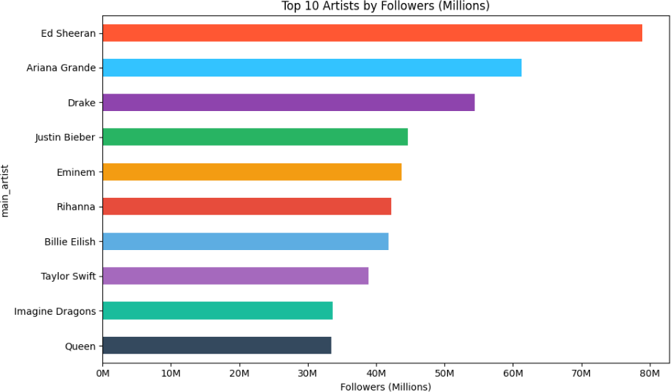

EDA · INSIGHT 06
11
Artist Popularity and Followers
Leading Names
Ed Sheeran leads by a wide margin, followed by Ariana Grande, Drake, Justin Bieber, and Eminem.
Relationship
A large follower base → higher average popularity. Follower count is a reliable proxy for an artist's influence.
Fig 8 · Top 10 Artists by Followers (Millions)

Slide 12
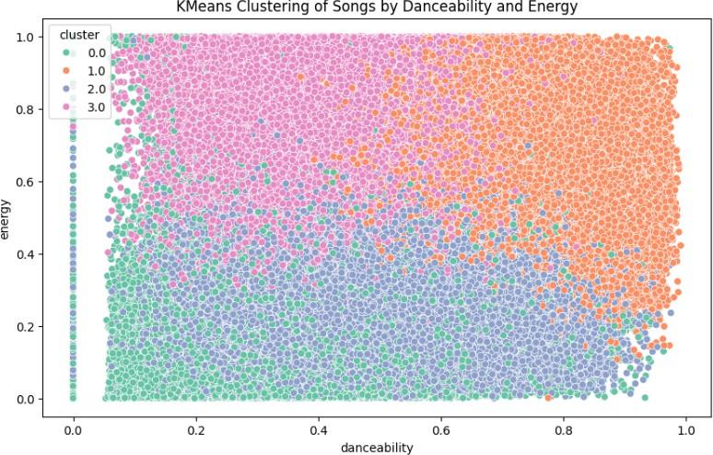


MACHINE LEARNING · MODEL 01
12
KMeans Clustering of Songs
Method
9 audio features were scaled with StandardScaler; k=4 clusters group songs into distinct musical styles / moods.
Application
Clusters provide cohesive musical themes for playlist generation, content categorization, and listener targeting.
Fig 9 · KMeans Clustering by Danceability & Energy

Slide 13

MACHINE LEARNING · MODEL 02
13
KNN-Based Recommendation Engine
→
→
→
User Input
Scaling
KNN Model
Top-5 Results
year · danceability
energy · followers
Feature standardization
with StandardScaler
NearestNeighbors
n=5 · euclidean
5 most similar songs
+ metadata
How It Works
The user enters release year, danceability, energy, and artist followers. The model finds the 5 nearest neighbors in the scaled space and returns each recommendation's song title, artist, popularity, followers, and core feature values — a proof-of-concept for a real-time, context-aware recommendation system.

Slide 14


RECOMMENDATIONS
14
Decision Support System (DSS) Applications
Playlist Curation
Artist Development
Use clustering and similarity algorithms to build mood-aligned thematic playlists.
Guide an artist's sound toward trends using historical feature–popularity patterns.
Marketing & Promotion
User Experience
Use the follower–popularity link to allocate resources to rising artists and boost ROI.
Raise engagement and loyalty with ML-based personalized recommendations.

Slide 15

CONCLUSION
Data Science + Music = Smarter Decisions
Energetic, danceable tracks tend to perform better on the platform.
Artist follower count is strongly correlated with track success.
Music production is growing exponentially, making timing strategic.
Clustering + recommendation models deliver practical value within a DSS.
Combining data analytics with music-domain knowledge opens the door to smarter strategies in content creation, marketing, and user engagement.

