Slide 1
Quantifying Effect
Modifier Similarity for
Regional Pooling in Multi-
Regional Clinical Trials
Tak Nagakubo

Slide 2
Agenda
1.
Introduction
: Regional pooling, methodological gap, and our aim
2.
Methods
: nABCD definition, theoretical foundation, and clinical calibration
3.
Simulation
: Estimation performance across 7 scenarios
4.
Application
: Hypothetical thrombolytic MRCT using GUSTO-I
5.
Discussion
: Key findings and practical recommendations
2026
nABCD: Effect Modifier Similarity for MRCTs
2

Slide 3
Introduction

Slide 4
Regional Pooling: A Practical Challenge
Why pooling is needed
MRCTs assess treatment effect consistency across regions
Individual regional sample sizes are often too small alone
ICH E17 strategy: pool regions with similar
effect modifier
distributions
(effect modifier = baseline characteristic for which treatment benefit differs across subgroups)
This paper focuses on
continuous effect modifiers
(e.g., age, baseline severity, laboratory values)
The challenge for sponsors
At the
planning stage
, sponsors must select pooling partners with evidence that two regions are "similar
enough"
Cautionary example: Secukinumab MRCT (Matsushima 2024)
Unassessed regional imbalance in CRP+/MRI- status → apparent treatment effect inconsistency at analysis.
2026
nABCD: Effect Modifier Similarity for MRCTs
4

Slide 5
Methodological Gap and Research Objectives
The gap
ICH E17 provides no specific metric, threshold, or procedure for "similar enough"
The standard tool for
continuous covariates
is the Standardized Mean Difference (SMD), which is
blind
to
differences in variance and shape
→ No quantitative evidence base for partner selection
Objectives
Develop a quantitative index that captures distributional similarity beyond means
Deliver a practitioner-facing tool for the
planning stage
of an MRCT
2026
nABCD: Effect Modifier Similarity for MRCTs
5

Slide 6
Methods

Slide 7
Existing Approaches and Their Limitations
SMD — blind to variance and shape
Mean difference / pooled SD.
vs
→ SMD = 0 despite a 3× difference in spread.
Kolmogorov–Smirnov — no link to treatment effects
captures full shape, but no theoretical bridge to clinical scale.
KL divergence — asymmetric, can diverge
requires density estimation; diverges with non-overlapping supports.
Three requirements
1.
Beyond location
(variance, shape)
2.
Clinically interpretable scale
3.
Theoretical link to treatment effect heterogeneity
2026
nABCD: Effect Modifier Similarity for MRCTs
7

Slide 8
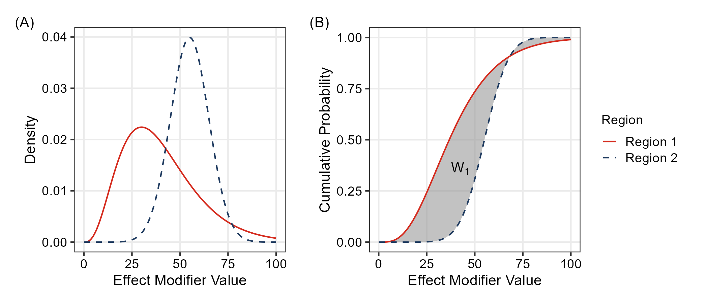
Defining nABCD: Wasserstein-1 over IQR
Wasserstein-1 distance
The total area between two CDFs — captures differences in
location, variance, and shape
.
nABCD: scale-free dissimilarity
Normalized by the pooled IQR — a one-IQR location shift yields nABCD = 1.0.
2026
nABCD: Effect Modifier Similarity for MRCTs
8

Slide 9
Theoretical Foundation: Heterogeneity Bound
Kantorovich-Rubinstein Duality
Heterogeneity Bound (Proposition 2)
If the CATE
is Lipschitz continuous with constant
:
: upper bound on treatment effect change per unit change in the effect modifier
A quantitative bridge from distributional distance to treatment effect differences
2026
nABCD: Effect Modifier Similarity for MRCTs
9

Slide 10
Estimation
Empirical estimator
Computation:
— sort dominates
Inference: Percentile bootstrap
Asymptotic distribution non-standard:
— Brownian bridge (del Barrio
1999)
No universal critical values →
percentile bootstrap
(
resamples)
Consistent for
via Hadamard derivative linearity (Sommerfeld 2018)
Convergence rate
Boundary case
: parameter space edge — addressed in simulation
2026
nABCD: Effect Modifier Similarity for MRCTs
10

Slide 11
Clinical Calibration: Two Pathways
Pathway 1: When L is available —
Δ
max
Worst-case regional treatment effect difference on the
clinical scale
Confirmatory or post-hoc evaluation when
is estimable
Pathway 2: When L is unknown — L* reverse calculation
: clinically important difference (e.g., NI margin)
above plausible range: distributional difference unlikely to be clinically concerning
Primary calibration tool at the planning stage
, where
is typically unavailable
Estimation-Centered Design
No fixed nABCD cutoff
Quantitative inputs (point estimate + bootstrap CI +
) support sponsor judgment
2026
nABCD: Effect Modifier Similarity for MRCTs
11

Slide 12
Simulation

Slide 13
Simulation Design: Seven Scenarios
ID
Description
Distribution 1
Distribution 2
True nABCD
S1
Null (identical)
0.000
S2
Location 0.2
0.146
S3
Location 0.5
0.358
S4
Location 1.0
0.656
S5
Scale 1.5x
0.244
S6
Skew (Log-normal)
LogN
0.606
S7
Location + Scale
0.347
per region; 10,000 replications;
bootstrap resamples
2026
nABCD: Effect Modifier Similarity for MRCTs
13

Slide 14
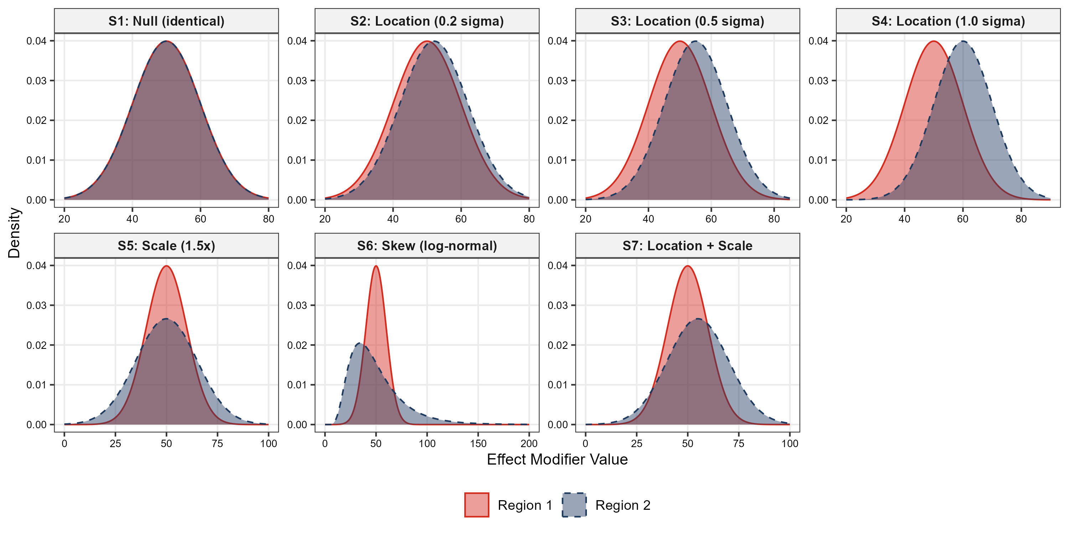
Simulation Design: Scenario Overview
Distribution pairs for scenarios S1--S7 — covering null, pure location shifts, scale-only, skewness, and combined
location+scale differences
2026
nABCD: Effect Modifier Similarity for MRCTs
14

Slide 15
Simulation Results: Bias and Coverage
Bias (
)
True nABCD
: bias
(S3, S4: +0.003 — negligible)
Near-boundary (S1): larger positive bias from non-negativity constraint
Coverage Probability (95% CI)
Scenario
S3 (0.5 )
0.947
0.951
0.947
S4 (1.0 )
0.950
0.950
0.957
S6 (Skew)
0.953
0.954
0.954
S7 (Loc+Scale)
0.917
0.935
0.944
Recommendation
:
per region for reliable estimation and inference
2026
nABCD: Effect Modifier Similarity for MRCTs
15

Slide 16
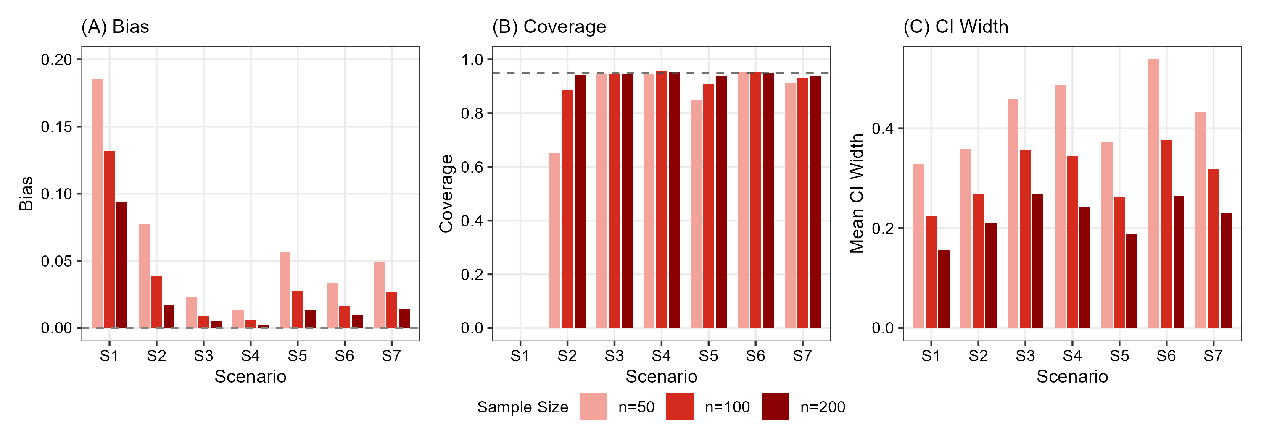
Estimation Properties: Visual Summary
Bias (A), coverage (B), and CI width (C) across scenarios S1--S7 and sample sizes
2026
nABCD: Effect Modifier Similarity for MRCTs
16

Slide 17
nABCD vs SMD: Sensitivity (
)
Scenario
nABCD (mean
SD)
SMD (mean
SD)
Implication
S3 (Location)
Both detect
S5 (Scale only)
Only nABCD detects
S6 (Skew only)
Only nABCD detects
Key Finding
Location shift: SMD and nABCD provide equivalent information
Scale and skewness
: SMD remains at zero --- only nABCD detects
S6 is particularly striking: a large distributional difference (nABCD
) is entirely invisible to SMD
2026
nABCD: Effect Modifier Similarity for MRCTs
17

Slide 18
Application

Slide 19
Application: Thrombolytic MRCT (GUSTO-I)
Setting
Phase 3 MRCT for a novel thrombolytic agent (Drug T) in AMI
GUSTO-I (public IPD;
, 16 anonymized regions) used as a distributional source
GUSTO-I is not an MRCT and regions are anonymized — methodological illustration only
Anchor Region
Region 8
(
) designated as the small-sample anchor
Remaining 15 partner regions evaluated as pooling candidates
Two Candidate Effect Modifiers
Age
and
SBP
(systolic blood pressure)
Per-unit CATE slope (
) unavailable a priori for either
Age: FTT meta-analysis (1994) reports only "irrespective of age"
SBP: no quantitative class-level CATE sensitivity
reverse calculation
applied for both
2026
nABCD: Effect Modifier Similarity for MRCTs
19

Slide 20
nABCD Results: R8 vs Partners
Age nABCD
Range:
0.022 (R5, R7) -- 0.151 (R3)
— narrow; 11 of 15 partners
SBP nABCD
Range:
0.030 (R2) -- 0.219 (R9)
— wider; most cluster in 0.100--0.220
Bootstrap CIs
Mid-rank CIs overlap → varying ranking confidence; widths reported alongside point estimates
2026
nABCD: Effect Modifier Similarity for MRCTs
20

Slide 21
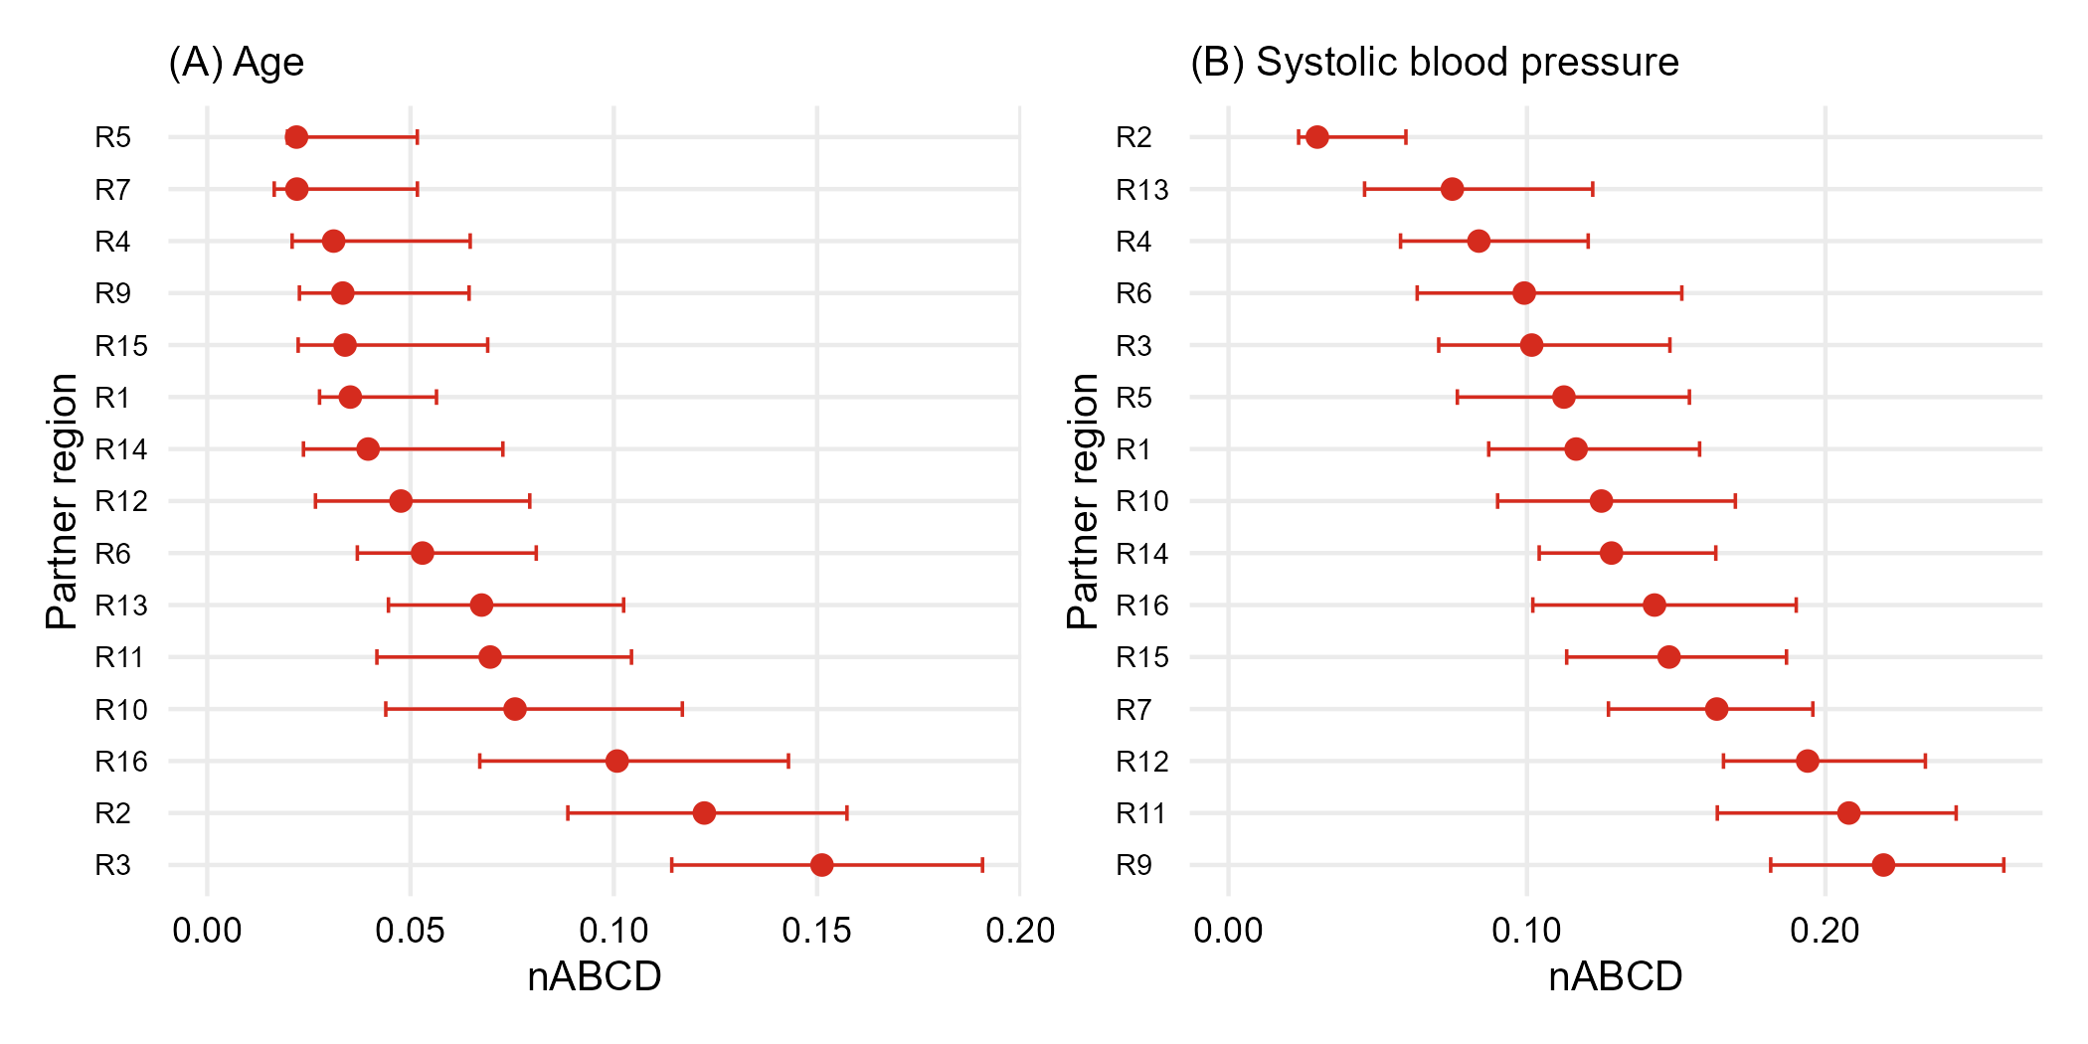
Region 8 vs Partners: Forest Plot
Forest plots of nABCD with 95% bootstrap CIs — age (A) and SBP (B)
2026
nABCD: Effect Modifier Similarity for MRCTs
21

Slide 22
R2 vs R9: Why Evaluate Jointly
R2
R9
nABCD
0.122
(2nd largest)
0.033 (4th smallest)
nABCD
0.030
(smallest)
0.219
(largest)
Implication
A single effect modifier →
opposite conclusions
; R2 best on SBP, near-worst on Age; R9 good on Age, worst
on SBP
Evaluate all candidate effect modifiers jointly
2026
nABCD: Effect Modifier Similarity for MRCTs
22

Slide 23
Leading Candidate: R4 (Six Eligible)
Plausible Upper Bounds for
/yr;
/mmHg (class-level evidence; GUSTO-I, FTT 1994)
A partner is
eligible
on a modifier if
Joint Eligibility
Six partners jointly eligible
on both modifiers:
R1, R4, R5, R6, R14, R15
R4
is the
leading single-pool candidate
— 3rd-lowest age (0.031) and 4th-lowest SBP (0.084); balanced
across both modifiers
R5 has lowest age nABCD (0.022) but only 6th-lowest on SBP — asymmetric profile
Quantitative inputs; final judgment with clinical/regulatory advisors
2026
nABCD: Effect Modifier Similarity for MRCTs
23

Slide 24
Discussion

Slide 25
Summary of Findings
Simulation
Percentile bootstrap is
reliable
at moderate sample sizes for non-negligible distributional differences
Positive bias and zero coverage at the null / near-boundary define the
lower limit of reliable inference
GUSTO-I Application
Two candidate effect modifiers (Age, SBP) produced
markedly different partner rankings
Some partners ranked similar on one but dissimilar on the other
Six partners
(R1, R4, R5, R6, R14, R15) emerged as
jointly eligible
;
R4
is the leading single-pool candidate
2026
nABCD: Effect Modifier Similarity for MRCTs
25

Slide 26
Interpretation: Two Implications
Implication 1: Evaluate all candidate effect modifiers jointly
R2 vs R9 contrast: a partner similar on one modifier may not be on another
Restricting to a subset risks omitting modifiers that later compromise consistency
Implication 2: Partner selection cannot rest on nABCD alone
varies markedly across partners and modifiers
Same nABCD carries different clinical weight depending on partner-specific differences
Six partners (R1, R4, R5, R6, R14, R15) emerged as
jointly eligible
;
R4
stood out as leading single-pool
candidate due to balanced ranking on both modifiers
Pooling judgments require
distributional ranking + clinical calibration
across all candidates
2026
nABCD: Effect Modifier Similarity for MRCTs
26

Slide 27
Strengths: Dual-Pathway Calibration
Strength 1: Adapts to the evidence state
Planning stage with
unknown:
reverse-calculation as primary calibration
Confirmatory stage with
available:
provides complementary clinical-scale calibration
No fixed nABCD cutoff imposed
Strength 2: Distributional value is invariant
nABCD captures
scale and skewness
differences invisible to SMD
This property holds
regardless of whether
is available
Clinical calibration
enhances
, not replaces, the distributional assessment
2026
nABCD: Effect Modifier Similarity for MRCTs
27

Slide 28
Practical Recommendations
1. Compute
nABCD + bootstrap CI
for every candidate effect modifier (
per region)
2. When
is estimable: translate to
with bootstrap CI
3. When
is unknown: compute
at pre-specified
values
4. Report alongside
overall treatment effect and non-inferiority margin
to support deliberation
5. Multiple effect modifiers: conservative (maximum
, smallest
) or totality-of-evidence approach
Policy Advantage
nABCD requires only baseline distributions → applicable to
trials, registries, EHR, RWE
Aligns with ICH E6(R3) RWE promotion
2026
nABCD: Effect Modifier Similarity for MRCTs
28

Slide 29
Future Work and Closing
Future Work
Extension to
categorical effect modifiers
Upstream identification of which baseline characteristics constitute relevant effect modifiers — a non-trivial
problem deserving dedicated investigation
Multivariate extensions and small-sample bias correction
The Principal Contribution
nABCD + bootstrap CI + clinical calibration (
or
)
Transforms the
previously qualitative
judgment of "similar enough"
Into a
reproducible quantitative basis
for sponsor judgment
Filling the methodological gap left by ICH E17
2026
nABCD: Effect Modifier Similarity for MRCTs
29

Slide 30
Thank You
Questions welcome
Tak Nagakubo

