Slide 1
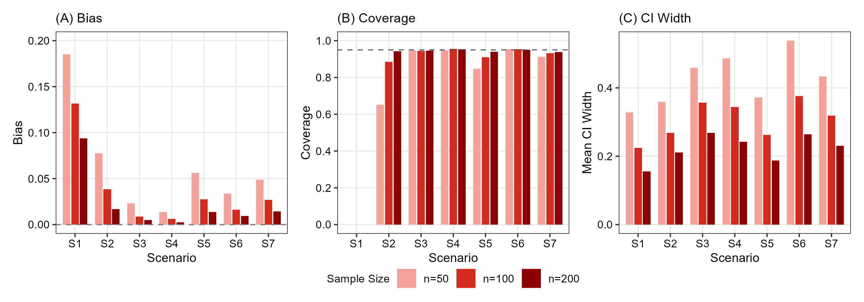
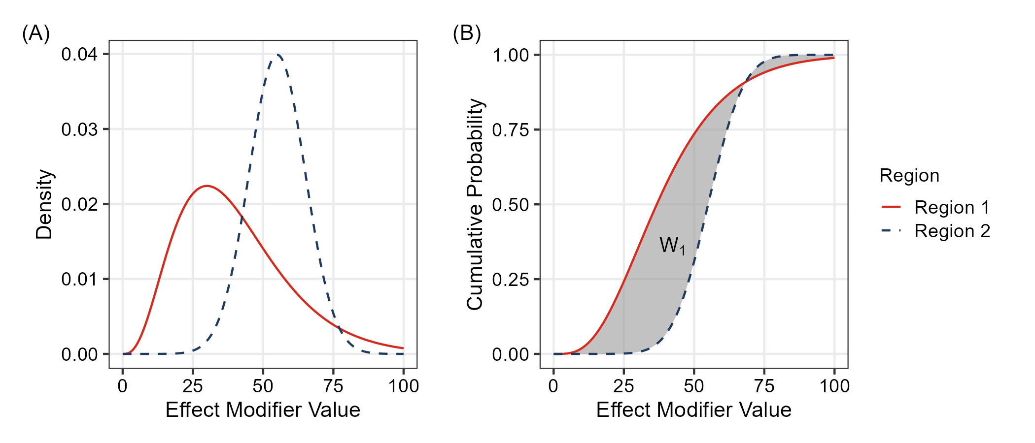
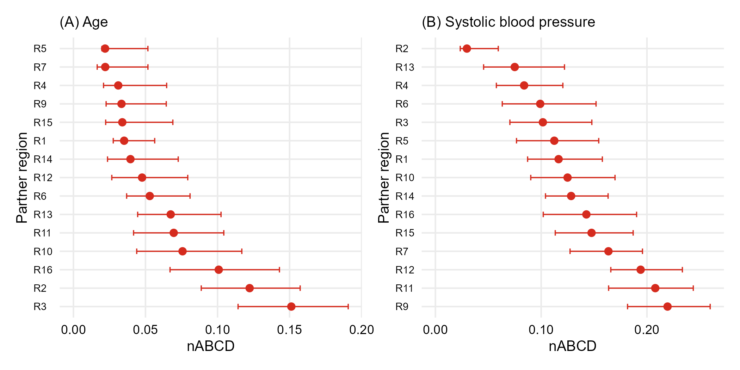
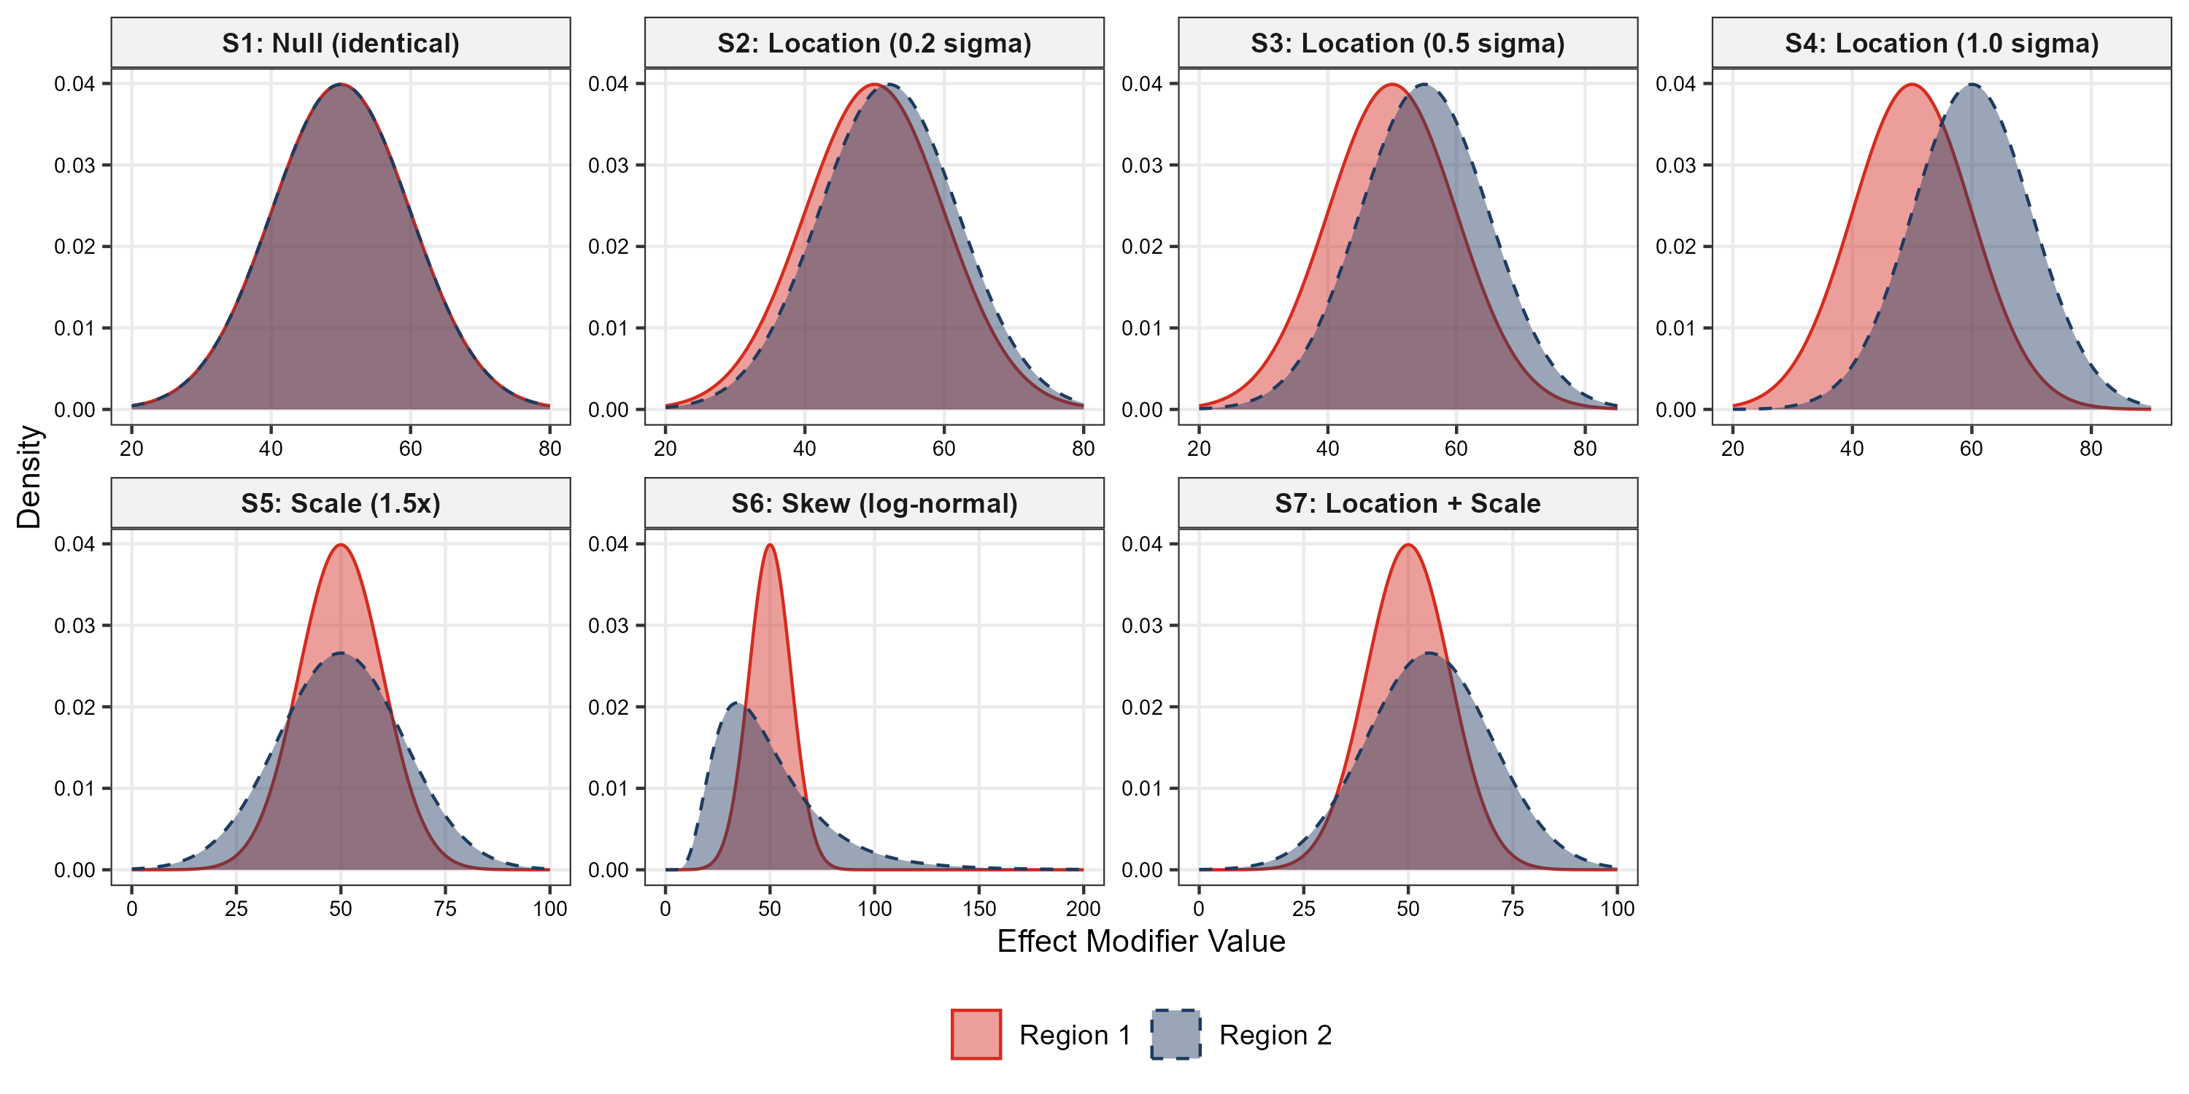
Quantifying Effect Modifiers Similarity for Regional Pooling Strategy in Multi-Regional Clinical Trials
Takashi Nagakubo¹
¹Evidence & Analytics Center of Excellence, Global Statistical Sciences Japan
Background
Treatment effect consistency across regions is assessed in MRCTs
Individual regional sample size are often too small alone for consistency assessment
ICH E17 strategy: pool region with similar effect modifier (EM) distributions
At the planning stage, sponsors must select pooling partners with evidence that regions are “similar enough”
Objectives
Develop a quantitative index that captures distributional similarity
Deliver a practitioner-facing tool for the planning stage of an MRCT
Dissimilarity Index
Wasserstein-1 distance:
nABCD: normalized Area Between Cumulative Distributions:
$$nABCD\left(F_{1},F_{2}\right)=\frac{W_{1}(F_{1},F_{2})}{IQR_{pooled}}$$
nABCD(𝐹_1,𝐹_2 )=(𝑊_1 (𝐹_1,𝐹_2))/(IQR_pooled )
Kantorovich-Rubinstein Duality:$W_{1}\left(F_{1}, F_{2}\right) = \sup_{{\left\|f\right\|}_{Lip}≤ 1}\left|\int{fdF_{1}−\int{fdF_{2}}}\right|$
Kantorovich-Rubinstein Duality:𝑊_1 (𝐹_1, 𝐹_2 ) = sup┬(‖𝑓‖_Lip≤ 1)⁡|∫1▒〖𝑓d𝐹_1−∫1▒〖𝑓d𝐹_2 〗〗|
Heterogeneity bound: If the conditional average treatment effect $τ(x)$ is Lipschitz continuous with constant $L$
Heterogeneity bound: If the conditional average treatment effect 𝜏(𝑥) is Lipschitz continuous with constant 𝐿
$$\left|{\overline{τ}}_{1}−{\overline{τ}}_{2}\right|≤L ⋅IQT_{pooled}⋅nABCD(F_{1},F_{2})$$
|𝜏 ̅_1−𝜏 ̅_2 |≤𝐿 ⋅IQT_pooled⋅nABCD(𝐹_1,𝐹_2)
Simulation Design
Distribution pairs for scenarios (S1–S7) covering null, location-shift, scale-shift, skewness, and combined location+scale differences
10,000 replications, sample size (50, 100, 200), bootstrap B=2,000
$L$: upper bound on treatment effect change per unit change in the EM
𝐿: upper bound on treatment effect change per unit change in the EM
Clinical calibration
Pathway 1: When L is available $Δ_{max}=L⋅IQR_{pooled}⋅nABCD$. Worst-case regional treatment effect difference on the clinical scale
Pathway 1: When L is available Δ_max=𝐿⋅IQR_pooled⋅nABCD. Worst-case regional treatment effect difference on the clinical scale
Pathway 2: When L is unknown $L^{∗}={Δ_{clin}}/{\left({IQR}_{pooled}⋅nABCD\right)}$. $Δ_{clin}$: clinically important difference. $L^{∗}$ above plausible range means that distributional difference unlikely to be clinically concerning.
Pathway 2: When L is unknown 𝐿^∗=Δ_clin∕(IQR_pooled⋅nABCD) . Δ_clin: clinically important difference. 𝐿^∗ above plausible range means that distributional difference unlikely to be clinically concerning.
$$W_{1}\left(F_{1},F_{2}\right)=\int{\left|F_{1}\left(x\right)−F_{2}\left(x\right)\right|dx}$$
𝑊_1 (𝐹_1,𝐹_2 )=∫▒|𝐹_1 (𝑥)−𝐹_2 (𝑥)|𝑑𝑥
Simulation Results
Bias: Bias is negligible for non-null scenarios (S3–S7) at n ≥ 100. At the null (S1), a positive bias persists because Wasserstein distance is non-negative
Coverage: 95% bootstrap CI coverage is 0.88–0.96 for non-null scenarios (S3–S7) at n ≥ 100. At the null (S1), the non-negative bootstrap CI cannot contain zero.
I Width: CI width shrinks with sample size as expected
Application
Goal: A sponsor planning a Phase 3 MRCT for a novel thrombolytic in acute myocardial infarction (AMI) must identify pooling partners for a region within a regulatory market. Age and systolic blood pressure (SBP) are candidate EMs. The goal is to identify regions with similar distributions of the EMs as the anchor region (region 8).
Data: GUSTO-I individual patient data (16 anonymized regions) serves as the distributional source
Findings
Categorical EM extension: Current framework focuses on continuous EMs; extension to binary and multi-level categorical EMs requires distinct distance metrics designed for discrete distributions
Multivariate extension: EM evaluation could be extended to joint multivariate distributional comparison via Wasserstein-2 or sliced Wasserstein distances, capturing correlation structure
Upstream EM identification: Which baseline characteristics constitute relevant EMs is a non-trivial assumed solved in this work; formal methodology deserves dedicated investigation
Methodological gap filled: nABCD provides the quantative metric for EM distributional similarity — transforming “sufficient similar” from qualitative judgement into a reproducible quantitative basis
Heterogeneity bound: Via Kantrovich-Rubinstein duality, maximum of CATE is established, providing the theoretical bridge from distributional distance to treatment effect differences
Reliable bootstrap inference at moderate n: Across 7 simulation scenarios, small bias and enough coverage for non-null distributional differences at n ≥ 100
Dual-pathway clinical calibration: When $L$ is estimable $Δ_{max}$ gives clinical-scale interpretation and when $L$ is unknown $L^{∗}$ reverse-calculation supports judgement without imposing a fixed nABCD cutoff
Dual-pathway clinical calibration: When 𝐿 is estimable Δ_max gives clinical-scale interpretation and when 𝐿 is unknown 𝐿^∗ reverse-calculation supports judgement without imposing a fixed nABCD cutoff
Future Work
Joint eligibility via $L^{∗}$: at $Δ_{clin}=1\%pt$ with class-level upper bounds ($L_{UB,age}={10}^{−2}/yr$; $L_{UB,SBP}={2×10}^{−3}/mmHg$), 6 partners (R1, R4, R5, R6, R14, R15) emerged as jointly eligible on both EMs
Joint eligibility via 𝐿^∗: at Δ_clin=1%pt with class-level upper bounds (𝐿_(UB,age)=10^(−2)/yr; 𝐿_(UB,SBP)=〖2×10〗^(−3)/mmHg), 6 partners (R1, R4, R5, R6, R14, R15) emerged as jointly eligible on both EMs
R4 leading candidate: balanced ranking on both EMs
Copyright ©2025 Eli Lilly and Company. All rights reserved.

