Slide 1
Effect of Mitochondrial DNA Variation on the Nuclear Epigenome and Transcriptome
Tyler Nagano
Castellani Lab
April 6th, 2021

Slide 2
Outline
Background and Rationale
Objectives and Hypothesis
Methods
Results
Discussion and Future Steps

Slide 3
Background and Rationale
Mitochondria Function, DNA and Copy Number
Nuclear Epigenome
Mitochondria Effect on the Nuclear Epigenome
mtDNA-CN as biomarker of disease
Background

Slide 4
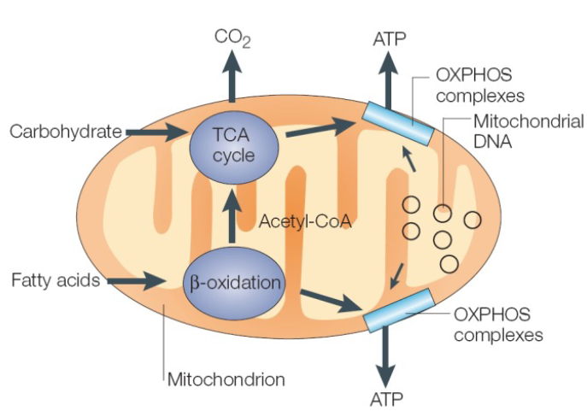
Mitochondrial Function
Vital for energy metabolism:
Oxidative Phosphorylation
Programmed Cell Death
Apoptosis
Mitochondria (mt) dysfunction known to be important in rare diseases and many age-related chronic diseases
Background

Slide 5
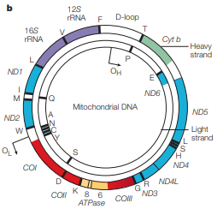
Mitochondrial DNA
Mitochondrial genome:
Circular, 16.6 Kb in length
Encodes 37 genes
13 proteins, 22 tRNAs, 2 rRNAs
Inherited maternally
Depending on cell type:
2-10 copies of mtDNA per cell
10s to 1000s mt per cell
Background

Slide 6
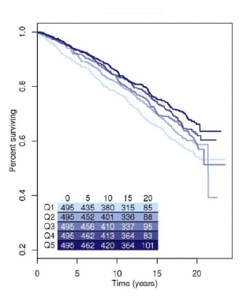
Mitochondrial DNA Copy Number
Mitochondrial DNA copy number is number of mitochondrial genomes per cell
Variation between individuals
Declines with age
Higher in women
mtDNA-CN indirectly measures mitochondrial function
Predictor of all-cause mortality
Background
(Ashar et al., 2015)

Slide 7
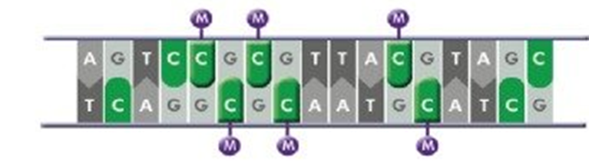
Nuclear Epigenome
Post-translational modifications: phosphorylation, histone acetylation, methylation
epigenetic marks are heritable
Helps to dynamically regulates gene expression in response to the environment
DNA methylation most common epigenetic mark
Located at CG dinucleotides called CpGs; clusters called CpG islands
Background

Slide 8
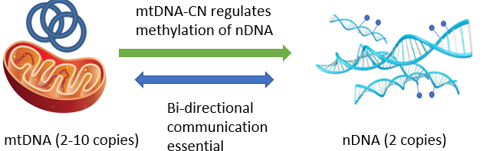
Mitochondrial Effect on Nuclear Epigenome
mtDNA and nuclear DNA (nDNA) bi-directional communication
Essential to cell function; disruptions contribute to many diseases
mtDNA-CN regulates nuclear gene expression via nDNA methylation (Castellani et al., 2020)
Previous studies show that mtDNA has effects on nDNA methylation
Identical nDNA; different mtDNA show differences in methylation and gene expression in mice (Vivian et al., 2017)
Background

Slide 9
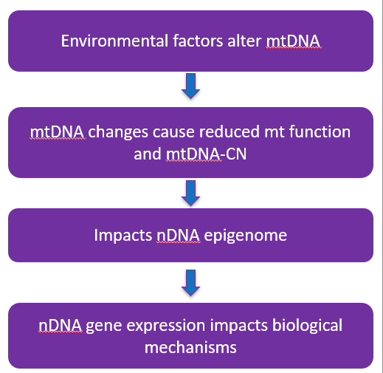
mtDNA-CN Biomarker of Age-Related Diseases
mtDNA-CN is a biomarker of mitochondrial function
Many age-related chronic diseases associated with reduced mt function
Can estimate levels of mtDNA-CN via DNA in blood samples
mtDNA-CN become clinical diagnostic tool to screen for many age-related diseases
Background

Slide 10
Objectives and Hypothesis
Hypothesis:
In vitro reduction of mtDNA-CN leads to differentially methylated sites/regions and differential gene expression in shared genes and biological pathways which mediate the effect of mtDNA-CN on disease
Objectives and Hypothesis

Slide 11
Objectives and Hypothesis
Objectives:
Analyze data generated from cell model to determine differentially methylated sites and differential gene expression
Integrate results of methylation and gene expression analyses to find overlapping pathways and genes
Perform functional enrichment analyses on significant results to discover relevant biological mechanisms
Functional Enrichments
Feature Overrepresentation
Objectives and Hypothesis

Slide 12
Methods
Cell Line Model Generation
EPIC Array and RNA Seq Overview
Methylation Preprocessing and Analysis
RNA Seq Preprocessing and Analysis
Integration Analyses of Gene Expression and Methylation
Functional Enrichment Analyses
Network and Pathway Analysis
Feature Overrepresentation
Methods

Slide 13
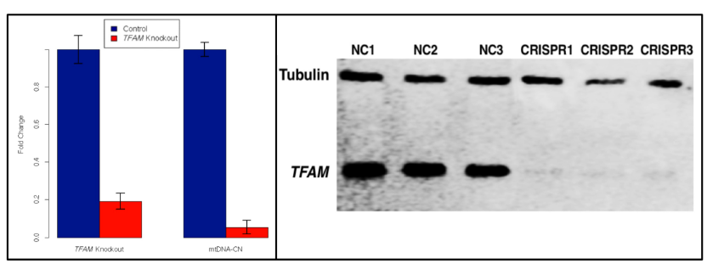
Cell Model Generation
Human Embryonic Kidney (HEK293) with mitochondrial transcription factor A (TFAM) heterozygous knockout performed 3 times independently
TFAM is a nuclear encoded protein essential for mtDNA transcription and regulates mtDNA-CN
TFAM knockout (KO) 5-fold reduction in RNA expression and 18-fold reduction in mtDNA-CN compared to negative controls (NC)
Methods
(Castellani et al., 2020)

Slide 14

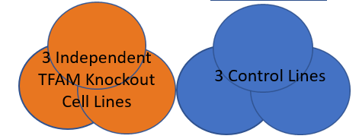
EPIC Microarray – Methylation Data
Illumina Infinium EPIC BeadChip hybridized to TFAM KO and NC to measure methylation
6 samples (3 KO and 3 NC) sequenced twice at two different time points (N=6)
Heterozygous Knockout (1 of 2 copies) of TFAM
Methods

Slide 15
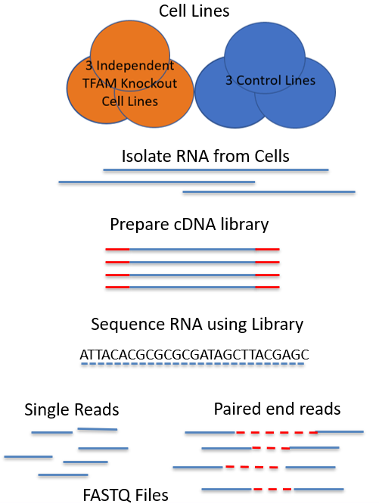
RNA-Seq – Gene Expression Data
TFAM KO and NC cell lines RNA extracted using AllPrep DNA/RNA Mini Kit RNA-Seq
qPCR used to quantify gene expression
6 samples (3 KO and 3 NC) sequenced using RNA-Seq twice at same point in time (N=6)
Methods

Slide 16
Differentially Methylated Site Analysis
Process raw .idat Files from EPIC Array into beta values using Minfi
Beta: amount of methylation at CpG site
Perform quality control, preprocessing and normalization
Detection p-value, Pidsley cross-reactive probes, SNPs
Samples with >0.15 difference in mean negative control beta value between runs removed
Linear Regression using DMPFinder: mtDNA-CN from qPCR as independent variable and methylation as dependent variable
Significance Threshold (EWAS): p < 1e-7
Methods

Slide 17
Differentially Methylated Region Analysis
Same preprocessing and quality control as differentially methylated site analysis
Linear Regression in DMRcate: Treatment Status (KO vs NC) as independent variable and methylation as dependent variable
Adjust for Batch as a fixed effect
Significance threshold (EWAS) p < 1e-7
Region: Defined as minimum 10 CpGs with at most 1000 nucleotides between each CpG in the region
Mean beta shift between KO and NC < 0.05
Significance threshold for regions p < 1.17e-5 using Bonferroni correction
Methods

Slide 18
RNA-Seq Analysis
Process Raw RNA-Seq FASTQ files using Kallisto
Pseudo-align sequences to reference to generate estimated transcript counts
Bootstrap 100 times to account for uncertainties in counts
Take max count of transcript isoform of gene to convert to gene counts
Perform RNA-Seq analysis using EdgeR
Uses Trimmed Mean of m-values (TMM) to scale for effective library size
Filters genes with < 15 raw count across all samples
Filter genes with < 0.5 CPM average across samples meeting CPM cut off
Maximize negative binomial likelihood using weighted empirical bayes to model
Likelihood Ratio Test between observed model and null model
Adjusts for batch as fixed effect
Remove genes with logFC < +/-2
Significance threshold p < 3.53e-6 using a Bonferroni correction
Methods

Slide 19
Integrate Methylation and Gene Expression
Methylation data:
Significant CpGs from differentially methylated site analysis
Gene Expression data:
Gene counts from significant genes in EdgeR
Identify inverse correlations between methylation and gene expression using ELMER
Compare each probe to nearest 20 genes (10 upstream, 10 downstream)
Test each pair using a one-sided Mann-Whitney U test for difference in methylation expression between KO and NC
Remove probes < 1Mb from transcriptional start site of gene
Gene-Probe pair significance threshold: False Discovery Rate (FDR) < 0.01
Test for difference in gene expression between using Student’s T test
Gene expression significance threshold: p < 0.001
Methods

Slide 20
Functional Enrichment Analyses
Find overrepresentation of functional groups and pathways
Map differentially methylated sites/regions and differentially expressed genes to gene groups and pathways using the Gene Ontology (GO) and Kyoto Encyclopedia of Genes and Genomes (KEGG) databases using missMethyl and limma
Combine results of methylation and gene expression pathway analyses using Fisher’s combined probability test for meta-analysis
Remove all with p < 0.05 in either methylation or gene expression
Methods

Slide 21
Functional Enrichment Analysis
Perform additional analyses to check for overrepresentation of functional groups
MsigDB: Reactome pathways and Transcription factor groups
MitoCarta: Mitochondrial Proteins and Pathways
Use student’s T test on genes in functional group compared to genes out of functional groups
Combine results using Fisher’s combined probability test for meta-analysis
Remove all with p < 0.05 in either methylation or gene expression
Perform enrichment testing for CpG and gene region annotations of methylation and gene expression data using DMRichR
Use Fisher’s Exact test to test for overrepresentation of features
Significance threshold: FDR < 0.05
Methods

Slide 22
Results
Differentially Methylated Sites Analysis
Differentially Methylated Regions Analysis
Differentially Expressed Genes Analysis
ELMER Integration Analysis
Functional Enrichment Analyses
Results

Slide 23
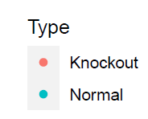
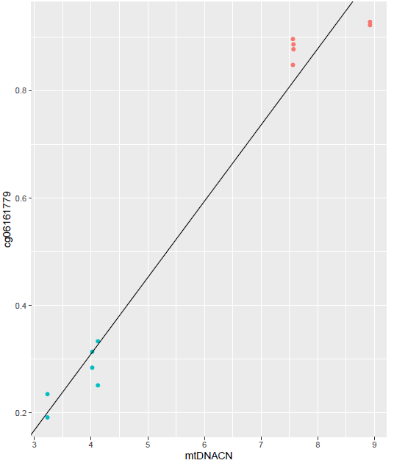
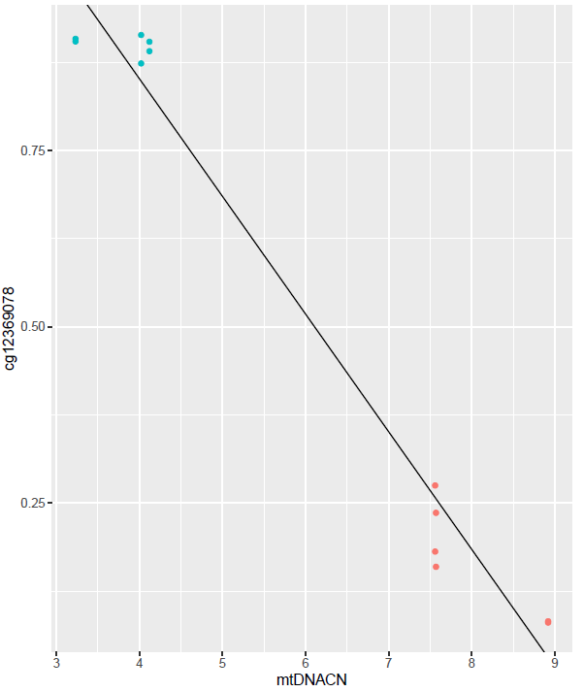
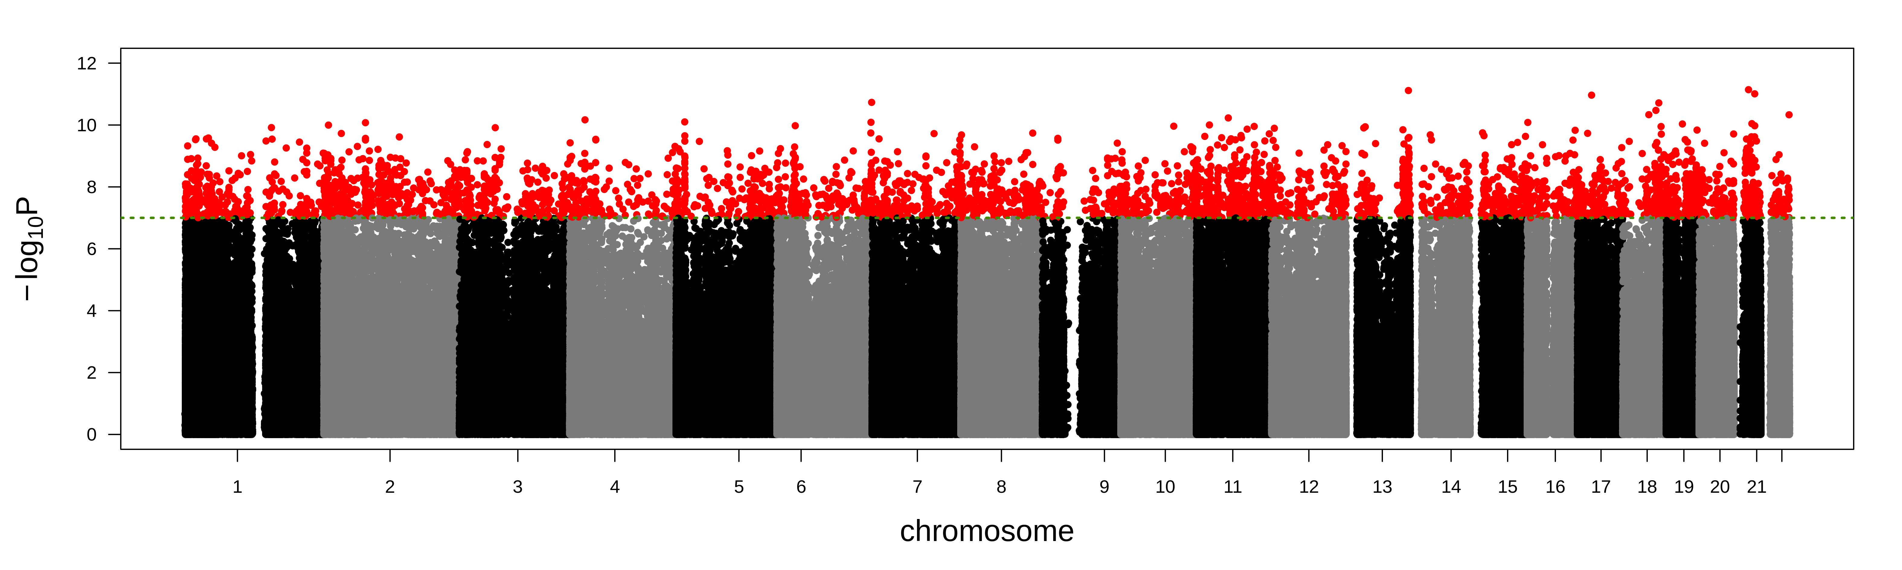
Differentially Methylated Sites
Top 2 CpGs
After normalization and quality control 769026 probes remain
Linear regression mtDNA-CN from qPCR as independent variable and methylation as dependent variable
4242 sites differentially methylated p < 1e-7
Results
22

Slide 24
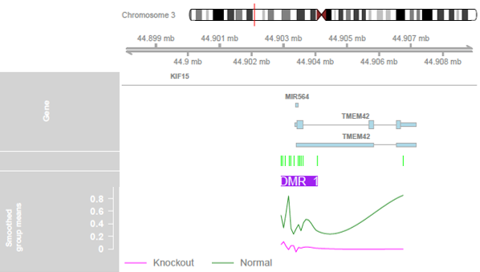
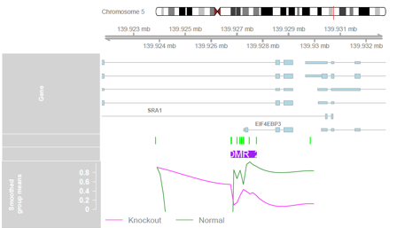
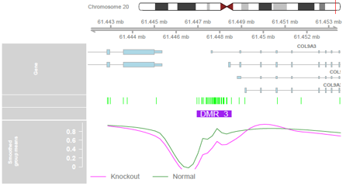
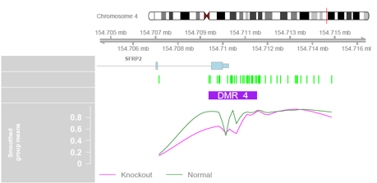
Differentially Methylated Region Analysis
Linear model with treatment status as independent variable and methylation as dependent variable
228 differentially methylated regions p < 1.17e-5
Results

Slide 25
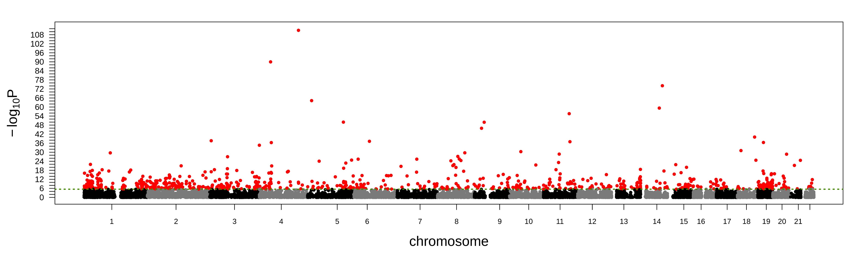
Differentially Expressed Genes Analysis
After filtering and normalization 14149 genes remain
Likelihood Ratio Test between observed model and null model
179 genes differentially expressed p < 3.53e-6
22
Results
Notes:
Add list of top genes?

Slide 26
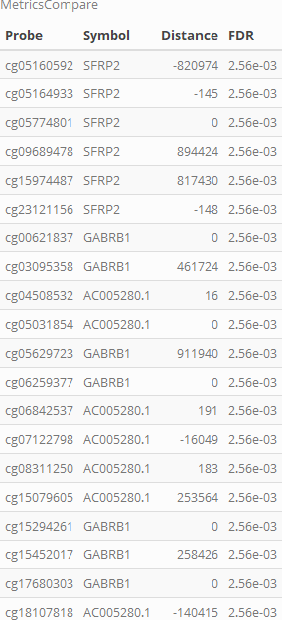
Integration Analysis
Tested 35347 gene-probe pairs
314 gene probe pairs meet significance thresholds and distance filters
45 unique genes and 286 probes
70 pairs have probe at transcriptional start site
Results
Notes:
Check if 0 means in the gene or TSS

Slide 27
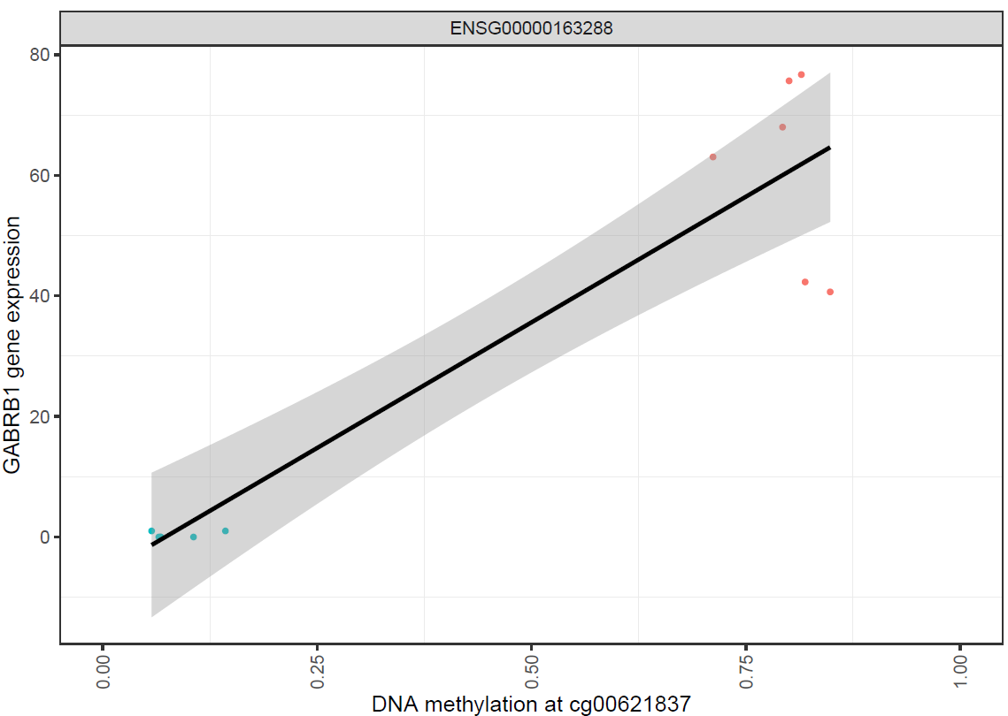
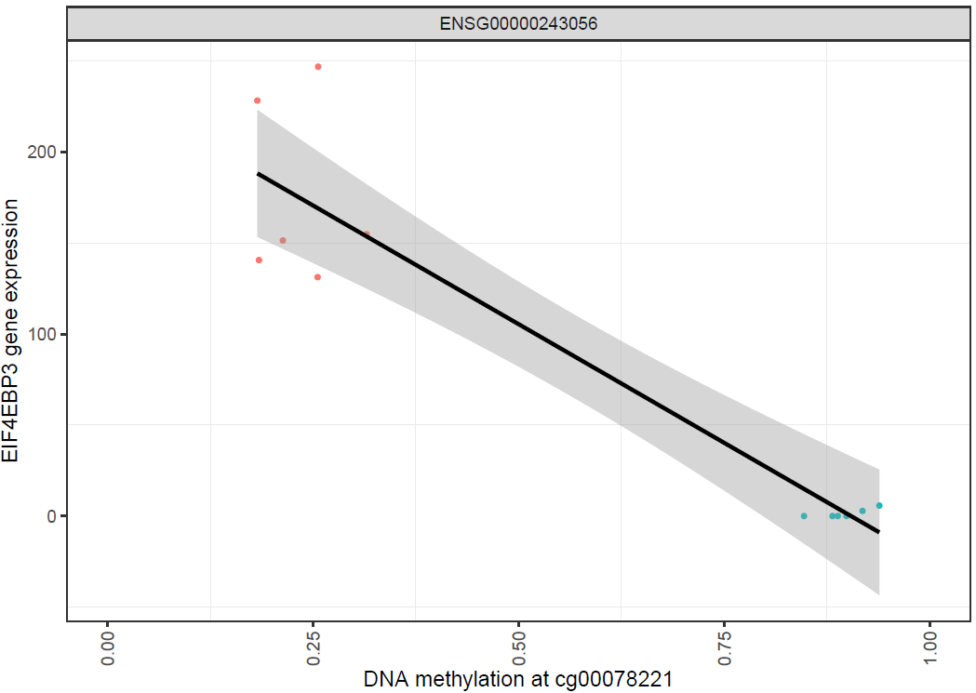
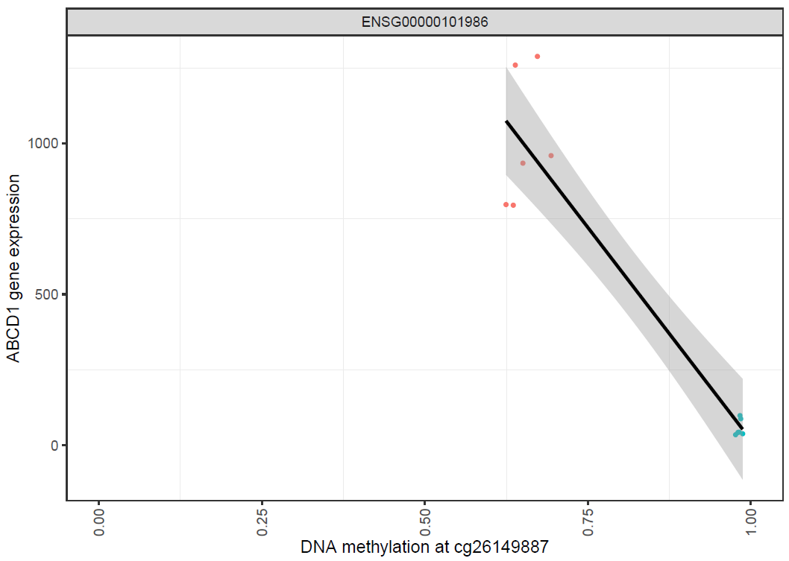
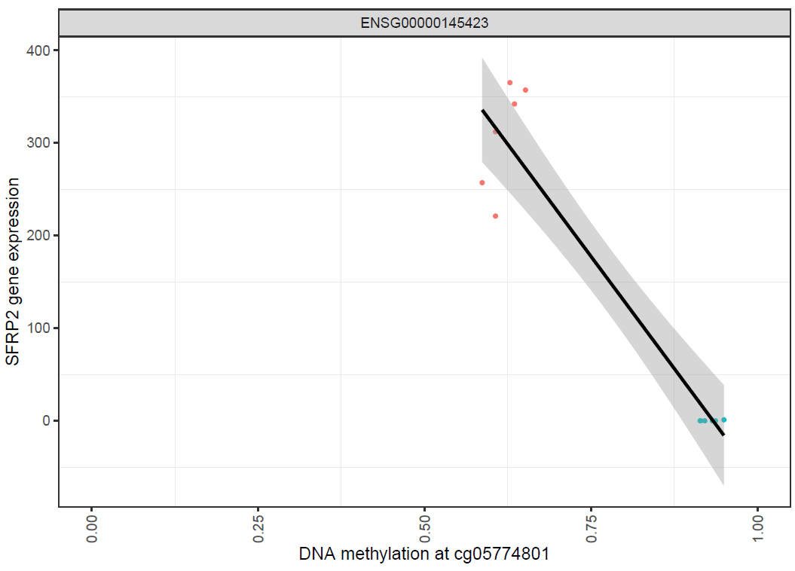
Integration Analysis
EIF4EBP3 is an initiation factor prevents assembly of EIF4E which is the rate limiter of protein synthesis
GABRB1 is a subunit of GABA_{A} Receptor
The ABCD1 is an ATP-binding cassette transporter for very long chain fatty acid (VLCFA)-CoA from the cytosol to the peroxisome
SFRP2 is most differentially expressed gene; acts as soluble modulators of Wnt signaling

Slide 29
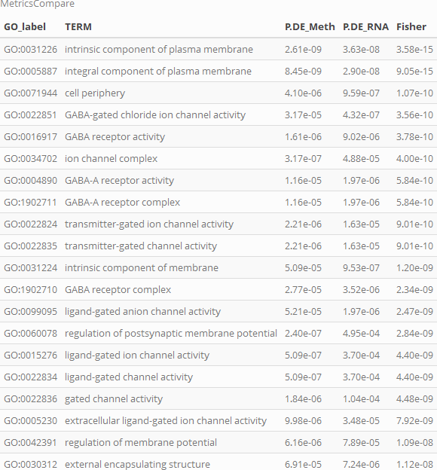
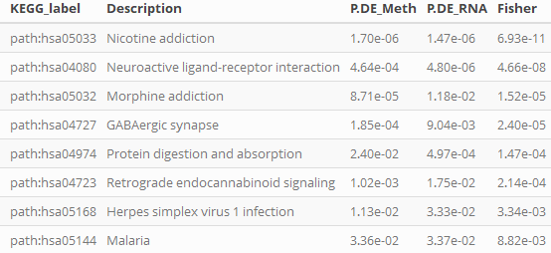
GO/KEGG Methylation Site and RNA
Results
Notes:
GO/KEGG Fisher combined methylation site

Slide 30
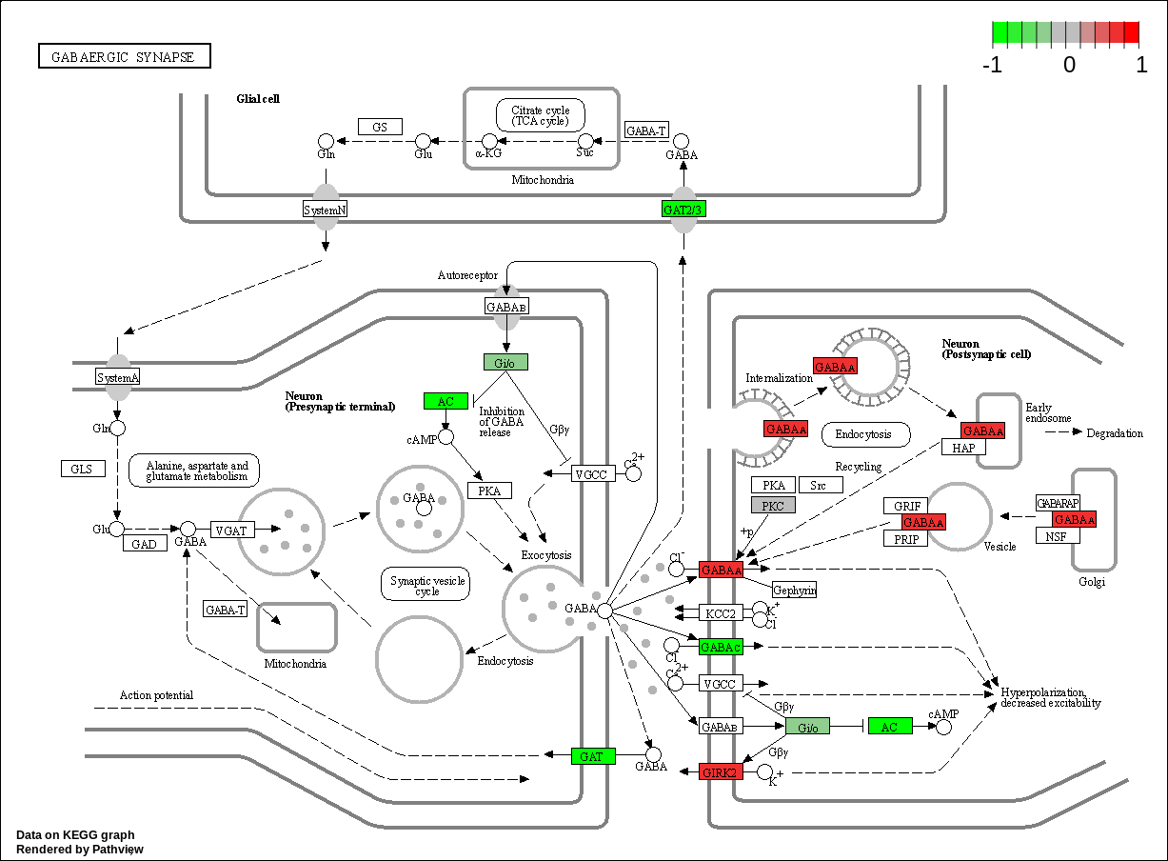
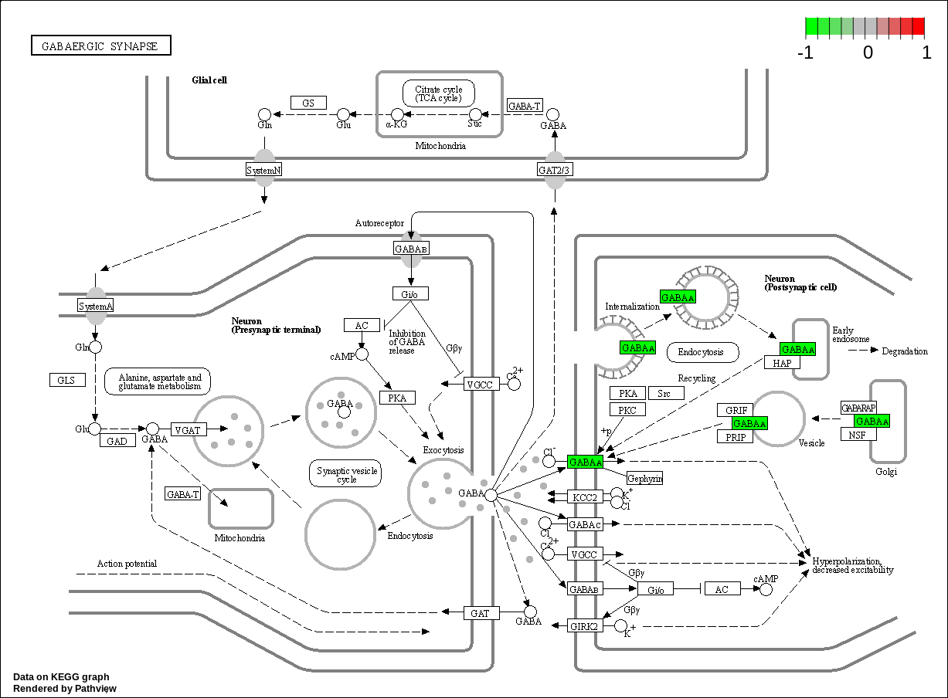
KEGG GABAergic Synapse
Methylation Site (left) and RNA (right). GABA A gene hypermethylated and under expressed
Results

Slide 31
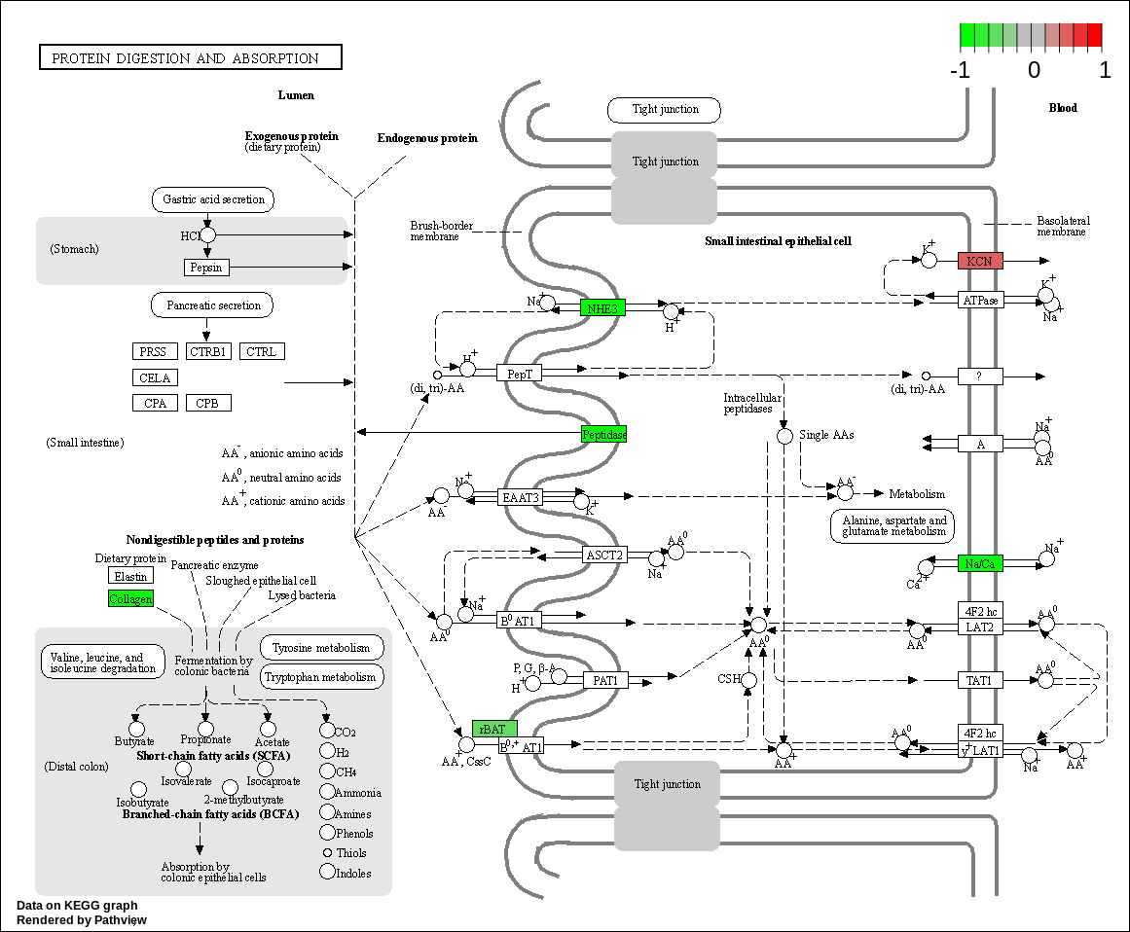
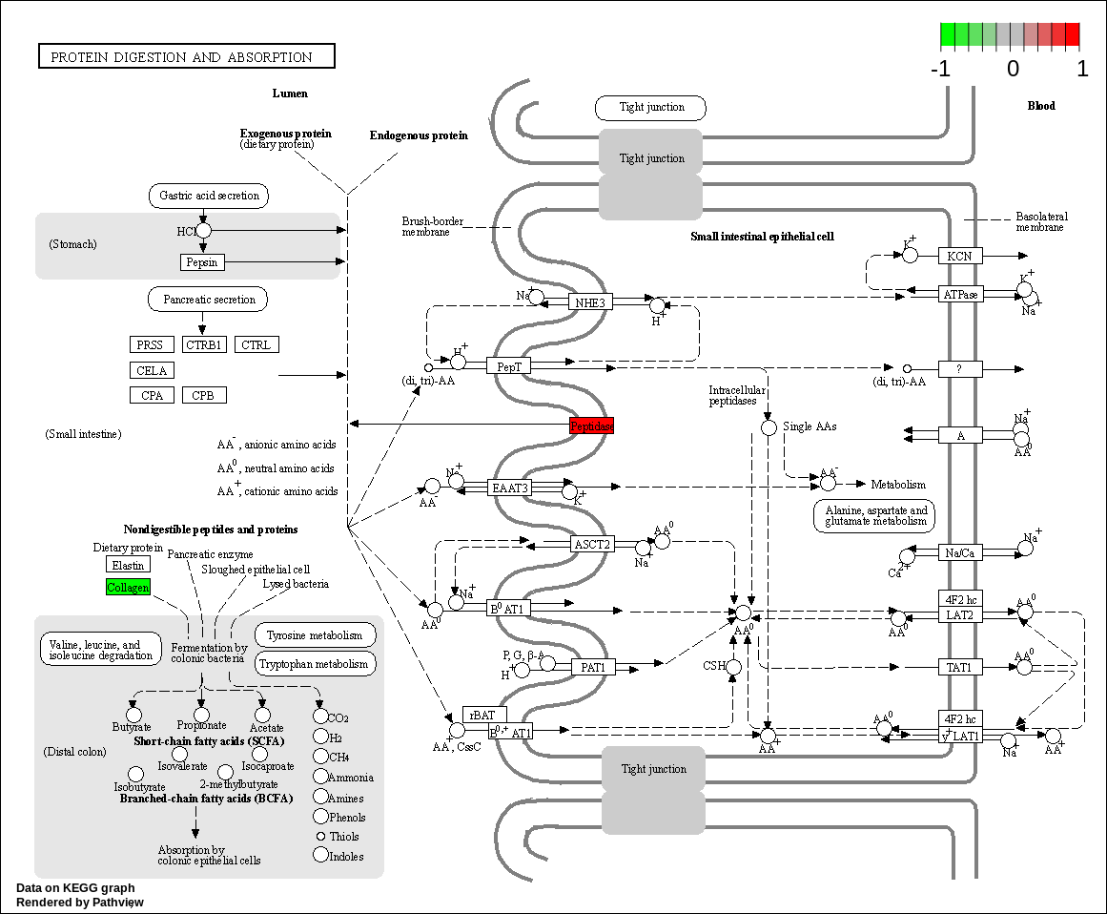
KEGG Protein Digestion and Absorption
Methylation Site (left) and RNA (right). Peptidase gene hypomethylated and over expressed
Results

Slide 32
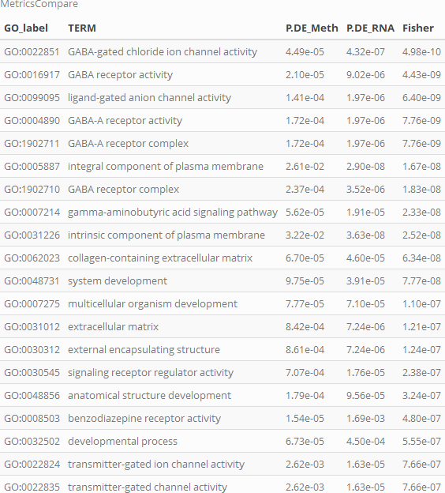
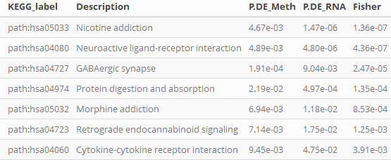
GO/KEGG Methylation Region and RNA
Results
Notes:
GO/KEGG Fisher combined methylation region

Slide 33
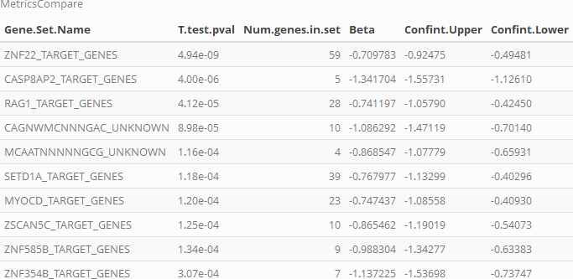
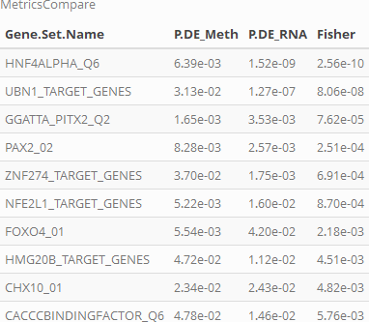
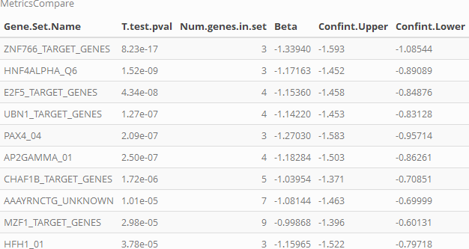
Functional Enrichment – Transcription Factor
Methylation
RNA
Fisher Combined Methylation and RNA
Results
Notes:
Transcription factor

Slide 34
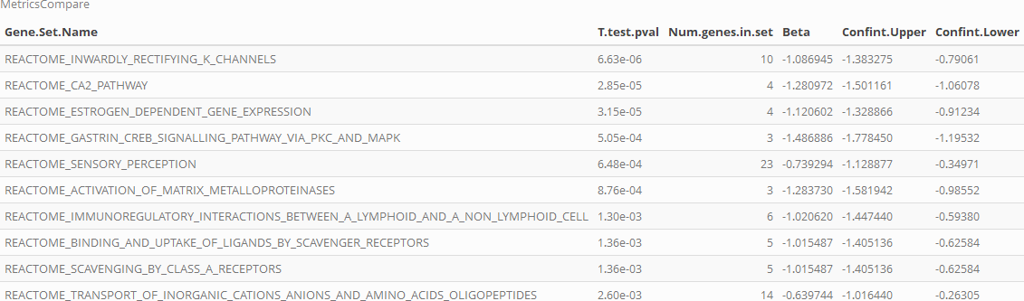
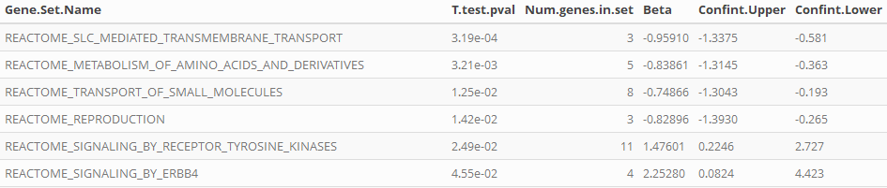
Functional Enrichment - Reactome
Methylation
RNA
Results
Notes:
Reactome

Slide 35
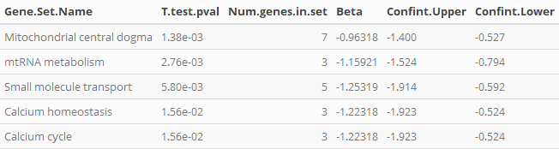
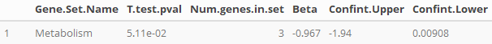
Functional Enrichment - MitoCarta
Methylation
RNA
Results
Notes:
mitocarta

Slide 36
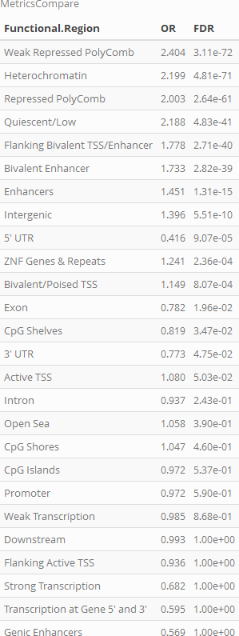
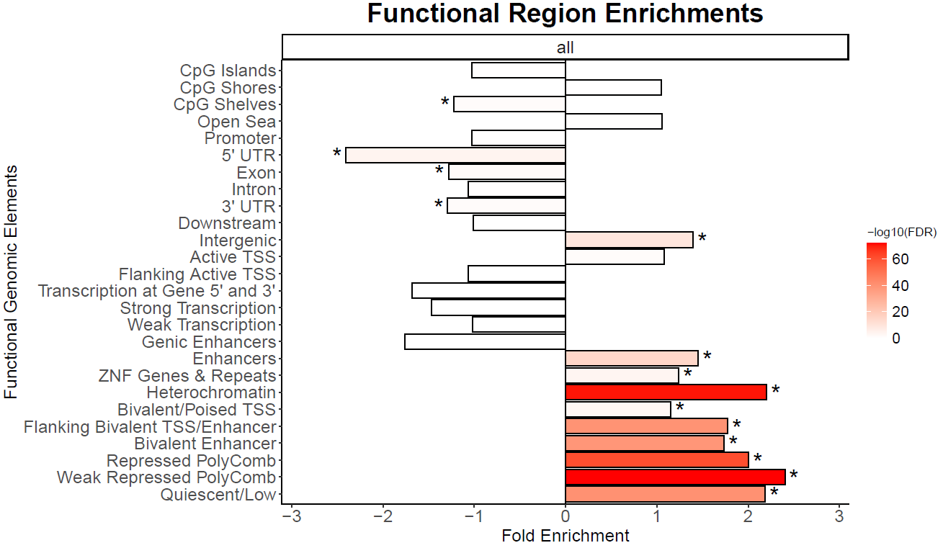
Feature Overrepresentation
* Indicate FDR < 0.05
Results
Notes:
DMRichR
Check for RNA by mapping to specific sites, compare with methylation

Slide 37
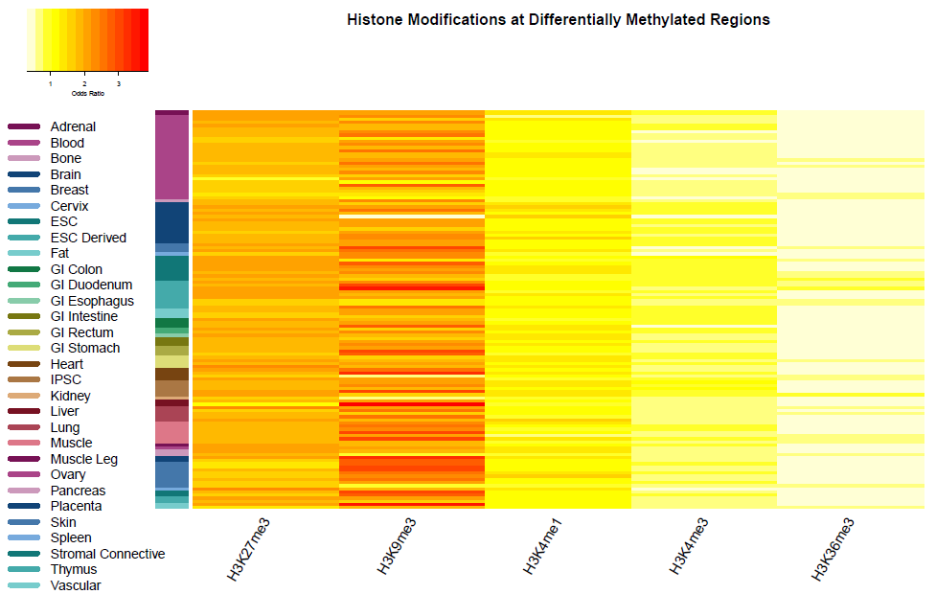
Feature Overrepresentation
Results

Slide 38
Discussion
EIF4EBP3 expression is inversely related to DNA methylation
Binds to EIF4E to prevent formation of EIF4F which recognizes the 7-methylguanosine cap at 5’ end of mRNA to initiate translation
Decreased EIF4EBP3; Increased EIF4E; Increased EIF4F leads to global increased protein synthesis; also increased tumorigenesis and metastasis (cancer)
CXCL12 expression inversely related to DNA methylation
mtDNA-CN reduction demethylates CpGs causing CXCL12 to be expressed; can bind to CXCR4 which impacts a variety of cell functions
Tissues (e.g. lung) with high expression is linked to metastasis of cancers containing CXCR4 to these tissues
Many Zinc Finger Genes significant; Zinc Finger proteins important in regulation of transcription
ZNF257, ZNF385D, ZNF486, ZNF492, ZNF595, ZNF625, ZNF66, ZNF681, ZNF737, ZNF81, ZNF83, ZNF85, ZNF91
Discussion

Slide 39
Discussion
5 of 179 significant genes are related to mitochondria
ABCD1: only significant mitochondria gene from integration analysis
ATP-binding cassette transporter; moves very long chain fatty acid-CoA (VLCFA-CoA) from cytosol to peroxisome
Important in X-linked adrenoleukodystrophy
Chromatin States and Histones:
H3K27me3 (polycomb repression) and H3K9me3 (heterochromatin)
Both hypermethylated; leads to decreased transcription
H3K4me3 (active promoters) and H3K36me3 (gene bodies)
Both hypomethylated; decreased transcription of genes
Decreased methylation of gene bodies associated with genes that change expression during aging
RIOX1: demethylates H3K4me3
Discussion

Slide 40
Discussion
Overrepresented KEGG Pathways using Fisher’s Combined
GABAergic Synapse
Nicotine Addiction
Morphine Addiction
Neuro-Active Ligand Receptor Interaction
Protein Digestion and Absorption
Retrograde Endocannabinoid Signaling
Genes in the above pathways may have importance in facilitating the effect that mtDNA-CN has on nDNA methylation
The KEGG Orthology database demonstrates that GABBR gene is in all of the pathways above except Protein Digestion and Absorption
Discussion

Slide 41
Discussion
Within the GABAergic Synapse and Protein Digestion and Absorption pathways there is an inverse relationship between methylation and gene expression for the GABA_{A} and Peptidase genes respectively
GABA_{A} is under expressed; Peptidase is over expressed in KO
GO groups demonstrate that GABA related genes are overrepresented
GABRA2, GABRB1, GABRB3, GABRE, GABRG1
Peptidase helps to break down exogenous proteins (e.g. dietary protein) into amino acids. One amino acid is glutamate which is the precursor to GABA
Integration analysis demonstrates multiple subunits of GABA_{A} receptor have inverse relationship with methylation
GABA_{A} Receptor may facilitate the effect mtDNA-CN has on nDNA methylation
Discussion

Slide 42
Next Steps
WGCNA: weighted correlation network analysis (Mandatory)
To find clusters of highly correlated genes related to mtDNA-CN
Motif Enrichment – Meme Suite Tools (Optional)
Map all CpGs to genes; take 1000 bp sequences upstream of start of the gene from reference genome
Use STREME to determine enriched motifs between genes associated to significant CpGs and the rest of the genes
Further analyses using different cell line as model with TFAM knockout to determine tissue specific differences for mtDNA-CN effect on nDNA methylation and disease
Future Steps

