Slide 1
A modern approach to electron transport: A crash course in PYboltz/MagBoltz
Austin D McDonald
Department of Physics
University of Texas at Arlington
Harvard University

Slide 2
Development of PyBoltz
Refactored MagBoltz into a modern language for ease of development and understanding.
This refactorized code retains the functionality of MagBoltz. However, it is done in an object oriented structure. Which eases the reading and future development.
The comprehensive gas cross sections that MagBoltz is famous for (Thanks Steve!) have been extracted and implemented in there own github. This allows them to be used/developed independently of MagBoltz.
PyBoltz github
https://github.com/UTA-REST/PyBoltz
Cross section github
https://github.com/UTA-REST/PyGasMix
You can get these both through pip!
Check out the PyBoltz README.
Also see the corresponding paper.
Al Atoum, B., Biagi, S.F., González-Díaz, D., Jones, B.J.P. and McDonald, A.D., 2020. Electron transport in gaseous detectors with a Python-based Monte Carlo simulation code. Computer Physics Communications, p.107357.

Slide 3
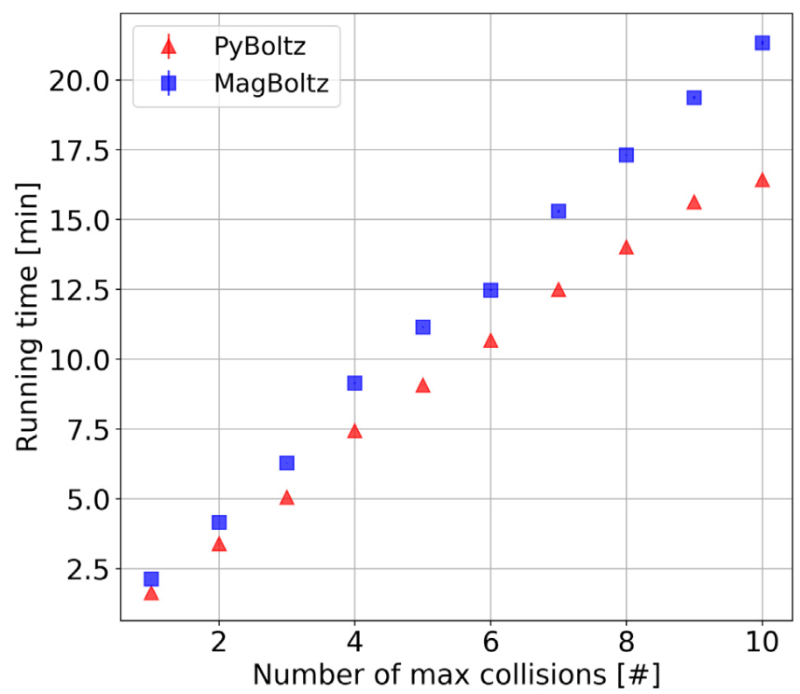
MagBoltz & PyBoltz
We have compared both MagBoltz and PyBoltz thoroughly, and both codes agree within errors.
This required reproducing the same random number generator that FORTRAN utilizes (fortunately its pretty good even by today’s standards).
Unlike the name suggests PyBoltz is not fully python based. It is mainly in Cython, which compiles like C/C++ but looks like python.
One concern from moving away from FORTRAN was the code would be considerably slower. However, in our testing Cython manages to out compete FORTRAN!

Slide 4
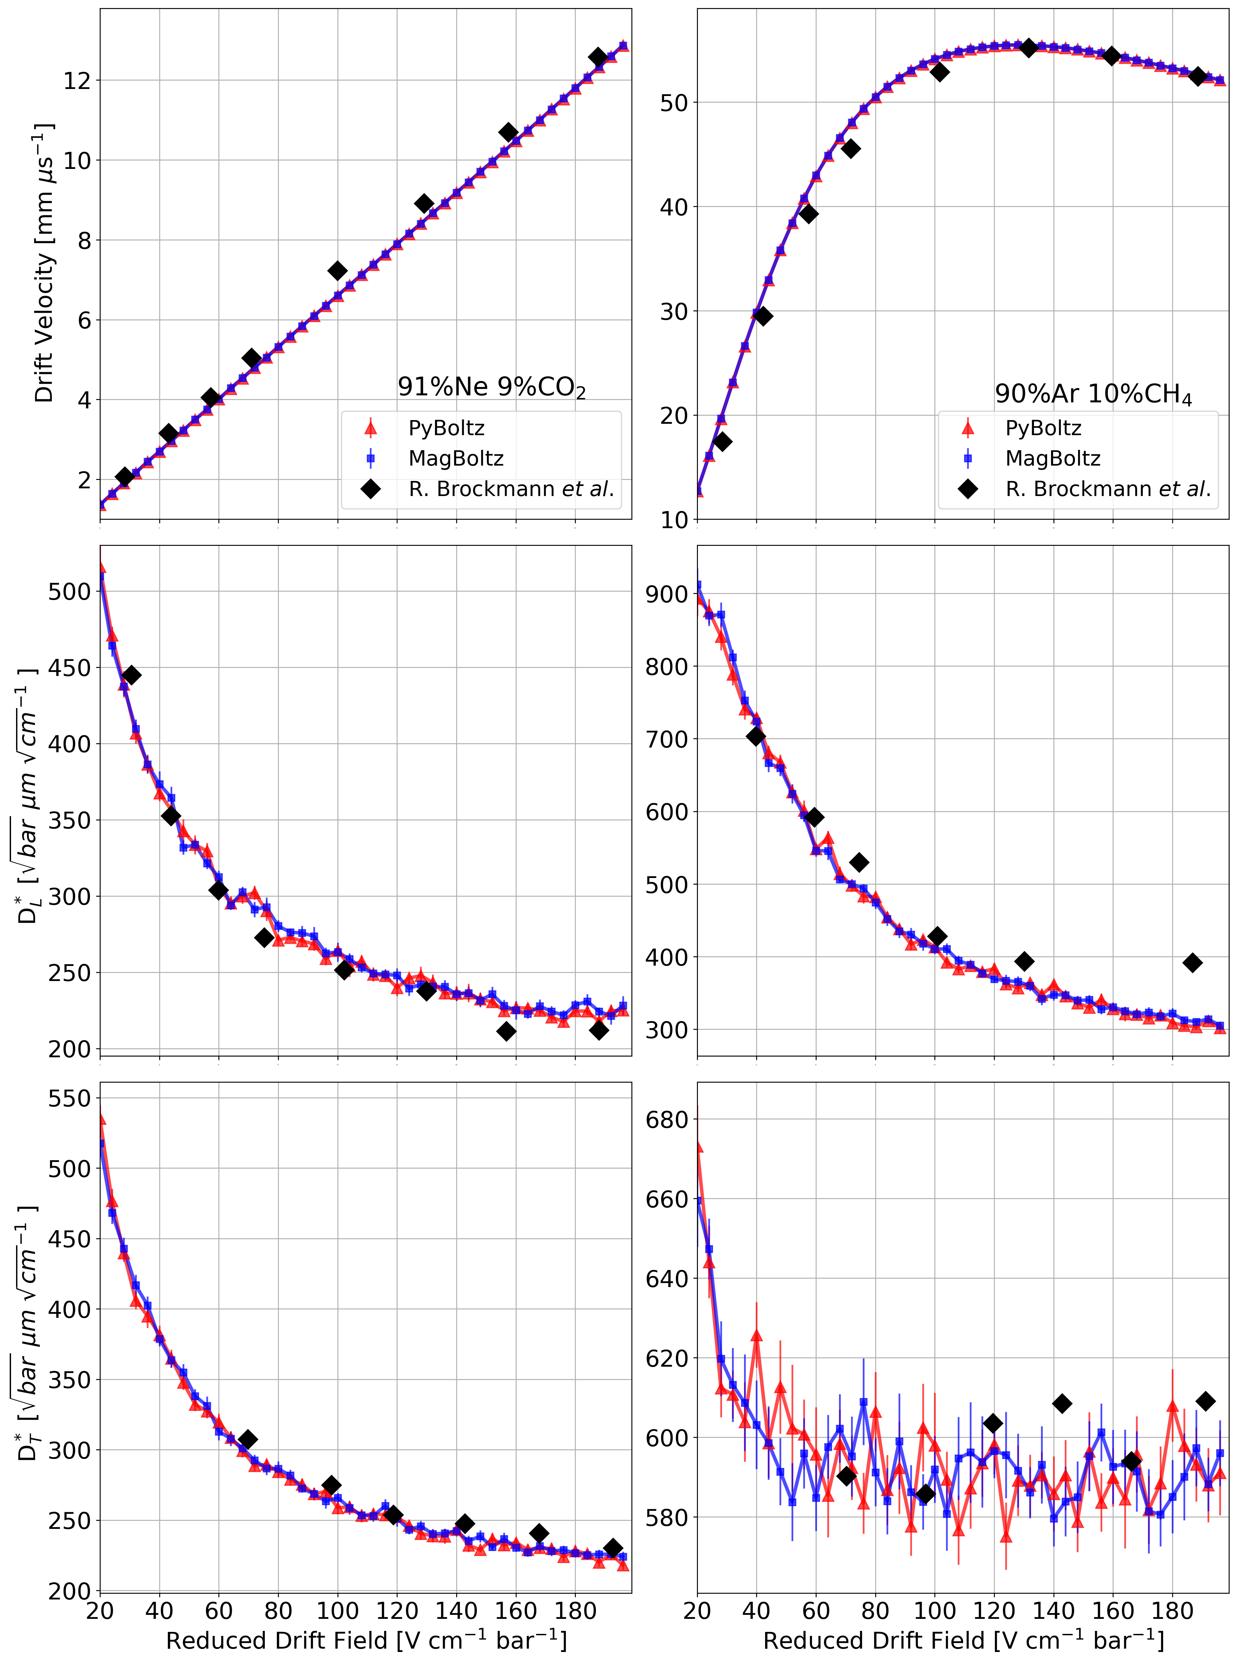
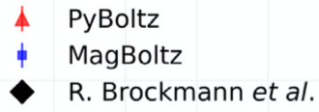
MagBoltz & PyBoltz
Comparing the outputs of both MagBoltz and PyBoltz. We have very good agreement with each other and when comparing to drift data.

Slide 5
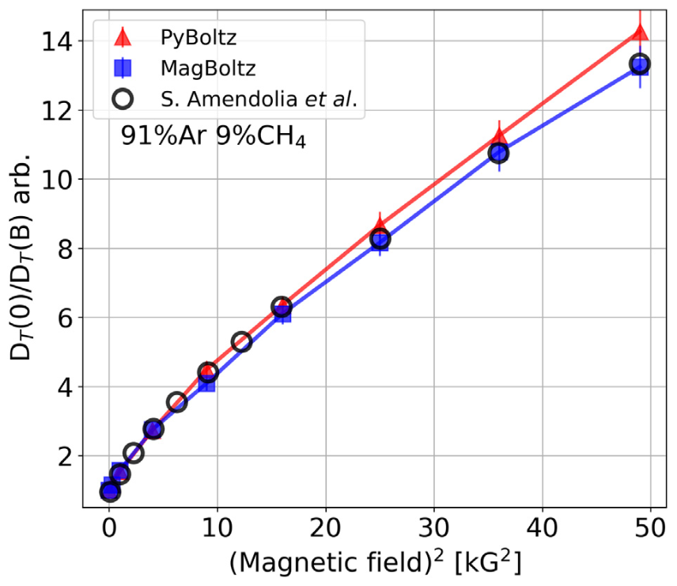
MagBoltz & PyBoltz
Comparing the outputs of both MagBoltz and PyBoltz. We have very good agreement with each other and when comparing to drift data.
Also agree when in the presence of a magnetic field!

Slide 6
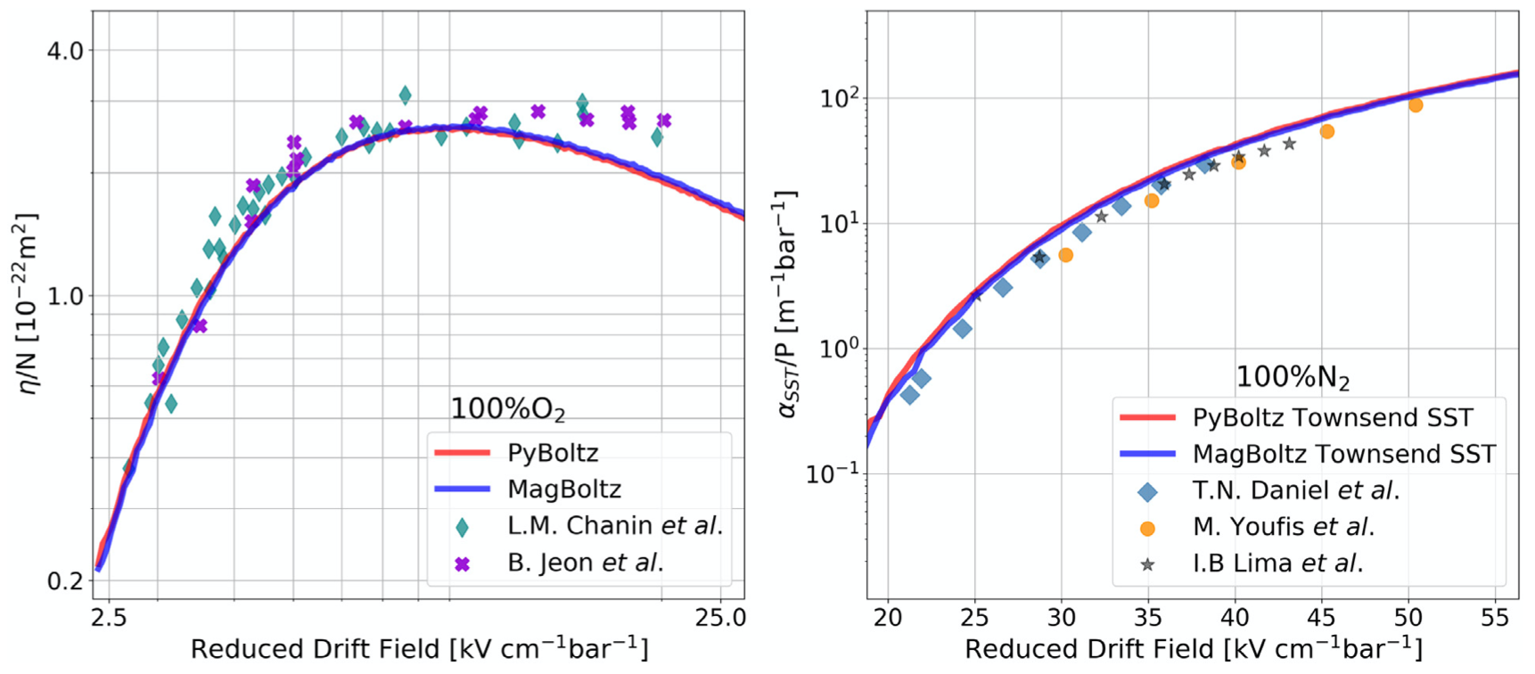
MagBoltz & PyBoltz
Are you more interested in the attachment or Townsend parameters?
PyBoltz matches Magboltz here too as expected. Both of which agree with data.
An added functionality in PyBoltz is a counter that counts the different interaction type.
(like the collision counters in Garfield++)

Slide 7
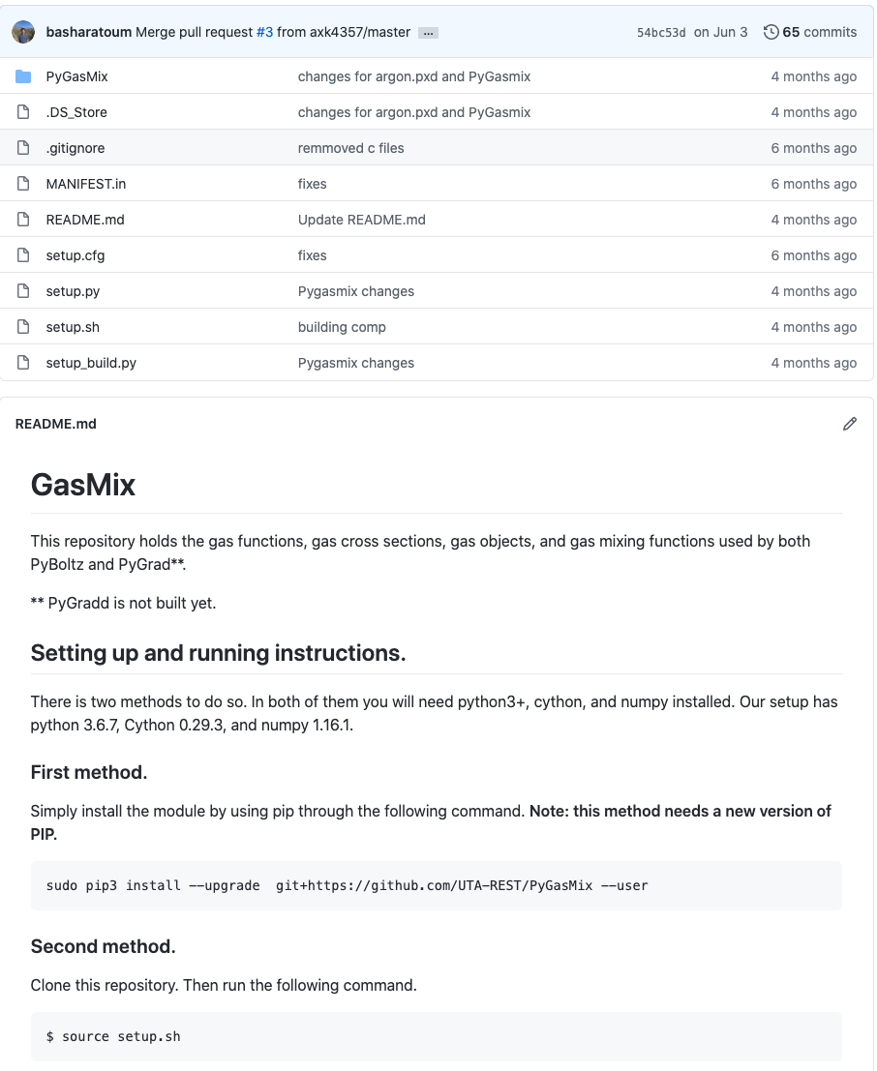
Cross Sections
All the cross sections are stored in the cross section github in the numpy file gases.npy. Each “gas function” e.g. ARGON.pyx pulls the relevant cross sections. For example argon has 102 arrays.
A subset of the argon cross sections in the gases.npy file

Slide 8
Cross Sections
All the cross sections are stored in the cross section github in the numpy file gases.npy. Each “gas function” e.g. ARGON.pyx pulls the relevant cross sections. For example argon has 102 arrays.
Don’t worry! Argon is the only noble gas where the Ramsauer-Townsend minimum is calculated in the gas function via a MERT parameterization.
A subset of the argon cross sections in the gases.npy file
Argon
Example at 100V/cm/bar

Slide 9
Cross Sections
All of these independent cross sections are grouped into 5 main cross sections Elastic, ionization, attachment, inelastic, and superelastic.
The gas function serves to put the individual cross sections into coherent units and perform interpolation and/or extrapolation where necessary.
Don’t worry! Argon is the only noble gas where the Ramsauer-Townsend minimum is calculated in the gas function via a MERT parameterization.
Oxygen
Argon
Example at 100V/cm/bar

Slide 10
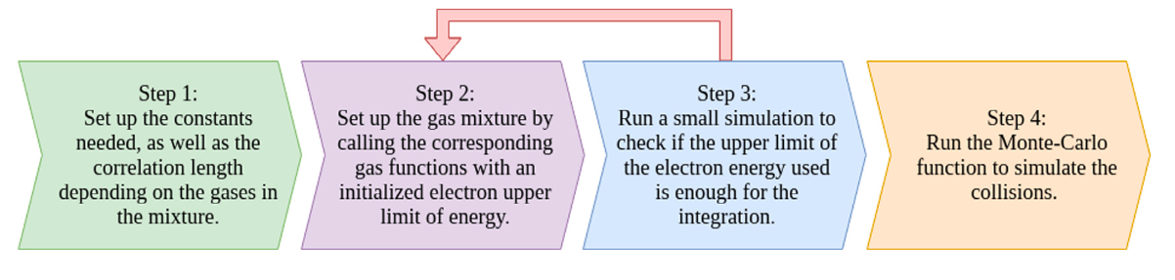
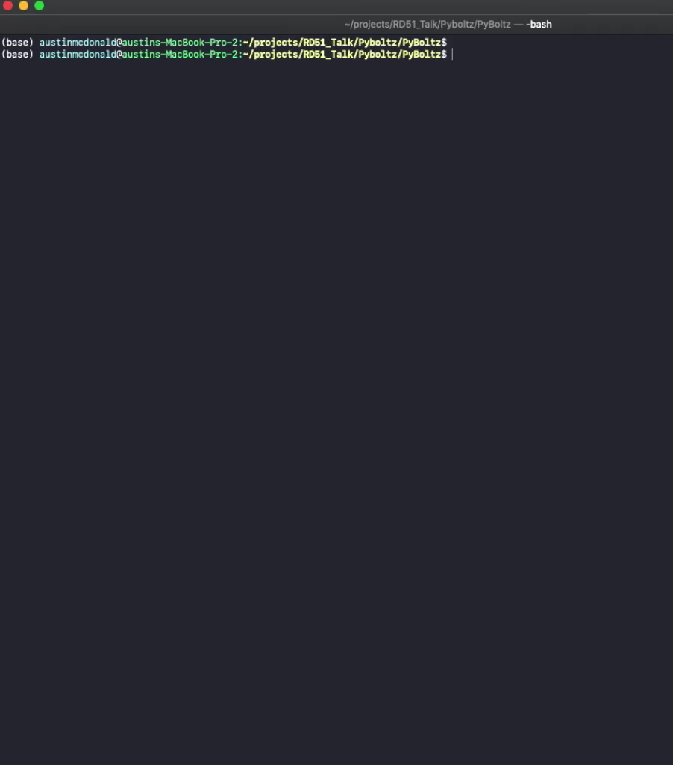
PyBoltz Structure Outline
PyBoltz runs in 4-5 steps (depending if there are townsend calculations). These steps serve 3 basic functions,
1) Load the gas and running parameters
2) Setup the gas and find the upper electron energy
3) Run the Monte-Carlo and output the swarm parameters

Slide 11
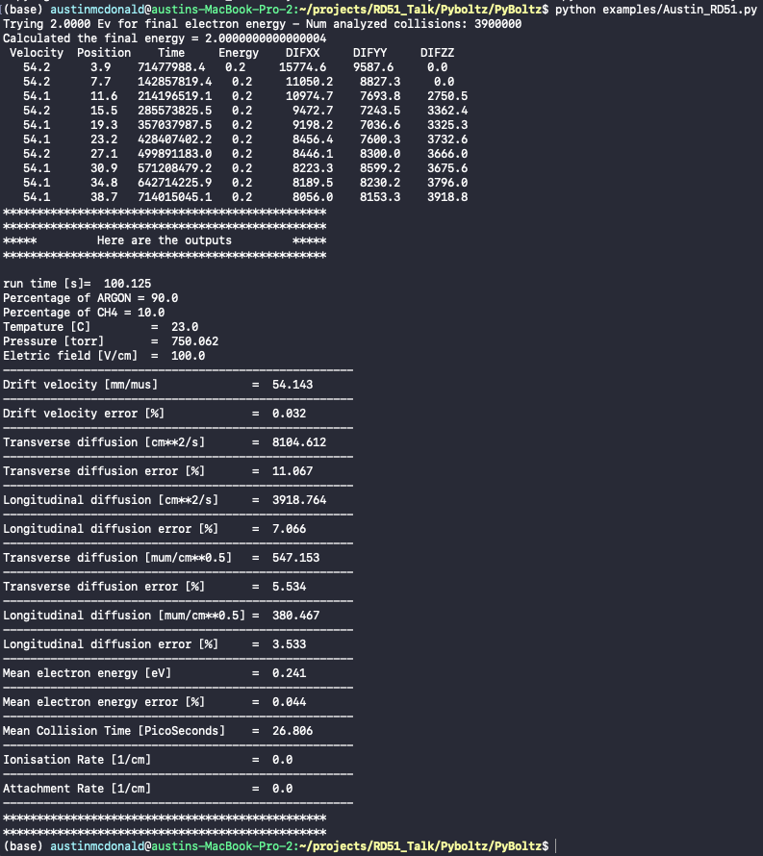
PyBoltz Structure Outline
(Just to clarify the steps)

Slide 12
PyBoltz Structure Outline
(Just to clarify the steps)
Set up the ”MixObject” which is a class of “Gasmix” that is in the Cross section github. This calculates the collision frequencies, which is based off the cross sections and is dependent of the max electron energy. (this happens in Mixers.pyx)

Slide 13
PyBoltz Structure Outline
(Just to clarify the steps)
Set up the ”MixObject” which is a class of “Gasmix” that is in the Cross section github. This calculates the collision frequencies, which is based off the cross sections and is dependent of the max electron energy. (this happens in Mixers.pyx)
Calculates the upper electron energy if not specified. Essentially runs a dummy MC function and if it goes out of energy range it increases the max energy and tries again.(EnergyLimits.pyx)

Slide 14
PyBoltz Structure Outline
(Just to clarify the steps)
Set up the ”MixObject” which is a class of “Gasmix” that is in the Cross section github. This calculates the collision frequencies, which is based off the cross sections and is dependent of the max electron energy. (this happens in Mixers.pyx)
Calculates the upper electron energy if not specified. Essentially runs a dummy MC function and if it goes out of energy range it increases the max energy and tries again.(EnergyLimits.pyx)
The MC function which is based on the methods of Frasier and Mathieson utilizing Skullerud’s null collision method. (MONTET.pyx for this example) (Don’t worry well talk about this more!)
G. Fraser, E. Mathieson, Nucl. Instrum. Methods Phys. Res. A 247 (3) (1986) 92 544–565
H. Skullerud, J. Phys. D: Appl. Phys. 1 (11) (1968) 1567

Slide 15
Null Collision Method
The Simulation utilizes the null collision method to determine the time between real collisions.
This is done since the cross sections are velocity dependent and calculating the real time between collisions would involve a costly numerical integration.
Here the collision frequency is assumed higher than the real frequency

Slide 16
Null Collision Method
The Simulation utilizes the null collision method to determine the time between real collisions.
This is done since the cross sections are velocity dependent and calculating the real time between collisions would involve a costly numerical integration.
Here the collision frequency is assumed higher than the real frequency
Picking a random collision time as prescribed by Skullerud
Randomly select velocity directions and calculate the energy post step
Compare collision frequency at that energy bin with random number
If null collision add a new time to the counter and go again
If real collision calculate the velocity vectors and proceed

Slide 17
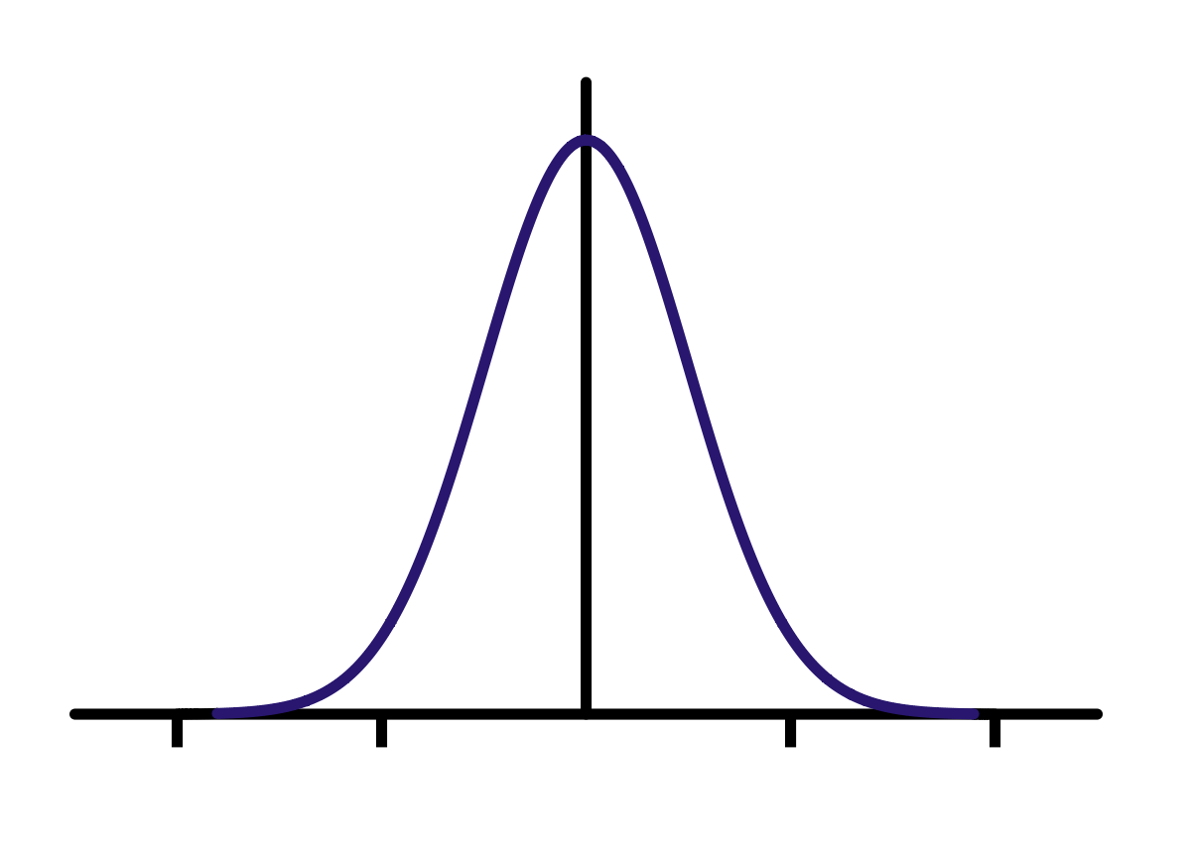
Calculating the Swarm Parameters
Now that we have a method to efficiently determine the time between real collisions, we need a way to determine the drift parameters etc..
An obvious way to do this is simulating several independent electrons. However, like determining the time to next collision this would be computationally costly.

Slide 18


Calculating the Swarm Parameters
Now that we have a method to efficiently determine the time between real collisions, we need a way to determine the drift parameters etc..
An obvious way to do this is simulating several independent electrons. However, like determining the time to next collision this would be computationally costly.
The MC function in MagBoltz/PyBoltz is based on the work of Frasier and Mathieson which utilizes a decorrelation length which allows one electron to mimic a swarm.
This is done by looking back X collisions where X is large enough that the electron no longer has a correlation with that collision. (default for noble elements is 2 million, for others its 400 thousand)
($x_{i−M},y_{i−M},z_{i−M}$, $t_{i−M}$)
e.g. M=6
($x_{i},y_{i},z_{i}$, $t_{i}$)

Slide 19
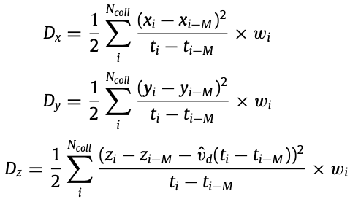


Calculating the Swarm Parameters
($x_{i−M},y_{i−M},z_{i−M}$, $t_{i−M}$)
e.g. M=6
($x_{i},y_{i},z_{i}$, $t_{i}$)

Slide 20
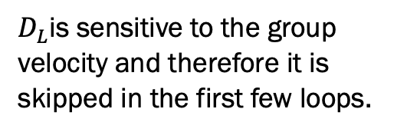
Calculating the Swarm Parameters
The mean squared distance the electron has travelled
Converts it to a time averaged sum weighted by the time between collisions
($x_{i−M},y_{i−M},z_{i−M}$, $t_{i−M}$)
e.g. M=6
($x_{i},y_{i},z_{i}$, $t_{i}$)
The longitudinal component get an additional term for the swarm velocity
$D_{L}$is sensitive to the group velocity and therefore it is skipped in the first few loops.

Slide 21
Calculating the Swarm Parameters
The number of collisions specified is separated into 10 subsamples. Which are used to calculate the error.
The numbers in this example fluctuate a lot at the beginning, this is because a higher number of max collisions should have been specified (using default 40 million).
Typically a few hundred million will produce a few percent error (this depends on a lot of factors but a good rule of thumb).

Slide 22
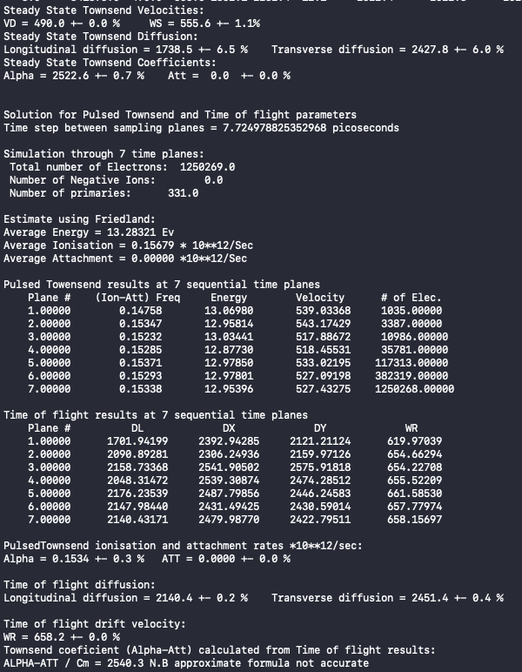
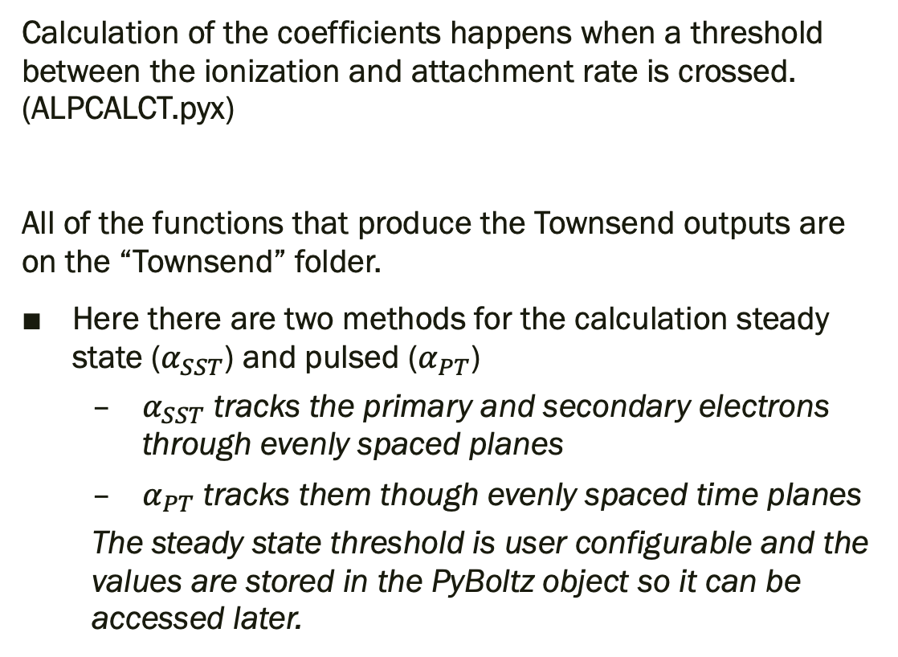
The Townsend Coefficients
Calculation of the coefficients happens when a threshold between the ionization and attachment rate is crossed. (ALPCALCT.pyx)
All of the functions that produce the Townsend outputs are on the “Townsend” folder.
Here there are two methods for the calculation steady state ($α_{SST}$) and pulsed ($α_{PT}$)
$α_{SST}$ tracks the primary and secondary electrons through evenly spaced planes
$α_{PT}$ tracks them though evenly spaced time planes
The steady state threshold is user configurable and the values are stored in the PyBoltz object so it can be accessed later.

Slide 23
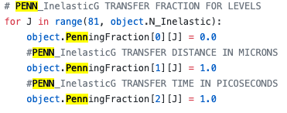
Penning
Each gas function sets a penning
Fraction
Transfer distance (1 micron)
Transfer time (1 ps)
The mixers function then sets these for a given gas combination.
In the main MC function only the penning fraction is used. Which allows for extra ionization to be added to the counter. (to trigger the Townsend calc)
In the Townsend calculations are where the penning really comes into play (as you would expect) for example in “Townsend/Monte/MONTEFDT”
If there is a penning transfer it moves the position (randomly around the transfer distance)
It also keeps track of the time of the penning transfer through the transfer time
This is how the transfers are roughly accounted for
(However the details here get quite messy)

Slide 24
Conclusions
PyBoltz is a complete refactorization of MagBoltz into an easily accessible language.
PyBoltz matches MagBoltz output without added computational time.
Decoupling the cross sections should allow for easier outside development.
While PyBoltz is quite far along it is not finished! If you are interested in developing or further understanding the physics, feel free to reach out!
(ben.jones@uta.edu or austin.mcdonald@uta.edu)
Thank you for your time.

