Slide 1
Anset Project Technical Overview

Slide 2
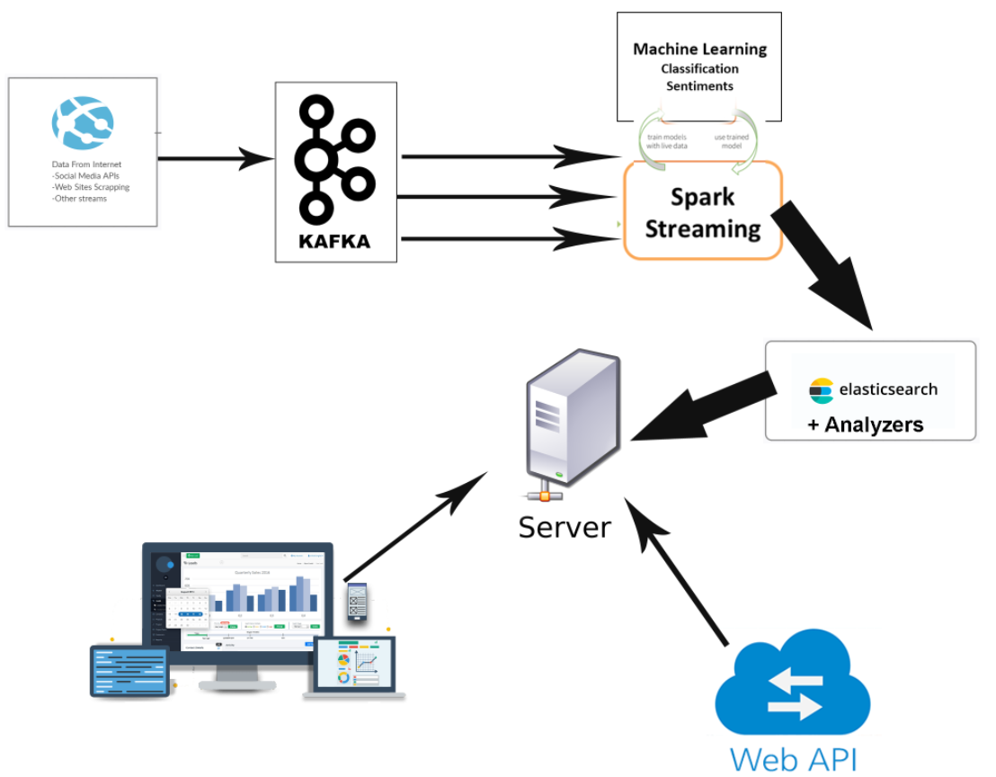
Project Architecture
Our project contains the following components and flow.
Data Source Extractors
Data Integration, Kafka
Spark Streaming
DB, Elasticsearch
Web Application & API

Slide 3
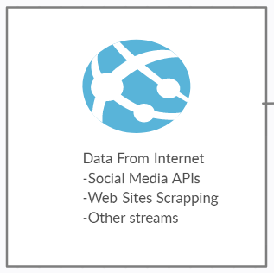
Project Architecture – Data Sources Extractors
The Social media represent the project data source, and each of platform has its own method to get its data, and each platform has deferent output.
So we may need to build separate logic to extract data for each media, to deal with its output .
Also for some data source we me need to use Web scrapping methods to extract data.

Slide 4

Project Architecture – Data Integration and Kafka
Data extraction is continuous process, So we need to integrate new data and prepare it to the next step.
Each data source has a different output, so need to be consumed by deferent process.
Kafka is the best solution that receive the data from deferent sources and submit it to the appropriate consumer in real time

Slide 5
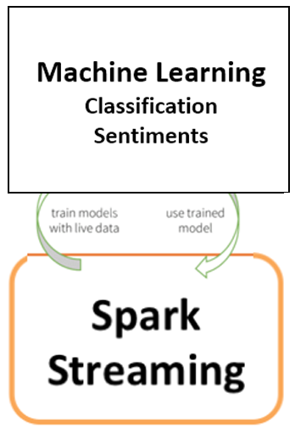
Project Architecture – Data Analysis & Spark Streaming
For data processing and analyzing we are using Spark and its APIs and extensions.
Spark Streaming will implement consumers for the data coming from Kafka server.
Consumers will pass the data to trained model to predict its class and sentiment analysis.

Slide 6
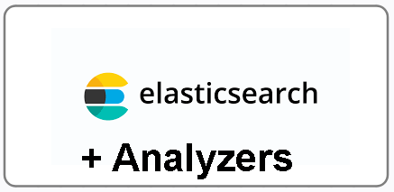
Project Architecture – Elasticsearch
After data analyzed, spark streaming will submit the data into Elasticsearch server.
Elasticsearch maintain the data as a database
It is the best solution to search through texts as it have some feature such as analyzer that will help to extract correct data based on text search

Slide 7
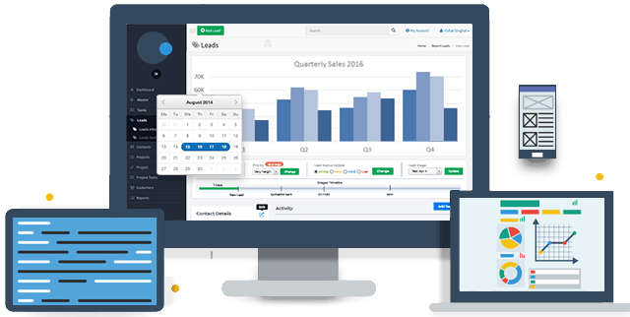

Project Architecture – Web Application & APIs
We built a web application as Project UI based on Java spring boot framework
Thought the application the clients can signup and access to system services
The client can request his search statements and get the result as a static or interactive report
We can implement APIs to request data or results

Slide 8
Thanks

