Slide 1


INStItUtE FOR ADVANCED COMPUtING AND
SOFtWARE DEVELOPMENt AKURDI, PUNE
DEFENSE IN DEPTH
GROUP NO: 20
KALYANI JAGTAP (239416)
TANISHKA NALE (239446)
MR. ROHIT PURANIK CENTRE COORDINATOR
MRS. SUSHMAHATTARKI PROJECT GUIDE

Slide 2
INTRODUCTION
In today's digital landscape, cybersecurity threats are constantly evolving, making it imperative for organizations to adopt robust defensive measures to protect their assets and data. The "Defense in Depth" approach offers a comprehensive strategy for bolstering cybersecurity defenses by implementing multiple layers of security controls. At the forefront of this strategy is the Perimeter Security Layer, where technologies like Snort, an intrusion detection system, help detect and prevent external threats from breaching the network. Moving inward, Network Security focuses on safeguarding the internal network using tools like iptables and sshguard to enforce strict access controls and detect suspicious activities. Endpoint Security strengthens defenses by securing individual devices with technologies like Honeypots and Haproxy, while Data Security ensures the confidentiality and integrity of sensitive information by encrypting data stored in internal databases. Identity and Access Management restricts access to critical resources, limiting administrative privileges to a single sudo user. Security Monitoring and Incident Response tools like tcpdump enable real-time detection and response to security incidents, while Application Security protects web-based services with HTTPS encryption on public networks

Slide 3
PURPOSE
Defense in depth is a cybersecurity strategy that employs multiple layers of defense to protect a system or network.
The primary purpose is to create redundant and overlapping security measures to mitigate the impact of a single point of failure.
It involves a combination of technical, procedural, and physical security controls to safeguard against various types of cyber threats.
The strategy aims to thwart potential attackers at different stages of an attack, making it more challenging for them to compromise the system.
By implementing defense in depth, organizations can enhance their resilience and reduce the likelihood of successful cyber attacks.
It includes measures such as firewalls, intrusion detection systems, encryption, access controls, and regular security training for personnel.
The strategy acknowledges that no single security measure is foolproof, and a combination of measures provides a more robust defense posture.
Defense in depth helps organizations stay ahead of evolving cyber threats by continuously adapting and updating their security measures. It is a proactive approach that anticipates potential vulnerabilities and addresses them before they can be exploited.
The strategy is crucial for protecting sensitive data, maintaining business continuity, and safeguarding the integrity of systems and networks.

Slide 4
REQUREMENTS
Hardware Requirement :
RAM: 08 GB minimum , 16 GB Recommended
HDD: 100GB free space for virtual machines
Software Requirement :
Operating System: Debian 12 for virtual machines
Tool: Virtual Box

Slide 5
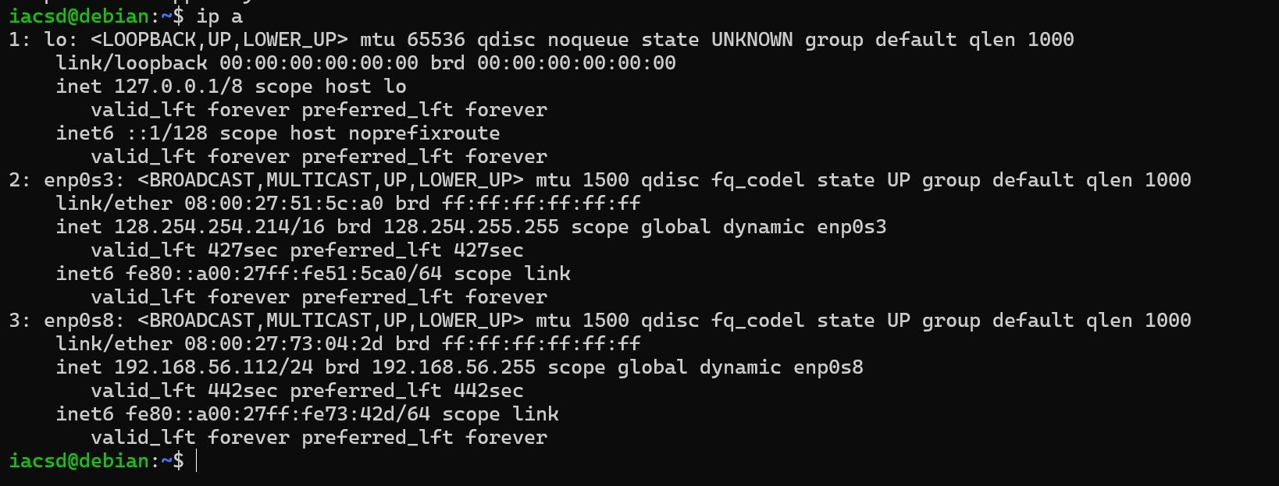
Project Execution
INTERNAL NETWORK

Slide 6
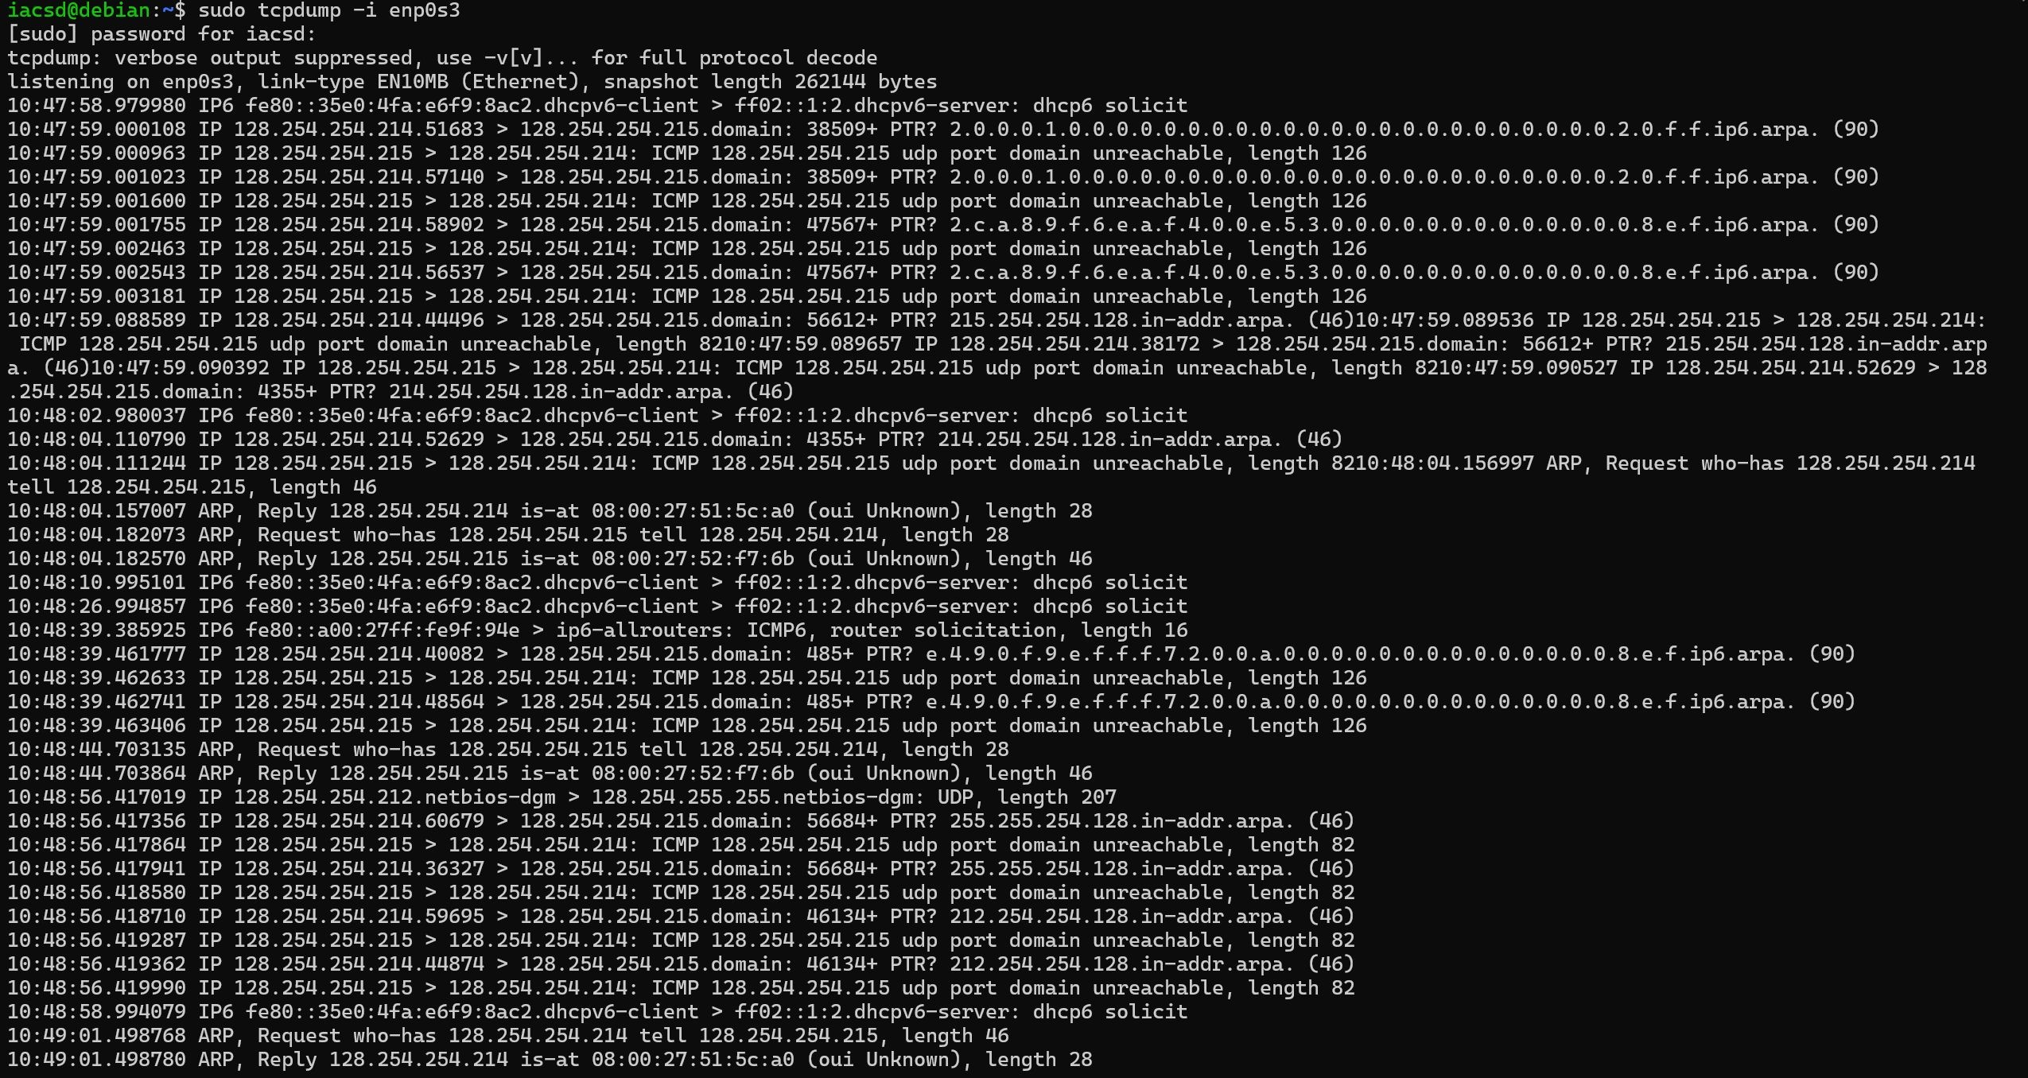
MARIADB ENCRYPTION

Slide 7
TCPDUMP

Slide 8
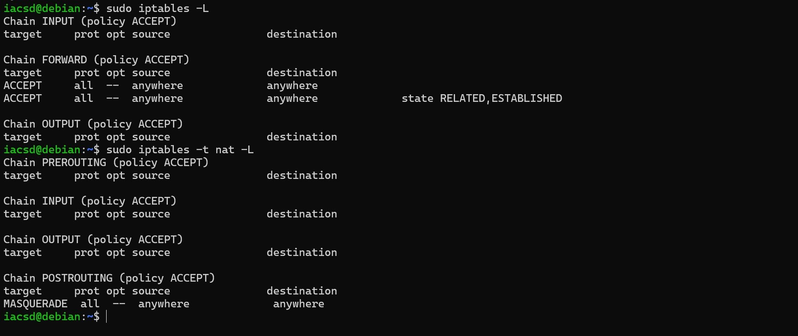
IPTABLES

Slide 9
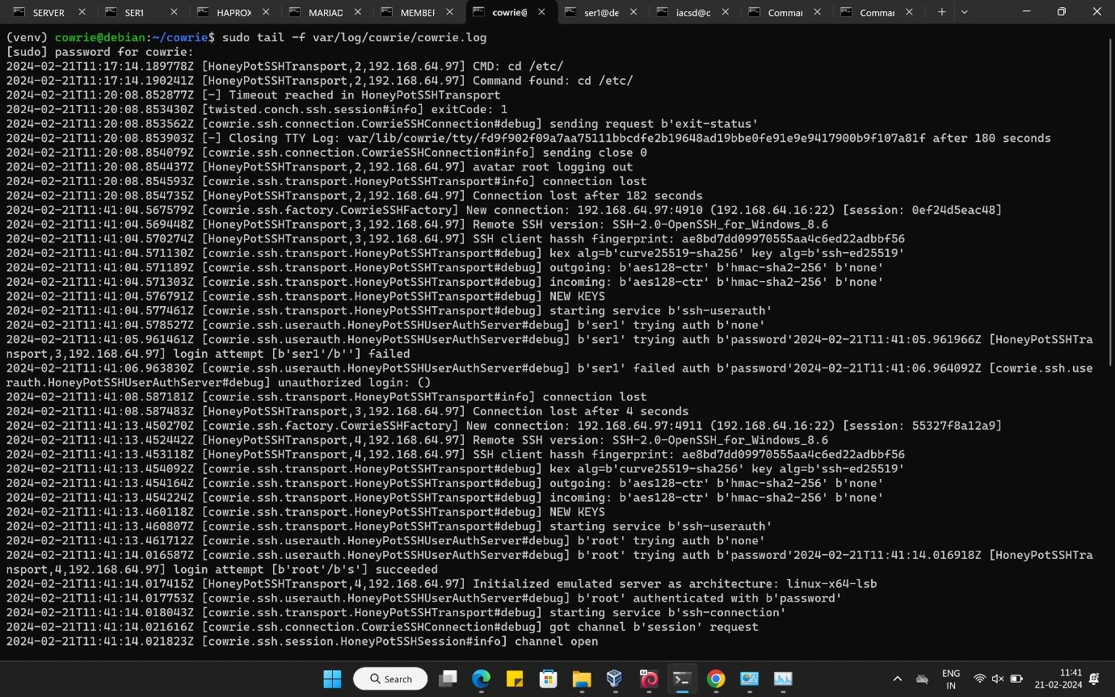
HONEYPOT

Slide 10
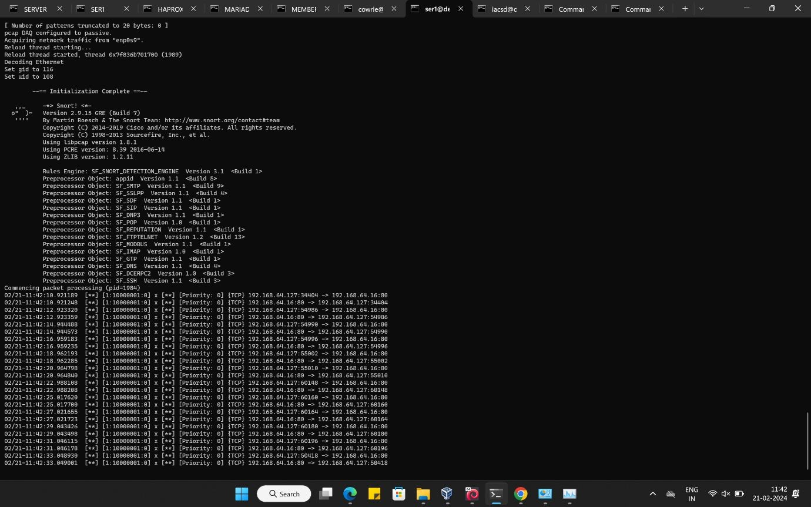
SNORT

Slide 11
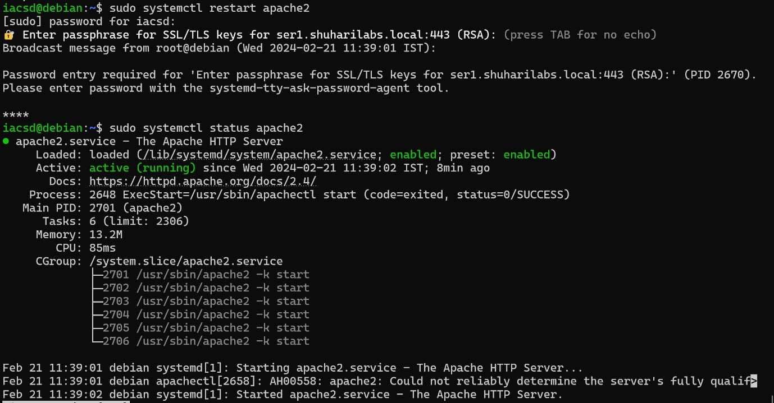
APACHE2

Slide 12
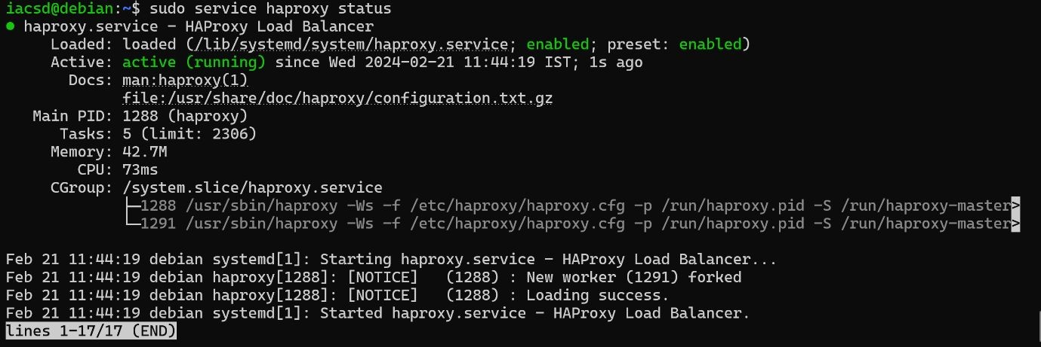
HAPROXY

Slide 13
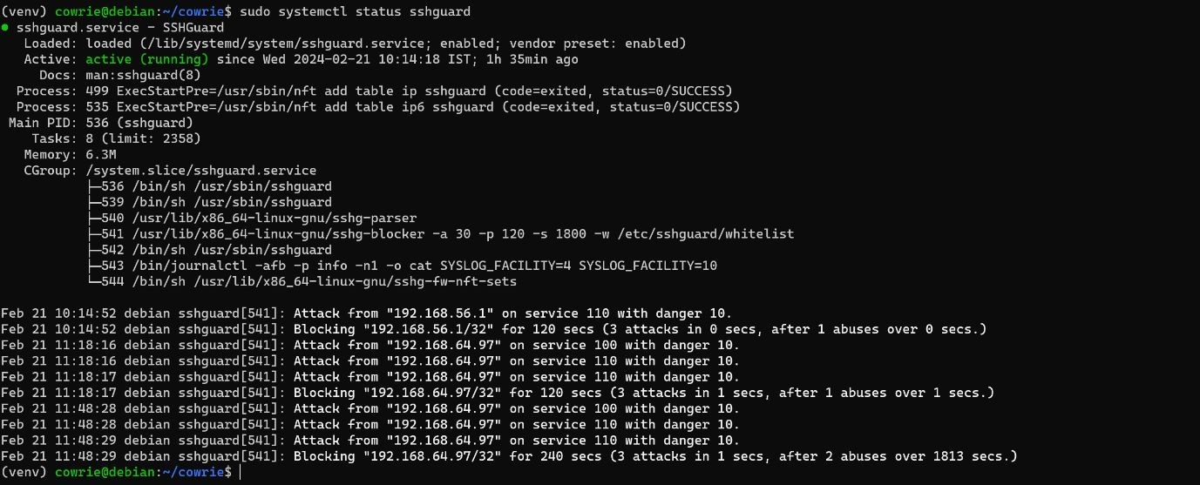
SSHGUARD

Slide 14
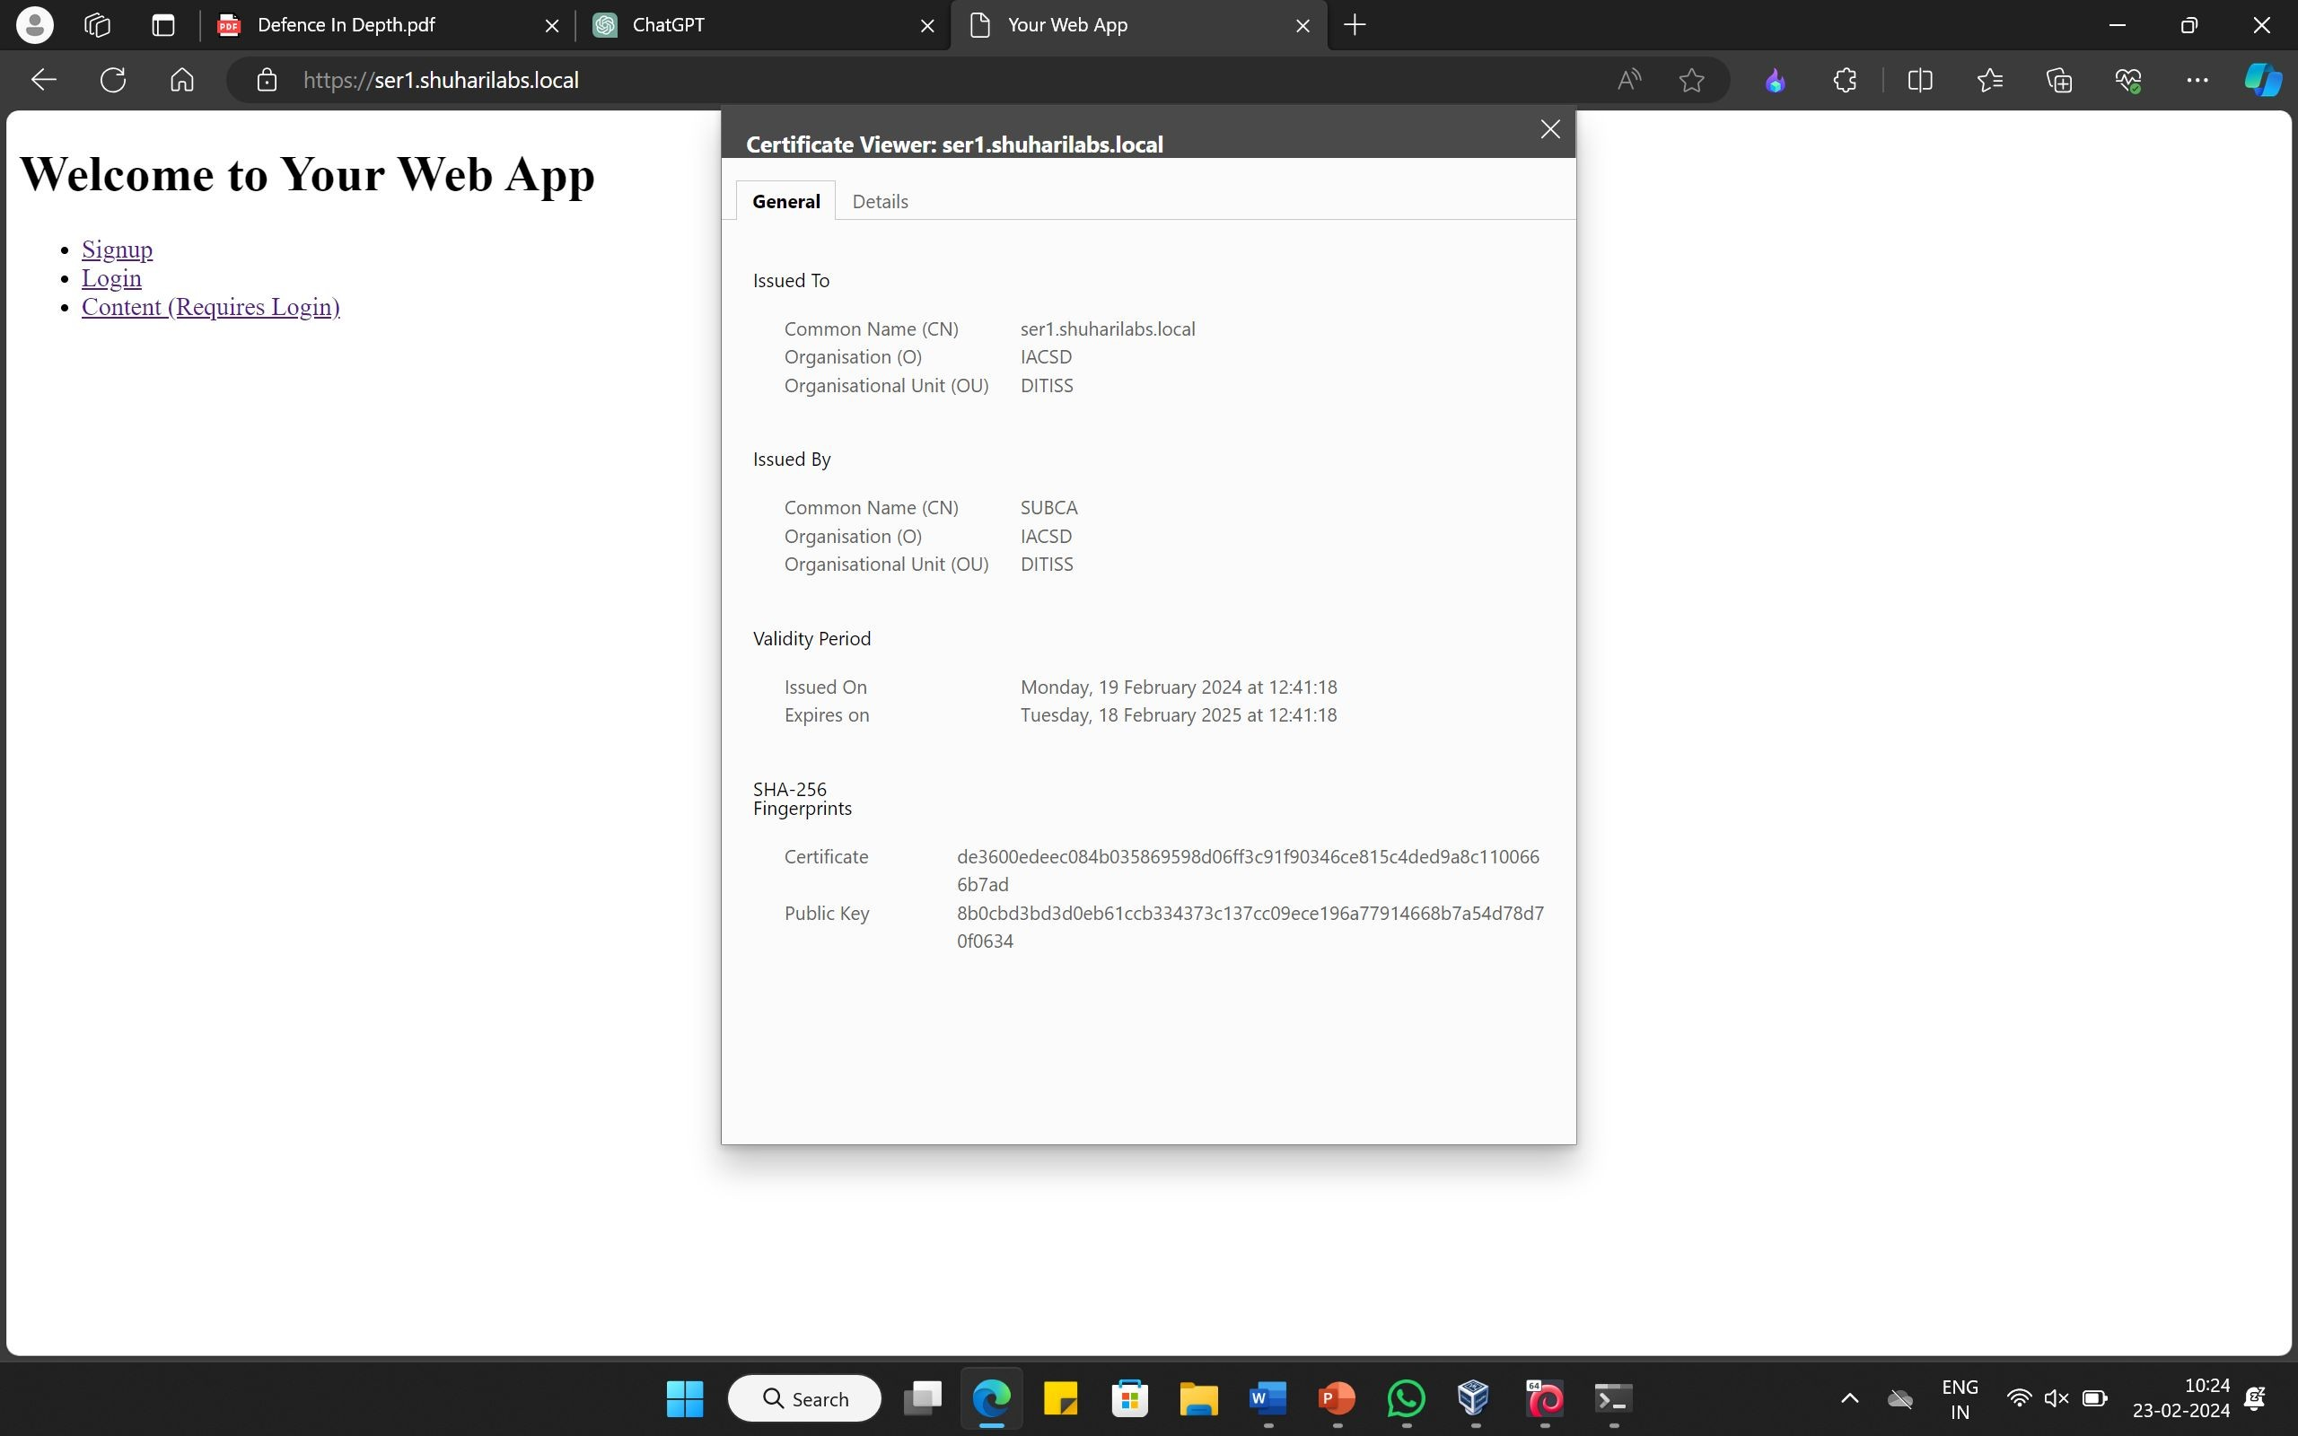
WEB-CERTIFICATE

Slide 15

WEB PAGES

Slide 16


Slide 17
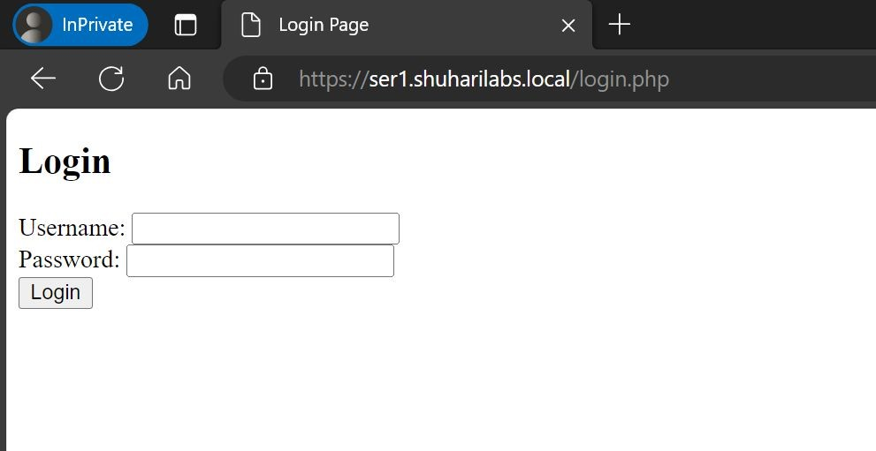

Slide 18
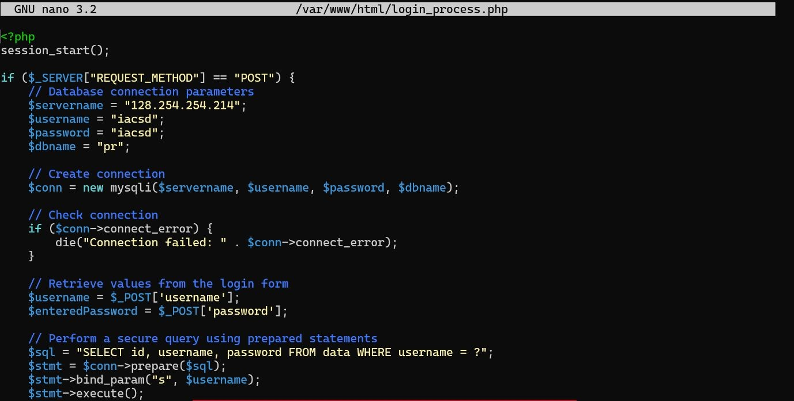
PHP CODE

Slide 19
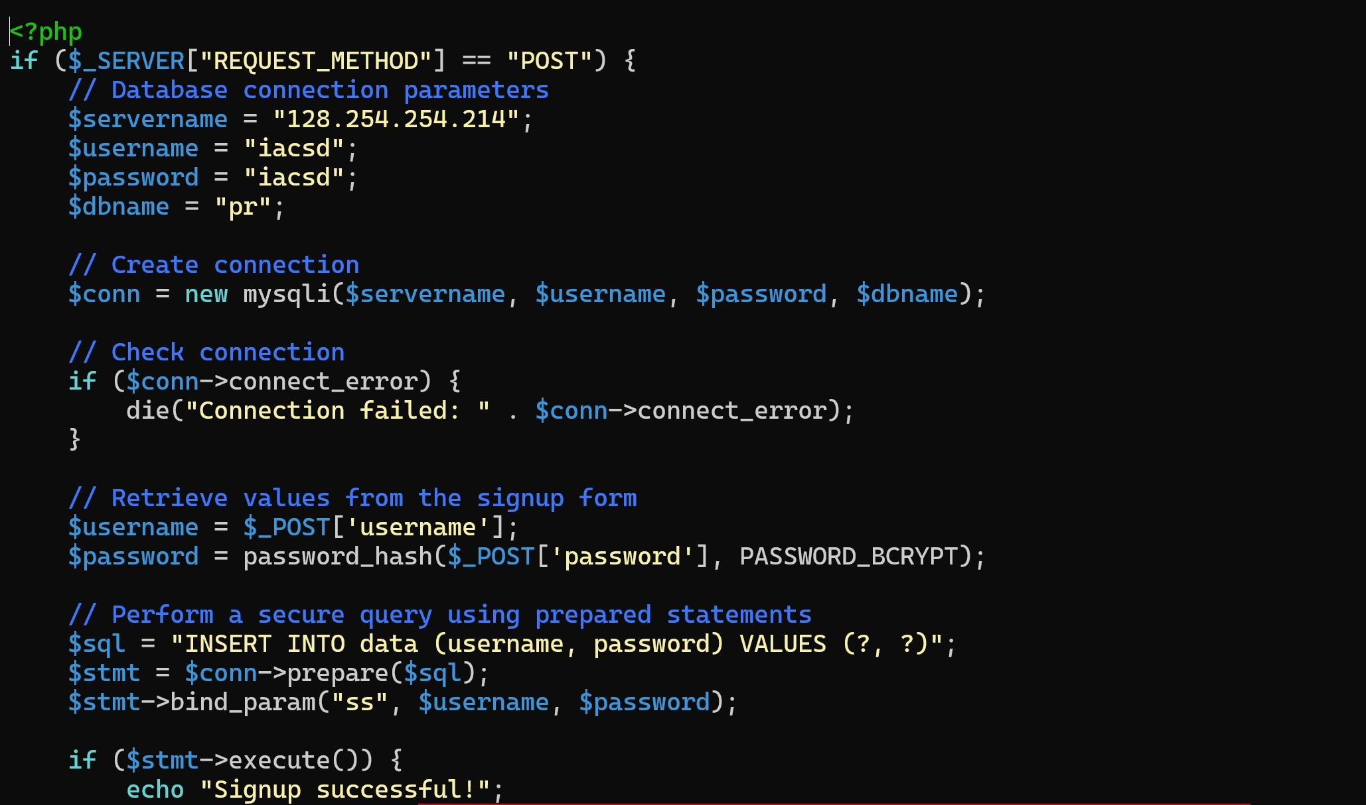

Slide 20
Features
□Layered Protection: Defense in depth employs multiple layers of security measures, creating a robust and multi-faceted defense strategy.
□Network Segmentation: It involves dividing the network into segments to contain and isolate potential breaches, preventing lateral movement by attackers.
□Firewalls and Intrusion Prevention Systems (IPS): Utilizes firewalls and IPS to monitor and control incoming and outgoing network traffic, preventing unauthorized access and detecting malicious activities.
□Encryption: Implements encryption techniques to protect sensitive data both in transit and at rest, ensuring that even if a breach occurs, the data remains secure.
□Access Controls: Enforces strict access controls, limiting user privileges to the minimum necessary for their roles, and regularly reviews and updates access permissions.

Slide 21
FEARURES
□Regular Audits and Assessments: Conducts periodic security audits and assessments to identify vulnerabilities, weaknesses, and areas for improvement in the defense strategy.
□User Education and Training: Prioritizes user awareness by providing regular training on security best practices, phishing awareness, and social engineering prevention.
□Incident Response Plan: Establishes a well-defined incident response plan to efficiently and effectively address and mitigate the impact of security incidents.
□Patch Management: Ensures timely application of security patches and updates to software, operating systems, and devices to eliminate known vulnerabilities.
□Endpoint Protection: Implements security measures on individual devices (endpoints), such as antivirus software and endpoint detection and response (EDR) solutions.

Slide 22
CONCLUSION
□In conclusion, a defense in depth project is essential for creating a resilient and comprehensive security posture. By employing multiple layers of protection, including technical, procedural, and physical measures, organizations can mitigate the risk of cyber threats. This strategy acknowledges the dynamic nature of cybersecurity, emphasizing continuous adaptation and vigilance. The layered approach not only reduces the likelihood of successful attacks but also minimizes the impact by containing and isolating potential breaches. Ultimately, defense in depth is a proactive and holistic approach crucial for safeguarding sensitive data, ensuring business continuity, and maintaining the integrity of systems and networks.

Slide 23
THANK YOU

