Slide 1
Project: Memory Game

Slide 2
Outline
Introduction of rules
Design
Code skeleton

Slide 3
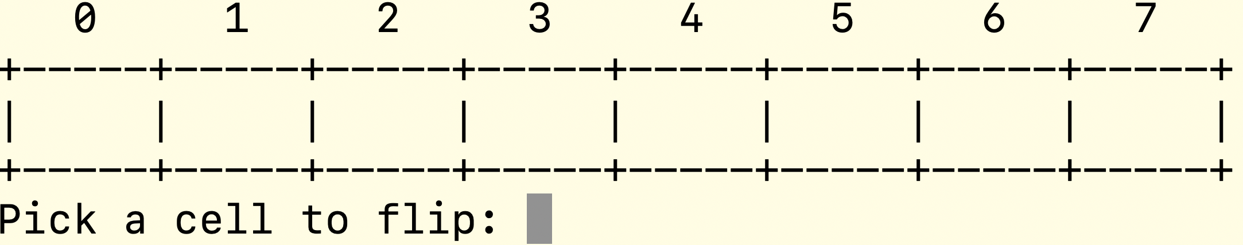
Introduction
Two-face cards with content-side facing down.
Here is an example of 8 cards.

Slide 4
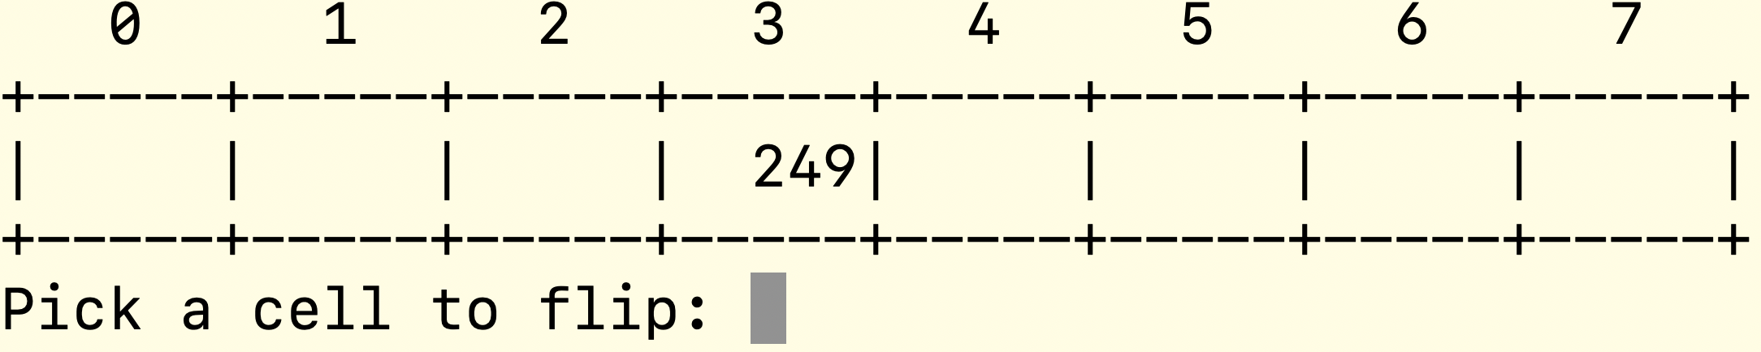
The first flip in a round
In each round, flip two cards.
Flip the card by entering an integer representing an index, starting from 0. In our example, the last index is 7, so the input should be in [0, 7]. Suppose we select 3.
After the first flip, the content of the card, which can be an integer, is shown.

Slide 5
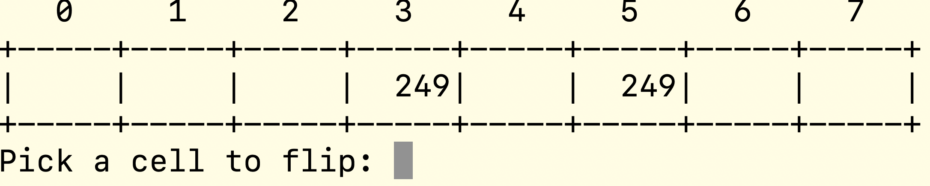
Second flip in a round match to first flip
Afterwards, flip the second card.
If the integer of the second card matches that of the first one, the second card is opened; otherwise, close both cards.
Suppose we choose 5, since both space 3 and 5 have the same number, we find a match.

Slide 6
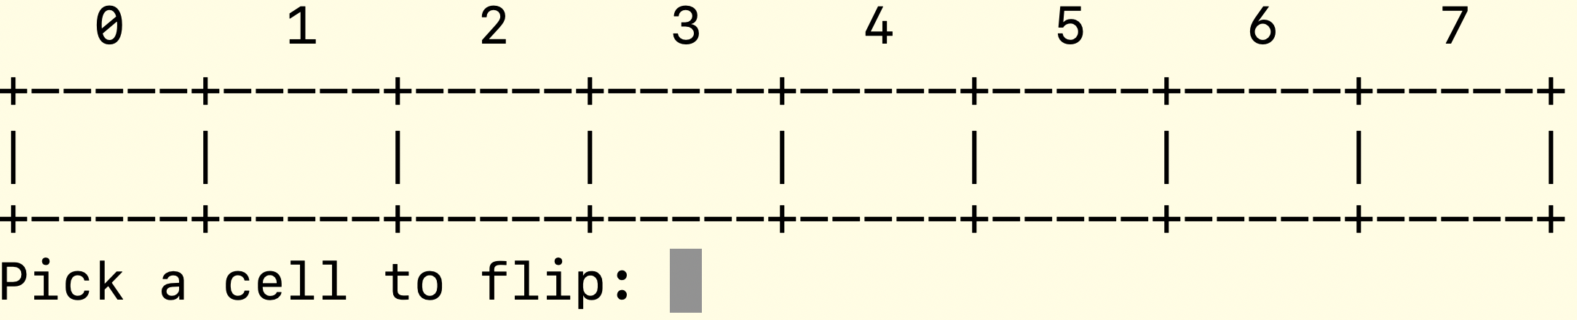
Second flip in a round not to match to first flip
Suppose we choose 6. Since Card 6 does not have the same number as that of the first flip, ie, Card 3, in this round, both cards are turned.

Slide 7
Continue until all matched numbers are found
To make the game challenging, add cards whose sides are both empty.
In a round, if the first flip shows an empty face (ie, no integer disclosed), then this card has two empty faces. In this case, we cannot tell whether the second flip has an integer or not.
Stop until all matched twin integers are found.
Report the total number of flips to find out all matches.
Print out “Congratulations! Take … steps to find all matched pairs.”, where … is the number of steps.

Slide 8


Object Oriented Programming
an intelligent hamburger
getCalories
changeMeat
getMeat
changeVegetable
getVegetable
changeBread
getBread

Slide 9
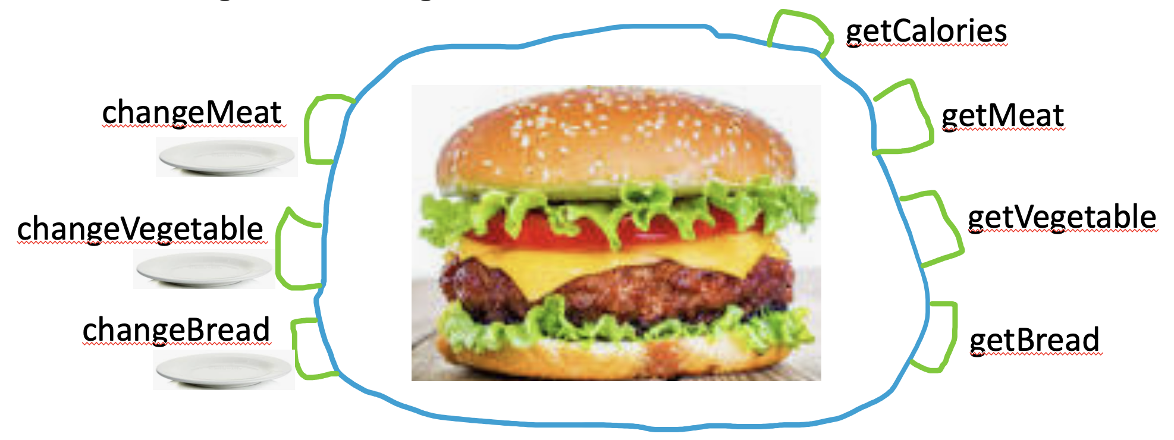
Data and operations for an intelligent hamburger
Data of a hamburger: bread-, vegetable- and meat- layer.
An intelligent hamburger combines data with operations on those data.
Operations to access data
getBread, getVegetable, getMeat, getCalories
Operations to change the data
changeBread, changeVegetable, changeMeat
Why is there a plate besides those changeXYZ buttons? For example, in changeBread button, need to use a plate (parameter) to hold the new bread layer, which is used to replace the current bread layer.

Slide 10
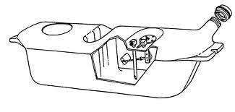
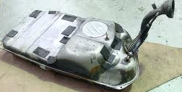
Class and Object
A class is the blueprint from which objects are made.
For example, class as blueprint of fuel tank of a car, while objects as the implemented fuel tanks.
Notes:
P107 Core Java
P34 Head first Java

Slide 11
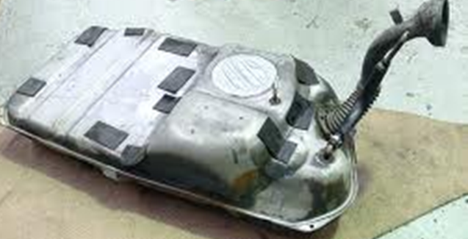
Data member vs. methods
Things object knows are data members
Things object does are methods
Object
fuel tank
Data members
Current gas level
Methods
Fill tank with more gas
Send gas through the gas lines
Get current gas level of tank
Notes:
P34 Head first Java
http://www.ehow.com/how-does_4899947_cars-gas-tank-work.html

Slide 12
Encapsulation
Combine data members and methods in one package
Encapsulation is also called information hiding
encapsulation hides the implementation details from the user of the object.
One can use a fuel tank without knowing how it works.
current gas level
Fill tank with gas
Send gas through gas line
Get current level of tank
Do you need to be an auto engineer to operate the car?

Slide 13
Take home message – what is class?
class is the encapsulation of data members and methods performed on those data members.
Encapsulation: class = data member + operations on those data members
Next task:
Define class MemoryGame
Construct an object game from class MemoryGame
Use object game
Data Members
Operations on Data Members
Notes:
For example, knead operation can be applied to flour, but not to person.
A person can have a name, change it if necessary, also can do things like think, talk, and walk, but not flour.

Slide 14
Data members of Memory Game
private: //private data members, private means that
//only methods in this class, not other class,
//can access or modify these data members.
int numPairs; //numPairs of identical twin items
int numSpaces; //size of array value, besides identical twins,
//may contain empty string to make the problem more challenging
string *values; //a string to represent the layout of data,
//mixed with possible empty strings.
//Use array to access each element in const time.

Slide 15
Operations for data in Memory Game
public:
MemoryGame(); //default constructor, with 3 pairs of numbers
//randomly located in 8 blocks (two blocks are empty).
~MemoryGame(); //destructor
void play(); //play the game
void display(bool* bShown); //display array values.
//if bShown[i], where i is index, is true,
//them values[i] is displayed, otherwise, values[i] is not displayed.

Slide 16
Tasks of the Project
Define functions swap and randomize, which will be used by class MemoryGame but they are not method members of MemoryGame.
Implement MemoryGame, finish its methods
Default constructor MemoryGame(): initialize data members
Destructor ~MemoryGame(): release dynamic memory
Method play: simulate the playing of game
Method display: display the cards
Test MemoryGame class.

