Slide 1
Introduce to class and object
Sections 9.1 and 9.2

Slide 2
Define individual methods vs. class
Both can increase code reusability.
Define methods in the class with main method is like to expand the company, but only to the level of consultant service. That is, given a request from user, provide service to satisfy that request (for example, given an integer, find out whether it is prime or not).
Many times we would like to concentrate on making a product. In those cases we need to define a class which combines attributes (properties describing products) and operations (methods) performed on the products .

Slide 3
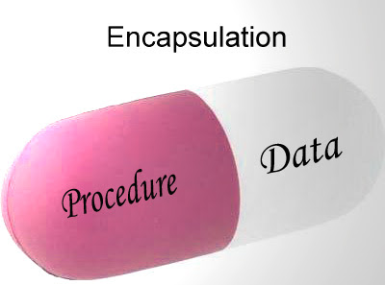
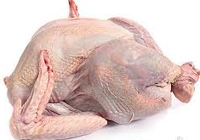

class = data + operations on data
class ThanksgivingDinner {
public: //operations
cookTurkey();
cookPie();
private: //data member
Turkey peace;
Pumpkin cuty;
}
class

Slide 4


Class = data + operation on data: II
other examples:
beef and receipt to cook beef
Chicken and receipt to cook chicken

Slide 5
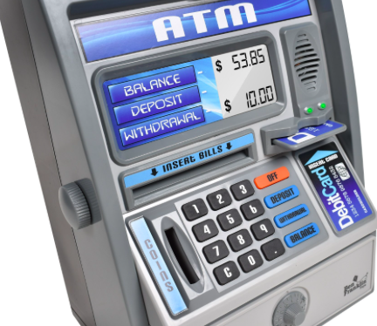
Example of encapsulation
Given a bank account, the data can be account name, pin, account number, and balance.
Operations can be log in (using your name and pin), balance inquiry, deposit and withdrawal.
ATM machine provides buttons for operations.
Notes:
Figure source: https://cdn.shopify.com/s/files/1/0765/2253/products/BF550.PT05_2048x2048.jpg?v=1476278164

Slide 6
Why Encapsulation?
Different objects have different attributes (properties common to objects of the same class) and different operations.
A person object has height attribute, and operations on this attribute can include
initialize (height-at-birth)
change (increase when young and shrink when one gets old)
get height

Slide 7
Why Encapsulation? II
A car has attribute current gas level in a fuel tank. Corresponding operations can be
Initialize current gas level
Increase gas level by pumping more oil or decrease gas level by driving
Get the current gas level
Different operations on different attributes.
Can you ask MPI of a person?
Can you ask IQ of a car?

Slide 8
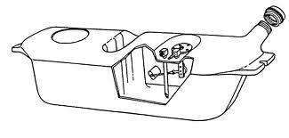
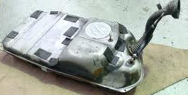
Class and Object
A class is the blueprint from which objects are made.
For example, class as blueprint of fuel tank of a car, while objects as the implemented fuel tanks.
Notes:
P107 Core Java
P34 Head first Java

Slide 9
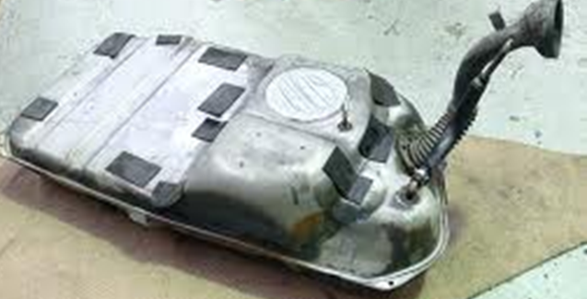
Data member vs. methods
Things object knows are data members
Things object does are methods
Object
fuel tank
Data members
Current gas level
Methods
Fill tank with more gas
Send gas through the gas lines
Get current gas level of tank
Notes:
P34 Head first Java
http://www.ehow.com/how-does_4899947_cars-gas-tank-work.html

Slide 10
Encapsulation
Combine data members and methods in one package
Also called information hiding
encapsulation hides the implementation details from the user of the object.
One can use a fuel tank without knowing how it works.
current gas level
Fill tank with gas
Send gas through gas line
Get current level of tank
Do you need to be an auto engineer to operate the car?

Slide 11
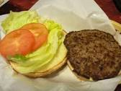
Hamburger
Suppose each hamburger has bun, vegetable, and meat layer.
data members are
bun
vegetable
Meat
constructors are like cashiers, who take the order to make a hamburger. It can be a default-configured hamburger (bun + lettuce + beef), or a customer-ordered one (whole-wheat bun + onion + chicken).

Slide 12
Hamburger: II
Assessors (getters) are like: get information of bun, meat, or vegetable layer, calculate calorie.
Modifiers (setters) are like: change bun, change meat, change vegetable

Slide 13
Envelop with filled form analog
A class is a blank form to fill in data information. For example, any person needs to fill in name, birth date.
An object of that class is a filled form. Your data will differ from mine (different names and/or birth dates).
……
Name
BirthDate
Name | Ann Smith
BirthDate | 1/1/80
Name | Bob West
BirthDate | 1/1/90

Slide 14

Envelop with filled form analog: II
Filled in form is put in envelop.
You can use extension number (like method name) to find information of data.
For example, get name extension 1, get birth date extension 2.
Different objects have different phone number (like object name).
For example, the first object has phone number 718-111-1111, the second object has phone number 516-123-4567.
Name | Ann Smith
BirthDate | 1/1/80
Name | Bob West
BirthDate | 1/1/90

Slide 15
Summary
How to create a Person object with name Ann and age 21?
Define class Person once, then others can use the blueprint to implement many instances (objects) of Person. This fulfills the goal of code reuse.

Slide 16
Summary II
Due to encapsulation, users can only access private data members through given methods, this will reduce the chance of errors in code.
For example, user can only select date to travel from a calendar. So the designer of booking system do not need to worry about wrong dates.
If a data member has wrong value, we only need to check those methods that can access the data member.
So it is easy to write and maintain bug-free code.

Slide 17
More good things coming out from Object Oriented Programming
Inheritance
Polymorphism

