Slide 1
Polymorphism

Slide 2
Outline
Motivation
Review of Object Oriented Design Concepts
Definition of Polymorphism
Example
Summary

Slide 3
Motivation
Code reusability
Add new functionalities to current code with slight or no modification.
Notes:
reusability is the likelihood that a segment of source code can be used again to add new functionalities with slight or no modification. Reusable modules and classes reduce implementation time, increase the likelihood that prior testing and use has eliminated bugs and localizes code modifications when a change in implementation is required.

Slide 4
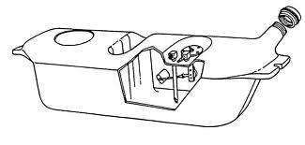
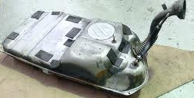
Class and Object
A class is the blueprint from which objects are made.
For example, class as blueprint of fuel tank of a car, while objects as the implemented fuel tanks.
Notes:
P107 Core Java
P34 Head first Java

Slide 5
Inheritance
A subclass inherits all the members (data members and methods) from its superclass.
Constructors are not members, so they are not inherited by subclasses, but the constructor of the superclass can be invoked from the subclass.

Slide 6
Inheritance II
An instance method is a method without keyword static in the head of its definition.
An instance method in a subclass with the same signature (name, plus the number and the type of its parameters) and return type as an instance method in the superclass overrides the superclass's method.
For example, methods display from superclass Question is overridden in subclass ChoiceQuestion.

Slide 7
Inheritance and Polymorphism
Inheritance allows us to treat an object as an instance of its own class OR an instance of its base class.
For example, let Dog be a subclass of Animal, then a dog diesl can be treated as a Dog object or an Animal object.
That is, diesl is a dog and can do whatever a dog can do (bark, entertain its master, …).
At the same time, diesl is an animal and can do whatever an animal can do (make sound, eat, …).

Slide 8
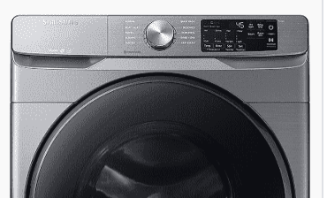
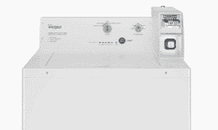
Side note: difference between overload and override
method overload means several methods
Share exactly the same name
Have similar functionality
Different parameter list in method header
Example: home washing machine vs. commercial washing machine

Slide 9
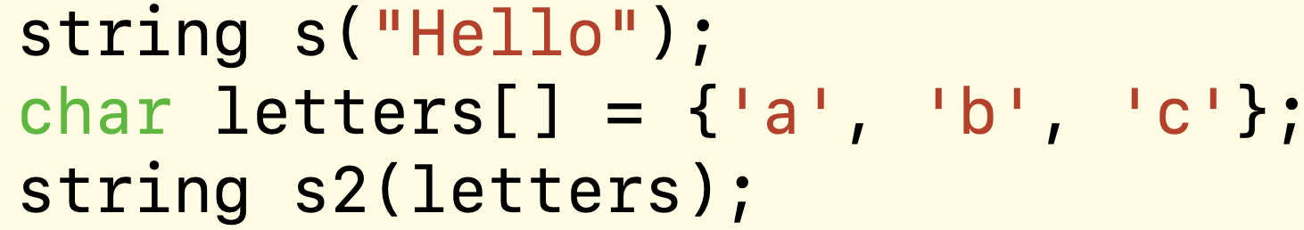
Overload example
Overload constructors of string class can take string or array of chars.
string (const string& str);
string (const char* s);

Slide 10
Override
Rewrite the functions inherited from superclass.
Both methods need to have exactly the same header, which includes return type, method name, parameter list.
The behavior (or functionality) from subclass will be different from the same method of the superclass.

Slide 11
Override definition
use one's authority to reject or cancel (a decision, view, etc.).

Slide 12
Inheritance and Polymorphism
The ability to treat an object as an instance of its own class OR an instance of its base class allows many subclasses derived from the same base class to be treated as if they were one class.
Methods defined for objects of base class can be used by objects of sub-classes.

Slide 13
Subclass vs. Superclass
A class that is derived from another class is called a subclass.
The class from which the subclass is derived is called a superclass.
Animal
superclass
Dog
subclass

Slide 14
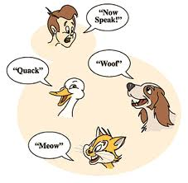
Polymorphism
For the same message (“Make a sound!”), objects of different subclasses give different responses.
Make a sound!
Notes:
Application of Polymorphism
Define a method for animal.
Apply that method on dog, horse, or any current/future animal species.

Slide 15
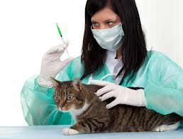
Vet as “Animal talker”
When he/she gives shots to animals, they cry in their own way.
Make a sound!
Notes:
Application of Polymorphism
Define a method for animal.
Apply that method on dog, horse, or any current/future animal species.

Slide 16
Class Animal
For class Animal, we only care about the following:
Each animal can make a sound.
What methods should be in Animal class?
Animal
void makeSound()

Slide 17
Code of Animal.h
#ifndef ANIMAL_H_ //include guard
#define ANIMAL_H_
class Animal
{
public:
virtual void makeSound();
//add keyword virtual when declaring a method in
//super class that will be overridden in subclass.
};
#endif

Slide 18
Code of Animal.cpp
#include "Animal.h"
void Animal::makeSound()
//When define a method,
//no virtual is needed.
{ //A general animal can be any
//species, we cannot tell what
//sound it may make. Hence we
//use empty method body.
}
Animal
void makeSound()

Slide 19
Extend Subclass from Superclass
Subclasses share some of the same functionality of the superclass.
As an animal, dog can make a sound.
Subclasses can define their own unique behaviors.
Dog is the animal that woofs.
Animal
superclass
Dog
subclass

Slide 20
Dog.h
#ifndef DOG_H_
#define DOG_H_
#include "Animal.h"
class Dog : public Animal
{
public:
virtual void makeSound();
//override makeSound method from super class
//Animal. Keyword virtual is optional but encouraged.
};
#endif
This method overrides makeSound method in superclass Animal.

Slide 21

Code of Class Dog
//Dog is an animal that woofs.
#include "Dog.h"
#include <iostream>
using namespace std;
void Dog::makeSound()
{
cout << "Dog goes woof." << endl;
}

Slide 22
Code of Class Cat
//Cat is an animal that
//make sound meows.
//You define code for Cat.h and
//Cat.cpp

Slide 23
Vet
A vet gives shots to animals.
Warning: Vet is not a subclass of Animal.
As a result, an animal given a shot makes sound.
For simplicity, we do not define any data member (like name or certification) for vet.
Vet
Animal
works on
void giveShot(Animal)
void makeSound()

Slide 24
Vet.h
Keys:
giveShot method applies to Animal, a superclass.
Must be a pointer to super class to avoid information slicing for subclasses.
#ifndef VET_H_
#define VET_H_
#include "Animal.h"
class Vet
{
public:
void giveShot(Animal* beast);
};
#endif

Slide 25
Code of Vet.cpp
Key: giveShot method applies to Animal *, a pointer to superclass.
#include "Vet.h"
#include "Animal.h"
void Vet::giveShot(Animal* beast)
{ //When vet gives shot to an
//animal, it makes a sound.
beast->makeSound();
}

Slide 26
When Vet give shots to animals
int main()
{ const int SIZE = 2;
Animal* animals[SIZE];
animals[0] = new Dog();
animals[1] = new Cat();
Vet v;
for (int i = 0; i < SIZE; i++)
v.giveShot(animals[i]);
A dog can be used as an animal.

Slide 27
Continue of VetAndAnimals
//Do not forget to release dynamic memory.
for (int i = 0; i < SIZE; i++)
{
delete animals[i];
animals[i] = 0;
}
}

Slide 28
Structure of project vetAnimal
The project contains the following files:
Animal.h Animal.cpp
Cat.h Cat.cpp
Dog.h Dog.cpp
Vet.h Vet.cpp
VetAndAnimals.cpp (contain main method)
makefile

Slide 29
Give a shot to Duck
Extend a species (say Duck ) from Animal.
Override makeSound method in Class Duck.
Now giveShot method applies to a duck.
When a duck is given a shot, it quacks.
Make a sound!
Notes:
http://technofriends.files.wordpress.com/2008/02/polymorphism.gif

Slide 30
Polymorphism increases code reusability
When we extend subclass Duck from Animal class, we do not need to modify Vet class:
giveShot method works for any animal, including a duck, or whatever newer species that the designer of Vet class may not foresee when writing the code.
With polymorphism, we write code for a superclass that can handle ALL future subclasses.
Notes:
A variable that can hold a reference to an object of class A can also hold a reference to an object belonging to any subclass of A.
Actual type vs. declared type
Every variable has a declared type at compile-time
But during runtime, the variable may refer to an object with an
actual type (either the same or a subclass of the declared type)
Use a variable without knowing the exact type of the object that it refers to.
Variable animal can refer to a dog, a cat, a duck, or whatever new species.

