Slide 1
Template

Slide 2
Inheritance
Any object of a subclass is an object of a super class.
- For example, any student is a person. But not vise versa.
Person
student

Slide 3
Design a subclass
class Subclass : public superclass
{
public:
constructors of subclass //constructors are not inherited
getters (accessors) for data members unique to subclass
setters (modifiers) for data members unique to subclass
methods inherited from superclass but behaves differently in subclass
private:
data members unique to subclass
}

Slide 4
Inheritance and polymorphism
Polymorphism enables functions written for a superclass apply to all its subclasses.
In superclass, methods to be overridden by subclasses is declared as virtual.
In subclass, override the methods inherited from superclass but behave different in subclasses.
Person class is a superclass of Doctor class. Both classes have to_string method, which returns a textual representation of corresponding object.
to_string method in Person class returns a string representing name and age, while to_string method in Doctor class returns a string representing name, age, and insurances.

Slide 5
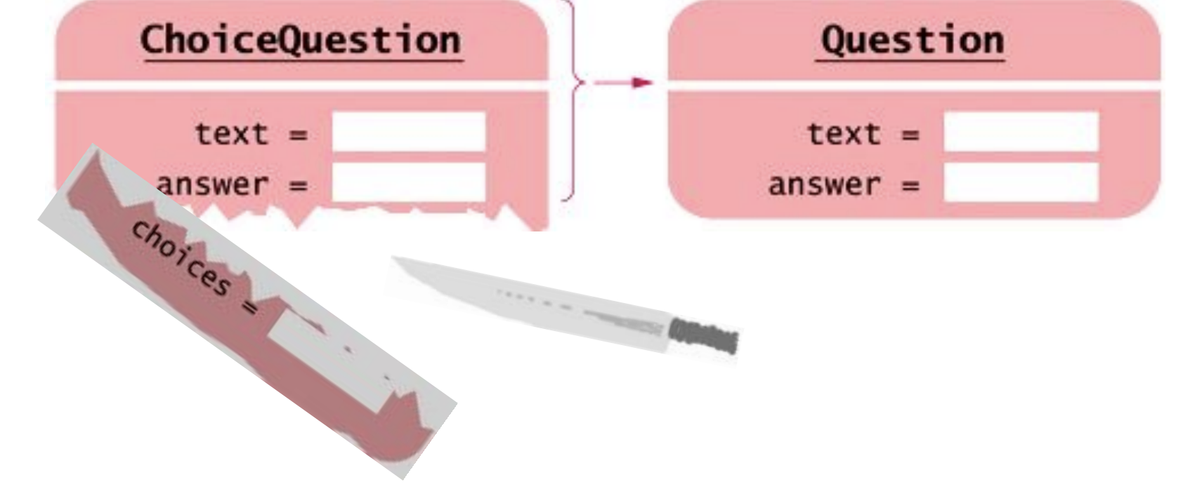
Polymorphism
Polymorphism: define a function, where input parameter is a pointer to supe class. Then the function can take a pointer to subclass as well.
Can the input parameter be super class instead of a pointer to super class? NO.
An object of a subclass is an object of superclass, but when an object of subclass is passed to an object of superclass, there can be information slicing since a superclass object does not have attributes that unique to subclasses.

Slide 6
Template
Function templates are special functions that can operate with generic types. This allows us to create a function template whose functionality can be adapted to more than one type or class without repeating the entire code for each type.
Format for declaring function templates with type parameters template <class identifier> function_declaration; OR template <typename identifier> function_declaration;
In function_declaration, identifier is pass as type to the template function.

Slide 7
Template function example: add
#include <iostream>
#include <string> //stoi, which convert a string to an int
using namespace std;
//reference: https://www.bogotobogo.com/cplusplus/template_specialization_function_class.php
//int add(int a, int b); //old time before template
template<typename T>
T add(T a, T b);

Slide 8
Define template function
Similar to function definition with two differences.
Before function declaration, add a template declaration with type parameters.
Use type parameter instead of specific type.
//template<typename T> or template<class T>
//must be used to start a template function,
//or T is undefined.
template<typename T>
T add(T a, T b)
{
return a + b;
}

Slide 9
Template specification
How to add two strings with numerical chars?
Cannot use + directly between two strings. By default, + operator between two strings is catenation, not addition.
//template specialization: string addition differs from number addition
//1. use template<> instead of the boil plate template<typename T>.
//2. Because this is part of a template function,
//after function name, add <string> or whatever special type
//otherwise, the header looks like an ordinary non-template function.
//Write function to mimic adding two strings. Say, "-11" + ”123" returns ”112".

Slide 10
Template example: add II
template<>
string add<string>(string a, string b)
{ int num = stoi(a);
int num2 = stoi(b);
int result = num + num2;
return to_string(result);
}

Slide 11
Call template function like non-template one
int main()
{
int a = 5;
int b = 6;
cout << add(a, b) << endl; //output 11
double num = 1.6;
double num2 = 7.8;
cout << add(num, num2) << endl; //output 9.4
string str = "-11";
string str2 = "123";
cout << add(str, str2) << endl; //output "112"
return 0;
}

Slide 12
Next: Template class example ArrayBag
Bag class implemented using an array.
To handle different types, we define a template class.

