Slide 1

Alligators Test Plan
FP 8
gd3451er@go.minnstate.edu
sapana.kunwar@my.metrostate.edu
tenzin.nangsel@go.minnstate.edu
jx3563ek@go.minnstate.edu
Xf1675pp@go.minnstate.edu

Slide 2
Test case : 1
Test case title: Creation MOVIE, ANAGRAM,
Description: This program will run to check if MOVIE from movie_anagrams.txt file exist in the movies table by comparing between the data in movie_anagrams to movies table with corresponding native_name, year_made and anagrams. If native_name , year_made and anagrams doesn’t exist, then it will create and insert into the movies table and movie_anagram table.
Test case data:
Insert anagram from movie_anagrams.txt to movies_anagrams table.
Expected results:
[1] Creates movie and anagrams if it doesn’t already exist.

Slide 3
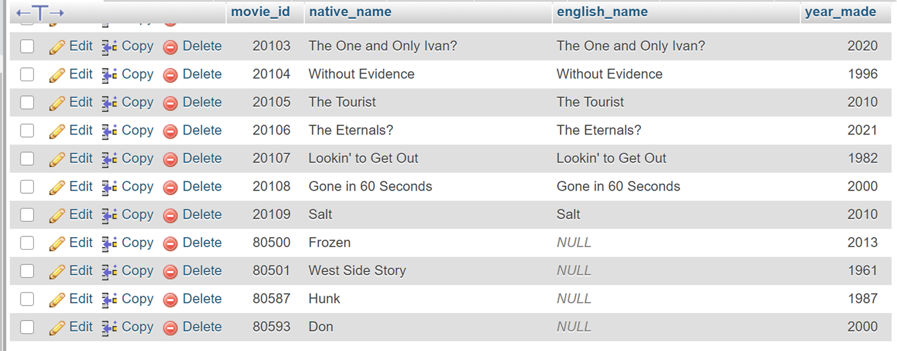
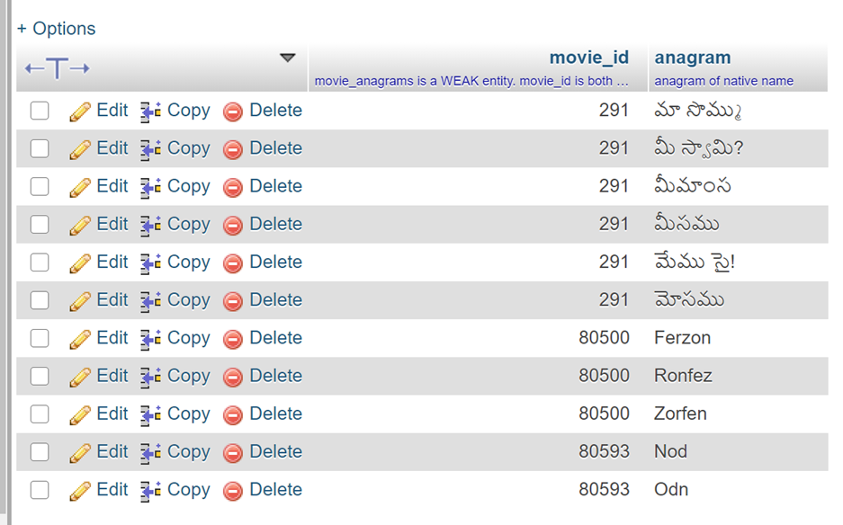
Creates the movie and anagrams

Slide 4
Test case : 2
Test case title: Ignores MOVIE and ANAGRAM creation
Description: This program will run to check if MOVIE from movie_anagrams.txt file exist in the movies table by comparing between the data in movie_anagrams to movies table with corresponding native_name and year_made. If native_name and year_made already exist, then it will ignore inserting into the movies table. It will then checks for the anagram from the txt file to movie_anagram table, if it doesn’t exist. It will insert the anagrams in the movie_anagram table.
Test case data:
Ignore the movie already exist and creates the anagrams that doesn’t exist in the movies_anagrams table.
Expected results:
[1] Ignores a MOVIE creation (since it already exists) and creates an ANAGRAM.

Slide 5
Ignore the movie and creates anagrams

Slide 6
Test case: 3
Test case title: Ignores MOVIE and ANAGRAM,
Description: This program will run to check if MOVIE from movie_anagrams.txt file exist in the movies table by comparing between the data in movie_anagrams to movies table with corresponding native_name and year_made. If native_name and year_made already exist, then it will ignore inserting into the movies table. It also checks for the anagrams in the movie_anagram table and if already exist, then it will ignore inserting into the movie_anagram table.
Test case data:
Ignores of inserting movie and anagram.
Expected results:
[1] Ignores a MOVIE creation (since it already exists) and it ignores the ANAGRAM creation (since it already exists).

Slide 7
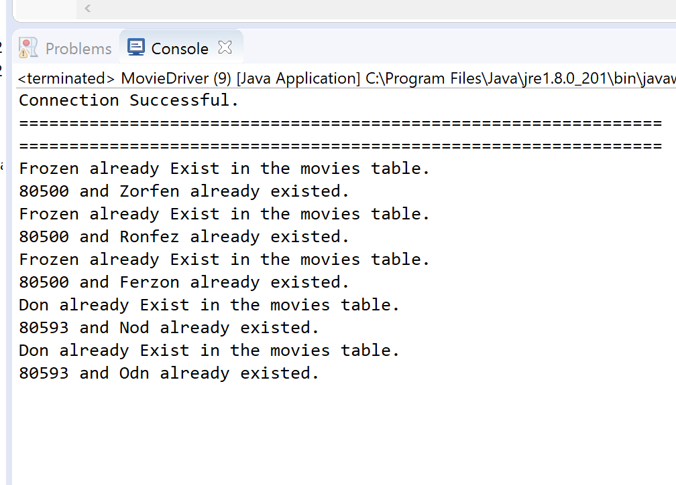
Ignores movie and anagrams

