Slide 1
A web-based CMap query result visualizer

Slide 2
Motivation
Learn something new and cool
Apply to a concrete use case
Get your thoughts & feedback

Slide 3
Motivation
Learn something new and cool
Apply to a concrete use case
Get your thoughts & feedback
THESIS

Slide 4
A CMap query
database of >400k signatures
expression signature
(ex: tumor vs. normal)
ranked list of connections

Slide 5
The problem
run a CMap query…

Slide 6
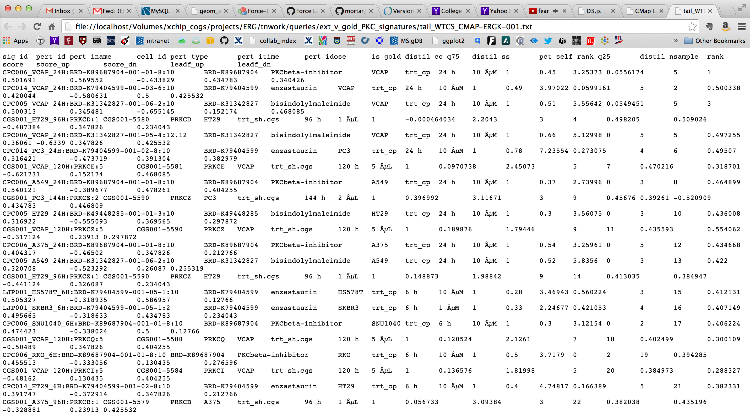
… get a long list of hits
Notes:
current size of CMap dataset is huge

Slide 7
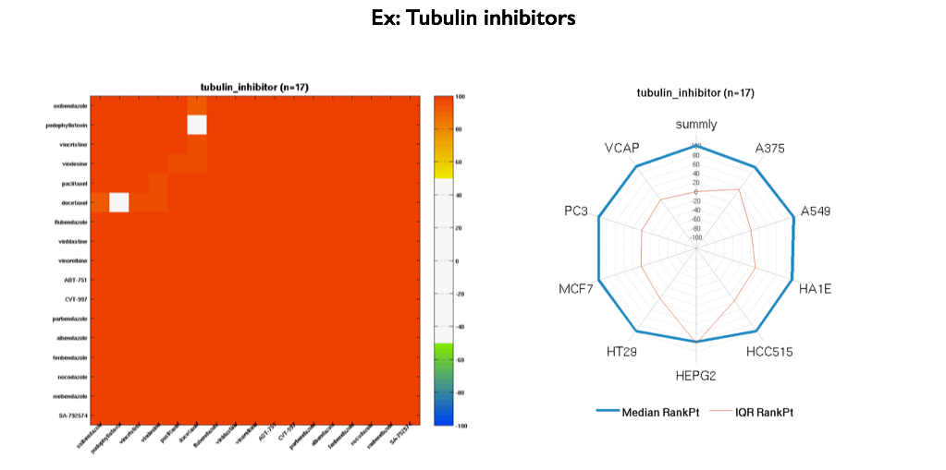
Current methods to address the issue
summly: algorithm for collapsing query results across cell lines to yield reagent-centric hit lists
Pharmacological classes (PCLs): algorithm to identify sets of compounds with similar canonical MOA and empirical support in CMap data
Notes:
link to summly with a couple examples

Slide 8
Both leverage data across many cell contexts, but what if only one context is relevant (i.e. ERG)?
Notes:
show the summly clustering by Josh

Slide 9
An app that accepts an arbitrary query space as input…
Examples:
the entire database
only compound signatures
only VCAP cell line
Notes:
each node is a cmap signature
each edge is drawn only when a connection exists between two signatures

Slide 10
… and tries to summarize
query result
(subset of query space)
app
summarized view of query in context of query space
query space
Notes:
each node is a cmap signature
each edge is drawn only when a connection exists between two signatures

Slide 11
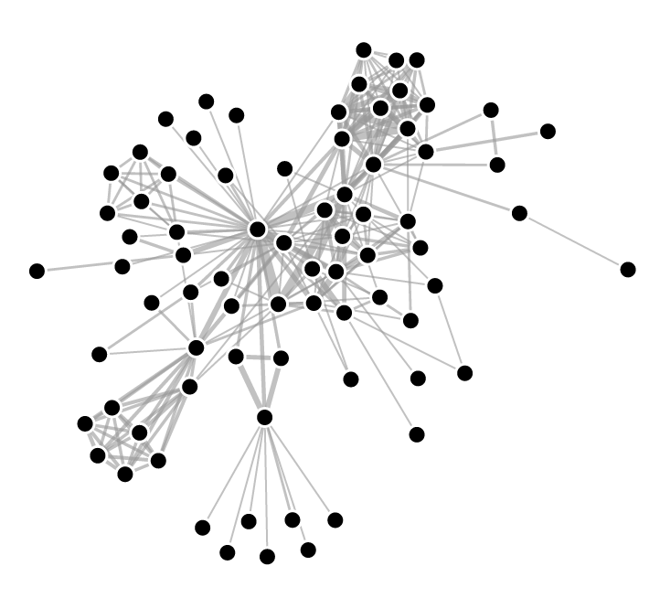
Model the query space as a graph
signature or perturbation
connection

Slide 12
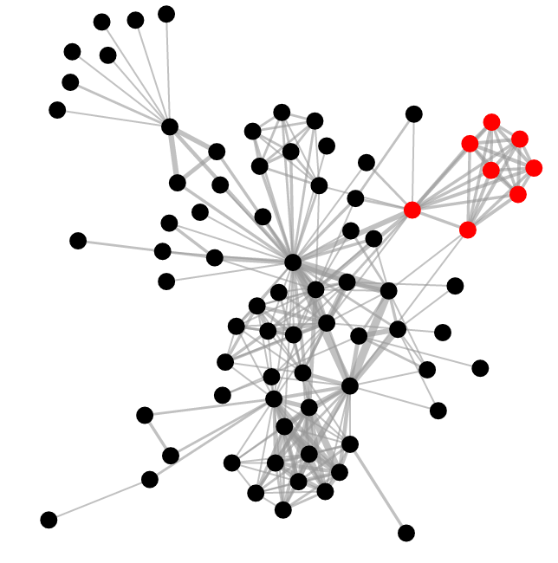
Project query results onto graph
Notes:
case when all neighboring nodes are lit up is more interesting than when they are more diffuse

Slide 13
Potentially identify subsets of high interconnectivity
interesting
not so interesting
Notes:
case when all neighboring nodes are lit up is more interesting than when they are more diffuse

Slide 14
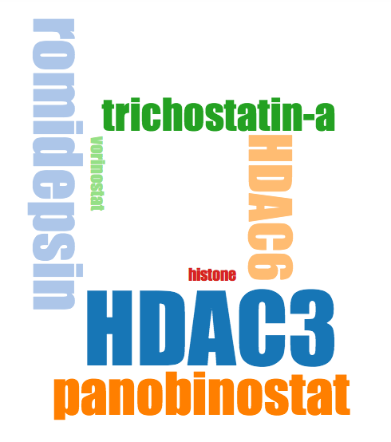
Incorporate metadata
Notes:
case when all neighboring nodes are lit up is more interesting than when they are more diffuse

Slide 15
D3.js

