Slide 1
2. query for connectivity scores
3. query passed to MongoDB
web application
Node.js
web server
MongoDB database
1. User inputs list
of signatures
5. query response passed to application
4. query response as JSON objects

Slide 2
2. query for connectivity scores
3. query passed to MongoDB
web application
Node.js
web server
MongoDB database
1. User inputs list
of perturbagens
7. original query response and clique metrics passed to application
4. query response as JSON objects
6. insert analysis record into database and send analysis_id to Node
5. compute clique metrics
R / igraph

Slide 3
1. Order Q
2. Compute ES_{up} as the enrichment of the n most up-regulated genes in R
3. Compute ES_{dn} as the enrichment of the n most down-regulated genes in R
ES_{up and} ES_{dn} are of the same sign
ES_{up and} ES_{dn} are of different sign
0
(|ES_{up}|+|ES_{dn}|) / 2 , where the resulting WTCS is given the sign of ES_{up}
4. Compute WTCS:

Slide 4
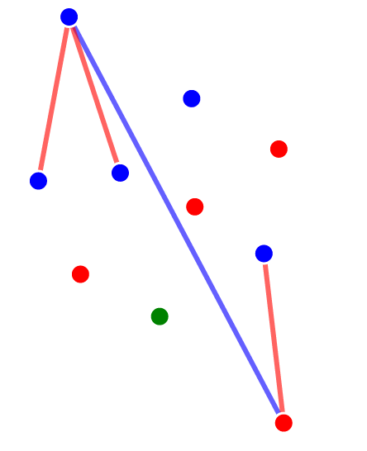
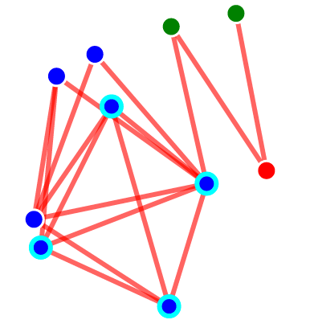
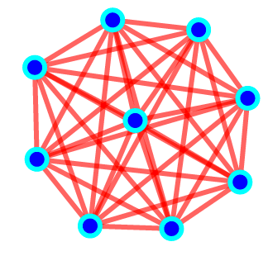
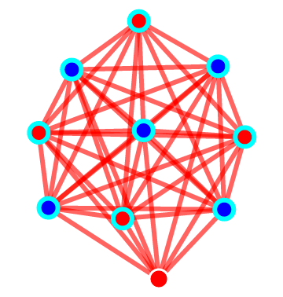
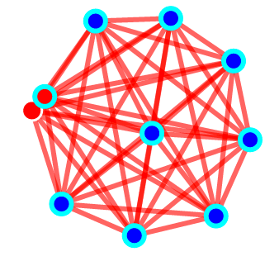
Glucocorticoid agonist: 0.0
HMGCR inhibitor: 1.2
MEK inhibitor: 51.8
Proteasome inhibitor: 71.3
PI3K/MTOR inhibitor: 71.3

