Slide 1
Practical Data Science: Recommender Systems
Practical Data Science – COSC2670
Dr. Yongli Ren
(yongli.ren@rmit.edu.au)
Computer Science & IT
School of Science

Slide 2
Outline
Highlight
Q/A

Slide 3
What is A Recommender System?
It is a system
Attempting to recommend products,
which a user probably likes.
Recommendations are based on the user’s preference profiles extracted from their consuming/rating history, including
The content of consumed items;
The explicit/implicit ratings given to those items.
The product could be:
Movies from IMDB/Netflix …
Videos from Youtube …
Books from Amazon …
Music…
….

Slide 4
Why Recommendations? - Purposes
Information Overload:
is a term used to describe the difficulty of understanding an issue and effectively making decisions when one has too much information about that issue.
To discover the large volume of long-tail items.
Specifically, the purpose of recommendations:
For a particular user, recommend items he/she may be interested in.
Movie, book recommendations, …
For a particular item, identify potential users who may like it.
Personalised advertising, …
Recommender System is an important topic in both
Academia / research:
It is still young, as it emerged in the 1990s.
Industry:
Very practical, especially for online retailers/organizations.
https://en.wikipedia.org/wiki/Information_overload

Slide 5
Data in Recommender System
User Information:
E.g. the user profile when joining one online system (e.g. Youtube)
Item Information:
E.g. the characteristics about the item.
User-item interaction:
E.g. Ratings:
Implicit (click or not-click)
Explicit (give 4 out 5 for a movie).

Slide 6
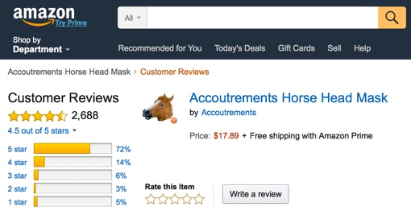
Data Example - Amazon Customer Rating/Review
$$\text{5 ∗ 0.72 + 4 ∗ 0.14 + 3 ∗0.06 + 2 ∗ 0.03 + 1 ∗ 0.05} ≈4.5$$
https://www.techlicious.com/blog/amazon-five-star-ratings-system-algorithm-changes/

Slide 7
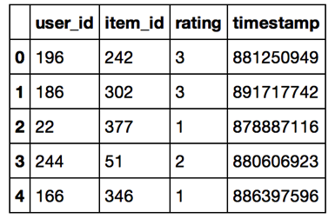
Data in Recommender System
User Information:
E.g. the user profile when joining one online system (e.g. Youtube)
Item Information:
E.g. the characteristics about the item.
User-item interaction:
E.g. Ratings:
Implicit (click or not-click)
Explicit (give 4 out 5 for a movie).

Slide 8


User Representation
User-Item rating matrix.
Users: a long vector with each cell value representing the users’ rating on the corresponding item.
E.g. there are around 500,000 movies, so users in a movie recommender system is a vector of length 500,000.
Items. e.g. films
 | Spider-Man | 2012 | The Godfather | The Social Network
Bob | 3 | 2 | 4 | 5
Cindy |  | 3 | 5 | 4
Paul | 2 | 3 | 4
David | 3 |  | 4 | 1
Users
$$∅$$
$$∅$$
$$∅$$
rating
No rating
David did not watch ‘2012’ ?
David does not like ‘2012’ ?

Slide 9
Challenge: Data Sparsity
Data Sparsity refers to
insufficient information on a user’s rating history
The corresponding user-item matrix
is extremely sparse (the density normally is around 1%)
This is mainly because users are only able to rate a small number of available items.
E.g. each user only watched/rated around 500 movies on average.

Slide 10
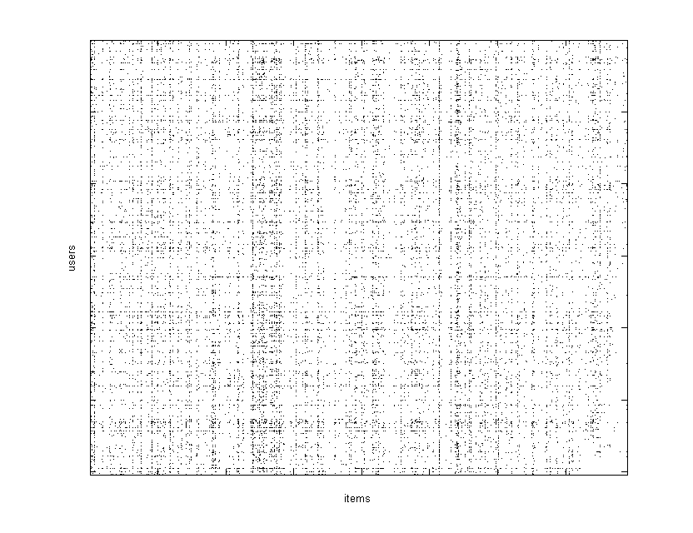
Challenge: Data Sparsity
MovieLens: 1M ratings from 6040 users on 3900 movies with a density 4.25%

Slide 11
How to Do Recommendations?
Although peoples’ tastes vary, they do follow patterns, which can be used to predict such likes and dislikes.
People tend to like things that are similar to other things they like.
People tend to like things that similar people like.
Recommendation is all about
Estimating these patterns of taste, and
Discovering new and desirable items
That people didn’t already know.

Slide 12
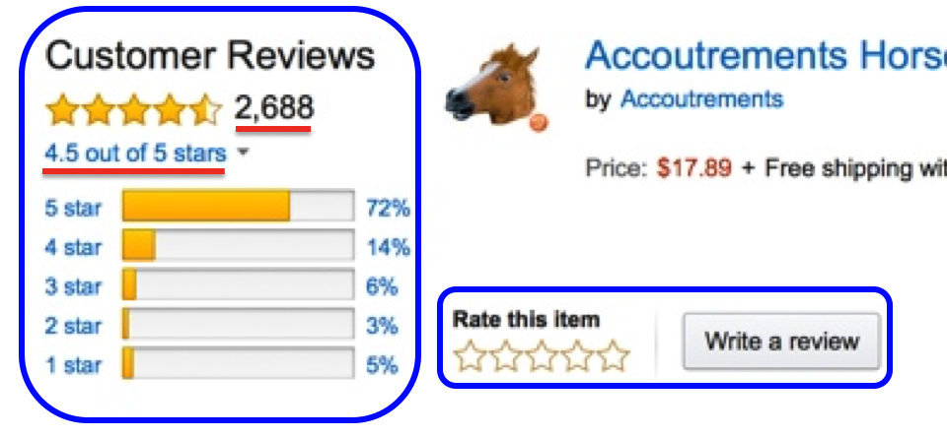
How to Do Recommendations?
Non-personalized vs personalized
Non-personalized:
Recommended items are generated without considering a user’s rating/consuming history.
TopPop (Top Popular): recommends items with the highest popularity (largest number of ratings).
MovieAvg (Movie Average): recommends top-N items with the highest average rating.
Personalized
Recommended items are generated based on a user’s rating/consuming history.
Collaborative Filtering
Content-based Methods
https://www.techlicious.com/blog/amazon-five-star-ratings-system-algorithm-changes/

Slide 13
How to Do Recommendations? - Data From A Movie Recommender System
New MovieLens
It contains 100836 ratings and 3683 tag applications across 9742 movies.
These data were created by 610 users between March 29, 1996 and September 24, 2018.
This dataset was generated on September 26, 2018.
Users were selected at random for inclusion.
All selected users had rated at least 20 movies.

Slide 14
How to Do Recommendations? - Personalized
Personalized
According to the information used, personalized method are categorized as:
Content-based methods
Estimate the rating on an unknown item based on the content of that item and the contents of other rated items.
Collaborative Filtering
Predict the rating on an unknown item based on the ratings on that item by other similar users.
Hybrid Methods
Make rating prediction based on both item content and ratings.

Slide 15


Content-based Methods
For the active user, content-based method
estimate the rating on an unknown item based on the content of that item and the contents of other rated items.
Books
Books rated highly by the active user
User Profile

Slide 16
Content-based Methods
The term “content” refers to the descriptions of the item.
For example, consider a situation where
John has rated the movie Terminator highly.
The item description of Terminator contains similar genre keywords as other science fiction movies, such as Alien and Predator.
In such cases, these movies can be recommended to John.

Slide 17
Content-based Methods
New User Problem
Refers to the difficulty of making recommendations to a new user who has no rating history
This means no item content can be used to produce recommendations.
Limitation in item content
Extracting content from some items is much more difficult than extracting from text documents,
E.g. multi-media resources (songs, videos, pictures) …

Slide 18

Thanks!

