Slide 1

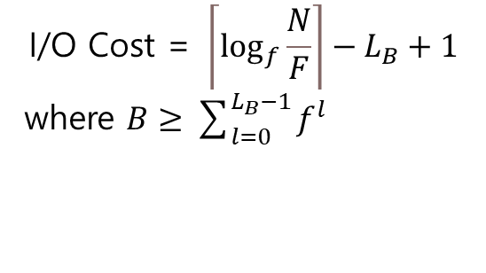
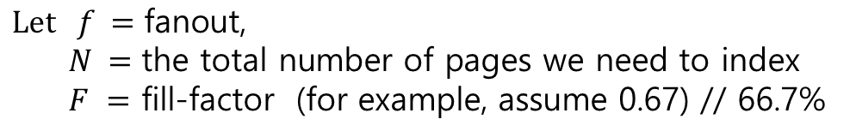
$$\text{B}≥\text{1} \text{+} \text{f} \text{+}\text{ ⋯}\text{ + }f^{L_{B}−1} =\sum_{l=0}^{L_{B}−1}{f^{l}}$$
$$\text{I}\text{/}\text{O} \text{Cost}\text{ = }\left\lceil \log_{f}{\frac{N}{F}}\right\rceil −L_{B}+1$$
where $B≥\sum_{l=0}^{L_{B}−1}{f^{l}}$
$$\text{L}\text{et} f =\text{fanout}\text{,}$$
$$N =\text{the} \text{total} \text{number} \text{of} \text{pages} \text{we} \text{need} \text{to} \text{index}$$
$F =$ fill-factor (for example, assume 0.67) // 66.7%

