Slide 1

Cityrealty.com Web Scraping and Analyzing with Python
By Ted DOGAN

Slide 2
What are the most influential predictors of rental price of an apartment?
Hypothesis:
  Ho: # of bedrooms and bathrooms, square footage, doorman, furnished, etc. have no impact on rental prices in NYC.
  Ha: # of bedrooms and bathrooms, square footage, doorman, furnished, etc. have an impact on rental prices in NY
Data:
  Scrapped variables: price, square footage, building type, address, city, longitude and latitude, bedrooms, bathrooms, furnished, doorman, amenities, date.
  Apartments for rental >> by Oct 25th 2019 >> 2500 observations
  Apartments for sale >> by Oct 25th 2019 >> 2500 observations
  Apartments sold >> from Oct 2018 to Oct 2019 >> 15000 observations

Slide 3
Possible Deterministic Factors of Rent
  EXTRINSIC from NYC Open Data
  github.com/ted2020/determining-the-NYC-rental-prices
Crime Rate
Median Income
Population
Employment
Poverty rate
Racial Diversity
Income Diversity
Rental Vacancy rate
Education
Closeness to a park
Closeness to a subway station
New residential permits
Public & Subsidized Housing
Housing Units
College nearby
Tourist Attractions
  INTRINSIC from Cityrealty.com
  github.com/ted2020/cityrealty-web-scraping
Age of building
Square footage
Number of bedrooms
Number of bathrooms
Kitchen size & quality
w/ or w/o a garage
Street parking permit
Frontyard / Backyard
Washer/Dryer
Pool
Fitness
Doorman
Furnished
Building Type
  PERSONAL
  coming-up
Single/Married
Have kids
Education level
Age
Disabled
Smoke
Race
Personal Income
Own a pet
Where born

Slide 4
Literature
Title | Method | Finding
“Determining Apartment Rent: The Value of Amenities, Services, and External Factors” by Sirmans, Stacy G., et al. | Dependent variable: rent per rental unit Independent Variables: Number of Bedroom, Comp Size, Age, Employment, Distance, Bus lines, covered parked, Modern Kitchen, etc. | The study found that covered car parks increase monthly rent by $50. Also modern kitchen with an inbuilt garbage disposal unit increased the rent by $15. Lastly, access to public transportation has significant effect on rent.
“Determinants of Rental Value for Residential Properties: A Land Owner’s Perspective for Boarding Homes." by Nishan | Dependent variable: Rental Value of the Residential Properties Independent Variables: age, space, quality of construction, availability of water, distance to bus, etc | The study found that age, space, quality of construction, and the bus or train have significant impact on the rent
"Social Factors Affecting Landlords in the Determination of Rent." by Gilderbloom, John I. | Log-linear model Dependent variable: RENT PER DAY Independent Variables: location , population, distance, etc. | The study found that the location of apartment are significant determinants of rental prices in the city. Likewise, an increase in New York’s population influenced the demand for accommodation. Finally the distance from the central business district, and the socioeconomic composition influenced the rent prices.

Slide 5
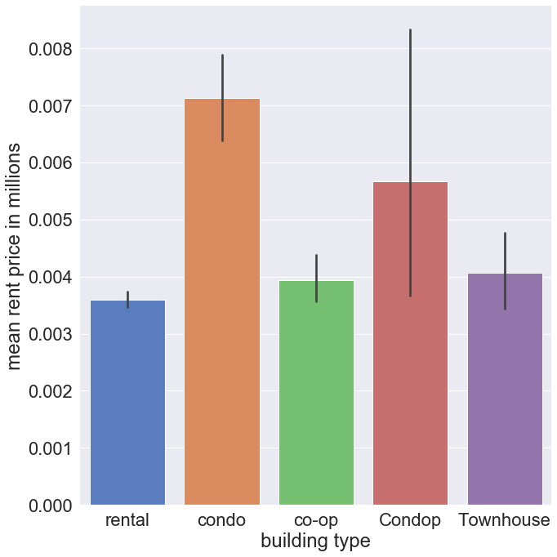
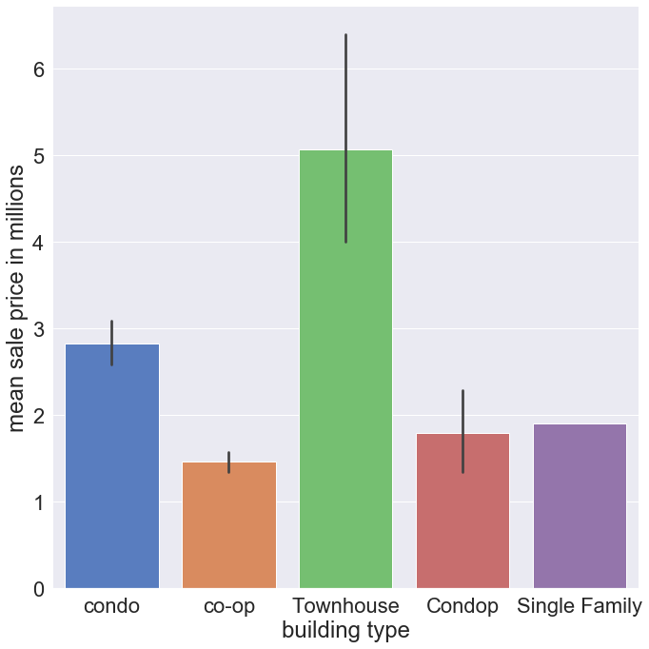
Mean Price Comparison: Rent vs Sale

Slide 6
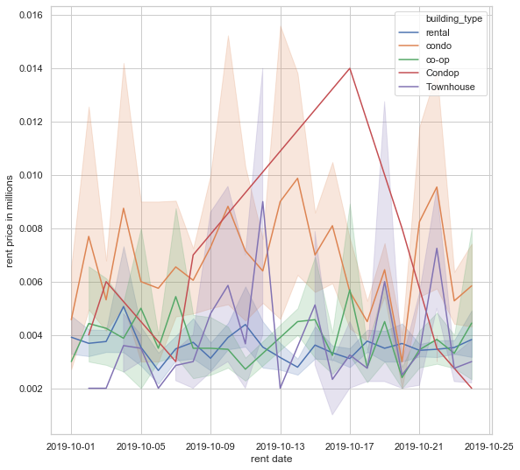
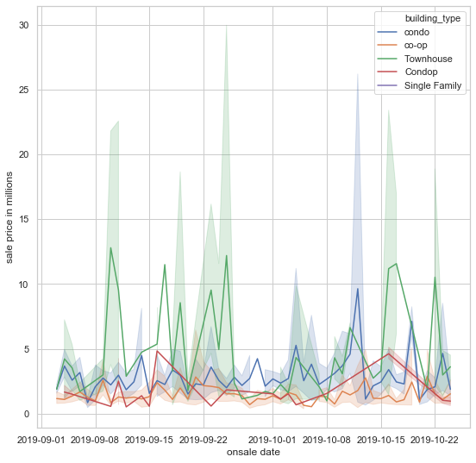
Time Series: Rent vs Sale

Slide 7
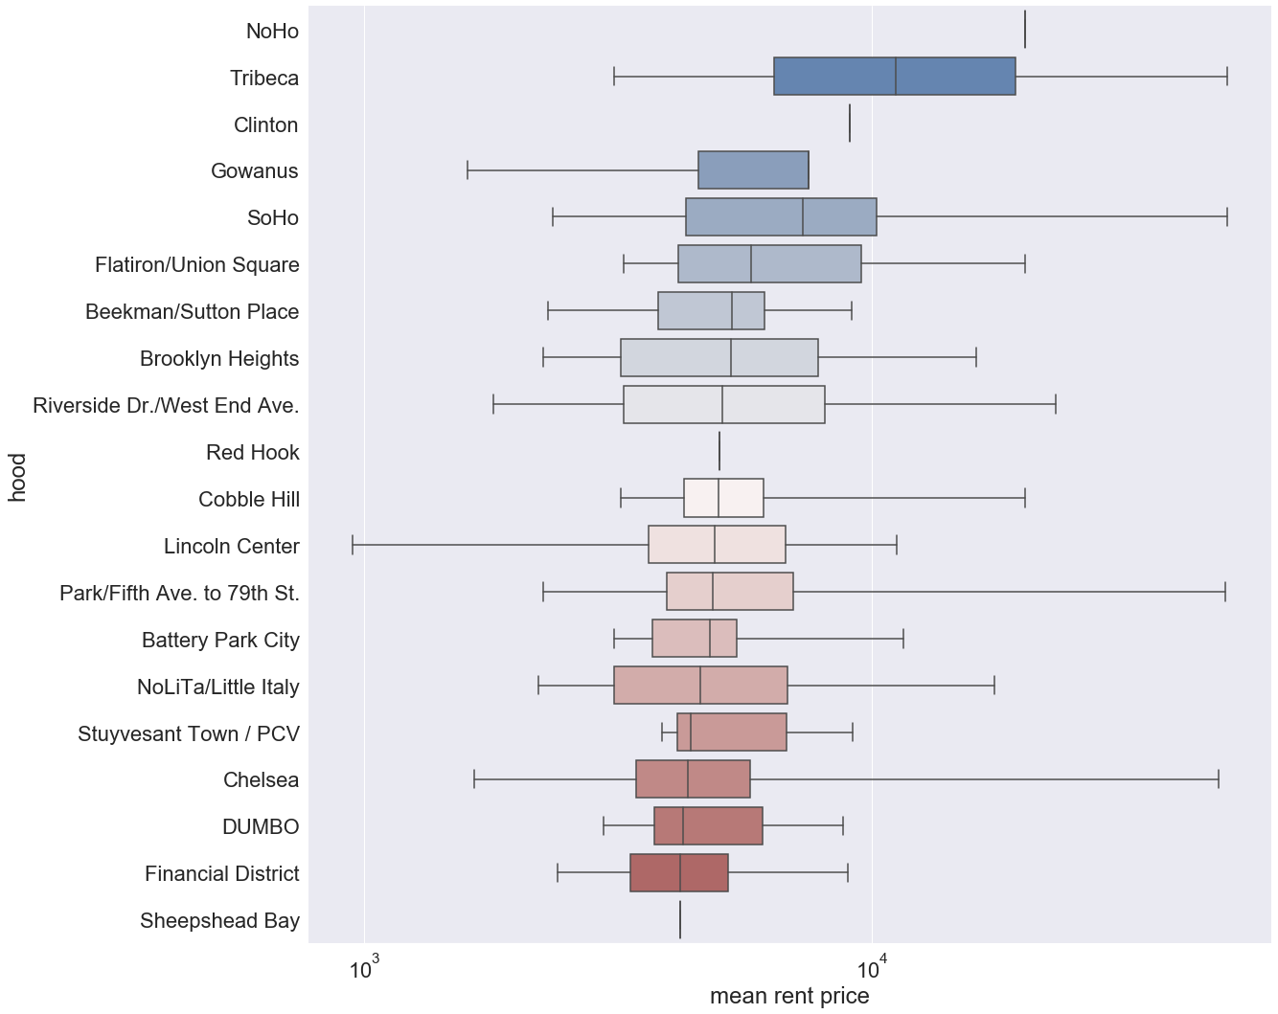
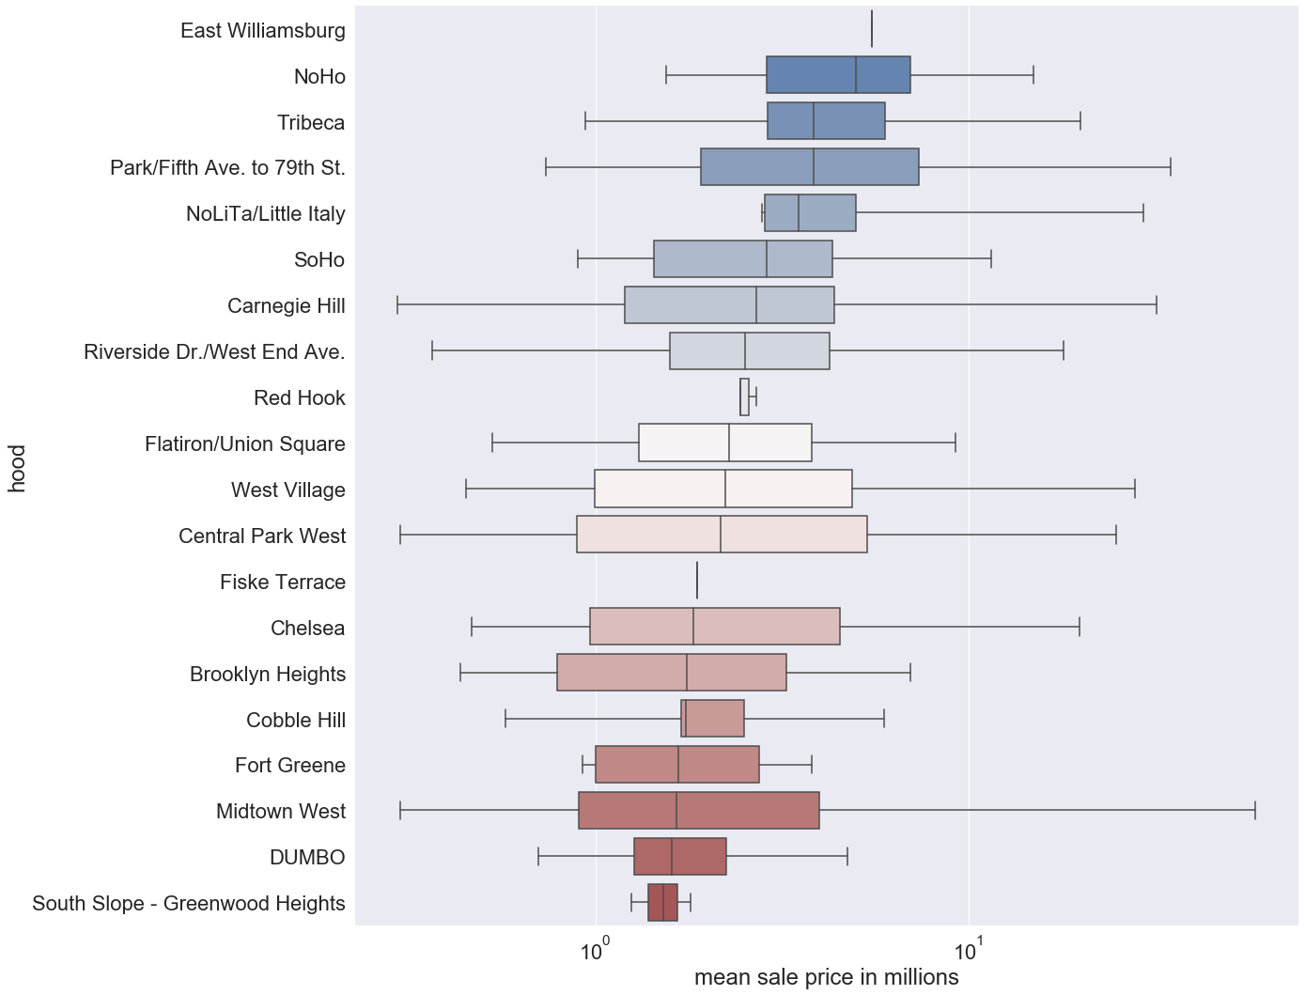
Sub-Boro Comparison: Rent vs Sale

Slide 8
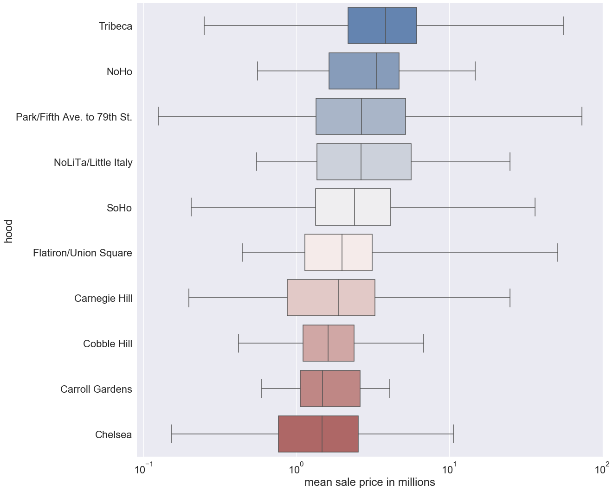
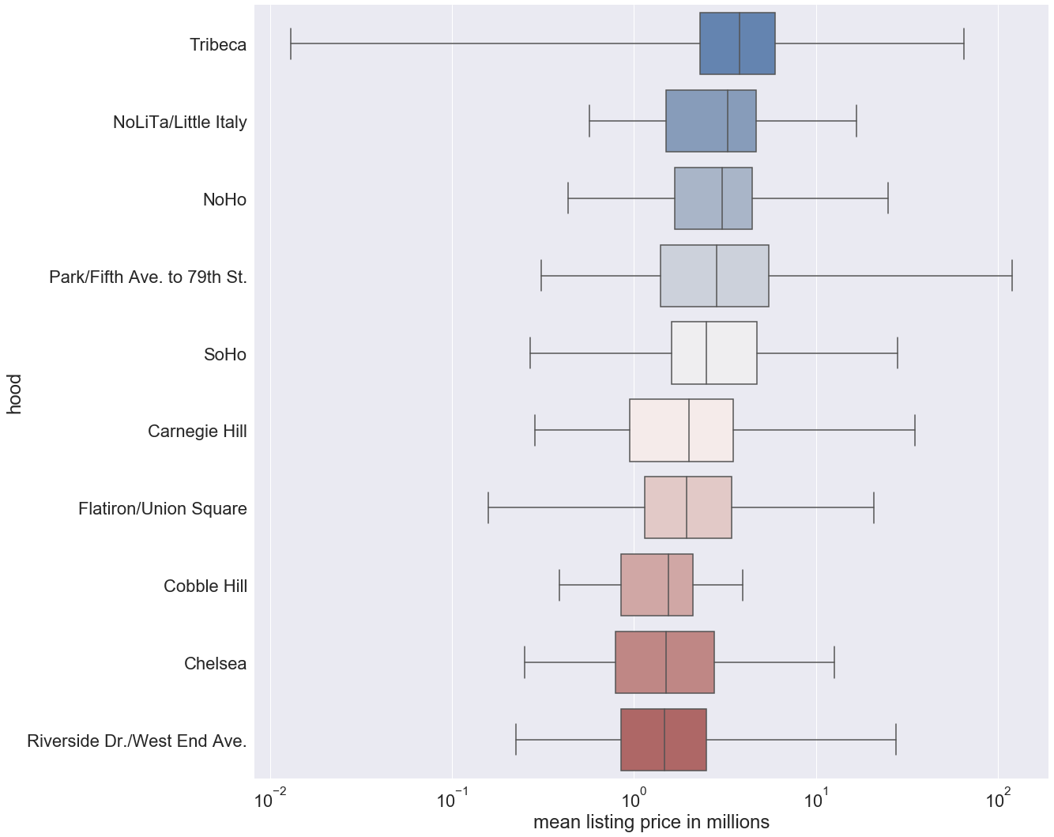
Apartments Sold

Slide 9
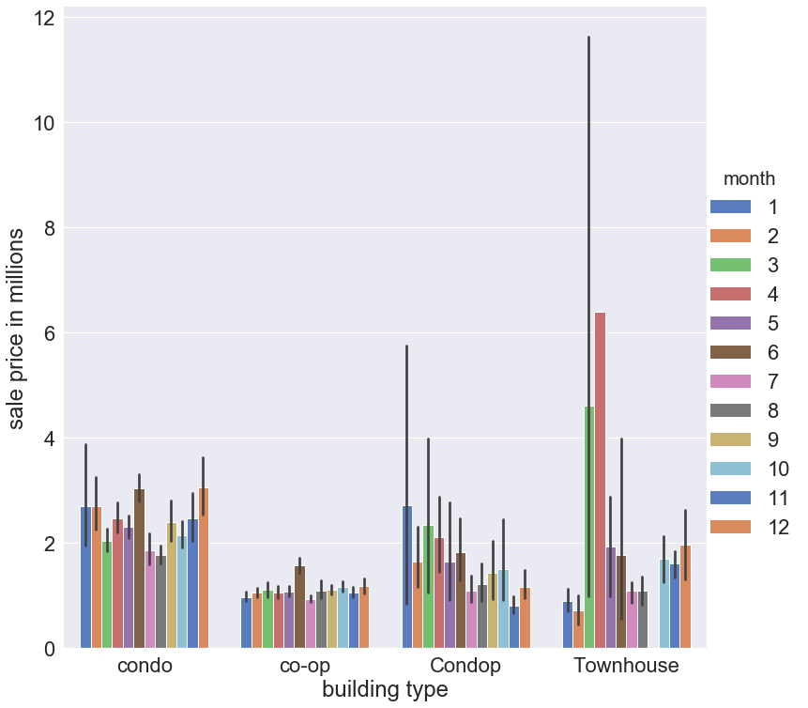
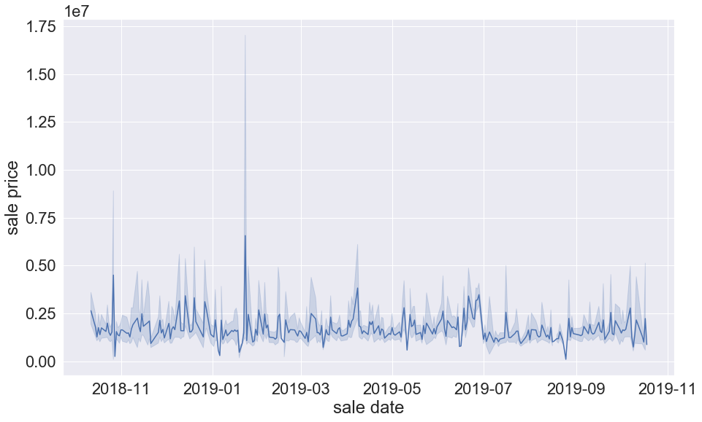
Apartments Sold

Slide 10
OLS Model
Apartments for rental >> square footage + bedrooms + bathrooms + doorman + furnished + sub-boro + amenities
  day + building name + building type
    Reason for building type: investors who buy and rent out until realizing generous returns.
Apartments for sale >> square footage + bedrooms + bathrooms + doorman + furnished + sub-boro + amenities + building type
  day + building name
Apartments sold >> listing price + square footage + bedrooms + bathrooms + doorman + furnished + sub-boro + amenities + building type
  day
Checked for OLS assumptions: heteroskedasticity, multicollinearity, normality of residuals, independent errors

Slide 11
Limitations, What’s Next, and References
Lacking time series data of deterministic factors
More literature review is required
Data required by the zipcode
Merge with extrinsic factors data
Collect personal factors data
Do Panel data analysis
In addition to rent, analyze property prices and land value
Collect Uber data for its impact on rent and property prices
Impact of Airbnb
Impact of Amazon delivery on businesses and communities
Impact of changing demographics
Housing & Construction Stocks
Look into other cities
Amenyah, Ivy Drafor, and Ernest Afenyi Fletcher. "Factors Determining Residential Rental Prices." Asian Economic and Financial Review, vol. 3, no. 1, 2013, pp. 39-50.
City of New York, NYC Open Data. “NYC Open Data.” NYC Open Data WP Engine, opendata.cityofnewyork.us/data.
Egner, Björn, and Katharina J. Grabietz. "In Search of Determinants for Quoted Housing Rents: Empirical Evidence from Major German Cities." Urban Research & Practice, vol. 11, no. 4, 2017, pp. 460-477.
Gilderbloom, John I. "Social Factors Affecting Landlords in the Determination of Rent." Urban Life, vol. 14, no. 2, 1985, pp. 155-179.
KARP, Jennifer White. (2019, July 10). Report: Influx of buyers in the NYC rental market hurts renters looking for a deal. Retrieved from https://www.brickunderground.com/rent/douglas-elliman-manhattan-brooklyn-queens-rental-market-report-may-2019.
Linear Regression. (2018, April 11). Retrieved from https://pythonfordatascienceorg.wordpress.com/linear-regression-python/.
Long, J. S., & Ervin, L. H. (2000). Using Heteroscedasticity Consistent Standard Errors in the Linear Regression Model. The American Statistician, 54(3), 217–224. doi: 10.1080/00031305.2000.10474549
New York City Real Estate, Apartments and Condos. (n.d.). Retrieved from https://www.cityrealty.com/.
Pros and Cons Between Condo, Co-op and Condop. (n.d.). Retrieved from https://streeteasy.com/guides/buyers-guide/what-are-pros-and-cons-between-condo-and-condops/.
Sirmans, Stacy G., et al. "Determining Apartment Rent: The Value of Amenities, Services, and External Factors." n Journal of Real Estate Research, vol. 4, no. 2, 1989, pp. 33-44.
Stephanie. (2017, October 15). Durbin Watson Test & Test Statistic. Retrieved from https://www.statisticshowto.datasciencecentral.com/durbin-watson-test-coefficient/.
Stephanie. (2017, December 9). Jarque-Bera Test. Retrieved from https://www.statisticshowto.datasciencecentral.com/jarque-bera-test/.
Wickramaarachchi, Nishan. "Determinants of Rental Value for Residential Properties: A Land Owner’s Perspective for Boarding Homes." Built-Environment Sri Lanka, vol. 12, no. 1, 2016, pp. 10-22

