Slide 1
Flexible Consensus Mechanism for Current Allocation in DC Microgrid
Khoa Dang Nguyen Tran, Trinh Thi Ly, Khoa Truong Hoang, Nhuan An Le, Hung Duc Nguyen
Tran Nguyen Dang Khoa

Slide 2
Table of Contents
1. Motivation & Problems
2. Proposed method & Consensus Algorithm
3. Simulation Results
4. Conclusions
5. Acknowledgement
6. References
ISEE 2023
Flexible Consensus Mechanism for Current Allocation in DC Microgrid

Slide 3
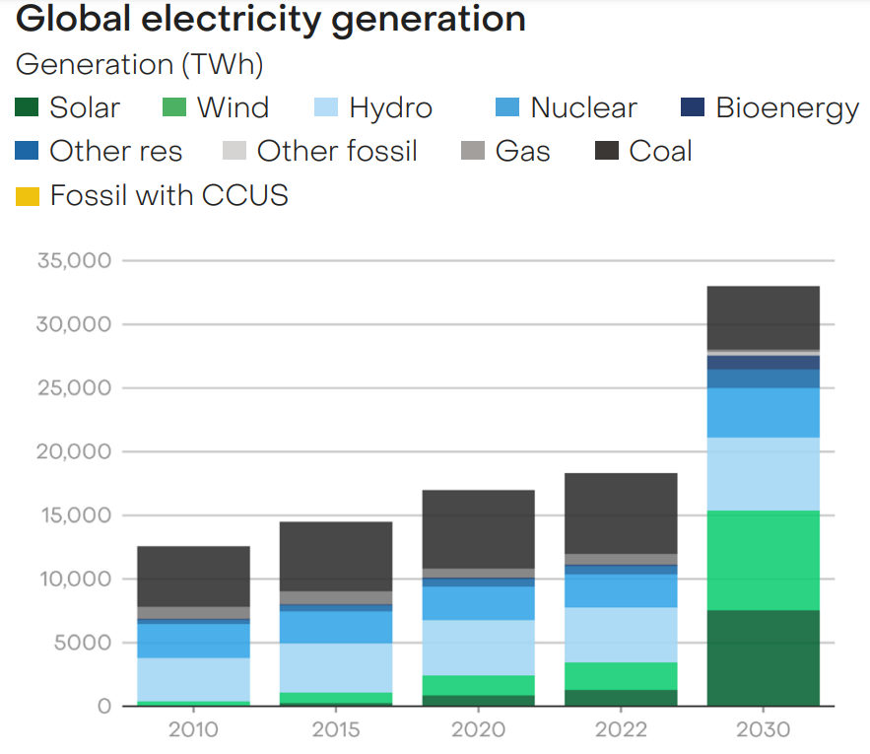
Motivation & Problems
Renewable energy sources (RESs) like Solar, Wind or Hydro have become the predominant trend in the development of energy systems in many countries.
Global-Electricity-Review-2023
ISEE 2023
Flexible Consensus Mechanism for Current Allocation in DC Microgrid

Slide 4
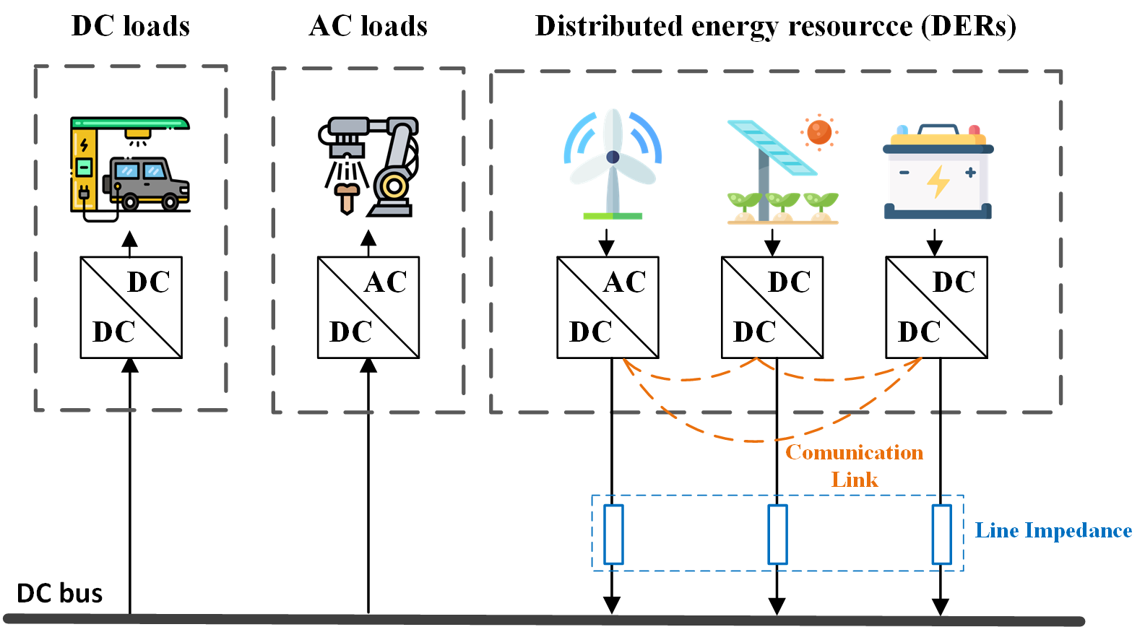
Motivation & Problems
Fig. 1. Simplified diagram of Microgrid with communication link.
To coordinate RESs, microgrids have emerged as an efficient and optimal solution. However, the microgrid is facing the problem of inaccurate power sharing between the generators
ISEE 2023
Flexible Consensus Mechanism for Current Allocation in DC Microgrid

Slide 5
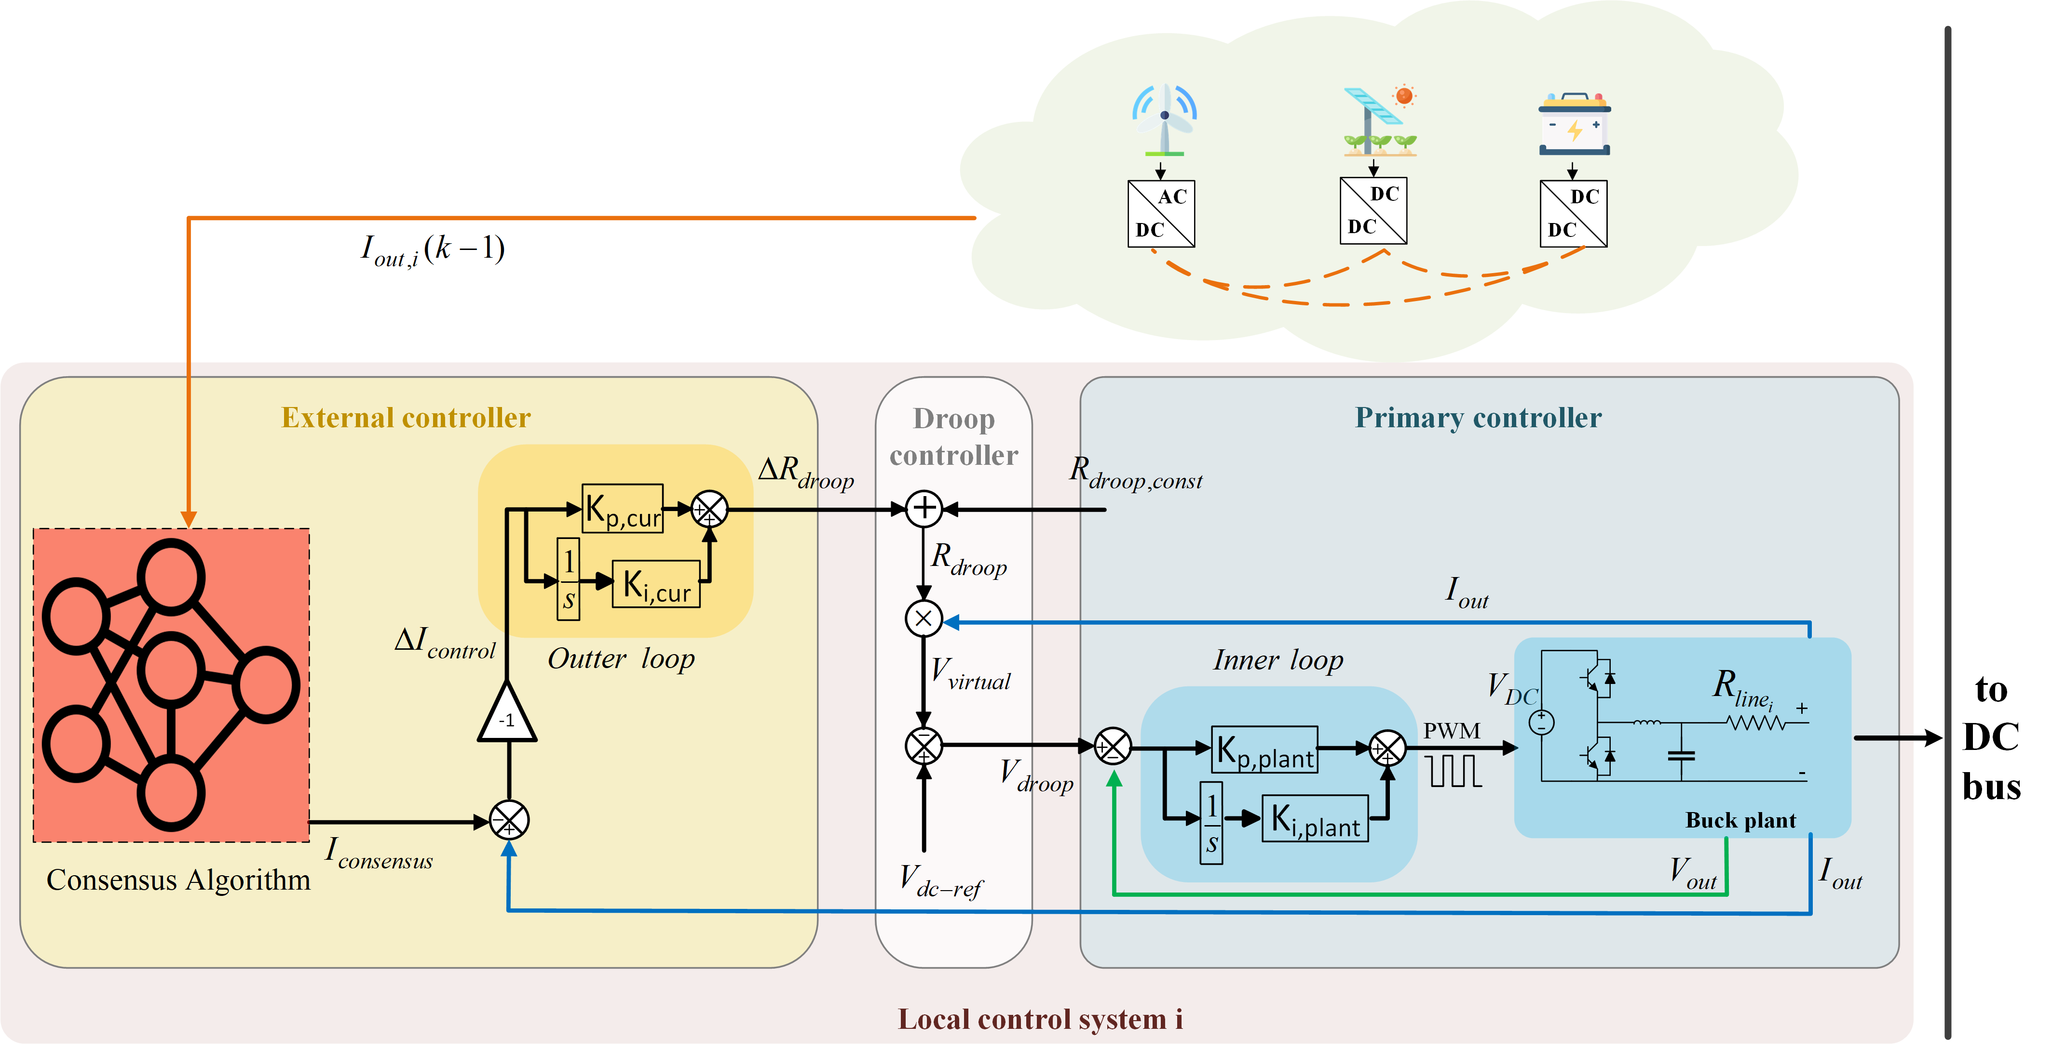
Proposed method
Fig. 2. Block diagram of the combined Consensus-Droop control loop.
Order of analysis :
Combination Droop Control & Consensus Algorithm
Droop Control
Consensus Algorithm
ISEE 2023
Flexible Consensus Mechanism for Current Allocation in DC Microgrid

Slide 6
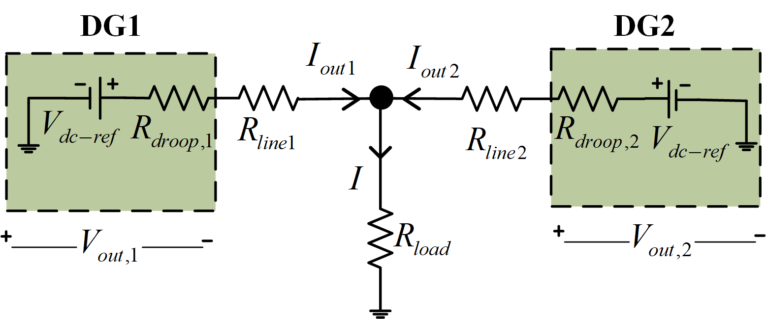
Proposed method
Droop Control
To analyze the characteristics of the droop control method, the Microgrid circuit with Thevenin transformation is established as :
Fig. 3. Microgrid ciruit with thevenin transformation
Where are the control parameters, and represent the sensor feedback values.
In the conventional droop control, the relationship between voltage and current at the output of each generator is expressed as follows:
(1)
(2)
ISEE 2023
Flexible Consensus Mechanism for Current Allocation in DC Microgrid
6

Slide 7
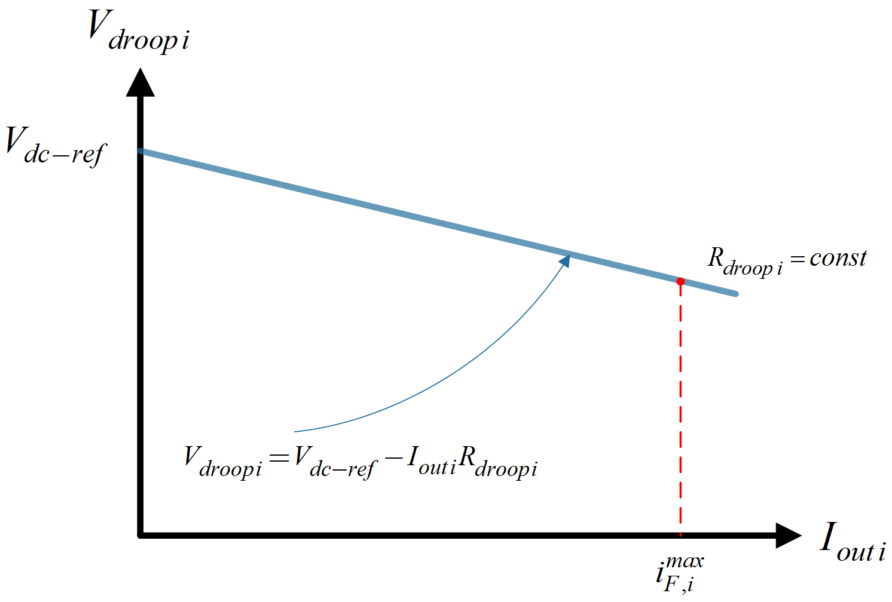
Proposed method
Droop Control
Autonomous power sharing is achieved by regulating the power output of each generator according to its deviation from the operating point, which is expressed as
(3)
Fig. 4. Droop curve in a DC microgrids with conventional Droop controller.
Where is the maximum current that the source converter can provide, and is the maximum voltage deviation.
ISEE 2023
Flexible Consensus Mechanism for Current Allocation in DC Microgrid

Slide 8
Proposed method
Droop Control
It is important to note that the line impedance values are varied depending on the electricity grid area. From droop control theory for microgrid , the mismatched current sharing is inevitable due to the microgrid configuration. Thus, the feasible solution to deal with the problem of unequal current sharing is to modify the droop resistance. The adjustment of the droop resistance required a calculation of the current difference among generation units, which is estimated with the aid of a consensus algorithm
ISEE 2023
Flexible Consensus Mechanism for Current Allocation in DC Microgrid

Slide 9

Proposed method
Consensus Algorithm
Consensus algorithm is a mechanism used in distributed systems to achieve agreement among multiple nodes on a specific outcome. In a distributed system, where multiple generation units interact and collaborate to perform grid voltage support, consensus algorithms ensure that all nodes reach a consistent state and agree on validity
ISEE 2023
Flexible Consensus Mechanism for Current Allocation in DC Microgrid

Slide 10
Proposed method
Consensus Algorithm
The consensus algorithm employing the continuous time domain can be characterized as :
(4)
Where is a gain that represents the connection state from distributed generation unit i^{th} to j^{th}. and are the sent data in the generation unit i^{th} and j^{th}, respectively.
When taking the derivative of the equation in continuous time domain to the discrete-time domain, the following equation is obtained:
(5)
: the total number of agents
: the gain of the consensus algorithm
ISEE 2023
Flexible Consensus Mechanism for Current Allocation in DC Microgrid

Slide 11
Proposed method
Consensus Algorithm
Because the communication delay for processing is inevitable, the suitable discrete time equation for the consensus control algorithm is rewritten as :
(6)
: stored data of the 1st generation
: current data to be calculated
ISEE 2023
Flexible Consensus Mechanism for Current Allocation in DC Microgrid

Slide 12
Proposed method
Consensus Algorithm
Considering a scenario where three distributed generation units are considered in the microgrid system :
Initial values
Gain coefficient
Time sampling
ISEE 2023
Flexible Consensus Mechanism for Current Allocation in DC Microgrid

Slide 13
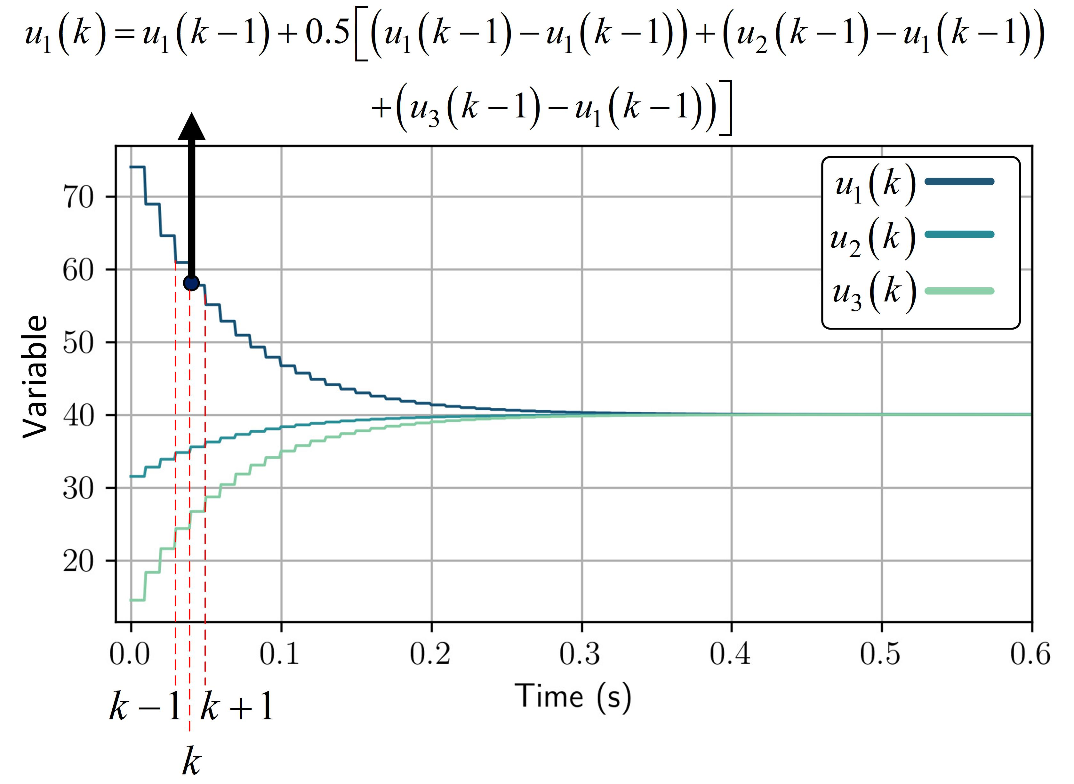
Proposed method
Consensus Algorithm
After a convergence time of 0.3s, the three variables , , and converge to the average value .
These variables change gradually until they approach the convergent value, and their performance is maintained in a steady state.
Fig. 7. Simulation example of data convergence in the consensus algorithm
ISEE 2023
Flexible Consensus Mechanism for Current Allocation in DC Microgrid

Slide 14
Proposed method
Combination Droop Control & Consensus Algorithm
Fig. 8. Block diagram of the combined Consensus-Droop control loop.
ISEE 2023
Flexible Consensus Mechanism for Current Allocation in DC Microgrid

Slide 15
Proposed method
Combination Droop Control & Consensus Algorithm
The first part is the external controller, which is calculated using the consensus algorithm. The sent data is , and the consensus output variable is defined as .
By applying the consensus algorithm, the current error in the external controller is calculated as :
(7)
I_{out}
Fig. 8.1 Block diagram of the combined Consensus-Droop control loop – External control
ISEE 2023
Flexible Consensus Mechanism for Current Allocation in DC Microgrid

Slide 16
Proposed method
Combination Droop Control & Consensus Algorithm
The second part is the modified Droop control, where from the external controller is added to the droop constant to generate the modified
R_{droop_const}
I_{out}
(8)
Virtual voltage drop on the droop resistor, as defined in the following equation:
(9)
Fig. 8.2 Block diagram of the combined Consensus-Droop control loop – Droop controller.
ISEE 2023
Flexible Consensus Mechanism for Current Allocation in DC Microgrid

Slide 17
Proposed method
Combination Droop Control & Consensus Algorithm
Fig. 8.3 Block diagram of the combined Consensus-Droop control loop – primary controller
To control the output voltage according to the droop voltage, the primary controller is applied. The deviation between the desired voltage and is fed into the inner loop of the primary controller. Then the output PWM duty is generated to control the DC-DC converter.
ISEE 2023
Flexible Consensus Mechanism for Current Allocation in DC Microgrid

Slide 18
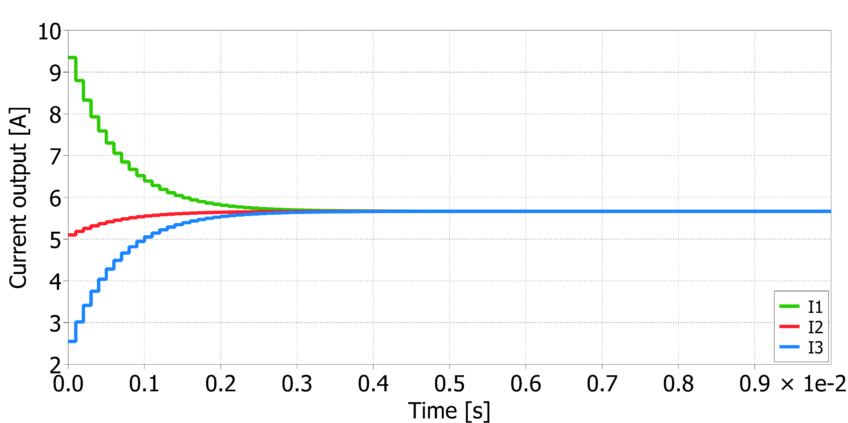
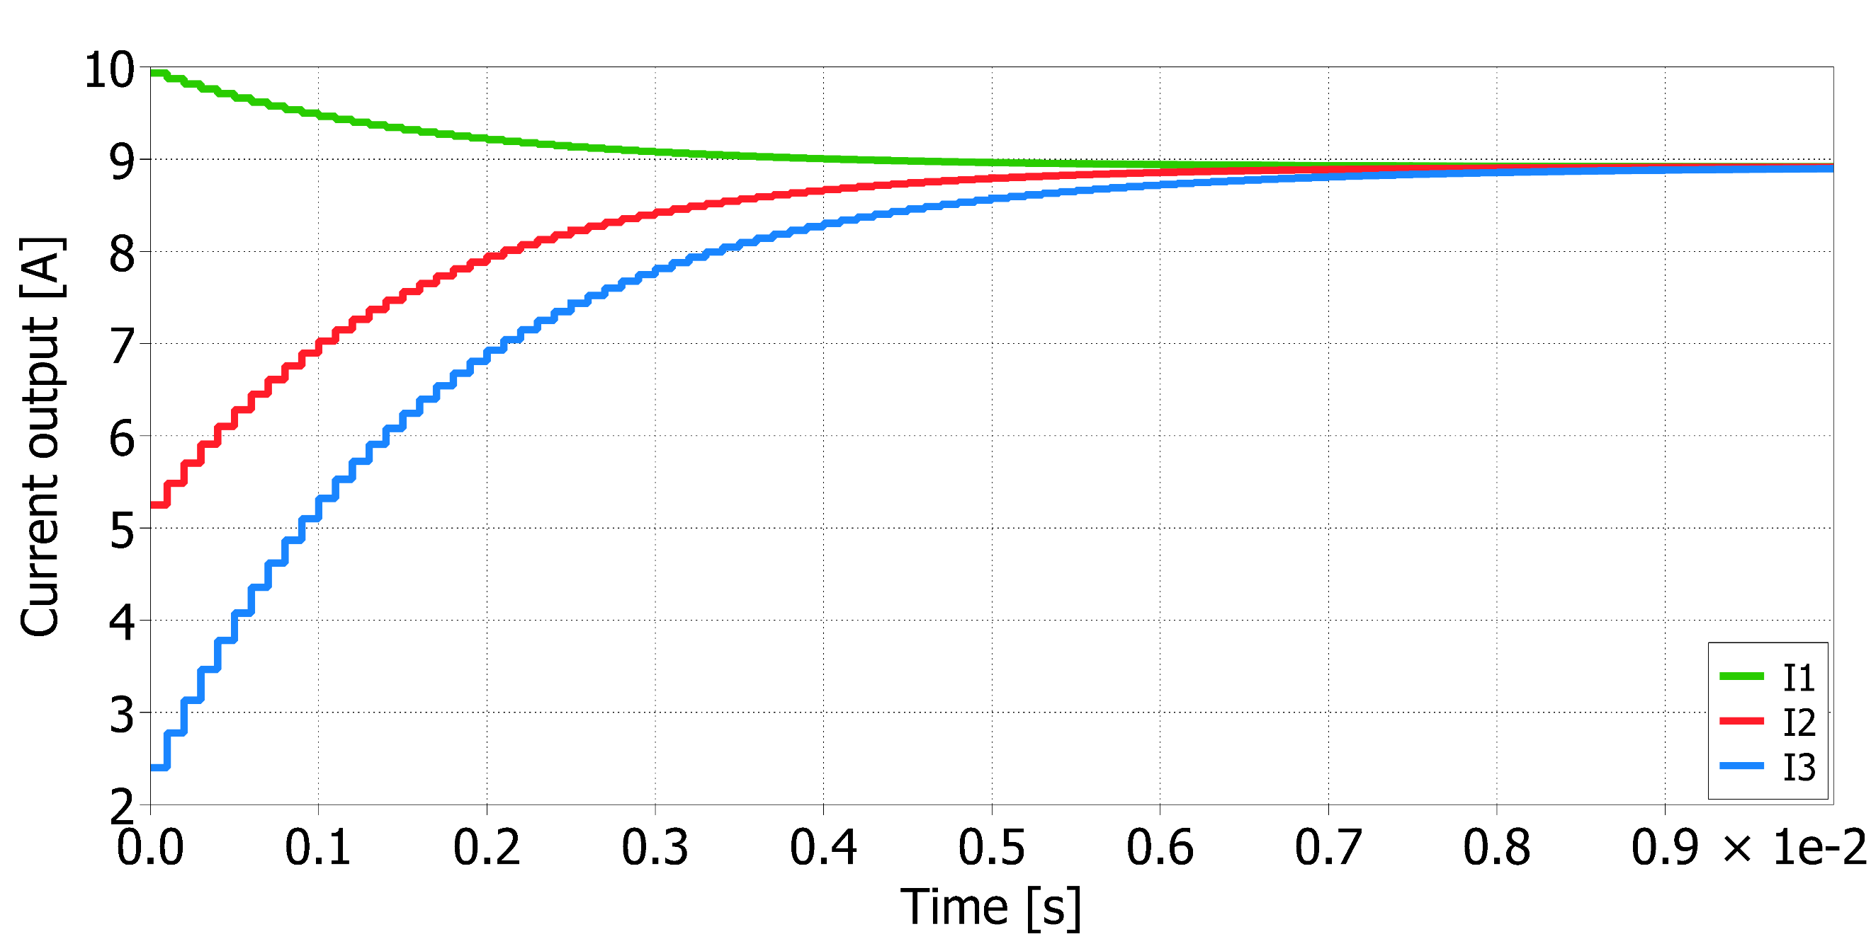
Simulation Results
Consensus Simulation Only with PLECS
Fig. 9. Consensus Simulation Only Input const with PLECS
ISEE 2023
Flexible Consensus Mechanism for Current Allocation in DC Microgrid

Slide 19
Simulation Results
Consensus Simulation Only with PLECS
In Fig. 9.1, the convergence performance of the Consensus algorithm is illustrated when . With the adoption of the Consensus algorithm, the control variables are gradually updated over time. After 30 steps (0.3s), these variables converge to their average values, indicating that a consensus is achieved among the generators.
Fig. 9.1 Consensus Simulation Only Input const with PLECS – 0.05 gain
ISEE 2023
Flexible Consensus Mechanism for Current Allocation in DC Microgrid

Slide 20
Simulation Results
Consensus Simulation Only with PLECS
In Fig. 9.2, the convergence performance of the Consensus algorithm is depicted when . In this specific scenario, DG1 is assumed to have superior infrastructure investment and minimal errors during surveys. Furthermore, there is no exchange of information between DG2 and DG3 ( ).
Fig. 9.2 Consensus Simulation Only Input const with PLECS – gain 0.005 – not all connected
ISEE 2023
Flexible Consensus Mechanism for Current Allocation in DC Microgrid

Slide 21
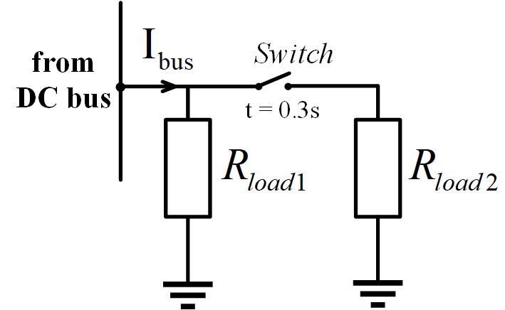
Simulation Results
Combined Consensus-Droop Control Simulation with PLECS
Load 1 remains connected to the DC bus throughout the simulation, while Load 2 is connected to the DC bus at 0.3 seconds to investigate the system stability characteristics
Fig. 10. Detail schematic of load connection at DC bus.
ISEE 2023
Flexible Consensus Mechanism for Current Allocation in DC Microgrid

Slide 22
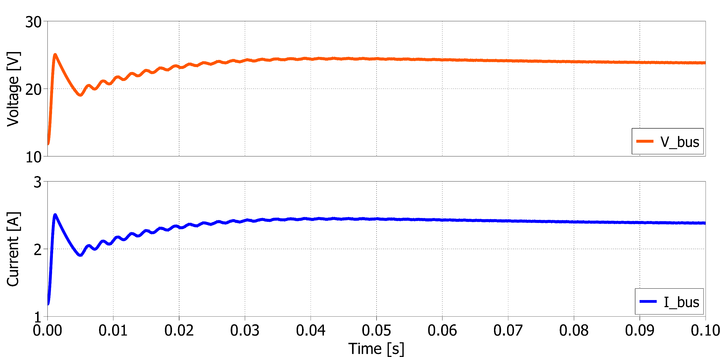
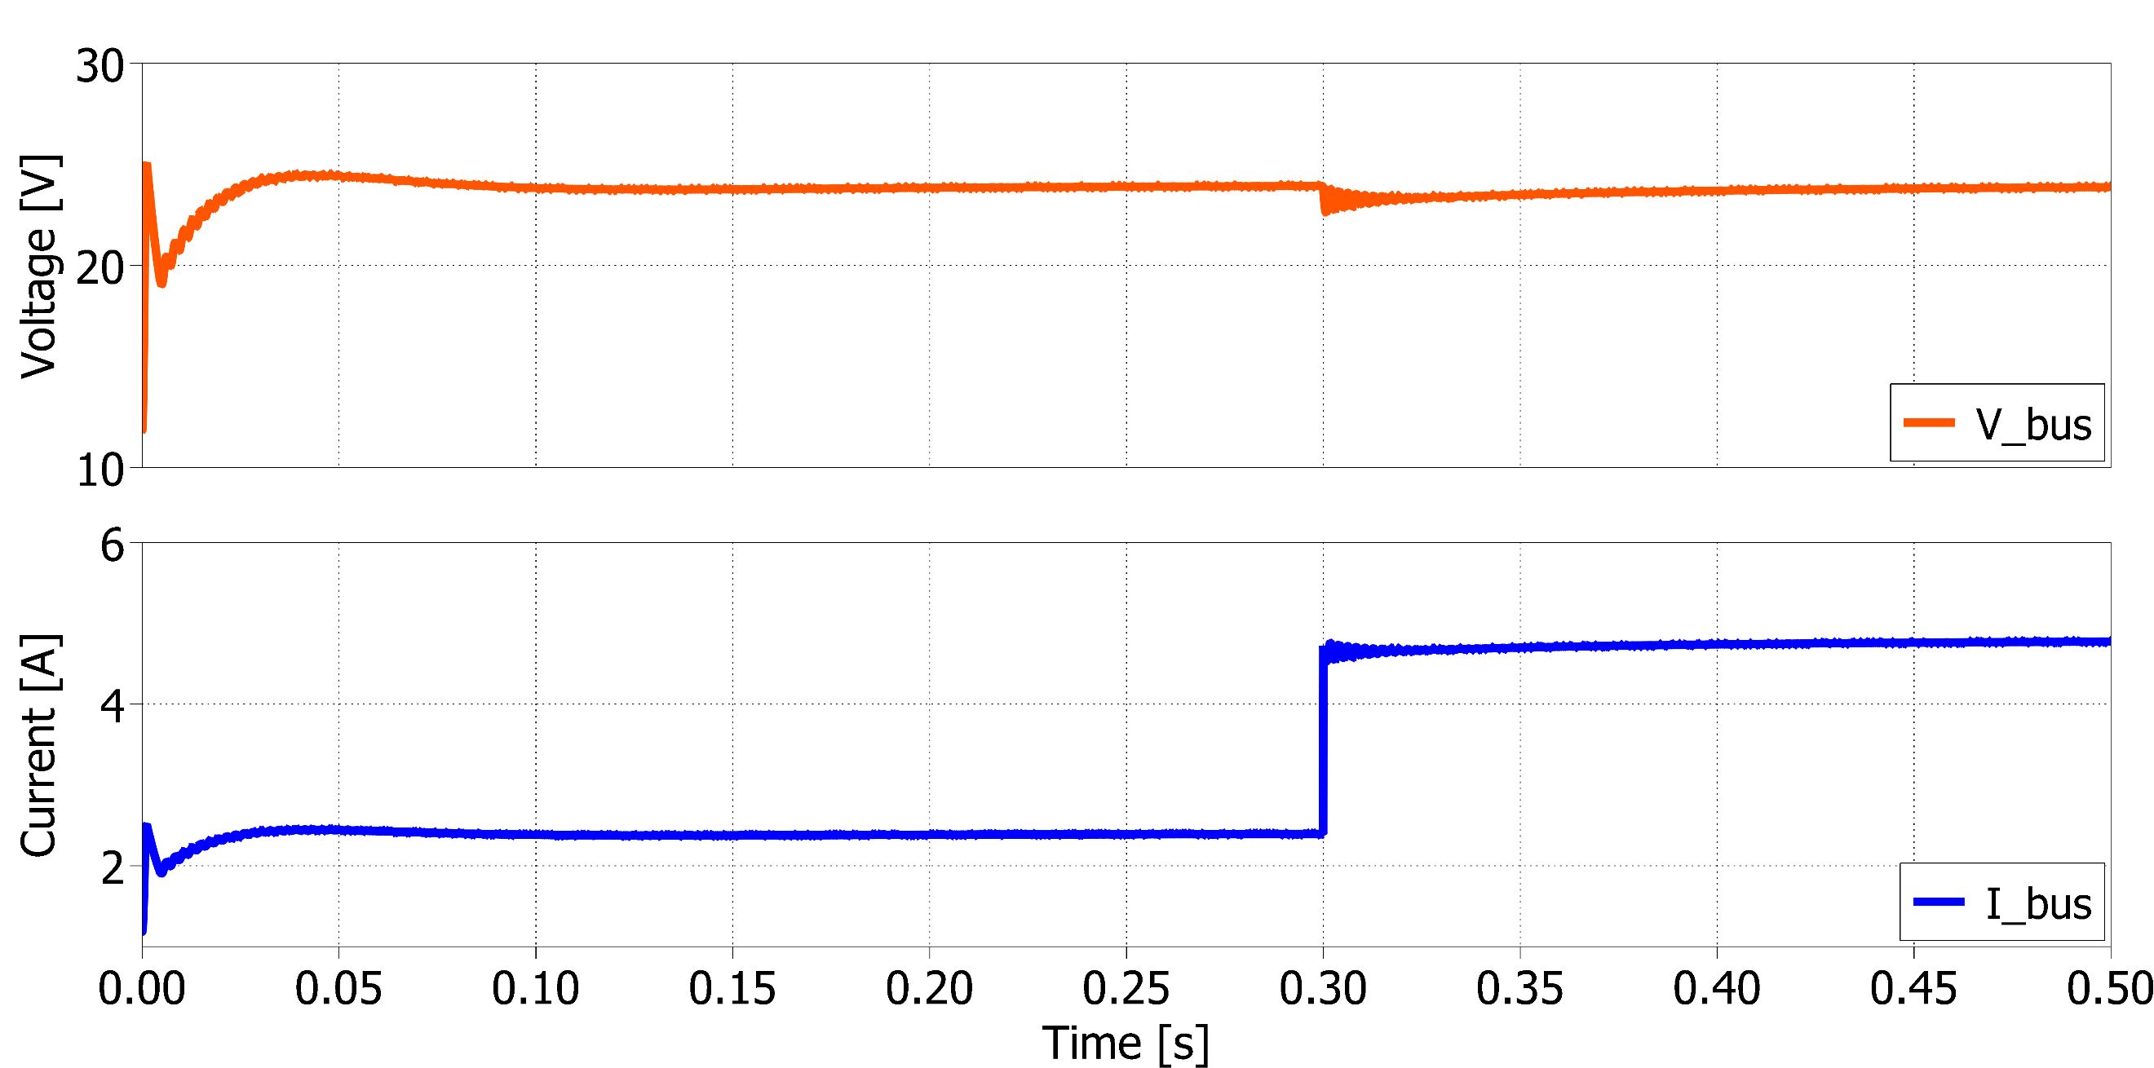
Simulation Results
Combined Consensus-Droop Control Simulation with PLECS
DC Bus :
Connection of DGs
TABLE I. PARAMETER INFORMATION
Parameters | Value
Line Resistors
DC source of DG1, DG2, DG3
Desired Voltage
Resistor of Load 1
Resistor of Load 2
Fig. 11. Voltage and Current output at the DC bus during the system startup.
Fig. 12. Voltage and Current output at the DC bus during the load change period.
ISEE 2023
Flexible Consensus Mechanism for Current Allocation in DC Microgrid

Slide 23
Simulation Results
Combined Consensus-Droop Control Simulation with PLECS
Fig. 11. Voltage and Current output at the DC bus during the system startup.
During the startup process, both the DC bus voltage and current reach a steady state within a short transient period of 0.015 seconds. Notably, there are no oscillations or overshoots observed during the startup, indicating a stable initial state
ISEE 2023
Flexible Consensus Mechanism for Current Allocation in DC Microgrid

Slide 24
Simulation Results
Combined Consensus-Droop Control Simulation with PLECS
Fig. 12. Voltage and Current output at the DC bus during the load change period.
At 0.3 seconds, when Load 2 is connected to the system, there is a slight voltage drop; however, this drop quickly diminishes after 0.05 seconds.
ISEE 2023
Flexible Consensus Mechanism for Current Allocation in DC Microgrid

Slide 25
Simulation Results
Combined Consensus-Droop Control Simulation with PLECS
Based on the results presented in Figs. 11 and 12, it can be concluded that the combination of the consensus algorithm and droop control has effectively maintained the quality of the DC bus voltage and supported the load demand without significant disturbances or deviations
ISEE 2023
Flexible Consensus Mechanism for Current Allocation in DC Microgrid

Slide 26
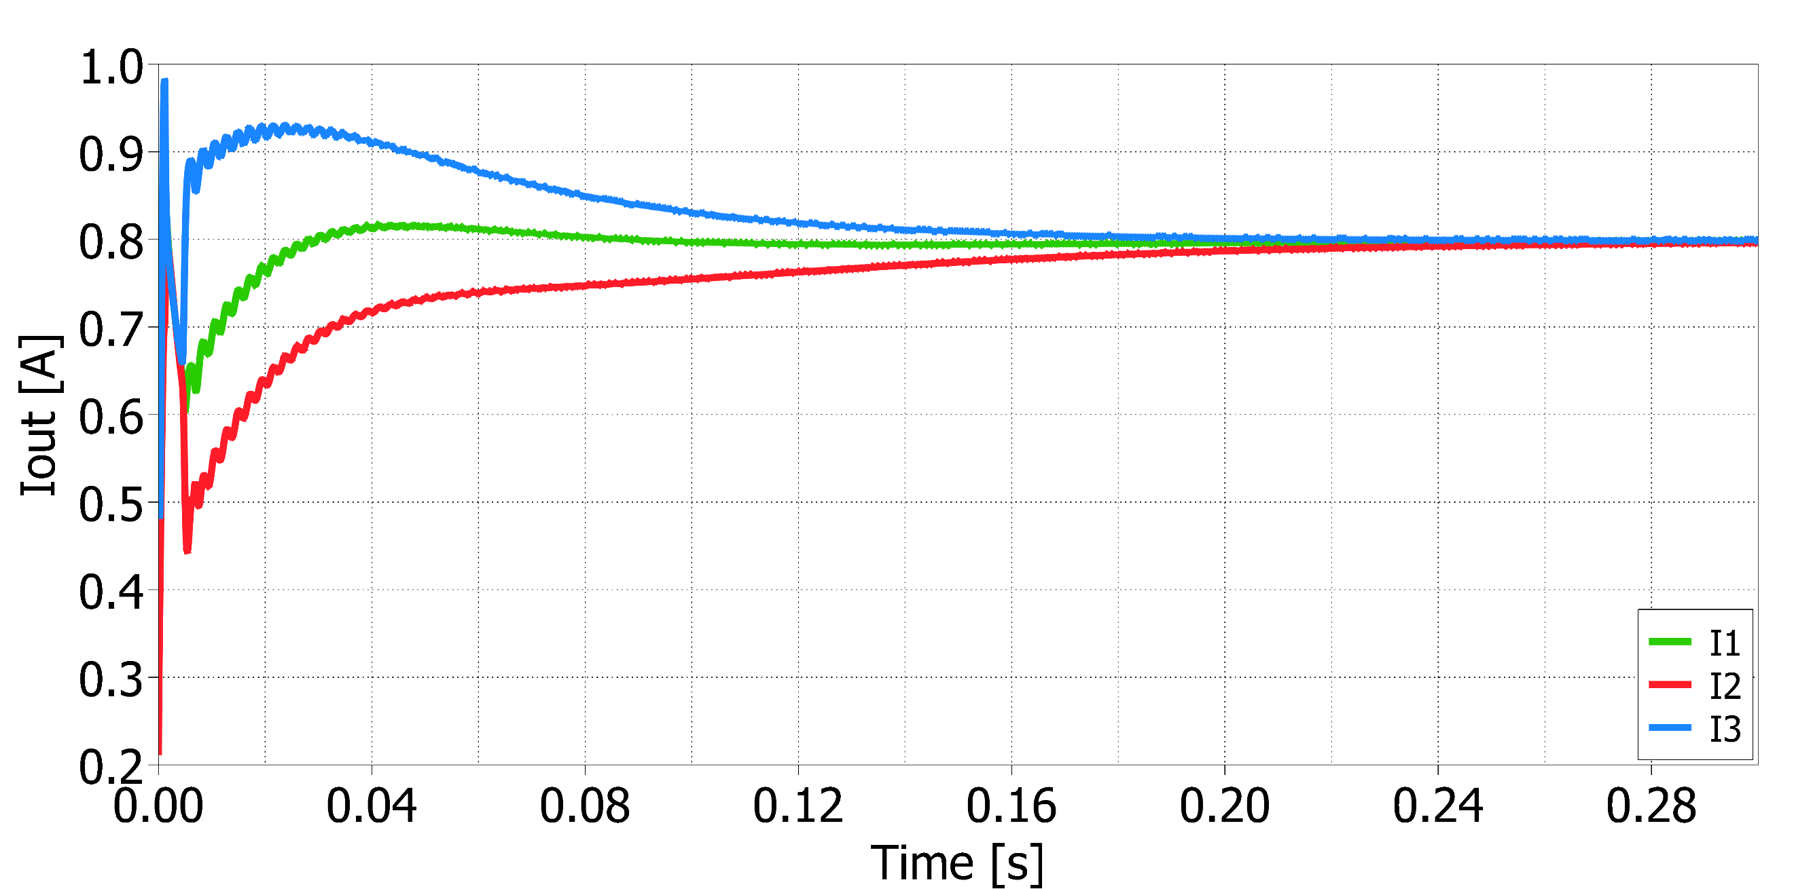
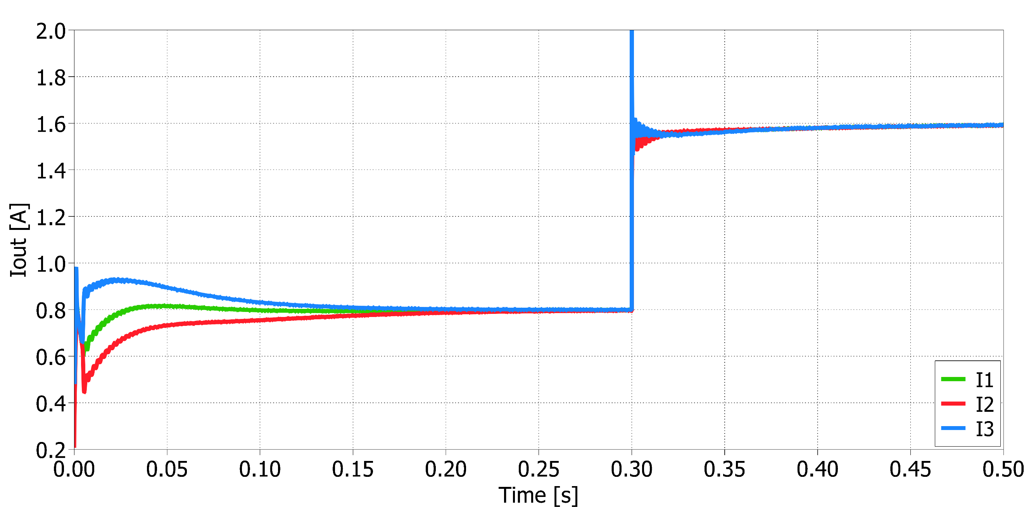
Simulation Results
Combined Consensus-Droop Control Simulation with PLECS
Output Current of DGs :
Connection of DGs
TABLE I. PARAMETER INFORMATION
Parameters | Value
Line Resistors
DC source of DG1, DG2, DG3
Desired Voltage
Resistor of Load 1
Resistor of Load 2
Fig. 13. The waveforms of the output currents during the start-up transient period.
Fig. 14. The waveforms of the output currents during the load change period
ISEE 2023
Flexible Consensus Mechanism for Current Allocation in DC Microgrid

Slide 27
Simulation Results
Combined Consensus-Droop Control Simulation with PLECS
Fig. 13. The waveforms of the output currents during the start-up transient period.
The current sharing mismatch caused by line impedance mismatches has been resolved using the consensus algorithm combined with droop control. All three output currents reach the same established value after approximately 0.25 seconds.
ISEE 2023
Flexible Consensus Mechanism for Current Allocation in DC Microgrid

Slide 28
Simulation Results
Combined Consensus-Droop Control Simulation with PLECS
Fig. 14. The waveforms of the output currents during the load change period
Upon connecting Load 2 to the system at 0.3 seconds, a small current overshoot occurs in the generators to compensate for the load change. Importantly, it should be noted that the overshoot current remains within the maximum allowable current limit of the system, as illustrated in Fig. 14. Subsequently, a minor current sharing mismatch persists after 0.35 seconds.
ISEE 2023
Flexible Consensus Mechanism for Current Allocation in DC Microgrid

Slide 29
Simulation Results
Combined Consensus-Droop Control Simulation with PLECS
Based on the results depicted in Fig. 13 and 14, it is evident that the proposed method effectively mitigates current sharing errors in the microgrid. Furthermore, its performance remains stable even under load condition changes, demonstrating its suitability for maintaining power-sharing accuracy in practical scenarios.
ISEE 2023
Flexible Consensus Mechanism for Current Allocation in DC Microgrid

Slide 30
Conclusions
This paper proposes an improved approach that combines droop control with a consensus algorithm to tackle current sharing mismatches and enhance synchronization among distributed generation units. By integrating these two techniques, we have addressed the single point of failure issue often encountered in conventional methods.
The consensus algorithm plays a crucial role in achieving convergence of the control variables, even in the presence of diverse communication network configurations. Through simulations conducted under various scenarios, the effectiveness of the z-domain discrete-time consensus algorithm has been demonstrated.
This combined method offers a promising solution for improving power-sharing accuracy and maintaining synchronization in microgrids. Further research and Hardware-in-the-loop implementations will be valuable to validate and extend the effectiveness of this study
ISEE 2023
Flexible Consensus Mechanism for Current Allocation in DC Microgrid

Slide 31
Acknowledgement
We acknowledge Ho Chi Minh City University of Technology (HCMUT), VNU-HCM for supporting this study.
ISEE 2023
Flexible Consensus Mechanism for Current Allocation in DC Microgrid

Slide 32
References
[1] V. K. Garg and S. Sharma, “Overview on Microgrid System,” in 2018 Fifth International Conference on Parallel, Distributed and Grid Computing (PDGC), Solan Himachal Pradesh, India: IEEE, Dec. 2018, pp. 694–699. doi: 10.1109/PDGC.2018.8745849.
[2] S. K. Sahoo, A. K. Sinha, and N. K. Kishore, “Control Techniques in AC, DC, and Hybrid AC–DC Microgrid: A Review,” IEEE J. Emerg. Sel. Top. Power Electron., vol. 6, no. 2, pp. 738–759, Jun. 2018, doi: 10.1109/JESTPE.2017.2786588.
[3] K. M. Bhargavi, N. S. Jayalakshmi, D. N. Gaonkar, A. Shrivastava, and V. K. Jadoun, “A Comprehensive Review on Control Techniques for Power Management of Isolated DC Microgrid System Operation,” IEEE Access, vol. 9, pp. 32196–32228, 2021, doi: 10.1109/ACCESS.2021.3060504.
[4] O. Ouramdane, E. Elbouchikhi, Y. Amirat, and E. Sedgh Gooya, “Optimal Sizing and Energy Management of Microgrids with Vehicle-to-Grid Technology: A Critical Review and Future Trends,” Energies, vol. 14, no. 14, p. 4166, Jul. 2021, doi: 10.3390/en14144166.
[5] J. M. Guerrero, J. C. Vasquez, J. Matas, L. G. De Vicuna, and M. Castilla, “Hierarchical Control of Droop-Controlled AC and DC Microgrids—A General Approach Toward Standardization,” IEEE Trans. Ind. Electron., vol. 58, no. 1, pp. 158–172, Jan. 2011, doi: 10.1109/TIE.2010.2066534.
[6] Y. Huang and C. K. Tse, “Circuit Theoretic Classification of Parallel Connected DC&ndash;DC Converters,” IEEE Trans. Circuits Syst. Regul. Pap., vol. 54, no. 5, pp. 1099–1108, May 2007, doi: 10.1109/TCSI.2007.890631.
[7] Shiguo Luo, Zhihong Ye, Ray-Lee Lin, and F. C. Lee, “A classification and evaluation of paralleling methods for power supply modules,” in 30th Annual IEEE Power Electronics Specialists Conference. Record. (Cat. No.99CH36321), Charleston, SC, USA: IEEE, 1999, pp. 901–908. doi: 10.1109/PESC.1999.785618.
[8] J. C. Vasquez and J. M. Guerrero, “Modeling, Analysis, and Design of Stationary Reference Frame Droop Controlled Parallel Three- Phase Voltage Source Inverters,” 2011.
[9] R. Majumder, B. Chaudhuri, A. Ghosh, R. Majumder, G. Ledwich, and F. Zare, “Improvement of Stability and Load Sharing in an Autonomous Microgrid Using Supplementary Droop Control Loop,” IEEE Trans. Power Syst., vol. 25, no. 2, pp. 796–808, May 2010, doi: 10.1109/TPWRS.2009.2032049.
[10] R. Olfati-Saber and R. M. Murray, “Consensus Problems in Networks of Agents With Switching Topology and Time-Delays,” IEEE Trans. Autom. Control, vol. 49, no. 9, pp. 1520–1533, Sep. 2004, doi: 10.1109/TAC.2004.834113.
[11] N. Yang, B. Nahid-Mobarakeh, F. Gao, D. Paire, A. Miraoui, and W. Liu, “Modeling and stability analysis of multi-time scale DC microgrid,” Electr. Power Syst. Res., vol. 140, pp. 906–916, Nov. 2016, doi: 10.1016/j.epsr.2016.04.014.
ISEE 2023
Flexible Consensus Mechanism for Current Allocation in DC Microgrid

