Slide 1
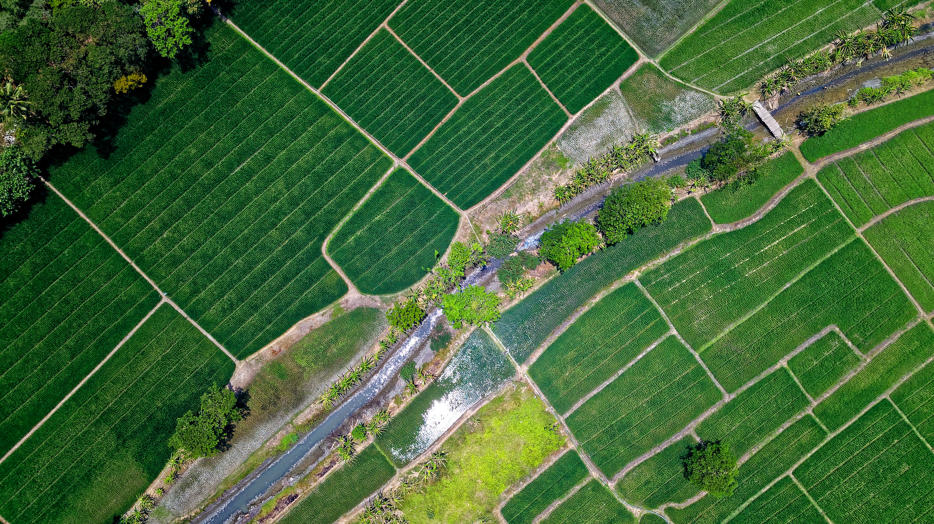

Modelling the Impact of Climate Change on Soil Moisture and UK’s Future Agriculture
Project 2
27 February 2025
Group 2: Cameron Meekums-Spence, Huabin Ye, Tania Diamanta

Slide 2

Agenda
1
Project Background
2
Project Scope
3
Methodology
4
The Datasets
5
Data Preprocessing
6
Exploratory Data Analysis
7
Model Development
8
Key Findings
9
Further Research

Slide 3




Project Background
This project focuses on understanding near-surface air temperature (TREFHT) trends in the UK using ensemble climate model simulations from 2006 to 2080. The analysis is based on six NetCDF datasets generated by the same climate model under slightly varied conditions (ensembles).
IPCC states that global temperatures could increase by up to 4.8°C by the end of the century, substantially raising the risk of severe climate-related impacts.
This study leverages 6 datasets containing 3 dimensional data across the UK, including variables such as TREFHT amongst several others.
ERA5 data on topsoil temperature and moisture was also used across the same coordinates and merged to analyse the impact on agriculture.
1

Slide 4

Agenda
1
Project Background
2
Project Scope
3
Methodology
4
The Datasets
5
Data Preprocessing
6
Exploratory Data Analysis
7
Model Development
8
Key Findings
9
Further Research

Slide 5

Project Scope
(1) Analyse Trend & Patterns of TREFHT
Combine the six given datasets and analyse seasonal, long-term and regional trends of TREFHT over time. TREFHT was chose over TREFMAX_U due to its cover of rural regions, and therefore relevance to agriculture.
Average daily temperature (TREFHT)
(2) Analyse Trend & Patterns of Topsoil
Analyse soil temperature at layer 1 (stl1) and volumetric soil water at layer 1 (swvl1) due to their strong influence on biological processes such as seed germination, availability of nutrients, root development and several others.
Soil Temperature at Layer 1
(stl1)
Volumetric Soil Moistre at Layer 1
(swv1)
(3) What Is The Long-Term Effect?
Long Term Effect
Build a model to analyse the long-term effect of temperature on topsoil and its potential impacts on the agriculture industry.
5
Notes:
In this section, we will talk through the approach in selecting the top four European markets for expansion. Our goal was to ensure that only countries with strong legal frameworks and viable market conditions were prioritised and considered for further analysis.
We started with an initial selection of the 10 European countries provided by the Papilo team —Austria, Belgium, France, Germany, Hungary, Italy, the Netherlands, Poland, and Spain. Our evaluation process was based on two key factors: Regulatory Analysis and Market Opportunities.
Regulatory analysis included aspects like environmental compliance, taxation, operational requirements, and political stability. Meanwhile, market viability assessed factors such as market size, cultural readiness, workforce availability, and competitive intensity. Data for these metrics were collected from Eurostat, the World Bank, and the European Environmental Agency.
By applying equal weight to both regulatory strength and market potential, we systematically ranked these countries to identify the top four that offer the best conditions for expansion.

Slide 6

Agenda
1
Project Background
2
Project Scope
3
Methodology
4
The Datasets
5
Data Preprocessing
6
Exploratory Data Analysis
7
Model Development
8
Key Findings
9
Further Research

Slide 7

Project Methodology and Delivery
The project follows a 6-phase methodology comprehensively evaluating datasets to build accurate predictive model
Project Phase
Activity Overview
Deliverable
Combine Provided Datasets
Take the average of each variable value across 6 datasets to reduce variability and enhance robustnes
Merged dataset
Data Preprocessing
Check data type, missing values, duplicates, variable units, incorrect values
Preprocessed merged dataset
Gather External Dataset + Preprocessing + Merge
Gather ERA5 data on soil metrics, preprocess, align timestamps and coordinates before merging.
Enriched dataset
Examine pattern in target variable (TREFHT), how it correlates with other variables, stl1 and swvl1.
Trends and key factors affecting target variable
Exploratory Data Analysis
Divide the dataset into training period (2006-2014) and testing period (2015-2080). Two models will be explored: XGBoost and Prophet.
Best predictive model with the highest accuracy
Build Predictive Models
The results will be used to analyse the effect of rising temperatures on agriculture. How will farming conditions look in 2080?
Draw Conclusion
Key findings and future recommendations
3
Notes:
The following is the overview of the project scope and deliverables.
In the next few slides our team will focus on each phase's activities and data collection methodology in detail.
Phase 1:
10 Markets namely Austria, Belgium, France, Germany, Hungary, Italy, The Netherlands, Poland, Spain, and Switzerland (henceforth refer to as ‘the Ten Markets)
From Phase 2 onwards:
(Explain what we'll be doing for Phase 2 and 4)
We will focus on the top few countries based on our analysis on Phase 1, as well as according to your inputs on which markets you are the most keen on entering based on existing resources and client base.
Based on the meetings the team had with Papilo, we understand that the 4 you would like to focus on are: Netherlands, Germany, France and Belgium
At this point we just want to confirm with the team - would you like us to focus on these 4 countries with primary research and go to market plans? Or would you like us to determine the countries based on our secondary research analysis in Phase 1?

Slide 8

Agenda
1
Project Background
2
Project Scope
3
Methodology
4
The Datasets
5
Data Preprocessing
6
Exploratory Data Analysis
7
Model Development
8
Key Findings
9
Further Research

Slide 9
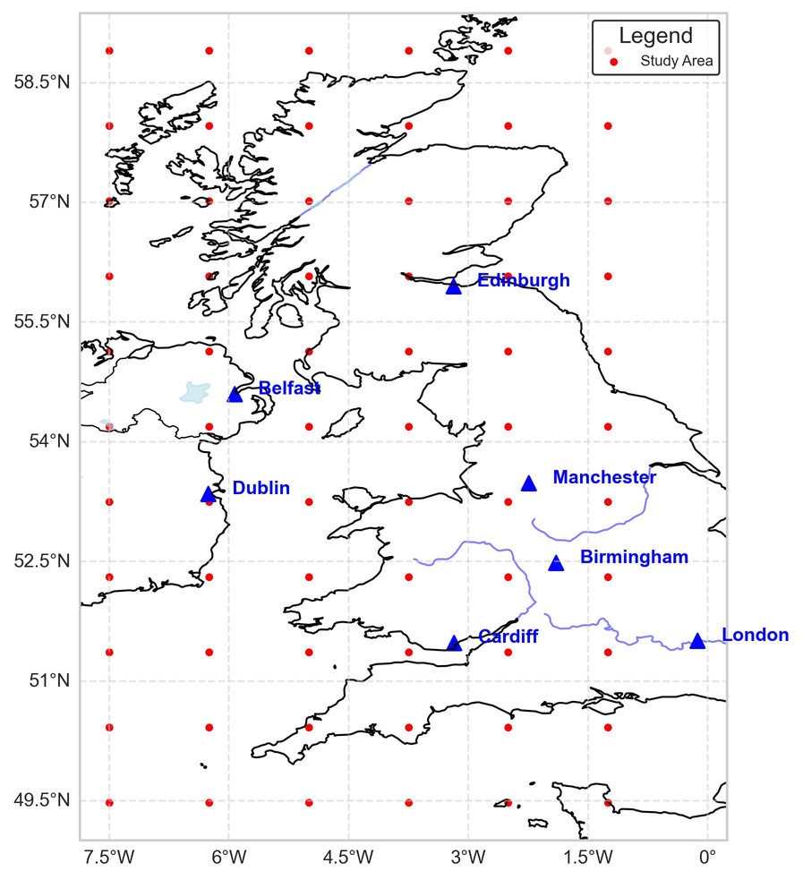
The Provided Datasets:
Climate Data from Year 2006 - 2080
003_2006_2080_352_360.nc
6 Datasets with the same Spatial and Temporal Coverage
004_2006_2080_352_360.nc
66 locations across UK (6 lon x 11 lat)
27,374 days (2 January 2006 - 12 December 2080)
9 variables: TREFHT, TREFMAX_U, FSNS, FLNS, PRECT, PRSN, QBOT, UBOT, VBOT (same as project 1)
005_2006_2080_352_360.nc
006_2006_2080_352_360.nc
007_2006_2080_352_360.nc
008_2006_2080_352_360.nc
What’s different?
Slightly different values
Which means:
Ensemble/multiple runs of the same simulation
1

Slide 10

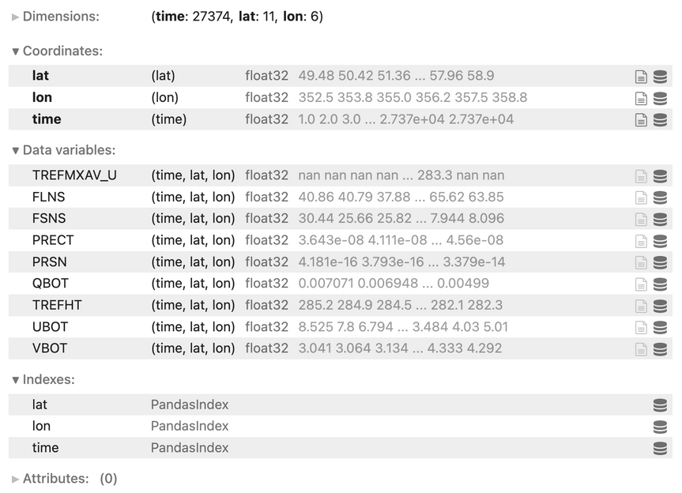
The Provided Datasets:
Climate Data from Year 2006 - 2080
003_2006_2080_352_360.nc
004_2006_2080_352_360.nc
Merged Dataset
(averaged)
005_2006_2080_352_360.nc
006_2006_2080_352_360.nc
007_2006_2080_352_360.nc
008_2006_2080_352_360.nc
Merge the Datasets: Take the Average
Reduce random variability
Enhance robustness
Improve comparisons with external datasets which normally use multi-model ensembles (averaging across models)
1

Slide 11

The External Dataset
One dataset containing:
Time
Latitude
Longitude
2-metre air temperature (t2m)
Soil temperature at layer 1 (stl1)
Volumetric Soil Water at layer 1 (swvl1)
6,940 timetamps
39 latitudal coordinates
26 longitudal coordinates
Time ranging from 01/01/06 to 31/12/24
Latitude ranging from 49.4 to 58.9
Longitude ranging from -7.5 to -1.25
1

Slide 12

Agenda
1
Project Background
2
Project Scope
3
Methodology
4
The Datasets
5
Data Preprocessing
6
Exploratory Data Analysis
7
Model Development
8
Key Findings
9
Further Research

Slide 13
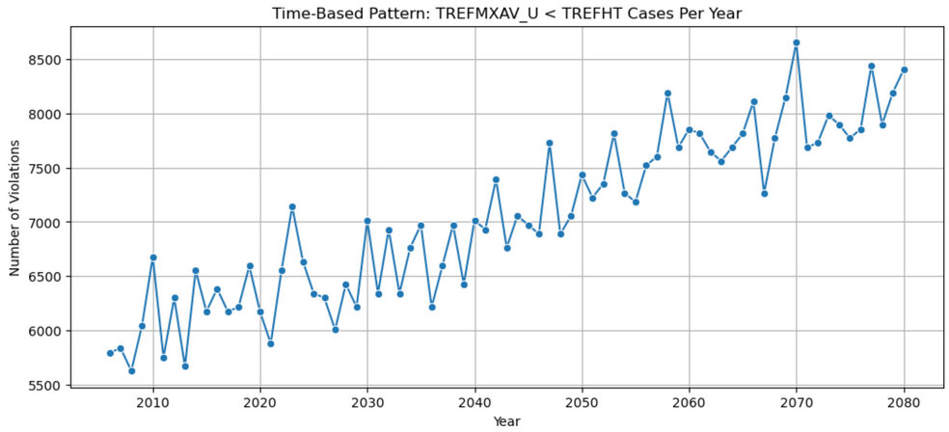
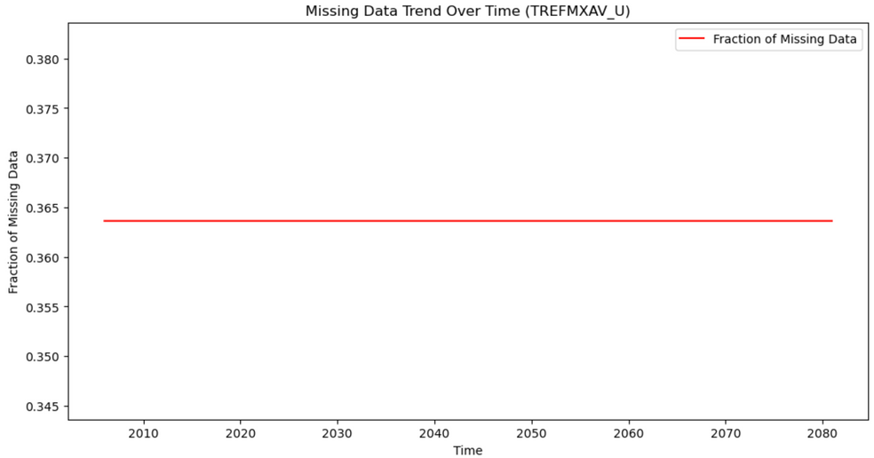
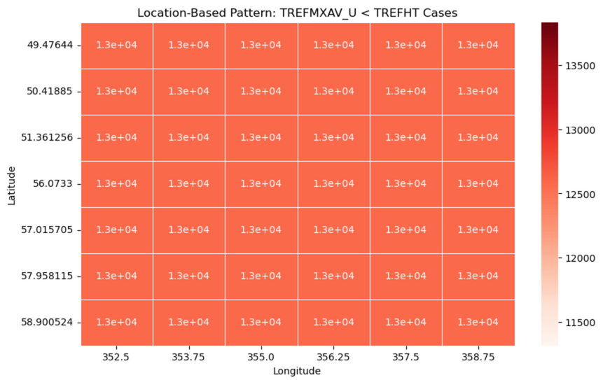
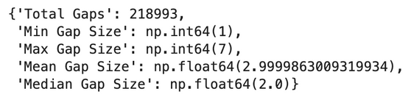
Data Preprocessing of the Provided Datasets
5 steps taken to ensure dataset is ready for further modelling
1
Correct Datatype
5
Fix Incorrect Values
“Time” from float32 to datetime
4
Adjust Units
Replace 45,477 negative values in PRSN with 0
Handle 196,499 cases where TREFMAX_U is lower than TREFHT
Check distribution of error (against time and location)
Duplicates
TREFHT and TREFMAX_U from Kelvin to Celcius
2
No duplicated values found
3
Missing Values
656,976 missing values in TREFMAX_U (36.4%)
Check spread of MVs
Cases where TREFMAX_U < TREFHT occur consistently over time with a slight increasing trend
Also distributed evenly across locations
Systemic error
Check gaps between MVs
% MVs remains constant overtime (randomly distributed).
Gap size is relatively small (2-3 steps missing at a time)
Use forward fill to impute MVs
Divide errors into 2:
Small error (0 to 1°C) --> setting TREFMAX_U = TREFHT + 0.1°C
Large error (> 1°C) --> median-based correction with scaling

Slide 14
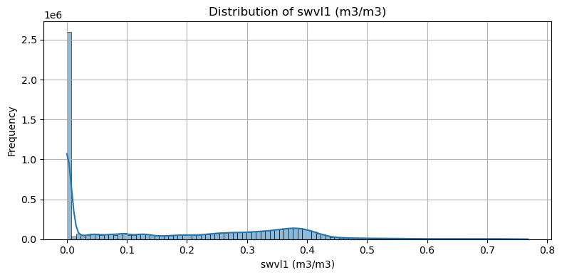
Data Preprocessing of the External Datasets
Align the component and naming of coordinates (time, lat, lon)
Set time to index
Check for missing values and duplicates
Convert temperature from Kelvin to Celsius
Check negative values
Negative values in swvl1 skewed the distribution of the data and needed to be investigated further as negative values are invalid.
Negative values imputed with the median as it is robust to skewness and outliers unlike the mean.
1

Slide 15

Agenda
1
Project Background
2
Project Scope
3
Methodology
4
The Datasets
5
Data Preprocessing
6
Exploratory Data Analysis
7
Model Development
8
Key Findings
9
Further Research

Slide 16
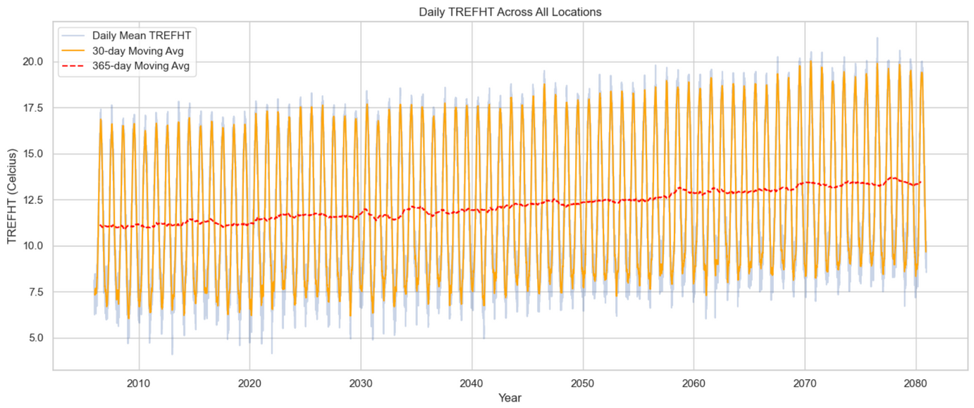
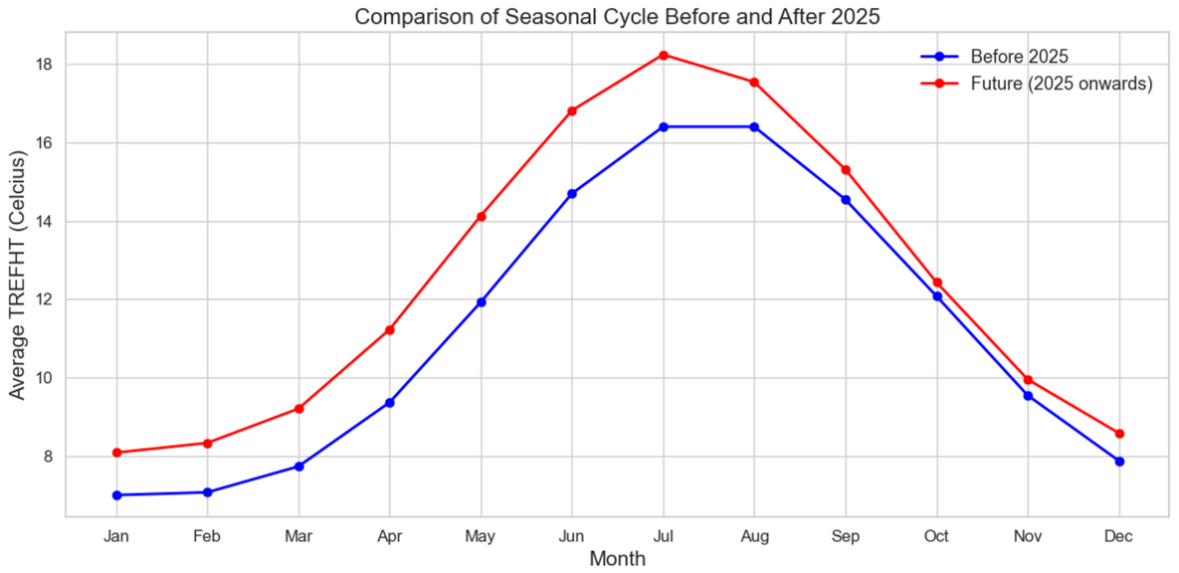
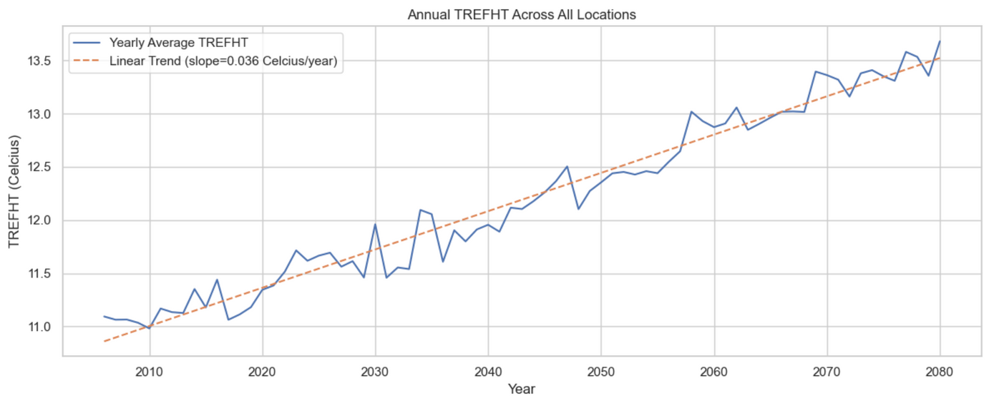
Temporal Analysis of TREFHT
A visual summary of long-term temperature trends, seasonal cycles, and projected climate changes using TREFHT data
1
3
Key Takeaways
2
(1) The consistent annual cycle and rising long-term trend suggest climate change impacts. Seasonal extremes (peaks and throughs) also appear to grow over time (summer vs winter temperature gap becomes larger).
(2) Annual mean TREFHT with a linear trend line, reinforcing the overall warming despite natural yearly fluctuations.
(3) The red line shows consistently higher temperatures than the blue, confirming a warming temp in the future. Seasonal extremes grow more pronounced, with future summers ~12.5% hotter and milder winters. Sharper transitions suggest shorter spring and autumn periods.

Slide 17
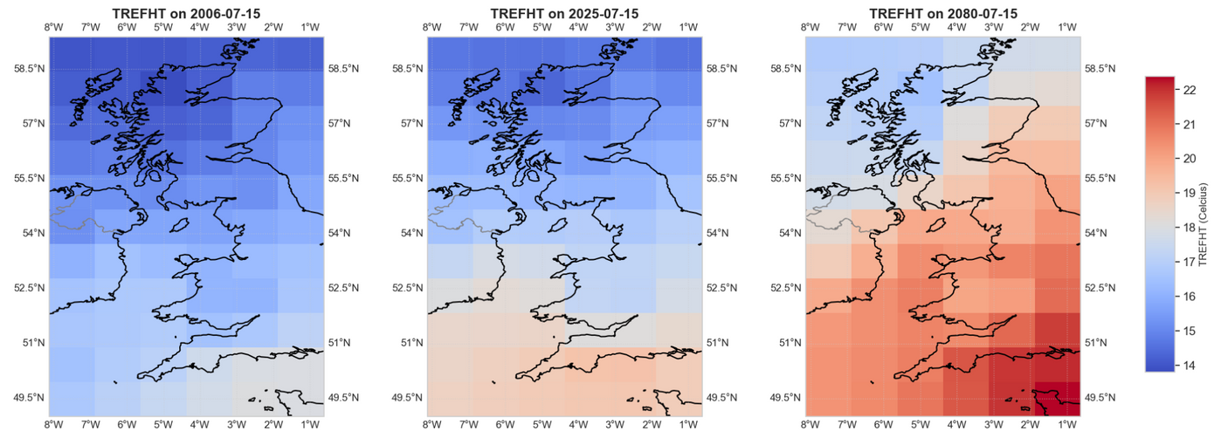
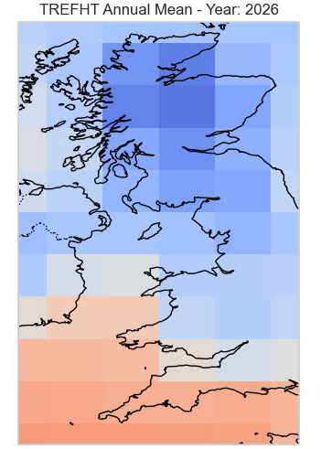
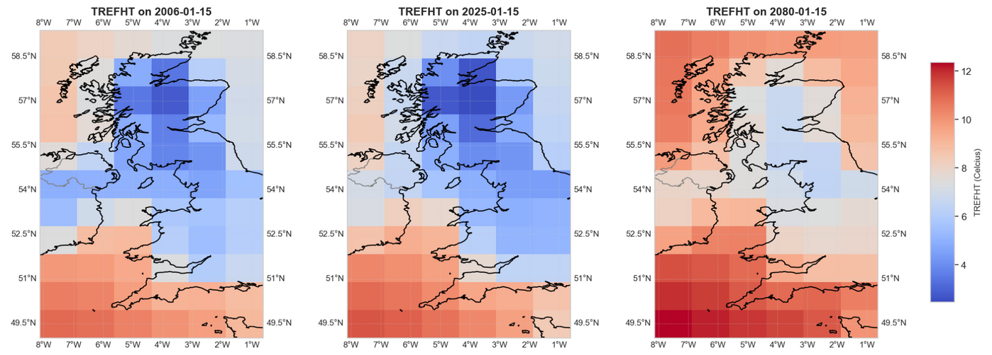
Spatiotemporal Analysis of TREFHT
A visual overview of how near-surface air temperature (TREFHT) changes across space and time in the UK.
1
2
Key Takeaways
(1) Temperatures in the UK on 15 July (peak summer) across 2006, 2025, and 2080, with a clear warming trend—especially in southern England, where temperatures exceed 22°C by 2080.
(2) Temperatures across UK on 15 January (peak winter) from 2006 to 2080, with much of England exceeding 10°C by 2080—indicating a clear warming trend and milder winters.

Slide 18
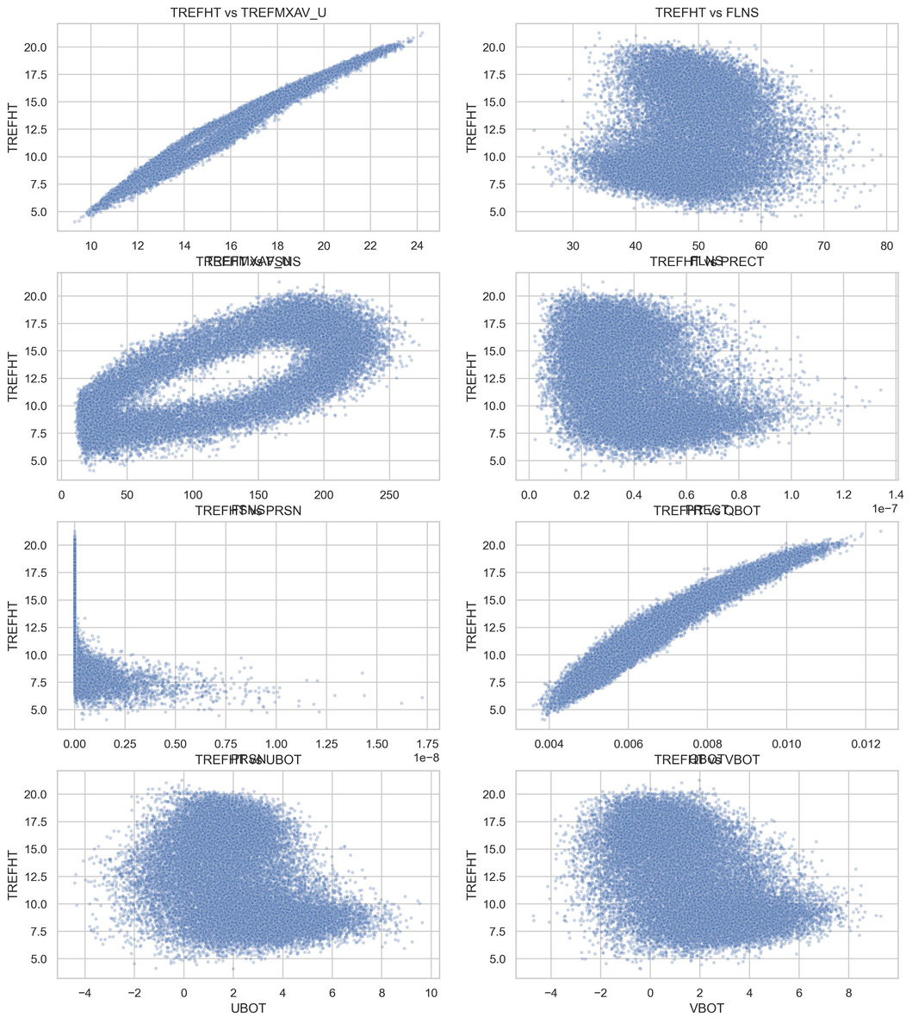
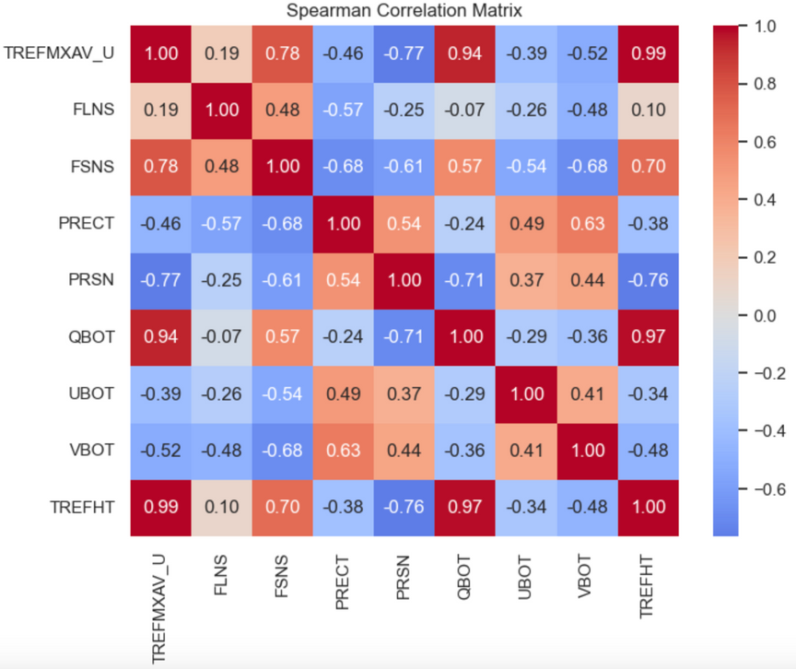
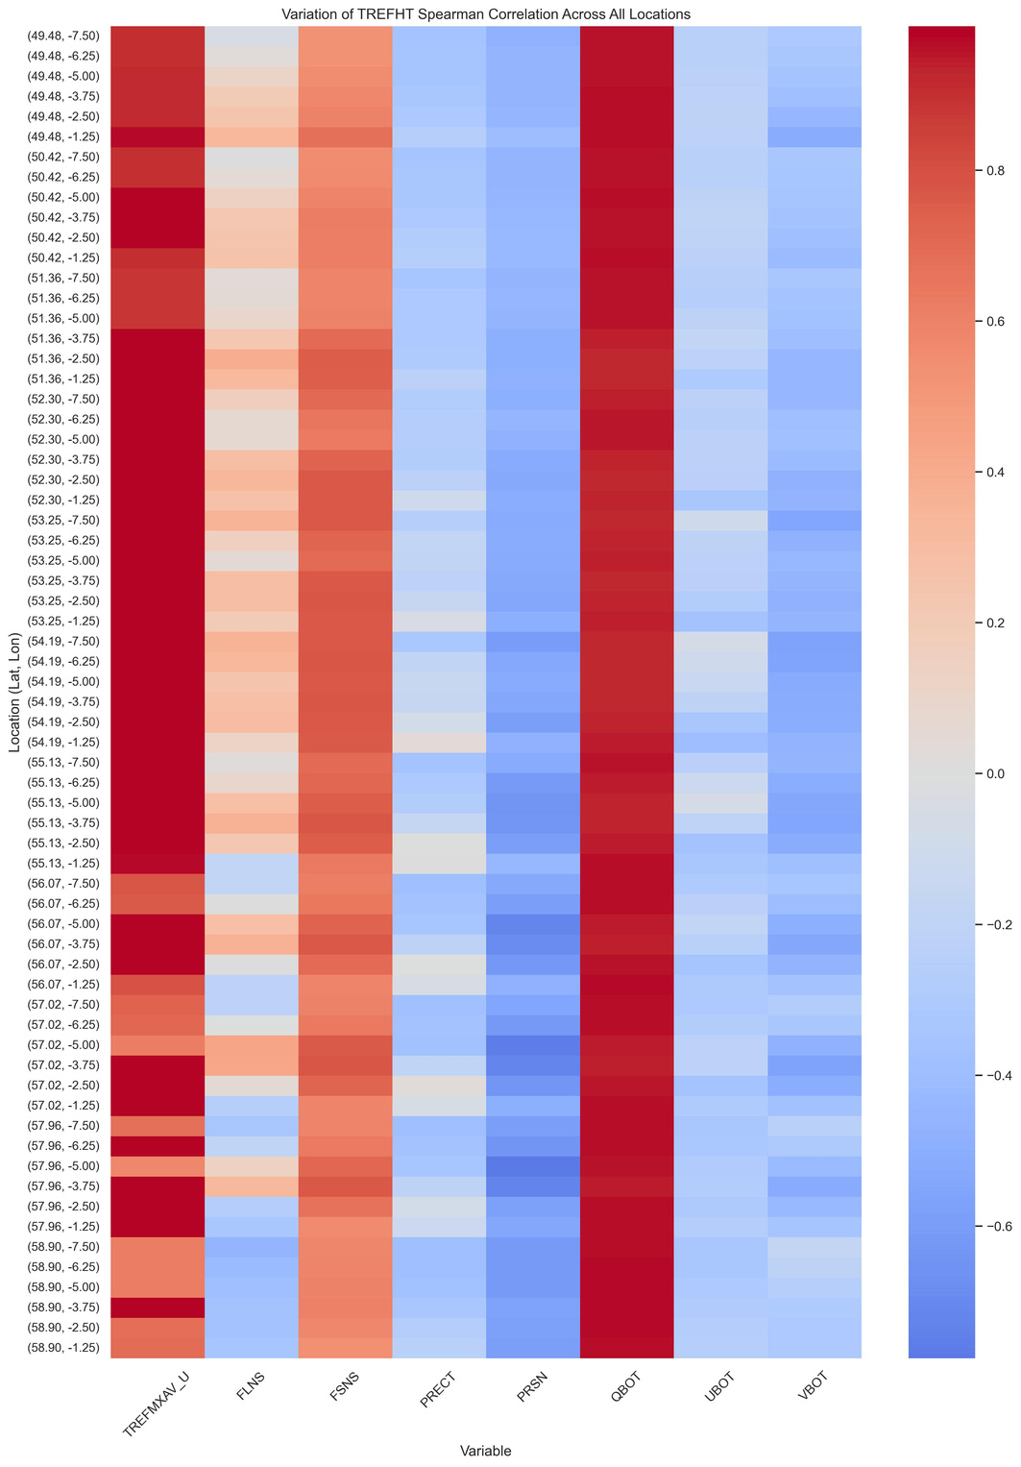
Understanding TREFHT Drivers: Correlation and Relationship Patterns
This slide explores how TREFHT relates to key climate variables, highlighting both overall correlations and regional variations across the UK.
1
2
3
Key Takeaways
(1) TREFHT Shows Mixed Linear and Nonlinear Relationships with Predictors
(2) QBOT/humidity (ρ = 0.97), PRSN/snowfall rate (ρ = -0.76), and FSNS/solar flux (ρ = 0.70) have the strongest correlation with TREFHT
(3) Compare spearman correlation matrix across all locations to see if the key factors are consistent: QBOT, FSNS, and PRSN consistently correlate strongly with TREFHT across locations, while FLNS and wind variables vary more by region. This suggests core drivers are stable, but some effects are location-dependent.

Slide 19
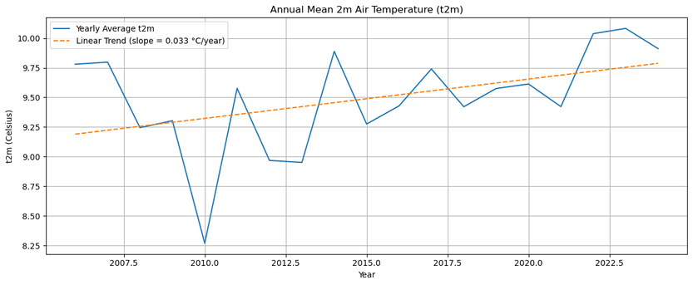
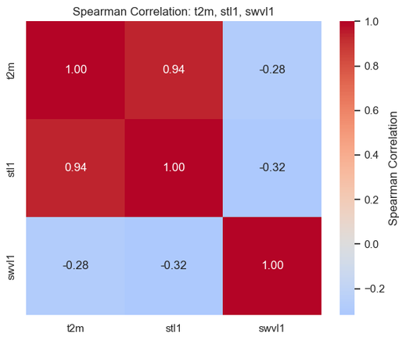
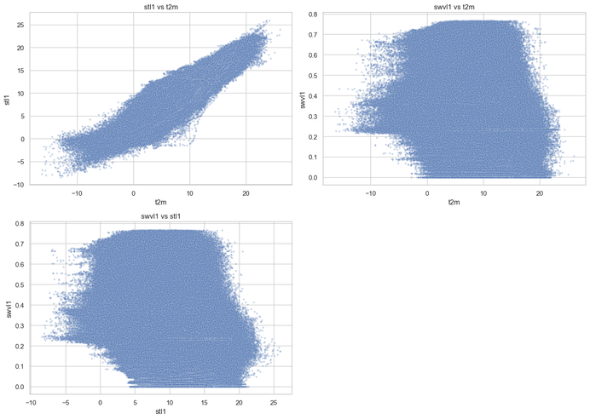
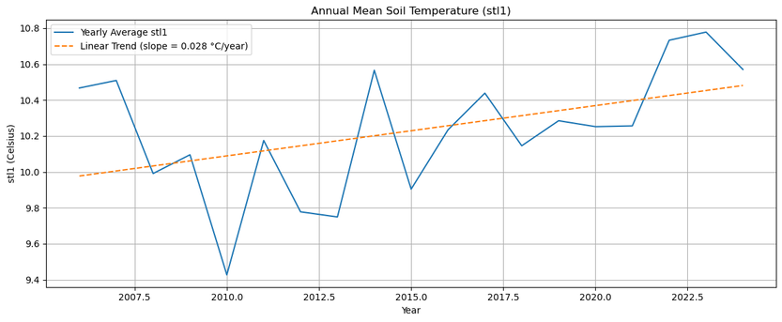
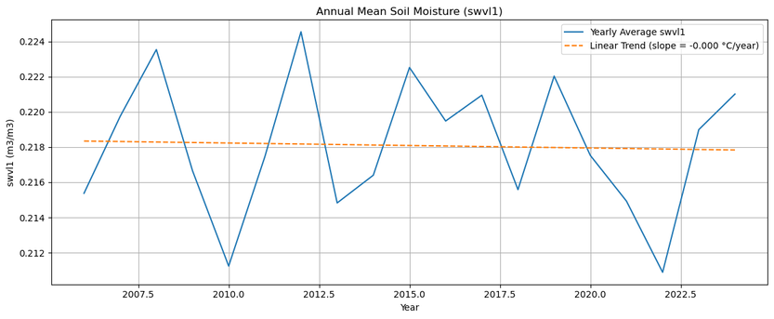
Understanding Topsoil Temperature & Moisture: Correlations & Trends
Annual mean soil and air temperature show simiar trends over time with a steady increase between 2006-2024 at a similar rate (approx. 0.03 Celsius/year).
These two variables show a strong positive correlation
As temperatures have risen, soil moisture has slowly decreased, showing a weak-to-moderate negative correlation with both temperature variables
Soil moisture trending towards 0.2 m³/m³ which would be where plants begin to experience water stress, especially during dry periods
Should water moisture drop below 0.1, the soil will become very dry, posing serious risks such as drought and crop failure
1

Slide 20

Agenda
1
Project Background
2
Project Scope
3
Methodology
4
The Datasets
5
Data Preprocessing
6
Exploratory Data Analysis
7
Model Development
8
Key Findings
9
Further Research

Slide 21

Modelling Future Soil Moisture under Climate Change
A Two-Stage Framework Combining Time Series Forecasting and Machine Learning
Stage 1
Variables
Methodology
Target: TREFHT
Predictor: FSNS, FLNS, PRECT, PRSN, QBOT, UBOT, and VBOT
Three modelling strategies were explored for temperature forecasting:
(1) Prophet – applied to the average TREFHT across all spatial locations
(2) XGBoost – using the average TREFHT values across locations
(3) XGBoost with XESMF interpolation – preserving the spatial component to enable location-specific predictions
Each model was evaluated using cross-validation to improve generalisation and ensure robust performance.
Output
CEMS Datasets (2006-2080)
Projected TREFHT 2025-2080
Use this projection to validate the synthesis TREFHT data in the given dataset, choose the projection with the lowest error, then use it as input for the second modelling stage.
Train vs Test
Train: 2006-2024
Test: 2025-2080
Stage 2
Variables
Projected TREFHT from stage 1
Target: swvl1 (soil moisture)
Predictor: t2m (temperature)
Output
Methodology
An XGBoost regression model was trained to predict future soil moisture levels. This approach allowed us to examine how projected temperature increases may influence surface soil moisture, which is critical for agricultural productivity and land surface processes.
Projected soil moisture 2025-2080
Compare this projection with the soil moisture standard from Food and Agriculture Organization (FAO) to see how rising temperature impacts future crop yields
Train vs Test
ERA 5 Soil Dataset
Train: 2006-2024
Test: 2025-2080

Slide 22
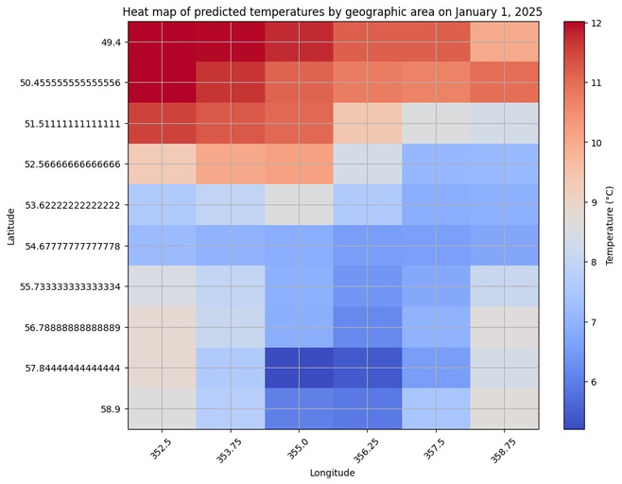
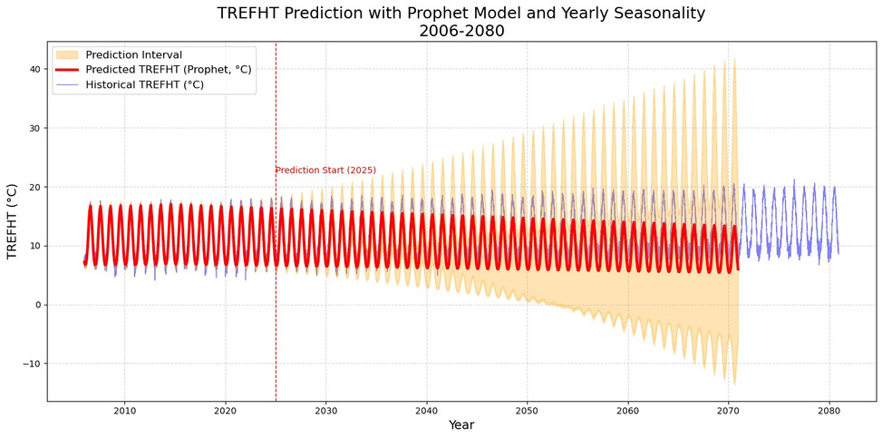
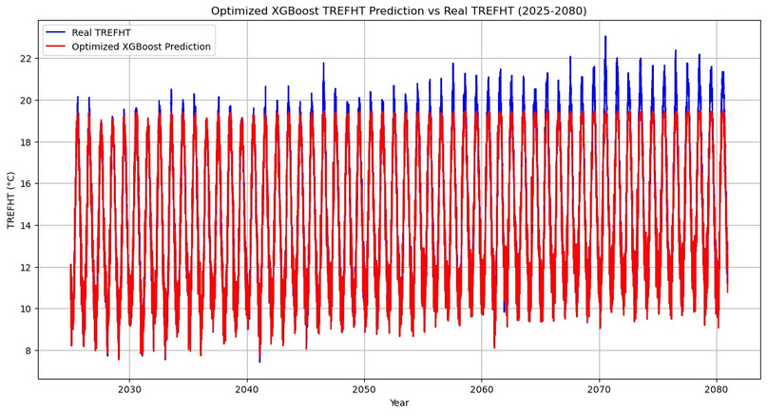
Forecasting Temperature with 3 models
Modelling Long-Term Trends in Near-Surface Air Temperature (TREFHT)
Prophet Forecast
Forecasted average TREFHT with Prophet model. Shows seasonality but weak long-term warming trend. Prediction uncertainty increases sharply over time.
XGBoost Forecast (per location)
Time series prediction at one grid point (lat 50.42, lon 355.0). Captures seasonal cycles and upward trend more clearly than Prophet.
Heatmap from
XESMF + XGBoost
Spatial distribution of predicted TREFHT on Jan 1, 2025. Shows geographic variability in near-surface temperature across the region.
1

Slide 23
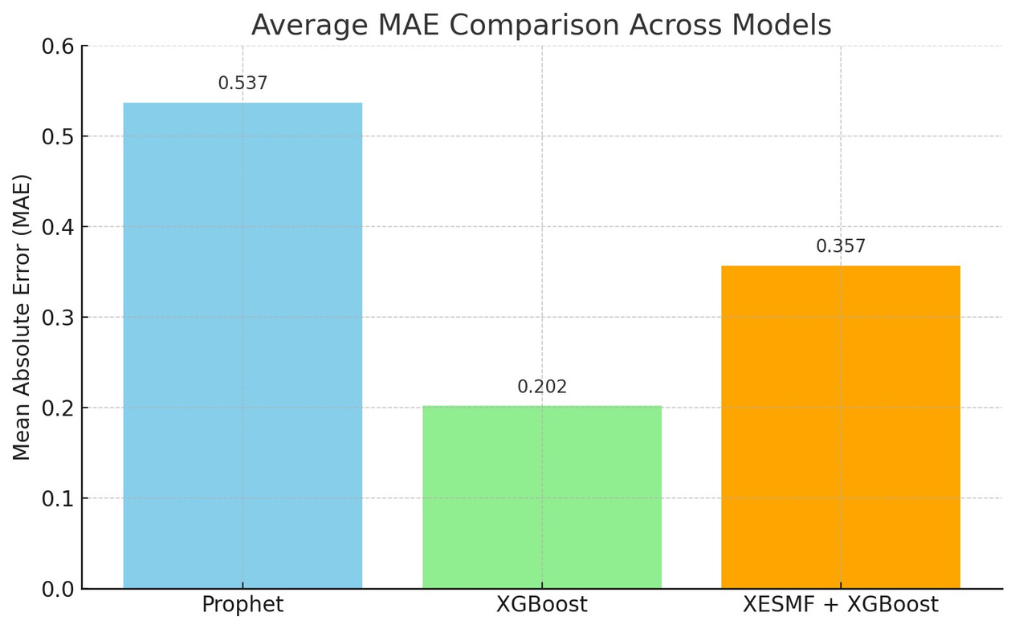
Comparing Different Models
Choosing the Best Model with the Lowest Error
Key Takeaways
Prophet has the highest error, indicating it struggles with capturing long-term trends accurately
XGBoost performs the best with the lowest error, making it well-suited for modeling complex nonlinear patterns.
XESMF + XGBoost falls in between in terms of accuracy, possibly trading off some precision for better spatial consistency.
1

Slide 24
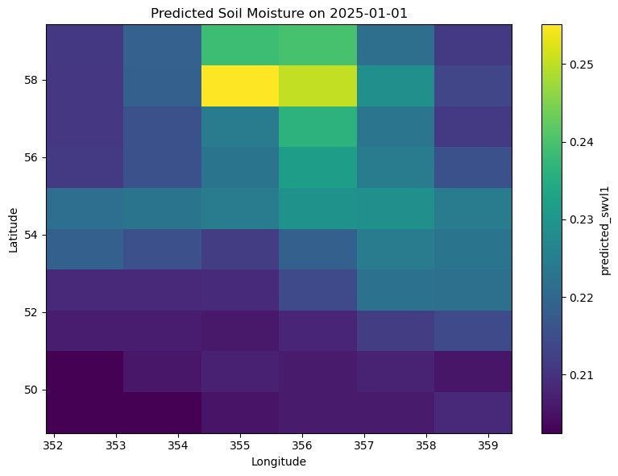
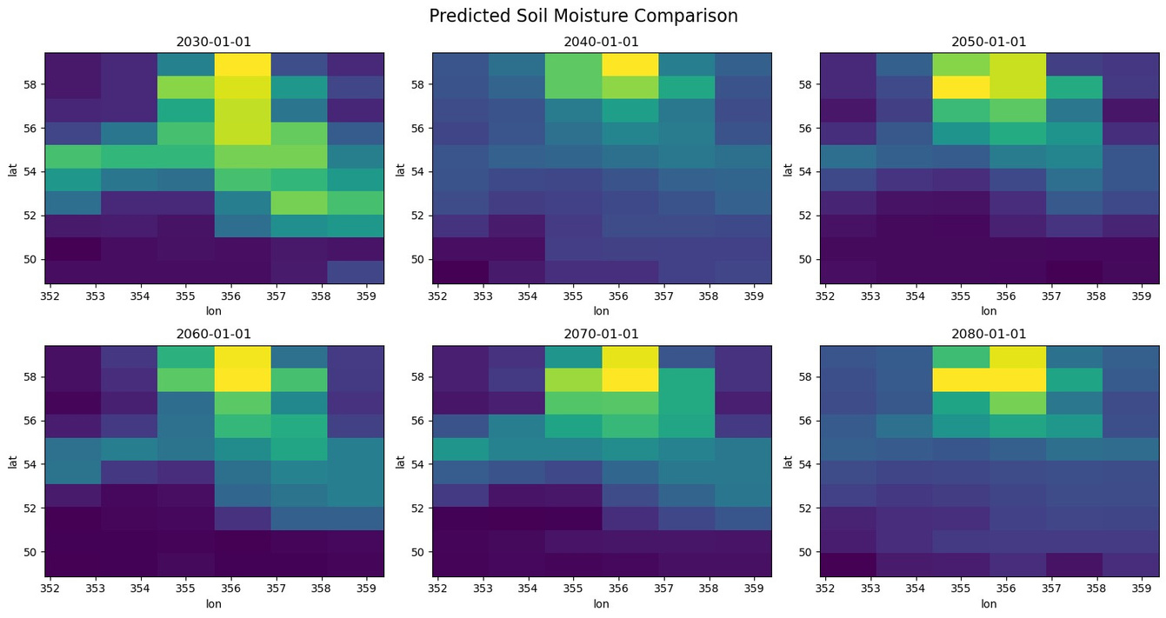
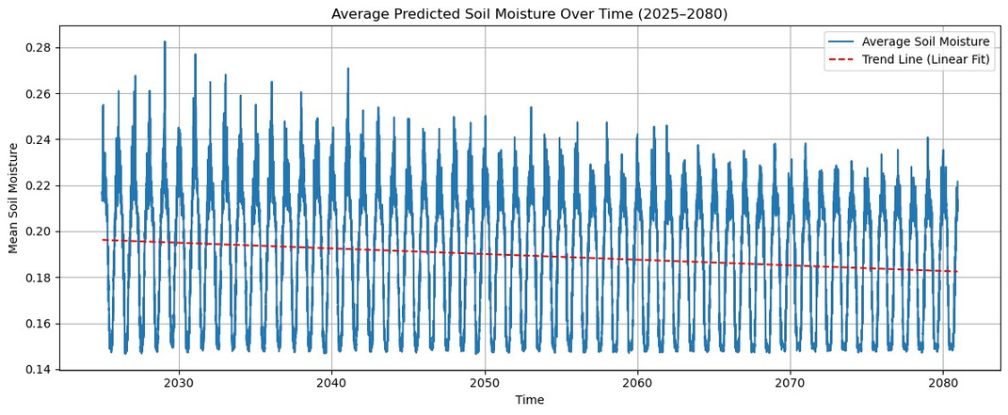
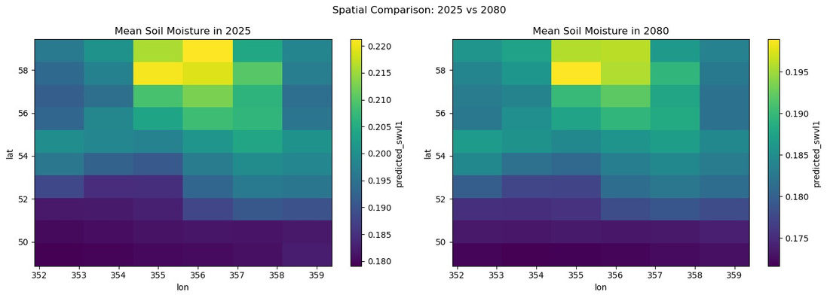
Projection of Soil Moisture 2025-2080
Use the Predicted TREFHT for Soil Moisture Projection
1

Slide 25

Agenda
1
Project Background
2
Project Scope
3
Methodology
4
The Datasets
5
Data Preprocessing
6
Exploratory Data Analysis
7
Model Development
8
Key Findings
9
Further Research

Slide 26

Result Interpretations: Climate Impacts on Soil Moisture and Agriculture
From Rising Temperatures to Drying Soils: Implications for Crop Health and Ecosystem Stability
1
Temperature
TRFHT is projected to rise steadily through 2080 across all areas in the UK
3
Agricultural Impact
Soil Moisture Benchmarks (FAO):
🌱 0.3–0.4 m³/m³ → Field capacity (ideal for crops, balanced water cycle)
🌤 0.2 m³/m³ → Below field capacity (risk of water stress)
🔻 0.1 m³/m³ → Approaching wilting point (plants can’t extract water)
🛑 0.1 m³/m³ → Severe drought stress, crop failure, and land degradation
Agricultural & Environmental Impact
⚠️ Crop yields may decline, increasing irrigation demands.
💧 Reduced groundwater recharge and potential hydrological imbalance.
🌿 Ecosystem vulnerability through vegetation loss, erosion, and soil degradation.
🔁 Feedback loop: Dryer soils intensify heatwaves, escalating climate impacts (Saxton et al., 2006).
2
Soil Moisture
The rising temperature is closely linked to the decline in soil moisture from 0.218 in 2006 to a projection of 0.18 in 2080
Seasonal pattern persists until 2080: higher moisture in summer, but the overall trend is decreasing

Slide 27

Agenda
1
Project Background
2
Project Scope
3
Methodology
4
The Datasets
5
Data Preprocessing
6
Exploratory Data Analysis
7
Model Development
8
Key Findings
9
Further Research

Slide 28


Recommendations for Further Research
Consider more features for the model when predicting soil moisture (e.g. top soil temperature) when modelling future projections.
Remove the winter months before rerunning the model to focus on crop-growing seasons.
How might rising temperatures affect other industries?
Expand the area of analysis to a wider range of geographical coordinates.
1

Slide 29
References
D. Hillel, 2005. Thermal Properties And Processes. In: Encyclopedia of Soils in the Environment. Elsevier. Pages: 156-163. ISBN 9780123485304. https://doi.org/10.1016/B0-12-348530-4/00523-3.
European Centre for Medium-Range Weather Forecasts, no date. ERA5 climate reanalysis data documentation. [online] ECMWF. Available at: https://confluence.ecmwf.int/pages/viewpage.action?pageId=197702790 [Accessed 25 Mar. 2025].
European Environment Agency, 2021. Soil moisture deficit. [online]. Available at: https://www.eea.europa.eu/en/analysis/indicators/soil-moisture-deficit?activeAccordion=ecdb3bcf-bbe9-4978-b5cf-0b136399d9f8.
IPCC, 2013. Summary for Policymakers. In: Stocker, T.F., Qin, D., Plattner, G.-K., Tignor, M., Allen, S.K., Boschung, J., Nauels, A., Xia, Y., Bex, V. and Midgley, P.M. (eds.) Climate Change 2013: The Physical Science Basis. Contribution of Working Group I to the Fifth Assessment Report of the Intergovernmental Panel on Climate Change. Cambridge: Cambridge University Press.
IPCC, 2021. Summary for Policymakers. In: Climate Change 2021: The Physical Science Basis. Contribution of Working Group I to the Sixth Assessment Report of the Intergovernmental Panel on Climate Change. Cambridge University Press. https://www.ipcc.ch/report/ar6/wg1/.
Qian, B., De Jong, R., Gameda, S., Huffman, T., & Neilsen, D. (2010). Temporal and spatial patterns of soil temperature in Canada. Agriculture, Ecosystems & Environment, 138(3-4), 373–382. https://doi.org/10.1016/j.agee.2010.05.013
Saxton, K. E., & Rawls, W. J. (2006). Soil water characteristic estimates by texture and organic matter for hydrologic solutions. Soil Science Society of America Journal, 70(5), 1569–1578.
1

