Slide 1



FORAGE VIRTUAL WORK EXPERICE PROGRAM
BRITISH
AIRWAYS
Web Scraping to Gain Company Insights
START

Slide 2
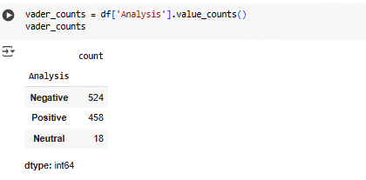
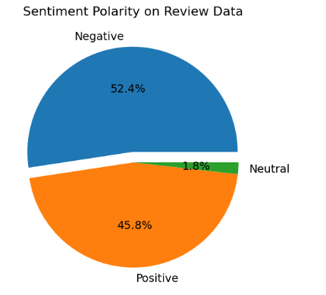
INSIGHT FROM REVIEWS
From cleaning 1000 reviews given by customers, we obtained:

Slide 3
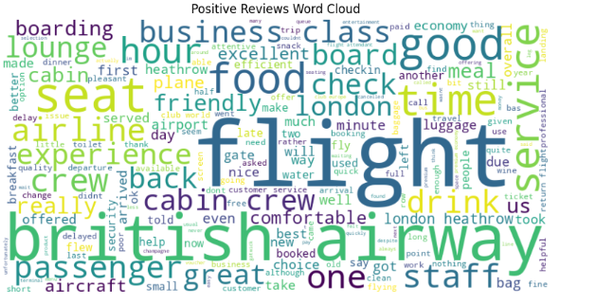
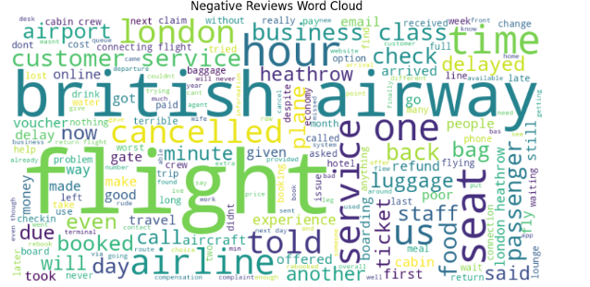
NEGATIVE & POSITIVE WORD CLOUD

