Slide 1


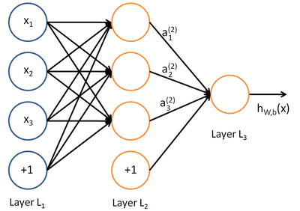

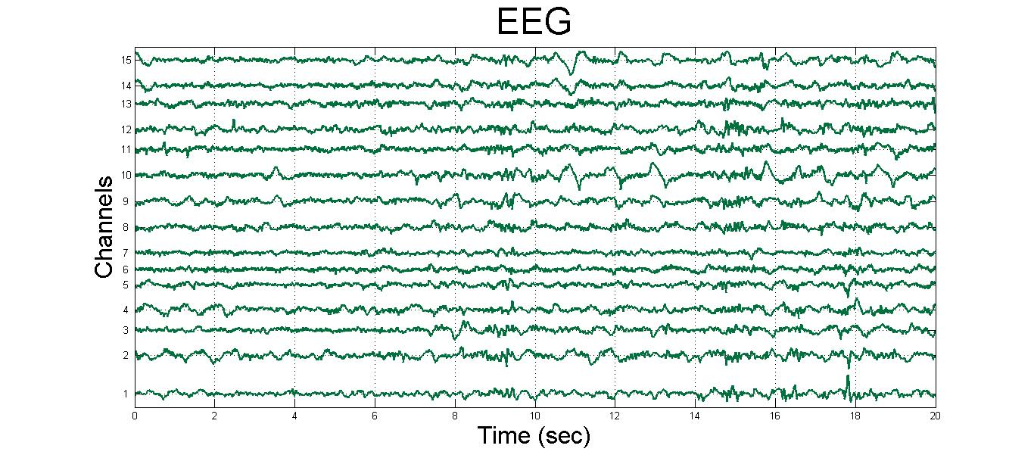
ANN Seizure Prediction System for Epileptic Dogs
Taylor Neely and Jack Terwilliger
Department of Computer Science, Dartmouth College, USA
Methods
Results
Background: Epilepsy is a neurological disorder characterized by random, spontaneous seizures that afflicts 1% of the global population. Current treatments are ineffective for 30% of those effected
Computational Problem: Create an early warning system for seizures by predicting a subjects current ictal state.
Data: EEG data of pre-ictal and inter-ictal states sampled from 5 epileptic dogs, in which there were ~600 examples per dog, each recorded through 16 channels over time 240,000 points.
Constraints: The prediction system is intended to be implemented as an implanted device which can make predictions in real time, thus we chose features which are relatively cheap to compute.
Approach: Generate frequency based features which are passed to a three layer ANN trained on a per-subject basis.
Methods
Discussion/Conclusions
People who are frustrated are less generous with other individuals
This effect is reversed when dealing with an emotional situation
This may be an example of cognitive hypercorrection (See Gil-White)
References
FFA
Yu, R., Mobbs, D., Seymour, B., Rowe, J. B., & Calder, A. J. (2014). The neural signature
of escalating frustration in humans. Cortex, 54, 165-178.
Gray, K., Ward, A. F., & Norton, M. I. (2014). Paying it forward: Generalized reciprocity
and the limits of generosity. Journal of Experimental Psychology: General, 143(1), 247.
Sanfey, A. G., Rilling, J. K., Aronson, J. A., Nystrom, L. E., & Cohen, J. D. (2003).
The neural basis of economic decision-making in the ultimatum game.
Science, 300(5626), 1755-1758.
Thaler, R. H. (1988). Anomalies: The ultimatum game. The Journal of Economic
Perspectives, 195-206.
Spectral Edge
Average Power
Spectral Power
Contact: jack.f.terwilliger@gmail.com, tneely417@gmail.com

