Slide 1
From the Informal to the Formal (and back again)
Tim Nelson
(SPECS Summer School 2025)
Notes:
This is joint work with collaborators at Brown.

Slide 2
What is a ”specification”?
Unit
Test Suite?
Program?
(with all context)
Totality

Slide 3
What is a ”specification?”
LTL?
(Not really just one dimension...)
Abstraction
Flip-flops?
Hardware timings?
Wire inductance?

Slide 4
What is a ”specification?”
What can we do with one?
Execute vs. Verify
Level of Formality

Slide 5
Today:
Is it useful to blur the distinction
between specification and program?
Tomorrow:
How is informal or semi-formal specification useful?

Slide 6
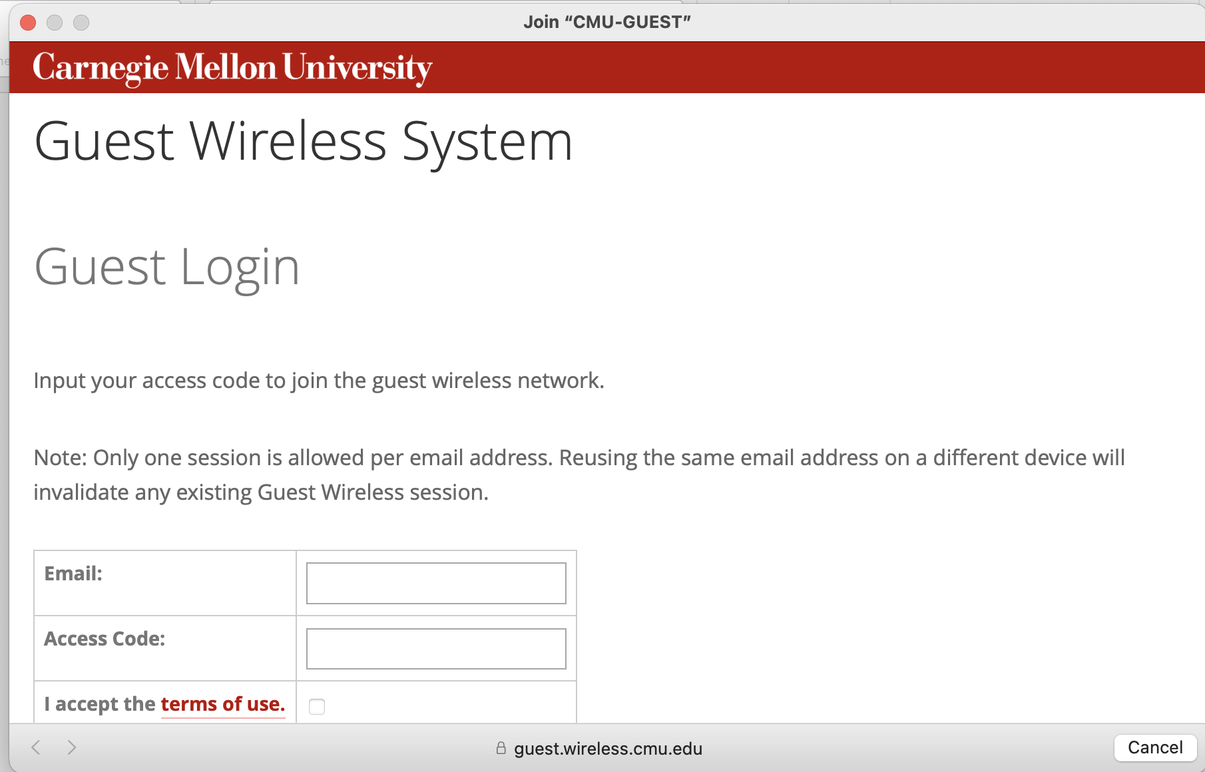

Slide 7



Datastore
Controller Program State
(Onix, Cassandra, Zookeeper, …)
Control plane program
(Java, C++, Python, Haskell, ...)
Control logic
Packets
Rules
Data plane (on switches)
“match-action” OpenFlow Rules
Forwarding
Rules
Notes:
SDN 2 key elements: Controller program. Switches. Send packets. INSTALL rules.
Switches limited m-a rules. Ctrler program arbitrary full-featured. Like most programs, state.
SDN application is really a three-tier program.

Slide 8
Database
Tier
Datastore
Server /
Business logic
Tier
Control logic
OpenFlow Rules
Match on packet header
Forward and modify header fields
Rules
Client /
Presentation
Tier
Forwarding
Rules
Notes:
Not dissimilar to web prog… One major difference: limitations of m-a → stark sep between.
Thus a controller program is really a META program that constantly…in accordance with state and needs of state

Slide 9
NAT Library (POX) =
from pox.core import core
import pox
log = core.getLogger()
from pox.lib.packet.ipv4 import ipv4
from pox.lib.packet.arp import arp
import pox.lib.packet as pkt
from pox.lib.addresses import IPAddr
from pox.lib.addresses import EthAddr
from pox.lib.util import str_to_bool, dpid_to_str, str_to_dpid
from pox.lib.revent import EventMixin, Event
from pox.lib.recoco import Timer
import pox.lib.recoco as recoco
import pox.openflow.libopenflow_01 as of
from pox.proto.dhcpd import DHCPD, SimpleAddressPool
import time
import random
FLOW_TIMEOUT = 60
FLOW_MEMORY_TIMEOUT = 60 * 10
class Record (object):
def __init__ (self):
self.touch()
self.outgoing_match = None
self.incoming_match = None
self.real_srcport = None
self.fake_srcport = None
self.outgoing_fm = None
self.incoming_fm = None
@property
def expired (self):
return time.time() > self._expires_at
def touch (self):
self._expires_at = time.time() + FLOW_MEMORY_TIMEOUT
def __str__ (self):
s = "%s:%s" % (self.outgoing_match.nw_src, self.real_srcport)
if self.fake_srcport != self.real_srcport:
s += "/%s" % (self.fake_srcport,)
s += " -> %s:%s" % (self.outgoing_match.nw_dst, self.outgoing_match.tp_dst)
return s
class NAT (object):
def __init__ (self, inside_ip, outside_ip, gateway_ip, dns_ip, outside_port,
dpid, subnet = None):
self.inside_ip = inside_ip
self.outside_ip = outside_ip
self.gateway_ip = gateway_ip
self.dns_ip = dns_ip # Or None
self.outside_port = outside_port
self.dpid = dpid
self.subnet = subnet
self._outside_portno = None
self._gateway_eth = None
self._connection = None
# Which NAT ports have we used?
# proto means TCP or UDP
self._used_ports = set() # (proto,port)
# Flow records indexed in both directions
# match -> Record
self._record_by_outgoing = {}
self._record_by_incoming = {}
core.listen_to_dependencies(self)
def _all_dependencies_met (self):
log.debug('Trying to start...')
if self.dpid in core.openflow.connections:
self._start(core.openflow.connections[self.dpid])
else:
core.openflow.addListenerByName('ConnectionUp',
self.__handle_dpid_ConnectionUp)
self.expire_timer = Timer(60, self._expire, recurring = True)
def _expire (self):
dead = []
for r in self._record_by_outgoing.itervalues():
if r.expired:
dead.append(r)
for r in dead:
del self._record_by_outgoing[r.outgoing_match]
del self._record_by_incoming[r.incoming_match]
self._used_ports.remove((r.outgoing_match.nw_proto,r.fake_srcport))
if dead and not self._record_by_outgoing:
log.debug("All flows expired")
def _is_local (self, ip):
if ip.is_multicast: return True
if self.subnet is not None:
if ip.in_network(self.subnet): return True
return False
if ip.in_network('192.168.0.0/16'): return True
if ip.in_network('10.0.0.0/8'): return True
if ip.in_network('172.16.0.0/12'): return True
return False
def _pick_port (self, flow):
"""
Gets a possibly-remapped outside port
flow is the match of the connection
returns port (maybe from flow, maybe not)
"""
port = flow.tp_src
if port < 1024:
# Never allow these
port = random.randint(49152, 65534)
# Pretty sloppy!
cycle = 0
while cycle < 2:
if (flow.nw_proto,port) not in self._used_ports:
self._used_ports.add((flow.nw_proto,port))
return port
port += 1
if port >= 65534:
port = 49152
cycle += 1
log.warn("No ports to give!")
return None
@property
def _outside_eth (self):
if self._connection is None: return None
#return self._connection.eth_addr
return self._connection.ports[self._outside_portno].hw_addr
def _handle_FlowRemoved (self, event):
pass
@staticmethod
def strip_match (o):
m = of.ofp_match()
fields = 'dl_dst dl_src nw_dst nw_src tp_dst tp_src dl_type nw_proto'
for f in fields.split():
setattr(m, f, getattr(o, f))
return m
@staticmethod
def make_match (o):
return NAT.strip_match(of.ofp_match.from_packet(o))
def _handle_PacketIn (self, event):
if self._outside_eth is None: return
#print
#print "PACKET",event.connection.ports[event.port].name,event.port,
#print self.outside_port, self.make_match(event.ofp)
incoming = event.port == self._outside_portno
if self._gateway_eth is None:
# Need to find gateway MAC -- send an ARP
self._arp_for_gateway()
return
packet = event.parsed
dns_hack = False
# We only handle TCP and UDP
tcpp = packet.find('tcp')
if not tcpp:
tcpp = packet.find('udp')
if not tcpp: return
if tcpp.dstport == 53 and tcpp.prev.dstip == self.inside_ip:
if self.dns_ip and not incoming:
# Special hack for DNS since we've lied and claimed to be the server
dns_hack = True
ipp = tcpp.prev
if not incoming:
# Assume we only NAT public addresses
if self._is_local(ipp.dstip) and not dns_hack: return
else:
# Assume we only care about ourselves
if ipp.dstip != self.outside_ip: return
match = self.make_match(event.ofp)
if incoming:
match2 = match.clone()
match2.dl_dst = None # See note below
record = self._record_by_incoming.get(match2)
if record is None:
# Ignore for a while
fm = of.ofp_flow_mod()
fm.idle_timeout = 1
fm.hard_timeout = 10
fm.match = of.ofp_match.from_packet(event.ofp)
event.connection.send(fm)
return
log.debug("%s reinstalled", record)
record.incoming_fm.data = event.ofp # Hacky!
else:
record = self._record_by_outgoing.get(match)
if record is None:
record = Record()
record.real_srcport = tcpp.srcport
record.fake_srcport = self._pick_port(match)
# Outside heading in
fm = of.ofp_flow_mod()
fm.flags |= of.OFPFF_SEND_FLOW_REM
fm.hard_timeout = FLOW_TIMEOUT
fm.match = match.flip()
fm.match.in_port = self._outside_portno
fm.match.nw_dst = self.outside_ip
fm.match.tp_dst = record.fake_srcport
fm.match.dl_src = self._gateway_eth
# We should set dl_dst, but it can get in the way. Why? Because
# in some situations, the ARP may ARP for and get the local host's
# MAC, but in others it may not.
#fm.match.dl_dst = self._outside_eth
fm.match.dl_dst = None
fm.actions.append(of.ofp_action_dl_addr.set_src(packet.dst))
fm.actions.append(of.ofp_action_dl_addr.set_dst(packet.src))
fm.actions.append(of.ofp_action_nw_addr.set_dst(ipp.srcip))
if dns_hack:
fm.match.nw_src = self.dns_ip
fm.actions.append(of.ofp_action_nw_addr.set_src(self.inside_ip))
if record.fake_srcport != record.real_srcport:
fm.actions.append(of.ofp_action_tp_port.set_dst(record.real_srcport))
fm.actions.append(of.ofp_action_output(port = event.port))
record.incoming_match = self.strip_match(fm.match)
record.incoming_fm = fm
# Inside heading out
fm = of.ofp_flow_mod()
fm.data = event.ofp
fm.flags |= of.OFPFF_SEND_FLOW_REM
fm.hard_timeout = FLOW_TIMEOUT
fm.match = match.clone()
fm.match.in_port = event.port
fm.actions.append(of.ofp_action_dl_addr.set_src(self._outside_eth))
fm.actions.append(of.ofp_action_nw_addr.set_src(self.outside_ip))
if dns_hack:
fm.actions.append(of.ofp_action_nw_addr.set_dst(self.dns_ip))
if record.fake_srcport != record.real_srcport:
fm.actions.append(of.ofp_action_tp_port.set_src(record.fake_srcport))
fm.actions.append(of.ofp_action_dl_addr.set_dst(self._gateway_eth))
fm.actions.append(of.ofp_action_output(port = self._outside_portno))
record.outgoing_match = self.strip_match(fm.match)
record.outgoing_fm = fm
self._record_by_incoming[record.incoming_match] = record
self._record_by_outgoing[record.outgoing_match] = record
log.debug("%s installed", record)
else:
log.debug("%s reinstalled", record)
record.outgoing_fm.data = event.ofp # Hacky!
record.touch()
# Send/resend the flow mods
if incoming:
data = record.outgoing_fm.pack() + record.incoming_fm.pack()
else:
data = record.incoming_fm.pack() + record.outgoing_fm.pack()
self._connection.send(data)
# We may have set one of the data fields, but they should be reset since
# they won't be valid in the future. Kind of hacky.
record.outgoing_fm.data = None
record.incoming_fm.data = None
def __handle_dpid_ConnectionUp (self, event):
if event.dpid != self.dpid:
return
self._start(event.connection)
def _start (self, connection):
self._connection = connection
self._outside_portno = connection.ports[self.outside_port].port_no
fm = of.ofp_flow_mod()
fm.match.in_port = self._outside_portno
fm.priority = 1
connection.send(fm)
fm = of.ofp_flow_mod()
fm.match.in_port = self._outside_portno
fm.match.dl_type = 0x800 # IP
fm.match.nw_dst = self.outside_ip
fm.actions.append(of.ofp_action_output(port=of.OFPP_CONTROLLER))
fm.priority = 2
connection.send(fm)
Control logic
Control logic
Notified about first
packet in every flow…
…reply with actions
for first packet…
…update NAT state…
…install appropriate
rules on switches
Datastore
Forwarding
Rules
Notes:
Example: nat in python. It has to do a lot of things.
[things]
Key here: state affects rules, and rules affect what packets the ctrler sees (which affects state updates)
Installing the right rules WITH RESPECT TO STATE is subtle, easy to get wrong.

Slide 10

Bugs!
Datastore
Control logic
Inconsistent packet-handling between controller and switches
Switch fails to notify controller when state update needed
Switch notifies controller more than necessary
Hard to verify Java, Python, …
Multiple tiers make it even harder.
Forwarding
Rules
Notes:
A few common bugs. [bugs]
SDN let us program. Verify!
But heroic effort. And the fact that control programs effectively do code-generation makes verification harder: additional abstractions to work in.

Slide 11
Datastore
Flowlog
A Tierless SDN Programming Language
Automatic compilation to flow tables
(…including state and state updates)
Built-in cross-tier verification support
Flowlog
Program
Control logic
Forwarding
Rules
Notes:
TIERLESS SDN programming language called Flowlog.
Tierless = runtime handles flow table maintenance and flow rules IN SERVICE OF STATE transparently to programmer.
**Not only about forwarding policy---tierless runtime also governs what packets go to the ctrler to maintain state.
Designed the language with built-in support for program verification
The syntax will be reminiscent of SQL, and it may be helpful to keep that analogy in mind.

Slide 12

Nat in Flowlog
Outgoing
Internal
External
port = 1
port = 2
Public IP = 192.168.100.100
Public MAC = 00:00:00:00:00:02
Notes:
Basic NAT in Flowlog. For simplicity, we‘ll just consider outgoing direction + a single
switch, with an internal port (#1) and an external port (#2)

Slide 13
Internal
External
port = 1
port = 2
TABLE nat(macaddr, ipaddr, tpport, tpport);
VAR nextport: tpport = 10000;
ON tcp_packet(p) WHERE p.locPt = 1 AND
nat(p.dlSrc, p.nwSrc, p.tpSrc, natport):
DO forward(new) WHERE new.tpSrc = natport AND
new.nwSrc = 192.168.100.100 AND
new.dlSrc = 00:00:00:00:00:02 AND new.locPt = 2;
ON tcp_packet(p) WHERE p.locPt = 1 AND
NOT nat(p.dlSrc, p.nwSrc, p.tpSrc, ANY):
DO forward(new) WHERE new.tpSrc = nextport AND
new.nwSrc = 192.168.100.100 AND
new.dlSrc = 00:00:00:00:00:02 AND new.locPt = 2;
INSERT(p.dlSrc, p.nwSrc, p.tpSrc, nextport) INTO nat;
INCREMENT nextport;
Existing
Flow:
natport
NOT
ANY
New
Flow:
Notes:
Table. Var.
Outgoing dir = 2 cases: packet in an existing flow, or first packet in new flow. Blocks.
1: *TRIGGERS* on […] provided there is a row corresponding to the packet's source + a translation port, which we bind to "natport".
Second case similar; no row in table
((This slide contains black rectangles to make the highlighting effects look right.))

Slide 14
Internal
External
port = 1
port = 2
TABLE nat(macaddr, ipaddr, tpport, tpport);
VAR nextport: tpport = 10000;
ON tcp_packet(p) WHERE p.locPt = 1 AND
nat(p.dlSrc, p.nwSrc, p.tpSrc, natport):
DO forward(new) WHERE new.tpSrc = natport AND
new.nwSrc = 192.168.100.100 AND
new.dlSrc = 00:00:00:00:00:02 AND new.locPt = 2;
ON tcp_packet(p) WHERE p.locPt = 1 AND
NOT nat(p.dlSrc, p.nwSrc, p.tpSrc, ANY):
DO forward(new) WHERE new.tpSrc = nextport AND
new.nwSrc = 192.168.100.100 AND
new.dlSrc = 00:00:00:00:00:02 AND new.locPt = 2;
INSERT(p.dlSrc, p.nwSrc, p.tpSrc, nextport) INTO nat;
INCREMENT nextport;
Existing
Flow:
natport
NOT
ANY
nextport
New
Flow:
And that’s it.
Notes:
Add actions.
Simple for pre-existing: forward: ext port, mod 2/3/4 src. Natport from table.
If a new flow, same fwd: but use nextport, since nothing stored in db.
insert a new row to the NAT table: this flow -> nextport
Since that value is now used, we have to increment the value in nextport.
That's it. Around 20 lines. Incoming NAT takes another 3 to 5 lines. No OF.

Slide 15
Another example
Notes:
But you can do more than just packet-handling in Flowlog. The three-tier
diagram I showed you is AN OVERSIMPLIFICATION: a controller program
doesn't run in a vacuum! There are other applications that it may need to
interact with. For instance...

Slide 16



Campus Police
Stolen laptop located!
Laptop stolen!
Campus Network
Controller
Packets
Notes:
Suppose that you run a campus SDN, and provide connectivity for thousands of
student laptops. Unfortunately, some community members are dishonest
characters, and may steal others' laptops.
If a laptop is reported stolen, you'd like campus police to inform the
controller right away, so that if the thief attempts to use the stolen device
on campus, the police can find them and recover the laptop.
Let's write a Flowlog program to do just that. There are three pieces
required.

Slide 17
Core
Logic
Northbound API
Remote Tables
// Event API
EVENT stolen_laptop_report
{laptop: macaddr}; EVENT stolen_laptop_cancel
{laptop: macaddr};
EVENT stolen_laptop_found
{laptop: macaddr,
swid: switchid,
time: int};
// Named pipe for event output
OUTGOING notify_police(stolen_laptop_found)
THEN SEND TO 127.0.0.1:5050;
Thrift
Campus Police
Stolen laptop located!
Laptop stolen!
Campus Network
Controller
Packets
Notes:
First, there's the northbound API provided to the police: the program accepts
theft and recovery notifications, and promises to provide "found laptop"
reports in a standard format. The last part here is just a named pipe that
sends those reports where the police expect them.

Slide 18
Core
Logic
Northbound API
Remote Tables
// Get time() from another process
REMOTE TABLE get_time
FROM time AT 127.0.0.1:9091
TIMEOUT 1 seconds;
Campus Police
Stolen laptop located!
Laptop stolen!
Campus Network
Controller
Packets
Notes:
Next, Flowlog doesn't require all of the controller state to be local, or
even be maintained by a Flowlog program. Non-Flowlog programs can use a basic
RPC library to provide data synchronously to Flowlog, in the form of a remote
table. Here, an external timer process provides Flowlog with the seconds since
epoch, and naturally updates every second.

Slide 19
Core
Logic
Northbound API
Remote Tables
// store MAC of stolen devices
TABLE stolen(macaddr);
// react to events from police
ON stolen_laptop_cancel(ev):
DELETE (ev.mac) FROM stolen;
ON stolen_laptop_report(ev):
INSERT (ev.mac) INTO stolen;
// notify police if stolen laptop appears
ON packet(pkt) WHERE
stolen(pkt.dlSrc) AND
edgePort(pkt.locSw, pkt.locPt):
DO notify_police(sto) WHERE
sto.mac = pkt.dlSrc AND
sto.swid = pkt.locSw AND
get_time(sto.time);
Campus Police
Stolen laptop located!
And
that’s it.
Laptop stolen!
Campus Network
Controller
Packets
Notes:
Finally, there's the core logic: the "rules", like we saw in the NAT
program. All these do is remember stolen laptops reported by the police, and
inform the police if the stolen laptop appears on the network.
... and we're done. The runtime handles all of the flow-table book-keeping,
RPC handling, and so on.

Slide 20
How do we make Flowlog efficient?

Slide 21



First cut implementation: “reactive” compilation
Initial packet in a flow → controller
Controller → flow table rules
Future packets → NOT sent to controller
Netflix Server
Lab PC
Netflix to Lab PC → Forward

Slide 22
Better: “proactive” compilation
Controller → flow table rules (no initial packet needed)
Doing this for a stateful language is new.
Netflix Server
Lab PC
Netflix to Lab PC → Forward

Slide 23
DO forward(new) WHERE
nat(p.nwSrc, p.tpSrc, new.tpSrc);
Incoming packet: p.nwSrc = 10.1.1.1, p.tpSrc = 12345
Incoming packet: p.nwSrc = 192.168.1.1, p.tpSrc = 1701
Equivalent switch rules:
nwSrc = 10.1.1.1 and tpSrc = 12345 → set tpSrc := 10000
nwSrc = 10.1.1.2 and tpSrc = 54321 → set tpSrc := 10001
nat(p.nwSrc, p.tpSrc, new.tpSrc)
10.1.1.1 | 12345 | 10000
10.1.1.2 | 54321 | 10001
nat
10.1.1.1 | 12345 | 10000
10.1.1.2 | 54321 | 10001
Once the switches install these, Flowlog’s forwarding is
“as fast as hardware”

Slide 24
INSERT(p.nwSrc, p.tpSrc, pt) INTO nat WHERE
not nat(p.nwSrc, p.tpSrc, ANY);
Incoming packet: p.nwSrc = 10.1.1.1, p.tpSrc = 12345
Incoming packet: p.nwSrc = 192.168.1.1, p.tpSrc = 1701
nat(p.nwSrc, p.tpSrc, ANY)
10.1.1.1 | 12345 | 10000
10.1.1.2 | 54321 | 10001
The controller doesn’t need to see packets that teach it nothing
(nwSrc != 10.1.1.1 or tpSrc != 12345) and
(nwSrc != 10.1.1.2 or tpSrc != 54321)
→ send to controller
Never miss a needed packet, and never send an unnecessary packet
Stateful compilation made possible by limited, rule-based language

Slide 25

Flowlog programs are equivalent to
first-order logic formulas.
Flowlog
Verification Tool
Notes:
Every Flowlog rule is equivalent
to a formula of first-order logic, and we exploit that fact to automatically
translate Flowlog programs to the verification tool Alloy.

Slide 26

ON tcp_packet(p) WHERE p.locPt = 1 AND
nat(p.nwSrc, p.tpSrc, natport):
DO forward(new) WHERE new.tpSrc = natport AND …
Gives a first-order theory for every program.
Subset of Non-recursive Datalog with negation
(and limited arithmetic)
Notes:
Under the hood: every flowlog rule defines a logical implication. Standard Datalog-style interpretation with variables existential in body.

Slide 27

The “ANY” keyword is a tight-binding wildcard:
nat(p.nwSrc, p.tpSrc, ANY)
NOT nat(p.nwSrc, p.tpSrc, ANY)
Quantifier nesting is (by design) severely restricted:
∃*∀* in rule bodies
Notes:
ANY keyword is the exception: tightly binding wildcard variable. So Flowlog is between semi-positive NR DL and NRDLneg. Quantifier nesting is extremely limited: EA in rule bodies (E alone without any ANY in negated atom).

Slide 28
“Only a stolen_laptop_cancel event can remove addresses from the stolen table.”
assert onlyPoliceRemoveStolen {
all st1, st2: State, ev: Event |
transition[st1, ev, st2] and
some (st1.stolen – st2.stolen)
implies
ev in EVstolen_laptop_cancel
}
Bounded check, not proof
Notes:
Here's that property again, written concisely in Alloy's assertion language.
When we give it to Alloy, along with the automatically generated program spec,
Alloy says the property is correct---in a
fairly short time.

Slide 29
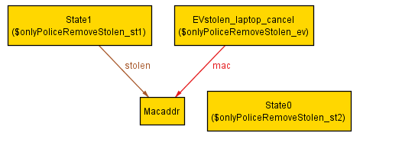
“Only a stolen_laptop_report event can remove addresses from the stolen table.”
assert onlyPoliceRemoveStolen {
all st1, st2: State, ev: Event |
transition[st1, ev, st2] and
some (st1.stolen – st2.stolen)
implies
ev in EVstolen_laptop_report
}
Notes:
If we change the property to make it fail, Alloy finds a counterexample
quickly and presents it in a clear graphical manner that helps the programmer
understand the failure. This clear output format is one reason why we chose to
convert Flowlog to Alloy.

Slide 30
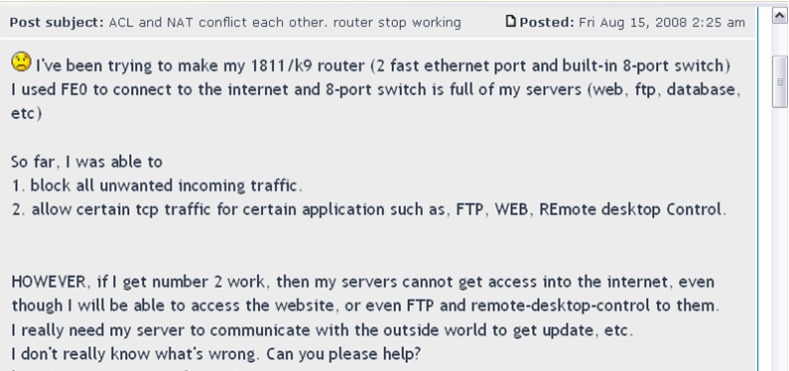
What kinds of properties can we check?
Will web requests get through my network?
Will NAT be performed on all packets?
Is NAT performed correctly?
Can my network ever route packets in a loop?
Ok, I made a fix.
Did it “work”?
Can a packet be sent without its external port being saved?

Slide 31
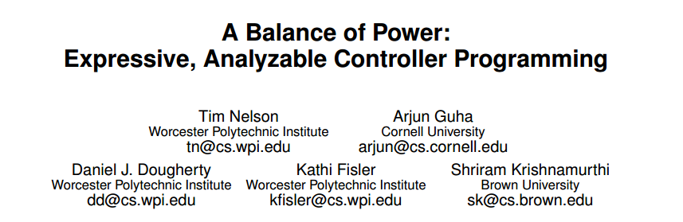
Can my network ever route packets in a loop?
Trace Properties
Properties about how
packets cross the network
Will web requests get through my network?
Trace properties:
Require topology as part of input
State-space blowup on large networks

Slide 32
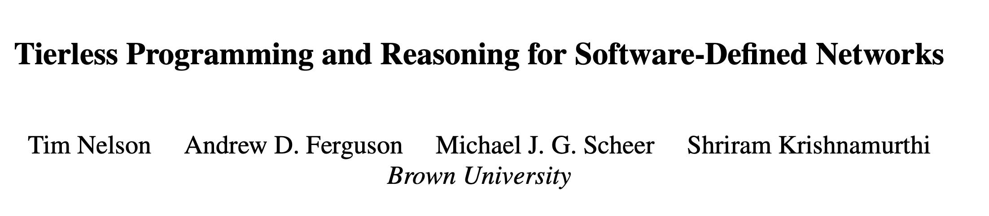
Will NAT be performed on all packets?
Topology-free reasoning
About the program, not
the specific network
“Two different hosts will always be NATted to different ephemeral ports.”
“If the NAT table is an injective partial function before a packet arrives, then it will be one afterward.”
Is NAT performed correctly?

Slide 33
“But what if I don’t have properties?”

Slide 34
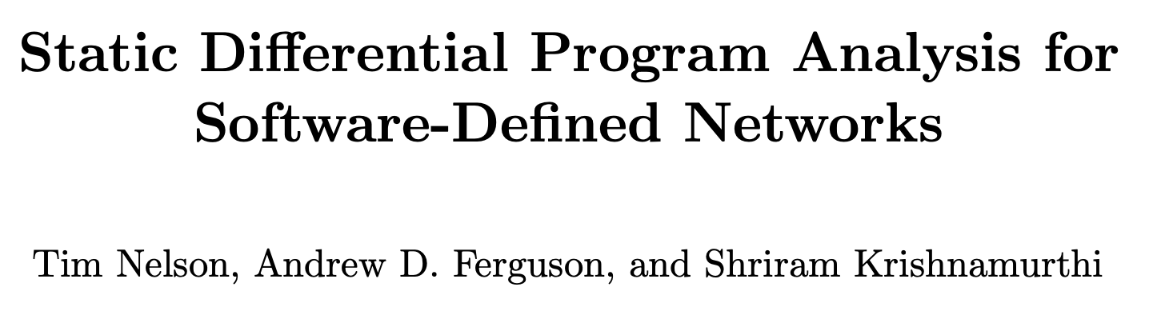
P
=
P
?
Undecidable in most languages.
…but decidable for Flowlog
(subject to limitations on ”ANY”)
1
2
How do the programs differ?
How do the programs differ?
How do their behaviors differ?

Slide 35
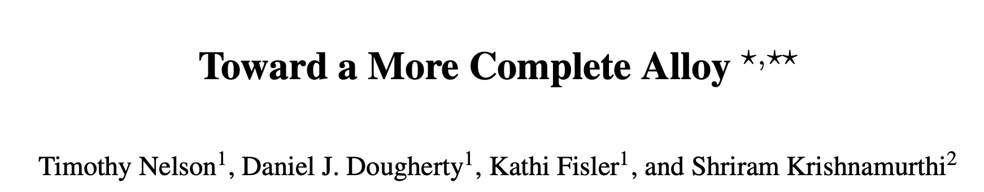
Satisfiability for ∃^{j}∀^{k} fragment of FOL
(Bernays–Schönfinkel-Ramsey)
is decidable (search up to j atoms)
∃
∃
∃
Negated ANY
pred changePolicyOut[st: State, ev: Event] {
some out: Event |
prog1/outpolicy[st,ev,out] and
not prog2/outpolicy[st,ev,out]
or
prog2/outpolicy[st,ev,out] and
not prog1/outpolicy[st,ev,out]
}
∃*∀*
∀*∃* ???
Notes:
Chimp uses only first order relational part of Alloy, so we can use this well-known result… can extend to world with types, so by counting… if a query falls into EA, we can compute sufficient bounds.

Slide 36

… nat(p.nwSrc, somevar, p.tpSrc) AND
NOT nat(p.nwSrc, p.tpSrc, ANY) …
NOT
The wildcard is only used in one literal.
The named variable is only used in a different literal.
Back in ∃*∀*
Notes:
forall p: packet, new: packet, natport : TCPport | forward(new) <==
justArrivedPacket(p) and nat(dlSrc(p), nwSrc(p), tpSrc(p), natport) and tpSrc(new) = natport and …
LaTeX source used:
\color{white}
\begin{align*}
\forall p^{\scriptscriptstyle \mathit{Packet}}, \, new^{\scriptscriptstyle \mathit{Packet}}, \, \mathit{natport}^{\scriptscriptstyle \mathit{TCPPort}} \\
forward(new) \impliedby & \mathit{justArrivedPacket}(p) \, \wedge \\
& nat(\mathit{dlSrc}(p), \mathit{nwSrc}(p), \mathit{tpSrc}(p), \mathit{natport}) \, \wedge \\
& \mathit{tpSrc}(new) = \mathit{natport} \, \wedge ...\\
\end{align*}

Slide 37

NOT nat(p.nwSrc, somevar, ANY):
NOT
“Cyclic” body
Basic differential queries are complete for acyclic Flowlog. User-defined bounds required otherwise.
Notes:
forall p: packet, new: packet, natport : TCPport | forward(new) <==
justArrivedPacket(p) and nat(dlSrc(p), nwSrc(p), tpSrc(p), natport) and tpSrc(new) = natport and …
LaTeX source used:
\color{white}
\begin{align*}
\forall p^{\scriptscriptstyle \mathit{Packet}}, \, new^{\scriptscriptstyle \mathit{Packet}}, \, \mathit{natport}^{\scriptscriptstyle \mathit{TCPPort}} \\
forward(new) \impliedby & \mathit{justArrivedPacket}(p) \, \wedge \\
& nat(\mathit{dlSrc}(p), \mathit{nwSrc}(p), \mathit{tpSrc}(p), \mathit{natport}) \, \wedge \\
& \mathit{tpSrc}(new) = \mathit{natport} \, \wedge ...\\
\end{align*}

Slide 38
Flowlog has no loops or recursion.
Limited expressive power seems bad!

Slide 39
Expressive Limitations and Workarounds
Reachability seems important in a network!
(between switches)
Doesn’t this need recursion?
reach(x, y) <- connected(x, y).
reach(x, y) <- connected(x, z), reach(z, y).

Slide 40
Connect
Add Reachable
Already learned
Step 1: Emit a probe packet from every switch port.
Step 2: When a probe packet is received:
A
B
A
B
C
A
B
C
No recursion isn’t always a limitation.
Notes:
INSERT (pkt.dlSrc, pkt.locSw) INTO ucTC;
INSERT (sw, pkt.locSw) INTO ucTC WHERE ucTC(sw, pkt.dlSrc);
INSERT (pkt.dlSrc, sw) INTO ucTC WHERE ucTC(pkt.locSw, sw);

Slide 41
A story about bugs and validation

Slide 42
Assume: switches emit probe packets.
Guarantee: These Flowlog rules correctly capture reachability in the network.
A
B
A
B
C
A
B
C

Slide 43
A
B
A
B
C
A
B
C
What’s wrong?
Flowlog is non-recursive.
Alloy and Forge have built-in transitive closure.
check { all s1, s2: Switch |
s1->s2 in ucTC iff
s1->s2 in ^wires }
Passed!

Slide 45
A
B
Evaluated at the same time.
(One evaluation step per event.)
What’s missing?
D
C
Notes:
INSERT (pkt.dlSrc, pkt.locSw) INTO ucTC;
INSERT (sw, pkt.locSw) INTO ucTC WHERE ucTC(sw, pkt.dlSrc);
INSERT (pkt.dlSrc, sw) INTO ucTC WHERE ucTC(pkt.locSw, sw);
INSERT (sw1, sw2) INTO ucTC WHERE ucTC(sw1, pkt.dlSrc) AND ucTC(pkt.locSw, sw2);

Slide 46
Assume: switches emit probe packets.
Guarantee: These Flowlog rules correctly capture reachability in the network.
A
B
A
B
C
A
B
C
Needed if: >3 switches
A
B
C
D
Notes:
INSERT (pkt.dlSrc, pkt.locSw) INTO ucTC;
INSERT (sw, pkt.locSw) INTO ucTC WHERE ucTC(sw, pkt.dlSrc);
INSERT (pkt.dlSrc, sw) INTO ucTC WHERE ucTC(pkt.locSw, sw);
INSERT (sw1, sw2) INTO ucTC WHERE ucTC(sw1, pkt.dlSrc) AND ucTC(pkt.locSw, sw2);

Slide 47
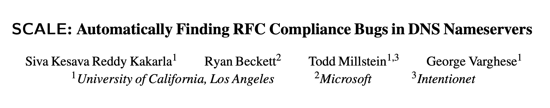
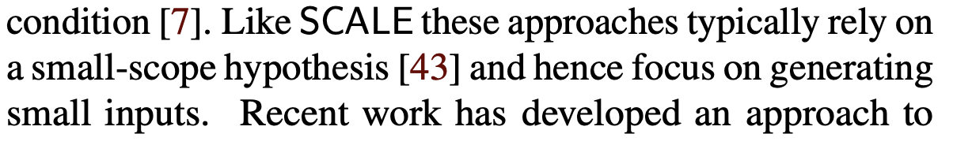
Lessons for Research
12 years ago, formal verification was rare in networking…

Slide 48
Lessons for Research
If you verify a program using a buggy specification, your verification is garbage!
Limiting expressive power can be useful for both reasoning and execution.
In research, cultivate both depth and breadth.

