Slide 1
Strategy Design Pattern
By: Travis Nelson

Slide 2
Summary
Common design pattern
Allows for run-time algorithm selection
Potentially reduces maintenance
(Tutorials Point, 2018)

Slide 3
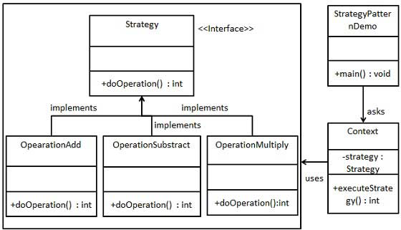
Simple Diagram
(Tutorials Point, 2018)

Slide 4
Sources
Tutorials Point. (2018, January 08). Design Patterns Strategy Pattern. Retrieved June 5, 2018, from https://www.tutorialspoint.com/design_pattern/strategy_pattern.htm

