Slide 1
Client Tracker Final Presentation
By: Travis Nelson

Slide 2
Summary
Intended for mental health professionals
Adding, editing, and deleting of client notes
Cloud hosted server and database
All data is encrypted (HIPPA compliant)

Slide 3
Design
Client-server model
  Client and server both written in Java
  Utilize sockets to communicate with each other
    Socket communication follows a protocol design pattern
    Easier to develop/maintain existing protocols
    Simple to add new protocols for future features
  MySQL Server database
  Server and database hosted via Amazon Web Services

Slide 4
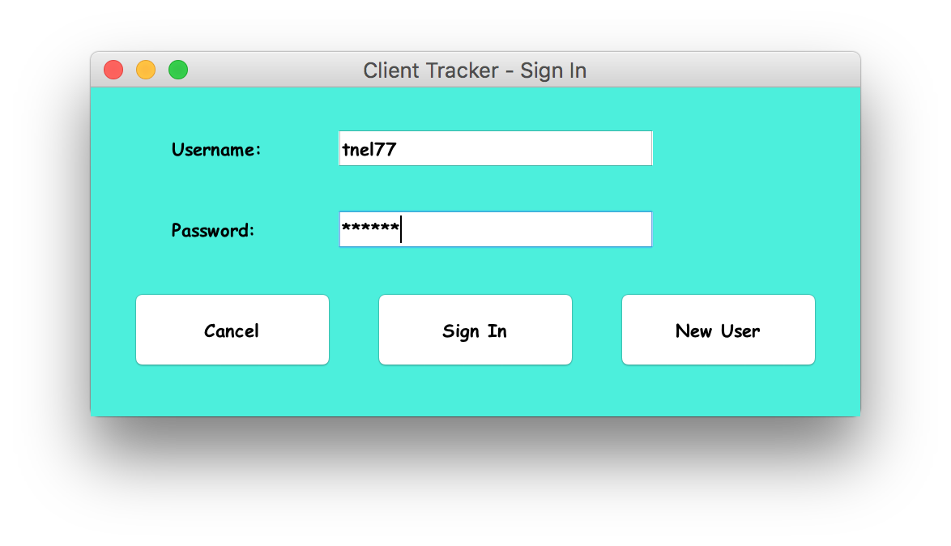
Sign-In

Slide 5
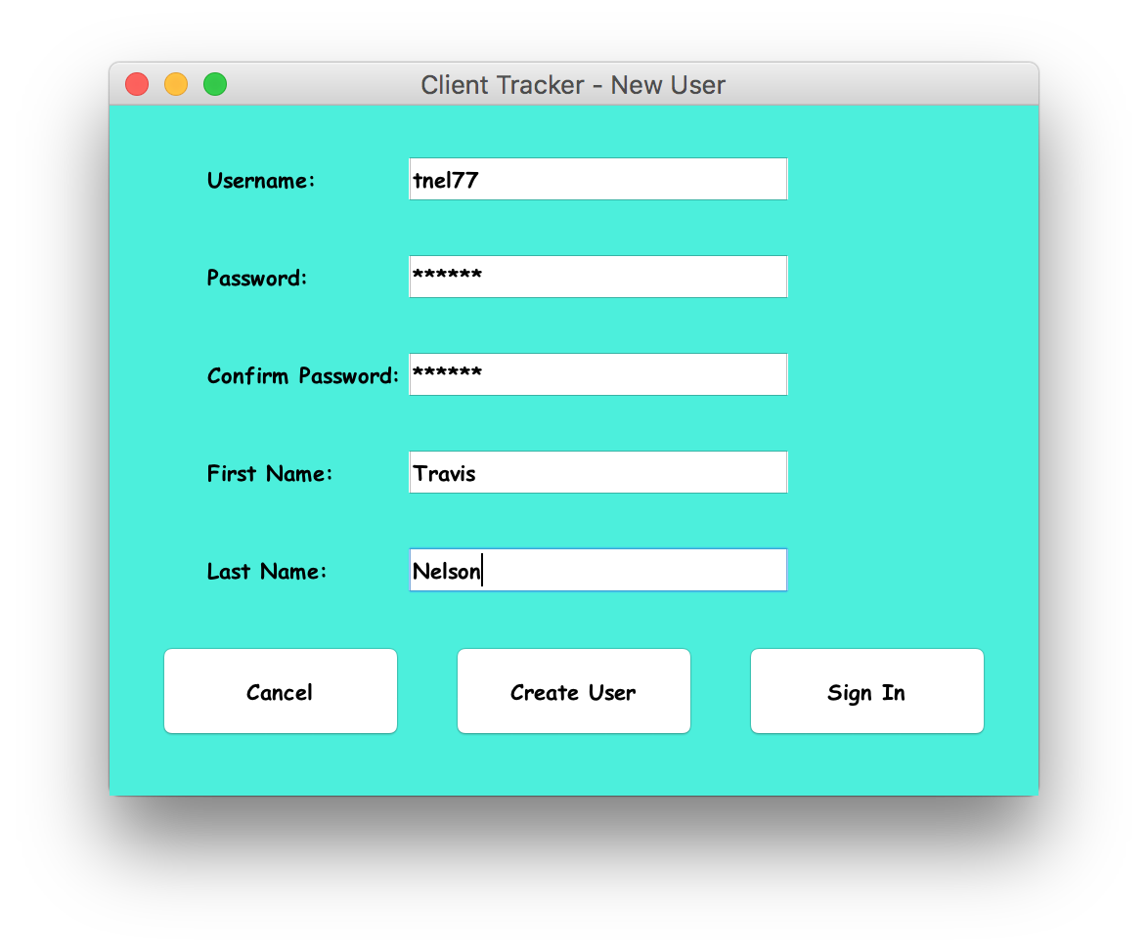
New User

Slide 6
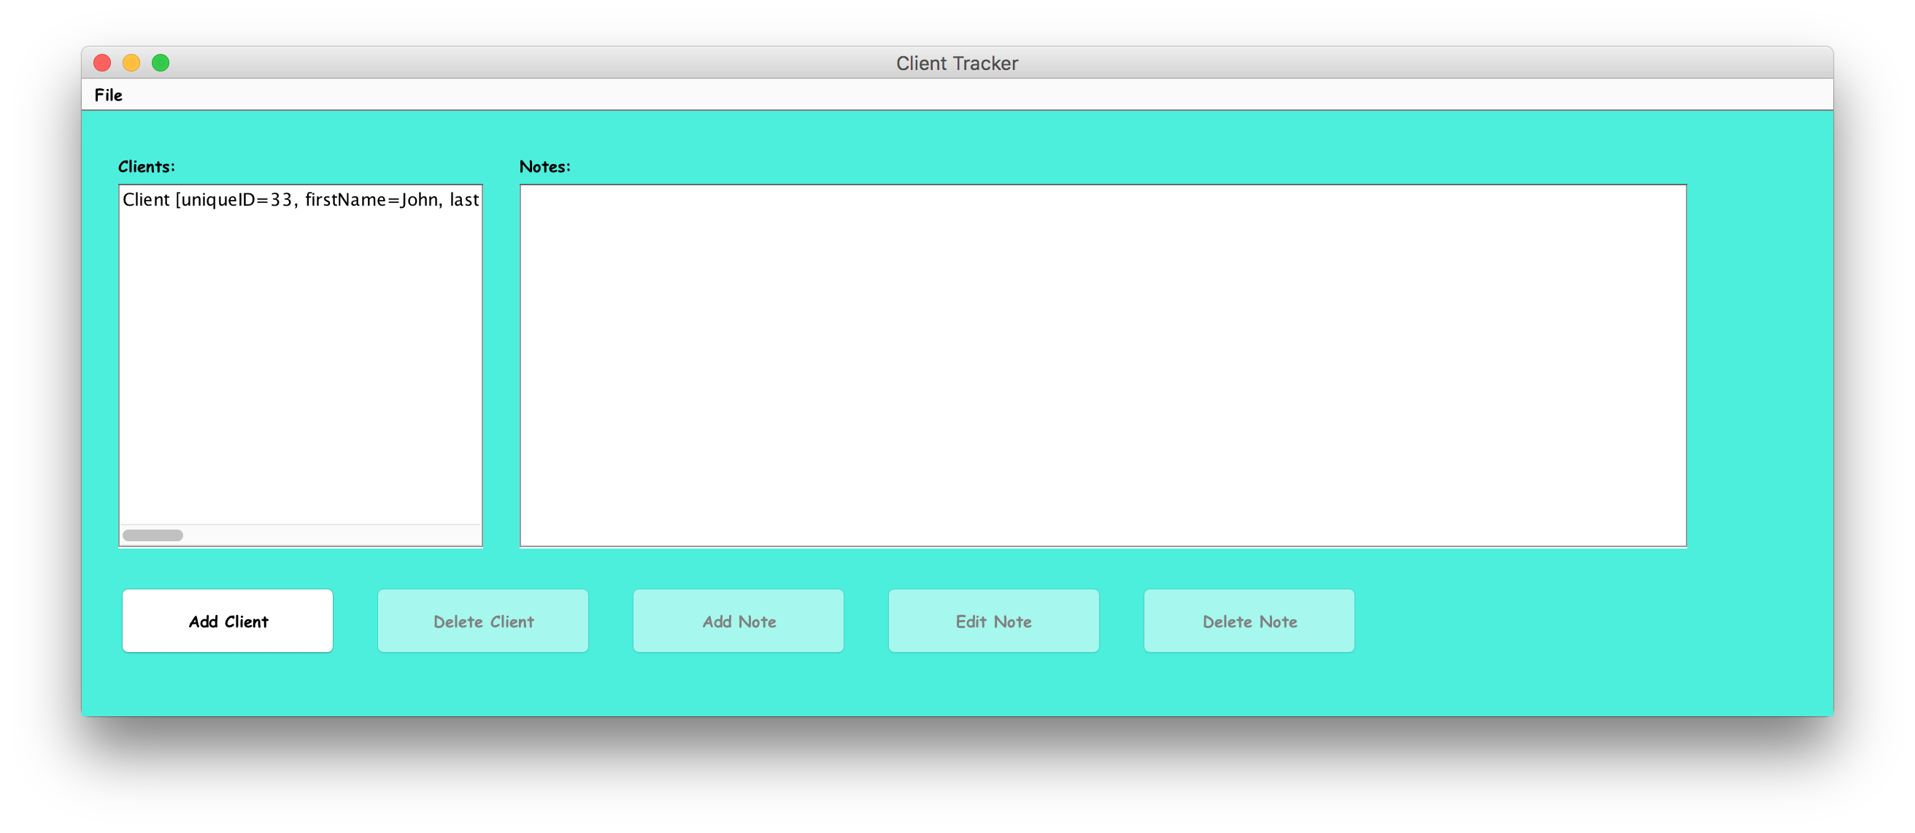
Home Screen

Slide 7
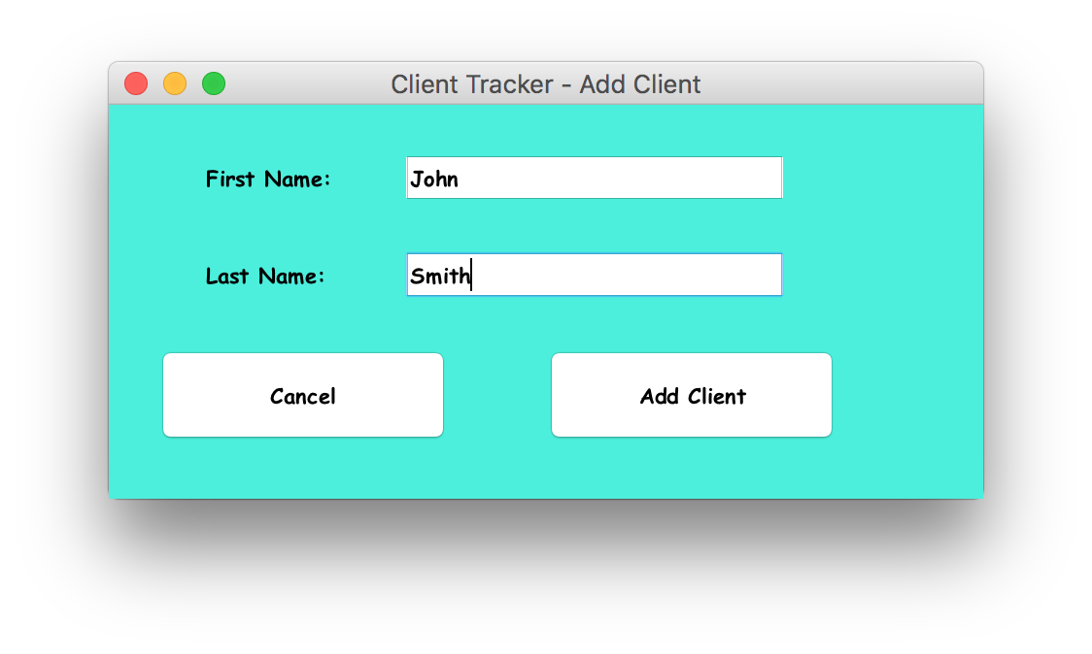
Add Client

Slide 8
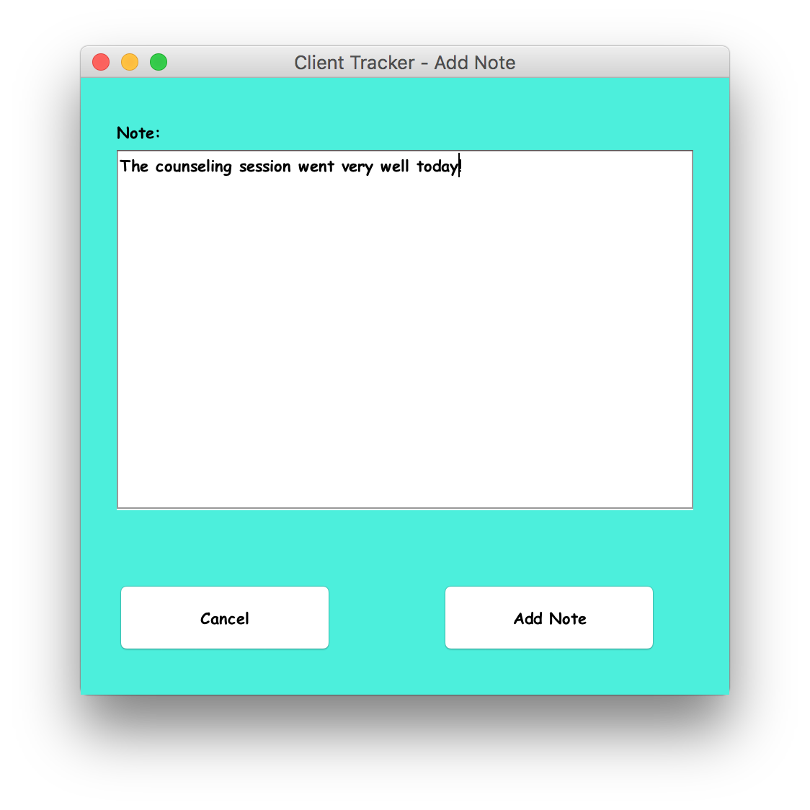
Add Note

Slide 9
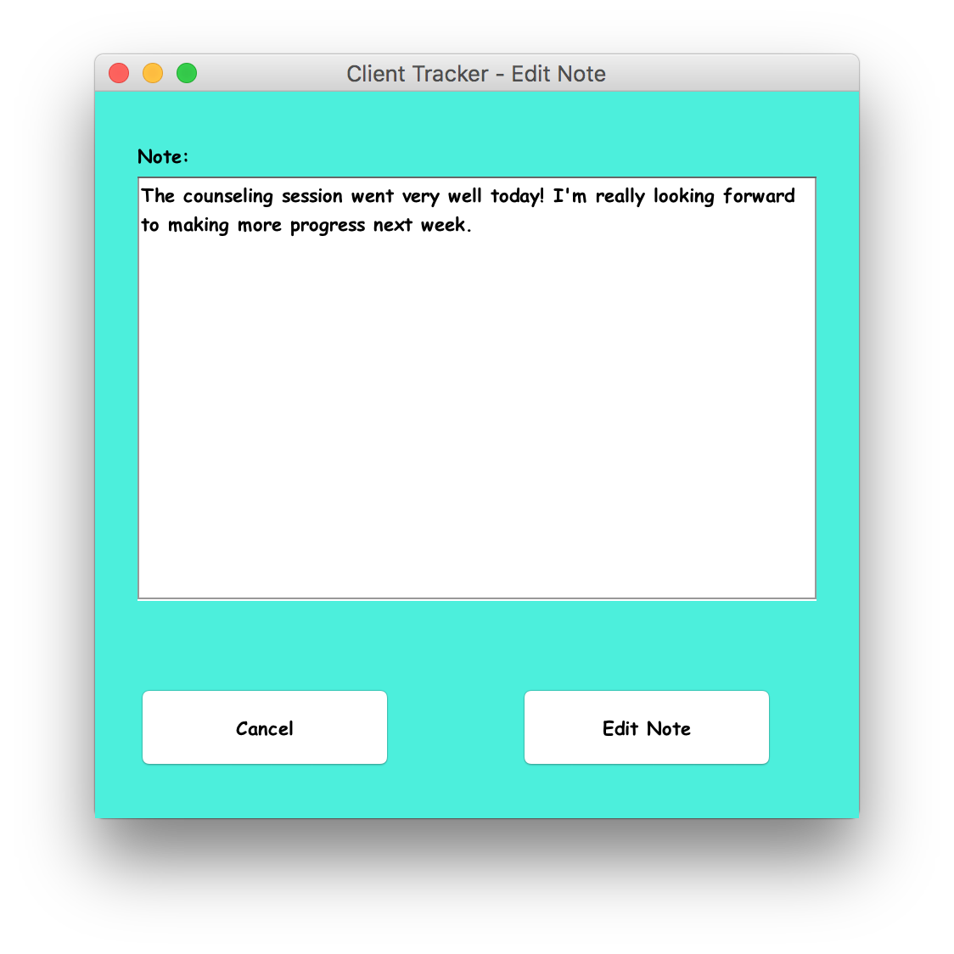
Edit Note

Slide 10
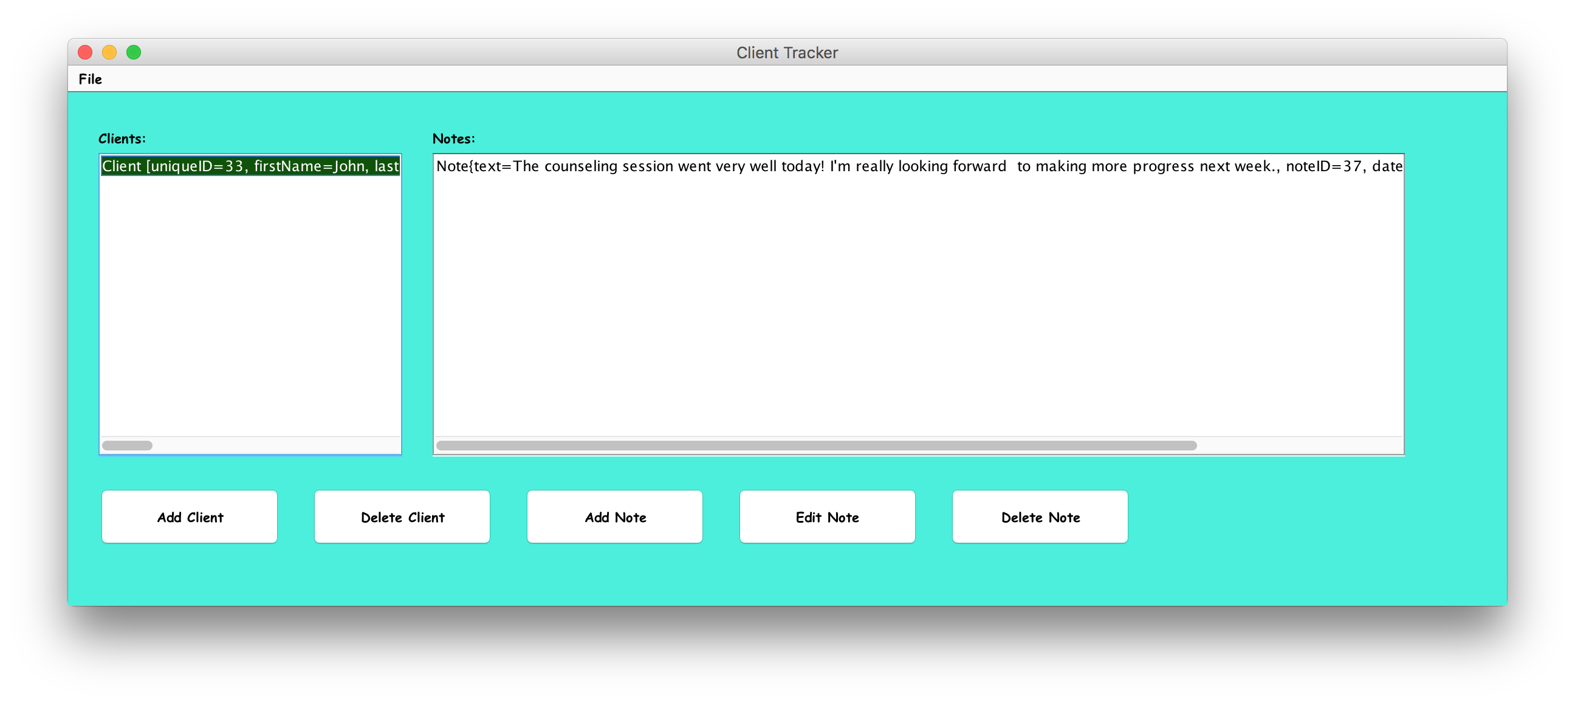
Home Screen (again)

Slide 11
EditNoteProtocol
Client
fromClient = Integer.toString(EDITNOTEPROTOCOL);
out.println(fromClient);
fromClient = Integer.toString(noteID);
out.println(fromClient);
fromClient = note.getText();
out.println(crypter.encrypt(fromClient));
String pattern = "yyyy-MM-dd HH:mm:ss";
SimpleDateFormat simpleDateFormat = new SimpleDateFormat(pattern);
fromClient = simpleDateFormat.format(note.getDate());
out.println(crypter.encrypt(fromClient));
Server
noteID = in.readLine();
text = in.readLine();
date = in.readLine();
this.query = this.conn.prepareStatement("UPDATE Notes SET text = ?, date = ? WHERE noteID = ?");
query.setString(1, text);
query.setString(2, date);
query.setString(3, noteID);
query.execute();

Slide 12
Hashing/Encryption
Hashing
  SHA512
    Stored in database in place of password
  SHA256
    Used to generate encryption seed
Encryption
  Advanced Encryption Standard (AES)
  256-bit

Slide 13
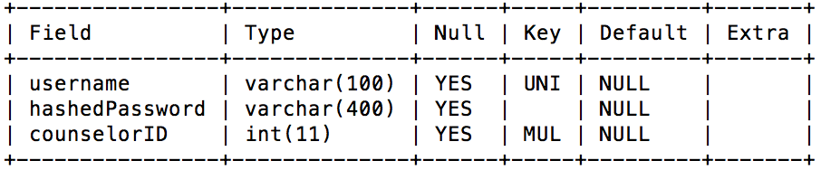
Users Table

Slide 14
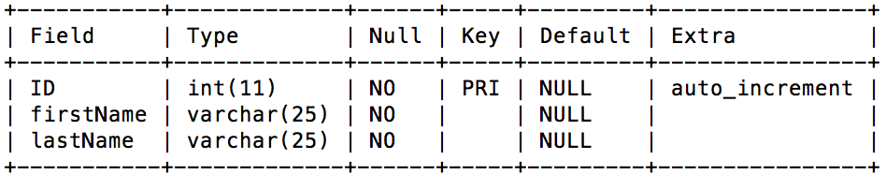
Counselors Table

Slide 15
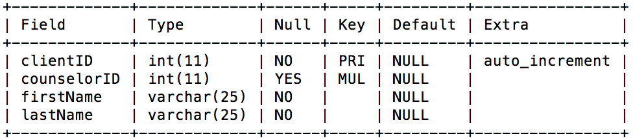
Clients Table

Slide 16
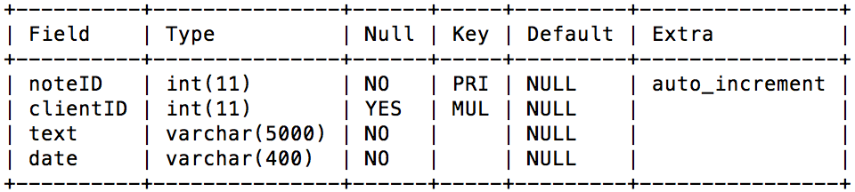
Notes Table

Slide 17
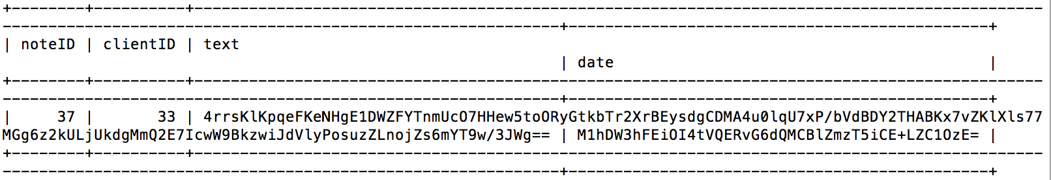
Notes Example Entry

Slide 18
Amazon Web Services
Free-tier products
Amazon Relational Database Service (RDS)
  MySQL Server instance
Amazon Elastic Compute Cloud (EC2)
  ClientTrackerService instance

Slide 19
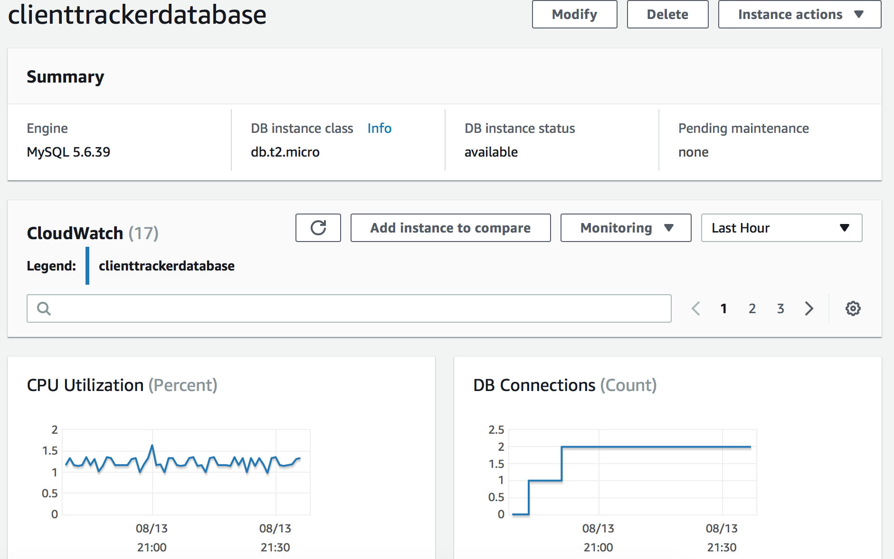
Relational Database Service

Slide 20
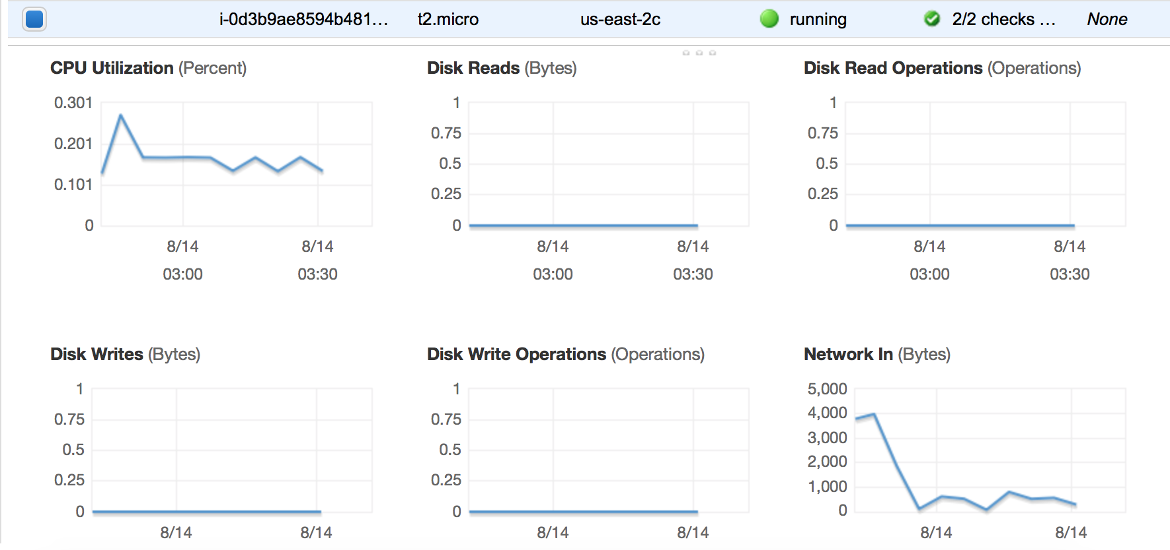
Elastic Compute Cloud

Slide 21
Questions?

