Slide 1
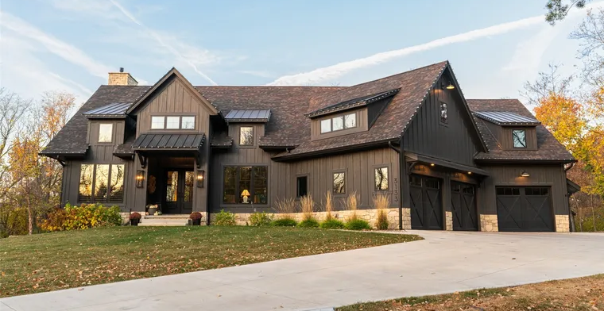
Predicting House Prices using Regression Models
Newton Tran

Slide 2
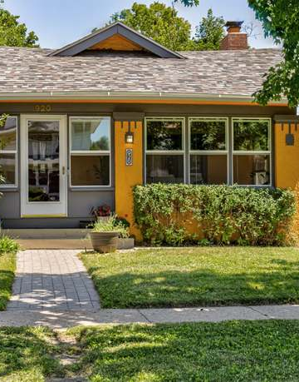
Problem Overview
Goal: Predict house prices using regression analysis on the Ames, Iowa housing dataset
Dataset: 1460 training entries, 1459 test entries, 80 features (numerical + categorical)
Target variable: SalePrice

Slide 3
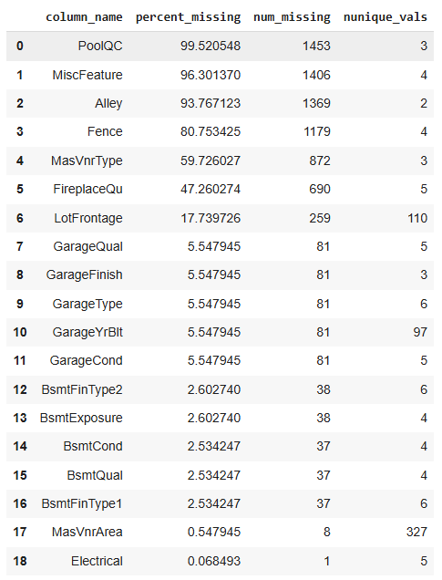
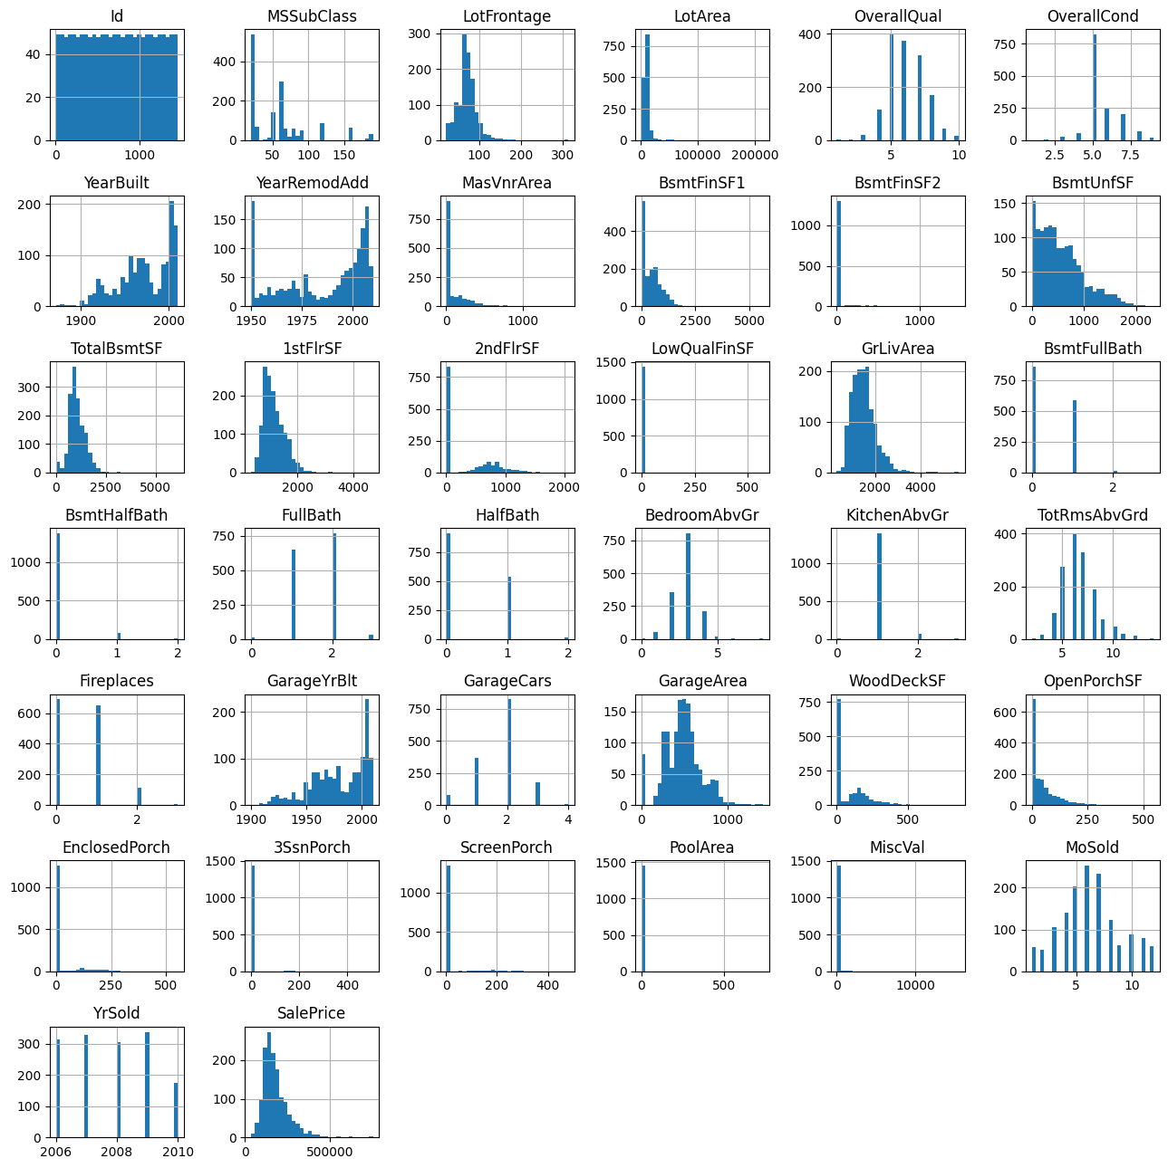
Exploratory Data Analysis
Analyzed missing values, distributions, skewness, and outliers

Slide 4
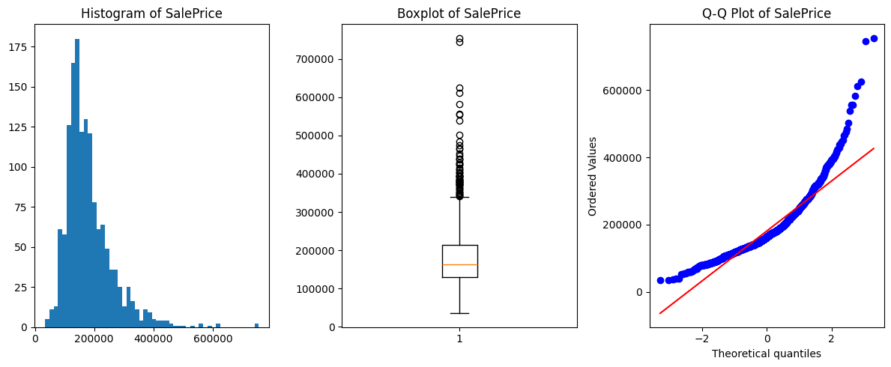
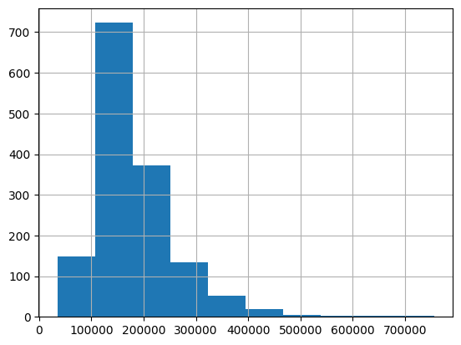
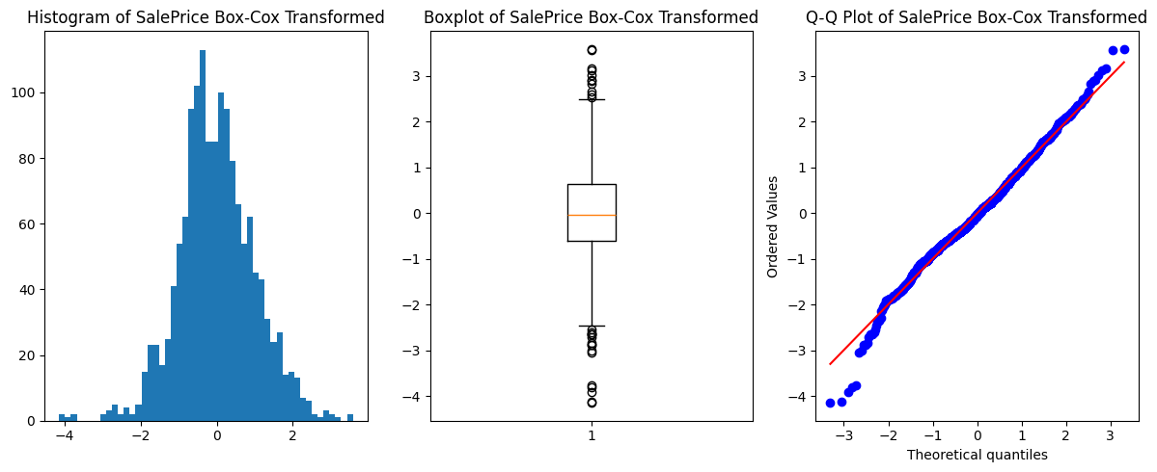
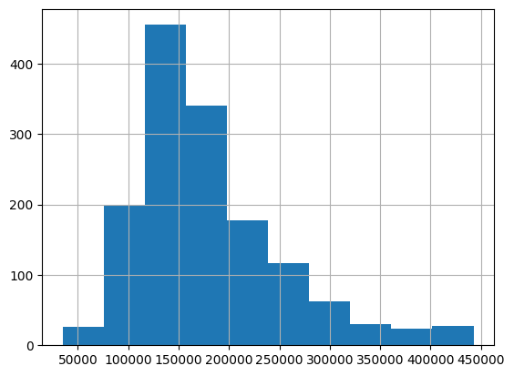
Exploratory Data Analysis
Applied Box-Cox transformation and winsorization of top 1% observations ( $442,567.01) to normalize SalePrice

Slide 5
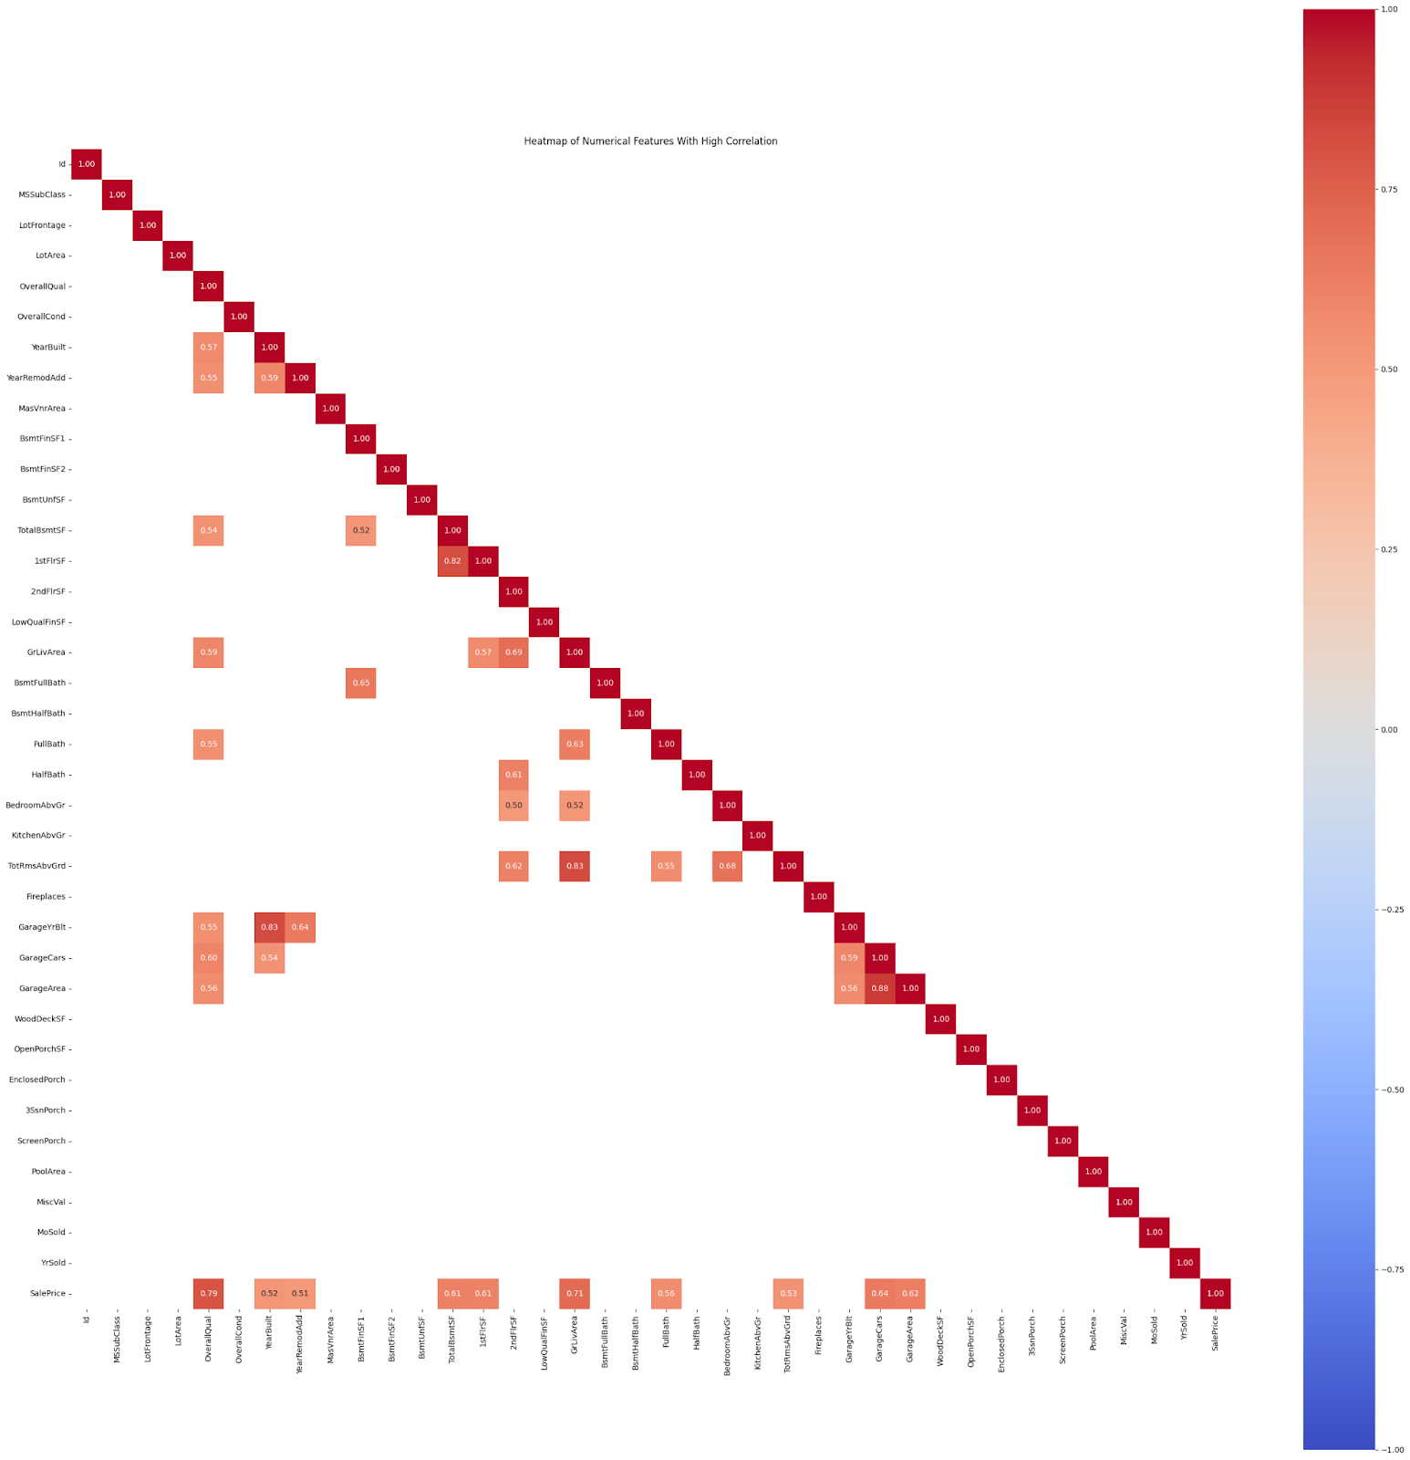
Exploratory Data Analysis
Identified multicollinearity (e.g., GarageCars vs GarageArea)
Features that had a correlation value of 0.5 or above were utilized for additional feature engineering

Slide 6
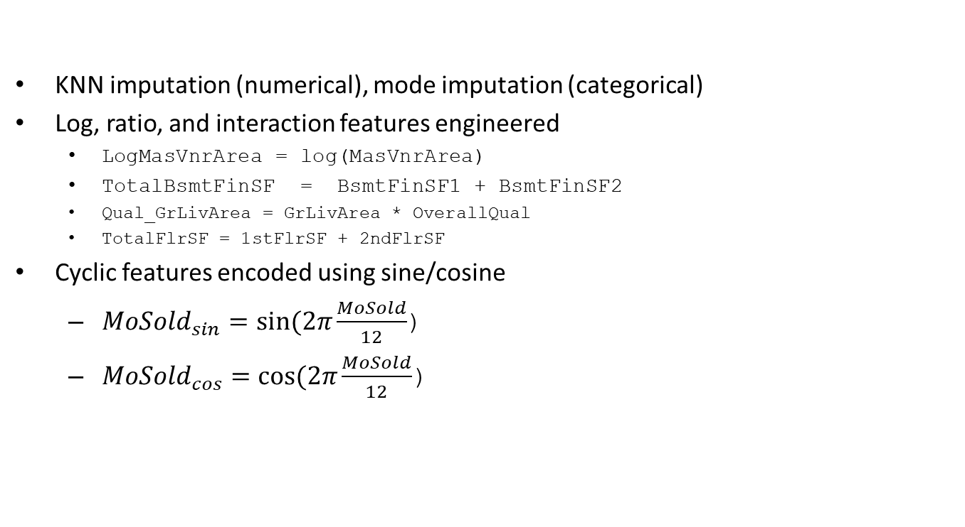
Feature Engineering & Preprocessing
KNN imputation (numerical), mode imputation (categorical)
Log, ratio, and interaction features engineered
LogMasVnrArea = log(MasVnrArea)
TotalBsmtFinSF = BsmtFinSF1 + BsmtFinSF2
Qual_GrLivArea = GrLivArea * OverallQual
TotalFlrSF = 1stFlrSF + 2ndFlrSF
Cyclic features encoded using sine/cosine
${MoSold}_{sin}=sin⁡(2π\frac{MoSold}{12}$)
${MoSold}_{cos}=cos⁡(2π\frac{MoSold}{12}$)

Slide 7
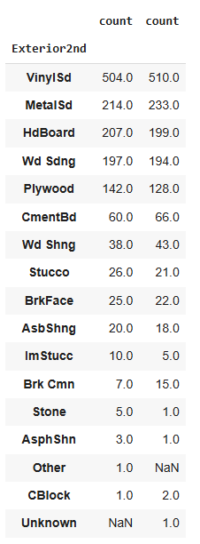
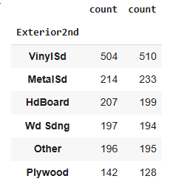
Feature Engineering & Preprocessing
For categorical features, one-hot or ordinal encoding were used
Some instances where a specific value was present in the train dataset but not in test dataset or vice versa
The value counts were consolidated on a numerical threshold
Final dataset: 214 features after robust scaling and encoding

Slide 8
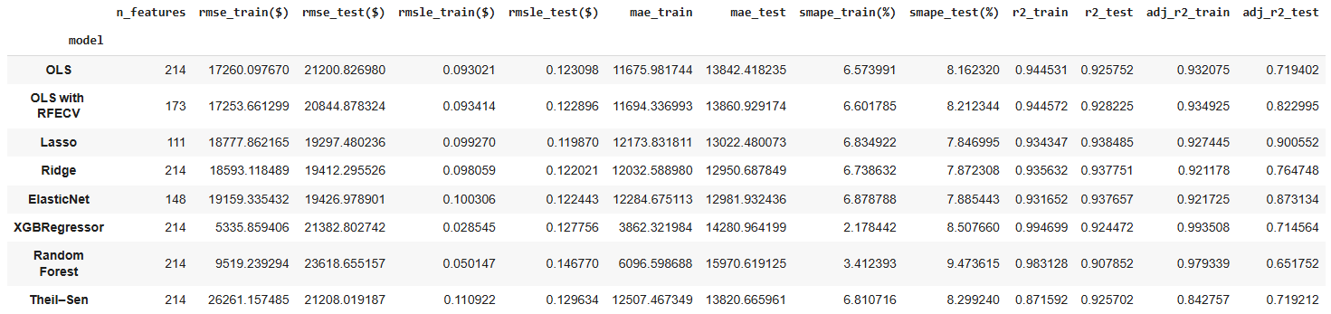
Models & Evaluation
Training data was 80/20 train-test split
Eight total models were developed
Linear Models: OLS, OLS with RFECV, Lasso, Ridge, ElasticNet, Theil-Sen
Tree-Based Models: Random Forest, XGBoost
Best Model: Lasso Regression
Test RMSE: $19,297 | Adjusted R²: 0.901

Slide 9
Key Observations
Lasso Regression generalizes best with regularization
Both tree-based models XGBoost and Random Forest overfit
Engineered interaction features improved results
Box-Cox and winsorization improved overall model predictive performance

Slide 10
Conclusion & Future Work
Lasso captured strong linear trends in SalePrice
Also helped achieve our goal of obtaining an interpretable model
Explore non-linear models (e.g., CatBoost, LightGBM)
Experiment with more feature engineering strategies
Apply dimensionality reduction for generalization

Slide 11
References
Real-Life Applications of Correlation and Regression. (2024, April 10). GeeksforGeeks. https://www.geeksforgeeks.org/real-life-applications-of-correlation-and-regression/
Regression analysis. (2019, March 22). Wikipedia; Wikimedia Foundation. https://en.wikipedia.org/wiki/Regression_analysis
‌Gupta, M. (2018, September 13). ML | Linear Regression - GeeksforGeeks. GeeksforGeeks. https://www.geeksforgeeks.org/ml-linear-regression/
GeeksforGeeks. (2024, August 13). Handling Missing Data with KNN Imputer. GeeksforGeeks; GeeksforGeeks. https://www.geeksforgeeks.org/handling-missing-data-with-knn-imputer/
‌Regression Analysis: Understanding the Why? | GEOG 586: Geographic Information Analysis. (n.d.). Www.e-Education.psu.edu. https://www.e-education.psu.edu/geog586/node/624

