Slide 1
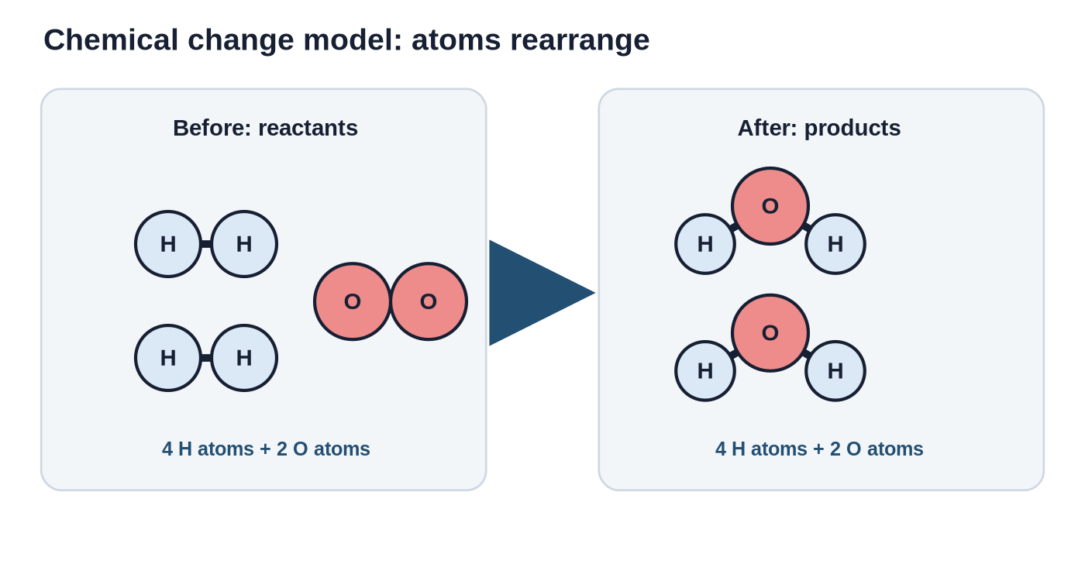
Intro Molecules
Models, chemical change, and temperature change
Learning target
I can make and draw a model of molecules showing the composition before and after a chemical change as well as what happens when temperature changes.
Intro Molecules | 1
Notes:
Open by telling students the day is about making invisible particles visible with models. The target has three pieces: draw molecules, show before/after a chemical change, and show what temperature changes do.
[Sources] Sources: OpenStax Chemistry: Atoms First 2e, sections 1.1 and 1 summary; ACS Middle School Chemistry Lesson 1.2 Molecules in Motion, last modified 2024-07-18.

Slide 2
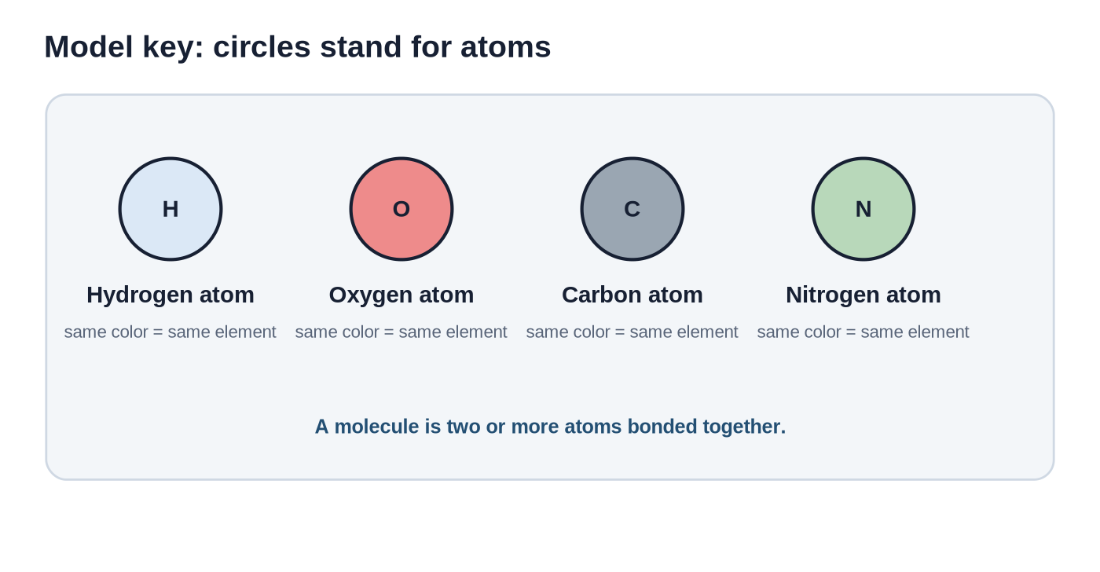
What a molecule model shows
A model is a useful simplification - not a photograph.
Atom
One particle of an element. In our model, one circle = one atom.
Molecule
Two or more atoms bonded together. Bonded atoms move as a unit.
Composition
The types and number of atoms in a molecule.
Intro Molecules | 2
Notes:
Emphasize that the colors and letters are a code. Students should not worry that real atoms look exactly like circles.
[Sources] Sources: OpenStax Chemistry: Atoms First 2e, sections 1.1 and 1 summary; ACS Middle School Chemistry Lesson 1.2 Molecules in Motion, last modified 2024-07-18.

Slide 3
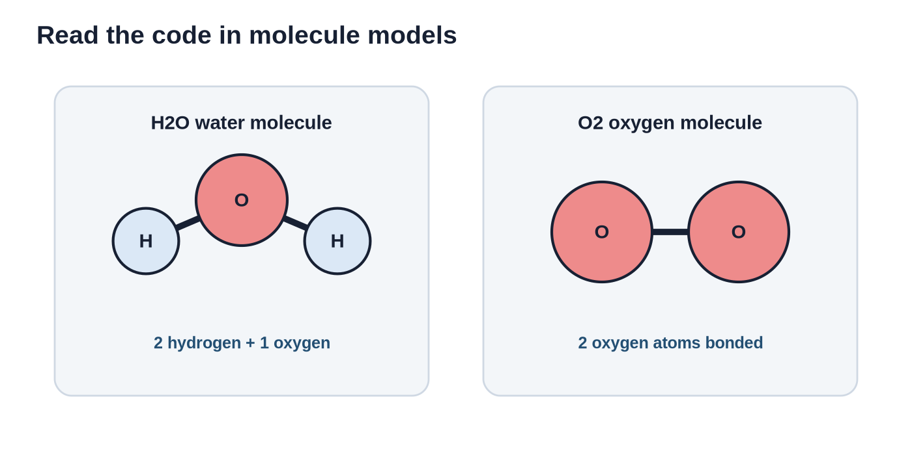
Read the code in a model
Color tells the element. Connections tell what is bonded.
Water molecule
Composition: 2 hydrogen atoms + 1 oxygen atom
Oxygen molecule
Composition: 2 oxygen atoms bonded together
Model reading move
Say what stays the same: atom colors/counts. Say what changes: partners, spacing, or motion.
Intro Molecules | 3
Notes:
This slide sets up the repeated sentence frame students will use: what stays the same, and what changes?
[Sources] Sources: OpenStax Chemistry: Atoms First 2e, sections 1.1 and 1 summary; ACS Middle School Chemistry Lesson 1.2 Molecules in Motion, last modified 2024-07-18.

Slide 4
Before and after: count atoms
Chemical models must keep track of matter.
Count before
4 H atoms and 2 O atoms
Count after
4 H atoms and 2 O atoms
Claim
The atoms were rearranged into new molecules. The atoms were not created or destroyed.
Intro Molecules | 4
Notes:
Connect to conservation of matter at the atom-count level. Students do not need coefficients yet; the visual count is enough for grade 7.
[Sources] Sources: OpenStax Chemistry: Atoms First 2e, sections 1.1 and 1 summary; ACS Middle School Chemistry Lesson 1.2 Molecules in Motion, last modified 2024-07-18.

Slide 5
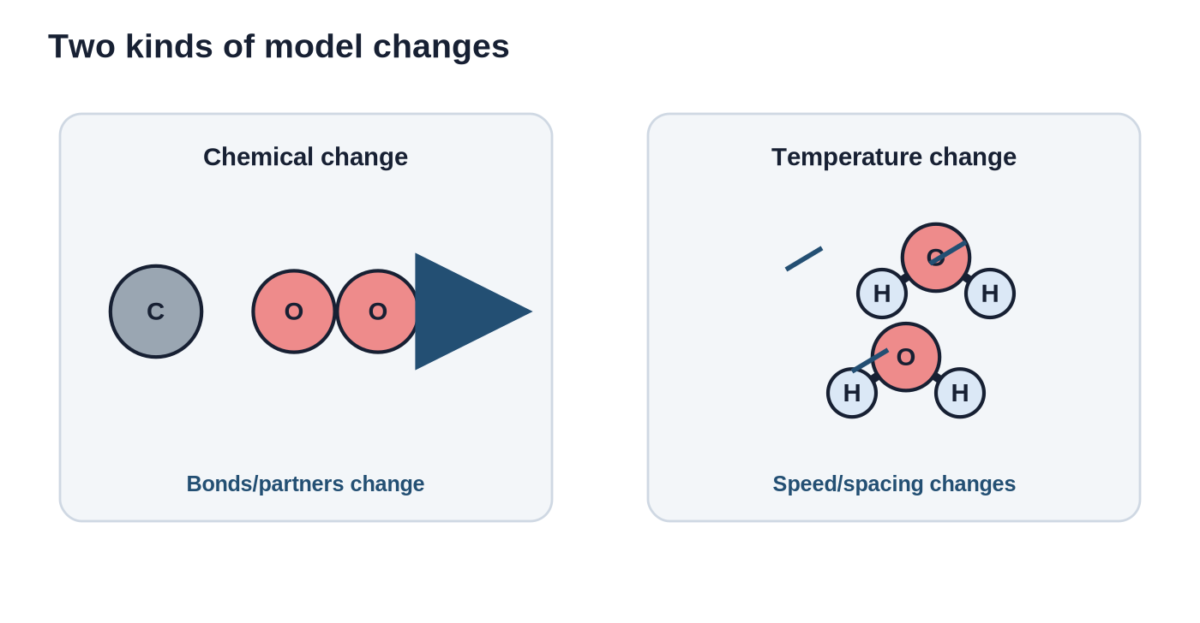
Chemical change = new particle arrangement
Same atoms. New partners. New substances.
Evidence in a model
Bonds or partners are different after the change.
Not enough
Molecules moving faster or spreading out is not by itself a chemical change.
Model check
Can you account for every atom before and after?
Intro Molecules | 5
Notes:
Keep the distinction narrow: a chemical change creates new substances because atoms are connected differently. Temperature affects motion/spacing unless chemistry also occurs.
[Sources] Sources: OpenStax Chemistry: Atoms First 2e, sections 1.1 and 1 summary; ACS Middle School Chemistry Lesson 1.2 Molecules in Motion, last modified 2024-07-18.

Slide 6
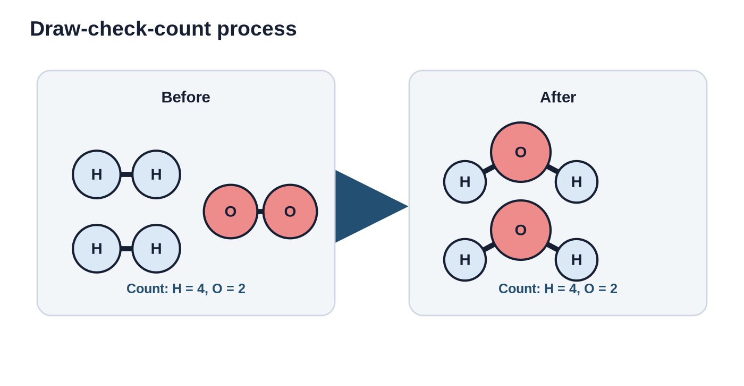
Teacher model: how to draw a chemical change
Use the same atom key on both sides.
Step 1: Key
Choose one color/letter for each atom type.
Step 2: Before
Draw the starting molecules. Keep atoms bonded correctly.
Step 3: After
Redraw the same atoms in new molecules.
Step 4: Count
Check each atom type before and after.
Draw-check-count
Use the same colors, draw new molecules, then count each atom type on both sides.
Intro Molecules | 6
Notes:
Model the exact student process: make a key, draw before, draw after, count both sides. Avoid turning it into balancing equations; keep the focus on model meaning.
[Sources] Sources: OpenStax Chemistry: Atoms First 2e, sections 1.1 and 1 summary; ACS Middle School Chemistry Lesson 1.2 Molecules in Motion, last modified 2024-07-18.

Slide 7
Formative check 1: Which model works?
Silent think -> partner talk -> whole class.
Model A
Model B
Explain
Before: 2 red atoms + 2 white atoms
After: 1 red atom + 2 white atoms
Does it conserve atoms?
Before: 2 red atoms + 4 white atoms
After: 2 red atoms + 4 white atoms
Does it conserve atoms?
Sentence frame:
“I think ___ works because the model shows ___ before and ___ after.”
Teacher look-for: students justify with atom counts, not with picture neatness.
Intro Molecules | 7
Notes:
Expected response: Model B is acceptable for conservation of atom counts; Model A loses one red atom. Push students to name what evidence in the model supports the answer.
[Sources] Sources: OpenStax Chemistry: Atoms First 2e, sections 1.1 and 1 summary; ACS Middle School Chemistry Lesson 1.2 Molecules in Motion, last modified 2024-07-18.

Slide 8
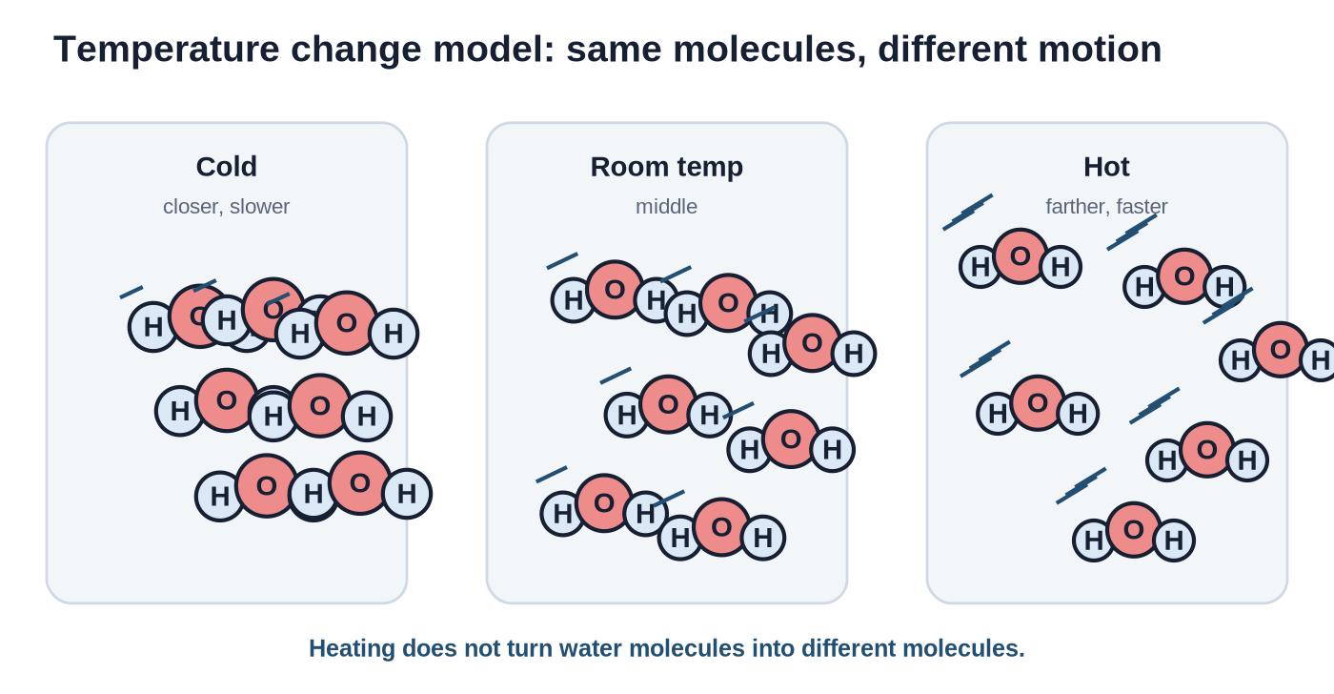
Temperature changes molecular motion
Heating and cooling change how molecules move.
Heating
Molecules move faster and tend to be farther apart.
Cooling
Molecules move slower and tend to be closer together.
Important
The water molecules are still H₂O molecules. This is a motion/spacing change.
Intro Molecules | 8
Notes:
Use the ACS example: hot water and food coloring mix faster because molecules move faster. Keep wording age appropriate: “tend to” acknowledges phase and substance differences.
[Sources] Sources: OpenStax Chemistry: Atoms First 2e, sections 1.1 and 1 summary; ACS Middle School Chemistry Lesson 1.2 Molecules in Motion, last modified 2024-07-18.

Slide 9
How to draw temperature in a model
Do not change the molecule formula. Change spacing and motion lines.
Cold
Room temperature
Hot
closer dots, fewer motion lines
middle spacing and motion
farther dots, more motion lines
Intro Molecules | 9
Notes:
Tell students that the motion lines are model symbols. They show speed in a still drawing.
[Sources] Sources: OpenStax Chemistry: Atoms First 2e, sections 1.1 and 1 summary; ACS Middle School Chemistry Lesson 1.2 Molecules in Motion, last modified 2024-07-18.

Slide 10
Compare the two model stories
Ask: did the composition change?
Chemical change
Temperature change
What changes in the model?
• Atoms have new partners
• New molecules form
• Composition of molecules changes
What stays the same?
• Total atom count for each element
What changes in the model?
• Molecules move faster/slower
• Spacing changes
What stays the same?
• Molecule identity/composition
Key question: Are the atoms rearranged into different molecules, or are the same molecules just moving differently?
Intro Molecules | 10
Notes:
This is the conceptual hinge of the lesson. Accept student wording that captures the idea even if vocabulary is still developing.
[Sources] Sources: OpenStax Chemistry: Atoms First 2e, sections 1.1 and 1 summary; ACS Middle School Chemistry Lesson 1.2 Molecules in Motion, last modified 2024-07-18.

Slide 11
Formative check 2: Draw the model
Individual draw -> pair check.
Student task
Pair check questions
Use the atom key below. Draw a before-and-after model for:
2 H₂ molecules + 1 O₂ molecule -> 2 H₂O molecules
Then count H and O atoms before and after.
1. Did you use the same colors on both sides?
2. Did every atom from before appear after?
3. Did your after model show new molecules, not just moved-apart molecules?
H = white circle O = red circle
Intro Molecules | 11
Notes:
Circulate for two common errors: drawing single H and O atoms instead of H2/O2, and losing atoms during the redraw. This is a formative drawing check, not an equation-balancing quiz.
[Sources] Sources: OpenStax Chemistry: Atoms First 2e, sections 1.1 and 1 summary; ACS Middle School Chemistry Lesson 1.2 Molecules in Motion, last modified 2024-07-18.

Slide 12
Exit ticket
One model. Three claims.
1. Draw
Draw a molecule-level before-and-after model for a chemical change using at least two atom types.
2. Count
Write the atom counts before and after.
3. Explain
One sentence: “This shows a chemical change because ___.”
Bonus connection
How would your drawing change if the temperature increased but no chemical change happened?
Intro Molecules | 12
Notes:
Collect or spot-check for whether students can separate chemical rearrangement from temperature motion/spacing.
[Sources] Sources: OpenStax Chemistry: Atoms First 2e, sections 1.1 and 1 summary; ACS Middle School Chemistry Lesson 1.2 Molecules in Motion, last modified 2024-07-18.

