Slide 1
Datatypes II
Chapter 2

Slide 2
Outline
Logical Operations on Bits
  AND, OR, NOT, XOR, (NAND, NOR)
Other Representations
  Bit vectors
  Floating Point
  ASCII
  Hexadecimal
  Octal

Slide 3
AND | 0 | 1
0
1

Slide 4
A | B | A AND B
0 | 0
0 | 1
1 | 0
1 | 1

Slide 5
Bitwise AND
0101 AND 0110 (5 & 6)
0101
0110
0100

Slide 6
A | B | A OR B
0 | 0
0 | 1
1 | 0
1 | 1

Slide 7
Bitwise OR
0101 OR 0110 (5 | 6)
0101
0110
0111

Slide 8
A | NOT A
0
1

Slide 9
Bitwise NOT (Complement)
NOT 0101 ~5
0101
1010

Slide 10
A | B | A XOR B
0 | 0
0 | 1
1 | 0
1 | 1

Slide 11
Bitwise XOR
0101 XOR 0110 5^6
0101
0110
0011

Slide 12
A | B | A NAND B
0 | 0
0 | 1
1 | 0
1 | 1

Slide 13
Bitwise NAND
0101 NAND 0110 No C Operator
~(5 & 6)
0101
0110
1011

Slide 14
A | B | A NOR B
0 | 0
0 | 1
1 | 0
1 | 1

Slide 15
Bitwise NOR
0101 NOR 0110 No C Operator
~(5 | 6)
0101
0110
1000

Slide 16
Left Shift
0101 Leftshift 10 5 << 2
Before 0101
After 0100

Slide 17
Right Shift
0101 Rightshift 10 5 >> 2
Before 0101
After 0001

Slide 18
Note Well
0101 Rightshift 10 5 >> 2
Before 1101
After 0011 or
1111

Slide 19
How would you negate using bitwise operators and the plus sign?

Slide 20
How would you negate using bitwise operators and the plus sign?
~x+1

Slide 21
Other Representations

Slide 22
Bit Vectors
Sometimes for reasons of space efficiency we can effectively store a group of booleans packed together in a single byte/word/etc.
7
6
5
4
3
2
1
0
0
0
1
0
0
1
0
0
Item 5 in use
Item 2 in use

Slide 23
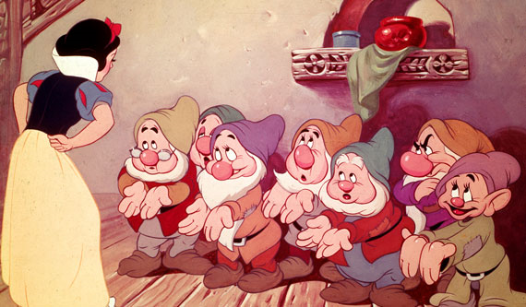

Slide 24
Bit Vectors
How do we manipulate the individual bits in the bit vector?
Example how do we set bit 6?
How do we clear bit 2?
How do we toggle a bit?
How do we test a bit?
7
6
5
4
3
2
1
0
0
0
1
0
0
1
0
0

Slide 25
Floating Point

Slide 26
Historically
The Indiana Legislature once passed legislation declaring that the value of π was exactly 3

Slide 27
Historically
Initially hardware manufacturers used whatever they thought was appropriate given their market and/or technology required.
IBM, DEC, CDC, etc. each had their own formats and in fact multiple formats
Typical implementations might range from 32 up to 128 bits. Common to find multiple formats available (i.e. float and double)
1985 IEEE published Floating Point Standard
  ANSI/IEEE Standard 754-1985,
  Standard for Binary Floating Point Arithmetic

Slide 28
How would you do it?

Slide 29
Scientific Notation
Sign of
Exponent
-6.023 x 10⁻²³
Exponent
Sign
Normalized
Mantissa
?
Base

Slide 30
Binary Floating Point Representation
Same basic idea as scientific notation
Modifications and improvements based on
  Hardware architecture
  Efficiency (Space & Time)
  Additional requirements
    Infinity
    Not a number
    Not normalized
    etc.
3

Slide 31
IEEE-754
31
30 23
22 0
0
00000000
00000000000000000000000
s
i
g
n
exponent
mantissa (significand)
(-1)^{S} * 1.M * 2 ^{E-127}
Sign
1 is understood
Mantissa (w/o leading 1)
Base
Exponent

Slide 32
IEEE-754
0
00000000
00000000000000000000000
s
i
g
n
exponent
mantissa (significand)
(-1)^{S} * 1.M * 2 ^{E-127}
Can any of these equal 0?

Slide 33
So how can we represent 0?
0
00000000
00000000000000000000000
s
i
g
n
exponent
mantissa (significand)
(-1)^{S} * 1.M * 2 ^{E-127}
E == 0
0 < E < 255
E == 255
M==0
0
Powers
of
Two
∞
M!=0
Non-normalized
typically
underflow
Ordinary
Old
Numbers
Not
A
Number

Slide 34

Can be written...
0
00000000
00000000000000000000000
s
i
g
n
exponent
mantissa (significand)
(-1)^{S} * 2 ^{E-127} * 1.M
E == 0
0 < E < 255
E == 255
M==0
0
Powers
of
Two
∞
M!=0
Non-normalized
typically
underflow
Ordinary
Old
Numbers
Not
A
Number

Slide 35
Pop Quiz!!!

Slide 36
0 00000000 00000000000000000000000
1 00000000 00000000000000000000000
= 0
= -0
0
00000000
00000000000000000000000
s
i
g
n
exponent
mantissa (significand)
(-1)^{S} * 2 ^{E-127} * 1.M
E == 0
0 < E < 255
E == 255
M==0
0
Powers
of
Two
∞
M!=0
Non-normalized
typically
underflow
Ordinary
Old
Numbers
Not
A
Number

Slide 37
0 11111111 00000000000000000000000
1 11111111 00000000000000000000000
= Infinity
= -Infinity
0
00000000
00000000000000000000000
s
i
g
n
exponent
mantissa (significand)
(-1)^{S} * 2 ^{E-127} * 1.M
E == 0
0 < E < 255
E == 255
M==0
0
Powers
of
Two
∞
M!=0
Non-normalized
typically
underflow
Ordinary
Old
Numbers
Not
A
Number

Slide 38
0 11111111 00000100000000000000000
1 11111111 00100010001001010101010
= NaN
= NaN
0
00000000
00000000000000000000000
s
i
g
n
exponent
mantissa (significand)
(-1)^{S} * 2 ^{E-127} * 1.M
E == 0
0 < E < 255
E == 255
M==0
0
Powers
of
Two
∞
M!=0
Non-normalized
typically
underflow
Ordinary
Old
Numbers
Not
A
Number

Slide 39
0 10000000 00000000000000000000000
= +1 * 2⁽¹²⁸⁻¹²⁷⁾ * 1.0
= 2
0
00000000
00000000000000000000000
s
i
g
n
exponent
mantissa (significand)
(-1)^{S} * 2 ^{E-127} * 1.M
E == 0
0 < E < 255
E == 255
M==0
0
Powers
of
Two
∞
M!=0
Non-normalized
typically
underflow
Ordinary
Old
Numbers
Not
A
Number

Slide 40
0 10000001 10100000000000000000000
1 10000001 10100000000000000000000
= +1 * 2⁽¹²⁹⁻¹²⁷⁾ * 1.101
= -1 * 2⁽¹²⁹⁻¹²⁷⁾ * 1.101
= 6.5
= -6.5
0
00000000
00000000000000000000000
s
i
g
n
exponent
mantissa (significand)
(-1)^{S} * 2 ^{E-127} * 1.M
E == 0
0 < E < 255
E == 255
M==0
0
Powers
of
Two
∞
M!=0
Non-normalized
typically
underflow
Ordinary
Old
Numbers
Not
A
Number

Slide 41
0 00000001 00000000000000000000000
0 00000000 10000000000000000000000
= +1 * 2⁽¹⁻¹²⁷⁾ * 1.0
= +1 * 2⁽⁻¹²⁶⁾ * 0.1
= 2⁽⁻¹²⁶⁾
= 2⁽⁻¹²⁷⁾
0
00000000
00000000000000000000000
s
i
g
n
exponent
mantissa (significand)
(-1)^{S} * 2 ^{E-127} * 1.M
E == 0
0 < E < 255
E == 255
M==0
0
Powers
of
Two
∞
M!=0
Non-normalized
typically
underflow
Ordinary
Old
Numbers
Not
A
Number

Slide 42
0 00000000 00000000000000000000001
= +1 * 2⁽⁻¹²⁶⁾ * 0.00000000000000000000001
= 2⁽⁻¹⁴⁹⁾ (Smallest positive value)
0
00000000
00000000000000000000000
s
i
g
n
exponent
mantissa (significand)
(-1)^{S} * 2 ^{E-127} * 1.M
E == 0
0 < E < 255
E == 255
M==0
0
Powers
of
Two
∞
M!=0
Non-normalized
typically
underflow
Ordinary
Old
Numbers
Not
A
Number

Slide 43
0
00000000
00000000000000000000000
s
i
g
n
exponent
mantissa (significand)
(-1)^{S} * 2 ^{E-127} * 1.M
0 11111111 00000100000000000000000 = NaN
1 11111111 00100010001001010101010 = NaN
0 11111111 00000000000000000000000 = Infinity
0 10000001 10100000000000000000000 = +1 * 2⁽¹²⁹⁻¹²⁷⁾ * 1.101 = 6.5
0 10000000 00000000000000000000000 = +1 * 2⁽¹²⁸⁻¹²⁷⁾ * 1.0 = 2
0 00000001 00000000000000000000000 = +1 * 2⁽¹⁻¹²⁷⁾ * 1.0 = 2⁽⁻¹²⁶⁾
0 00000000 10000000000000000000000 = +1 * 2⁽⁻¹²⁶⁾ * 0.1 = 2⁽⁻¹²⁷⁾
0 00000000 00000000000000000000001
= +1 * 2⁽⁻¹²⁶⁾ * 0.00000000000000000000001
= 2⁽⁻¹⁴⁹⁾ (Smallest positive value)
0 00000000 00000000000000000000000 = 0
1 00000000 00000000000000000000000 = -0
1 10000001 10100000000000000000000 = -1 * 2⁽¹²⁹⁻¹²⁷⁾ * 1.101 = -6.5
1 11111111 00000000000000000000000 = -Infinity

Slide 44
Smallest positive normalized number
0 00000001 00000000000000000000000 = +1 * 2⁽¹⁻¹²⁷⁾ * 1.0 = 2⁽⁻¹²⁶⁾
0
00000000
00000000000000000000000
s
i
g
n
exponent
mantissa (significand)
(-1)^{S} * 2 ^{E-127} * 1.M
E == 0
0 < E < 255
E == 255
M==0
0
Powers
of
Two
∞
M!=0
Non-normalized
typically
underflow
Ordinary
Old
Numbers
Not
A
Number

Slide 45
Next smallest positive number
0 00000000 11111111111111111111111
= +1 * 2⁽⁻¹²⁶⁾ * 0.11111111111111111111111
0
00000000
00000000000000000000000
s
i
g
n
exponent
mantissa (significand)
(-1)^{S} * 2 ^{E-127} * 1.M
E == 0
0 < E < 255
E == 255
M==0
0
Powers
of
Two
∞
M!=0
Non-normalized
typically
underflow
Ordinary
Old
Numbers
Not
A
Number

Slide 46
Why not -127?
0 00000001 00000000000000000000000 = +1 * 2⁽¹⁻¹²⁷⁾ * 1.0 = 1.0 x 2⁽⁻¹²⁶⁾
0 00000000 11111111111111111111111
= +1 * 2⁽⁻¹²⁶⁾ * 0.11111111111111111111111
If exponent was -127
2⁽⁻¹²⁷⁾ * 0.11111111111111111111111 or
2⁽⁻¹²⁶⁾ * 0.011111111111111111111111
E == 0
M!=0
Non-normalized
typically
underflow

Slide 47
Conversion
In CS 1331 we noted:
float f;
int i;
f = i;
i = (int)f;
What does this imply?
  Converting floats to ints we may lose information
  Converting ints to floats we may lose information
  Converting either way we may lose information

Slide 48
Reality
Int: 0000000000000000000000000000000
Float: 0 00000000 0000000000000000000000

Slide 49
IEEE-754 Double
0
1 11
12 63
0
000...00
000000000...00000000000
s
i
g
n
exponent
mantissa (significand)
(-1)^{S} * 1.M * 2 ^{E-1023}
Sign
1 is understood
Mantissa (w/o leading 1)
Base
Exponent

Slide 50
Specials
0
1 11
12 63
0
00000000
00000000000000000000000
s
i
g
n
exponent
mantissa (significand)
(-1)^{S} * 1.M * 2 ^{E-1023}
E == 0
0 <E< 2047
E == 2047
M==0
0
Powers
of
Two
∞
M!=0
Non-normalized
typically
underflow
Ordinary
Old
Numbers
Not
A
Number

Slide 51
Double (64 bits)
31
Int: 0000000000000000000000000000000
Double: 0 000...00 000000000...0000000000
11
52

Slide 52
Comparing FP Numbers
The layout of the formula allows certain operations (like > ) to be performed with no conversion

Slide 53
ASCII

Slide 54
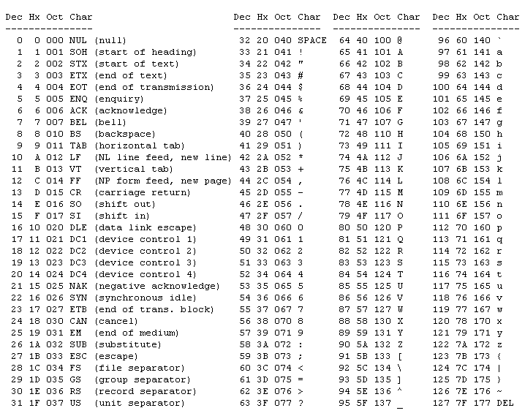
Why
two
codes?
Why
is
this
at
the
end?
What about these?

Slide 55
Fun ASCII Facts
‘A’ = 65 = 41₁₆ = 0100 0001
‘a’ = 97 = 61₁₆ = 0110 0001
‘0’ = 48 = 30₁₆ = 0011 0000
‘1’ = 49 = 31₁₆ = 0011 0001
‘2’ = 50 = 32₁₆ = 0011 0010
…
‘9’ = 57 = 39₁₆ = 0011 1001

Slide 56
Hexadecimal & Octal

Slide 57
Difficult
Using binary numbers is both a blessing a curse!
  One can examine directly any particular bit
  Reading, writing, etc. prone to error

Slide 58
Solution
Group bits and assign a single digit to represent each group
How big should each group be?

Slide 59
Bitwise Review
Can only be applied to integral operands
that is, char, short, int and long
(signed or unsigned)
& Bitwise AND
| Bitwise OR
^ Bitwise XOR
<< Shift Left
>> Shift Right
~ 1’s Complement (Inversion)

Slide 60
Bitwise Quiz
1 && 2
True! (1)
1 & 2
0
x << -2 Legal?
No!
x << 2 Write it another way?
x * 4
What does right shifting do to signed vars?
depends
x = x & ~077
Sets last six bits of x to zero!

Slide 61
Bitwise Quiz
Why is x = x & ~077 better than
x = x & 0177700
First one is independent of word length
(no extra cost...evaluated at compile time)
What does this do?
(x >> (p+1-n)) & ~(~0 << n);
/* getbits: get n bits from position p */
unsigned getbits(unsigned x, int p, int n)
{
return (x >> (p+1-n)) & ~(~0 << n);
}

Slide 62
Questions?

