Slide 1
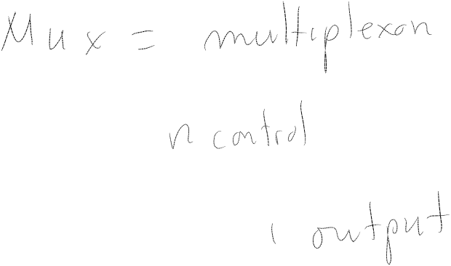
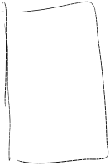

Digital Logic II
Chapter 3

Slide 2
So what are we doing?

Slide 3
Outline
Sequential Logic Circuits
  Memory
    Address space, Addessability, 2² x 3 bit mem.
  Examples, State, FSM's, Example Implementation
Datapath of the LC-3

Slide 4
Memory

Slide 5
Definitions
Address Space -- How many addresses?
Addressability -- How big is each memory location?

Slide 6
Question
A maxed out 32 bit processor would have an address space and an addressability of
  32 bits/8 bits
  4 GB (2³²)/8 bits
  2³² 32 bit words/1,2 or 4 bytes
  110 GB/32 MB

Slide 7
Memory
Basic Building Blocks
  Gated D Latch
  Decoder
  Multiplexors
  Register

Slide 8
Memory
Looking from the outside, what do we need?

Slide 9
Memory
Looking from the outside, what do we need?
ADDR
IN
WE
OUT

Slide 10

Memory

Slide 11
More Sequential Logic Circuits

Slide 12
Compare and Contrast
Combinational Logic Circuits
  Make decisions
  Same inputs always produce same output
  Depends on what is happening now
Sequential Logic Circuits
  Make decisions and store information
  Output depends on inputs AND state
  Depends on what has happened in the past as well as what is happening now

Slide 13
Sequential Logic Circuit
Input
Combinational
Logic Circuit
Output
Storage
Elements

Slide 14
Back to the Latch
Consider the Gated D latch…
It is simple and simple is what you want if you are going to implement a memory using 4 billion of them
But there is a drawback…
A Gated D Latch is a level triggered device that is it will store whatever value is present on the input when the write enable goes from true to false

Slide 15
Clocked Logic
To make the job of designing digital circuits easier it would be useful to be able to synchronize the operation using a clock

Slide 16
Why?

Slide 17
Possible Solution?

Slide 18
Edge Triggered Logic

Slide 19
Master-Slave Flip Flop

Slide 20
More State Machines

Slide 21
Sequential Logic Circuit
Input
Combinational
Logic Circuit
Output
Storage
Elements

Slide 22
Concept of State
Coke Machines
Adding Machines
Traffic Signal Controls
Parking Lot Controls
Combination Locks
Computers
Garage Door Openers

Slide 23
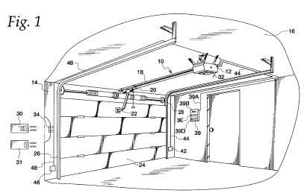

Slide 24
My Garage Door
L1
L2
The
Button

Slide 25
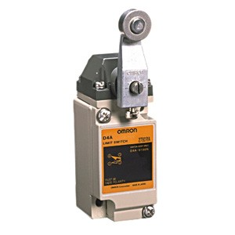
My Garage Door
L1
L2
The
Button

Slide 26
My Garage Door
L1
L2
mmmm
Motor Running
The
Button

Slide 27
My Garage Door
L1
L2
"Click"
The
Button

Slide 28
My Garage Door
L1
L2
mmmm
The
Button

Slide 29
My Garage Door
L1
L2
mmmm
The
Button

Slide 30
My Garage Door
L1
L2
mmmm
The
Button

Slide 31
My Garage Door
L1
L2
mmmm
The
Button

Slide 32
My Garage Door
L1
L2
mmmm
The
Button

Slide 33
My Garage Door
L1
L2
The
Button

Slide 34
My Garage Door
L1
L2
"Click"
The
Button

Slide 35
My Garage Door
L1
L2
mmmm
The
Button

Slide 36
My Garage Door
L1
L2
mmmm
The
Button

Slide 37
My Garage Door
L1
L2
mmmm
The
Button

Slide 38
My Garage Door
L1
L2
mmmm
The
Button

Slide 39
My Garage Door
L1
L2
mmmm
The
Button

Slide 40
My Garage Door
L1
L2
mmmm
The
Button

Slide 41
My Garage Door
L1
L2
The
Button

Slide 42

How can we describe the control logic?

Slide 43
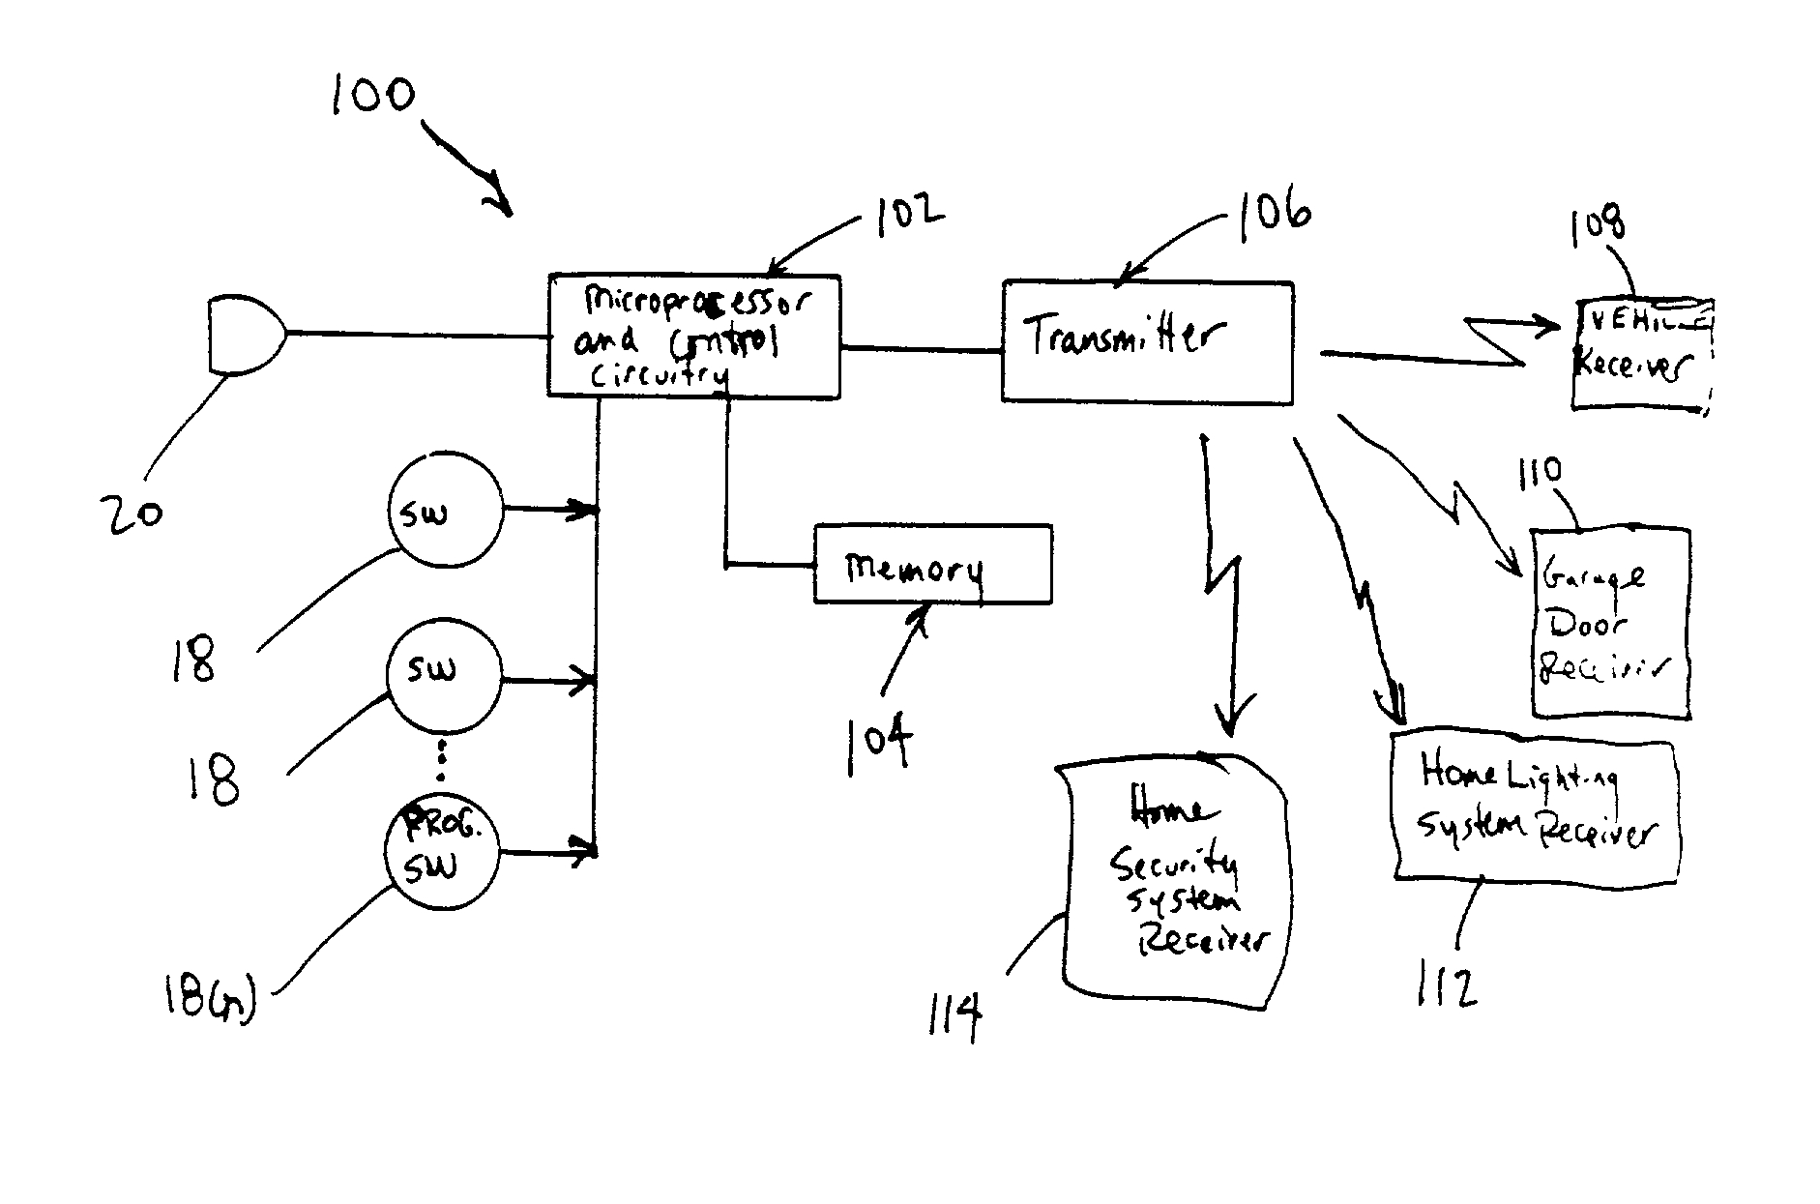

Slide 44
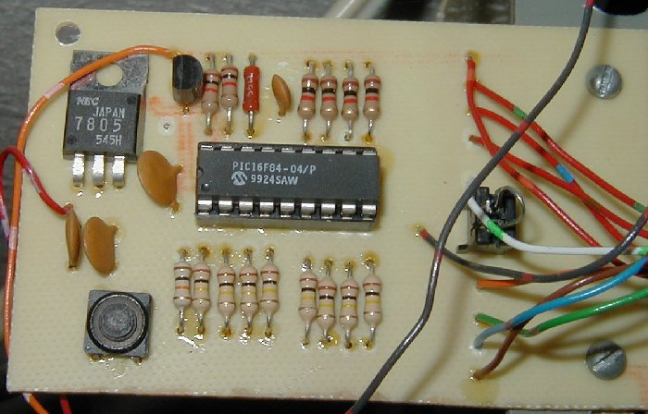

Slide 45
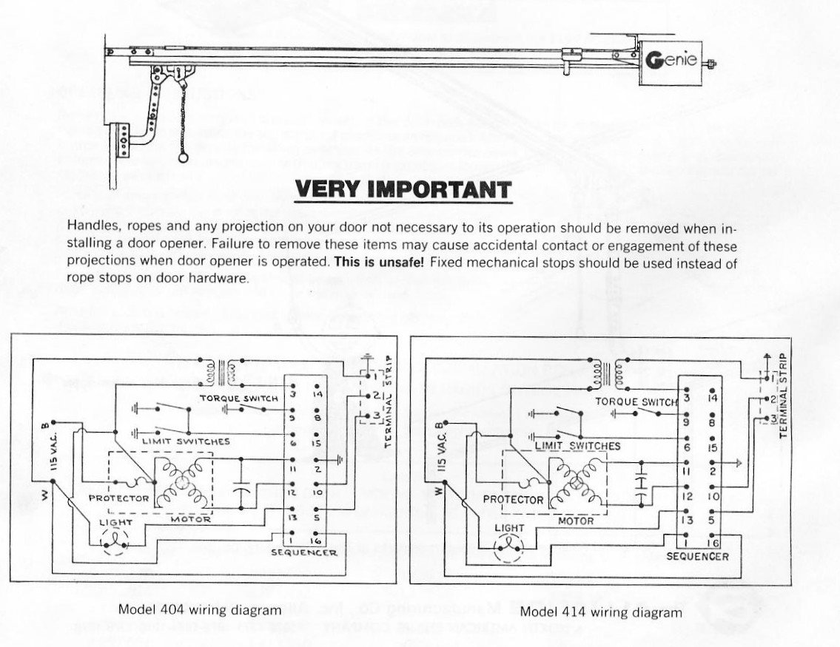

Slide 46
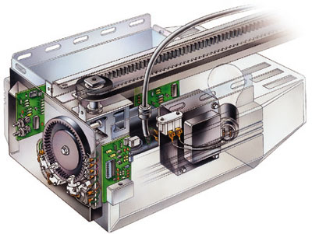

Slide 47
How can we describe the control logic?
A Finite State Machine (FSM) Diagram!

Slide 48
State Machine
Motor
Up
Stop
Start
Motor
Down
Enough States?

Slide 49
State Machine
Motor
Up
PB
Stop
(Up Next)
Stop
(Down
Next)
Start
Motor
Down
Assume we start
with the door down
ready to go up

Slide 50
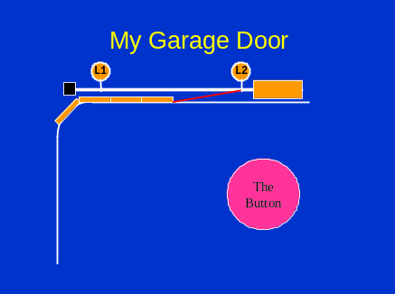
State Machine
Motor
Up
PB
L2
Stop
(Up Next)
Stop
(Down
Next)
Start
Motor
Down

Slide 51
State Machine
Motor
Up
PB
L2
Stop
(Up Next)
Stop
(Down
Next)
Start
Motor
Down
PB

Slide 52
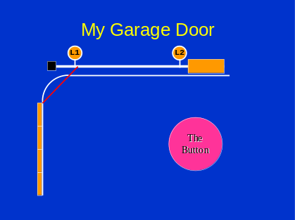
State Machine
Motor
Up
PB
L2
Stop
(Up Next)
Stop
(Down
Next)
Start
Motor
Down
L1
PB
Okay?

Slide 53
My Garage Door
L1
L2
The
Button

Slide 54
My Garage Door
L1
L2
"Click"
The
Button

Slide 55
My Garage Door
L1
L2
mmmm
The
Button

Slide 56
My Garage Door
L1
L2
mmmm
The
Button

Slide 57
My Garage Door
L1
L2
mmmm
"Click"
The
Button

Slide 58
My Garage Door
L1
L2
The
Button

Slide 59
My Garage Door
L1
L2
mmmm
"Click"
The
Button

Slide 60
My Garage Door
L1
L2
mmmm
The
Button

Slide 61
My Garage Door
L1
L2
mmmm
The
Button

Slide 62
My Garage Door
L1
L2
mmmm
The
Button

Slide 63
My Garage Door
L1
L2
The
Button

Slide 64
State Machine
Motor
Up
PB
L2
Stop
(Up Next)
Stop
(Down
Next)
Start
Motor
Down
L1
PB

Slide 65
State Machine
Motor
Up
PB
L2
Stop
(Up Next)
PB
Stop
(Down
Next)
Start
Motor
Down
L1
PB

Slide 66
State Machine
Motor
Up
PB
L2
PB
OR
Stop
(Up Next)
Stop
(Down
Next)
Start
Motor
Down
L1
PB

Slide 67
State Machine
Motor
Up
PB
L2
PB
OR
Stop
(Up Next)
Stop
(Down
Next)
Start
PB
Motor
Down
L1
OR
PB

Slide 68
Suppose we wish to build a circuit to control our garage door?
NOON

Slide 69
What do we need?
Something to hold state
Combinational logic
Reset button
Limit switches
The Pushbutton
Handle being in no state! i.e. Startup
What keeps you in a state?

Slide 70
State Machine
Motor
Up
PB
L2
PB
PB
OR
Stop
(Up Next)
Stop
(Down
Next)
PB
PB
and
L2
PB
and
L1
Start
PB
Motor
Down
L1
OR
PB

Slide 71
State
Machine
Motor
Up
L2
PB
OR
PB
and
L2
PB
PB
PB
Stop
(Up Next)
Stop
(Down
Next)
PB
and
L1
PB
PB
Motor
Down
Start
L1
OR

Slide 72
Sequential Logic Circuit
Input
Combinational
Logic Circuit
Output
Storage
Elements

Slide 73
Sequential Logic Circuit
Storage
Elements
Combinational
Logic Circuit
Input
Output

Slide 74
State Machine Circuit

Slide 75
State Machine Circuit
INPUTS
REGISTER

Slide 76
What happens if we just hold down the pushbutton?

Slide 77
State
Machine
Motor
Up
L2
PB
Dummy
PB
OR
PB
and
L2
PB
PB
PB
Stop
(Up Next)
Stop
(Down
Next)
PB
and
L1
PB
PB
Motor
Down
Start
L1
OR

Slide 78
State
Machine
Motor
Up
L2
PB
Dummy
PB
OR
Dummy
PB
and
L2
PB
PB
PB
PB
Stop
(Up Next)
Stop
(Down
Next)
PB
and
L1
Dummy
Dummy
PB
PB
PB
Motor
Down
Start
PB
L1
OR

Slide 79
State
Machine
Motor
Up
L2
Dummy
Dummy
PB
PB
OR
PB
PB
PB
and
L2
PB
PB
PB
PB
Stop
(Up Next)
Stop
(Down
Next)
PB
and
L1
PB
PB
PB
PB
Motor
Down
Start
Dummy
Dummy
PB
PB
L1
OR

Slide 80
State Machine Circuit

Slide 81

My Garage Door
L1
L2
mmmm
The
Button

Slide 82
My Garage Door
L1
L2
mmmm
The
Button
IR
IR

Slide 83
State
Machine
IR
Motor
Up
PB
L2
PB
OR
Stop
(Up Next)
Stop
(Down
Next)
IR
Start
PB
Motor
Down
L1
OR
PB

Slide 84
Another Way

Slide 85
State
Machine
Motor
Up
001
010
L2
Dummy
011
Dummy
PB
PB
OR
PB
PB
PB
and
L2
PB
PB
PB
PB
100
Stop
(Up Next)
Stop
(Down
Next)
000
PB
and
L1
PB
PB
PB
PB
Motor
Down
Start
Dummy
Dummy
PB
PB
111
L1
OR
101
110

Slide 86
P | L1 | L2 | C2 | C1 | C0 | N2 | N1 | N0 | Out
0 | x | x | 0 | 0 | 0 | 0 | 0 | 0 | None
1 | x | x | 0 | 0 | 0 | 0 | 0 | 1 | None
0 | x | x | 0 | 0 | 1 | 0 | 1 | 0 | None
1 | x | x | 0 | 0 | 1 | 0 | 0 | 1 | None
0 | x | 0 | 0 | 1 | 0 | 0 | 1 | 0 | UP
x | x | 1 | 0 | 1 | 0 | 0 | 1 | 1 | UP
1 | x | x | 0 | 1 | 0 | 0 | 1 | 1 | UP
0 | x | x | 0 | 1 | 1 | 1 | 0 | 0 | None
1 | x | x | 0 | 1 | 1 | 0 | 1 | 1 | None
0 | x | x | 1 | 0 | 0 | 1 | 0 | 0 | None
1 | x | x | 1 | 0 | 0 | 1 | 0 | 1 | None
0 | x | x | 1 | 0 | 1 | 1 | 1 | 0 | None
1 | x | x | 1 | 0 | 1 | 1 | 0 | 1 | None

Slide 87
P | L1 | L2 | C2 | C1 | C0 | N2 | N1 | N0 | Out
0 | 0 | x | 1 | 1 | 0 | 1 | 1 | 0 | Down
1 | x | X | 1 | 1 | 0 | 1 | 1 | 1 | Down
x | 1 | x | 1 | 1 | 0 | 1 | 1 | 1 | Down
0 | x | x | 1 | 1 | 1 | 0 | 0 | 0 | None
1 | x | x | 1 | 1 | 1 | 1 | 1 | 1 | None

Slide 88
N₂ = ~P~C₂C₁C₀
+ ~PC₂~C₁~C₀
+ PC₂~C₁~C₀
+ ~PC₂~C₁C₀
+ PC₂~C₁C₀
+ ~P~L₁C₂C₁~C₀
+ PC₂C₁~C₀
+ L₁C₂C₁~C₀
+ PC₂C₁C₀

Slide 89
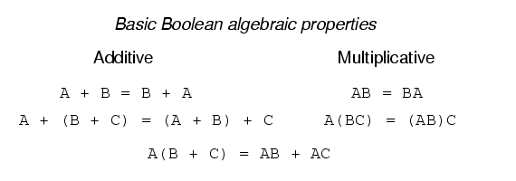
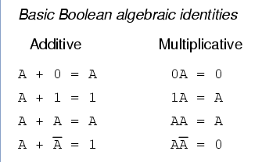

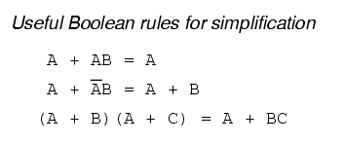

Boolean Simplification
DeMorgan’s Laws

Slide 90
N₂ = ~P~C₂C₁C₀
+ ~PC₂~C₁~C₀
+ PC₂~C₁~C₀
+ ~PC₂~C₁C₀
+ PC₂~C₁C₀
+ ~P~L₁C₂C₁~C₀
+ PC₂C₁~C₀
+ L₁C₂C₁~C₀
+ PC₂C₁C₀

Slide 91
N₂ = ~P~C₂C₁C₀
+ C₂~C₁~C₀
+ C₂~C₁C₀
+ ~P~L₁C₂C₁~C₀
+ PC₂C₁~C₀
+ L₁C₂C₁~C₀
+ PC₂C₁C₀

Slide 92
N₂ = ~P~C₂C₁C₀
+ C₂~C₁~C₀
+ C₂~C₁C₀
+ ~P~L₁C₂C₁~C₀
+ PC₂C₁~C₀
+ L₁C₂C₁~C₀
+ PC₂C₁C₀

Slide 93
N₂ = ~P~C₂C₁C₀ + PC₂C₁C₀
+ C₂~C₁~C₀
+ C₂~C₁C₀
+ ~P~L₁C₂C₁~C₀
+ PC₂C₁~C₀
+ L₁C₂C₁~C₀

Slide 94
N₂ = (~P~C₂ + PC₂ )C₁C₀
+ C₂~C₁~C₀
+ C₂~C₁C₀
+ ~P~L₁C₂C₁~C₀
+ PC₂C₁~C₀
+ L₁C₂C₁~C₀

Slide 95
N₂ = (~P~C₂ + PC₂ )C₁C₀
+ C₂~C₁~C₀
+ C₂~C₁C₀
+ ~P~L₁C₂C₁~C₀
+ (P+L₁)C₂C₁~C₀

Slide 96
N₂ = (~P~C₂ + PC₂ )C₁C₀
+ C₂~C₁~C₀
+ C₂~C₁C₀
+ ~P~L₁C₂C₁~C₀
+ (P+L₁)C₂C₁~C₀

Slide 97
N₂ = (~P~C₂ + PC₂ )C₁C₀
+ C₂~C₁
+ ~P~L₁C₂C₁~C₀
+ (P+L₁)C₂C₁~C₀

Slide 98
N₂ = (~P~C₂ + PC₂ )C₁C₀
+ C₂~C₁
+ ~P~L₁C₂C₁~C₀
+ (P+L₁)C₂C₁~C₀

Slide 99
N₂ = (~P~C₂ + PC₂ )C₁C₀
+ C₂~C₁
+ ((~P~L₁)+(P+L₁))C₂C₁~C₀

Slide 100
N₂ = (~P~C₂ + PC₂ )C₁C₀
+ C₂~C₁
+ (~P~L₁+P+L₁)C₂C₁~C₀

Slide 101
N₂ = (~P~C₂ + PC₂ )C₁C₀
+ C₂~C₁
+ C₂C₁~C₀

Slide 102
N₂ = (~P~C₂ + PC₂ )C₁C₀
+ C₂(~C₁+C₁~C₀)

Slide 103
N₂ = (~P~C₂ + PC₂ )C₁C₀
+ C₂(~C₁+C₁~C₀)
N₂=~P~C₂C₁C₀+PC₂C₁C₀+C₂~C₁+C₂C₁~C₀

Slide 104
N₂ = (~P~C₂ + PC₂ )C₁C₀
+ C₂(~C₁+C₁~C₀)
N₂=~P~C₂C₁C₀+PC₂C₁C₀+C₂~C₁+C₂C₁~C₀
PC2/C1C0 | 00 | 01 | 11 | 10
00
01
11
10

Slide 105
N₂ = (~P~C₂ + PC₂ )C₁C₀
+ C₂(~C₁+C₁~C₀)
N₂=~P~C₂C₁C₀+PC₂C₁C₀+C₂~C₁+C₂C₁~C₀
PC2/C1C0 | 00 | 01 | 11 | 10
00 |  |  | 1
01 | 1 | 1 |  | 1
11 | 1 | 1 | 1 | 1
10

Slide 106
N₂ = (~P~C₂ + PC₂ )C₁C₀
+ C₂(~C₁+C₁~C₀)
N₂=~P~C₂C₁C₀+PC₂C₁C₀+C₂~C₁+C₂C₁~C₀
PC2/C1C0 | 00 | 01 | 11 | 10
00 |  |  | 1
01 | 1 | 1 |  | 1
11 | 1 | 1 | 1 | 1
10

Slide 107
N₂ = (~P~C₂ + PC₂ )C₁C₀
+ C₂(~C₁+C₁~C₀)
N₂=~P~C₂C₁C₀+PC₂C₁C₀+C₂~C₁+C₂C₁~C₀
PC2/C1C0 | 00 | 01 | 11 | 10
00 |  |  | 1
01 | 1 | 1 |  | 1
11 | 1 | 1 | 1 | 1
10

Slide 108
N₂ = (~P~C₂ + PC₂ )C₁C₀
+ C₂(~C₁+C₁~C₀)
N₂=~P~C₂C₁C₀+PC₂C₁C₀+C₂~C₁+C₂C₁~C₀
PC2/C1C0 | 00 | 01 | 11 | 10
00 |  |  | 1
01 | 1 | 1 |  | 1
11 | 1 | 1 | 1 | 1
10
N₂=~P~C₂C₁C₀+PC₂+C₂~C₁+C₂C₁~C₀

Slide 109
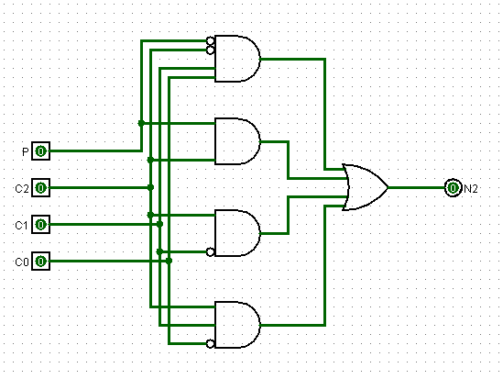
N₂=~P~C₂C₁C₀+PC₂+C₂~C₁+C₂C₁~C₀

Slide 110
Questions?

Slide 111
LC-3 Datapath

Slide 112
gateMARMUX
gatePC
16
DR
3
REG
FILE
SR2 SR1
OUT OUT
MARMUX
MARMUX
LD.PC
PC
16
PCMUX
+1
16
16
2
LD.REG
PCMUX
16
SR2
3
3
SR1
ZEXT
+
[7:0]
ADDR2MUX
2
ADDR1MUX
ADDR2MUX
ADDR1MUX
16
16
16
[10:0]
SEXT
16
16
16
16
16
0
16
[4:0]
SEXT
[8:0]
SEXT
FINITE
STATE
MACHINE
SR2MUX
[5:0]
SEXT
N
Z
P
LD.CC
B
A
2
ALU
LD.IR
IR
LOGIC
R
16
16
gateALU
16
16
GateMDR
16
16
LD.MDR
MDR
MEMORY
MAR
LD.MAR
INPUT
OUTPUT
MEM.EN, R.W

Slide 113
gateMARMUX
gatePC
16
DR
3
REG
FILE
SR2 SR1
OUT OUT
MARMUX
MARMUX
LD.PC
PC
16
PCMUX
+1
16
16
2
LD.REG
PCMUX
16
SR2
3
3
SR1
ZEXT
+
[7:0]
ADDR2MUX
2
ADDR1MUX
ADDR2MUX
ADDR1MUX
16
16
16
[10:0]
SEXT
16
16
16
16
16
0
16
[4:0]
SEXT
[8:0]
SEXT
FINITE
STATE
MACHINE
SR2MUX
[5:0]
SEXT
N
Z
P
LD.CC
B
A
2
ALU
LD.IR
IR
LOGIC
R
16
16
gateALU
16
16
GateMDR
16
MUXES
16
LD.MDR
MDR
MEMORY
MAR
LD.MAR
INPUT
OUTPUT
MEM.EN, R.W

Slide 114
gateMARMUX
gatePC
16
DR
3
REG
FILE
SR2 SR1
OUT OUT
MARMUX
MARMUX
LD.PC
PC
16
PCMUX
+1
16
16
2
LD.REG
PCMUX
16
SR2
3
3
SR1
ZEXT
+
[7:0]
ADDR2MUX
2
ADDR1MUX
ADDR2MUX
ADDR1MUX
16
16
16
[10:0]
SEXT
16
16
16
16
16
0
16
[4:0]
SEXT
[8:0]
SEXT
FINITE
STATE
MACHINE
SR2MUX
[5:0]
SEXT
N
Z
P
LD.CC
B
A
2
ALU
LD.IR
IR
LOGIC
R
16
16
gateALU
16
16
GateMDR
16
STATE
16
LD.MDR
MDR
MEMORY
MAR
LD.MAR
INPUT
OUTPUT
MEM.EN, R.W

Slide 115
gateMARMUX
gatePC
16
DR
3
REG
FILE
SR2 SR1
OUT OUT
MARMUX
MARMUX
LD.PC
PC
16
PCMUX
+1
16
16
2
LD.REG
PCMUX
16
SR2
3
3
SR1
ZEXT
+
[7:0]
ADDR2MUX
2
ADDR1MUX
ADDR2MUX
ADDR1MUX
16
16
16
[10:0]
SEXT
16
16
16
16
16
0
16
[4:0]
SEXT
[8:0]
SEXT
FINITE
STATE
MACHINE
SR2MUX
[5:0]
SEXT
N
Z
P
LD.CC
B
A
2
ALU
LD.IR
IR
LOGIC
R
16
16
gateALU
16
16
GateMDR
16
ALU
TYPE
16
LD.MDR
MDR
MEMORY
MAR
LD.MAR
INPUT
OUTPUT
MEM.EN, R.W

Slide 116
gateMARMUX
gatePC
16
DR
3
REG
FILE
SR2 SR1
OUT OUT
MARMUX
MARMUX
LD.PC
PC
16
PCMUX
+1
16
16
2
LD.REG
PCMUX
16
SR2
3
3
SR1
ZEXT
+
[7:0]
ADDR2MUX
2
ADDR1MUX
ADDR2MUX
ADDR1MUX
16
16
16
[10:0]
SEXT
16
16
16
16
16
0
16
[4:0]
SEXT
[8:0]
SEXT
FINITE
STATE
MACHINE
SR2MUX
[5:0]
SEXT
N
Z
P
LD.CC
B
A
2
ALU
LD.IR
IR
LOGIC
R
16
16
gateALU
16
16
GateMDR
16
FUNC
UNITS
16
LD.MDR
MDR
MEMORY
MAR
LD.MAR
INPUT
OUTPUT
MEM.EN, R.W

Slide 117
gateMARMUX
gatePC
16
DR
3
REG
FILE
SR2 SR1
OUT OUT
MARMUX
MARMUX
LD.PC
PC
16
PCMUX
+1
16
16
2
LD.REG
PCMUX
16
SR2
3
3
SR1
ZEXT
+
[7:0]
ADDR2MUX
2
ADDR1MUX
ADDR2MUX
ADDR1MUX
16
16
16
[10:0]
SEXT
16
16
16
16
16
0
16
[4:0]
SEXT
[8:0]
SEXT
FINITE
STATE
MACHINE
SR2MUX
[5:0]
SEXT
N
Z
P
LD.CC
B
A
2
ALU
LD.IR
IR
LOGIC
R
16
16
gateALU
16
16
GateMDR
16
CONTROL
16
LD.MDR
MDR
MEMORY
MAR
LD.MAR
INPUT
OUTPUT
MEM.EN, R.W

Slide 118
gateMARMUX
gatePC
16
DR
3
REG
FILE
SR2 SR1
OUT OUT
MARMUX
MARMUX
LD.PC
PC
16
PCMUX
+1
16
16
2
LD.REG
PCMUX
16
SR2
3
3
SR1
ZEXT
+
[7:0]
ADDR2MUX
2
ADDR1MUX
ADDR2MUX
ADDR1MUX
16
16
16
[10:0]
SEXT
16
16
16
16
16
0
16
[4:0]
SEXT
[8:0]
SEXT
FINITE
STATE
MACHINE
SR2MUX
[5:0]
SEXT
N
Z
P
LD.CC
B
A
2
ALU
LD.IR
IR
LOGIC
R
16
16
gateALU
16
16
GateMDR
16
16
LD.MDR
MDR
MEMORY
MAR
LD.MAR
INPUT
OUTPUT
MEM.EN, R.W

Slide 119
Tri State Buffer
CONTROL | INPUT | OUTPUT
0 | 0 | Z
0 | 1 | Z
1 | 0 | 0
1 | 1 | 1
OUTPUT
CONTROL
INPUT

Slide 120
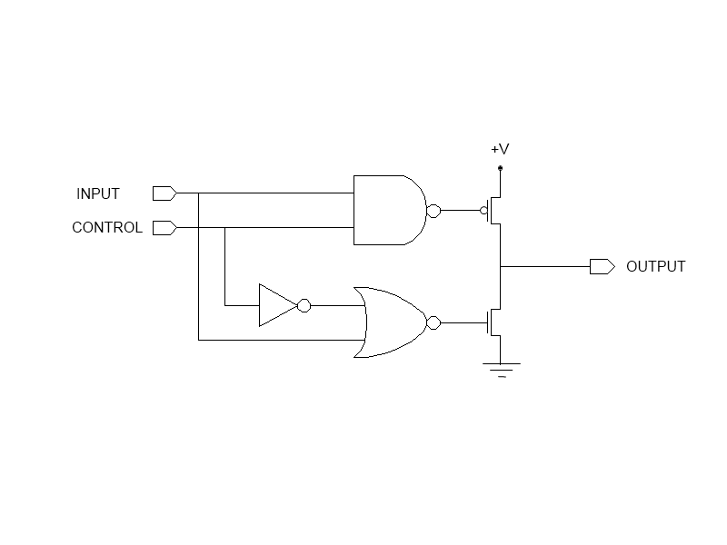
Tri State Buffer

Slide 121


Slide 122
16
3
16
+1
16
16
2
16
3
3
+
[7:0]
2
16
16
16
[10:0]
16
16
16
16
16
0
16
[8:0]
[4:0]
[5:0]
2
B
A
LD.IR
R
16
16
16
16
16
16

Slide 123
Questions?

Slide 125
DATAIN
WRITE
ENABLE
DECODER
ADDRESS
MUX
MUX
MUX
MUX
DATAOUT

