Slide 1
Von Neumann Model
Chapter 4

Slide 2
Outline
Basic Components
  Memory, Processing Unit, Input & Output, Control Unit
LC-3: An Example von Neumann Machine
Instruction Processing
  The Instruction, The Instruction Cycle
    Fetch, Decode, Evaluate Address, Fetch Operands, Execute, Store Result
Changing the Sequence of Execution
Stopping the Computer

Slide 3
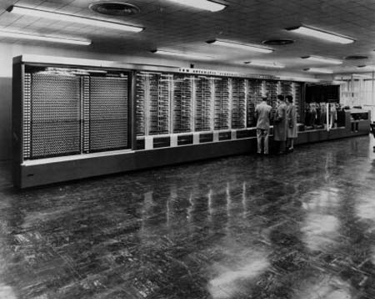
Harvard Mark I

Slide 4
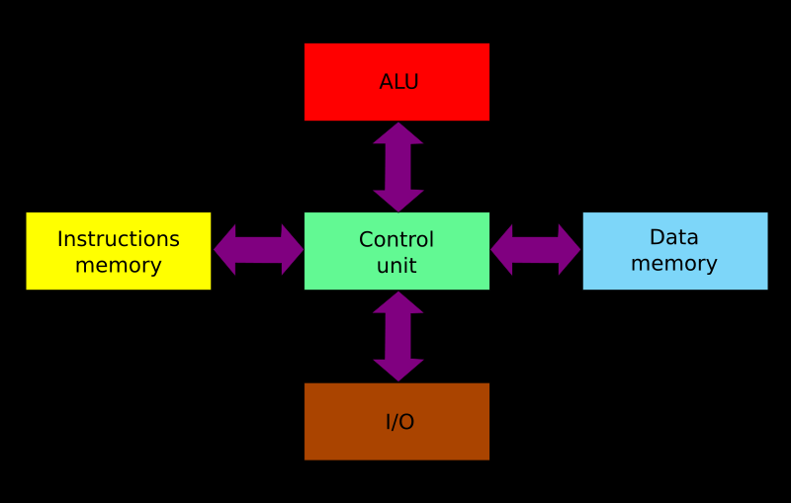
Harvard Model

Slide 5
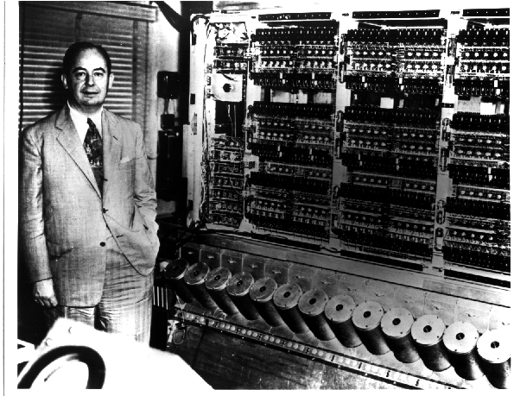
John von Neumann & EDVAC
Electronic Discrete Variable Automatic Computer

Slide 6
First Draft of a Report on the EDVAC by John von Neumann,
Contract No. W-670-ORD-4926,
Between the United States Army Ordnance Department and the University of Pennsylvania Moore School of Electrical Engineering
University of Pennsylvania
June 30, 1945

Slide 7
Memory
What is stored in memory?
How many memories do we need?

Slide 8
What is an instruction?

Slide 9
von Neumann Model

Slide 10
von Neumann Model
12

Slide 11
Memory
IN
ADDR
DATA IN
OUT
MAR
MDR
OUT
WE
DATA OUT
IN
MUX

Slide 12
von Neumann Model
CONTROL
PROCESSOR
INPUT
OUTPUT
MDR
MAR

Slide 13
gatePC
16
Control
DR
3
REG
FILE
SR2 SR1
OUT OUT
LD.PC
PC
PCMUX
+1
2
LD.REG
PCMUX
16
SR2
3
3
SR1
16
16
16
FINITE
STATE
MACHINE
SR2MUX
Processor
2
B
A
R
ALU
LD.IR
IR
16
gateALU
16
16
GateMDR
16
INPUT
OUTPUT
16
KBDR
DDR
LD.MDR
MDR
MEMORY
MAR
LD.MAR
KBSR
DSR
MEM.EN, R.W

Slide 14
Issues
Memory
  MAR, MDR
Processing Unit
  Register File, ALU (size)
Input and Output
  KBDR, KBSR, DDR, DSR
Control
  FSM, PC (Instruction Pointer), IR

Slide 15
Test Yourself
The Program Counter (PC) holds
  The count of instructions executed
  The address of the next instruction to be executed
  The instruction currently being executed
  Number of programs completed since the last boot

Slide 16
Test Yourself
The Instruction Register (IR) holds
  All legal op codes
  The address of the next instruction to be executed
  The instruction currently being executed
  All data needed to execute the current instruction

Slide 17
The central idea in the von Neumann model of computer processing is that the program and data are both stored as sequences of bits in the computer's memory, and the program is executed, one instruction at a time, under the direction of the control unit.

Slide 18
Instructions
ADD
0
0
0
1
0
0
0
0
0
0
0
0
0
0
0
0

Slide 19
ADD+
0001
DR
SR1
0
00
SR2
ADD+
0001
DR
SR1
1
imm5
AND+
0101
DR
SR1
0
00
SR2
AND+
0101
DR
SR1
1
imm5
BR
0000
n
z
p
PCoffset9
JMP
1100
000
BaseR
000000
JSR
0100
1
PCoffset11
JSRR
0100
0
00
BaseR
000000
LD+
0010
DR
PCoffset9
LDI+
1010
DR
PCoffset9
+ Indicates instructions that modify condition codes

Slide 20
gatePC
16
Control
DR
3
REG
FILE
SR2 SR1
OUT OUT
LD.PC
PC
PCMUX
+1
FETCH
2
LD.REG
PCMUX
16
SR2
3
3
SR1
16
16
16
FINITE
STATE
MACHINE
SR2MUX
Processor
2
B
A
R
ALU
LD.IR
IR
16
gateALU
16
16
GateMDR
16
INPUT
OUTPUT
16
KBDR
DDR
LD.MDR
MDR
MEMORY
MAR
LD.MAR
KBSR
DSR
MEM.EN, R.W

Slide 21
gatePC
16
Control
DR
3
REG
FILE
SR2 SR1
OUT OUT
LD.PC
PC
PCMUX
+1
2
LD.REG
DECODE
PCMUX
16
SR2
3
3
SR1
16
16
16
FINITE
STATE
MACHINE
SR2MUX
Processor
2
B
A
R
ALU
LD.IR
IR
16
gateALU
16
16
GateMDR
16
INPUT
OUTPUT
16
KBDR
DDR
LD.MDR
MDR
MEMORY
MAR
LD.MAR
KBSR
DSR
MEM.EN, R.W

Slide 22
gatePC
16
Control
DR
3
REG
FILE
SR2 SR1
OUT OUT
LD.PC
PC
PCMUX
+1
2
LD.REG
PCMUX
16
SR2
3
3
SR1
EVALUATE ADDRESS
16
16
16
FINITE
STATE
MACHINE
SR2MUX
Processor
2
B
A
R
ALU
LD.IR
IR
16
gateALU
16
16
GateMDR
16
INPUT
OUTPUT
16
KBDR
DDR
LD.MDR
MDR
MEMORY
MAR
LD.MAR
KBSR
DSR
MEM.EN, R.W

Slide 23
gatePC
16
Control
DR
3
REG
FILE
SR2 SR1
OUT OUT
LD.PC
PC
PCMUX
+1
2
LD.REG
PCMUX
16
SR2
3
3
SR1
FETCH OPERANDS
16
16
16
FINITE
STATE
MACHINE
SR2MUX
Processor
2
B
A
R
ALU
LD.IR
IR
16
gateALU
16
16
GateMDR
16
INPUT
OUTPUT
16
KBDR
DDR
LD.MDR
MDR
MEMORY
MAR
LD.MAR
KBSR
DSR
MEM.EN, R.W

Slide 24
gatePC
16
Control
DR
3
REG
FILE
SR2 SR1
OUT OUT
LD.PC
PC
PCMUX
+1
2
LD.REG
PCMUX
EXECUTE
16
3
3
SR2
SR1
16
16
16
FINITE
STATE
MACHINE
SR2MUX
Processor
2
B
A
R
ALU
LD.IR
IR
16
gateALU
16
16
GateMDR
16
INPUT
OUTPUT
16
KBDR
DDR
LD.MDR
MDR
MEMORY
MAR
LD.MAR
KBSR
DSR
MEM.EN, R.W

Slide 25
gatePC
16
Control
DR
3
REG
FILE
SR2 SR1
OUT OUT
LD.PC
PC
PCMUX
+1
2
LD.REG
PCMUX
16
SR2
3
3
SR1
STORE RESULT
16
16
16
FINITE
STATE
MACHINE
SR2MUX
Processor
2
B
A
R
ALU
LD.IR
IR
16
gateALU
16
16
GateMDR
16
INPUT
OUTPUT
16
KBDR
DDR
LD.MDR
MDR
MEMORY
MAR
LD.MAR
KBSR
DSR
MEM.EN, R.W

Slide 26
Instructions
LDR
0
1
1
0
0
0
0
0
0
0
0
0
0
0
0
0
noon

Slide 27
gateMARMUX
gatePC
16
DR
3
REG
FILE
SR2 SR1
OUT OUT
MARMUX
MARMUX
LD.PC
PC
16
PCMUX
+1
16
16
2
LD.REG
PCMUX
16
SR2
3
3
SR1
ZEXT
+
[7:0]
ADDR2MUX
2
ADDR1MUX
ADDR2MUX
ADDR1MUX
16
16
16
[10:0]
SEXT
16
16
16
16
16
0
16
[4:0]
SEXT
[8:0]
SEXT
FINITE
STATE
MACHINE
SR2MUX
[5:0]
SEXT
N
Z
P
LD.CC
B
A
2
ALU
LD.IR
IR
LOGIC
R
16
16
gateALU
16
16
GateMDR
16
16
LD.MDR
MDR
MEMORY
MAR
LD.MAR
INPUT
OUTPUT
MEM.EN, R.W

Slide 28
Flow Control
Normally we execute instructions one after another
Test Yourself
When might we not want to do this?
  Tuesdays
  During compilation
  When branching, jumping or looping
  When playing pirated games

Slide 29
Instructions
JMP
1
1
0
0
0
0
0
0
0
0
0
0
0
0
0
0

Slide 30
gateMARMUX
gatePC
16
DR
3
REG
FILE
SR2 SR1
OUT OUT
MARMUX
MARMUX
LD.PC
PC
16
PCMUX
+1
16
16
2
LD.REG
PCMUX
16
SR2
3
3
SR1
ZEXT
+
[7:0]
ADDR2MUX
2
ADDR1MUX
ADDR2MUX
ADDR1MUX
16
16
16
[10:0]
SEXT
16
16
16
16
16
0
16
[4:0]
SEXT
[8:0]
SEXT
FINITE
STATE
MACHINE
SR2MUX
[5:0]
SEXT
N
Z
P
LD.CC
B
A
2
ALU
LD.IR
IR
LOGIC
R
16
16
gateALU
16
16
GateMDR
16
16
LD.MDR
MDR
MEMORY
MAR
LD.MAR
INPUT
OUTPUT
MEM.EN, R.W

Slide 31
Stopping
Clock
S
R

Slide 32
gateMARMUX
gatePC
16
DR
3
REG
FILE
SR2 SR1
OUT OUT
MARMUX
MARMUX
LD.PC
PC
16
PCMUX
+1
16
16
2
LD.REG
PCMUX
16
SR2
3
3
SR1
ZEXT
+
[7:0]
ADDR2MUX
2
ADDR1MUX
ADDR2MUX
ADDR1MUX
16
16
16
[10:0]
SEXT
16
16
16
16
16
0
16
[4:0]
SEXT
[8:0]
SEXT
FINITE
STATE
MACHINE
SR2MUX
[5:0]
SEXT
N
Z
P
LD.CC
B
A
2
ALU
LD.IR
IR
LOGIC
R
16
16
gateALU
16
16
GateMDR
16
16
LD.MDR
MDR
MEMORY
MAR
LD.MAR
INPUT
OUTPUT
MEM.EN, R.W

Slide 33
Questions

