Slide 1
The LC-3 Part II
Chapter 5

Slide 2
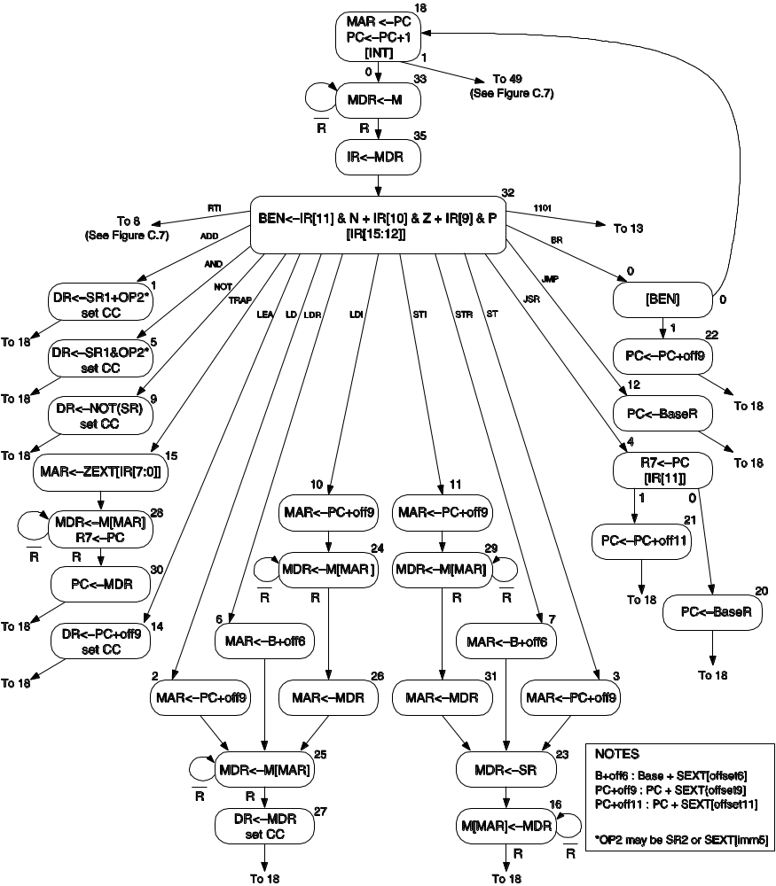

Slide 3
Outline
Control Instructions
  Conditional Branches, Example, Two Methods for Loop Control, Example, Jump Instruction, TRAP Instruction
Example: Counting Occurences of a Character
Data Path Revisited
  Basic Components, Instruction Cycle

Slide 4
Control Instructions
BR
0000
n
z
p
PCoffset9
JMP
1100
000
BaseR
000000
JSR
0100
1
PCoffset11
JSRR
0100
0
00
BaseR
000000
RET
1100
000
111
000000
RTI
1000
000000000000
TRAP
1111
0000
trapvect8

Slide 5
Conditional Branch
BR
0000
n
z
p
PCoffset9

Slide 6
gateMARMUX
gatePC
16
DR
3
REG
FILE
SR2 SR1
OUT OUT
MARMUX
MARMUX
LD.PC
PC
16
PCMUX
+1
16
16
2
LD.REG
PCMUX
16
SR2
3
3
SR1
ZEXT
+
[7:0]
ADDR2MUX
2
ADDR1MUX
ADDR2MUX
ADDR1MUX
16
16
16
[10:0]
SEXT
16
16
16
16
16
0
16
[4:0]
SEXT
[8:0]
SEXT
FINITE
STATE
MACHINE
SR2MUX
[5:0]
SEXT
N
Z
P
LD.CC
B
A
2
ALU
LD.IR
IR
LOGIC
R
16
16
gateALU
16
16
GateMDR
16
16
LD.MDR
MDR
MEMORY
MAR
LD.MAR
INPUT
OUTPUT
MEM.EN, R.W

Slide 7
Example
Write a program to be located at address x3000 which will sum up 12 integers located in memory addresses x3100-x310B

Slide 8
R1 <- x3100
R3 <- 0
R2 <- 12
R2 ?= 0
YES
NO
R4 <- M[R1]
R3 <- R3 + R4
Increment R1
Decrement R2

Slide 9
Program
x3000 R1 <- x3100
x3001 R3 <- 0
x3002 R2 <- 0
x3003 R2 <- 12
x3004 BRz x300A
x3005 R4 <- M[R1]
x3006 R3 <- R3 + R4
x3007 R1 <- R1 + 1
x3008 R2 <- R2 - 1
x3009 BRnzp x3004

Slide 10
Program
x3000 R1 <- x3100
x3001 R3 <- 0
x3002 R2 <- 0
x3003 R2 <- 12
x3004 BRz x300A
x3005 R4 <- M[R1]
x3006 R3 <- R3 + R4
x3007 R1 <- R1 + 1
x3008 R2 <- R2 - 1
x3009 BRnzp x3004
LEA 1110001011111111
AND 0101011011100000
AND 0101010010100000
ADD 0001010010101100
BRz 0000010000000101
LDR 0110100001000000
ADD 0001011011000100
ADD 0001001001100001
ADD 0001010010111111
BRnzp 0000111111111010

Slide 11
Loop Control
R1 <- x3100
R3 <- 0
R4 <- M[R1]
Counter
Sentinel
R4 ?=
Sentinal
YES
NO
R3 <- R3 + R4
Increment R1
R4 <- M[R1]

Slide 12

What can we do with a BR?

Slide 13
What can we do with a BR?
If then else
For
While
Do while

Slide 14
JMP Instruction
JMP
1100
000
BaseR
000000

Slide 15
What can we do with a JMP?

Slide 16
What can we do with a JMP?
Go To!!!!
Branch long distances!!!

Slide 17
TRAP Instruction
Modern computers contain hardware and software protection schemes to prevent user programs from accidentally (or maliciously) interfering with proper system function.
We won't go into the details of this in CS2110
Suffice it to say, we need a way to communicate with the operating system

Slide 18
Trap Instruction
TRAP
1111
0000
trapvect8
Vector | Routine
x23 | IN - input a character from the keyboard (R0)
x21 | OUT - output a character to the monitor (R0)
x25 | HALT - halt the program
See Table A.2 p 543

Slide 19
What can we do with a TRAP?
IN - input a character from the keyboard (R0)
OUT - output a character to the monitor (R0)
HALT - halt the program
Plus See Table A.2 p 543
Plus: Use as the basis for a memory protection scheme (beyond the scope of 2110 see 2200)

Slide 20
Question???
What happens if there is no HALT instruction?
  Nothing, the processor will stop when it runs out of instructions
  A memory boundary trap will occur
  The processor will start to execute your data
  Zombies will try and kill you

Slide 21
Questions?

Slide 23
ADD+
0001
DR
SR1
0
00
SR2
ADD+
0001
DR
SR1
1
imm5
AND+
0101
DR
SR1
0
00
SR2
AND+
0101
DR
SR1
1
imm5
BR
0000
n
z
p
PCoffset9
JMP
1100
000
BaseR
000000
JSR
0100
1
PCoffset11
JSRR
0100
0
00
BaseR
000000
LD+
0010
DR
PCoffset9
LDI+
1010
DR
PCoffset9
+ Indicates instructions that modify condition codes

Slide 24
LDR+
0110
DR
BaseR
offset6
LEA+
1110
DR
PCoffset9
NOT+
1001
DR
SR
111111
RET
1100
000
111
000000
RTI
1000
000000000000
ST
0011
SR
PCoffset9
STI
1011
SR
PCoffset9
STR
0111
SR
BaseR
offset6
TRAP
1111
0000
trapvect8
reserved
1101
+ Indicates instructions that modify condition codes

