Slide 1

Regression Analysis
By Tuyen Nguyen
AI&Cloud club SEMO

Slide 2
Math in Machine Learning
Statistic
Linear Algebra
Calculus

Slide 3
Objectives
Introduce linear regression
Important statistical concepts
How to statistically interpret regression analysis result

Slide 4
What is the question that we are trying to answer?
Is there an association between height and weight? Can we quantify?
Is there an association between student SAT and their GPA? Can we quantify?
Is there an association between the number of hours that you slept yesterday and the score of the exam that you took this morning? Can we quantify?
Is there an association between economic growth and the global warming level?

Slide 5
Problem
Determine whether there is a relationship between a variable x and a variable y?
x is independent variable/ explanatory variable/ feature
y is dependent variable, y is dependent on x

Slide 6
Another problem
Longitudinal data about x and y
2. Observe the data: higher x, higher y
but higher y may be confounded by other factors
3. Does x really cause y, or is it another factor or a combinations (x1,x2,...,xn) variables/factors that causes y
Notes:
is data that is collected sequentially from the same respondents over time.
Example: is it the more you sleep the better you get the score since sleeping gives you the energy or the number of sleeps associates to the kind of person (organized and discipline) to get high score

Slide 7
The problems to solve
Regression analysis helps us verify and quantify the relationship between x (independent variable) and y (outcome) while controlling for other factors
Keep other factors constant

Slide 8
What is regression analysis
Regression analysis can estimate the effect of one variable x apart from other variables on the outcome y if it is done properly.
*** If it is done properly, what does this mean?
Regression analysis is not hard because we have libraries to do the math, but:
Our sample must be representative of the population that we care about.
The hard part is to determine which variables ought to be considered in the analysis model.

Slide 9
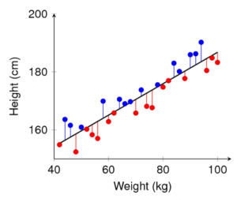
Regression analysis
At its core, a simple linear regression seeks to find the best fit for a linear relationship between two variables.
ˆy= a · x+b

Slide 10
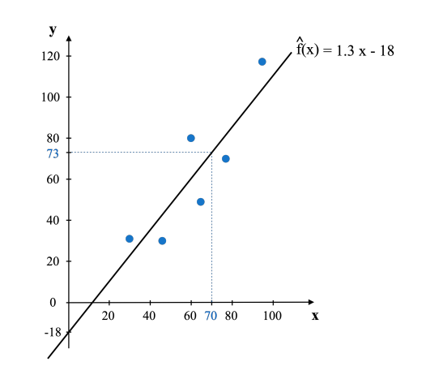
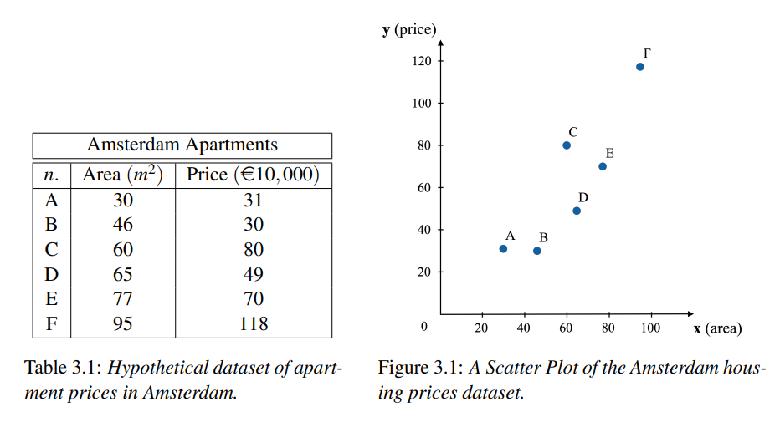

Slide 11
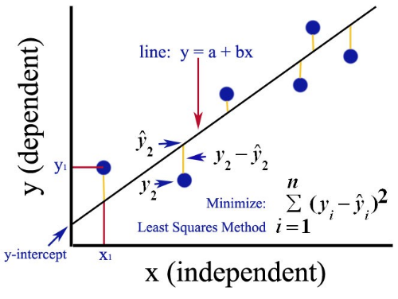
How exactly do we define as “best”
Using Ordinary Least Square (OLS)
OLS fits the line that minimizes the sums of squared residuals

Slide 12
How exactly do we define as “best”
Residual (or error term) =
the difference between
predicted value and the actual value
=> ri = yi − ˆf(xi)

Slide 13
Why square the residual (the error term)?
Make the error term to be positive
Increase the weight given to observations that lie far from the regression line (outlier)

Slide 14
How to minimize sum of squared residuals
Need Gradient Descent
Calculus can give us the answer

Slide 15
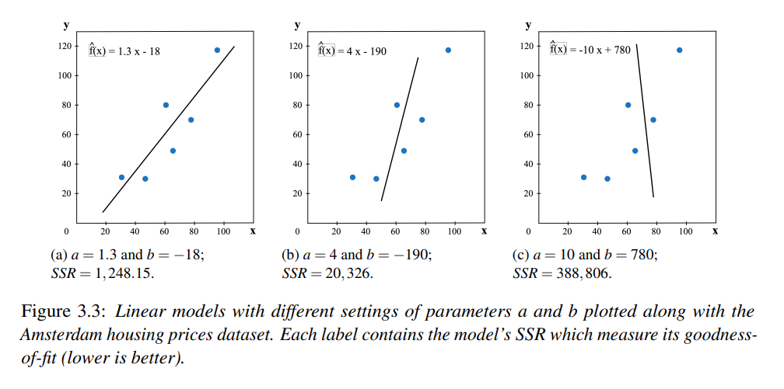

Slide 16
HEIGHT-WEIGHT example
Every observation can be explained as WEIGHT = a + b*HEIGHT + e;
where e is the residual that catches the variation in WEIGHT of the individual that is not explained by the HEIGHT
Our best guess for the WEIGHT of each person now is y = a+b*HEIGHT

Slide 17
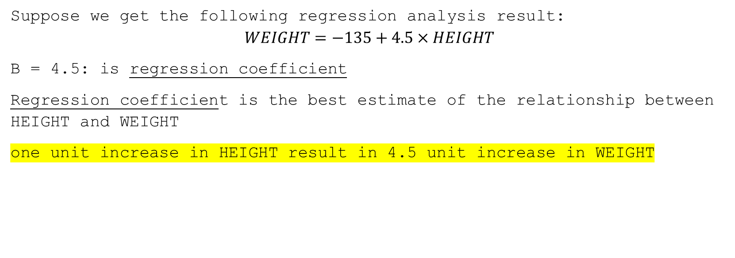
HEIGHT-WEIGHT example
Suppose we get the following regression analysis result:
$$WEIGHT=−135+4.5×HEIGHT$$
B = 4.5: is regression coefficient
Regression coefficient is the best estimate of the relationship between HEIGHT and WEIGHT
one unit increase in HEIGHT result in 4.5 unit increase in WEIGHT

Slide 18
Regression coefficient
1. Sign: tells us the direction of the association
b=4.5 which is >0
taller people tends to weigh more

Slide 19
Regression coefficient
2. Size: how big is the observed effect between the independent variable and dependent variable.
one inch increase in HEIGHT result in 4.5-pound increase in WEIGHT
We may find an explanatory variable that is proved to be statistically significant; but that effect may be too small, too trivial or socially insignificant.

Slide 20
Regression coefficient
3. Significance: does the association we found in our sample reflect a meaningful association that is likely to be observed for the population as whole, not just work right for this sample of data.
How do we test if the association that we found is significant?

Slide 21
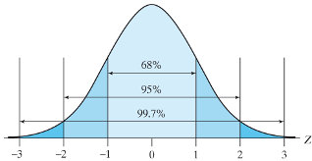
Central Limit Theorem
Central limit theorem: the mean of a large, proper drawn sample will not deviate wildly from the true mean of the population.
The sample means distributed normally around the true mean (or the population mean)

Slide 22
Central Limit Theorem
a sample of 3000 Americans, each inch of height is associate with 4.5 pounds
another sample 3000 Americans, each inch of height is associate with 4.3 pounds
another sample 3000 Americans, each inch of height is associate with 5.2 pounds
=> the various coefficient of each time we obtain another sample will be distributed normally around the true association/coefficent between Height and Weight

Slide 23
Standard error
The standard error of the regression coefficient gives us the approximate deviation of our sample regression coefficient from the true coefficient
If we were to do this analysis repeatedly with 100 different samples, we would expect our observed 95 samples gives us regression coefficients to be within two standard error of the true population
The value of one standard error varies from one dataset to another dataset that we working with.

Slide 24
Null hypothesis
Once we have regression coefficient, and standard error, we can test the following hypothesis:
H0: there is no association between height and weight: regression coefficient b=0

Slide 25
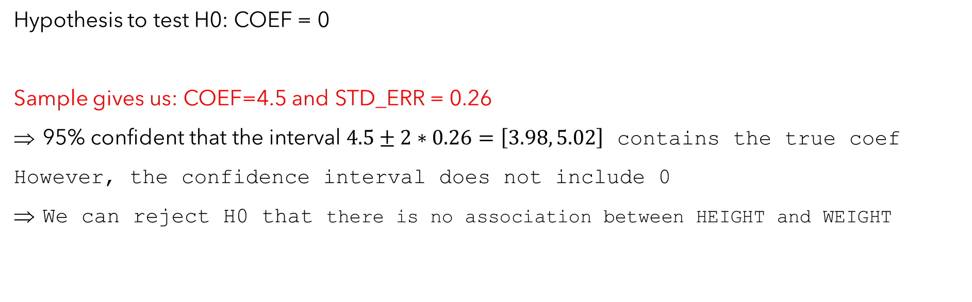
Hypothesis Testing
Hypothesis to test H0: COEF = 0
Sample gives us: COEF=4.5 and STD_ERR = 0.26
95% confident that the interval $4.5±2∗0.26=\left[3.98, 5.02\right]$ contains the true coef
However, the confidence interval does not include 0
We can reject H0 that there is no association between HEIGHT and WEIGHT

Slide 26
P-value
“In null-hypothesis significance testing, the p-value is the probability of obtaining test results at least as extreme as the result actually observed, under the assumption that the null hypothesis is correct.” (Wikipedia)
Suppose, statistical package also returns p-value = 0.000
Very small chance or zero chance of observing such coefficient (4.5) if it is correct that there is no true association between HEIGHT and WEIGHT
Thus, must reject H0 since we have observed such coefficient

Slide 27
R^2
how much of variation in WEIGHT is explained by HEITGH
if R^2=0.25 means that only 25% of the variation in WEIGHT is explained by HEIGHT. => 75% of the variation in WEIGHT remains unexplained

Slide 28
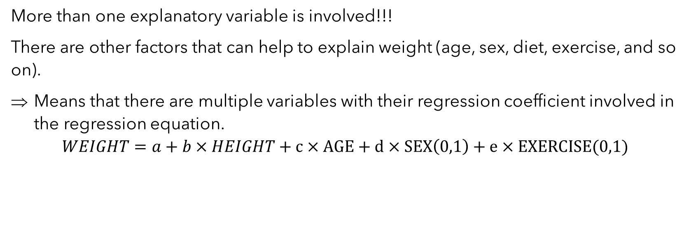
Multivariate regression analysis
More than one explanatory variable is involved!!!
There are other factors that can help to explain weight (age, sex, diet, exercise, and so on).
Means that there are multiple variables with their regression coefficient involved in the regression equation.
$$WEIGHT=a+b×HEIGHT+c×AGE+d×SEX\left(0,1\right)+e×EXERCISE(0,1)$$

Slide 29
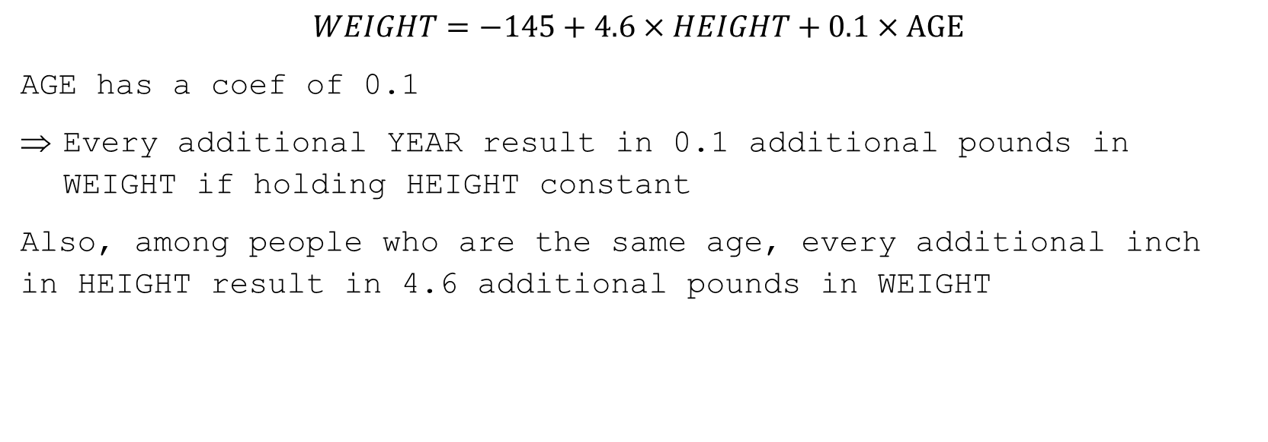
Regression Analysis with TWO explanatory variables
$$WEIGHT=−145+4.6×HEIGHT+0.1×AGE$$
AGE has a coef of 0.1
Every additional YEAR result in 0.1 additional pounds in WEIGHT if holding HEIGHT constant
Also, among people who are the same age, every additional inch in HEIGHT result in 4.6 additional pounds in WEIGHT

Slide 30
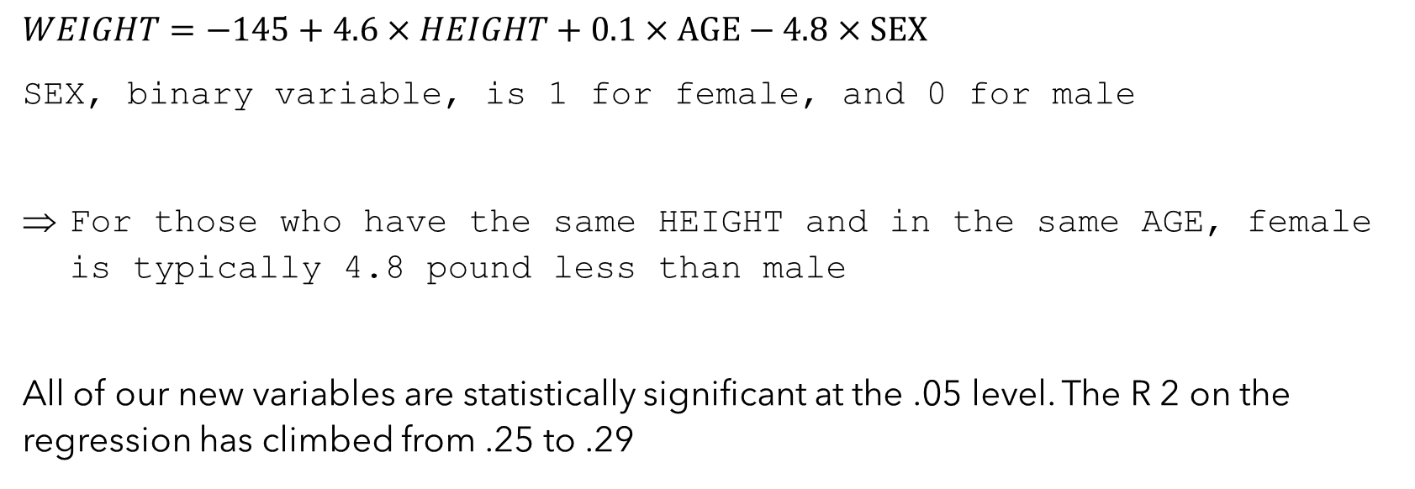
Regression Analysis with THREE explanatory variables
$WEIGHT=−145+4.6×HEIGHT+0.1×AGE−4.8$ $×SEX$
SEX, binary variable, is 1 for female, and 0 for male
For those who have the same HEIGHT and in the same AGE, female is typically 4.8 pound less than male
All of our new variables are statistically significant at the .05 level. The R 2 on the regression has climbed from .25 to .29

