Slide 1
Computer Vision

Slide 2
How we teach computers to understand pictures | Fei Fei Li - YouTube
Notes:
Professor Fei Fei Li at Standford university
She is pioneer in computer vision
She and her lab creates a repository of 15mil images of 22 thou categories

Slide 3
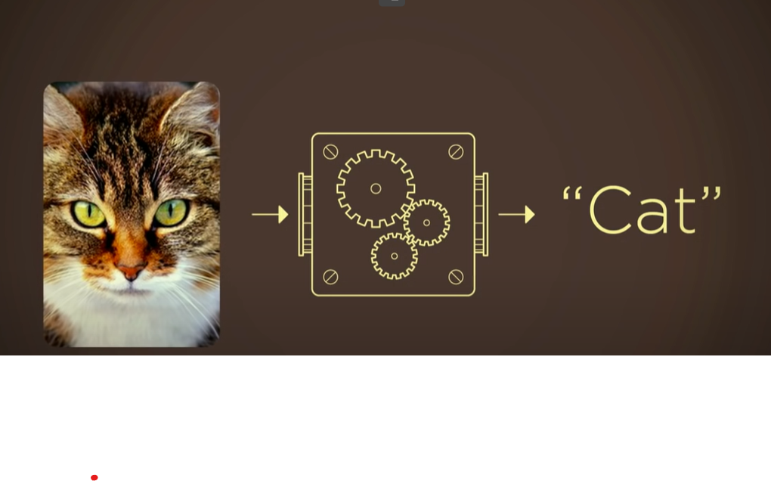
Notes:
Gives the computer training samples
ImageNet project -> label 15 million images and 22 thousand categories
A lot images -> feed into a mathematical model that would be able to do a classification task => would know that a cat is a cat

Slide 4
How computers learn to recognize objects instantly | Joseph Redmon – YouTube
Object detection: 1. putting bounding boxes around the objects and say what those objects are and their location.
Self driving vehicles
Robotic system
Require vision information to interact with the physical world

Slide 5
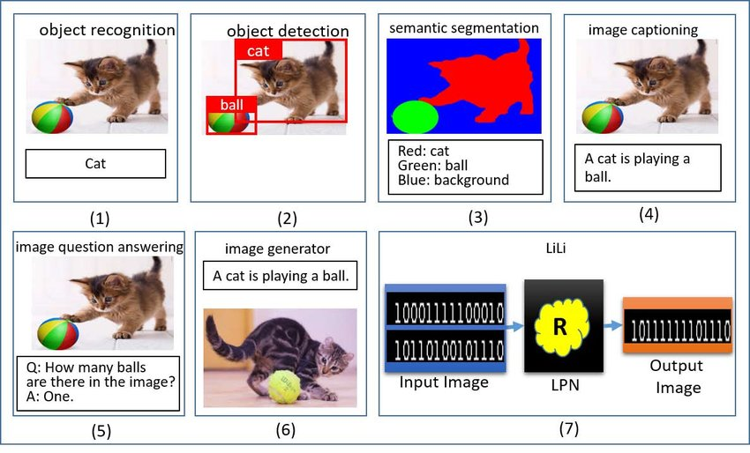

Slide 6
Handwritten Digit Classification Task
Notes:
In computer vision, the simplest task is to identify or label a given object

Slide 7

Notes:
We want our computer to learn that:
Input: a handwritten digit of 2
Output: the digit 2

Slide 8
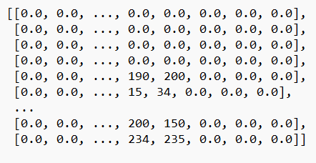

2
Some Neural Network model
Image input: matrix HxW
W = 28: number of pixels horizontally
H = 28: number of pixels vertically
Value: is the density of the gray scale image (value ranged from 0 to 255)
We expect P(2)>P(another digit) P(2) > 0.5
Ideally P(2)=1 and P(di#2)=0
Notes:
The mathematical model mimics how our brain (nervous system) works

Slide 9
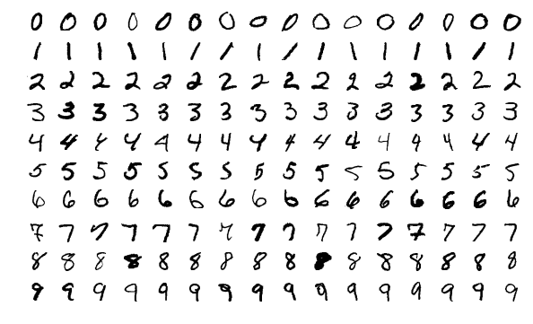
MNIST dataset
60,000 training images and 10,000 testing image

Slide 10
Concept Review
Stanford University CS231n: Deep Learning for Computer Vision

Slide 11
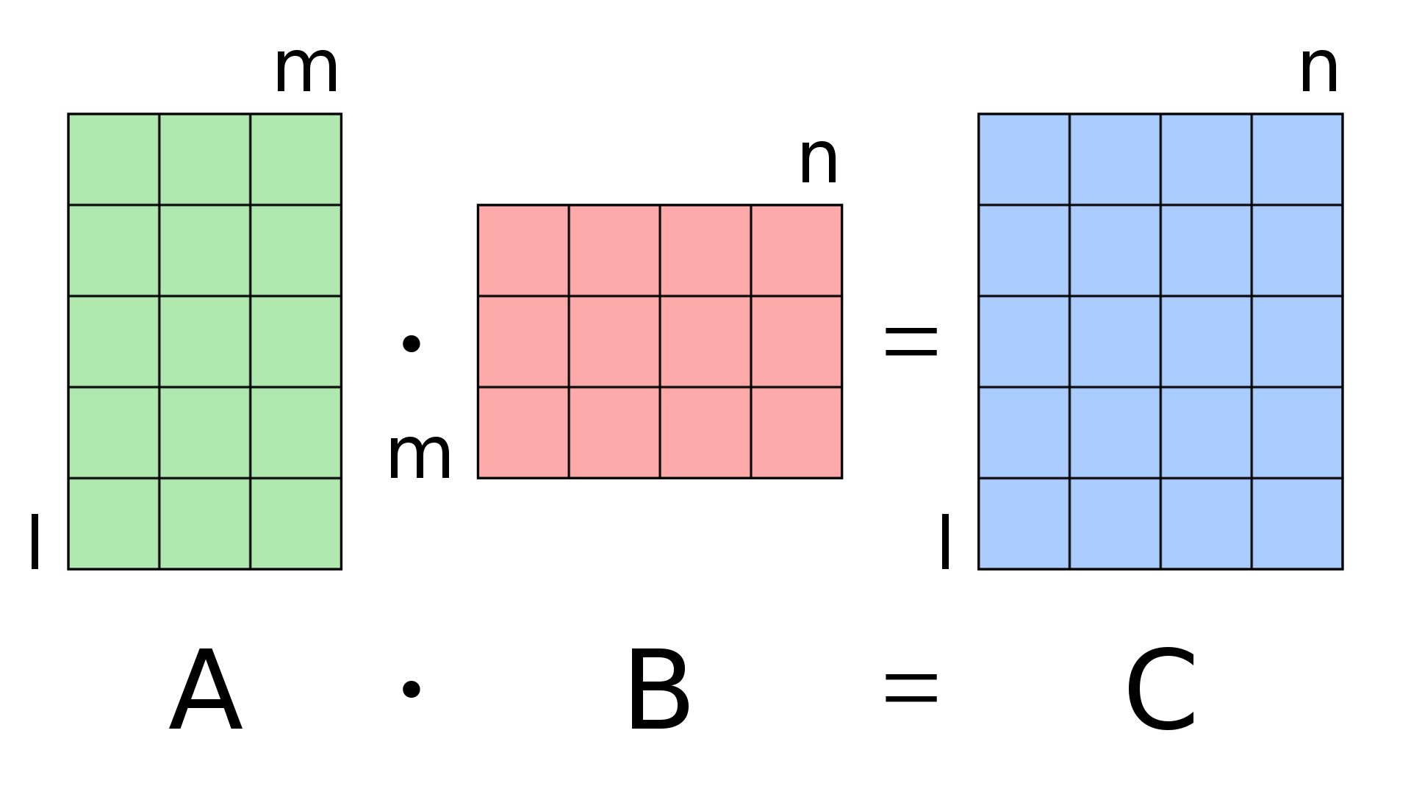
Matrix multiplication
What is matrix multiplication?
Each value in the result matrix is the dot product between a row in the first matrix and a column in the second matrix
(l, m) x (m, n) = (l, n)

Slide 12
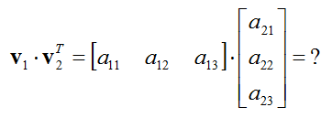
Matrix multiplication
What is dot product?
Dot product takes two equal-length sequences of numbers and return a single number

Slide 13
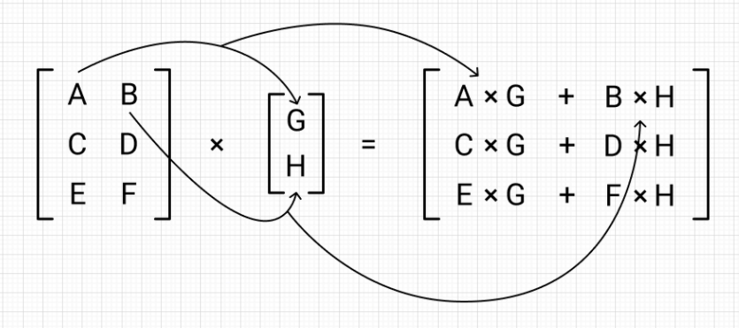
Matrix multiplication
What is the solution of the following matrix multiplication?

Slide 14
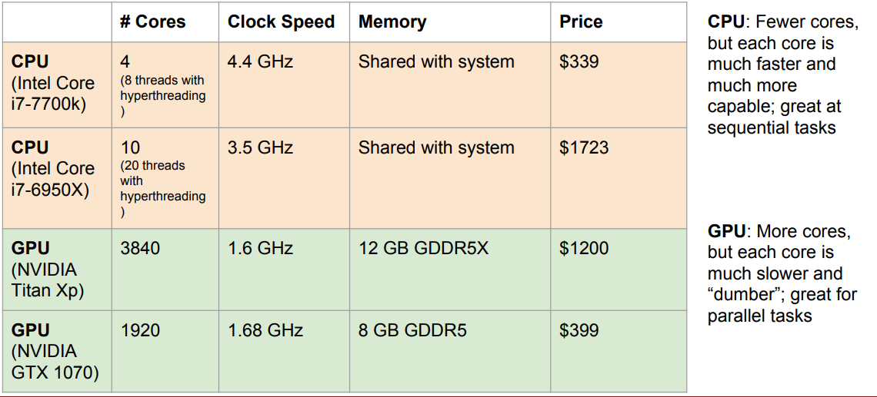
GPU for deep learning
From: Standford

Slide 15
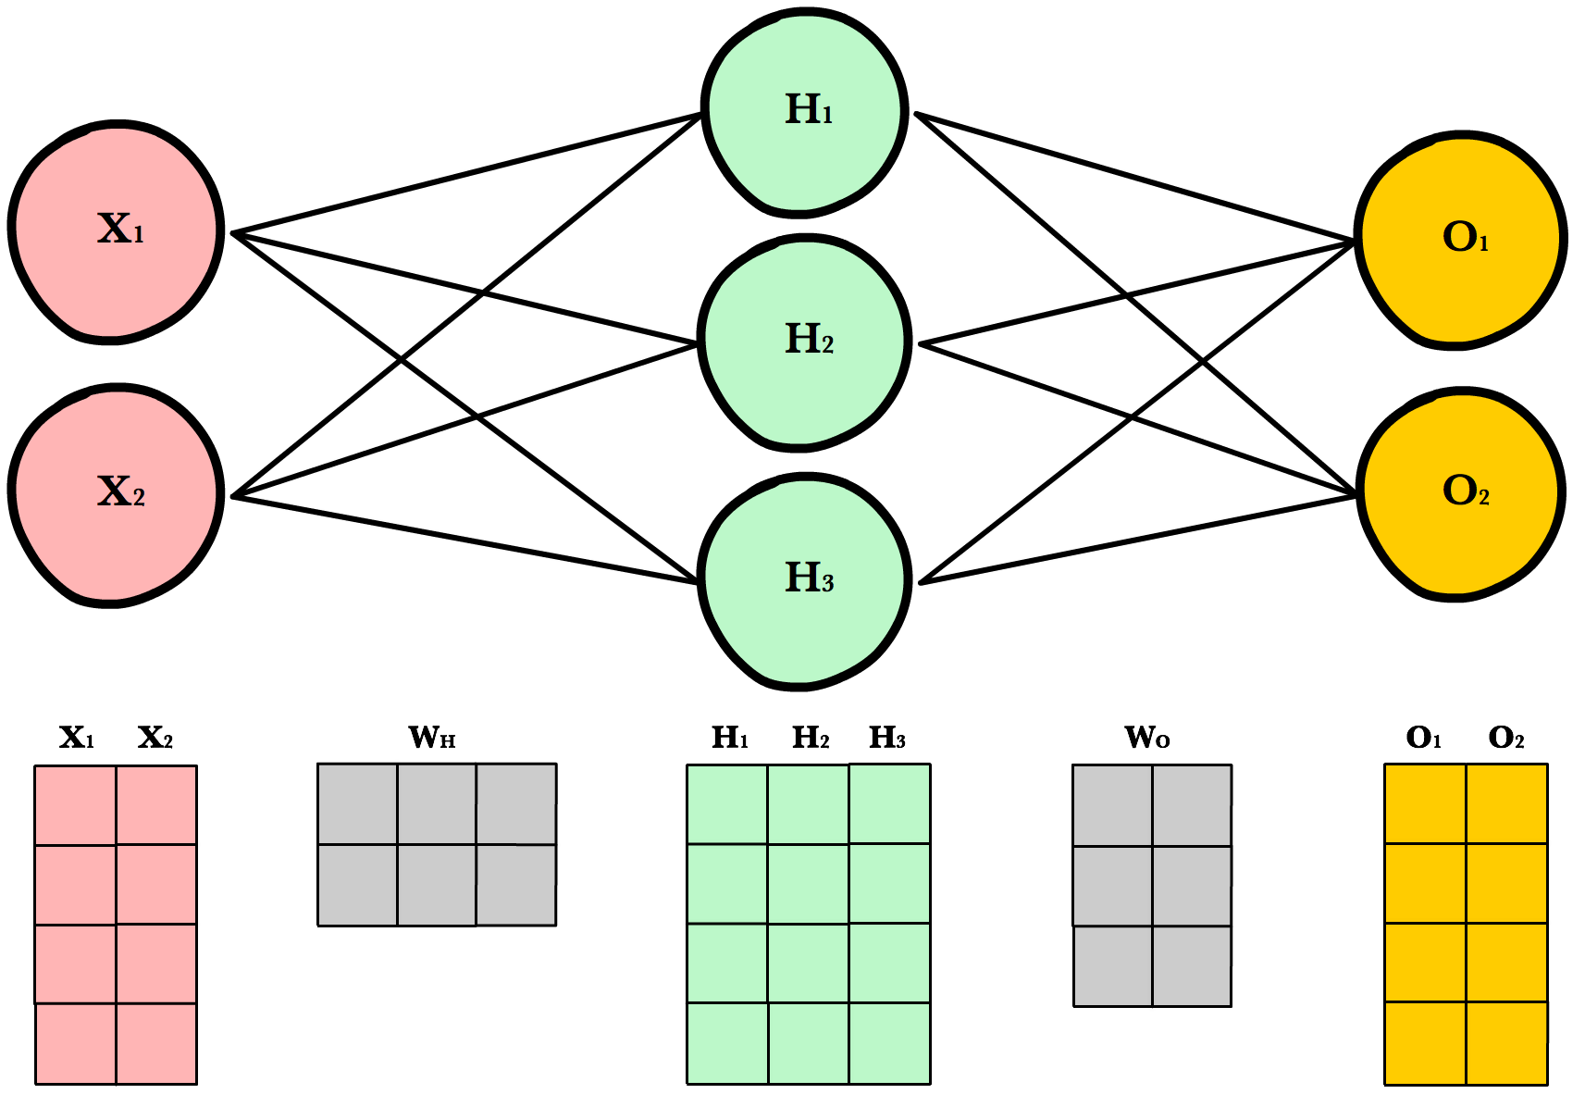
Parallel Processing in Neural Network
Neural Network involves a lot of matrix multiplication.
Each dot product in a matrix multiplication can be done independently
=> The opportunity for parallel processing comes to speed up the process.

Slide 16
Fully Connected Artificial Neural Network
Each circle is a neuron.
Neurons in an ANN structurally divided into layers
Information passes from one layer to the next layer (either hidden layer or output layer)
A fully connect neural means a neuron is connected to every neuron in the preceding layer

Slide 17






Fully Connected Artificial Neural Network
How is information passed from layer to the next layer?
Information coming into a neuron is called input. (yellow)
Information coming out from a neuron is called output (green)
All inputs coming to a neuron are taken as input to some computation in the middle to produce output, including linear transformation of the input and activation

Slide 18






Linear Transformation of the input
X1*w11 +x2*w21
w11
Each input connection (yellow) coming to H1 neuron has a certain influence on the output coming out from H1. We call influence/strength is weight.
Linear transformation involves linear interaction between inputs and weights of the connections
Basically, it is the weighted sum of the inputs in which the weights defined by the weight's matrix.
w21

Slide 19












Linear Transformation of the input
X1*w11 +x2*w21
In this network we have:
Input layer: of two neurons where each neuron contains some type of information.
We have a matrix X(2,1) for this layer
2. Weight matrix WH of shape (2,3). Each column contains weights of connections to a single neuron in the H layer
3. Linear transformation (or matrix multiplication) between X and WH produces H matrix of shape (3,1) for the hidden layer.
w11
w21
Same logic applied to from H layer to O layer

Slide 20
Activation function
X1*w11 +x2*w21
w11
The output from the linear transformation is not instantly passed, it must go through some non-linearity function
w21

Slide 21
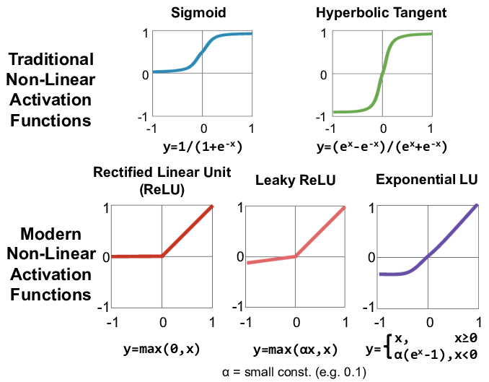

Slide 22
Why do we need activation function?
Introduce the nonlinearity to the network.
Allow model to have different hidden layers.
Otherwise, the model only have one layer.
=> allow the model to fit more complex functions
Notes:
[2,1]
[1,1,1] -> w = [1,0 -> w=[1, 2] -> [3,4]
1,0 1,0
1,1]
[1,2
1,2,
1,0]

Slide 23
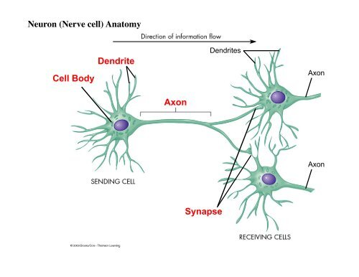
Biological Neural Network - Component
Dendrite receives input from many other neurons and carry those signals to the cell body (= input).
Axon is where the electrical impulses from the neuron travel away to be received by other neurons (= output).
Cell Body: connects to the dendrites which brings information to the neuron and the axon which sends information to other neurons (= hidden layer)
Synapse: is the point of contact between neurons where information is passed from one neuron to another neuron in the next layer. Synapses control the strength of the signals transmitted between neurons (=weights)

Slide 24
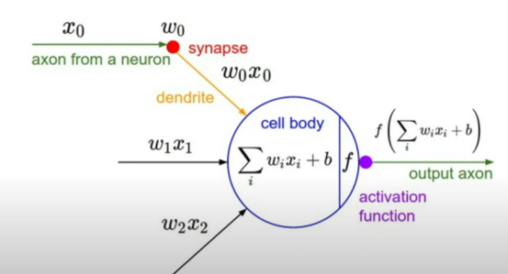
Biological Neural Network – Neuronal Computation
From: Standford

Slide 25
Who Invented A.I.? - The Pioneers of Our Future - YouTube

