Slide 1
Application of Area under ROC Curve in Machine Learning and usage of integration method to compute it
MA145, Dr. Andrew Schwartz
Honor Project
By: Tuyen Nguyen

Slide 2
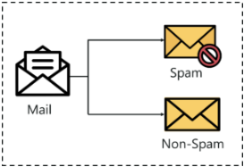
Classification Task
A Classification Task in Machine Learning predicts the class of a given data point.
For instance, a classification task predicts whether an email is spam or non-spam.
Notes:
Image Source: Classification In Machine Learning | Classification Algorithms | Edureka

Slide 3
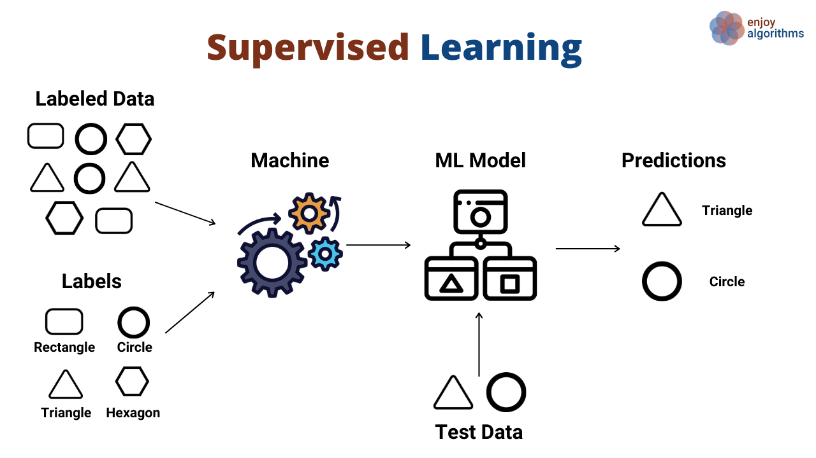
Classifier
In supervised learning, we create a model that can learn from Labeled Dataset (Training Set).
After the model goes through the training process, it can be used to make prediction on a Testing dataset that it has never seen before.
Notes:
Image Source: Different Types of Machine Learning Models (enjoyalgorithms.com)

Slide 4
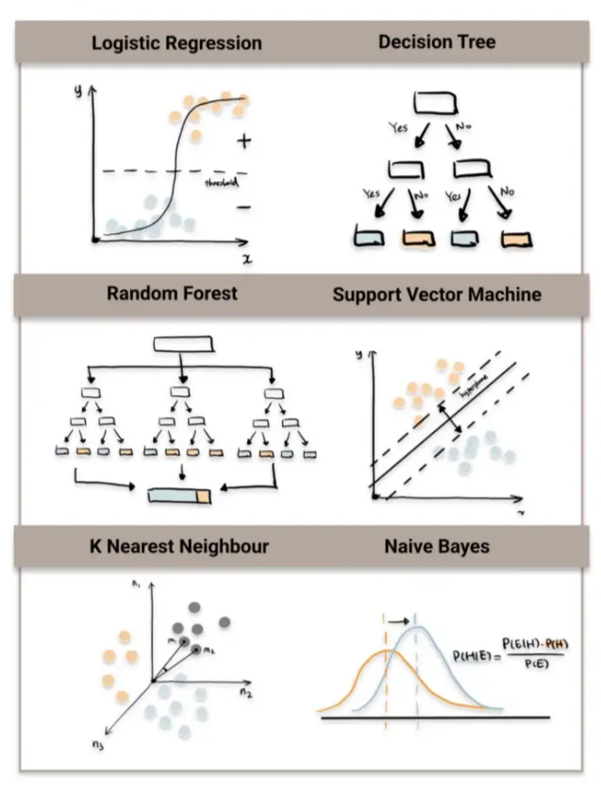
Models for Classification Task
The goal is to choose a suitable model with a suitable set of hyperparameters that give the best predictive performance.
Notes:
Image Source: Top 6 Machine Learning Algorithms for Classification | by Destin Gong | Towards Data Science

Slide 5

How to compare models’ performance?

Slide 6
Accuracy score
Accuracy = number of correct predictions / total number of predictions
For instance:
- 100 fruits (50 good apples and 50 bad apples)
correctly predicts 40 good apples and 45 bad apples
=> accuracy = (40+45)/100 = 85%

Slide 7

Accuracy Score may not a suitable metric for Unbalanced classes

Slide 8

Unbalanced Classes

Slide 9
Unbalanced Classes
Unbalanced classes is when there are unequal number of individuals in each class of our sample.
For instance,
80 good apples and 20 bad apples
If predict all fruits are apples, still achieve good accuracy score:
=> Accuracy = 80/(100) = 80%

Slide 10
Is there a better way to measure the performance of our classification models?

Slide 11
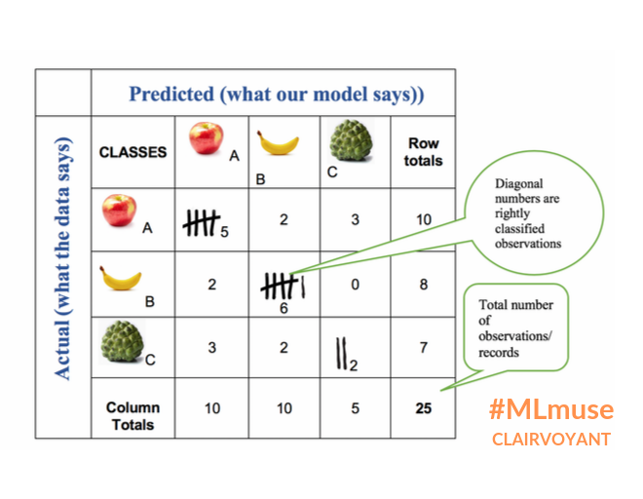
Confusion Matrix
Each row in a matrix represent an actual class and each column represents a predicted class.
The value along the diagonal is the number of correct classifications.
The value at other cells is the number of incorrect classification.
Notes:
Image Source: Confusion matrix- Machine learning | Clairvoyant Blog (clairvoyantsoft.com)

Slide 12
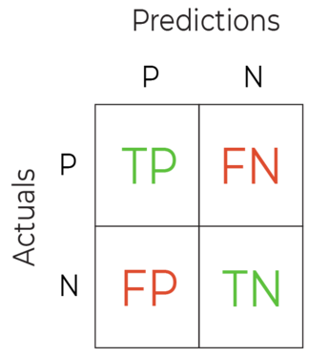
Confusion Matrix
In a binary classification problem, we use the following four terms for the four boxes:
True Positive (TP)
True Negative (TN)
False Positive (FP)
False Negative (FN)

Slide 13

True Positive Rate (TPR) and False Positive Rate (FPR)
TPR = $\frac{True Positive}{Positive}$ = $\frac{TP}{TP+FN}$ = 1 – FNR
(FNR = $\frac{False Negative}{Positive}$ = $\frac{FN}{TP+FN}$ )
FPR = $\frac{False Positive}{Negative}$ = $\frac{FP}{FP+TN}$ = 1 – TNR
(TNR = $\frac{True Negative}{Negative}$ = $\frac{TN}{TP+TN}$ )

Slide 14
Decision threshold
In a classification task, a model will return a probability that the sample belongs to the positive class.
Based on a predefined threshold, we can determine whether a data sample belongs to a positive class or a negative class
For instance,
threshold = 0.5
if P >= 0.5:
classified it to a “Positive” class
if P < 0.5:
classified it to a “Negative” class

Slide 15
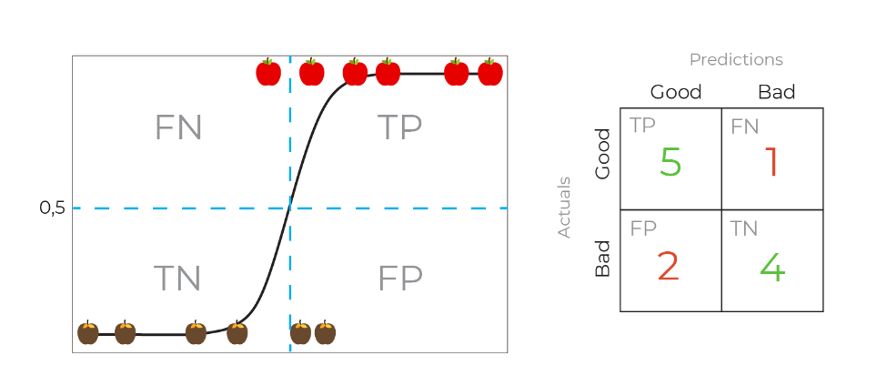
TPR = $\frac{TP}{TP+FN}$ = $\frac{5}{6}$
FPR = $\frac{FP}{TN+FP}$ = $\frac{2}{6}$

Slide 16
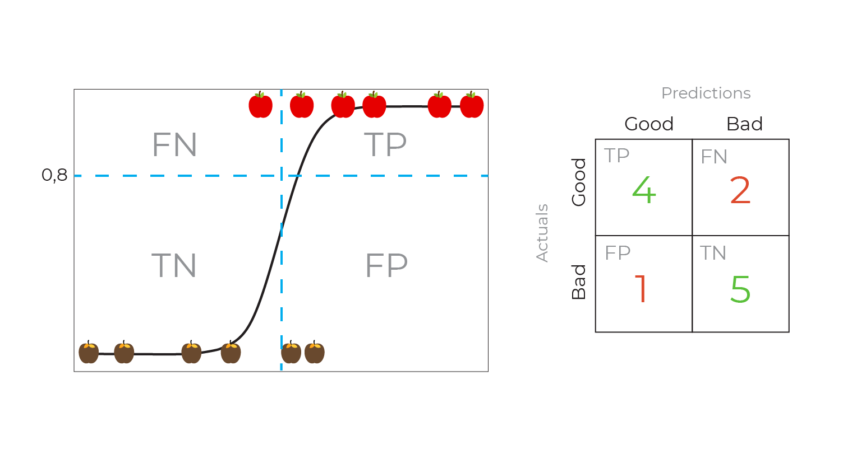
TPR = $\frac{TP}{TP+FN}$ = $\frac{4}{6}$
FPR = $\frac{FP}{TN+FP}$ = $\frac{1}{6}$

Slide 17
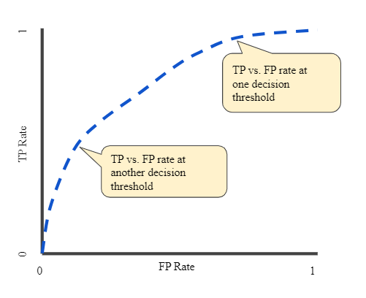
Receiver Operating Characteristic (ROC) curve
A ROC curve plots true positive rate (TPR) against false positive rate (FPT) for all possible decision threshold with threshold decreases.
Notes:
Image Source: Classification: ROC Curve and AUC | Machine Learning | Google Developers

Slide 18
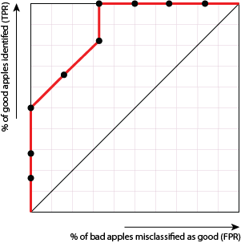


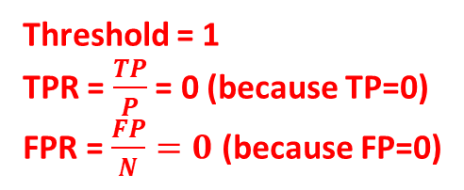

Receiver Operating Characteristic (ROC) curve
A ROC curve plots true positive rate (TPR) against false positive rate (FPT) for all possible decision threshold with threshold decreases.
Threshold = 0
TPR = $\frac{TP}{P}$ = 1 (because P=TP)
FPR = $\frac{FP}{N}=1$ (because N=FP)
Threshold = 1
TPR = $\frac{TP}{P}$ = 0 (because TP=0)
FPR = $\frac{FP}{N}=0$ (because FP=0)
Notes:
Source: Evaluate the Performance of a Classification Model - Improve the Performance of a Machine Learning Model - OpenClassrooms

Slide 19
The diagonal line crosses (0,0) and (1,1) represents the ROC curve of a purely random classifier. A good classifier has its ROC curve stays as far away from that line as possible (toward the top left corner)

Slide 20
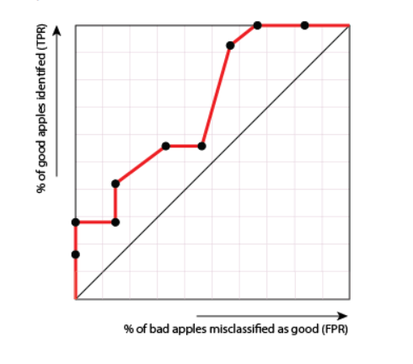
Because in order to achieve high (TPR), it must suffer from high (FPR)
This is a bad classifier. Why?

Slide 21
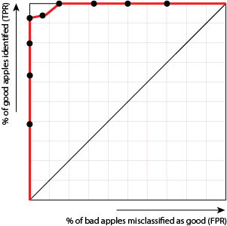
Because high TPR can be achieved without suffering from a high FPR.
This is an excellent classifier. Why?

Slide 22
A ROC curve is often used in the case when we care more about the false negatives than the false positives. A model that predicts whether a patient will get a heart disease will try to maximize the TPR, more heart disease patient are foreseen and provided with treatment in a timely manner.

Slide 23
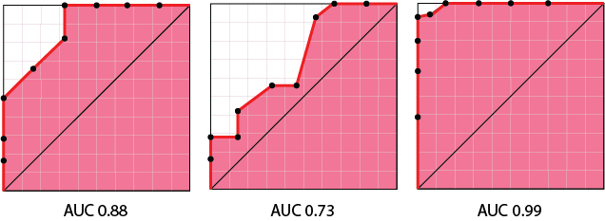
The Area under the ROC Curve

Slide 24
The Area under the ROC Curve
The AUC value is within the range [0.5–1.0], where the minimum value represents the performance of a random classifier, and the maximum value would correspond to a perfect classifier

Slide 25
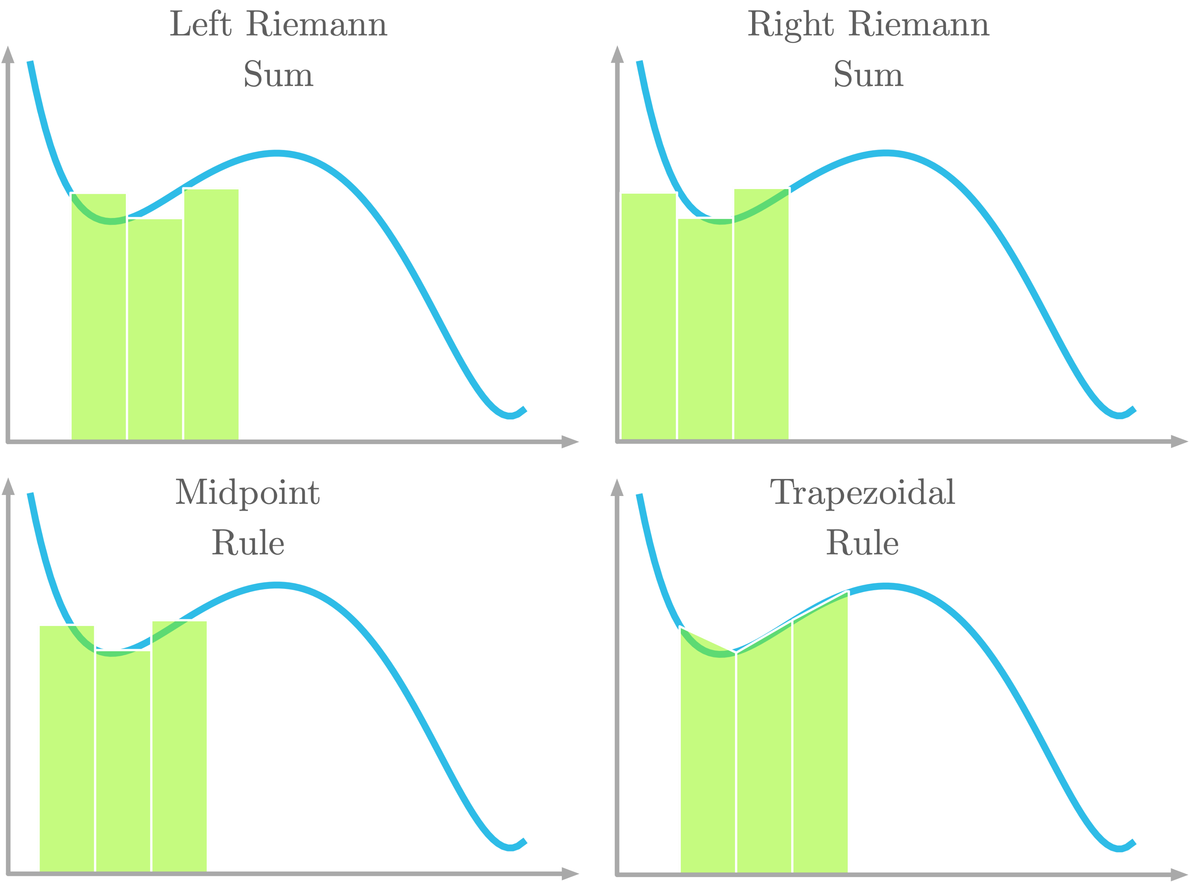
Compute AUC using the integration method

Slide 26
Classification Models to predict Heart Disease
The models will learn from a labeled Heart Disease dataset to predict whether a patient has a heart disease present or absent:
Hungarian Institute of Cardiology. Budapest: Andras Janosi, M.D.
University Hospital, Zurich, Switzerland: William Steinbrunn, M.D.
University Hospital, Basel, Switzerland: Matthias Pfisterer, M.D.
4. V.A. Medical Center, Long Beach and Cleveland Clinic Foundation: Robert Detrano, M.D., Ph.D.
UCI Machine Learning Repository: Heart Disease Data Set

Slide 27
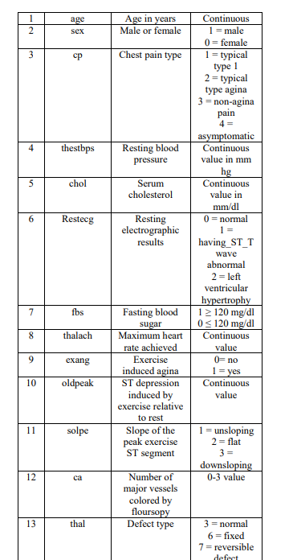
The Heart Disease dataset
While the databases have 76 raw attributes, only 14 of them used in past experiments.
The fourteen attribute indicates whether the patient has a heart disease (present) or not (absent)
Present or 1 is a positive class
Absent or 0 is a negative class

Slide 28
The Heart Disease dataset
After combining and removing records that have missing values, the dataset contains a total of 569 records.
Split dataset into 80% for training and 20% for testing with balanced classes

Slide 29
The Heart Disease dataset
The training set is used to fit our models. Following is the training set distribution according to the classes:
The testing set is used to measure our models’ performance. Following is the testing set distribution according to the classes:

Slide 30
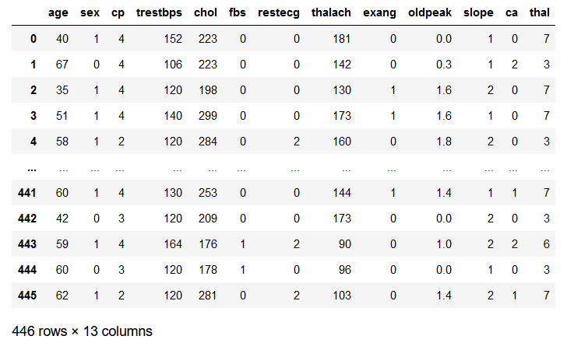
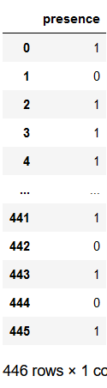




Train different models
Logistic Regression classifier
K Nearest Neighbor classifier
Random Forest classifier
Voting classifier

Slide 31
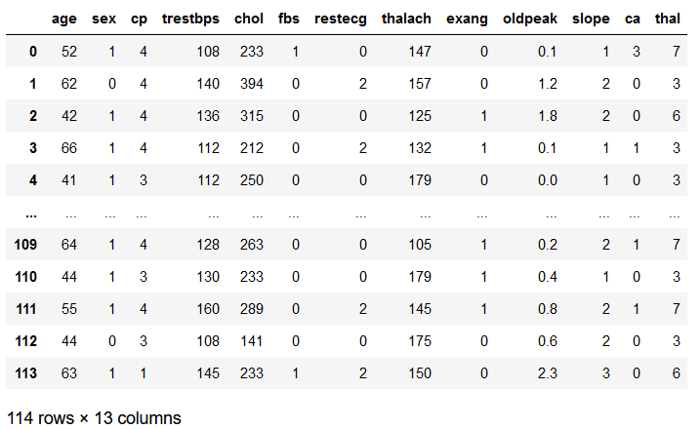
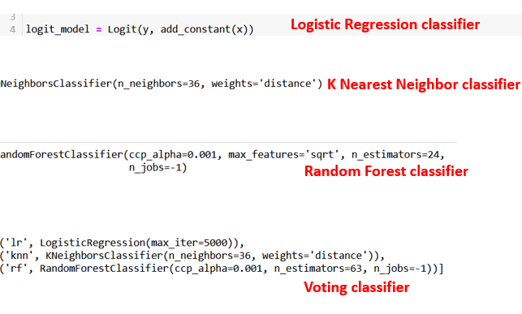
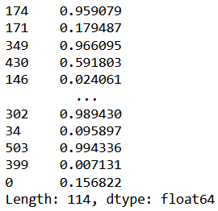
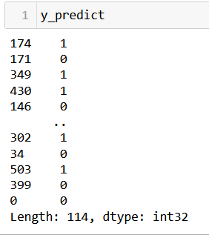




Make predictions
Decision threshold=0.5
Predicts
Probability estimate of positive class
The Predicted class

Slide 32
Accuracy score

Slide 33
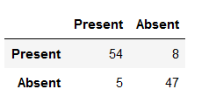
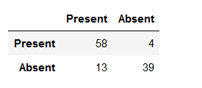
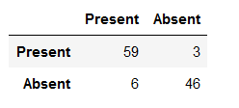
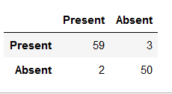
Confusion matrix (at decision threshold=0.5)
Logistic Regression
K Nearest Neighbors
Random Forest
Voting Classifier

Slide 34
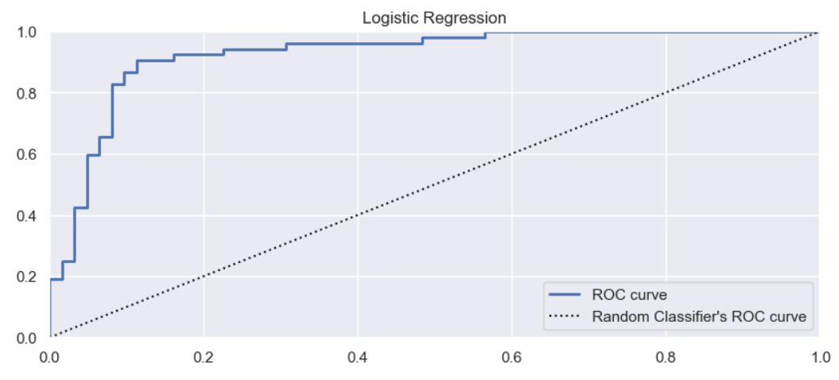
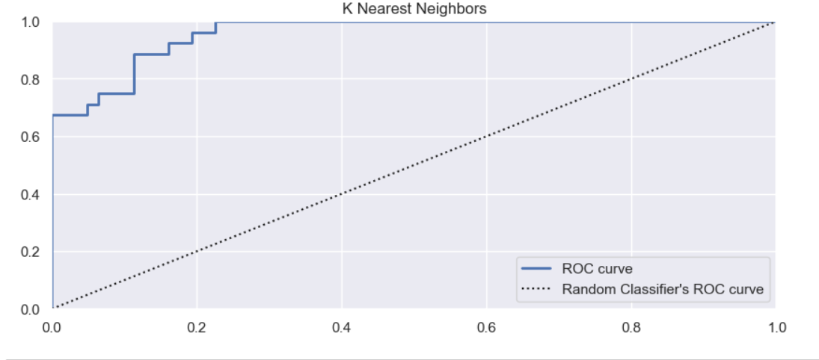
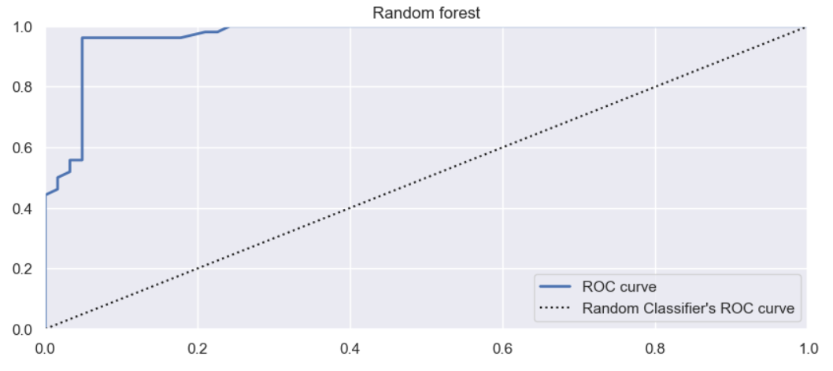
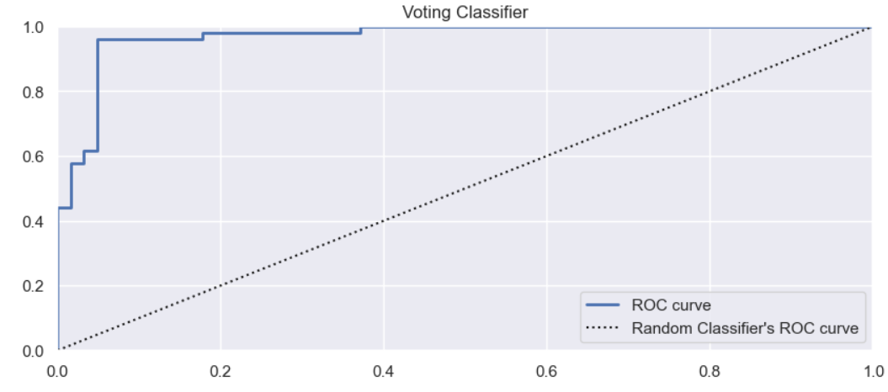
Receiver Operating Characteristic Curve (ROC)
Logistic Regression
K Nearest Neighbors
Random Forest
Voting Classifier

Slide 35

Area Under the ROC Curve (AUC)
TPR
At threshold = 0.9906
FPR = 0.016
TPR = 0.25
FPR

Slide 36
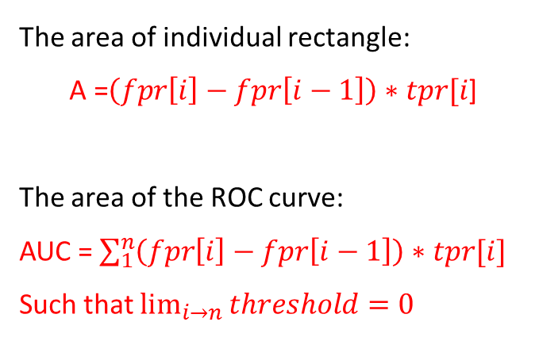
Area Under the ROC Curve (AUC)
TPR
fpr[i]-fpr[i-1]
The area of individual rectangle:
$$\text{A}\text{ =}\left(fpr\left[i\right]−fpr\left[i−1\right]\right)∗tpr[i\text{]}$$
The area of the ROC curve:
AUC = $\sum_{1}^{n}{\left(fpr\left[i\right]−fpr\left[i−1\right]\right)∗tpr[i]}$
Such that $\lim_{i→n}{threshold=0}$
tpr[i]
FPR

Slide 37

Area Under the ROC Curve (AUC)

Slide 38


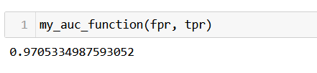

Area Under the ROC Curve (AUC)
Logistic Regression
K Nearest Neighbors
Random Forest
Voting Classifier

Slide 39
References
Chapter 1. correlation and regression. Correlation and Regression. (n.d.). Retrieved November 25, 2022, from http://digitalfirst.bfwpub.com/stats_applet/stats_applet_5_correg.html
Evaluate the performance of a classification model. OpenClassrooms. (2022, February 18). Retrieved November 25, 2022, from https://openclassrooms.com/en/courses/6401081-improve-the-performance-of-a-machine-learning-model/6519011-evaluate-the-performance-of-a-classification-model
Géron Aurélien. (2023). Hands-on machine learning with scikit-learn, keras and tensorflow: Concepts, tools, and techniques to build Intelligent Systems. O'Reilly.
Hadrienj. (2020, November 5). Essential Math for Data Science: Integrals and area under the curve. Code · Data Science. Retrieved November 25, 2022, from https://hadrienj.github.io/posts/Essential-Math-Integrals/
Khan Academy. (n.d.). Influential points in regression (video). Khan Academy. Retrieved November 25, 2022, from https://www.khanacademy.org/math/ap-statistics/bivariate-data-ap/assessing-fit-least-squares-regression/v/influential-points-regression
Leung, K. (2022, September 13). Assumptions of logistic regression, clearly explained. Medium. Retrieved November 25, 2022, from https://towardsdatascience.com/assumptions-of-logistic-regression-clearly-explained-44d85a22b290
Molnar, C. (2022, November 12). Interpretable machine learning. 5.2 Logistic Regression. Retrieved November 25, 2022, from https://christophm.github.io/interpretable-ml-book/logistic.html
S.Dangare, C., & S. Apte, S. (2012). Improved study of heart disease prediction system using data mining classification techniques. International Journal of Computer Applications, 47(10), 44–48. https://doi.org/10.5120/7228-0076

Slide 40
Code
tnguyen7s/ma145_study_ROC_curve (github.com)

Slide 41


