Slide 1
Poker – Determine Winner
By: toan Nguyen
01/05/2016

Slide 2
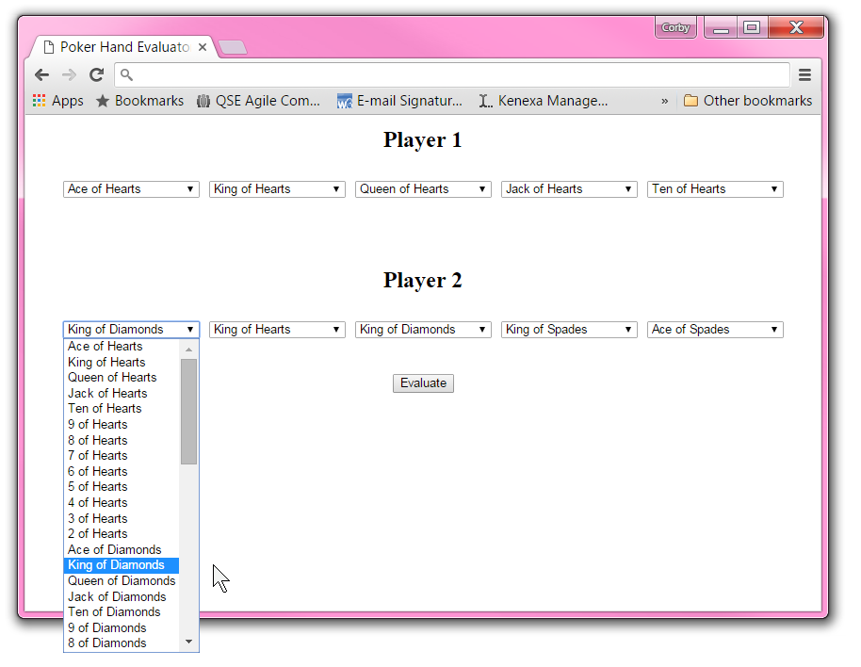
Problem Statement
Create a User Interactive Application where user can pick cards from a standard deck of cards and determine who wins the game.

Slide 3


Technologies
Visual Studio 2015 Community version
HTML and C# on ASP.NET framework using Razor Engine, MVC
JavaScript for Randomizer
CSS – Style Sheet
Chrome Browser for testing
Github – Repository
Localhost – local server

Slide 4
Solution
Created a Web Based Application
Let user pick cards from the deck for each player
Then a click of a button will take care of the rest
Winner are displayed below the buttons
Additional Features
Player(s) hands validation
Players’ hands can be randomly generated
Player score are kept through session
Display winning factor

Slide 5
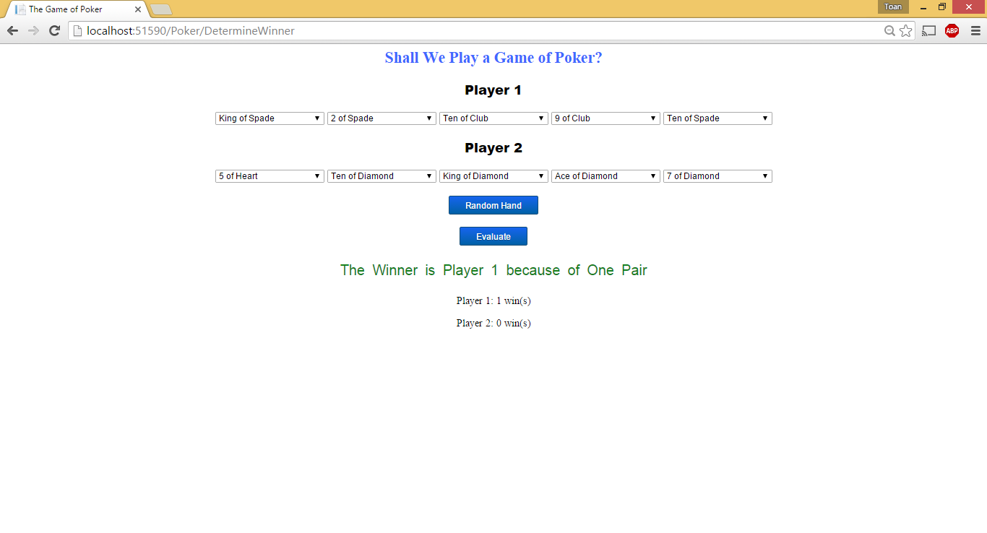

Slide 6
Lessons Learned
Learned .Net, MVC, C#, and CSS
Object Oriented Web Application
Working alone
Time management
Documentations

Slide 7
Architecture
PokerHandFromController
Card
View/Representation
PokerHandController
Player
PokerHandFromView

Slide 8
Demo

Slide 9

Questions and Answers

Slide 10
Conclusion
Thank you for the opportunity to learn, to improve and to excel at what I want to do.

