Slide 1
NOVA AETAS
Generative AI use within the ASIC physical design flow
Benefits and pitfalls
A PULP + CVA6 inference accelerator · OpenPDK gf180mcu + 7-track std cells · Claude Opus 5 generated the RTL
Nova Aetas · Generative AI use within the ASIC PD flow
1 / 49

Slide 2
CONTENTS
Contents
Introduction
Design, open-source flow, and SKILL files
01
RTL coding
Generation quality, metrics, and limits
02
Verification
Specification, cocotb, and pyuvm
03
Synthesis
Mapping, PPA, keep and reject
04
Place and Route (coming soon)
Floorplan, place, clock, and route
05
STA (coming soon)
Timing checks and rtl-timing-closure
06
Physical Verification (coming soon)
DRC, LVS, IR, and GDS
Close
Summary, references, and skill index
Nova Aetas · Generative AI use within the ASIC PD flow
2 / 49

Slide 3
INTRODUCTION
Introduction
Nova Aetas is a PULP-based inference accelerator: CVA6 RISC-V host, Snitch RV32 DMA, custom near-memory array. Open-source tools on the GlobalFoundries gf180mcu OpenPDK and GF 7-track standard cells. Agents load SKILL files at each flow stage.
Nova Aetas · Generative AI use within the ASIC PD flow
3 / 49

Slide 4
INTRODUCTION
What Nova Aetas is
Inference accelerator on open infrastructure. Three main blocks.
PULP (U. of Bologna)
CVA6 (Ariane)
SNITCH
THE INFRASTRUCTURE
RISC-V HOST
32-BIT DMA
The Parallel Ultra-Low Power platform is the SoC: fabric, memories, peripherals, and open RISC-V cores — including Snitch. Systems from PULPissimo to multi-cluster Hero. SolderPad license. pulp-platform.org
The host is CORE-V CVA6 — a highly configurable 6-stage RISC-V core. Application-class configs can boot Linux. Control, runtime, programming. github.com/openhwfoundation/cva6
The DMA controller is Snitch, a 32-bit 1-stage RISC-V core that ships with the PULP repo. It moves tensors into near-memory. The accelerator is a custom processing-near-memory systolic array: FP8, BF8, FP16, BP16, and INT16.
PULP / Snitch DMA: pulp-platform.org. Host: OpenHW CORE-V CVA6 — github.com/openhwfoundation/cva6
Nova Aetas · Generative AI use within the ASIC PD flow
4 / 49

Slide 5
INTRODUCTION
Goals
Learn and document best practices and pitfalls for generative AI at each step, from architecture to GDS.
01
RTL creation
02
Verification
03
Floorplan exploration and creation
04
Power grid creation (Coming soon)
05
Clock tree planning and creation (Coming soon)
06
Timing closure
07
Physical verification
Nova Aetas · Generative AI use within the ASIC PD flow
5 / 49

Slide 6
INTRODUCTION
Open-source IP and tools
Open IP, open tools, and an open PDK.
OPEN-SOURCE IP
OPEN-SOURCE TOOLS
▸ PULP — SoC infrastructure, memories, peripherals, Snitch.
▸ CVA6 — OpenHW CORE-V host processor.
▸ Snitch — 32-bit RISC-V DMA from the PULP repo.
▸ Custom array RTL generated in this project (Opus 5).
▸ PDK — GlobalFoundries gf180mcu OpenPDK.
▸ Std cells — GF 7-track, 5 V (gf180mcu_fd_sc_mcu7t5v0).
▸ Verilator — RTL simulation.
▸ cocotb — Python testbench.
▸ pyuvm — UVM-style tests on cocotb.
▸ Vaporview — waveform viewer.
▸ OpenROAD — backend, RTL to GDSII*
▸ OpenPDK – GF gf180mcu
Nova Aetas · Generative AI use within the ASIC PD flow
6 / 49

Slide 7
INTRODUCTION
Nova Aetas architecture
PULP INFRASTRUCTURE · SoC fabric, memory, peripherals
HOST PROCESSOR
CVA6
OpenHW CORE-V · 6-stage RISC-V · control, runtime, programming
DMA PROCESSOR
NEAR-MEMORY
ACCELERATOR · PROCESSING-NEAR-MEMORY
Snitch
SRAM 0
PE
PE
PE
PE
Custom systolic array.
Data stays next to SRAM.
32-bit 1-stage RISC-V from the PULP repo. Moves tensors into near-memory.
SRAM 1
PE
PE
PE
PE
PE
PE
PE
PE
SRAM 2
PE
PE
PE
PE
MULTIPLE DATA FORMATS
FP8
BF8
FP16
BP16
INT16
CVA6 host (github.com/openhwfoundation/cva6). Snitch RV32 DMA from PULP (pulp-platform.org). PDK: gf180mcu OpenPDK. Cells: GF 7-track mcu7t5v0. Datapath formats: FP8, BF8, FP16, BP16, INT16.
Nova Aetas · Generative AI use within the ASIC PD flow
7 / 49

Slide 8
INTRODUCTION
Open-source development flow
No commercial simulator, viewer, PDK, or backend. Implementation: OpenROAD on gf180mcu.
VERILATOR
VAPORVIEW
OPENROAD
RTL SIMULATION
WAVEFORM VIEWER
BACKEND · RTL → GDSII
Compile RTL to C++ and simulate. Cycle-accurate. Functional correctness is judged here before layout.
Inspect dumps and debug failures with waveforms, not only log text.
Open-source autonomous toolchain for digital implementation: floorplan, place, CTS, route, toward GDSII on the gf180mcu OpenPDK and the GF 7-track standard-cell library. Application plus OpenROAD-flow-scripts. DARPA IDEA / UC San Diego and partners.
FLOW
RTL
VERIFICATION
Verilator
Vaporview
OpenROAD
GDS
cocotb · pyuvm
OpenROAD on gf180mcu OpenPDK and GF 7-track cells (github.com/google/globalfoundries-pdk-libs-gf180mcu_fd_sc_mcu7t5v0).
Nova Aetas · Generative AI use within the ASIC PD flow
8 / 49

Slide 9
INTRODUCTION
Skills enable and constrain the AI
Versioned instruction the agent loads before acting. Example: .agents/skills/style-verilog/SKILL.md
.agents/skills/style-verilog/SKILL.md
name
---
name: "style-verilog"
description: "Load the SystemVerilog
RTL coding style guide."
argument-hint: "Optional: topic
(e.g. naming, ports, FSMs)"
user-invocable: true
---
Read the file at hw/verilog_coding_style.md
and apply it as the coding style guide
for all RTL work in this session.
$ARGUMENTS
How the agent finds the skill. style-verilog is the RTL house style.
description
The trigger. The agent matches “write RTL” to this line and loads the file first.
body
Points at hw/verilog_coding_style.md. The model does not invent naming, ports, or FSMs.
$ARGUMENTS
Optional focus from the engineer — naming, ports, FSMs — without rewriting the skill.
Nova Aetas · Generative AI use within the ASIC PD flow
9 / 49

Slide 10
INTRODUCTION
Skills by flow stage
style-verilog is the RTL example. The same SKILL.md format applies at later stages.
RTL · EXAMPLE
VERIFY
SYNTH
style-verilog
rtl-patterns
style-dv
hw-make
rtl-patterns
Load style-verilog first, then rtl-patterns for synthesizable structure — before timing fails.
Select the make target. Clean before reporting pass. Test against the specification, not the implementation.
Map from that RTL form. Record keep or reject from tool reports. Do not invent PPA.
PnR
STA
PHYS VER
hw-floorplan
rtl-timing-closure
ai-review
Place macros first. Set die size from the bounding box. Do not invent a floorplan.
Read the timing path, not the RTL. One change per run. Do not hide slack in the SDC.
Use the same criteria as the review gate. Do not waive a rule without documented justification.
Nova Aetas · Generative AI use within the ASIC PD flow
10 / 49

Slide 11
SECTION 1
RTL coding
Benefits and pitfalls of generative AI for RTL generation.
Nova Aetas · Generative AI use within the ASIC PD flow
12 / 49

Slide 12
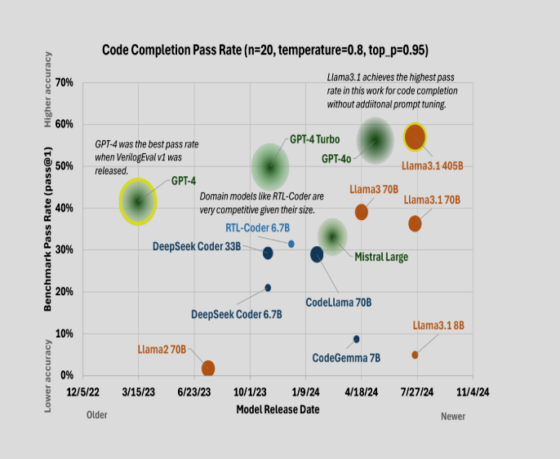
RTL CODING · CLAIM 1
RTL Generation has moved fast
▸ VerilogEval is the standard metric for Verilog correctness
▸ Nova Aetas generated RTL with Claude Opus 5 (Anthropic) which scores 95% with MaxEffort
Nova Aetas · Generative AI use within the ASIC PD flow
13 / 49

Slide 13
RTL CODING · CLAIM 1
RTL Generation has moved fast
▸ However, correctness hits a cliff and significantly decreases
Claude Opus 5 · VerilogEval-style problems
Generalize curve of both VerilogEval and RTLLM benchmarks
Functional
correctness
Claude Opus 5
48 lines of code
Pass rate 51%
Generated Verilog code size
Nova Aetas · Generative AI use within the ASIC PD flow
13 / 49

Slide 14
RTL CODING · CLAIM 3
Quality drops off with architectural depth
Shallow blocks often succeed. Hierarchical designs with multiple submodules do not.
▸ Combinational and shallow designs often succeed.
▸ Deep pipelines, floating-point, and unique architectures struggle.
▸ From 4 deep modules onward, all evaluated models failed (zero-shot, pass@5).
▸ VerilogEval and RTLLM inversely proportional to hierarchy.
▸ Standalone and one-submodule targets still show functional pass.
▸ Targets with two or more submodules: syntax pass@5 still 74.5%.
Purini et al., ArchXBench, arXiv:2508.06047. Tan et al., ChipVerilog, arXiv:2607.13079, Table 5.
Nova Aetas · Generative AI use within the ASIC PD flow
15 / 49

Slide 15
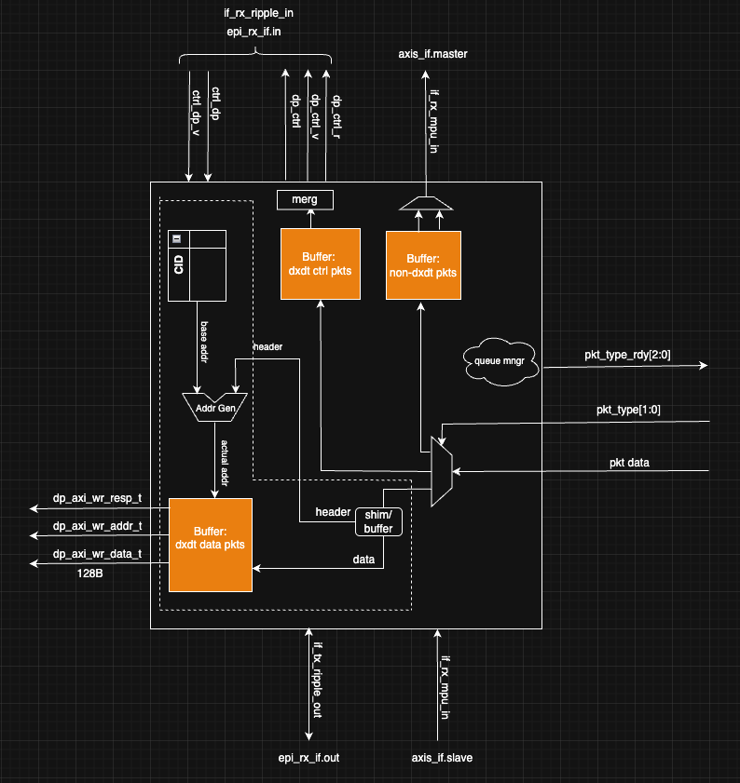
RTL CODING · IMPLICATIONS
Nova Aetas RX_FWD Block
239 rx_dp_ctrl_merge.sv
617 rx_dxdt_axi_mem_write.sv
78 rx_dxdt_ctrl.sv
225 rx_dxdt_data_shim.sv
143 rx_dxdt_data.sv
117 rx_fwd_ctrl_axis_pump.sv
178 rx_fwd_ctrl_ripple.sv
212 rx_fwd_ctrl_skid.sv
161 rx_fwd_mems.sv
217 rx_fwd_mpu_skid.sv
378 rx_fwd.sv
216 rx_fwd_window.sv
112 rx_mpu_axis_pump.sv
81 rx_mpu.sv
89 rx_queue_mgr.sv
3063 total
Nova Aetas · Generative AI use within the ASIC PD flow
17 / 49

Slide 16
RTL CODING · IMPLICATIONS
Nova Aetas RX_FWD Block
Original code handwritten and verified
4600 lines
49 tests passing
Experiment 1: Top level spec only
Over 10k lines of code
All tests fail
Not humanly debugable
Experiment 2: Top level spec + submodule specs
4k lines of code
46 of 49 tests passing
Experiment 3: Top level spec + Hierarchical Prompts
(planning mode: AI was directed to partition into submodules first, then code)
~7k lines of code
20 of 49 tests passing
Nova Aetas · Generative AI use within the ASIC PD flow
17 / 49

Slide 17
RTL CODING · IMPLICATIONS
Nova Aetas RX_FWD Block
Take-aways:
AI can write high-quality RTL code. If not overwhelmed. Saving a lot of coding time.
However, time does need to be spent to write quality submodule specifications.
Nova Aetas · Generative AI use within the ASIC PD flow
17 / 49

Slide 18
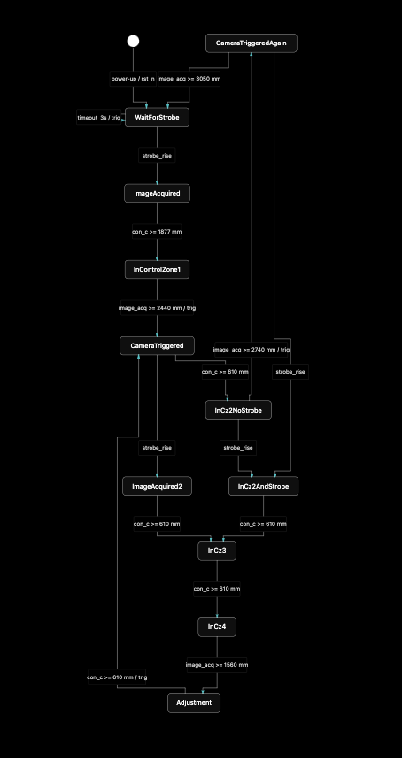
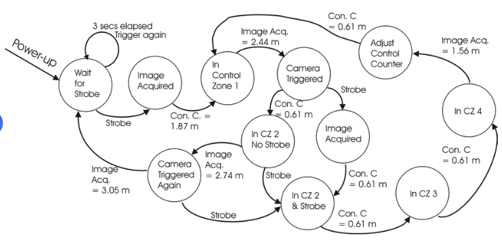
RTL CODING · CLAIM 4 · JUDGMENT
Graphical input vs graphical output
A sketch can specify RTL. Generating a reviewable diagram from generated RTL is still difficult.
RTL
OK! Much better
Judgment from Nova Aetas practice. Not a paper result.
Mermaid
Nova Aetas · Generative AI use within the ASIC PD flow
16 / 49

Slide 19
SECTION 2
Verification (where AI shines)
Nova Aetas · Generative AI use within the ASIC PD flow
19 / 49

Slide 20
RTL
Verify
Synth
PnR
STA
PhysVer
VERIFICATION
Verification
Where AI plays:
SV Assertion writing
  Code based
  Spec based (same spec that sourced RTL)
  Standard based (AIX, Ethernet, etc)
Writing testbenches/testcases (SV or cocotb)
Debugging failures
  Fail->bot[debug & fix]-> review
Quality checks during CI flow (Coding guidelines)
MR Reviews (different agent than author)
Stats collecting and Reporting:
  Regression status
  Test plan coverage
  Line/functional coverage
Nova Aetas · Generative AI use within the ASIC PD flow
20 / 49

Slide 21
VERIFICATION
Benefits and pitfalls
A passing testbench is not a passing design if it only tests the implementation.
BENEFIT
PITFALL
▸ Draft a test plan from the specification, not from the RTL.
▸ Generate directed tests, constrained-random stimulus, and SVA.
▸ Cluster logs. Rank failures. Record a hypothesis before a patch.
▸ Use coverage holes to identify untested requirements.
▸ Tests that pass the code rather than the specification.
▸ Meaningless assertions that never fire.
▸ Coverage bins filled without matching intent.
▸ Debug without a recorded hypothesis.
Nova Aetas · Generative AI use within the ASIC PD flow
21 / 49

Slide 22
SECTION 3
Synthesis
Map RTL to a standard-cell netlist. Timing is estimated. PPA is a keep/reject loop.
Nova Aetas · Generative AI use within the ASIC PD flow
22 / 49

Slide 23
SYNTHESIS
Benefits and pitfalls
Do not keep a PPA improvement if the testbench now fails.
BENEFIT
PITFALL
▸ Constraint Management
▸ Changing SDC to hide a path.
▸ Keeping a change that no longer simulates. (kepler)
▸ Treating pre-place timing as closed timing.
▸ Inventing a PPA win with no log behind it. (hallucinating)
Nova Aetas · Generative AI use within the ASIC PD flow
25 / 49

Slide 24
SECTION 4
Place and Route
Floorplan, placement, clock tree, and route.
Nova Aetas · Generative AI use within the ASIC PD flow
26 / 49

Slide 25
PLACE AND ROUTE · FLOORPLAN
ML methods for floorplanning
Automate decisions that previously required expert intuition. A candidate is not signoff.
RL
GAN
GNN
Reinforcement learning
Generative candidates
Graph neural networks
Place a macro, then score wirelength, congestion, and timing. The policy learns which sites improve those metrics.
Generate many constraint-satisfying floorplans. The engineer or the next tool selects; reports still score.
Model blocks and nets as a graph. Predict placements from those relations.
PUBLISHED EXAMPLE · NOT THIS CHIP
Mirhoseini, Goldie et al., Nature 2021: deep RL on Google TPU blocks (later Circuit Training / AlphaChip). Hours instead of weeks. Reported placements comparable or better than experts on wirelength and timing. This project still uses hw-floorplan for SRAM. See References.
Nova Aetas · Generative AI use within the ASIC PD flow
29 / 49

Slide 26
RTL
Verify
Synth
PnR
STA
PhysVer
PLACE AND ROUTE · CLOCK
Clock tree synthesis
Managing clock constraints
Catches CDC early
Nova Aetas · Generative AI use within the ASIC PD flow
31 / 49

Slide 27
SECTION 5
STA
Static timing analysis: extracted delay versus the SDC in every corner. Load rtl-timing-closure before proposing a fix.
Nova Aetas · Generative AI use within the ASIC PD flow
34 / 49

Slide 28
Close timing skill (general outline)
1. Measure before reasoning
Read the worst path's cell list, not the RTL. Then group the top 200 violators by endpoint pair -- one or two shapes usually account for all of them, and that tells you whether you have one problem or several:
2. One change per synthesis run
…
3. Prove equivalence before you synthesize
…
4. Don’t get lost in loop
….
5. Environment
Never run an EDA binary directly; the make targets wrap Slurm.
Nova Aetas · Generative AI use within the ASIC PD flow
34 / 49

Slide 29
STA
The rtl-timing-closure skill
.agents/skills/rtl-timing-closure/SKILL.md — close a block that already fails timing. For code not yet written, load rtl-patterns instead.
The skill is not a list of buffers. It is how the agent finds which rtl-patterns fix applies, and how not to waste runs. Read the synthesized path rather than the RTL. Decompose it into costed segments. Fix one thing per run. Do not retry rewrites already measured and lost.
1 MEASURE
2 ONE CHANGE
Read the worst path’s cell list, not the source. Group violators by endpoint pair. Cost each segment. Route often dominates; do not count levels and assume.
One edit per run. Write the expected gain first. A stacked pair that regresses cannot be bisected — you will not know which half to keep.
3 MAP A PATTERN
4 PROVE, THEN RERUN
Cell names identify the construct. Then apply rtl-patterns. Do not retry a rewrite this codebase already measured and reverted.
Equivalence before the next synth or STA. A green on a stale build is the previous design. Re-decompose after every accepted step — the critical path moves.
Nova Aetas · Generative AI use within the ASIC PD flow
37 / 49

Slide 30
STA
Benefits and pitfalls
OpenSTA is the timer in the open backend. rtl-timing-closure governs how the agent acts on a failing path.
BENEFIT
PITFALL
▸ Load rtl-timing-closure before proposing a fix.
▸ Triage WNS/TNS and failing endpoint clusters.
▸ Propose size, buffer, or a useful-skew hypothesis — then rerun STA.
▸ Draft an exception with a reason the protocol can defend.
▸ Changing SDC to hide a path.
▸ Dropping a corner or a view to look clean.
▸ Treating pre-route or no-SI slack as signoff.
▸ A false path that is not false in the protocol.
Nova Aetas · Generative AI use within the ASIC PD flow
38 / 49

Slide 31
SECTION 6
Physical Verification
DRC, LVS, IR, then GDS. Timing is already signed. Geometry must still pass.
Nova Aetas · Generative AI use within the ASIC PD flow
39 / 49

Slide 32
RTL
Verify
Synth
PnR
STA
PhysVer
PHYSICAL VERIFICATION · SIGNOFF
DRC
Nova Aetas · Generative AI use within the ASIC PD flow
40 / 49

Slide 33
SOURCES
References
▸ Liu, M., Pinckney, N., Khailany, B., and Ren, H. VerilogEval: Evaluating Large Language Models for Verilog Code Generation. ICCAD / arXiv:2309.07544, 2023.
▸ Pinckney et al. Revisiting VerilogEval: A Year of Improvements in Large-Language Models for Hardware Code Generation. ACM TODAES, 2025.
▸ Garcia-Gasulla, D., et al. TuRTLe: A Unified Evaluation of LLMs for RTL Generation. arXiv:2504.01986, 2025.
▸ Purini, S., et al. ArchXBench: A Complex Digital Systems Benchmark Suite for LLM Driven RTL Synthesis. arXiv:2508.06047, 2025.
▸ Tan, Y., Du, J., Meng, X., and Lyu, Y. ChipVerilog: A Large-Scale OpenCores-Derived Benchmark for LLM-Based Verilog RTL Generation. arXiv:2607.13079. Table 5: 2+ submodules, functional pass@k = 0%.
▸ Nova Aetas (this work). Claude Opus 5 generated the RTL. OpenPDK: GlobalFoundries gf180mcu. Standard cells: GF 7-track gf180mcu_fd_sc_mcu7t5v0. Entire development flow used open-source tools: Verilator (RTL sim), Vaporview (waveforms), OpenROAD (backend). Judgment: graphical input works; graphical output does not. Mermaid → Markdown is the popular workaround.
▸ OpenHW Foundation. CORE-V CVA6: highly configurable 6-stage RISC-V core. github.com/openhwfoundation/cva6. Host controller for Nova Aetas.
▸ PULP Platform. pulp-platform.org. Parallel Ultra-Low Power RISC-V systems. Snitch is the 32-bit 1-stage RISC-V core used as the Nova Aetas DMA controller (ships with the PULP repo).
▸ The OpenROAD Project. openroad.org; documentation at openroad.readthedocs.io. Open-source RTL-to-GDSII toolchain (application + OpenROAD-flow-scripts). DARPA IDEA / UC San Diego and partners.
▸ GlobalFoundries gf180mcu OpenPDK. 180 nm MCU process released as an open kit. github.com/google/gf180mcu-pdk. The PDK Nova Aetas implements on.
▸ GlobalFoundries 180 nm MCU 7-track standard cells (gf180mcu_fd_sc_mcu7t5v0). Apache 2.0. github.com/google/globalfoundries-pdk-libs-gf180mcu_fd_sc_mcu7t5v0.
▸ Mirhoseini, A., Goldie, A., et al. A graph placement methodology for fast chip design. Nature 594, 207–212 (2021). Deep RL floorplanning on Google TPU blocks. Preprint: Chip Placement with Deep Reinforcement Learning, arXiv:2004.10746.
Nova Aetas · Generative AI use within the ASIC PD flow
45 / 49

Slide 34
INDEX
Index
Agenda and every SKILL.md under .agents/skills. Descriptions on the following slides.
AGENDA
.AGENTS/SKILLS · 18 FILES
▸ Introduction — design, tools, SKILL files
▸ 01 RTL coding
▸ 02 Verification
▸ 03 Synthesis
▸ 04 Place and Route
▸ 05 STA — rtl-timing-closure
▸ 06 Physical Verification
▸ References
▸ Questions
▸ Index and skill reference
ai-review
mission-control-dev
apollo-ci
rtl-patterns
design-review-page
rtl-timing-closure
dev-model
slurm
doc-animation
style-dv
hw-docs-lint
style-rdl
hw-floorplan
style-verilog
hw-make
uarch-diagram
license
xpt-dev
Nova Aetas · Generative AI use within the ASIC PD flow
47 / 49

Slide 35
REFERENCE
.agents/skills
Short description of each SKILL.md. 1 of 2.
ai-review
On-demand MR review. Same filtered diff and criteria as CI, in the terminal — never posted.
apollo-ci
Reproduce HW CI jobs locally and read a failed job log for the real error.
design-review-page
Interactive design-review page: uarch diagram, cycle-accurate trace, dossier of decisions and risks.
dev-model
Load the SystemC modeling guide and the C++ / SystemC coding rules.
doc-animation
Stepped animation in hw/docs: live stepper, animated SVG, vector frames for the PDF.
hw-docs-lint
Lint hw/docs Markdown: Mermaid, relative links, markdownlint, AGENTS.md conventions.
hw-floorplan
Relative SRAM floorplan (fp.tcl, fp_macros.tcl) when macros are added, removed, or renamed.
hw-make
Makefile targets for compile, tests, lint, and clean on per-block sim trees.
license
EDA license utilities: list seats, who has a checkout, lmstat wrapper.
Nova Aetas · Generative AI use within the ASIC PD flow
48 / 49

Slide 36
REFERENCE
.agents/skills
Short description of each SKILL.md. 2 of 2.
mission-control-dev
Mission Control service and installer: operators UI, provisioning, GitOps.
rtl-patterns
Form of synthesizable RTL to write — per-element state, strobes, rings, queue heads. Load before the code exists.
rtl-timing-closure
Close a late block: read the path, not the RTL; one change per run; map cells to a pattern.
slurm
Cluster helpers: interactive shells, job status, logs, cancel, license queries.
style-dv
Load the SystemVerilog DV (UVM) coding style guide.
style-rdl
Load the SystemRDL authoring conventions.
style-verilog
Load the SystemVerilog RTL coding style guide. The example in the Introduction.
uarch-diagram
Author a microarchitecture diagram. Iterate in HTML; drawio.svg on explicit request.
xpt-dev
XPT interconnect service: datapath, switch drivers, EPI init, MPU software.
Nova Aetas · Generative AI use within the ASIC PD flow
49 / 49

