Slide 1
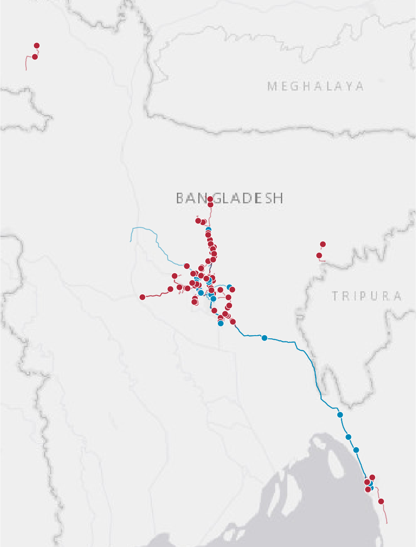
Spatial Analysis of Workers' Road Accident Hotspots in Bangladesh to Inform Safety Measures
Evidence from the Employment Injury Scheme Pilot Programme
Findings for stakeholder review
Tasbiul Islam Nibir
Research & Documentation Officer
Funded by GIZ
Faruque Hasan
Junior MIS Specialist, EIS-PSU
Funded by ILO
Notes:
Introduce both authors and the purpose: we want your review of these findings before the report is published. The talk runs about 20 minutes, with time for discussion at the end.

Slide 2

Most recorded cases were deaths on the journey to work
134
89%
81%
53%
worker cases
were deaths
on the commute
involved a worker on foot
Accidents dated November 2022 to March 2026
119 deaths and 15 disabilities
109 commuting and 25 on duty
71 pedestrian cases
99 of the 119 deaths were commuting cases, and national highways hold over half of road-matched points.
Source: EIS pilot intake records. All cases ended in death or disability, so minor injuries are not included.
Notes:
We looked at 134 cases in the EIS pilot, with accidents dated from November 2022 to March 2026. Every case ended in death or disability, so minor injuries are not included. 119 were deaths, and 99 of those deaths were commuting cases. 109 cases happened on the commute. 71 involved a worker on foot.

Slide 3






We linked case records to maps and to roads
134
121
1,000 m
27
102
intake records
mapped accident points
circle around each point
zones with 2+ points
matched to a road
Worker, case type, outcome, transport mode
The accident marker on each mapped journey
Overlapping circles are joined into one zone
Ranked by number of cases
Nearest OpenStreetMap road within 50 m
Read these as counts, not rates. Traffic volumes and workforce numbers are not available, so the results show where cases were recorded, not how risky each road is.
Notes:
There are 134 intake records, and 118 of them have a usable map. Two further mapped files have no intake record, and one case file holds two mapped journeys. That gives 121 mapped accident points. We drew a 1,000 metre circle around each point and joined overlapping circles into zones. That produced 27 zones with two or more points. Separately, 102 points were matched to a road within 50 metres. Without traffic or workforce data, these counts show where cases were recorded, not accident rates.

Slide 4
Two-thirds of mapped points share a zone
68%
82 of 121 mapped points fall in a zone with at least one other point
75%
91 of 121 journey routes pass within 1,000 m of an accident from another case file
Zones by priority class
1
2
11
13
Critical
Very high
High
Elevated
8+ cases
5–7 cases
3–4 cases
2 cases
Commuting
On duty
Basemap tiles © Esri (Esri, DeLorme, NAVTEQ).
Notes:
The districts with the most cases are Gazipur, Dhaka, Narayanganj and Chattogram. 82 of 121 mapped points share a zone with at least one other point. 91 of 121 journey routes pass within 1,000 metres of an accident from a different case file.

Slide 5
National highways hold over half of road-matched points
54%
55 of 102 road-matched points are on national highways
N3 leads with 23 cases
We recommend it as the first road to examine.
Top five hold 46 of 102
The five corridors with the most points.
Shows corridors with an English name or route number. Dhaka City Bypass (N105) also has 2 cases.
Notes:
55 of the 102 road-matched points are on national highways, and the top five corridors hold 46. The Dhaka to Mymensingh Highway, the N3, has the most, with 23 cases. Dhaka City Bypass (N105) also has 2 cases and ranks just below this chart. Most on-duty points have no road match, which we return to under limitations.

Slide 6
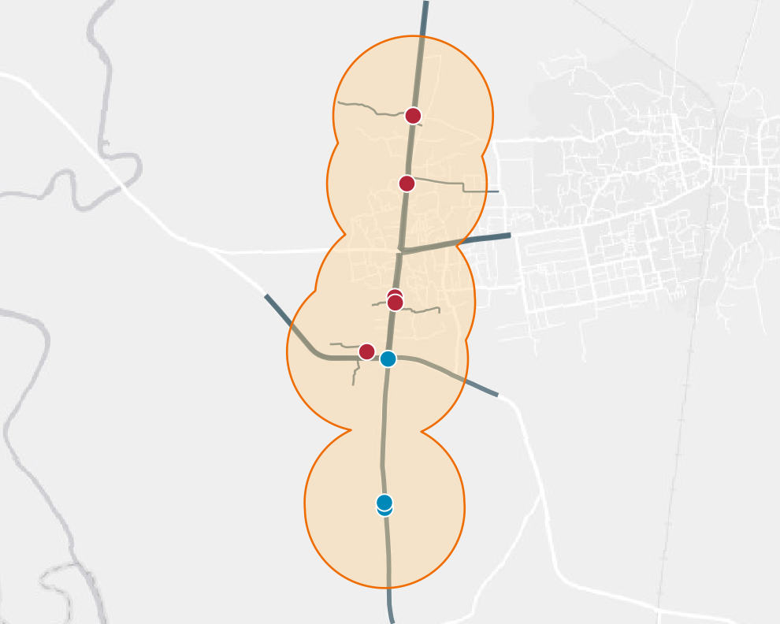
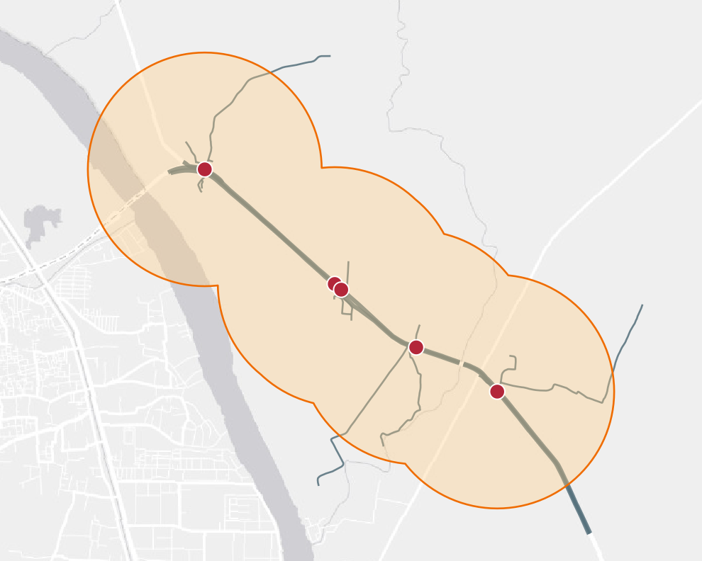
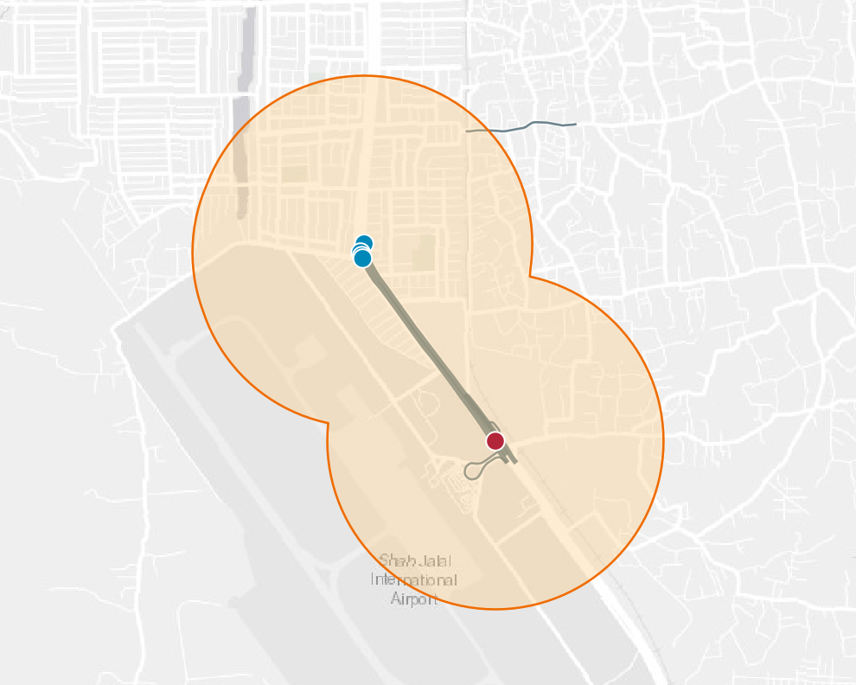
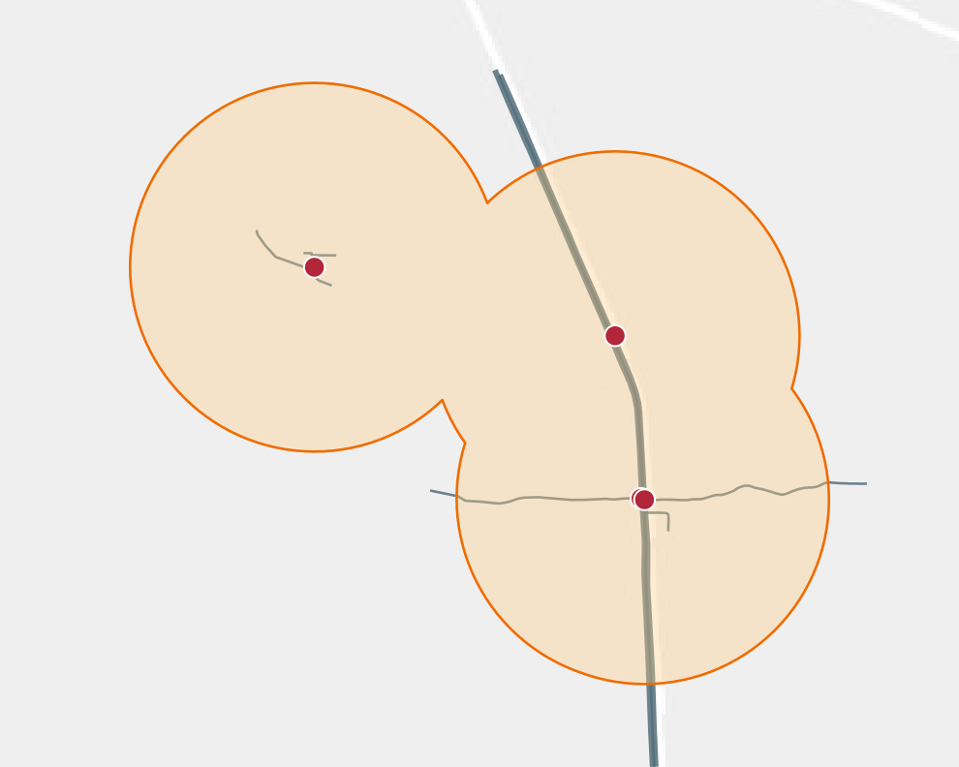
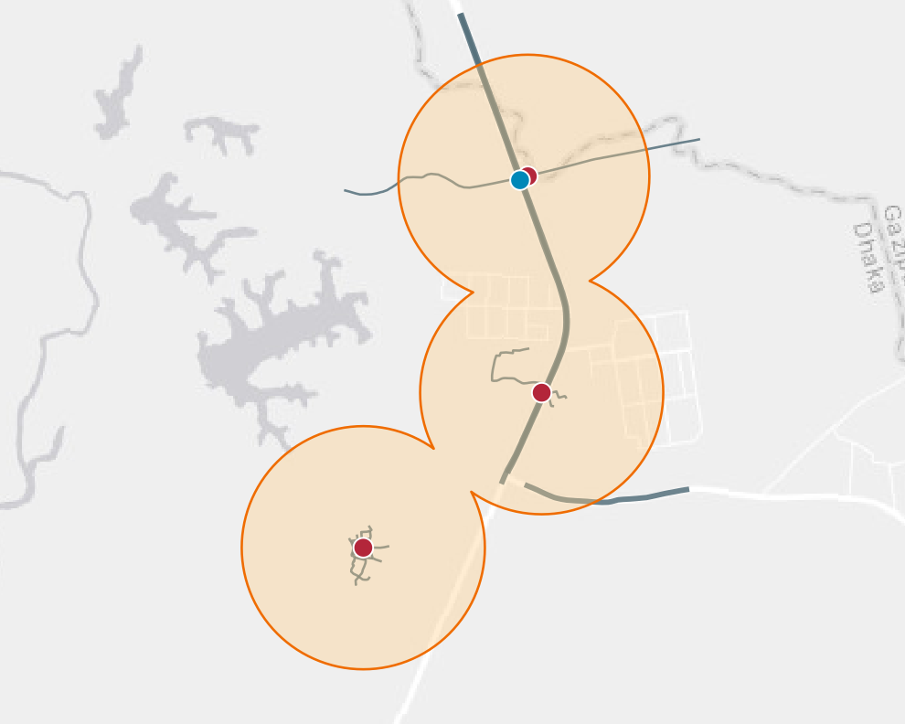
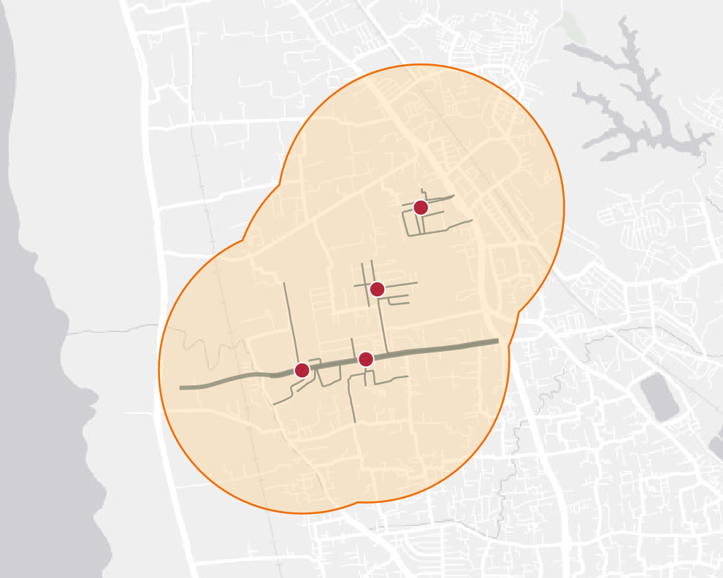
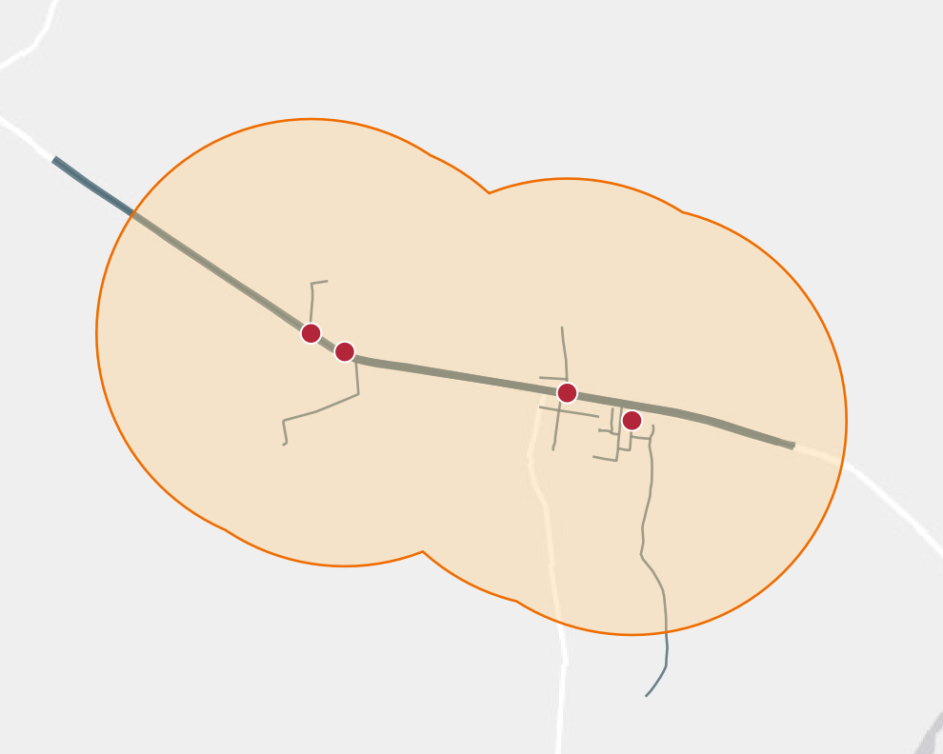
Seven zones hold four or more points
9
5
5
4
6 commuting, 3 on duty
5 commuting, 0 on duty
1 commuting, 4 on duty
4 commuting, 0 on duty
Zone 1: Gazipur Sadar – Vogra Bypass
N3, Gazipur
Zone 2: Kanchpur – Bandar – Dewanbag
N1, Narayanganj
Zone 3: Uttara – Jashimuddin Avenue
N3, Dhaka
Zone 4: Mawna – Gorgoria Master Bari
N3, Gazipur
4
4
4
The number shows the mapped points in each zone. The records do not state causes, so each site needs inspection before any works.
3 commuting, 1 on duty
4 commuting, 0 on duty
4 commuting, 0 on duty
Zone 5: Baipayl – Ashulia
N540, Dhaka
Zone 6: Sagarika Road – Pahartali
Sagarika Road, Chattogram
Zone 7: Konabari – BSCIC
N4, Gazipur
Notes:
These seven zones have the most points. Zone 1 near Vogra Bypass in Gazipur has 9. In six of the seven zones, most points are commuting. The exception is the Uttara zone, where 4 of 5 are on duty. Place names come from the case-file maps. The records do not state causes, so we recommend a road-safety inspection at each site before any works are planned.

Slide 7
All 43 cases involving women were on the commute
32%
of all cases involved women (43 of 134)
39%
of commuting cases involved women (43 of 109)
58%
of women's cases involved walking (25 of 43)
Recommended: street lighting on walking routes, safe crossings and proper boarding points.
Notes:
Men make up 91 of the cases and women 43. We do not have workforce data, so this does not show risk by gender. All 43 cases involving women happened while commuting, and 25 of them were on foot. All 25 on-duty cases involved men. The records do not give time of day. Our recommendations for these commuting cases are street lighting, safe crossings and proper boarding points.

Slide 8


Walking is by far the largest category
53% on foot
60 commuting and 11 on duty
20% vehicle to vehicle
Vehicle types are not recorded
13% motorcycle
16 commuting and 1 on duty
Recommended: pedestrian facilities, as this is the largest group.
Notes:
71 of 134 cases involved a pedestrian: 60 on the commute and 11 on duty. Vehicle to vehicle comes next with 27 cases, and the records do not say which vehicles were involved. Motorcycles come third with 17 cases. The remaining 19 cases are spread across other modes. We recommend pedestrian facilities as a priority because this is the largest group.

Slide 9
Most workers with a usable age were 25–44
34
median age in years
68%
aged 25–44 (87 cases)
14%
under 25 (18 cases)
18%
aged 45 and over (23 cases)
Based on 128 cases. 6 records with an age above 70 were left out.
Notes:
The median age is 34. Workers aged 25 to 44 account for 87 of the 128 cases with a usable age. Workers under 25 account for 18 cases and those aged 45 and over for 23. We left out 6 records with an age above 70. We do not have workforce data, so these figures do not show risk by age.

Slide 10




Priority actions: separate people on foot from fast traffic
Immediate
Short term
Mid term
First steps
Follows the inspections
Once works are in place
Day and night road-safety inspections at the top zones
Confirm exact accident locations on site
Footbridges with ramps and signalised crossings
Continuous footpaths and street lighting
Traffic calming, median barriers and speed enforcement
Compare speeds, crossing behaviour and new cases before and after the work
Employers can help now: safer transport, proper pick-up points, well-lit entrances, staggered shifts and prompt accident reporting.
Notes:
These are our recommendations, and their effect has not been tested in this study. First steps are day and night inspections at the top zones and confirming exact accident locations. Next come pedestrian facilities, lighting and speed measures. After works, compare speeds, crossing behaviour and new cases before and after. Employers can provide safer transport, set up pick-up points, keep entrances well lit and stagger shift times.

Slide 11


What these findings cannot tell us
Counts are not risk rates
Causes are not recorded
Traffic volumes and workforce numbers are not known.
Time of day, the other vehicle and crash sequence are not recorded. Clusters have not been tested against chance.
Road counts are incomplete
Records are not complete
Only 7 of 23 mapped on-duty points have a major road match. 32 matched points on roads with no English name or route number are not charted in OSM.
Only reported deaths and disabilities are included. 16 intake cases have no usable map.
Notes:
First, these are counts and not risk rates. Second, the data do not record time of day, the other vehicle or the sequence of events, and clusters have not been tested against chance. Third, only 7 of 23 mapped on-duty points have a road match, and 32 matched points on roads with no English name or route number are not shown in the corridor chart. Fourth, these are reported death and disability cases only, and 16 intake cases have no usable map.

Slide 12




What we expect from you
Review the findings
Support site inspections
Tell us what fits or conflicts with what you see on the ground.
Help arrange road-safety audits at the six densest zones.
Help complete the records
Advise on publication
Share missing maps and correct case details where you can.
Guide us on data permissions and on how results should be shared.
Questions and discussion
Notes:
These are the requests for the discussion. Please tell us what we have missed or misread. We need partners to support site inspections at the six densest zones, help complete the missing records, and advise on publishing. Then open the floor for questions.

