Slide 1

AI App Development Workshop — Week 6
Theory & Hands‑On With LLMs
Notes:
We’ll build a shared mental model of AI model families, then do a first query locally and in the cloud.

Slide 2
Class Schedule
✅ Week 1 [9/5] — Intro + Environment Setup
Goal: Get everyone’s dev environment ready and understand the landscape.
✅ Week 2 [9/12] — Querying LLMs from Python
Goal: Comfortably send queries to local and OpenAI endpoints.
✅ Week 3 [9/19] — Building out our App
Goal: Process a ticket in one go, Structured output from an LLM.
✅ Week 4 [9/26] —Vector DBs for RAG
Goal: Understand how we can retrieve things by “meaning” and use those things to supply context to LLMs
Week 5 [10/24] — RAG Part 2
Goal: Add RAG to our App.
Week 6 [10/31] — Rag Part 3 – Reranking & Framework Introduction
.
Week 7 [11/07] – TBD
>>> No class Friday 10/3 & 10/10 <<<

Slide 3
Our “Problem”
We want to automatically respond to a ticket with relevant, helpful information.
The LLMs we use have a lot of general knowledge, but may NOT have specialized or obscure knowledge (“Who are the Coneheads?”)
There are several different ways to get new, specialized knowledge into an LLM:
Training
Fine-Tuning
RAG

Slide 4

Retrieval-Augmented Generation
Combine search with AI generation to provide context-aware answers
Pattern: Document → Embed → Store → Query → Retrieve Similar → LLM Answer
Advantage: LLM answers grounded in actual historical data, not just general knowledge
Why RAG Matters
Traditional LLM: General knowledge, may hallucinate
RAG: Grounded in real historical tickets, traceable sources
Best of both: Search precision + LLM comprehension

Slide 5
How Text Becomes Searchable
Embeddings convert text to high-dimensional vectors using a specially trained model
Semantic similarity via cosine distance (similar ‘meaning’ = similar vectors)
Combined fields (subject + body + answer) capture full problem→solution pattern
ChromaDB vector database enables fast similarity search across thousands of tickets
Example Vectors:
"VPN connection failed" → [0.12, -0.34, 0.56, ...] "Cannot connect to VPN" → [0.11, -0.33, 0.58, ...] ← Very similar! "Printer not working" → [-0.45, 0.78, -0.12, ...] ← Different

Slide 6
Proper Evaluation
80/20 split for unbiased evaluation
70/20/10 for even better isolation
Training set: Build knowledge base (embed & store in vector DB)
Test set: Evaluate system on unseen tickets
Why This Matters
Prevent data leakage: Test tickets never seen during training
Unbiased metrics: Realistic performance on new tickets
Scientific rigor: Same as ML best practices

Slide 7
RAG End-to-End Flow
Pre-translated CSV →
Train/Test Split →
Generate Embeddings →
ChromaDB Storage ↓
New Ticket (JSON) →
Embed Query →
Vector Search →
Top-K Retrieval ↓ Context + Question →
LM Studio LLM →
Answer + Confidence
Pipeline Stages
Data Preparation: Load & split tickets
Embedding: Convert to vectors
Storage: ChromaDB vector database
Query: New ticket arrives
Retrieval: Find top-K similar tickets
Generation: LLM creates context-aware answer

Slide 8
Strict vs Augmented
Strict Mode
LLM uses ONLY historical ticket context (traceable, compliance-friendly)
Will say “I don’t have enough information” if context insufficient
Use case: QA testing retrieval quality, compliance environments
Augmented Mode
LLM uses context + general knowledge (helpful, flexible)
Always provides helpful answer, supplements with IT knowledge
Use case: Production support, maximize helpfulness
Trade-off
Strict = Traceability + Coverage gaps
Augmented = Helpfulness + Mixed sources

Slide 9

AI Judging AI Quality
Evaluation Criteria (1-5 scale)
Accuracy: Correctness of information
Completeness: Coverage of important points
Clarity: Ease of understanding
Helpfulness: Actionability of solution
Process
RAG generates answer for test ticket
LLM compares generated vs. original answer
Scores each criterion + provides feedback
Overall score (1-5) + detailed explanation
Why This Works
Consistent: Same evaluation logic for all tickets
Scalable: Batch evaluate hundreds of tickets
Detailed: Specific feedback for improvements

Slide 10
What You Learned
✅ Vector embeddings - Convert text to semantic representations
✅ Similarity search - Find relevant documents using cosine distance
✅ RAG pipeline - Combine retrieval with generation for grounded answers
✅ Train/test methodology - Proper ML evaluation practices
✅ LLM evaluation - Use AI to judge AI outputs systematically
✅ Batch processing - Scale evaluation across multiple examples

Slide 11

A Problem With RAG
We’d like to include a LOT of context so we get complete answers....
But we know that hallucinations can happen when unrelated retrieved text is included in context.
So, if we cast a very wide net in our vector search, we will get a lot of related docs, but we’ll accidently include unrelated text that could poison our response!
Solution: Use a reranker!

Slide 12
What is a Reranker?
A reranker acts as a second-pass filter, allowing us to retrieve a lot of results from the semantic search.
The reranker will rearrange the retrieved documents from the initial search and prioritize the most relevant ones.
Since the reranker is dealing with a smaller set of data, it can focus on relevance and nuance rather than brute force search of (possibly) millions of document chunks.
Once the reranker reorders the retrieved texts, by relevance, we can chuck out all but the best matches.
This helps reduce hallucinations.
Free Bonus: Uses less tokens = saves money during LLM usage during the RAG process.

Slide 13
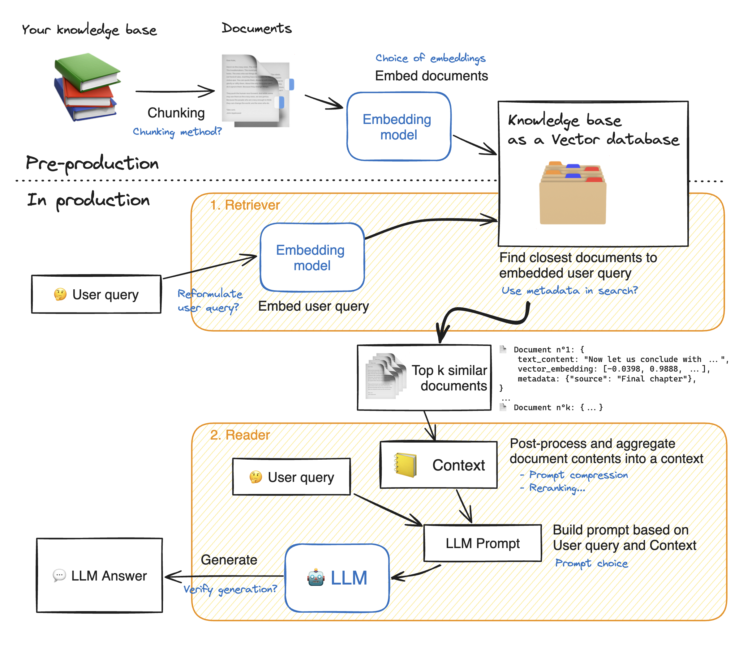
Reranker

