Slide 1

AI App Development Workshop — Week 4
Theory & Hands‑On With LLMs
Notes:
We’ll build a shared mental model of AI model families, then do a first query locally and in the cloud.

Slide 2
Class Schedule
✅ Week 1 [9/5] — Intro + Environment Setup
Goal: Get everyone’s dev environment ready and understand the landscape.
✅ Week 2 [9/12] — Querying LLMs from Python
Goal: Comfortably send queries to local and OpenAI endpoints.
✅ Week 3 [9/19] — Building out our App
Goal: Process a ticket in one go, Structured output from an LLM.
✅ Week 4 [9/26] —Vector DBs for RAG
Goal: Understand how we can retrieve things by “meaning” and use those things to supply context to LLMs
Week 5 [10/10] — Forecasting intro by Prerit
Goal: Prerit will cover some forecasting fundamentals.
Week 6 [10/17] — RAG Part 2
Goal: Add RAG to our App.
Week 7 [10/24] — TBD
.
Week 8 [10/31] – TBD
>>> No class Friday 10/3 <<<

Slide 3
Recap from Last week
We batched all of our LLM calls into one.
We learned about structured output; returning JSON rather than text.
In homework we expanded to iterating over multiple tickets, returning type, category, etc. and even an “answer”
Notes:
Next week: deeper control over prompts & responses programmatically.

Slide 4
Homework Review

Slide 5
Our “Problem”
We want to automatically respond to a ticket with relevant, helpful information.
The LLMs we use have a lot of general knowledge, but may NOT have specialized or obscure knowledge (“Who are the Coneheads?”)
There are several different ways to get new, specialized knowledge into an LLM:
Training
Fine-Tuning
RAG

Slide 6
Training from Scratch
How it works: Training a new model on a large corpus that includes the new knowledge or continuing to train an existing model on additional data.
Pros:
Knowledge becomes deeply integrated into the model's parameters
No additional inference overhead
Can handle complex reasoning across the new knowledge
Most comprehensive knowledge integration
Cons:
Extremely expensive computationally and financially
Requires massive datasets and infrastructure
Risk of catastrophic forgetting of previous knowledge
Long development cycles (months to years)
Best for: Foundational knowledge updates, domain-specific models, or when you need the knowledge to be permanently and deeply integrated.

Slide 7
Fine Tuning
How it works: Training the model on a smaller, curated dataset of examples that demonstrate the desired knowledge or behavior.
Pros:
Can teach specific formats, styles, or domain knowledge
Relatively quick to implement
Good for specialized tasks or knowledge domains
More cost-effective than full training
Cons:
Limited knowledge capacity compared to pre-training
Risk of overfitting to the fine-tuning data
May not generalize well beyond the training examples
Can degrade performance on other tasks
Best for: Specialized domains with well-defined knowledge sets, teaching specific response formats, adapting models for particular use cases or industries.

Slide 8
Approach Relative Costs
Approach | Cost Range | Time | Components | Best For
Training from Scratch | $500K - $5M+ | months | • Compute – Lots of GPUs • Data prep – need MANY examples • Engineering • Infrastructure | Permanent knowledge integration, complex reasoning across domains
Fine-tuning | $10K - $100K | weeks | • Data preparation • Training compute • Model hosting • Development • Retraining | Specialized domains, consistent response formats
Retrieval-Augmented Generation | $20K - $150K | days | • Knowledge base setup • Vector database • LLM API costs • Development • Maintenance | Frequently changing knowledge, transparency needed

Slide 9
Best Approach for Ticket Response: RAG
Knowledge Management Advantages
Operational Benefits
Cost and Implementation Advantages
IT-Specific Technical Benefits
Quality and Accuracy
Flexibility and Maintenance
Long-term Strategic Value

Slide 10
Knowledge Management Advantages
Dynamic Content Updates:
IT documentation, software versions, policies, and procedures change frequently.
RAG allows instant updates to the knowledge base without model retraining, ensuring responses always reflect current information.
Multi-Source Integration:
IT helpdesks need access to diverse sources: internal wikis, vendor documentation, troubleshooting guides, policy documents, and ticket histories.
RAG can seamlessly pull from all these sources in a single query.
Version Control:
When software updates or policy changes occur, you can maintain historical versions while prioritizing current information, crucial for supporting multiple software versions simultaneously.

Slide 11
Operational Benefits
Transparency and Accountability:
RAG can cite specific documentation sources, allowing agents to verify responses and users to access original materials.
This builds trust and enables easy fact-checking.
Compliance and Audit Trail:
Citations provide clear audit trails for regulatory compliance, showing exactly which approved documentation informed each response.
Human Handoff:
When escalation is needed, RAG provides context about which knowledge sources were consulted, helping human agents continue seamlessly.

Slide 12
Cost and Implementation Advantages
Predictable Scaling:
Costs scale with usage volume rather than requiring large upfront investments.
You pay for what you use rather than provisioning for peak capacity.
Fast Time-to-Value:
Can be operational in days versus months for custom training, allowing quicker ROI realization.
Lower Technical Risk:
Uses proven, stable base models rather than risking custom model development that might not meet performance requirements.
LLM training and fine-tuning require specialized knowledge and infrastructure to get good results.

Slide 13
IT-Specific Technical Benefits
Contextual Retrieval:
Can retrieve relevant troubleshooting steps based on specific error messages, software versions, and user configurations mentioned in tickets.
Hierarchical Problem Solving:
Can pull information from basic FAQs for simple issues while accessing detailed technical documentation for complex problems.
Multi-Modal Support:
Can incorporate screenshots, diagrams, and configuration files alongside text documentation for comprehensive problem-solving.

Slide 14
Quality and Accuracy
Reduced Hallucination:
RAG Grounds responses in actual documentation rather than relying solely on training data, reducing incorrect or outdated information.
Consistent Quality:
Response quality depends on curated knowledge base rather than potentially inconsistent training examples.
Easy Quality Control:
Can monitor and improve response quality by updating source documents rather than retraining entire models.

Slide 15
Flexibility and Maintenance
No Catastrophic Forgetting:
Adding new knowledge doesn't risk degrading existing capabilities, unlike fine-tuning approaches.
A/B Testing Capability:
Can test different retrieval strategies and knowledge organization approaches without full model redeployment.
Gradual Rollout:
Can implement department by department or use case by use case, allowing controlled deployment and learning.

Slide 16
Long-term Strategic Value
Future-Proof Architecture:
As better base models become available, you can swap them in without rebuilding your entire knowledge integration system.
Analytics and Insights:
Retrieval patterns reveal knowledge gaps, common issues, and documentation quality problems, informing continuous improvement.
Scalable Expertise:
Captures and scales institutional knowledge from your best IT professionals without requiring them to manually create training datasets.

Slide 17
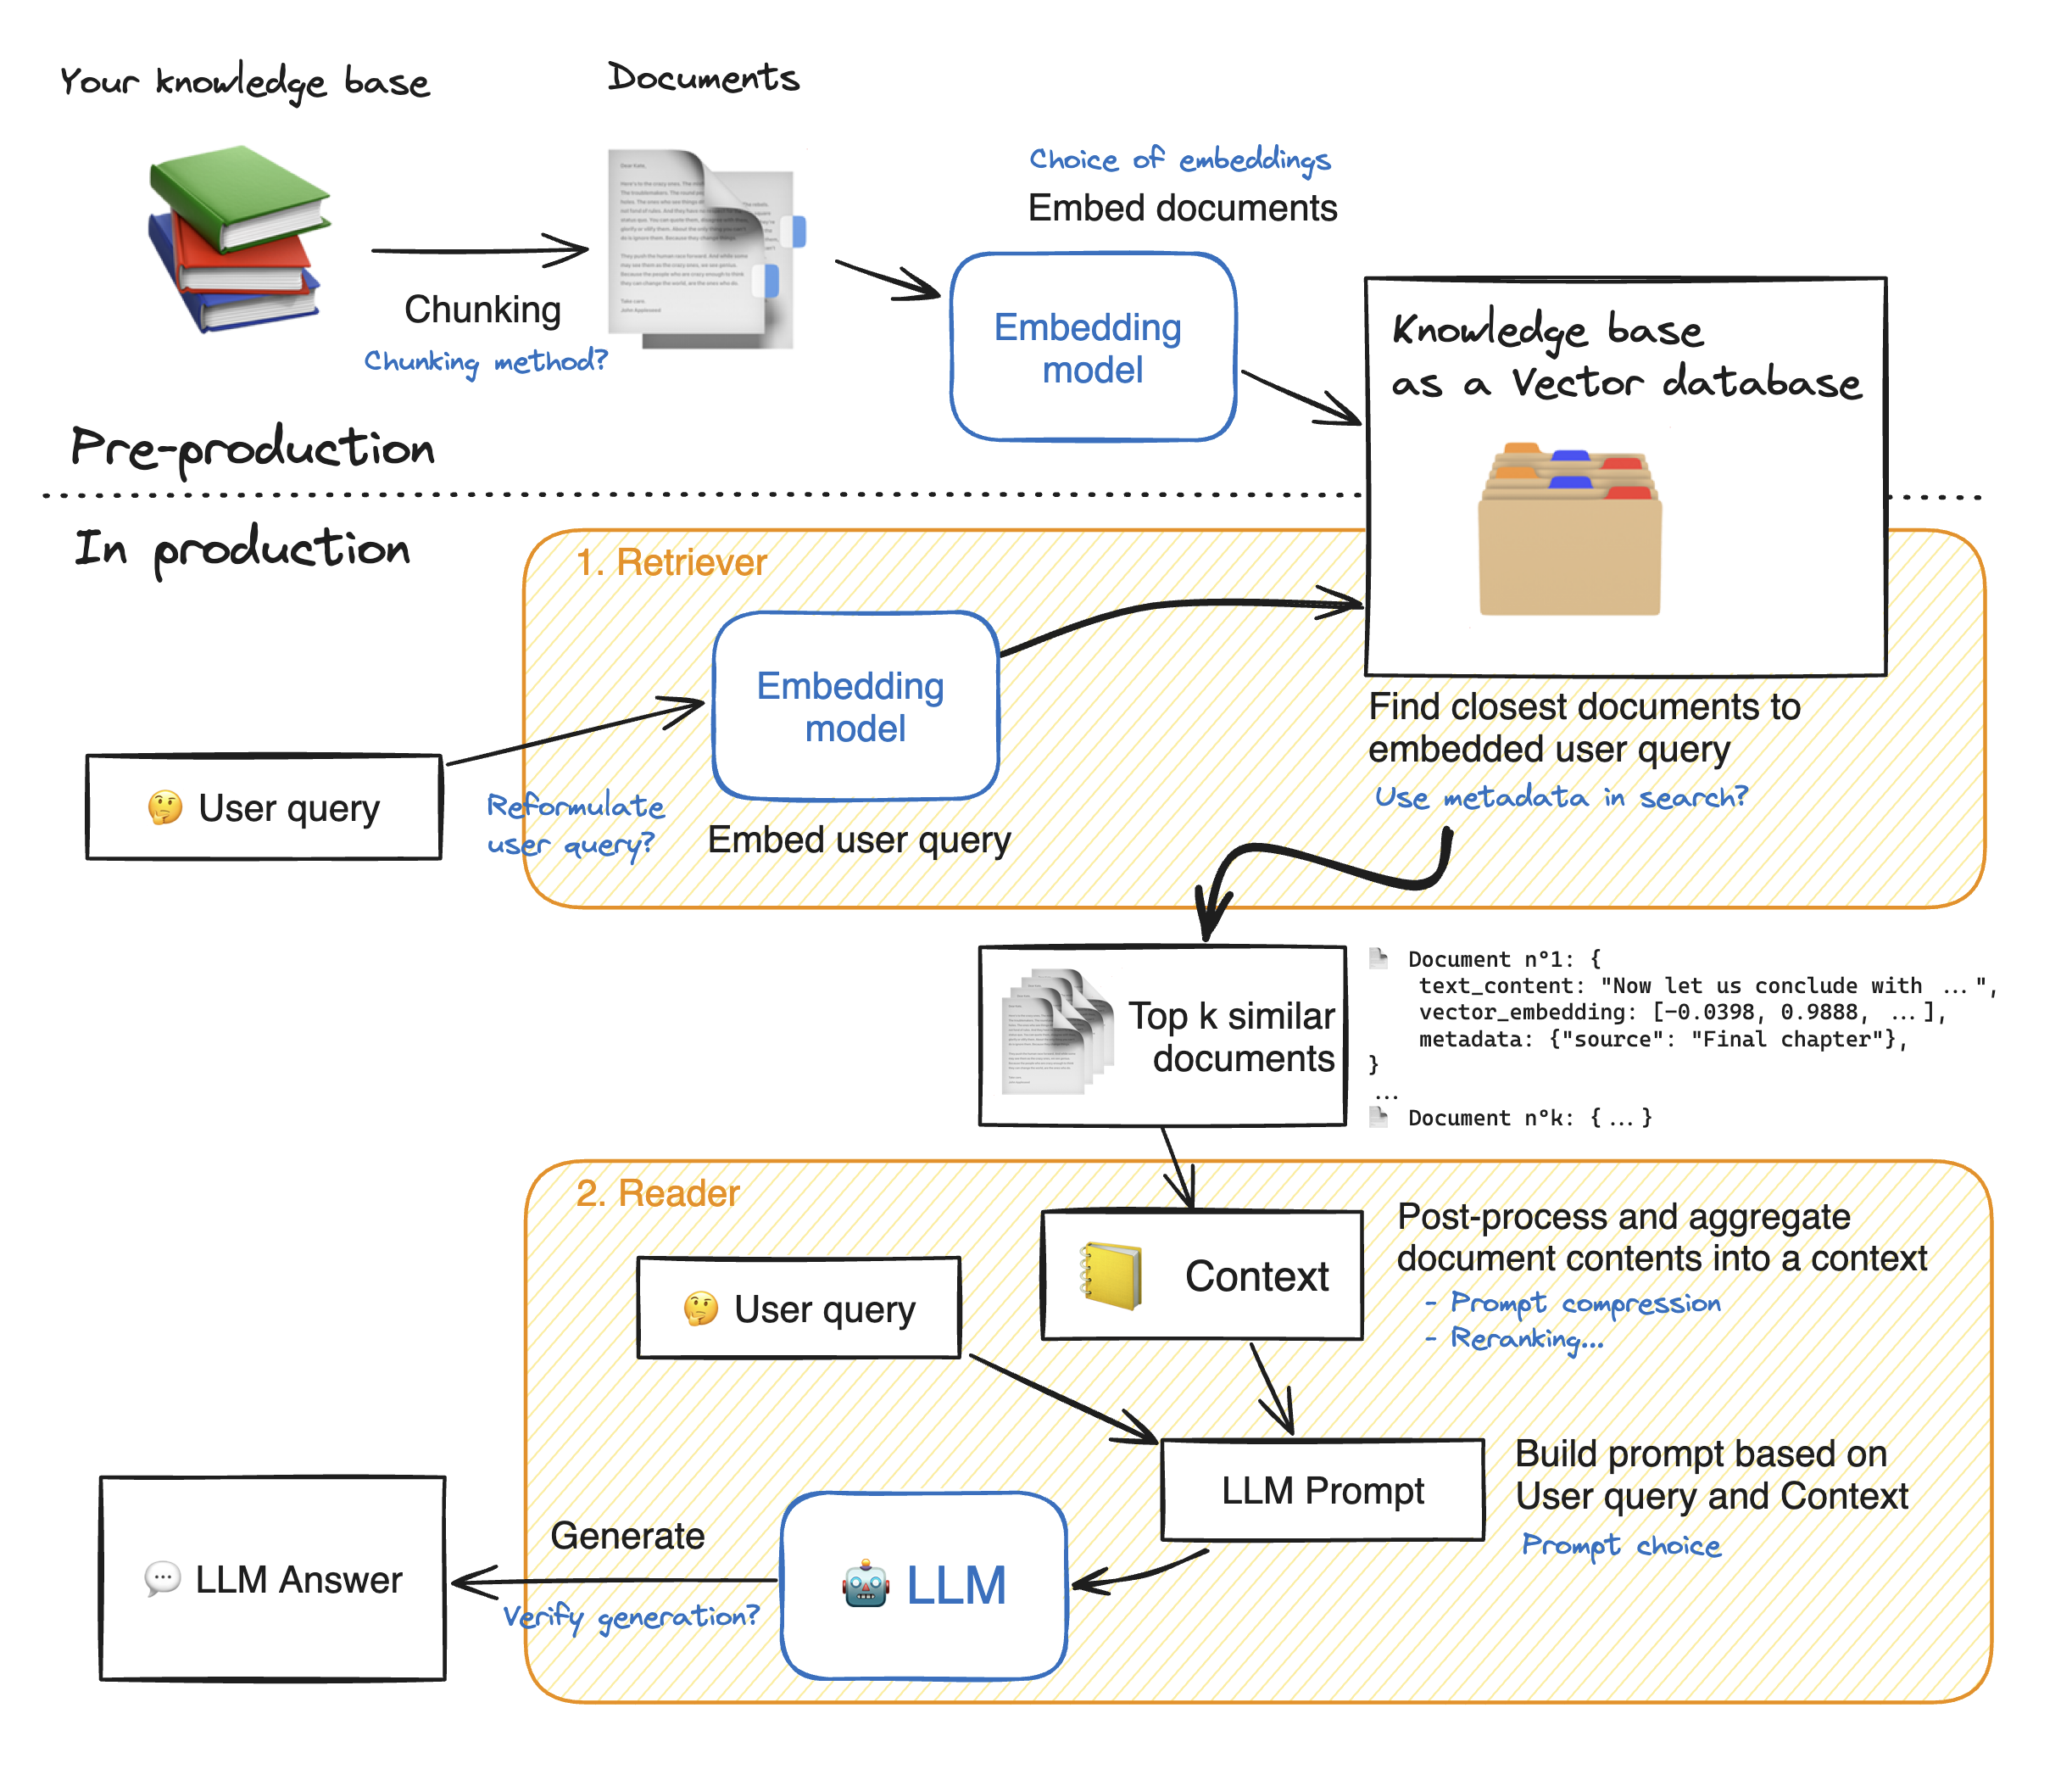

Slide 18
Embeddings
A text embedding can have hundreds of values, each representing a different aspect of a text’s meaning. Just as you might describe a house by its characteristics type, location, bedrooms, bathrooms, levels - the values in an embedding quantify a text’s linguistic features.
work
A pair of words like sea and ocean may not be used in identical contexts (we say ‘lost at sea’, not ‘lost at ocean’ so they aren’t always direct substitutes), but their meanings are close to each other, and embeddings allow us to quantify that closeness using mathematical measurements of ‘distance’.
Sea
Ocean
The way these characteristics are “learned” via training means we don't know exactly what each value represents, but words we expect to be used in comparable ways often have similar-looking embeddings.
football
Soccer
I
We

Slide 19
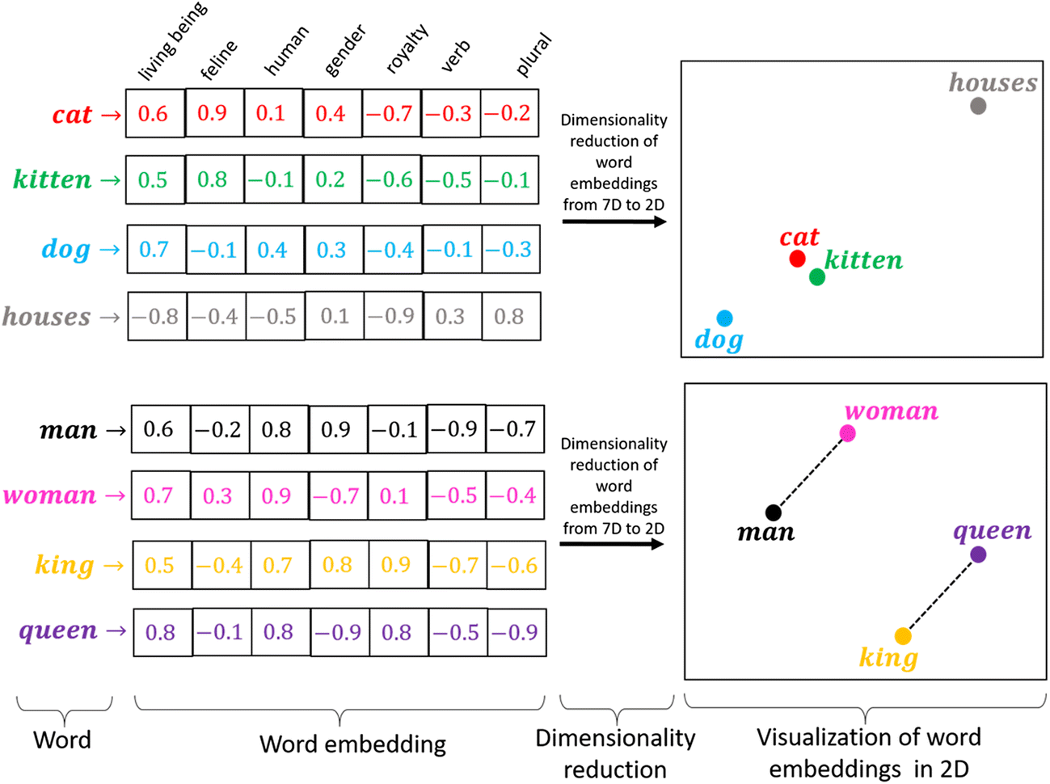
Vector “nearness” -> Meaning “nearness”

Slide 20
Simple Code Example

