Slide 1

Week 9: MCP Agents

Slide 2


Model Context Protocol: The USB-C for AI Apps
Kimi AI
2025/08/05

Slide 3

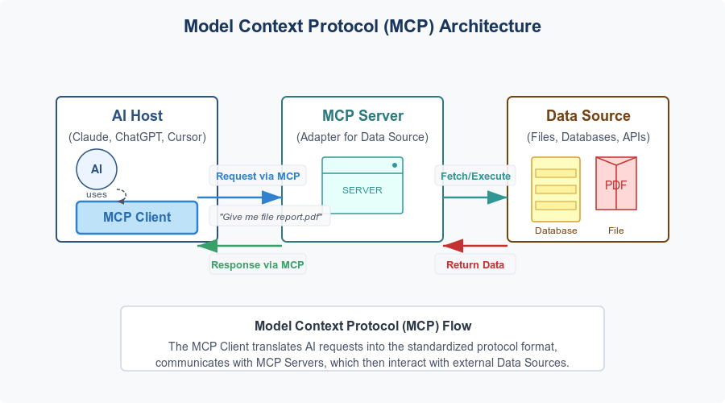
Core Architecture: Host, Client, Server

Slide 4
Installing an MCP Agent – Hugging Face MCP
Navigate to your Hugging Face account's Access Tokens settings.
Create a new token. Give it a descriptive name (e.g., lm-studio-mcp) and assign it the read role, which is sufficient for searching.
Copy the generated token (hf_...).
Next, add the following structure to your mcp.json file.
{
"mcpServers": {
"hf-mcp-server": {
"url": "https://huggingface.co/mcp?login",
"headers": {
"Authorization": "Bearer YOUR_HF_TOKEN"
}
}
}
}

Slide 5
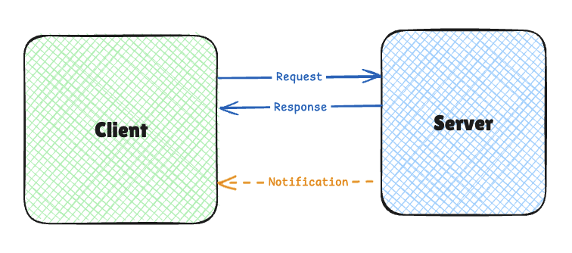
The MCP Communication Protocol: Standards
MCP defines a standardized communication protocol
Enables Clients and Servers to exchange messages
This is critical for interoperability (M+N!)
MCP uses JSON-RPC 2.0 as the message format
Human-readable and easy to debug
Language-agnostic, any programming environment
Clear specifications, widespread adoption

Slide 6
The MCP Communication Protocol: Messages
Example Request: {
"jsonrpc": "2.0",
"id": 1,
"method": "tools/call",
"params": {
"name": "weather",
"arguments": {
"location": "San Francisco"
}
}
}
Example Notification: {
"jsonrpc": "2.0",
"method": "progress",
"params": {
"message": "Processing data",
"percent": 50
}
}
Example Response: {
"jsonrpc": "2.0",
"id": 1,
"result": {
"temperature": 62,
"conditions": "Partly cloudy"
}
}

Slide 7
The MCP Communication Protocol: Transport
stdio (Standard Input/Output)
Used when the Client and Server on the same machine
Host launches the Server as a subprocess
Communication via standard input (stdin) and standard output (stdout).
Simple
No network configuration required
Secure: sandboxed by the operating system
HTTP + SSE (Server-Sent Events) / Streamable HTTP
Used when the Client and Server on different machines
Communication happens over HTTP
Server uses Server-Sent Events (SSE) to push updates to the Client over a persistent connection
Works across networks
Enables integration with web services
Compatible with serverless environments.

Slide 8
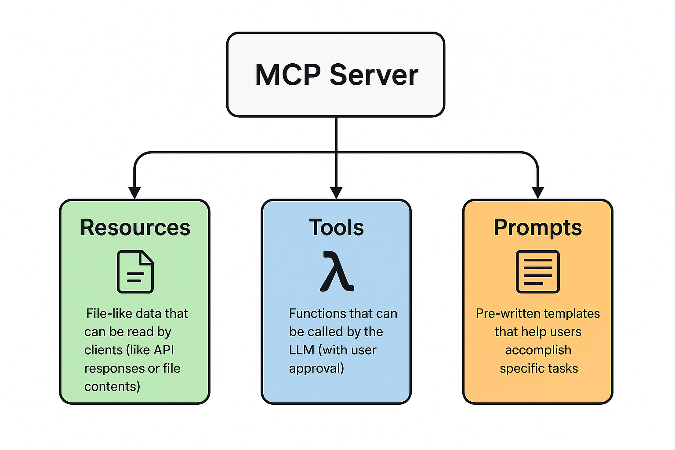
MCP: Capability Types

Slide 9
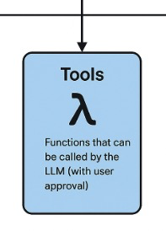
MCP: Tools
Functions that the AI model invokes using MCP protocol.
LLM/model-controlled, the AI model (LLM) decides when to call them based on the user’s request and context.
Safety: Tools can perform actions with side effects, This can be dangerous! Typically require explicit user approval.
Use Cases: Sending messages, creating tickets, querying APIs, performing calculations.
Example: A tool that fetches current weather for a location:
def get_weather(location: str) -> dict:
"""Get the current weather for a specified location."""
# Connect to weather API and fetch data
return {
"temperature": 72,
"conditions": "Sunny",
"humidity": 45
}

Slide 10
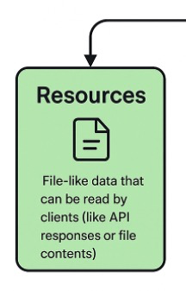
MCP: Resources
Provide read-only access to data sources, allowing the AI model to retrieve info without executing complex logic.
Application-controlled: the Host application typically decides when to access them.
Nature: They are designed for data retrieval with minimal computation, similar to GET endpoints in REST APIs.
Safety: Since they are read-only, they typically present lower security risks than Tools. Obviously depends on content!
Use Cases: Reading file contents, retrieving database records, reading configuration information.
Example: A resource that provides access to file contents:
def read_file(file_path: str) -> str:
"""Read the contents of a file at the specified path."""
with open(file_path, 'r') as f:
return f.read()

Slide 11
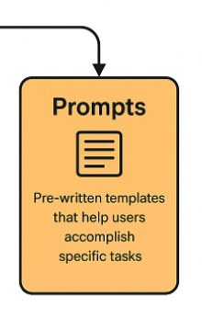
MCP: Prompts
Templates or workflows that guide the interaction between the user, the AI model, and the Server’s capabilities.
Control: User-controlled, presented as options in the Host’s UI.
Purpose: They structure interactions between user and agent.
Selection: Typically selected before the AI model begins processing, sets context for the interaction.
Use Cases: Common workflows, specialized task templates, guided interactions.
Example: A prompt template for generating a code review:
def code_review(code: str, language: str) -> list:
"""Generate a code review for the provided code snippet."""
return [{"role": "system",
"content": f"You are a code reviewer examining {language} code. Provide a detailed review highlighting best practices, potential issues, and suggestions for improvement."},
{"role": "user",
"content": f"Please review this {language} code: \n\n```{language}\n{code}\n```"}
]

Slide 12
MCP: Capabilities Work Together
Capability | Controlled By | Direction | Side Effects | Approval Needed | Typical Use Cases
Tools | Model (LLM) | Client → Server | Yes (potentially) | Yes | Actions, API calls, data manipulation
Resources | Application | Client → Server | No (read-only) | No | Data retrieval, context gathering
Prompts | User | Server → Client | No | No | Guided workflows, specialized templates
A user could select a Prompt to start a specialized workflow
The Prompt might include context from Resources
During processing, the AI model might call Tools to perform specific actions

Slide 13
MCP: Discovery
The MCP’s Client uses dynamic discovery to find out what capabilities are available on the server.
When a Client connects to a Server, it queries the available capabilities through standard methods:
tools/list: Discover available Tools
resources/list: Discover available Resources
prompts/list: Discover available Prompts
This discovery mechanism allows Clients to adapt dynamically to the capabilities of each Server without requiring hardcoded knowledge of the Server’s functionality.

Slide 14
MCP: Server Demo with FastMCP
Goal: Give an LLM a new capability – use the internet to find the weather in a location
We’ll use SERPAPI as our web interface to Google Search (free API Key for 1000 calls)
Then, we’ll create our MCP Server using the FASTMCP sdk
Then we can test our server using FASTMCP’s “Inspector”
When it works, we can install the client side in LM Studio, and use LM Studio’s “Client”
{
"mcpServers": {
"stoopid-weather": {
"command": "/Volumes/RAID0/repos/Apps_with_AI/.venv/bin/python",
"args": [
"/Volumes/RAID0/repos/Apps_with_AI/Week09/stoopid_wx_server.py"
]
}
}
}
Then our small LLM will have access to the weather.
Once it’s working we can install it in Claude Desktop, etc.

Slide 15



Credits
https://www.natebjones.com/

