Slide 1

AI App Development Workshop — Week 1
Theory & Hands‑On With LLMs
Notes:
We’ll build a shared mental model of AI model families, then do a first query locally and in the cloud.

Slide 2
Class Schedule
Week 1 [9/5] — Intro + Environment Setup
Goal: Get everyone’s dev environment ready and understand the landscape.
Week 2 [9/12] — Querying LLMs from Python
Goal: Comfortably send queries to local and OpenAI endpoints.
Week 3 [9/19] — Introduction to AI Frameworks
Goal: Move from raw prompts → structured pipelines.
Week 4 [9/26] — Building Pipelines
Goal: Create a full pipeline, not just one LLM call.
Week 5 [10/10] — Prompt Optimization
Goal: Automate prompt refinement.
Week 6 [10/17] — Agents & MCP Protocol
Goal: Add agent calling.
Week 7 [10/24] — HALT! Security!
Goal: Understand the vulnerabilities of LLM-apps.
Week 8 [10/31] – Present Capstone projects
Goal: Show off your work to the class
>>> No class Friday 10/3 <<<

Slide 3
Assumptions
You know python
You know an IDE (VS Code, etc.)

Slide 4
Today’s Agenda
Why AI Apps?
Taxonomy of AI models
Local & cloud setup
Querying your first LLM From Python
Notes:
Keep this tight; we’ll revisit details in later weeks.

Slide 5
Why AI Apps?
Traditional apps
Great at structured tasks (databases, forms, workflows)
Struggle with ambiguity, natural language, or messy data
AI-powered apps
Can Understand unstructured inputs (emails, docs, chat, NL) – useful for extracting structured data from unstructured
Can Generate “original” content: summaries, explanations, suggestions
Reason across information: connect facts, infer intent
Why this matters for us
Automate repetitive knowledge work
Enable natural, conversational interfaces
Build features quickly without hand-coding every case
Notes:
Emphasize shift from explicit rules to emergent behavior.

Slide 6
AI Model Evolution
Rule-based Systems (1950s–1980s)
Hand-crafted rules, expert systems
Good for narrow, fully defined tasks
Traditional Machine Learning (1980s–2010s)
Regression: predict a number
Classification: label something
Deep Learning (2010s)
CNNs → breakthroughs in vision (ImageNet, image recognition)
RNNs / LSTMs → early NLP, speech recognition
Current Generative Architectures (2017–present)
Transformers → sequence modeling, language, multimodal → LLMs (ChatGPT, Groq, etc.)
Diffusion models → generative media (images, audio, video) (Often built into current large models, eg. OpenAI generates images)
Notes:
Use a simple left-to-right timeline visual when presenting.

Slide 7
Types of Models
Classification → predict labels (spam/Not Spam, Hot dog/not hot dog, sentiment: Positive or negative)
Regression → predict numbers (forecasting: How much will we sell next month)
Generative → create content (Translate, summarize, generate text, create and edit images and audio)
Notes:
Ground with examples familiar to your team’s domain.

Slide 8
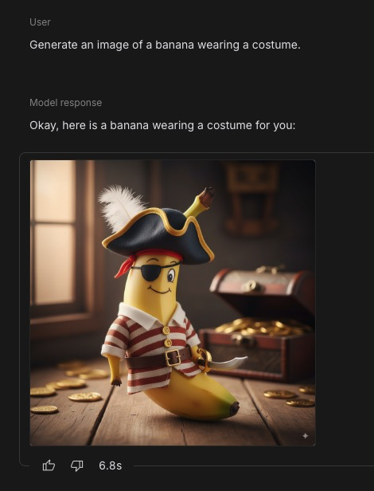
Generative Model Families
Diffusion Models
Stable Diffusion,
DALL·E (openAI),
Midjourney,
Nano Banana (google)
Notes:
Today’s focus is LLMs for app backends; diffusion for media.

Slide 9
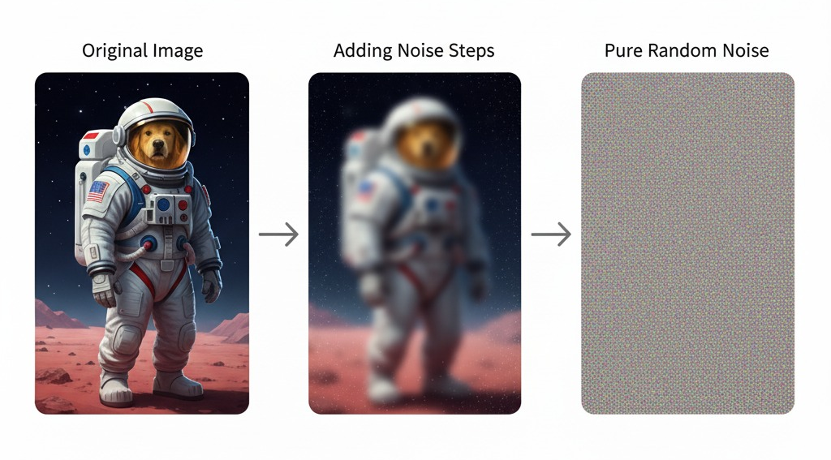
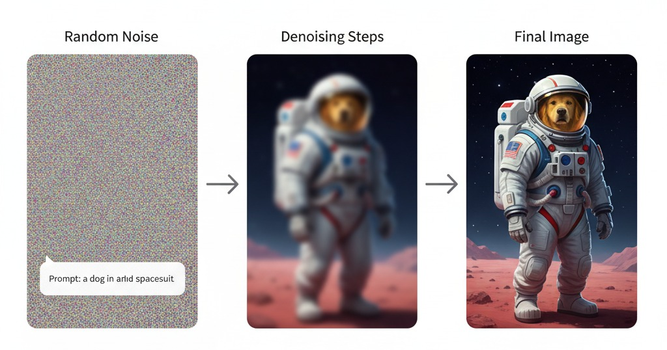
How Diffusion Models Work
Training – associate a text description with a picture – add noise and learn the steps in reverse
Generation – Provide a prompt (description) and denoise by reversing the learned steps

Slide 10
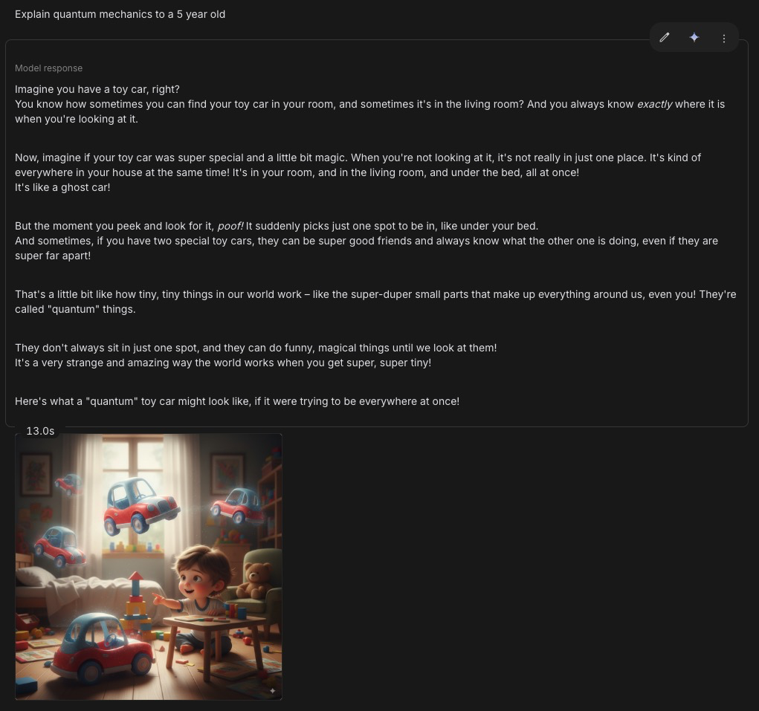
Generative Model Families
Transformer Models →
GPT-5
Claude
Llama
Gemini
Groq
Etc.
Notes:
Today’s focus is LLMs for app backends; diffusion for media.

Slide 11
How Transformers Work (LLMs)
Building/Training an LLM follows the same basic steps as any ML model ($$$):
Collect massive amounts of data (ideally, the entire internet).
Train a baseline model to capture patterns (but at this stage, it's just a glorified autocomplete).
Improve the model with fine-tuning and guardrails to make it useful. RLHF is a main technique.
Using an LLM is called “Inference” and uses the trained/fine-tuned model to generate text.
Prompt: “What is the capital of France?”
Answer: “Paris”
Notes:
LLMs (based on Transformers) are trained to predict the next token in a sequence. Given a prompt, they generate outputs token by token until the response is complete. Scale and training make outputs fluent and useful for apps.

Slide 12
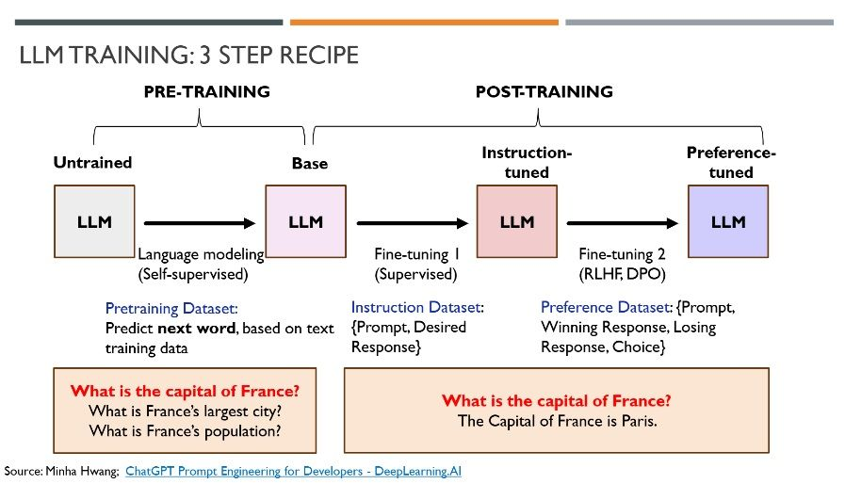

Slide 13
Adapting LLMs After Training
Prompt Engineering
Crafting instructions + context to steer behavior
Few-shot examples; role prompts
Fine-Tuning
Add new neuron layers inside the model
Train just those layers to add on a new behavior
Retrieval Augmented Generation
Use documents & semantic search
Add retrieved document sections to prompt

Slide 14
Diffusion Models vs LLMs
Diffusion
Noise → image/video/audio
Strengths: audio-visual fidelity
Limits: weak at logic/reasoning
LLMs (Transformers)
Prompt text → text output
Strengths: language + reasoning + code
Limits: not for rich media
From inside an App we could call either of these, depending on the use case!
Notes:
Reinforce they’re complementary; we’ll emphasize LLMs.

Slide 15
Local vs Cloud LLMs
Cloud (OpenAI, Anthropic, Google, Groq)
Access the biggenst “frontier" models
Scalable Access:
API-based, pay-by-the-token, or
Chatbot (free tier or monthly subscription)
Local (LM Studio, Ollama, llama.cpp)
Private, free after download
Runs smaller models on laptop
Models are some form of open source
⚠️Watch the licensing on “Open Source” Models!)
Direct access or API
Notes:
Key idea: treat LLMs as a service you call from code.

Slide 16
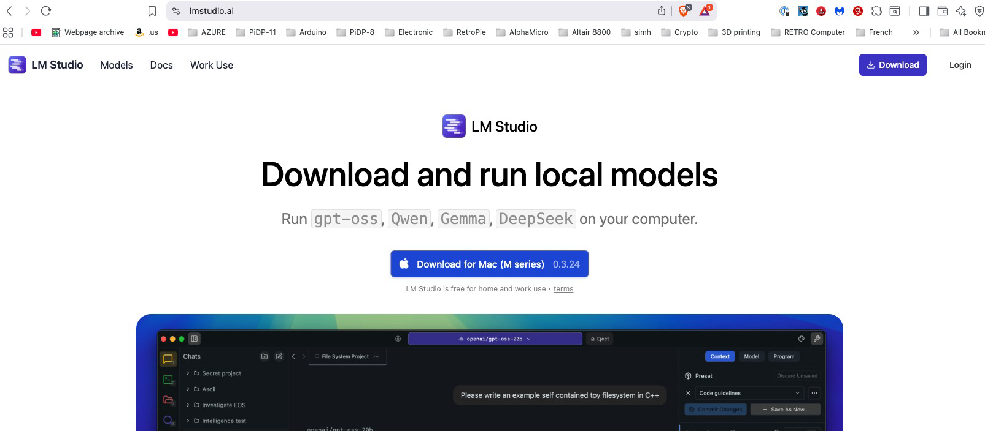
Setting Up LM Studio (Local)
Download: https://lmstudio.ai/ (macOS/Windows installers)
Enable server:
Settings → Developer → Local Inference Server
Default base URL: http://localhost:1234/v1 (OpenAI‑compatible)
Notes:
This compatibility makes swapping local↔cloud trivial.

Slide 17

Download a Small Model
Create account: https://huggingface.co/
Find an instruction‑tuned GGUF (e.g., mistral‑7b‑instruct) can search HF or Use LM Studio to search (on a mac you can also use MLX models)
Download & import into LM Studio
Start the model; sanity‑check via LM Studio chat UI
Some models are gated... Meta’s Llama models for example
Notes:
HF is the GitHub of models; GGUF works well locally.

Slide 18
Model Nomenclature Cheat Sheet
Base/Pretrain: raw next‑token model—good for further fine‑tuning, weak at following instructions out‑of‑the‑box.
Instruct / Chat / IT: tuned for instruction following (system→user→assistant). Safer/aligned for apps.
Reasoning / Thinking Models
Marked as Reasoning/Thinking/R/Deep/Think; optimized for multi‑step problem‑solving & tool use (often with hidden scratchpads).
Trade‑off: better multi‑hop performance but slower and costlier per token.
MoE — Mixture of Experts
Many sub-models, each an “expert” in an area; only a few activate per token (sparse routing). Higher capacity with lower compute.
Name clues: Mixtral 8x7B ⇒ 8 experts × 7B each.
Quantization
Compresses model weights for RAM/VRAM fit and speed; some quality loss. Rule: lower bits → smaller/faster → more loss.
Compression in this case is ”Lossy” resulting in a drop in quality; (but not much for Q4/5)
Memory Usage ≈ [params × bits / 8] (e.g., 8B @ 4‑bit ≈ 4 GB; plus KV cache/overhead).
V/VL/VLM: Vision/multimodal models – can take images (or sound/video) as input
Code/Coder: coding‑tuned
Size: 7B/8B/70B=parameter count in Billions
Context: 32k/128k/1M=max tokens in the context window
Provider cues:
Groq: llama‑3.1‑70b‑versatile (a meta llama model fine-tuned by Groq engineers)
Mixtral‑8x7b‑32768 (Mistral mixture of Experts, with 8 experts, each 7B parameters) and a 32,768 token context length
LM Studio: GGUF q‑types (LM studio loads GGUF types which is a conversion from another format)

Slide 19
Model Nomenclature — Quick Model Chooser
Safest instruction following → Instruct/Chat.
Need Long multi‑step reasoning? → Reasoning/Thinking.
Balance Speed with quality → MoE.
Local runs (LM Studio) → start with GGUF Q4_K_M; move to Q5_K_M/Q6_K if RAM allows.
Quantization Tag | Meaning (practical) | Typical use
Q2_K | Very aggressive (tiny) | Demos on tiny RAM; big quality hit
Q3_K_S/M | Low/medium quality | Quick tests when RAM is tight
Q4_K_M | Balanced default | Good quality/size for 7–13B
Q5_K_M | Higher fidelity | When you can spare more VRAM/RAM
Q6_K | Near‑FP16 quality | Quality‑sensitive local work
Q8_0 | Almost FP16; largest quant | Best quality without full FP16
Qx = quantized, compressed from original size to x-bits per weight
_K = quantizer “family” K is a smarter algorithm, get’s better quality at same bit size
_S/_M/_L: small medium or large (S = smallest RAM, L = largest RAM/best quality)
_0/_1: older quantization family than _K

Slide 20
Exploring Models of Different Sizes
Meta Llama-3.2-1B-Instruct (1 Billion parameters/1.23 GB)
OpenAI Gpt-oss-20b (20B parameters, Q4=12.10 GB)
Google Gemma-3-12b (12B parameters, Q4=8.07GB)
Deepseek-r1-0528-qwen3-8b (8B parameters, Q4=4.62GB)
Microsoft Phi-4-Mini-Instruct (4 B parameters, Q4=2.49GB)
Notes:
HF is the GitHub of models; GGUF works well locally. Show searching on HF; model cards; etc.

Slide 21
First Query — LM Studio (Local)
#LM Studio version - BASIC Chat Completion
#
import requests
url = "http://localhost:1234/v1/chat/completions"
payload = {
"model": "openai/gpt-oss-20b",
"messages": [ {"role":"system", "content":"You are a super helpful physics professor \
and youtube presenter that excels in explaining science to curious \
kids."},
{"role":"user","content":"ELI10 Quantum Mechanics"}],
"max_tokens":"1200",
"temperature":"0.3"
}
resp = requests.post(url, json=payload, headers={"Content-Type":"application/json"})
print(resp.json()["choices"][0]["message"]["content"])
Tip: ensure a model is loaded & server is enabled in LM Studio.
Notes:
Emphasize similar shape to OpenAI example; just the endpoint changes.

Slide 22
Alternative – if you can’t use LM Studio
First - Back to HuggingFace – create an access token
Second - Create a .env file in your IDE
Place the token in your .env file like:
HF_TOKEN=hf_********************************
Code:
# HuggingFace vesrion - BASIC Chat Completion
from openai import OpenAI
import os
client = OpenAI(
base_url="https://router.huggingface.co/v1", # or your HF Inference Endpoint URL
api_key=os.environ["HF_TOKEN"],
)
resp = client.chat.completions.create(
model="openai/gpt-oss-20b", # the model served by that endpoint
messages=[
{"role":"system", "content":"You are a super helpful physics professor and youtube \ presenter that excels in explaining science to curious kids."},
{"role":"user","content":"ELI10 Quantum Mechanics"}
],
max_tokens=1200,
temperature=0.3,
)
print(resp.choices[0].message.content)
Notes:
Emphasize similar shape to OpenAI example; just the endpoint changes.

Slide 23
Alternative #2 – OpenRouter
First – Create an Account on https://openrouter.ai/, and then create an access token
Second – review available models to see what’s “free”
Third - Create a .env file in your IDE
Place the token in your .env file like:
OPEN_ROUTER_API_KEY=sk-or-v1-********************************
Code:
#OPEN ROUTER Example
from openai import OpenAI
import os
from dotenv import load_dotenv
from openai import OpenAI
load_dotenv() # reads .env in the current working directory
api_key = os.getenv("OPEN_ROUTER_API_KEY") # extract the HF_TOKEN from the .env file
client = OpenAI(base_url="https://openrouter.ai/api/v1", api_key=api_key, )
completion = client.chat.completions.create(extra_headers={},
extra_body={},
model="moonshotai/kimi-k2:free",
messages=[
{"role":"system", "content":"You are a super helpful physics professor and youtube presenter \
that excels in explaining science to curious kids."},
{"role":"user","content":"ELI10 Quantum Mechanics"}
]
)
print(completion.choices[0].message.content)
Notes:
Emphasize similar shape to OpenAI example; just the endpoint changes.

Slide 24
AI Terms for the Rest of the Course
Term | Definition
MoE | Mixture of Experts – a way to scale up an LLM by using a set of smaller “expert” LLMs –a “router” activates the most appropriate experts that will respond to the prompt
RAG | Retrieval Augmented Generation – Uses a Vector DB to enrich an input prompt with information from a vector DB.
Vector DB | Store / Retrieve data semantically; Text is collapsed to a vector using an Embedding model – vector represents the ”meaning”
LRM | Large Reasoning Model – LLM tuned with reinforcement learning to work step by step before generating a response
Agent | Autonomous reasoning object, usually good at one specific skill, callable by general AI
MCP | Model Context Protocol – a standardized interface LLMs to connect to Agents
CUDA | An NVIDIA “eco system” of libraries and dev tools used to efficiently use GPUs for complex parallel processing of matrix operations
MLX | Apple’s version of CUDA that is optimized for Apple hardware. Possible to run MLX to run on NVIDIA GPUs.

Slide 25
Resources
Term | Definition
What is CUDA? | https://www.youtube.com/watch?v=K9anz4aB0S0
What is MLX? | https://www.youtube.com/watch?v=UbzOBg8fsxo
Intro to Vector DBs | https://www.youtube.com/watch?v=NEreO2zlXDk
How LLMs work? | https://www.youtube.com/watch?v=LPZh9BOjkQs
What are Agents? | https://www.youtube.com/watch?v=D7_ipDqhtwk
MCP vs API | https://www.youtube.com/watch?v=7j1t3UZA1TY
What is Quantization? | https://www.youtube.com/watch?v=K75j8MkwgJ0
What is a vector? | https://www.youtube.com/watch?v=fNk_zzaMoSs
How do Diffusion Models work? | https://pub.towardsai.net/how-do-diffusion-models-work-simple-explanation-no-mathematical-jargon-promised-54444f6b2e52

Slide 26
Wrap‑Up
Two pillars today: Diffusion (media) & LLMs (language/reasoning)
LLMs run locally or in cloud; same basic request/response template
Install LM Studio & create Hugging Face account; call api from python to get chat completion
Notes:
Next week: deeper control over prompts & responses programmatically.

Slide 27

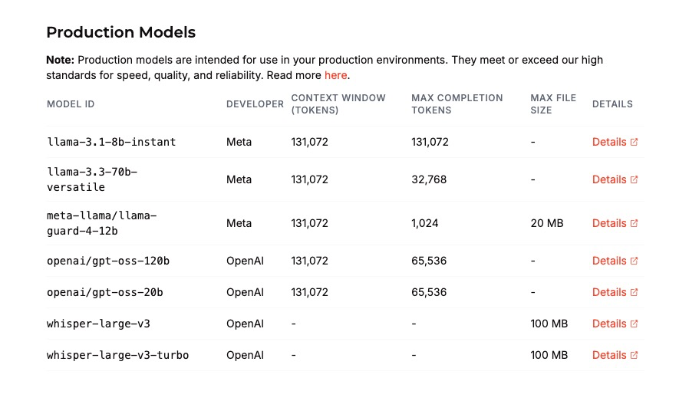

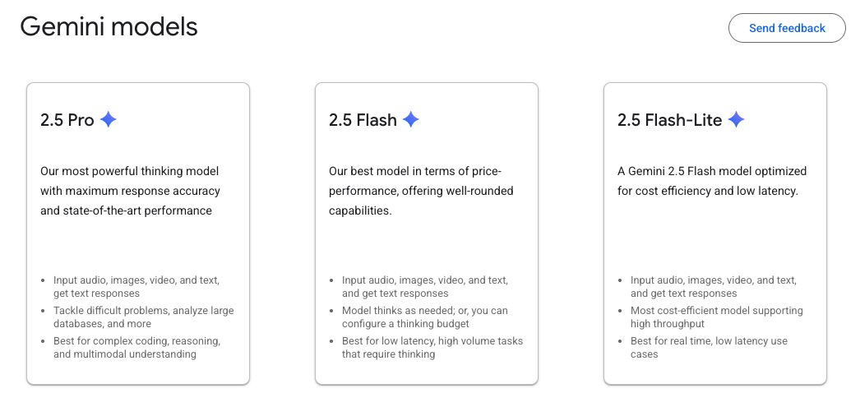
Homework
Add take what we’ve seen so far and:
Set up LM Studio on your computer, if possible;
Set up a HuggingFace Account;
Search HuggingFace for models to try;
Download/Test on LM Studio Chat
Set up your environment and try the code examples.
Try a completely different provider, Groq offers some free access for api calls, for example; and they host a few models you can try;
Google Gemini is another that provides a free API tier. You’re limited to Gemini models (Gemini 2.5 Pro, Flash, Flash-Lite);
Optional: If you’re good at python, consider implementing an LLM_provider class that encapsulates all the junk we need to talk to any of the above LLMs into a single Python class... Then your code needn’t worry about the differences between them!

