Slide 1

Week 10: MCP Clients

Slide 2


Model Context Protocol: The USB-C for AI Apps
Kimi AI
2025/08/05

Slide 3

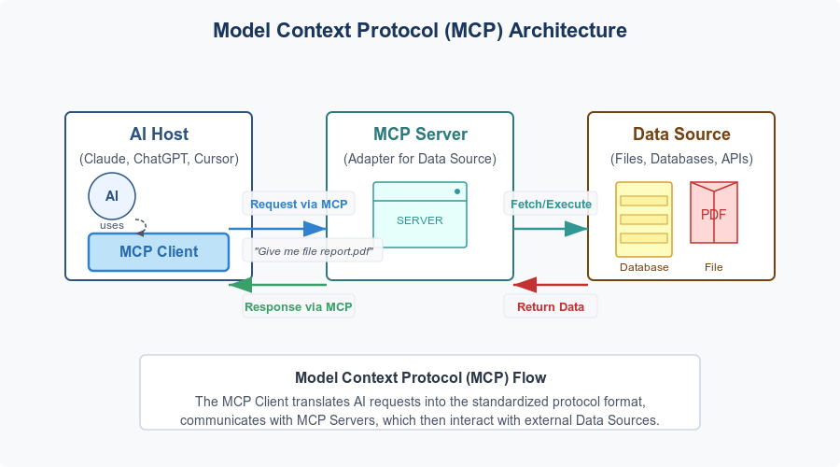
Core Architecture: Host, Client, Server

Slide 4
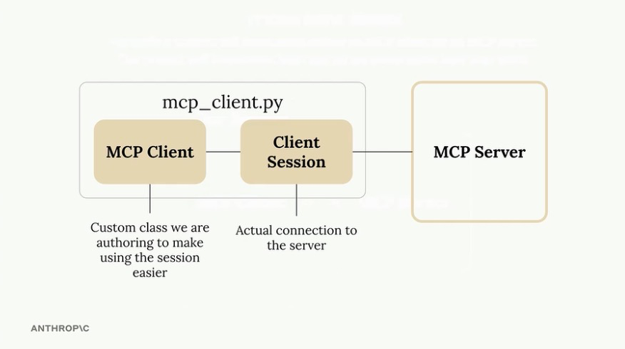
Introduction to MCP Clients
Connecting to the Server and Utilizing Features
Goal: Shift focus from Server implementation to Client implementation.
File: mcp_client.py Context:
Typical Setup: You usually build either a client or a server.
Our Project: Building both to understand the full ecosystem.

Slide 5
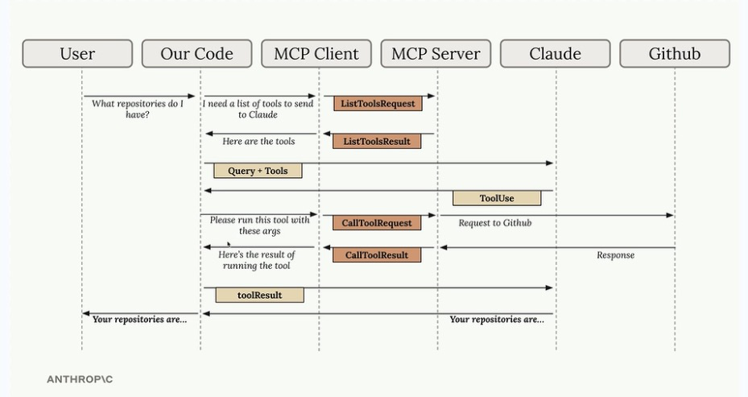
Why Build a Custom CLI?
We want to explore some cool MCP features
This IS a class on LLM powered apps
Chatbots like Claude, etc. have the MCP Client embedded in them, we don’t really have access to the client side
So far, many of the big apps (Claude, ChatGPT, LM Studio) do not implement the more advanced features in the MCP
We’ll just build our own Command Line Interface that implements a simple chat app, plus allows us to write our own code for the client side

Slide 6
The MCP Communication Protocol: Flow

Slide 7
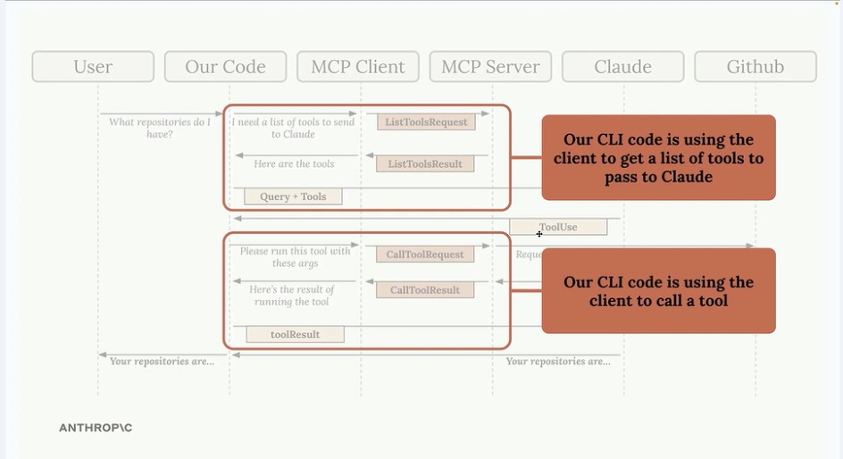
The MCP Communication Protocol: Flow

Slide 8
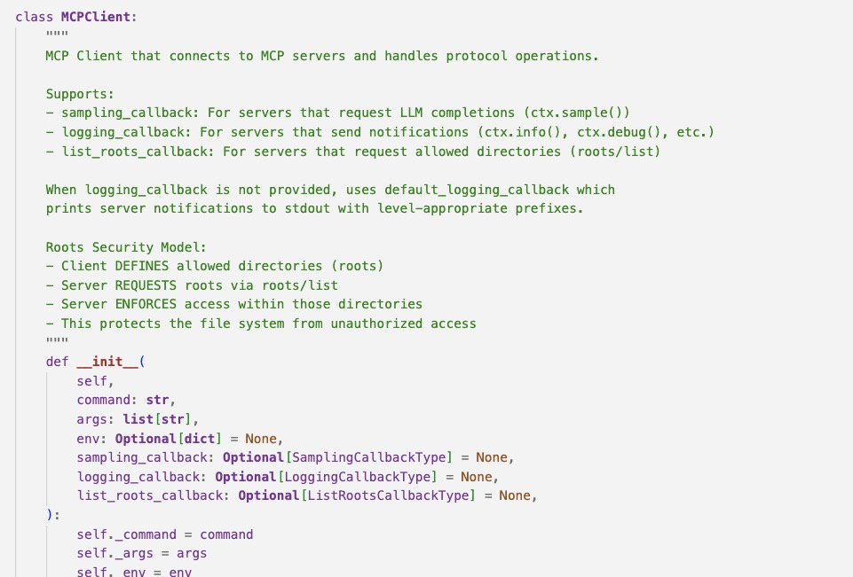
Client Wrapper Class
Why do we need a wrapper class?
The Component: The MCPClient class wraps the ClientSession from the MCP Python SDK.
Purpose:
Manages the connection to the MCP Server.
Handles Resource Cleanup:
Ensures the connection is closed properly (Async Enter/Exit).
Architecture:
The ClientSession is the raw connection.
The MCPClient class exposes functionality (Tools, Resources, Prompts) to the rest of the application (CLI/Core).

Slide 9
Implementing Tool Support
Connecting the CLI to Server Capabilities
The client needs two primary functions to interact with Tools:
list_tools()
Retrieves the definition of available tools from the server.
Code: return await self.session.list_tools()
call_tool(name, arguments)
Executes a specific tool requested by Claude.
Code: return await self.session.call_tool(name, arguments)
Integration: These are called by the Core logic when Claude decides it needs to perform an action that could use a tool

Slide 10
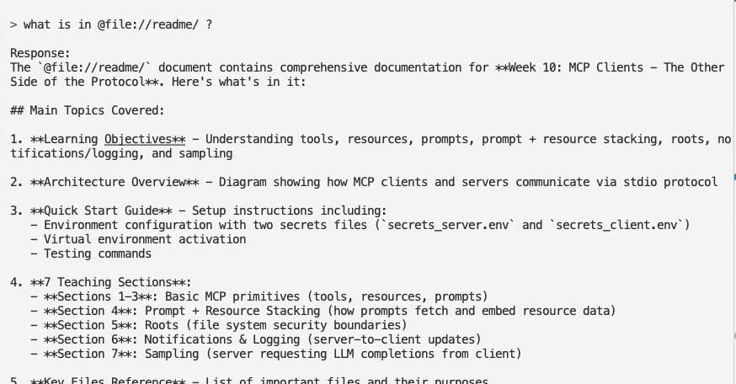
Resources
The MCP Concept: Resources
Resources allow the server to expose data for reading.
Distinct from Tools (which perform actions);
Resources are for fetching data.
The "@" CLI Feature
The Feature: Allow users to “mention” a document (e.g., "What is in @report.pdf?").
Workflow:
User types @ ...
App shows Autocomplete list of documents.
User selects a file...
App Fetches Content and injects it into the prompt context behind the scenes.

Slide 11
Resource Types & URIs
Defining Access Points
Direct (Static) Resources:
Fixed URI.
Use Case: Getting the list of all document names for autocomplete.
URI Example: docs://documents
Templated Resources:
Dynamic URI with parameters (Wildcards).
Use Case: Getting the content of a specific document.
URI Example: docs://documents/{doc_id}
Note: The SDK parses {doc_id} and passes it as an argument to the function.

Slide 12
Server-Side Resource Implementation
Adding Resources to stoopid_wx_server.py
1. List Documents (Static)
Decorator: @mcp.resource("docs://documents")
MIME Type: application/json (Hint to client: Parse this string).
Action: Returns LIST of document keys.
2. Fetch Document (Templated)
Decorator: @mcp.resource("docs://documents/{doc_id}")
MIME Type: text/plain (Hint to client: Raw text).
Action: Validates ID, returns content string.

Slide 13
Client-Side Resource Implementation
Handling Data Types in mcp_client.py
We need a generic read_resource(uri) function; we don’t know what the type of the resource is until we see the MIME Type come in
Logic Flow:
Request resource via self.session.read_resource(uri).
Inspect the MIME Type of the response.
If application/json: Parse the text string into a Python object (List/Dict).
If text/plain: Return the raw text string.
Integration: The CLI uses this to populate the autocomplete list and fetch document content seamlessly.

Slide 14
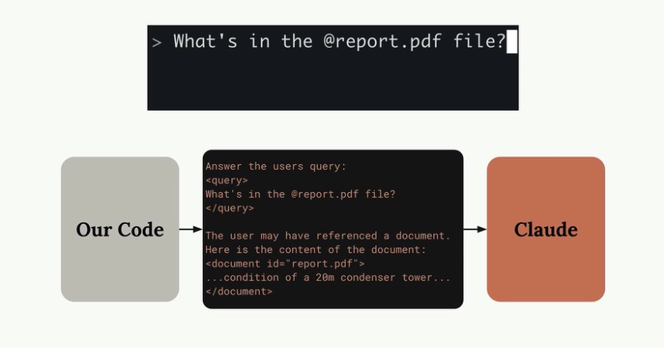
Client-Side Interaction with the Model

Slide 15
Prompts
The "/" Slash Command Feature
The Feature: Allow users to run predefined commands (e.g., /hip_weather).
Goal: Create a more complex prompt that’s pre-written for the user.
The MCP Concept: Prompts
Prompts are pre-written, reusable templates stored on the server.
Why use them?
Standardizes complex tasks.
Removes the need for the user to be a "prompt engineering" expert.
Ensures high-quality, tested, and evaluated results.

Slide 16
Implementing Prompts on the Server
Defining the Template
Decorator: @mcp.prompt()
Components:
Name: hip_weather
Arguments: location (The location for the weather).
Logic: Returns a list of Message objects (User/Assistant).
The Prompt Content:
Constructs a highly specific instruction: ”Give the weather report in location {location} in the style of George Carlin’s hippy-dippy weatherman character."
Newly constructed prompt sent to claude

Slide 17
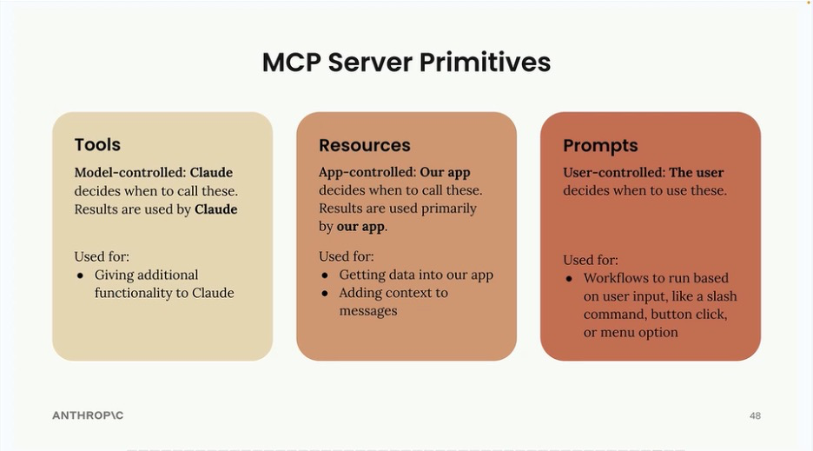
Server Primitives

Slide 18
Implementing Prompts on the Server
Summary of MCP Components
Component | Purpose | Interaction Style | Example Use Case
Tools | Actions & Execution | Model-driven (Claude asks to use them) | Get weather
Resources | Data Access | Application-driven (Client requests data) | Auto-complete lists, File context
Prompts | Reusable Templates | User-driven (Slash commands) | Complex, tuned prompts, Standard workflows

Slide 19
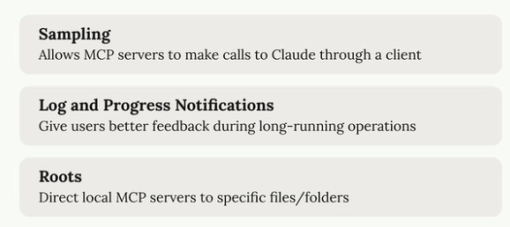
MCP: Advanced Features

Slide 20
Introduction to Sampling
Giving the Server a Voice
Definition: Sampling is a mechanism that allows an MCP Server to request access to a Language Model (like Claude) through the connected MCP Client.
The Scenario:
Imagine a Tool that fetches raw data (e.g., scraping google for the current and forecast weather)
The tool fetches the data, but we want to do something ”intelligent” before we pass it back to the user.
The Goal: The Server needs to "synthesize" or augment this raw data to make it more useful before sending it back to the user.

Slide 21
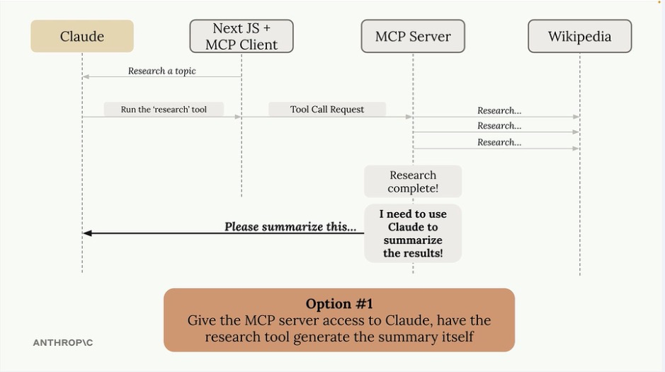
The Synthesis Challenge
How can the Server use intelligence to process raw data?
Once the MCP Server has fetched data (like the weather), it has two options to summarize that data:
Option 1: Direct Server-Side Generation
The Server maintains its own connection to an LLM.
The Server sends the raw data to the LLM and gets a summary.
The Problem:
Complexity: Server needs logic to handle LLM requests.
API Keys: The Server owner must provide and pay for their own API key.
Scalability: Dangerous for public servers (users spend your money).

Slide 22
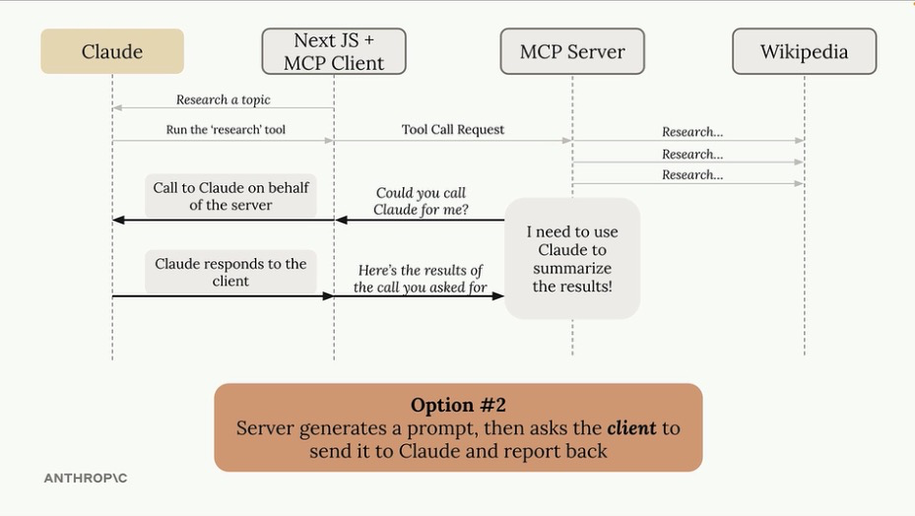
Or...
Option 2: Sampling (The Solution)
Shifting the Burden to the Client
How it works:
The MCP Server formulates a prompt (e.g., ”Advise the user on what to wear, given this weather forecast").
Instead of calling an LLM directly, it asks the MCP Client: "Can you run this prompt for me?"
The MCP Client (which already has a connection to Claude/LLM) runs the prompt.
The Client returns the generated text back to the Server.
Note: This is efficient because the Client acts as the gateway to the LLM anyway.

Slide 23
Benefits of Sampling
Why use this architecture?
No Server-Side API Keys: The Server does not need to store sensitive keys.
Cost Management:
Essential for Publicly Accessible Servers.
The User (via their Client) pays for the token generation, not the Server host.
Reduced Complexity: The Server focuses on logic/tools, while the Client manages the LLM connection.

Slide 24
Implementing Sampling: Server-Side
Requesting the Generation
To use sampling, the Server initiates the request typically inside a Tool execution.
Function: create_message()
Process:
Define a list of messages (System prompts, User content).
In other words, simulate a chatbot conversation!
Pass these messages into the create_message function.
Await the result from the client.

Slide 25
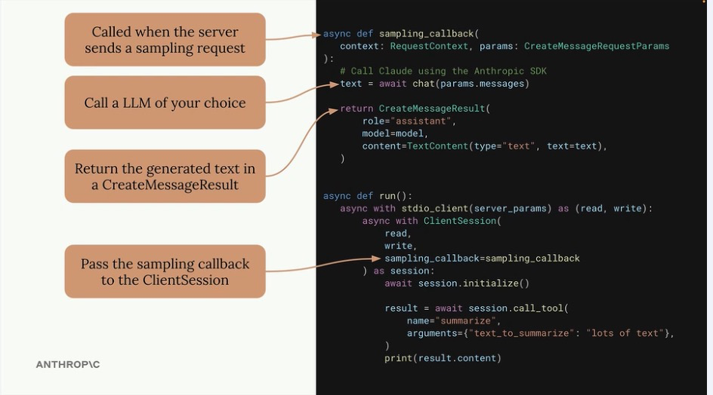
Implementing Sampling: Client-Side
Handling the Request
The Client requires a specific setup to listen for these requests.
Component: Sampling Callback
The Workflow:
The Client receives the list of messages from the Server.
Callback Logic: The developer writes code to send these messages to the client’s specific LLM (e.g., Claude via Anthropic API).
Return: The callback returns a CreateMessageResult containing the generated text back to the Server.

Slide 26
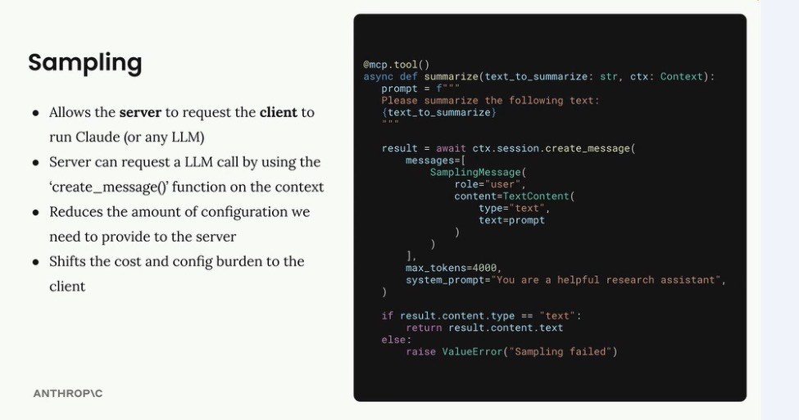
Implementing Sampling: Server-Side

Slide 27
Implementing Sampling: Summary
Feature | Direct Server Access | Sampling (MCP Standard)
Who calls the LLM? | The Server | The Client (on behalf of Server)
Who pays for tokens? | Server Owner | User / Client Owner
Ideal Use Case | Private, internal tools | Public, distributed tools
Complexity | High (Needs Key Management) | Low (Reuses Client Connection)

Slide 28
Logging and Progress Notifications
Improving User Experience for Long-Running Tools
The Problem:
Some tools take time to complete (e.g., "Researching Archaeology" might take 30+ seconds).
Without feedback, the user sees a "frozen" state. They might assume the application has crashed or the request failed.
The Solution:
Logging: distinct status messages sent from the server.
Progress: A quantifiable indicator (percentage/steps) of completion.
Result: Transforms a "black box" wait time into an interactive, transparent experience.

Slide 29
Logging and Progress Notifications
Server-Side Implementation
Using the Context Object
To send updates, we need access to the request context inside our tool functions.
The context Argument:
Automatically injected as the last argument to your tool function.
Available Methods:
Logging: context.info(”Getting Weather...")
Sends a log message object to the client.
Progress: context.report_progress(current, total)
Sends a progress update (e.g., Step 2 of 5).

Slide 30
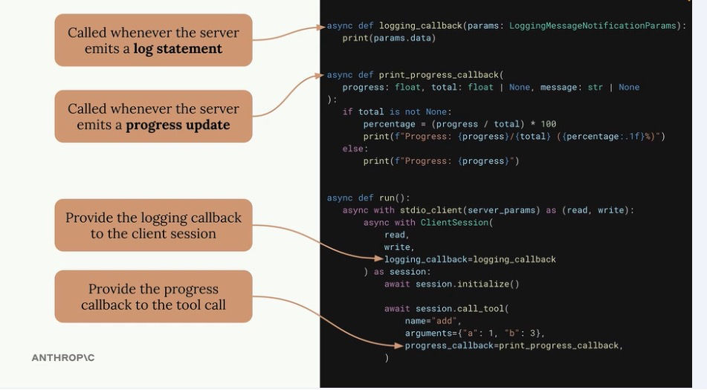
Logging - Client-Side Implementation
Handling Incoming Updates
Just like with Sampling, the Client uses Callbacks to handle this data.
1. Handling Logs:
Scope: Session-wide.
Setup: Define a callback function that accepts a log object.
Registration: Pass this callback to the ClientSession upon initialization.
2. Handling Progress:
Scope: Specific to a single tool call.
Setup: Define a callback to handle progress numbers (e.g., update a progress bar).
Registration: Pass this callback as an argument specifically to the call_tool function.

Slide 31
Logging - UI Implementation
UI Integration & Flexibility
How to Display the Data
The MCP Client logic acts as a bridge; how you display the data is up to your application's UI layer.
CLI Applications:
Simply print log statements to the terminal.
Use a library like tqdm for progress bars.
Web Applications:
Stream logs to a console window in the browser.
Update a visual Progress Bar component.
Optionality: You are not required to display this data. It is a UX enhancement, and clients can choose to ignore these callbacks if the UI doesn't support them.

Slide 32
Introduction to Roots
Defining File System Access
Definition: Roots are a codified mechanism for defining exactly which files and folders an MCP Server is allowed to access ON THE CLIENT.
The Concept:
Think of Roots as an "Allow List."
By default, an MCP Server shouldn't roam your entire hard drive.
Roots define specific entry points (e.g., ~/Desktop or /project/src) that the user explicitly grants to the server.

Slide 33
Why do we need Roots?
Scenario:
A user asks: "Convert biking.mp4 to MOV."
The Issue:
The Server doesn't know where biking.mp4 lives.
Is it in Downloads? Movies? Documents?
Result: The tool fails with "File not found" unless the user types the specific, absolute path (e.g., /Users/me/movies/biking.mp4).
User Experience: Forcing users to type absolute paths is tedious and poor design.

Slide 34
The Solution: Roots as Search Paths
Enabling Autonomous Discovery
The Setup:
The User launches the Client, passing ~/Desktop as a Root argument.
The Server implements a tool: list_roots.
The Workflow:
Claude checks availability: Calls list_roots -> sees ~/Desktop.
Claude searches: Calls read_directory on the Desktop.
Claude finds the file: Sees biking.mp4 exists there.
Action: Claude autonomously constructs the full path and calls convert_video successfully.

Slide 35
The Security Boundary - Enforcing Sandboxing
Roots also act as a security layer (Sandbox).
Scenario:
User asks: "Convert swimming.mp4" (which resides in ~/Documents).
Allowed Root: Only ~/Desktop.
The Outcome:
Claude tries to convert the file.
The Server checks the path against the Allowed Roots.
Access Denied: Since ~/Documents is not in the Root list, the server refuses to touch the file.
Benefit: Prevents the LLM from accidentally modifying or reading sensitive files outside the intended scope.

Slide 36
The Dual Purpose of Roots
Summary of Benefits
Roots solve two distinct problems simultaneously:
Security (Access Control):
Users explicitly grant permission.
Protects the wider file system from unauthorized access.
Focus (Context Window):
Allows the LLM to narrow its attention.
Instead of scanning the whole drive, Claude searches only relevant folders (Roots) to resolve file names automatically.

Slide 37
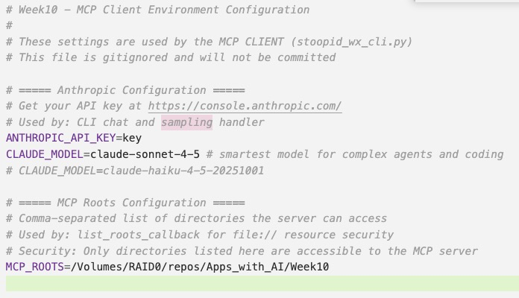
Implementation Reality - Developer Responsibility
Crucial Note: The MCP SDK does not automatically enforce Root boundaries. It is a protocol concept, not a magic firewall.
Your Job as a Developer:
You must implement the logic to check paths.
Pattern: Write a helper function (e.g., is_path_allowed(path)).
Logic:
Get the list of Roots from the Client.
Check if the requested tool path is inside one of those Roots.
If yes, proceed. If no, raise an error.
Exposing Roots: You can create a list_roots tool, or simply inject the allowed paths into the system prompt.
I chose to put the ROOTS in the ‘secrets’ file on the client

Slide 38



Credits
https://www.natebjones.com/

