Slide 1

AI App Development Workshop — Week 6
Theory & Hands‑On With LLMs
Notes:
We’ll build a shared mental model of AI model families, then do a first query locally and in the cloud.

Slide 2
Class Schedule
✅ Week 1 [9/5] — Intro + Environment Setup
Goal: Get everyone’s dev environment ready and understand the landscape.
✅ Week 2 [9/12] — Querying LLMs from Python
Goal: Comfortably send queries to local and OpenAI endpoints.
✅ Week 3 [9/19] — Building out our App
Goal: Process a ticket in one go, Structured output from an LLM.
✅ Week 4 [9/26] —Vector DBs for RAG
Goal: Understand how we can retrieve things by “meaning” and use those things to supply context to LLMs
Week 5 [10/24] — RAG Part 2
Goal: Add RAG to our App.
Week 6 [10/31] — Rag Part 3 – Reranking & Framework Introduction
.
Week 7 [11/07] – TBD
>>> No class Friday 10/3 & 10/10 <<<

Slide 3
Our “Problem”
We want to automatically respond to a ticket with relevant, helpful information.
The LLMs we use have a lot of general knowledge, but may NOT have specialized or obscure knowledge (“Who are the Coneheads?”)
There are several different ways to get new, specialized knowledge into an LLM:
Training
Fine-Tuning
RAG

Slide 4
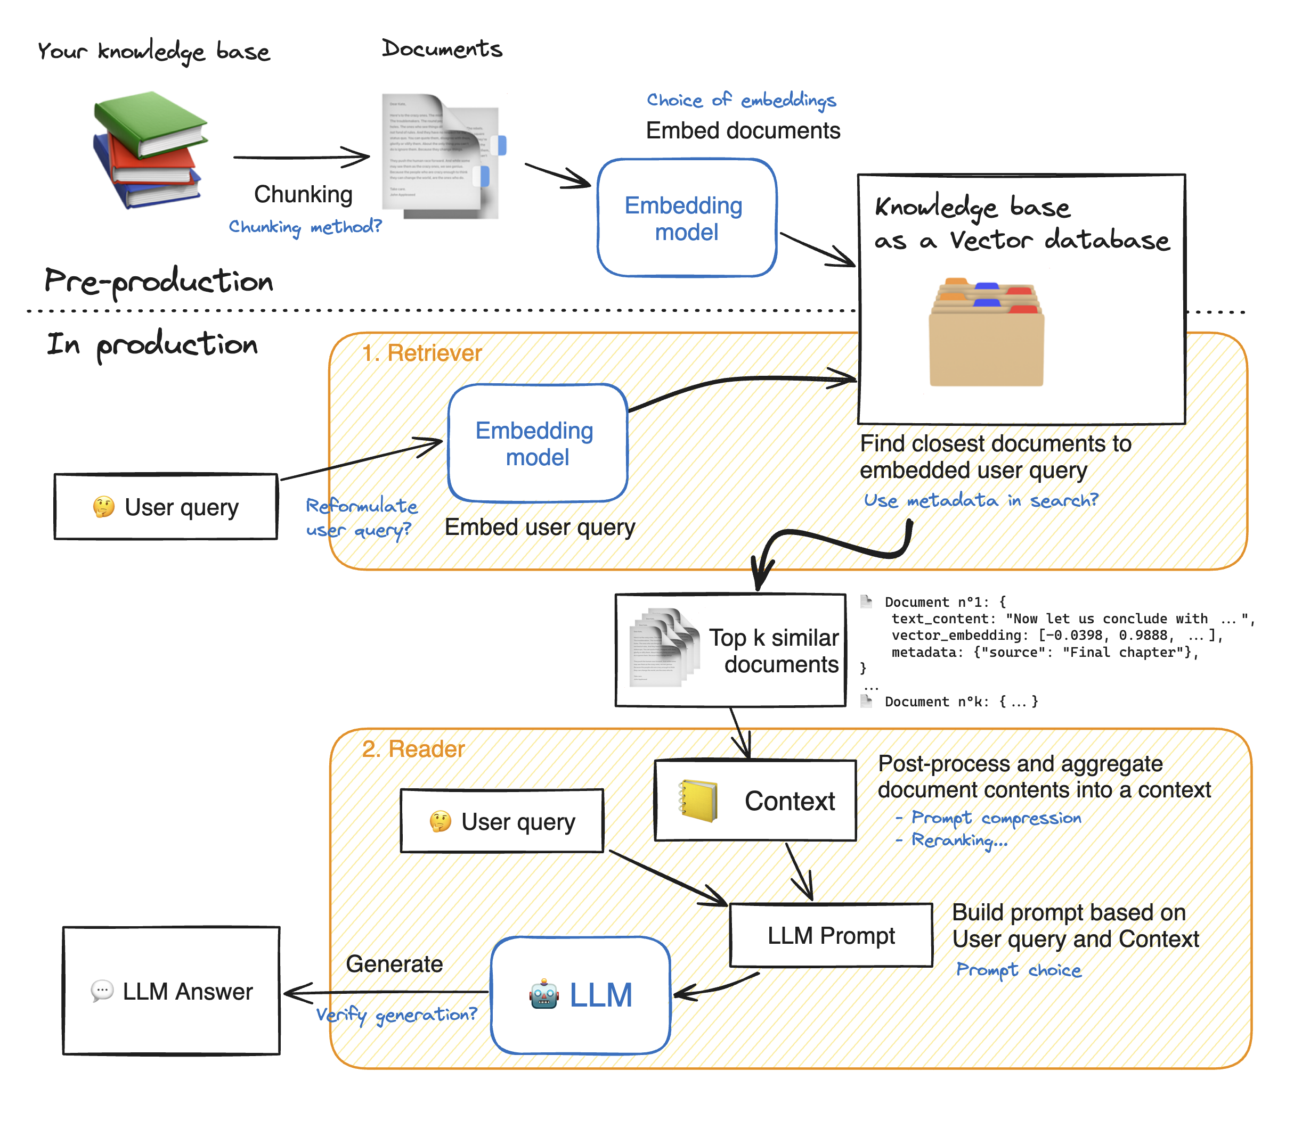
Reranker

Slide 5
Embeddings
A text embedding can have hundreds of values, each representing a different aspect of a text’s meaning. Just as you might describe a house by its characteristics type, location, bedrooms, bathrooms, levels - the values in an embedding quantify a text’s linguistic features.
work
A pair of words like sea and ocean may not be used in identical contexts (we say ‘lost at sea’, not ‘lost at ocean’ so they aren’t always direct substitutes), but their meanings are close to each other, and embeddings allow us to quantify that closeness using mathematical measurements of ‘distance’.
Sea
Ocean
The way these characteristics are “learned” via training means we don't know exactly what each value represents, but words we expect to be used in comparable ways often have similar-looking embeddings.
football
Soccer
I
We

Slide 6
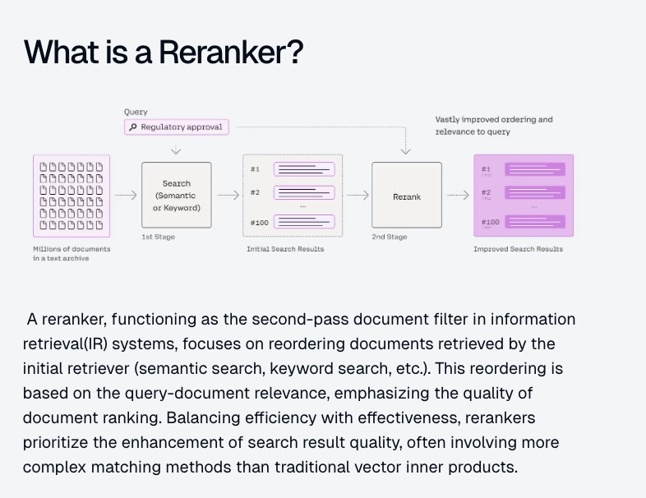

Slide 7
Why a reranker?
We know that hallucinations happen when unrelated retrieved docs are included in output context.
This is exactly where rerankers can be helpful!
They rearrange document records to prioritize the most relevant ones. This not only helps address hallucinations but also saves money during the RAG process.

Slide 8
Limitations of Embeddings
Limited Semantic Understanding
While embeddings capture semantic information, they often lack contrastive information. For example, embeddings may struggle to distinguish between "I love apples" and "I used to love apples" since both convey a similar semantic meaning.
Dimensionality Constraints
Embeddings represent documents or sentences in a relatively low-dimensional space, typically with a fixed number of dimensions (e.g., 1024). This limited space makes it challenging to encode all relevant information accurately, especially for longer documents or queries.
Generalization Issues
Embeddings must generalize well to unseen documents and queries, which is crucial for real-world search applications. However, due to their dimensionality constraints and training data limitations, embeddings-based models may struggle to generalize effectively beyond the training data.

Slide 9

Let’s get Coding!

