Slide 1

AI App Development Workshop — Week 5
Theory & Hands‑On With LLMs
Notes:
We’ll build a shared mental model of AI model families, then do a first query locally and in the cloud.

Slide 2
Class Schedule
✅ Week 1 [9/5] — Intro + Environment Setup
Goal: Get everyone’s dev environment ready and understand the landscape.
✅ Week 2 [9/12] — Querying LLMs from Python
Goal: Comfortably send queries to local and OpenAI endpoints.
✅ Week 3 [9/19] — Building out our App
Goal: Process a ticket in one go, Structured output from an LLM.
✅ Week 4 [9/26] —Vector DBs for RAG
Goal: Understand how we can retrieve things by “meaning” and use those things to supply context to LLMs
Week 5 [10/17] — RAG Part 2
Goal: Add RAG to our App.
Week 7 [10/24] — TBD
.
Week 8 [10/31] – TBD
>>> No class Friday 10/3 & 10/10 <<<

Slide 3
Recap from Last week
We batched all of our LLM calls into one.
We learned about structured output; returning JSON rather than text.
In homework we expanded to iterating over multiple tickets, returning type, category, etc. and even an “answer”
Notes:
Next week: deeper control over prompts & responses programmatically.

Slide 4
Our “Problem”
We want to automatically respond to a ticket with relevant, helpful information.
The LLMs we use have a lot of general knowledge, but may NOT have specialized or obscure knowledge (“Who are the Coneheads?”)
There are several different ways to get new, specialized knowledge into an LLM:
Training
Fine-Tuning
RAG

Slide 5
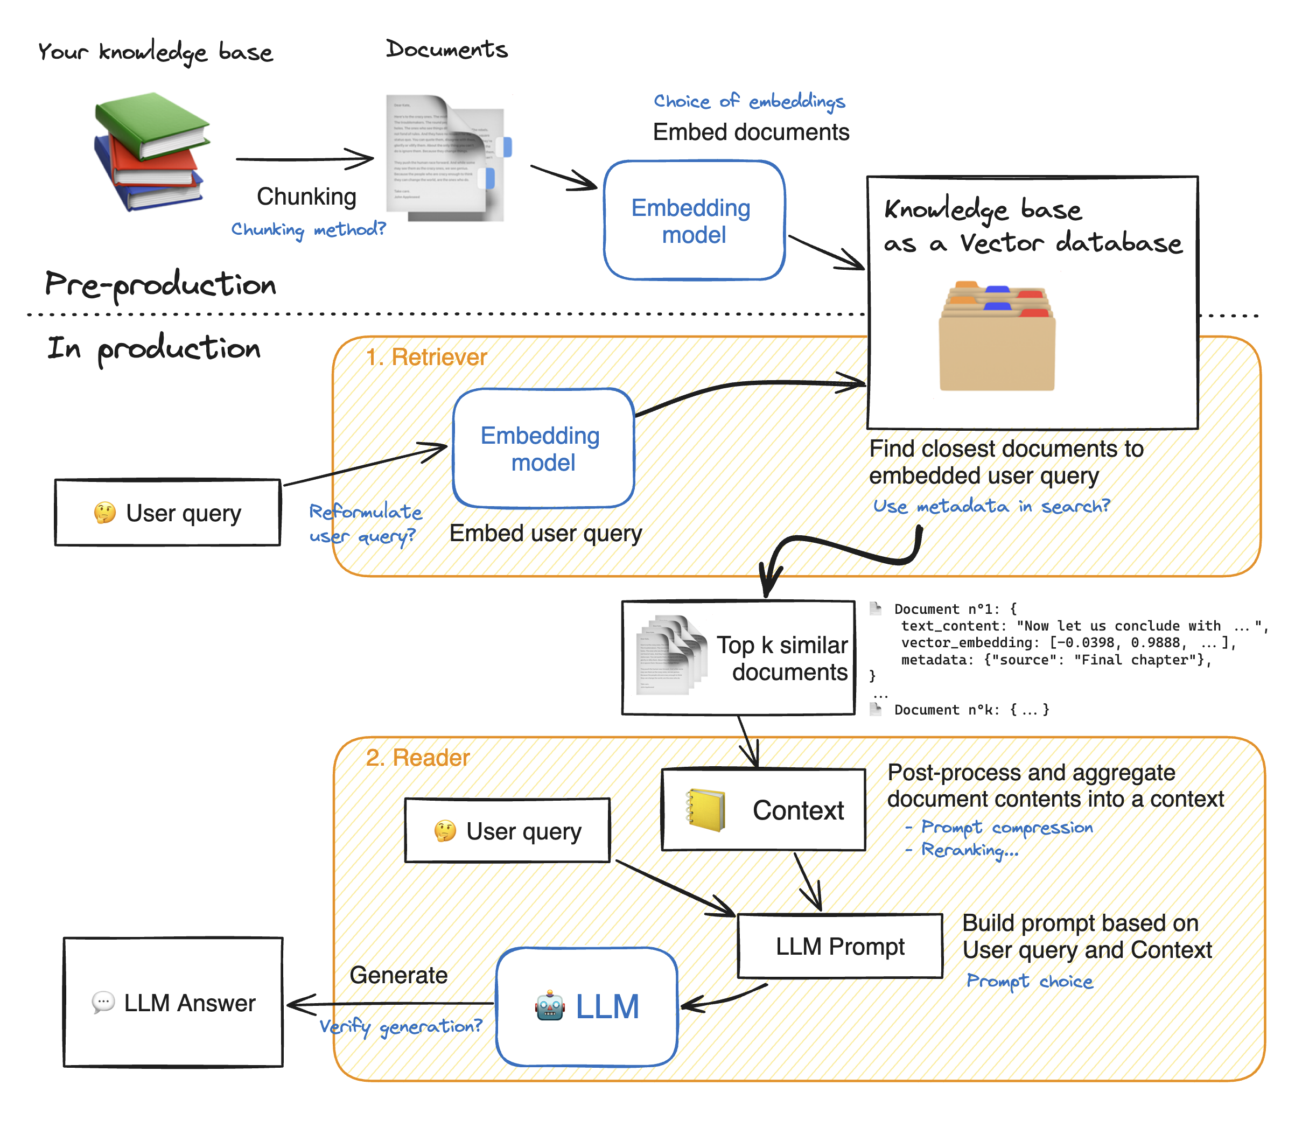

Slide 6
Embeddings
A text embedding can have hundreds of values, each representing a different aspect of a text’s meaning. Just as you might describe a house by its characteristics type, location, bedrooms, bathrooms, levels - the values in an embedding quantify a text’s linguistic features.
work
A pair of words like sea and ocean may not be used in identical contexts (we say ‘lost at sea’, not ‘lost at ocean’ so they aren’t always direct substitutes), but their meanings are close to each other, and embeddings allow us to quantify that closeness using mathematical measurements of ‘distance’.
Sea
Ocean
The way these characteristics are “learned” via training means we don't know exactly what each value represents, but words we expect to be used in comparable ways often have similar-looking embeddings.
football
Soccer
I
We

Slide 7
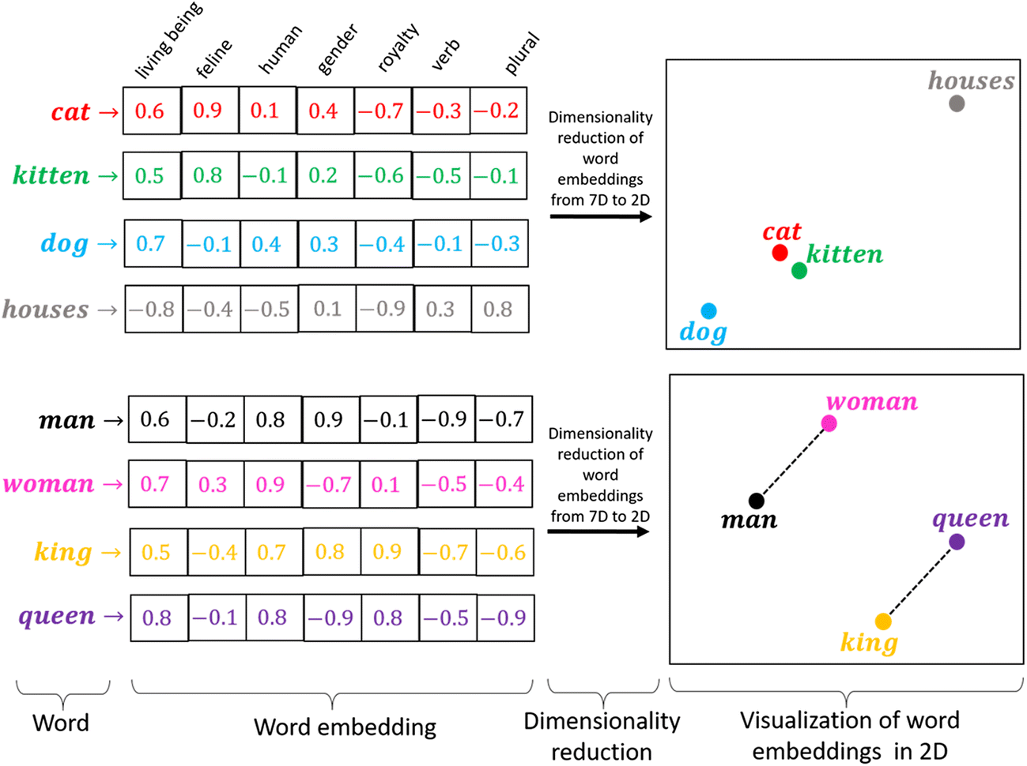
Vector “nearness” -> Meaning “nearness”

Slide 8
Simple Code Example

