Slide 1
Agile vs Waterfall
A look into two software development methodologies
Travis Nickerson
CSD 205
January 7th 2021

Slide 2

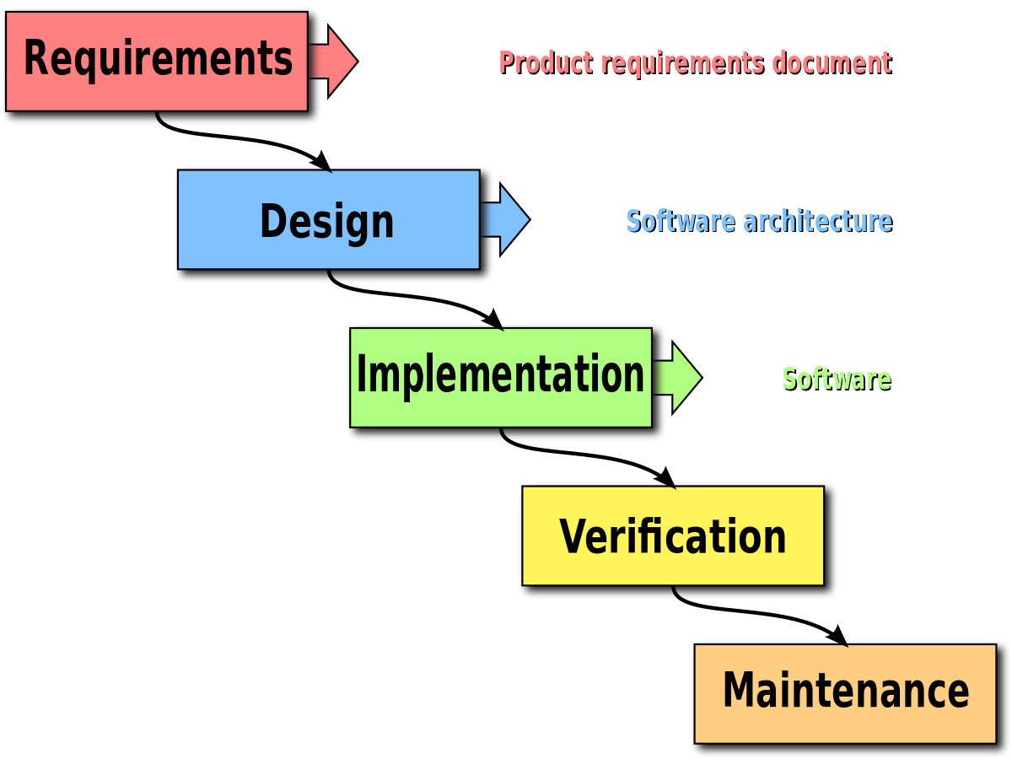
A Brief Overview of Waterfall
Created by Winston W Royce for a standard methodology to system analysis
The Waterfall software methodology is a classical way of structuring the software life cycle in a linear and sequential way.
Each phase must be completed before the next phase begins
A whole team focuses on each phase together

Slide 3
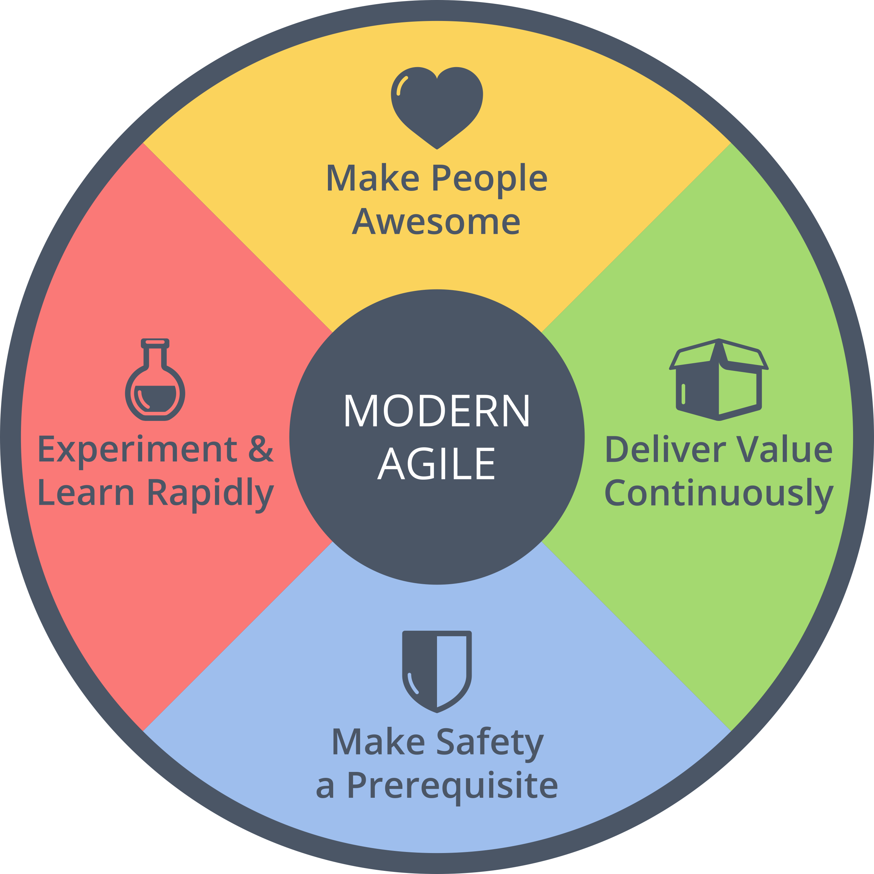
A Brief Overview of agile
Developed in response to the inflexible nature of Waterfall
Breaks down the project into smaller parts
Promotes adaptability
Able to show clients pieces of the project while being developed
Focus on teamwork and time

Slide 4

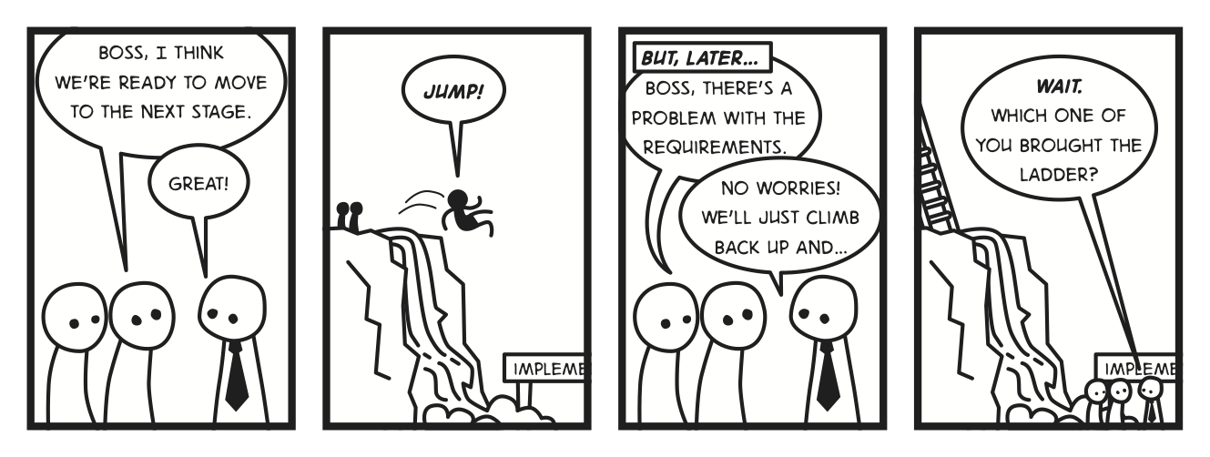
Phases of the WaterFall Life Cycle
Conception
Initiation and Analysis
Design
Construction and Coding
Testing
Implementation

Slide 5
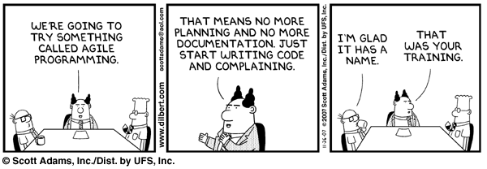
Phases of the Agile Life cycle
Requirements
Design
Development and Coding
Integration and Testing
Implementation and Deployment
Review

Slide 6
Pros to Waterfall
Clear framework
Documentation
Shared work load
Easy to manage
Great for small projects

Slide 7
Cons to Waterfall
Not Ideal for large projects
Changes can be difficult
Last minute testing
Less customer involvement

Slide 8
Pros to Agile
Flexibility for deliverables
Stakeholder involvement
Adaptability
Quality of the development is maintained

Slide 9
Cons to agile
Not useful for small projects
Requires increased management
Increased cost potential
Increased time potential

Slide 10
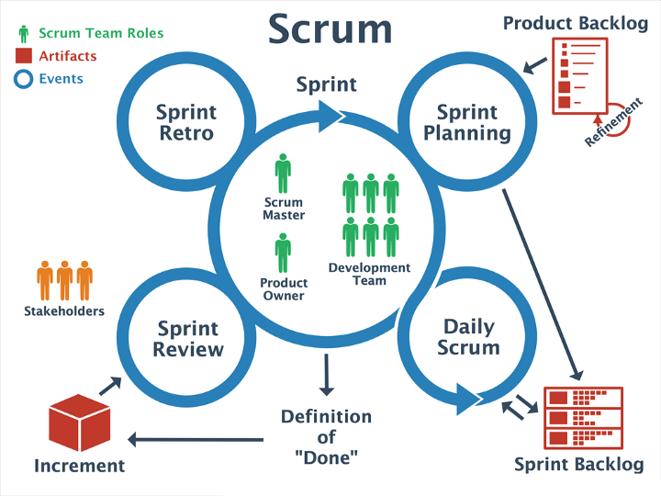
What is Scrum?
Scrum is a subset of the Agile process and it is, “an iterative software development model used to manage complex software and product development. Fixed-length iterations, called sprints lasting one to two weeks long, allow the team to ship software on a regular cadence. At the end of each sprint, stakeholders and team members meet to plan next steps.” (smartsheet.com)

Slide 11
The pros of scrum
Increased transparency and project visibility
Accountability across teams
Additional room for changes
Savings in cost

Slide 12
Cons to Scrum
Scope Creep
Harder to manage large teams
Teams require experience
Increased errors if tasks are not defined properly

Slide 13
Conclusion
Both the Waterfall and the Agile methodologies are integral to the development life cycle. With pros and cons to each, it provides a relatively structured process to what would otherwise be more a more chaotic environment. It is within these two core concepts that almost any project can be completed with structure and accuracy for the end user.

