Slide 1





The TEAM
Gautam Jain
Varsha Chhabria
Nikhita Thota
Team’s Vision:
Emergencies don’t wait — and with BosHealth, neither do you.
BOSHealth: Emergency Response System
PS NOTE: We recommend watching the ppt in slideshow for better transitions. For detailed understanding please refer to the document LINK

Slide 2

EXECUTIVE SUMMARY: Where do we IMPROVE?
Imagine a World Without Emergency Response Delays: BOSHealth is a smart emergency response system poised to eliminate critical delays by instantly connecting patients, dispatchers, and hospitals, transforming emergency care as we know it.
Your Health in Your Hands: With dedicated interfaces for patients, dispatchers, and hospitals, our mobile app empowers you to request ambulances, track arrival times, and securely share vital medical information, ensuring a coordinated response when every second counts.
Real-Time Data, Real-Time Decisions: BOSHealth's live and executive dashboards provide unprecedented real-time visibility into ambulance locations, case severity, and hospital capacity, enabling smarter, data-driven decisions that save lives.
Built for Everyone, Everywhere: Designed with user-centricity at its core, BOSHealth caters to diverse needs, from tech-savvy individuals to older adults living alone, ensuring inclusive access to emergency care through intuitive interfaces and accessibility features.

Slide 3


AGENDA
01
In the NEWS + Introduction
02
Data Visualization: Dashboards
03
BosHealth: App Interface
04
Lessons Learned + Conclusion

Slide 4
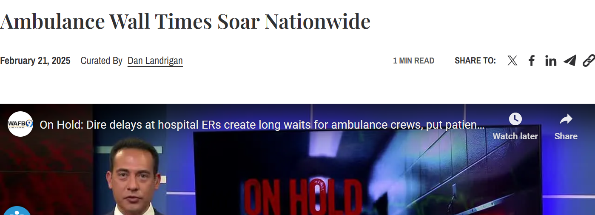

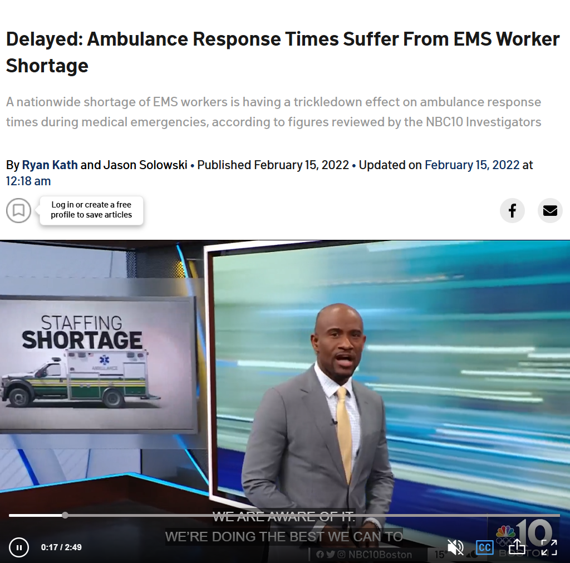

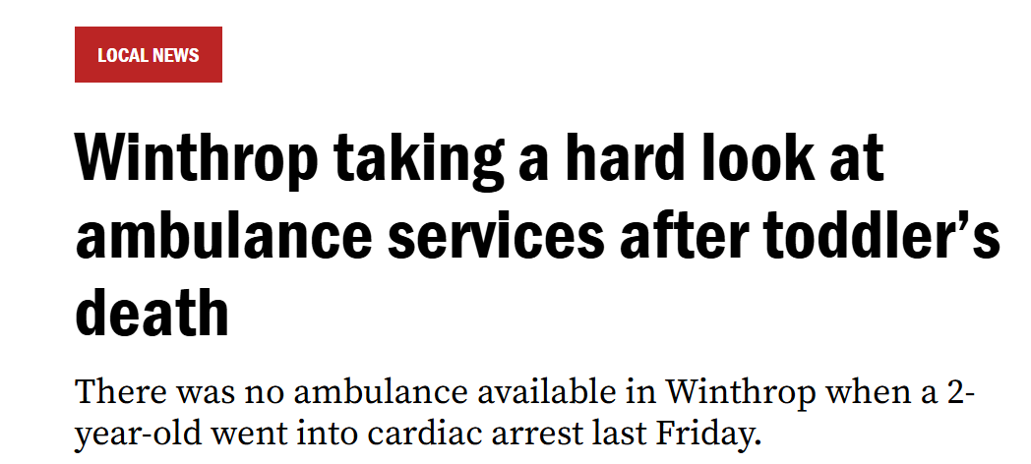
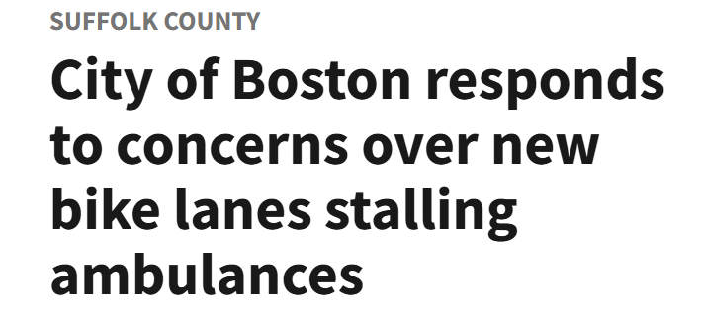
ATTENTION!!!!

Slide 5
INTRODUCTION
Welcome.
Today, we’re excited to introduce BOSHealth, a Smart Emergency Response System comprised of several key deliverables. These include a Live Dashboard for real-time operations, an Executive Dashboard for strategic insights, and the BOSHealth App with dedicated interfaces for patients, dispatchers, and hospitals. Together, these components work in harmony to revolutionize emergency care.

Slide 6
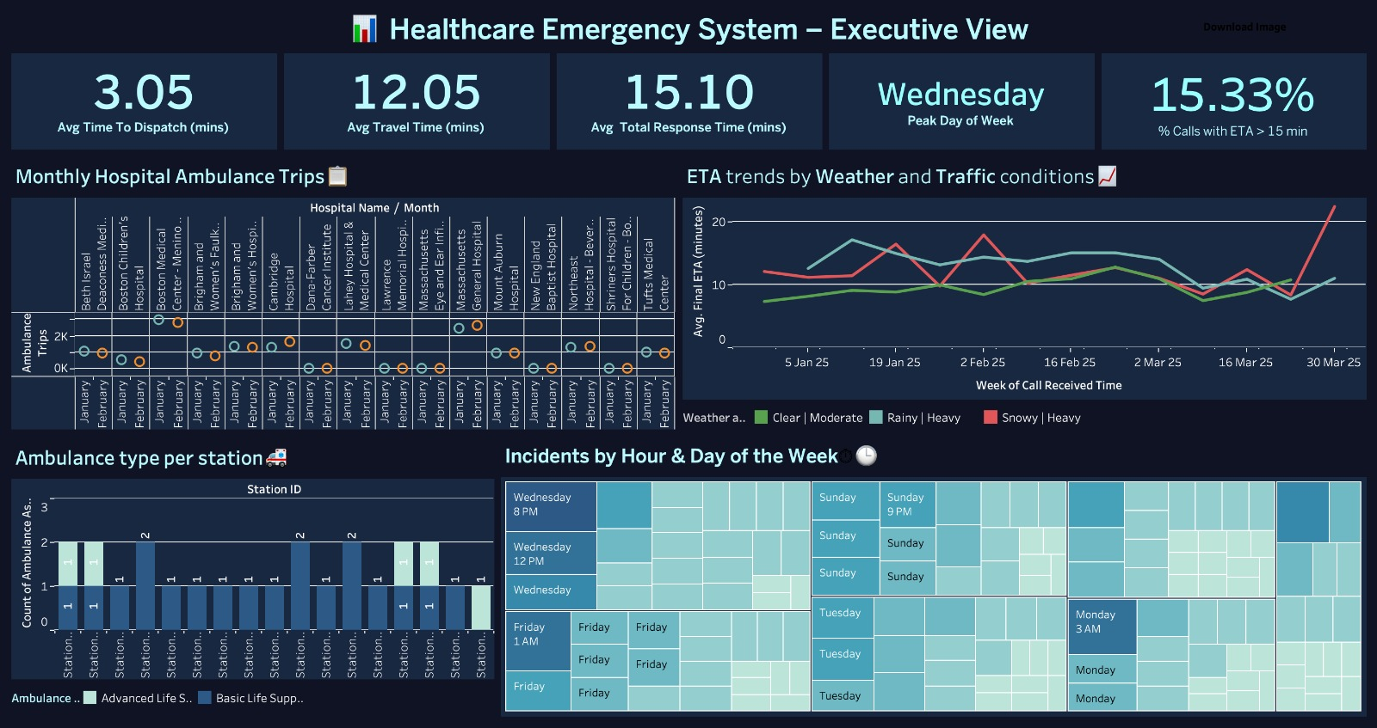
Visualizing the causes

Slide 11
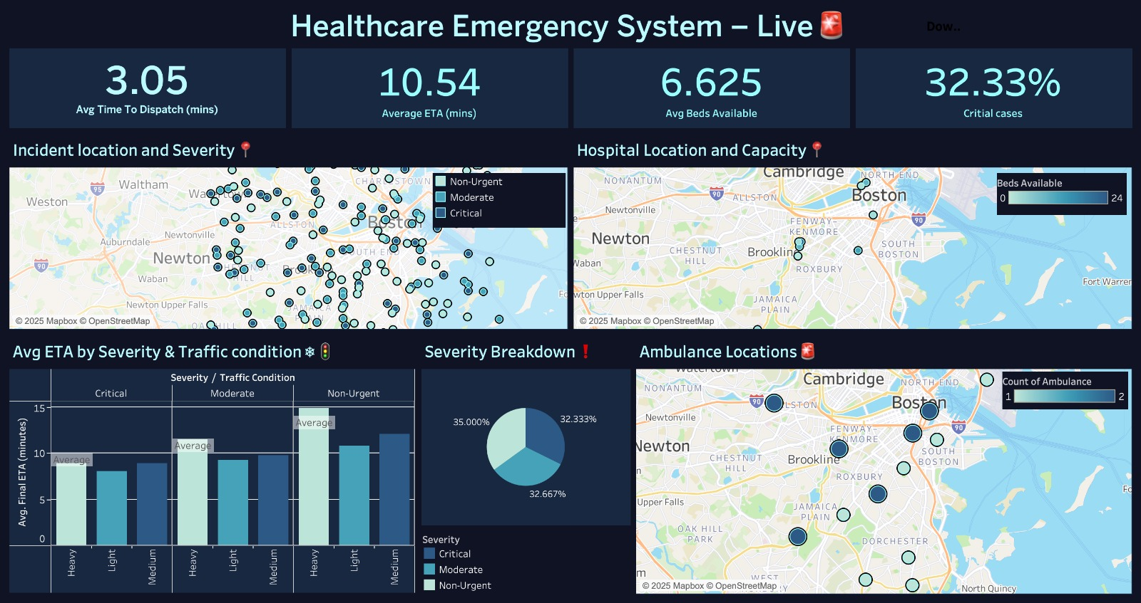
Visualizing the causes

Slide 16


BOSHealth Application Interface
Transitioning from our dashboards, which provide a real-time, high-level overview of emergency operations, let’s now explore the BOSHealth app interface—the hands-on tool that empowers patients, dispatchers, and hospitals to act on that data instantly. While dashboards set the stage with actionable insights, the app is where those insights turn into life-saving action, connecting every user directly to the emergency response network when it matters most

Slide 17
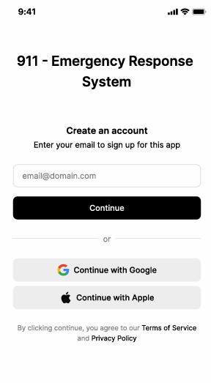
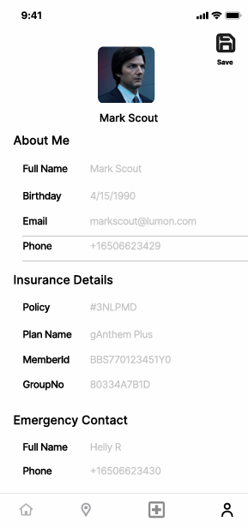
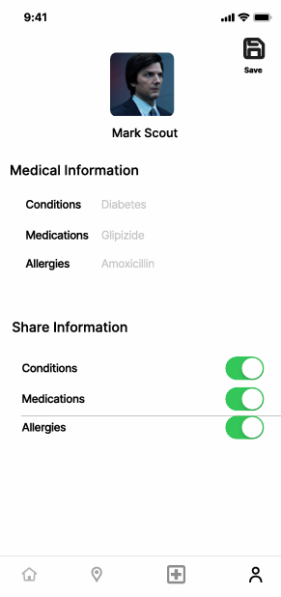
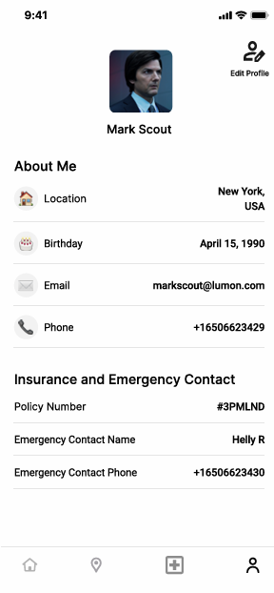
BOSHealth Patient’s Interface
Patient Profile Screen

Slide 18
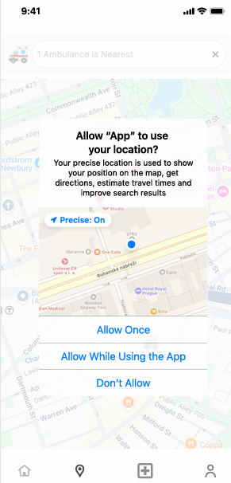
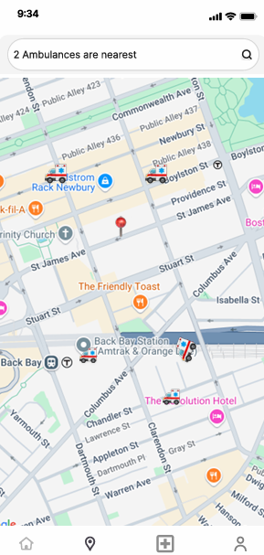
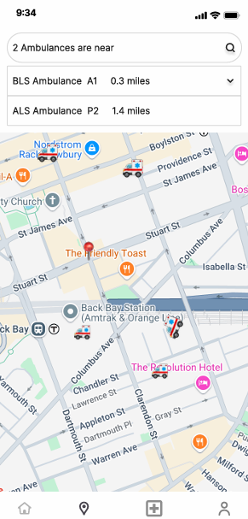
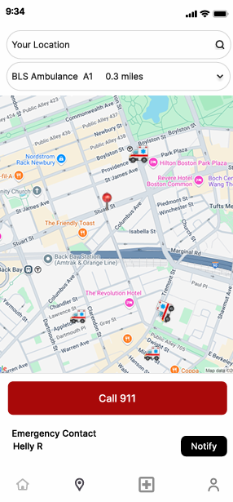
BOSHealth Patient’s Interface
Ambulance Booking and Real-Time Tracking Screen

Slide 19
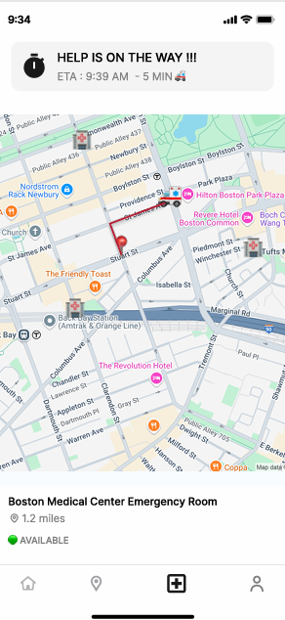
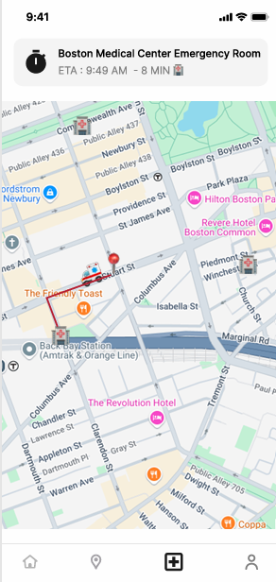
BOSHealth Patient’s Interface
The patient interface of the emergency ambulance service app is designed for speed, clarity, and ease of use during critical moments. It enables users to quickly register, book an ambulance with minimal steps, and track its arrival in real time.
LIVE DEMO: Link
Real-Time Tracking Screen

Slide 20
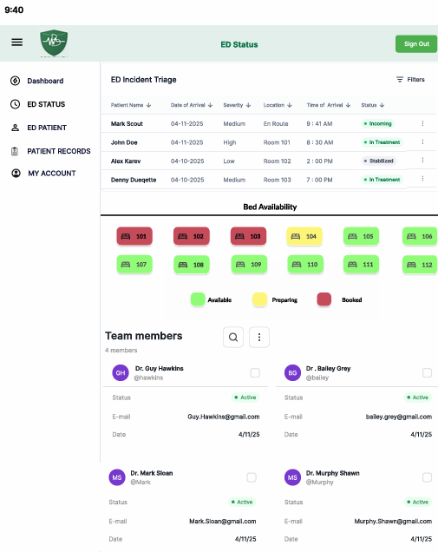
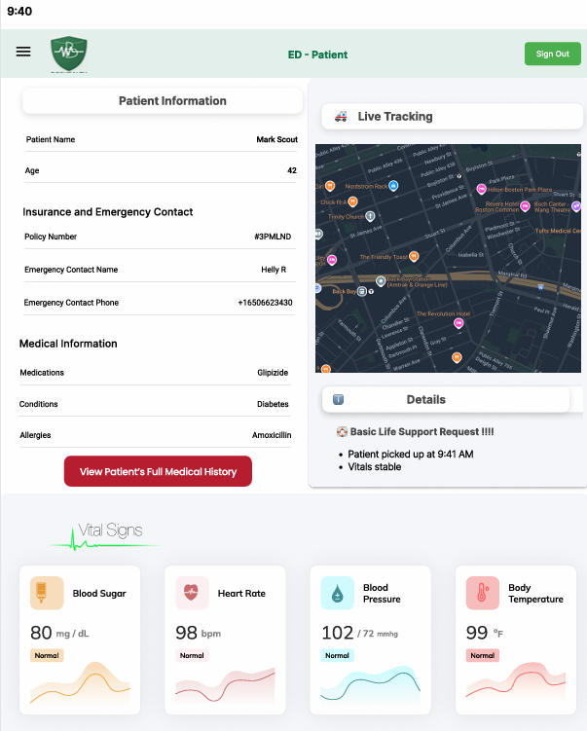
BOSHealth Hospital’s Interface
LIVE DEMO:Link
The hospital interface provides real-time patient data, ED status, and team coordination tools, ensuring efficient emergency response. Key features include live patient vitals, bed availability, team member status, and incoming patient tracking for optimized preparedness and streamlined workflows.

Slide 21
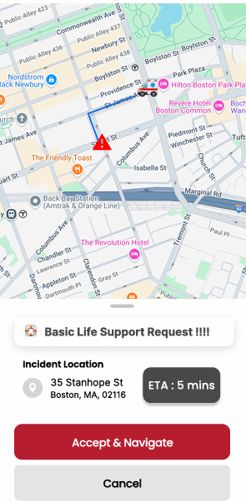
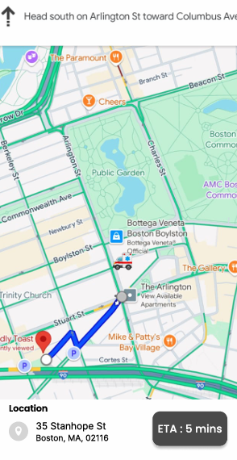
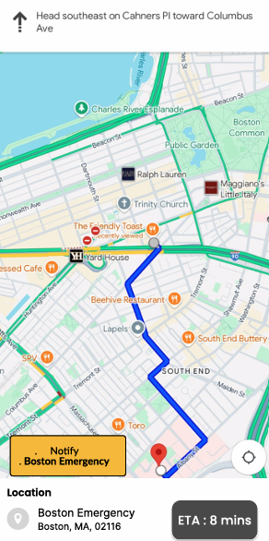
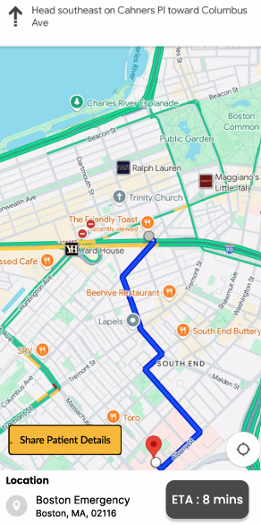
BOSHealth Dispatcher’s Interface
Real-Time Tracking, Two-Way Communication, Incident Management

Slide 22
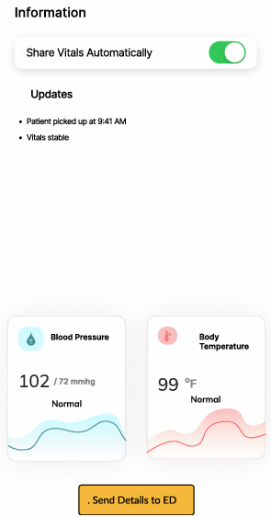
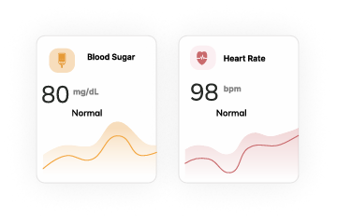
BOSHealth Dispatcher’s Interface
The dispatcher interface provides real-time coordination of ambulances, incidents, and hospitals via live tracking, AI-driven dispatch, and two-way communication. It streamlines emergency response with automated tools, performance analytics, and seamless hospital integration.
Analytics & Reporting
LIVE DEMO:Link

Slide 23





Lessons Learned
During the development and integration of the BOSHealth Emergency Response App and its associated dashboards, the team encountered several practical and technical insights that shaped the final product:
User-Centric Design
Real-Time Data Sync
Inter-Interface Communication
Prioritizing Features for Impact
Real-World Network Challenges

Slide 24

Closing Statement
“BOSHealth is a transformative solution for modern emergency care. From enabling informed dispatch decisions to equipping emergency rooms before the patient even arrives, BOSHealth closes the coordination gap that has long plagued emergency systems. It is not just a digital platform; it’s a human-centered system designed to protect life when time is most precious.”

