Slide 1
Perfect Date Application
Kelly Huynh
Samanvitha Basole
Aaron Escoto
Tri Ninh

Slide 2
Problem
You’re out on a date and not sure what to do

Slide 3
Solution
Random Generator Idea that would randomly generate a perfect date

Slide 4
Prototype
Keynote, and Paper prototypes to tell our story
Test out the UX, before we create the Web Application

Slide 5
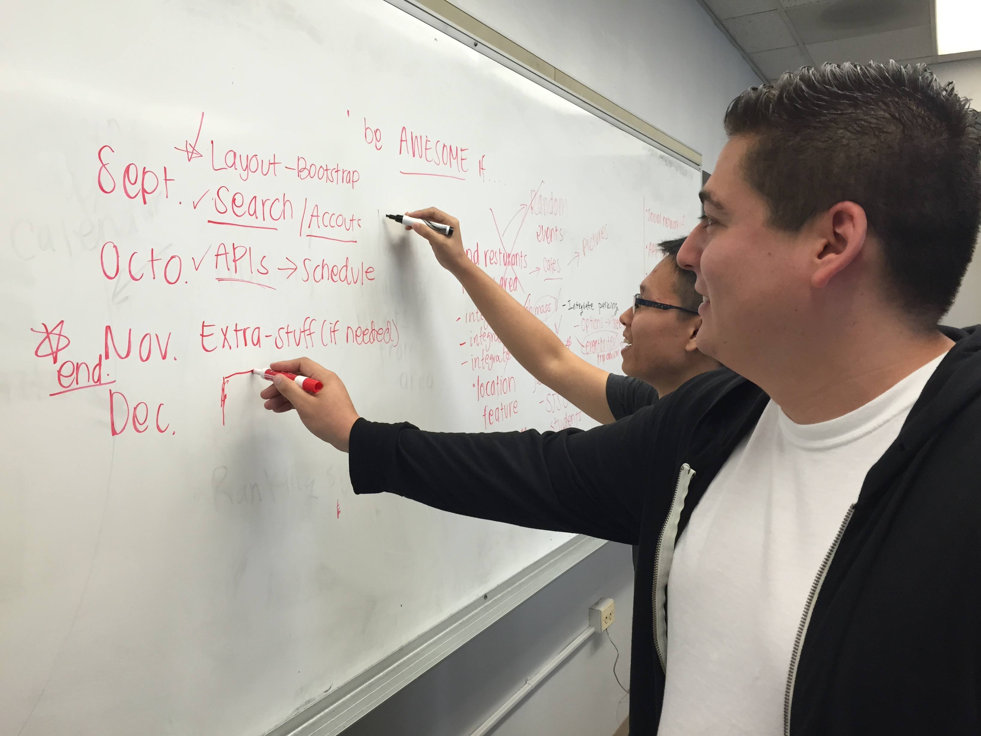

Slide 6
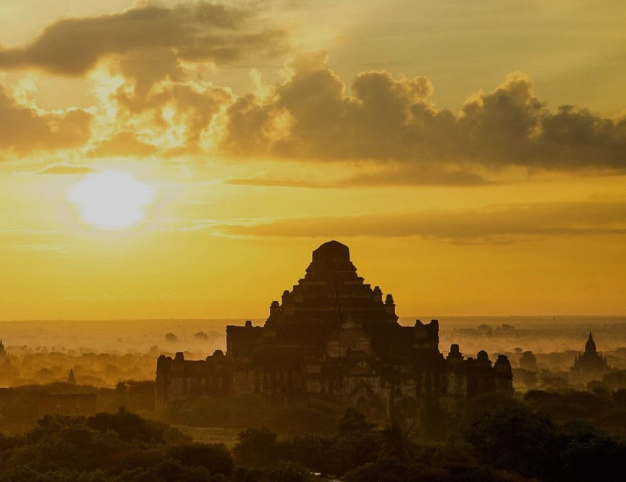
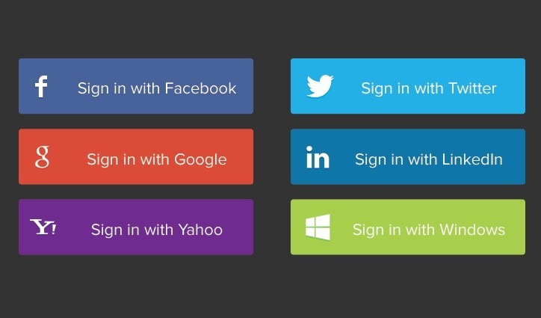
Perfect Day
Your Perfect Day
Let’s get started, Kelly
Or create an account

Slide 7
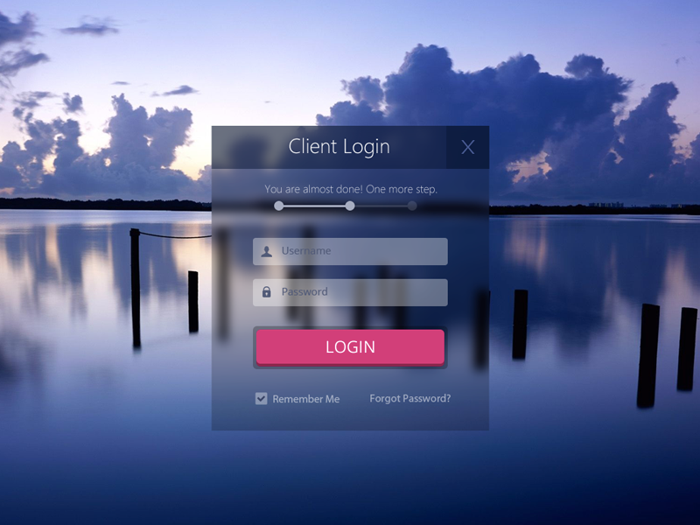

Slide 8

What are your favorite things to do?
Travel
Food
Couples
Art
Learning
Music
Sports
Local

Slide 9
What are your favorite things to do?
Travel
Food
Couples
Art
Learning
Music
Sports
Local

Slide 10
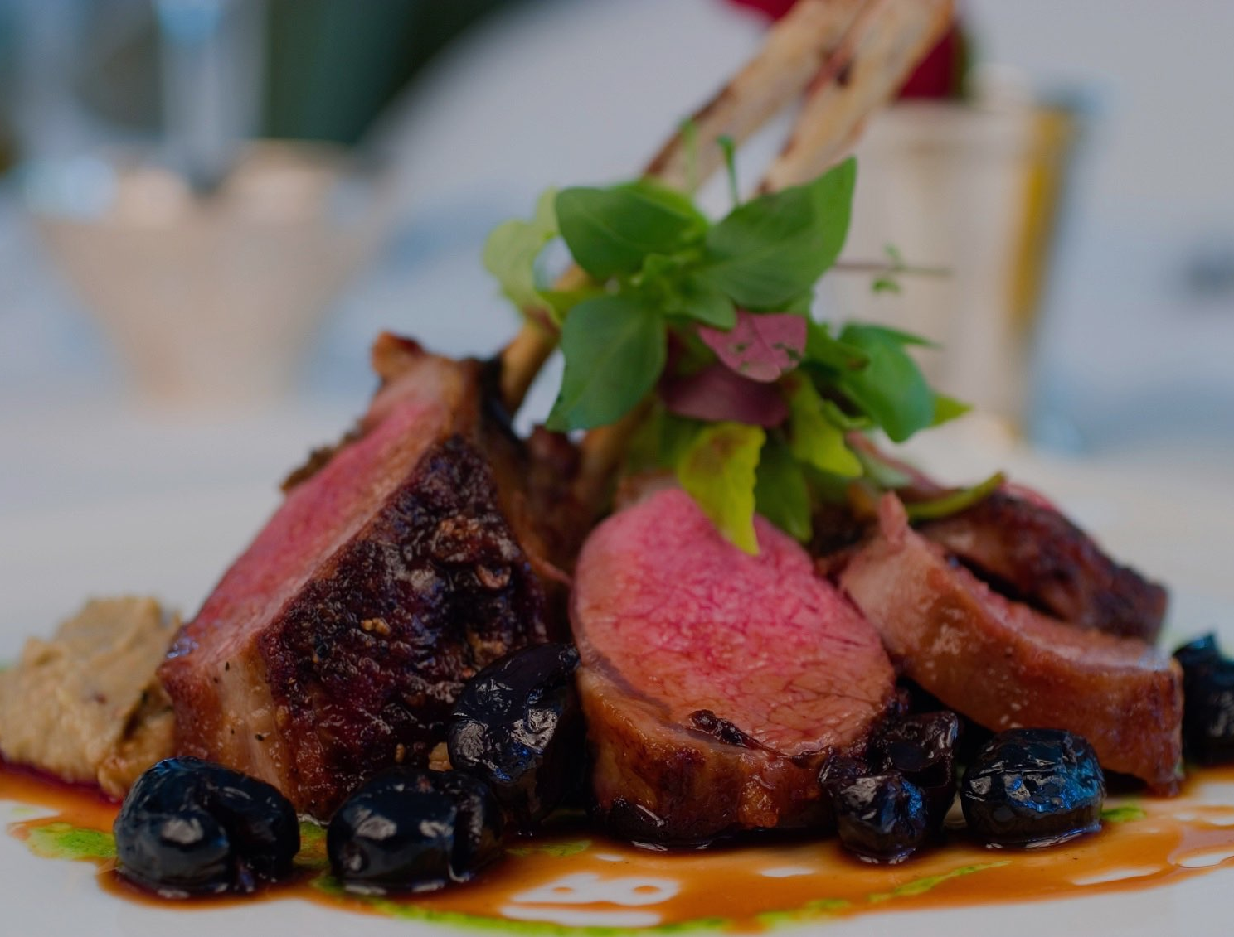
What do you like to eat?
Mexican
Chinese
Thai
American
Indian
Vietnamese
Desserts
Mix

Slide 11
What do you like to eat?
Mexican
Chinese
Thai
American
Indian
Vietnamese
Desserts
Mix

Slide 12
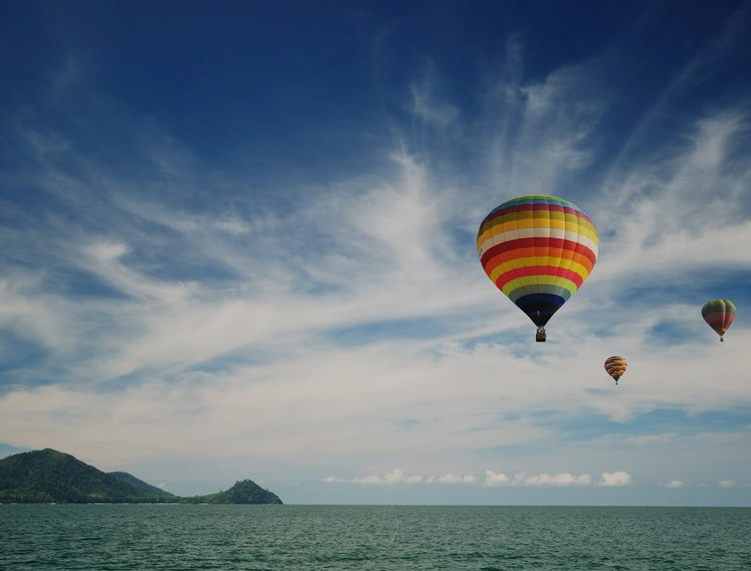
What your budget?
$0.00
$1000

Slide 13
What your budget?
$400
$1000

Slide 14
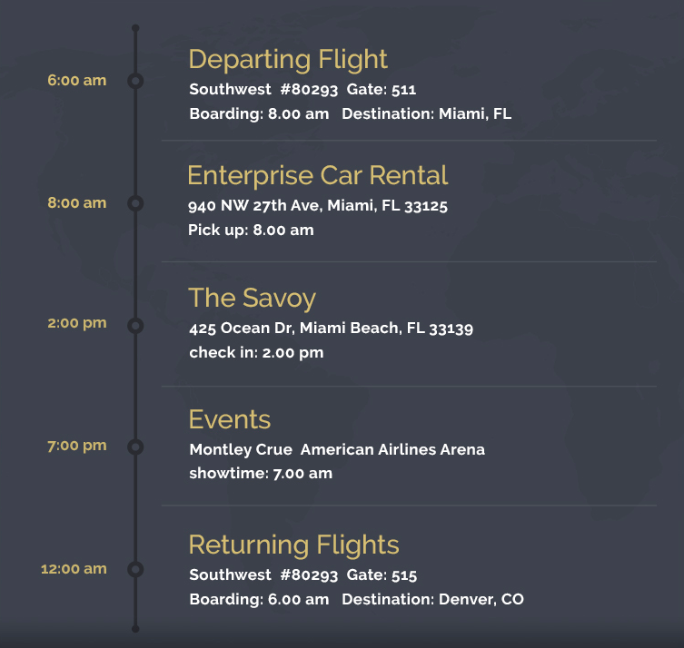
Hi Kelly, here’s your perfect day
Your Perfect Day

Slide 15
Demo of our application

Slide 16
What did we include in our project and how we contributed
Kelly: Front - End - HTML, CSS, JavaScript (Bootstrap)
Aaron:
Samanvitha:
Tri:
 | Front - End | Back - End | MySQL
Kelly
Aaron
Samantha
Tri

Slide 17
Kelly - talk about what you added to the web app

Slide 18
Aaron - talk about what you added to the web app

Slide 19
Samanvitha - talk about what you added to the web app

Slide 20
Tri - talk about what you added to the web app

Slide 21
What did we learn?
Our new favorite and sings about web development and JavaScript
JSON Derulo

