Slide 1
Electrical System Optimization and Maintenance

Slide 2

Purpose
The purpose of these guidelines is to provide students from diverse disciplines participating in projects through the Qollabb platform with a framework for preparing their project reports.
The project report is an essential document that showcases the students' work, methodologies, findings, and recommendations.

Slide 3
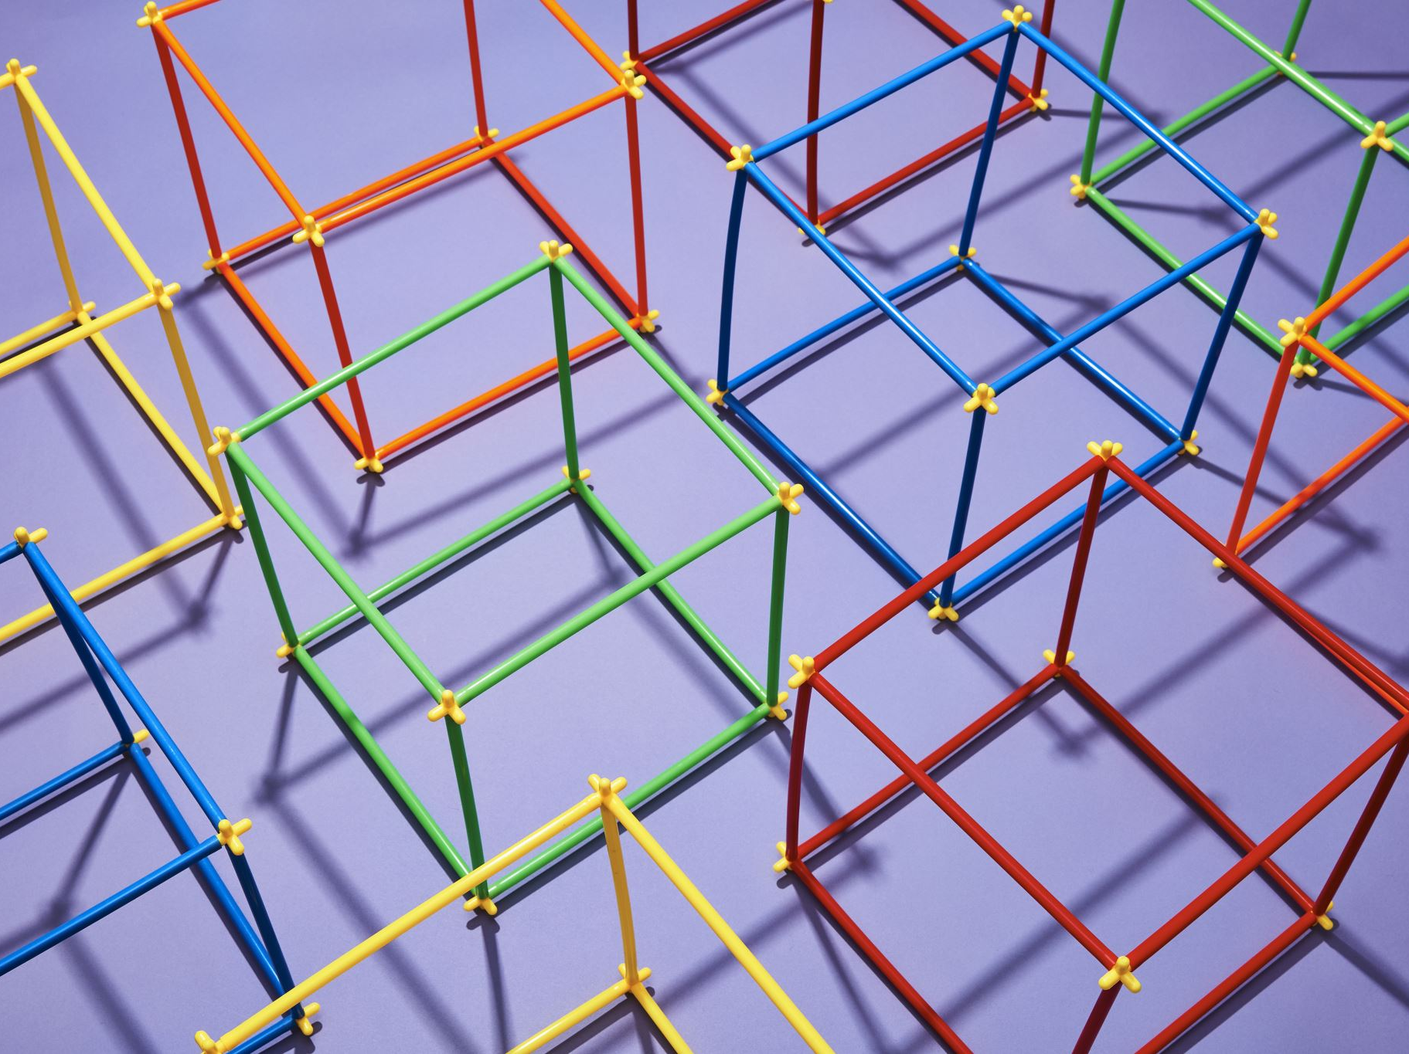
Clarity and Organization
Ensure the project report has a clear structure and is well-organized.
Use headings, subheadings, and a logical flow to present information in a coherent manner.
Use language that is appropriate for the target audience, avoiding excessive jargon or technical terms that may confuse readers from different disciplines.

Slide 4

Introduction
Begin the project report with an introduction that provides an overview of the project's objectives, scope, and significance.
Clearly state the problem statement or research question that the project aims to address.
Provide a brief background of the project, including relevant literature or previous work in the field.
Tailor the background information to suit the discipline and context of the project.

Slide 5

Methodology
Describe the methodologies, tools, and techniques employed in the project.
Explain the data collection methods, analysis procedures, and any experimental or research design used.
Provide sufficient details for readers to understand how the project was executed.
Include information on sample selection, data sources, and any limitations or constraints faced during the project.
Adapt the methodology section to align with the specific requirements of the discipline.

Slide 6

Methodology Details
Process involved assisting in installations, conducting routine checks, and troubleshooting.
Example: Assisted in wiring tasks for a new lighting system installation in the main office building (Week 2, Day 1).
Example: Conducted inspections of electrical panels and circuit breakers in the manufacturing unit (Week 2, Day 2).
Example: Diagnosed a problem with flickering lights due to a faulty dimmer switch (Week 2, Day 3).

Slide 7

Results and Findings
Present the findings, results, or outcomes of the project in a clear and concise manner.
Use tables, graphs, or visual representations where appropriate to enhance understanding.
Analyze and interpret the results, highlighting key observations or patterns.
Discuss any significant findings, unexpected outcomes, or deviations from initial expectations.
Emphasize the relevance and implications of the findings within the respective discipline.

Slide 8
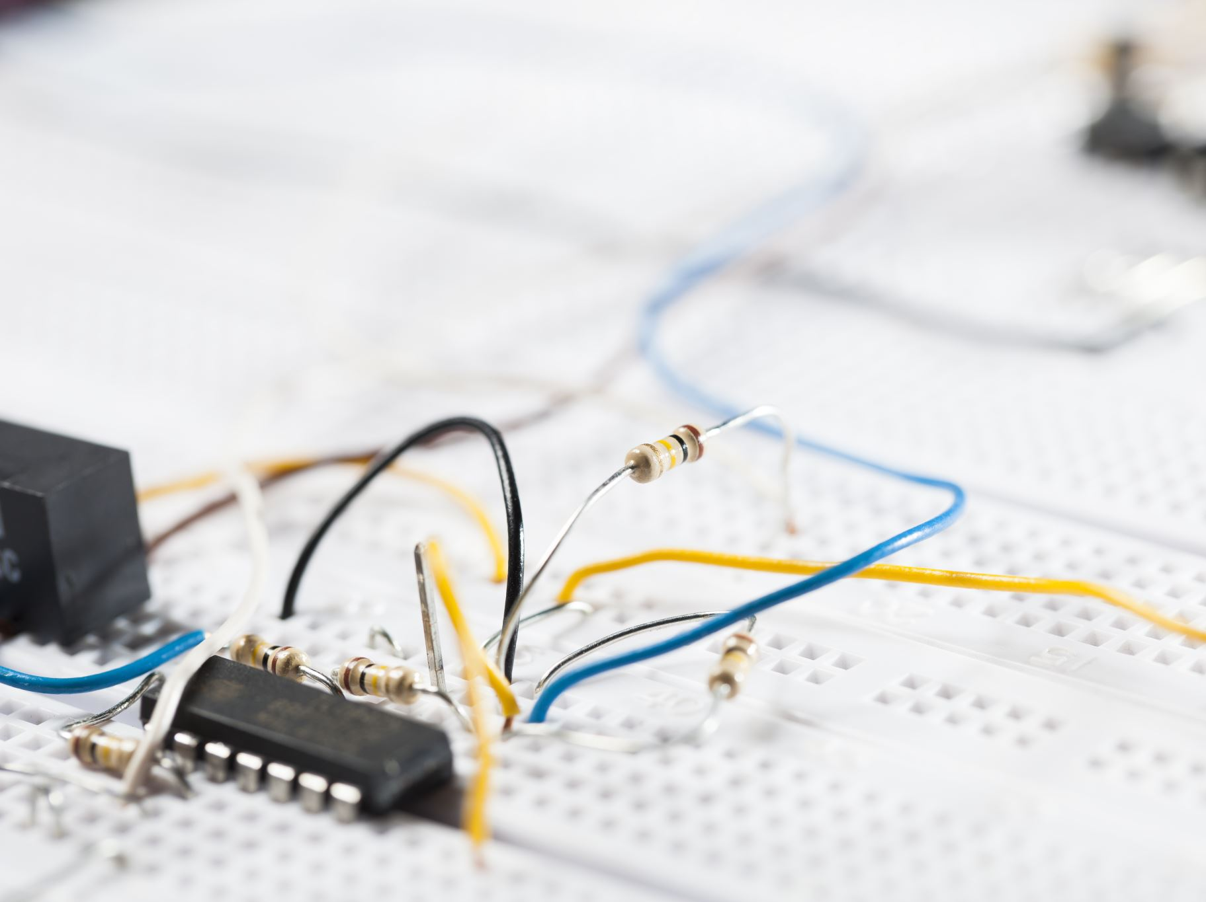
Results and Findings from Reports
Example: Successful replacement of a malfunctioning circuit breaker (Week 5, Day 1).
Example: Identification and correction of loose wire connections (Week 2, Day 2).
Example: Implementation of energy-efficient LED lights (Week 2, Day 4).

Slide 9

Discussion and Analysis
Provide a comprehensive discussion and analysis of the project results.
Connect the findings to the project's objectives and research question, exploring their implications and significance within the discipline.
Analyze the strengths, weaknesses, opportunities, and threats (SWOT) associated with the project.
Consider the project's impact, feasibility, and potential for further development or expansion within the specific discipline.

Slide 10
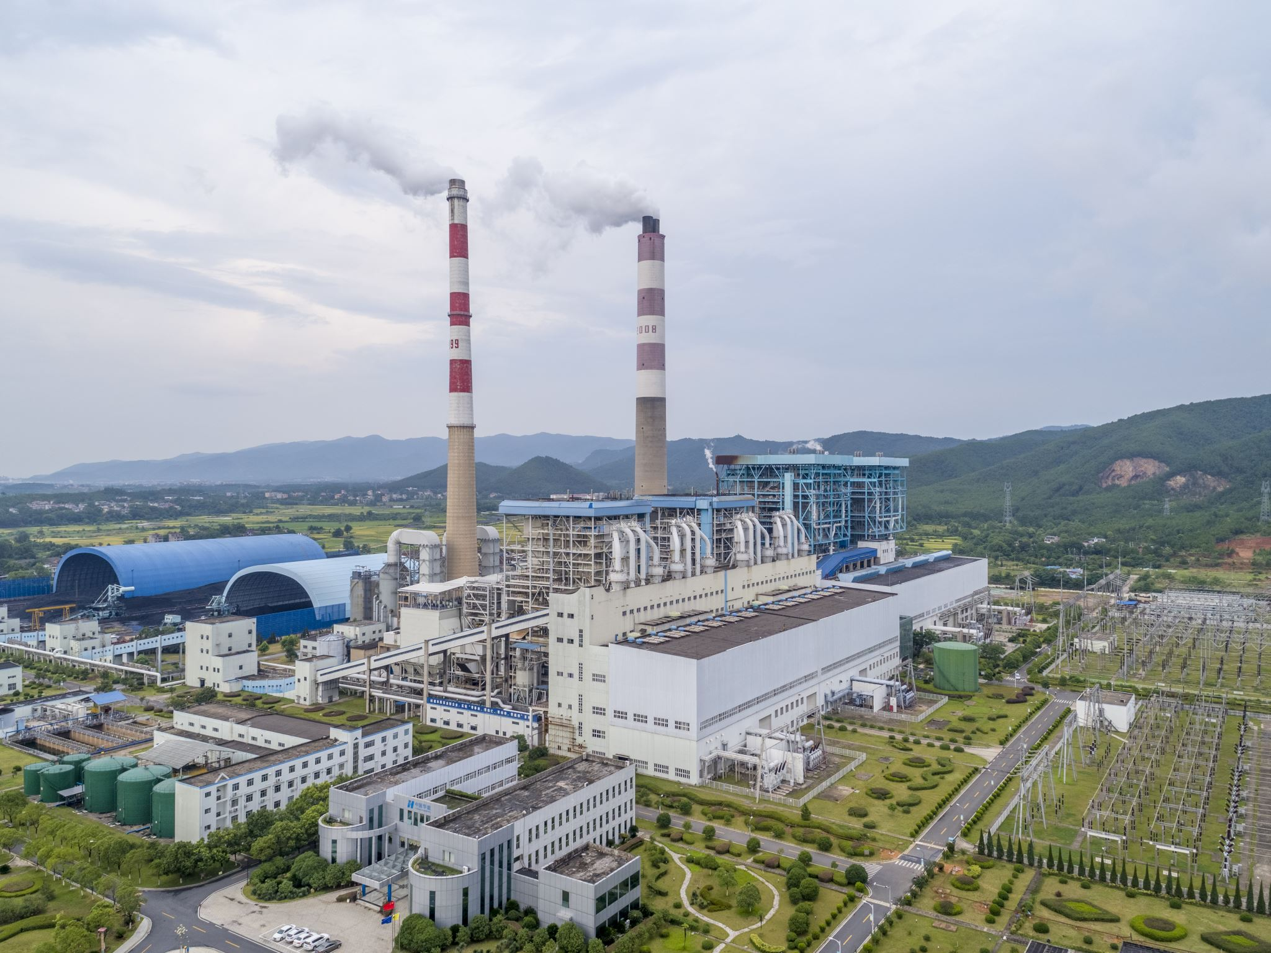
SWOT Analysis from Reports
Strengths: Hands-on experience in electrical installations and maintenance (Week 2, Day 1).
Weaknesses: Minor corrosion on a circuit breaker (Week 2, Day 2).
Opportunities: Optimization of electrical systems with energy-efficient solutions (Week 2, Day 4).
Threats: Potential issues with power fluctuations (Week 5, Day 3).

Slide 11

Conclusion and Recommendations
Summarize the main findings, outcomes, and conclusions of the project.
Key Learnings:
Optimization Strategies: Learned various techniques to optimize electrical system performance and efficiency, contributing to cost savings and sustainability.
Preventive Maintenance: Recognized the importance of preventive maintenance in minimizing downtime and extending equipment lifespan, improving overall system reliability.
Professional Growth: Developed communication skills, teamwork, and a proactive approach to learning in a professional electrical maintenance environment.

