Slide 1
Top 5 product recommendation for a User based on Sentiment Analysis and user –user based collaborative recommendation
Github Project - https://github.com/tnk1422/productRecommOnSentiment ( Private repository)
Heroku App- https://productrecommendationforuser.herokuapp.com/

Slide 2
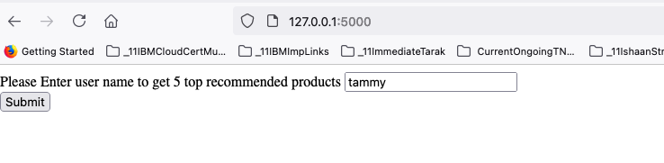
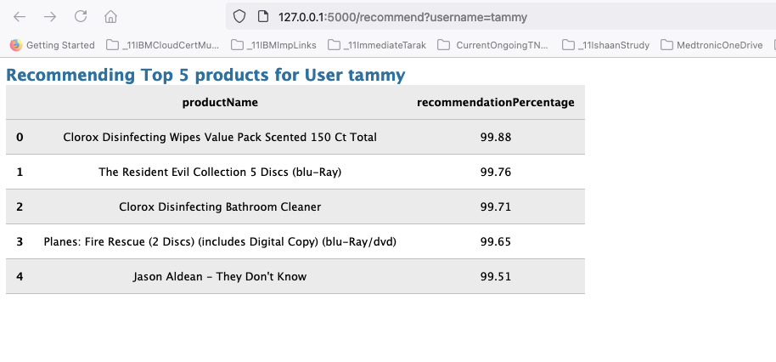
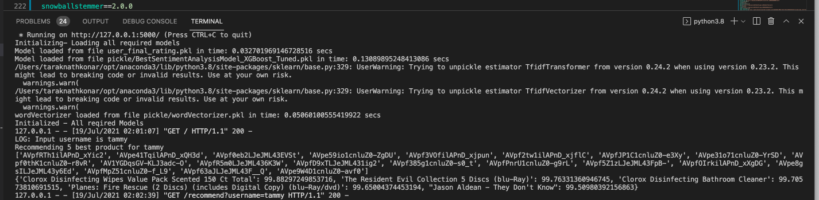
Running on Local Environment for User tammy

Slide 3
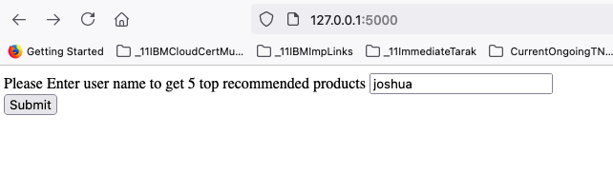
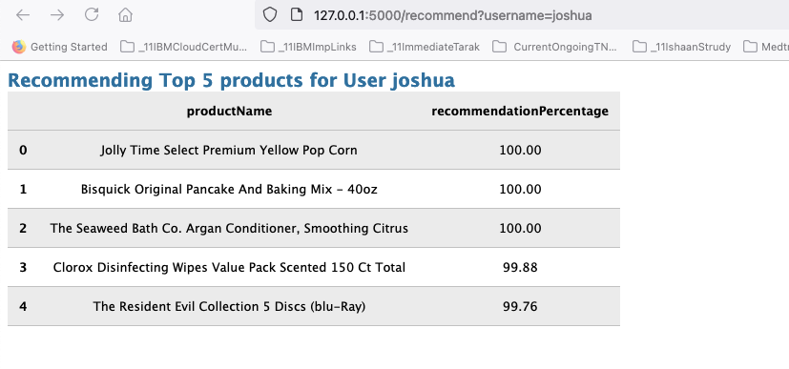
Running on Local Environment for user jashua

Slide 4
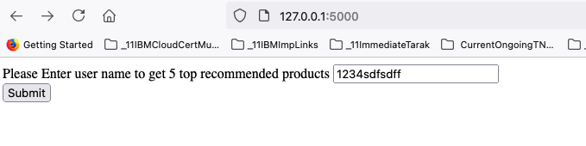
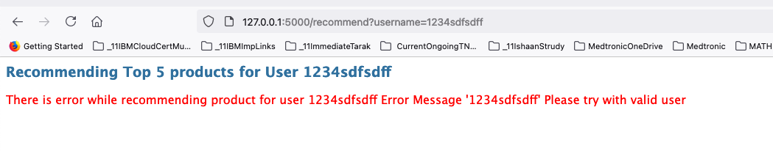
Running on Local Environment for user any User not available in data

Slide 5
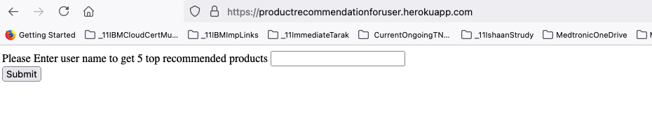
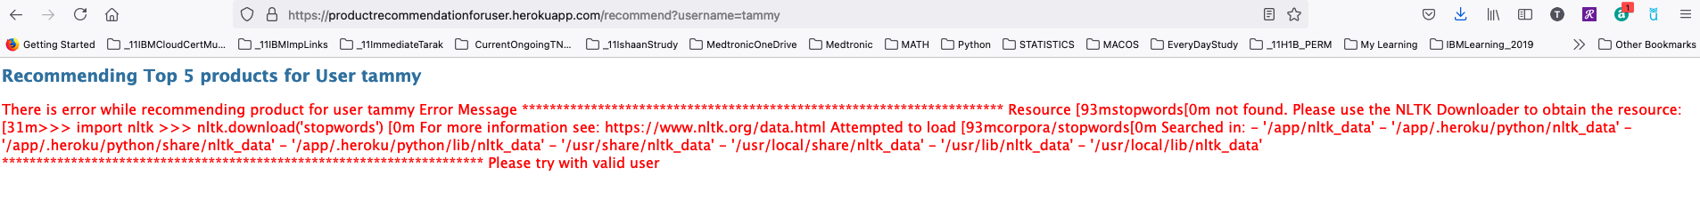
Running on Heroku cloud - https://productrecommendationforuser.herokuapp.com/
Error handling – Error is caught and return to Browser

Slide 6
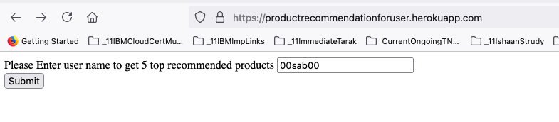
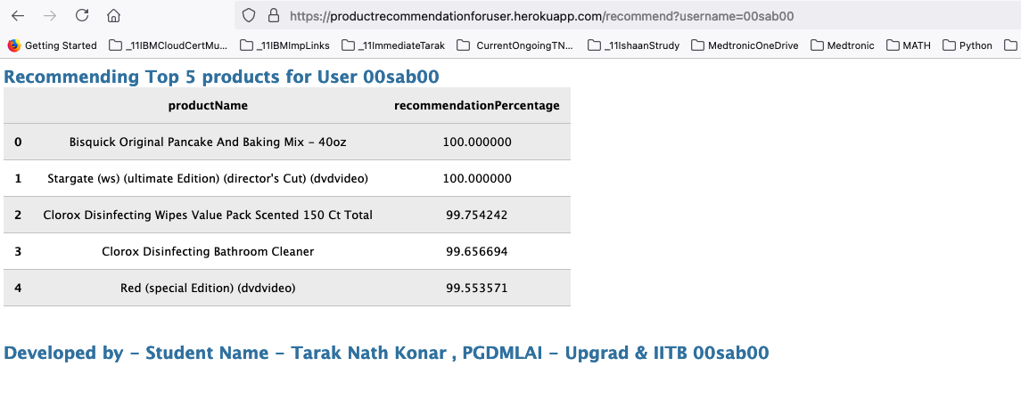
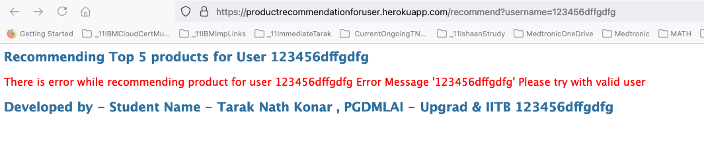
Running on Heroku cloud - https://productrecommendationforuser.herokuapp.com/
Success call
Test with username not exist in dataset

Slide 7
Thank you

